Slide 1
LCRA Freeze protection
Presented by: Jason Kessel
Created by: Jack Sandel

Slide 2

Agenda
Background
Heat Tracing Issues
Transmitters
Thermocouples
Scaffold Wrap

Slide 3
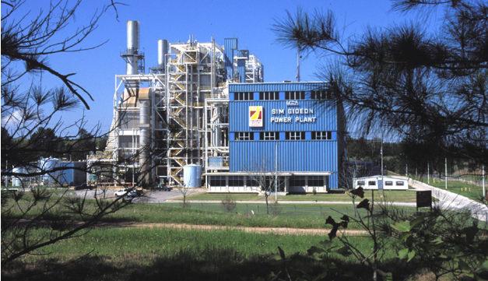
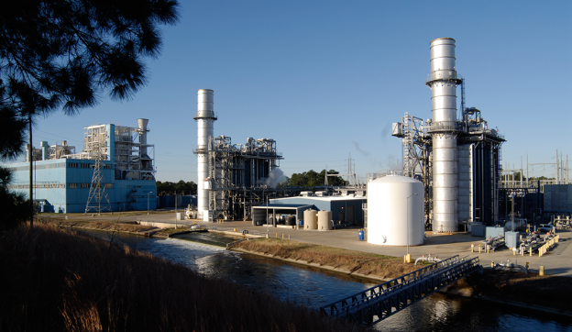
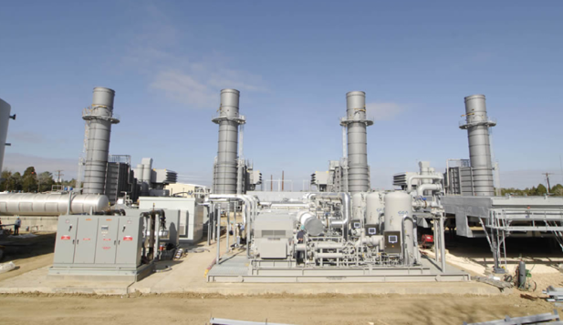
Background
Sim Gideon
3 Conventional Gas Fired Drum Units
Capacity ~ 607 MW
Lost Pines
2x1 Combined Cycle
Natural Gas
Capacity ~ 510 MW
Winchester
4 Simple Cycle
Natural Gas
Capacity ~ 176 MW

Slide 4
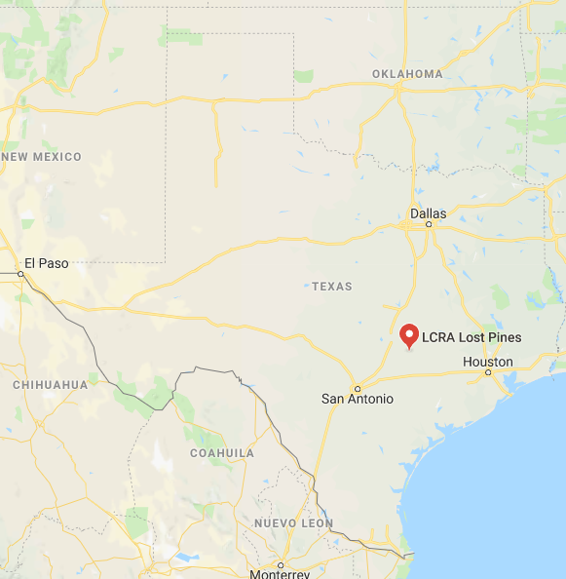
Background

Slide 5
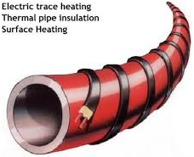
Heat Tracing Issues in the Past
Moisture can corrode heat trace
Insulation can fall off
Inadvertent line damage
Expensive to install and operate
Test today, fails tomorrow without notice

Slide 6
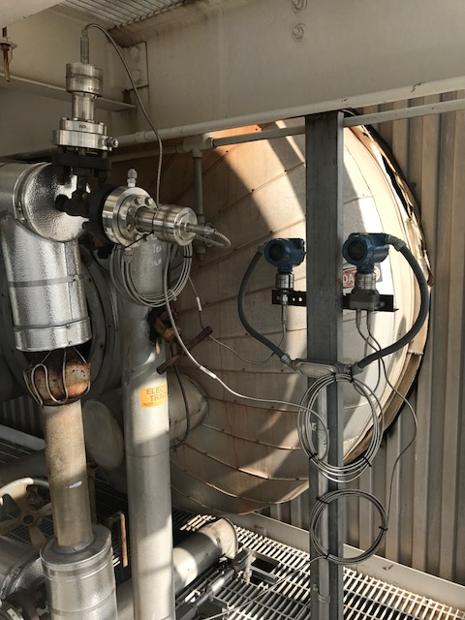
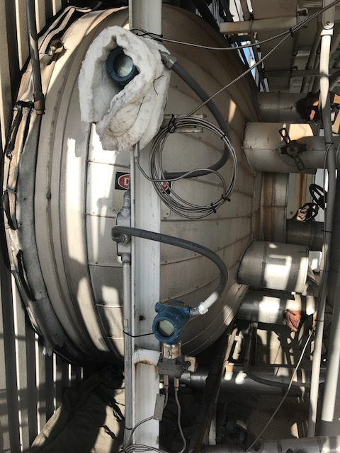
Transmitters

Slide 7
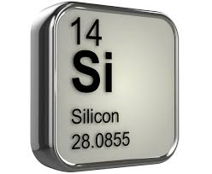
Transmitters
Capillary line
  Silicon fill fluid
  Freezes ~ - 40F
Reduces heat trace and insulation requirements
Works well during operation
Used for level and pressure transmitters

Slide 8
New Transmitter Issues
Fluctuations during startup/shutdown
Readings (fluid density) affected by:
  Skin leaks
  Ambient temperature
Expensive
Still have to heat trace leg to transmitter

Slide 9
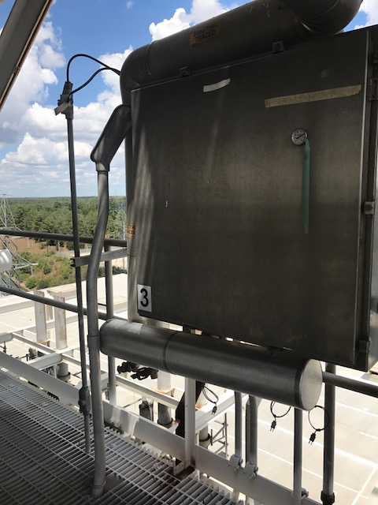

Thermocouples
Used for critical instrumentation
Validates heat trace effectiveness
Low skill set to monitor

Slide 10
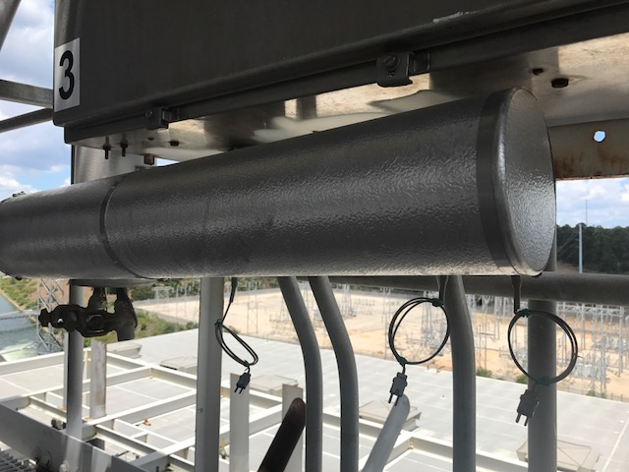
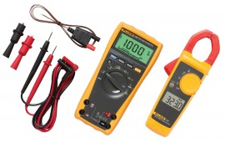
Thermocouples
Still take amp readings
Place a thermocouple near end of heat trace
Read with Fluke meter
Thermocouple Pigtails

Slide 11
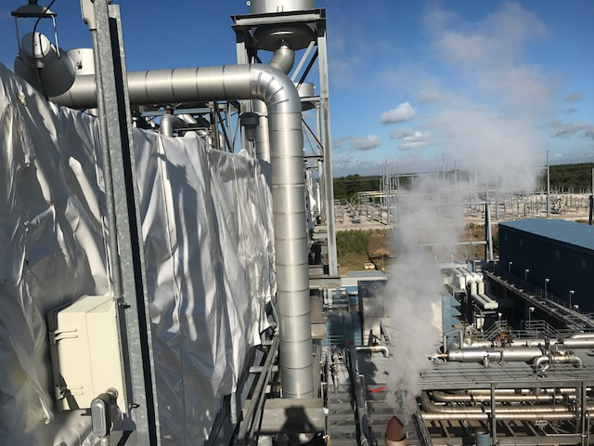
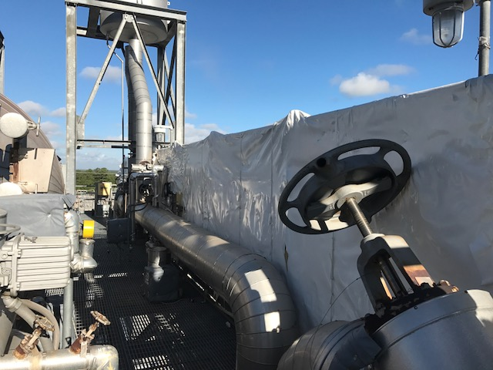
Scaffold Wrap

Slide 12
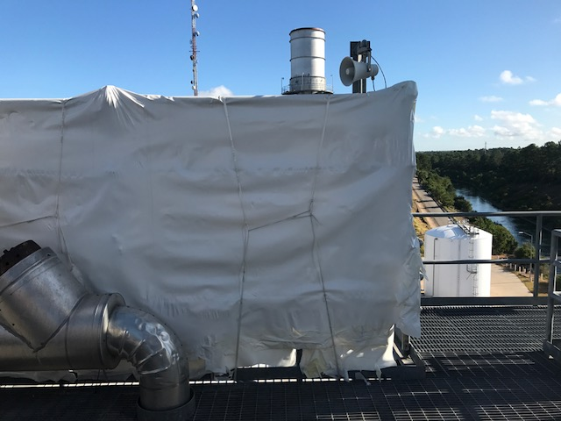
Scaffold Wrap
Acts as shield from wind
Shrink with open flame
Secure with rope
Reduces convective HX
Non-Flammable
More durable than tarps

Slide 13
Scaffold Wrap
Easy to install and repair
Long lasting and effective
More cost effective than replacing tarps
Fire retardant
Lightweight

Slide 14
Conclusion
LCRA Freeze Protection
  Gel filled transmitters
  Thermocouples
  Scaffold wrap

Slide 15
Questions?

