Slide 1
NERC and Texas RE Update
Mark Henry
Reliability Services, Texas Reliability Entity
ERCOT/Texas RE Generator Winter Weatherization Workshop
September 6, 2018
Notes:
Continued importance and visibility
Updates to winter weatherization readiness guidelines
Review of Lessons Learned

Slide 2
Overview
Recap winter 2017- 2018
NERC Metric
Winter Day Profiles
Wind Plant Extreme Condition Operations
Emissions Waivers
NERC Lessons Learned and Guidelines
Notes:
The title suggests trends and performance. This is high level, Alan and our guests will get into details.

Slide 3
Winter 2017-18 Recap
Notes:
Number of Heating Degree Days, SATX compared to DFW (Dec-Feb)
*Note: HDD = The number of degrees that a day's average temperature is below 65°
2016 vs 2018 SA 113% DFW120%
2017 vs 2018 SA 138% DFW 131%

Slide 4
Winter 2017-18 Resource Adequacy Predictions and Actuals
Actual (Extremes) Winter 2017-18
Peak Load (MWh): 65,750 (1/17/18 HE08)
Extreme Forced Outages (MW): | 13,287 (1/2/2019)
Notes:
For the 2017-18 Winter there was a concern about the extreme model and the number resources that retired at the end of the year.
Momentary peak 66,067 (1/17/18 @ 07:17:52)
ERCOT plans for extremes of forec outages, extreme low wind and load
New wind records happened the next couple of days:
Max Wind Hourly MW
17,414 (2/19/18 @HE04)
Max Wind %
51.2% (1/20/18 @ 23:58:44)

Slide 5
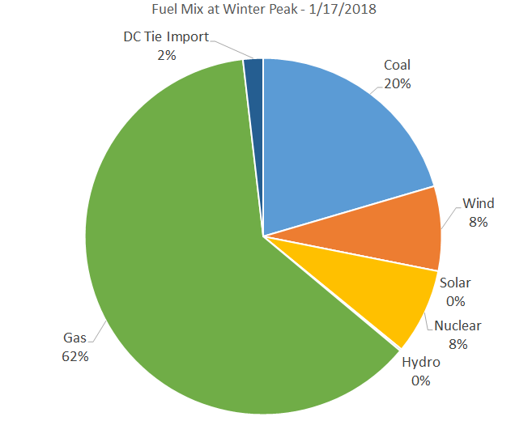
2018 Winter Peak Hour Generation Breakdown
Notes:
3 coal plants OOS - 13Gw coal still – but next winter others are also gone
Wind and nukes just under 5.3 GW - Expect another 2 ½ GW of wind capability sometime during this winter.
Gas almost 41GW
1.3 on the dc ties coming in

Slide 6
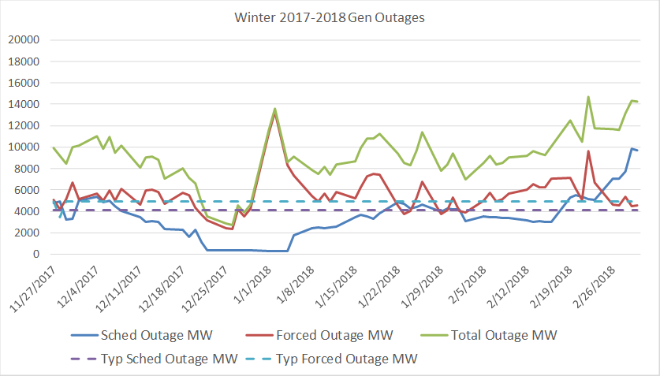
Winter 2017-18 Outages – All Causes
Extreme cold weather OCNs & Advisories (12/29, 1/1, and 1/16)
Notes:
Tend to learn from the first and improve
Alan will discuss freezing equipment outages

Slide 7
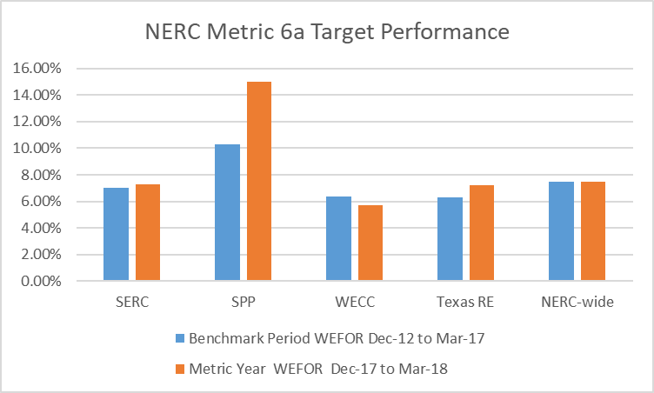
NERC Reliability Metric 6 – Reduced risks in targeted areas
Measure of Success, Metric 6a:. Reduced events caused by generating unit forced outages due to cold weather
Threshold - No firm load shed occurs from generating unit forced outages caused by cold weather
Target - Using most extreme cold winter months, the Weighted Effective Forced Outage Rate (WEFOR) decreases compared to a rolling previous 5 year benchmark average for each Regional Entity
Notes:
Benchmark Period Dec 12-Mar 17: Texas RE 6.3% NERC 7.5%
Metric year Dec 17 to Mar 18: Texas RE 7.2% NERC 7.5%

Slide 8
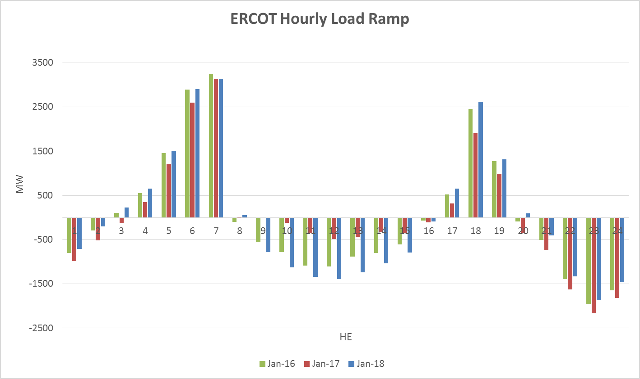
Average January Load Ramps 2016-2018
Source: ERCOT Reg Bias Analysis to PDCWG, Feb. 14, 2018
Notes:
Load shapes, up and down

Slide 9
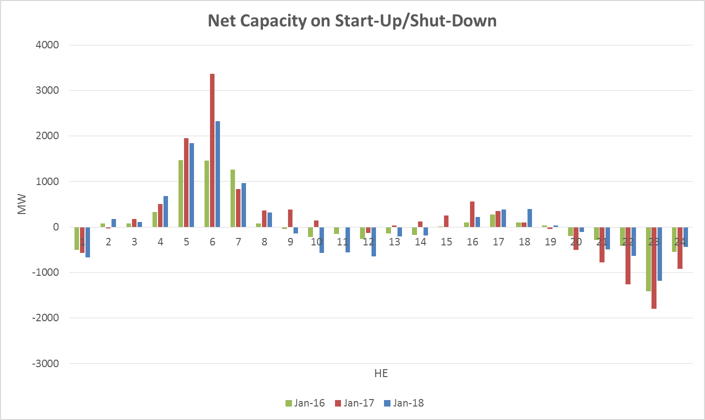
Average January Start-Up & Shut-Down Hours 2016-2018
Source: ERCOT Reg Bias Analysis to PDCWG, Feb. 14, 2018
Notes:
Much higher over peak days

Slide 10
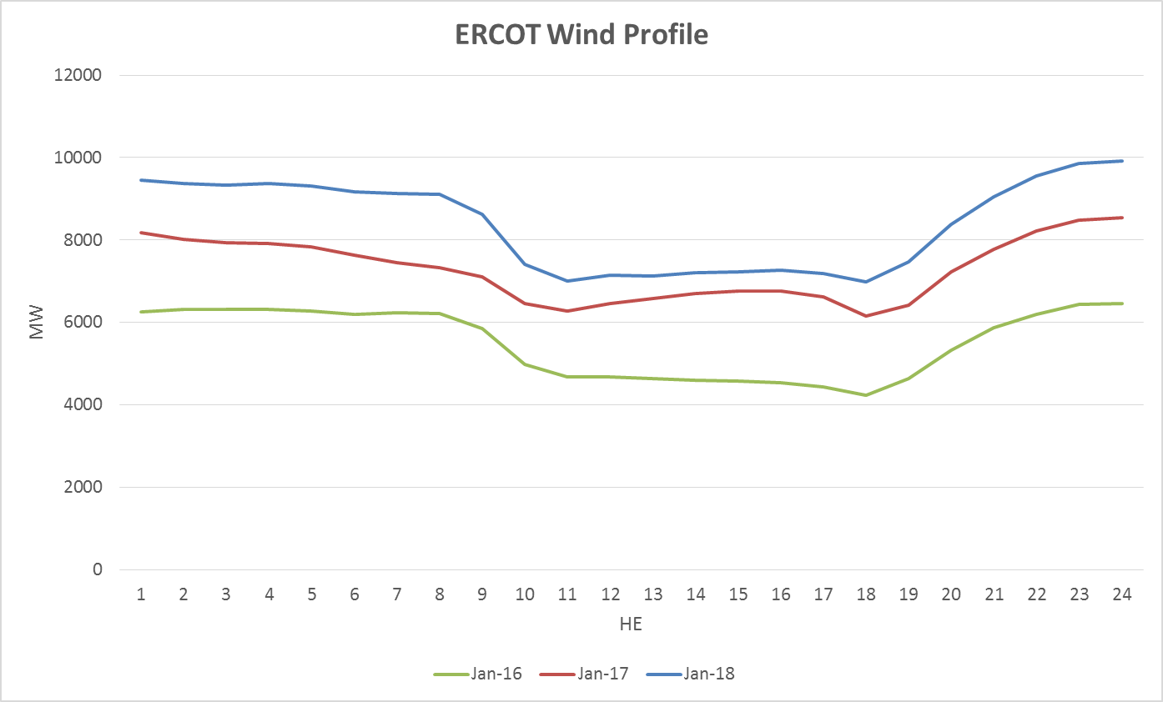
Average January Wind Profile 2016-2018
Source: ERCOT Reg Bias Analysis to PDCWG, Feb. 14, 2018
Notes:
Averages – wind dies down during morning ramp and dips a bit during evening
From 2011 to 2017, average during top load hours was 5.2% of peak but it has improved since 2015 with diversity
No solar at 8 am, either in West Texas

Slide 11
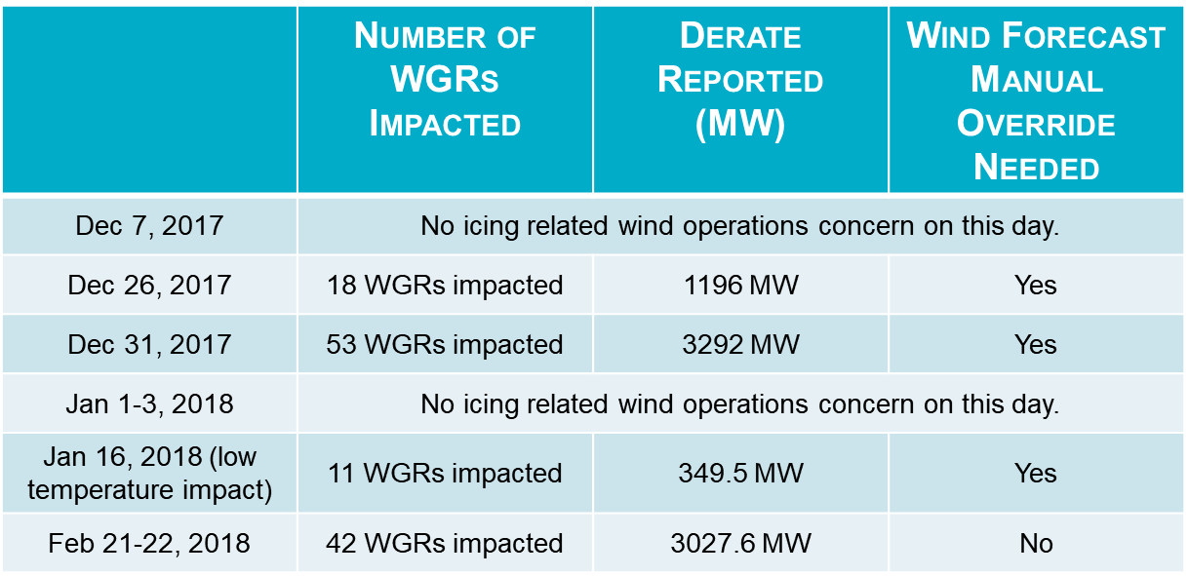
Wind Generation Derates During Winter 2017-18
Source: N. Mago, ERCOT
Notes:
Precisely forecasting wind power impacts during icing events continues to be a challenge.
During the 2017/2018 Winter ERCOT utilized a combination of procedures and tools helped improve ERCOT’s ability to manage the risk of icing events, particularly
-Weather outlook provided an early warning for the incoming icing event.
-Icing report issued by E&M provided a good indicator for the impact resulting from icing events
-Operators at Reliability Desk closely watched for the icing events, and were notified when the icing condition was being experienced
-Wind Forecast Override was used as a last resort to correct the wind forecast when the assumption used for wind prediction deviated significantly from what actually occurred.
These forecast overrides varied:
12/26 – 15 hours, 10 hrs over 1000MW
12/31 – 20 hrs, 12 hrs over 1000MW error but override helped a lot, spot on for 4 hrs (Mago reported no override on chart but shows in slides from webex)
1/16 – 13 hrs – made error greater during first 11 hrs, >3GW for 1 hr

Slide 12
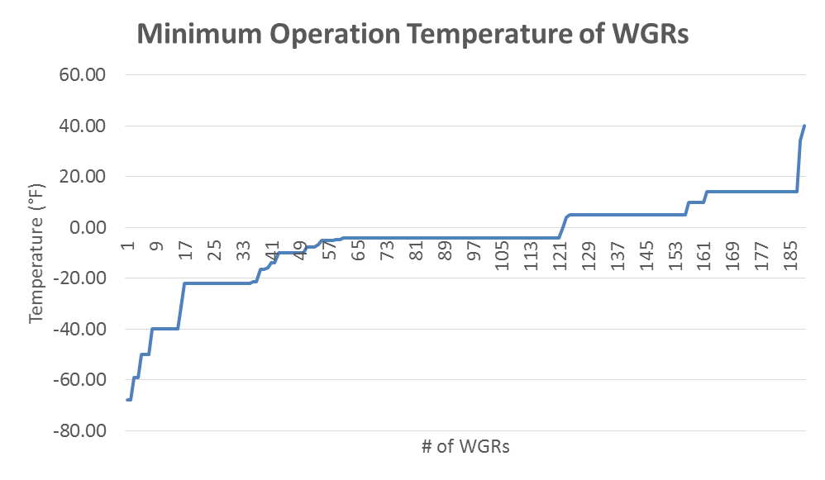
Operation Limits of WGRs (as of early 2018)
Source: N. Mago, ERCOT
Notes:
About 1/6 appear to have higher temps and possibly subject, newer windfarms are better prepared

Slide 13
Emissions in Emergencies – TCEQ Discretion
Jan 16 2018 21:16:01 CST Operations Message:
TCEQ has approved ERCOT's request for enforcement discretion for any power generating facility to exceed its air permit limits in order to provide continued or additional capacity to the ERCOT System through the morning on January 17, 2018. This enforcement discretion is effective immediately. More details will be provided in a Market Notice.
Excerpt from M-A011618-01 Operations, January 16, 2018:
“ Power generating facilities are authorized for maximum emission limits. If/when increased generation is requested, TCEQ will exercise enforcement discretion for exceedances of emission and operational limits of power generating plants for Generators who exceed air permit limits in order to maximize generation for the duration of the event.
Any Generator who will exceed its air permit limits during the event should provide a notice of this action to Kelly Cook (kelly.cook@tceq.texas.gov), Director of Critical Infrastructure Division (preferably by email). Unless ERCOT or TCEQ provides Notice otherwise, the period of enforcement discretion will end when ERCOT declares that it is no longer in this event.”
Notes:
entities (At least 3 of them during our recent plant visits) as that TCEQ will use their own discretion to determine if a waiver can be given or not if they follow the ERCOT request. Looks like during the emergency situations these entities are not following ERCOT requests as per their management decisions. We need to get clarification from ERCOT legal about it and I feel that ERCOT market notice has to read something like as follows to comfort these generators to follow ERCOT request:
TCEQ will use waive the penalties for power generating facilities that exceed its air permit limits during this event.
Duties of generator exceeding emissions limitations (“regulated entity”)
maintain records of operation that occurred during the Power Emergency including records required under TCEQ authorizations and rules.
send a list of all violations for which enforcement discretion is sought to the TCEQ Designated Contact, who in turn will provide this list to the appropriate TCEQ Regional Office.
send questions specific to enforcement discretion directly to the TCEQ Designated Contact and may copy ERCOT on any written communications.
Procedure for Requesting TCEQ Enforcement Discretion Relating to a Power Emergency (Update July 16, 2018)

Slide 14
Emissions in Emergencies – Cancellation Example
Operations Message: Jan 18 2018 12:20:11 CST:
ERCOT has cancelled the following notice: TCEQ has approved ERCOT's request for enforcement discretion for any power generating facility to exceed its air permit limits in order to provide continued or additional capacity to the ERCOT System through the morning on January 18, 2018. This enforcement discretion is effective immediately. More details will be provided in a Market Notice
Market Notice:
NOTICE DATE: January 18, 2018
NOTICE TYPE: M-A011618-02 Operations
SHORT DESCRIPTION: TCEQ Notice of enforcement discretion on air permitting requirements during a power emergency
INTENDED AUDIENCE: QSEs with Resources, Resource Entities
DAY AFFECTED: January 18, 2018
LONG DESCRIPTION: Due to improving system conditions resulting from warmer temperatures returning throughout the ERCOT Region, ERCOT has ended its request with the Texas Commission on Environmental Quality (TCEQ) for enforcement discretion for power generating facilities, as detailed in Market Notice M-A011618-01. Effective immediately, TCEQ has confirmed the end of enforcement discretion for power generating facilities.
CONTACT: If a QSE or Resource Entity has any questions concerning this Market Notice, please contact Chad V. Seely, ERCOT General Counsel, at (512) 225-7035.

Slide 15
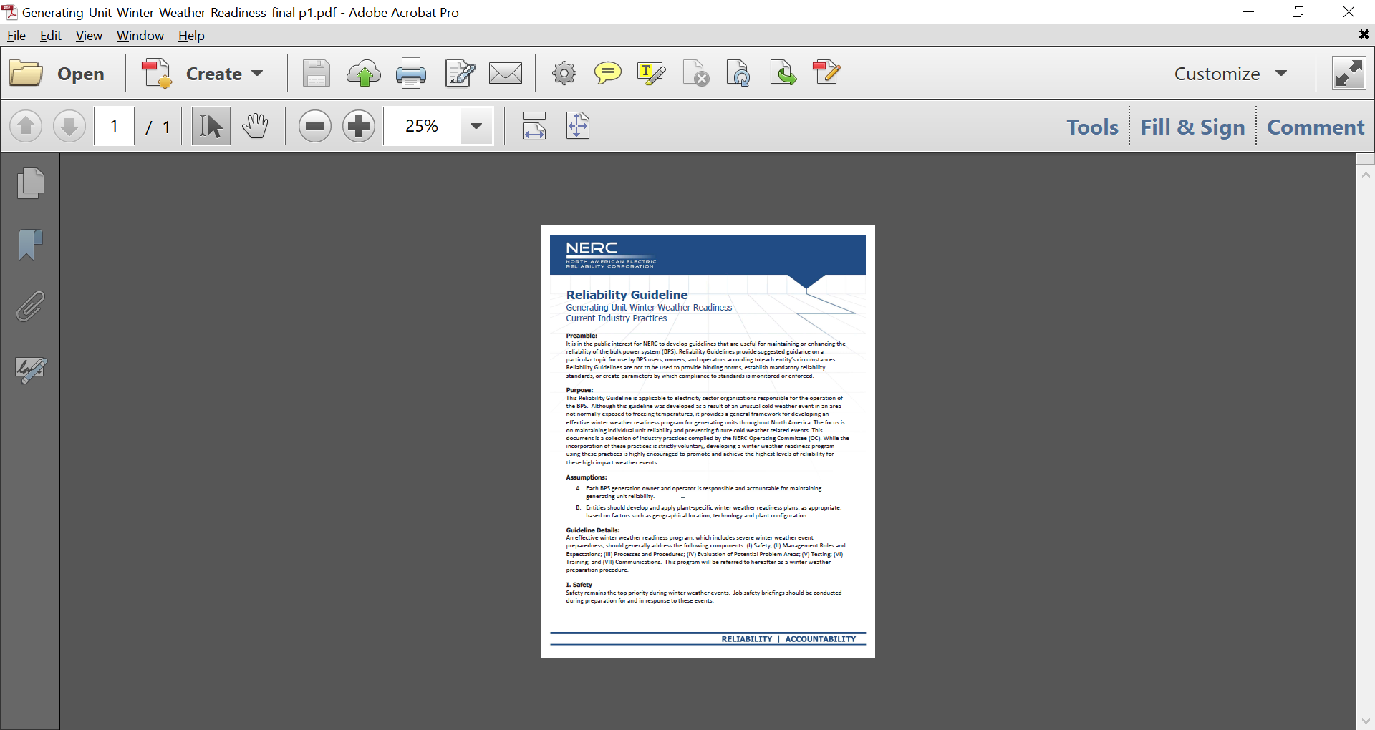
NERC Winter Weather Readiness Guideline
Approved by the Operating Committee on March 5, 2013
Revised with approval of the Operating Committee in September 2017
Notes:
(I) Safety; (II) Management Roles and Expectations; (III) Processes and Procedures; (IV) Evaluation of Potential Critical Components Problem Areas; (V) Testing; (VI) Training; and (VII) Communications. Assumptions
One Item
Details
Four large items one small
Attachment 1
Six items
5 year review

Slide 16
Preparing Circuit Breakers for Operation in Cold Weather
Failure-to-trip by three 500kV SF6 circuit breakers at a nuclear facility during 4 degree F conditions, recently posted as NERC Lesson Learned LL20180702
Thermostatically-controlled cabinet heaters added to prevent moisture from freezing inside pneumatic (air) control valve
Areas with possible cold-temperature-related failure mechanisms, to check on all breaker types as applicable:
  seal and compressor belt condition,
  lubrication,
  pressures,
  dielectric,
  dryers, and
  adequate functioning heaters or heat tracing
Notes:
SF6 gas condenses to liquid at temperatures encountered in northern winters (-10°F/-23.3°C to -30°F/34.4°C depending on pressure

Slide 17
Baker’s Dozen Winter Weather “Lessons Learned”
LL20110902 Adequate Maintenance and Inspection of Generation Freeze Protection
LL20110903 Gen. Unit Temperature Design Parameters & Extreme Winter Conditions
LL20111001 Plant Instrument &Sensing Eqpt Freezing Due to Heat Trace & Insulation Failures
LL20111002 Plant Fuel Switching and Cold Weather
LL20120101 Plant Onsite Material and Personnel Needed for a Winter Weather Event
LL20120102 Plant Operator Training to Prepare for a Winter Event
LL20120103 Transmission Facilities and Winter Operations
LL20120901 Wind Farm Winter Storm Issues
LL20120902 Transformer Oil Level Issues During Cold Weather
LL20120903 Winter Storm Inlet Air Duct Icing
LL20120904 Capacity Awareness During an Energy Emergency Event
LL20120905 Gas and Electricity Interdependency
LL20140503 Improved Contractor Oversight Needed
Notes:
Omitted Rotational Load Shed LL from 2012

Slide 18
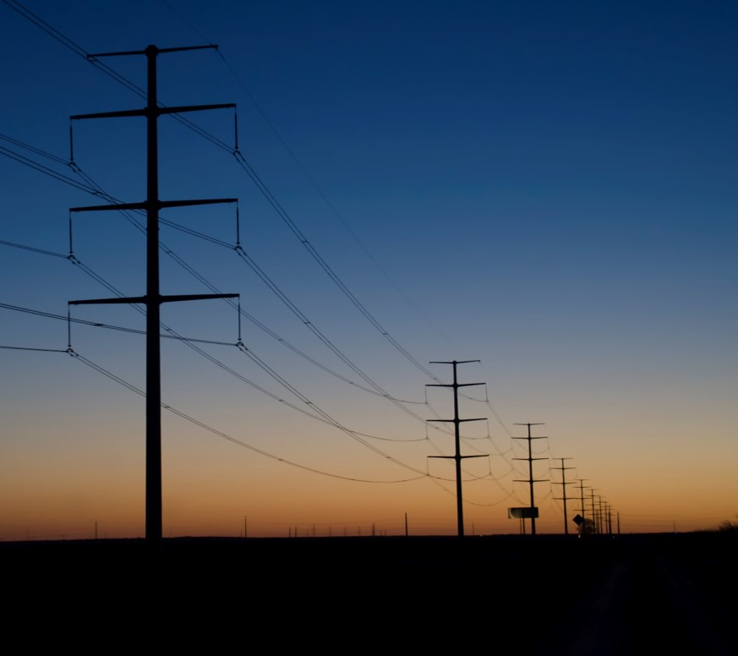
Questions?
For further information:
Bob Collins (512-583-4986)
Mark Henry (512-583-4988)
Email:
rapa@texasre.org

