Slide 1
ERCOT Frequency Control Report
July 2018
ERCOT
Operations Planning
PDCWG | August 23rd, 2018

Slide 2
Frequency Control
CPS1, BAAL, & RMS1

Slide 3
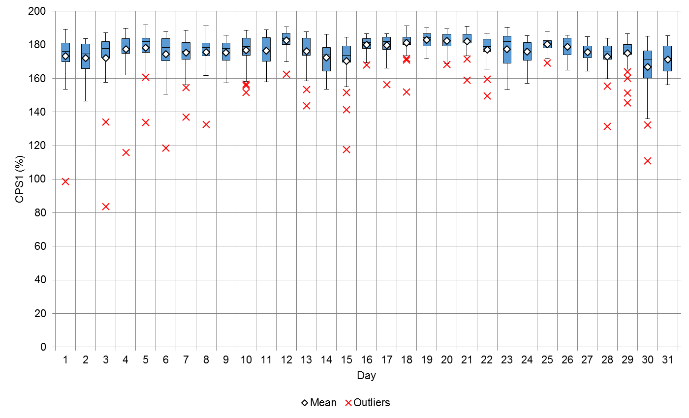
Hourly CPS1 by Day
July-18 CPS1 (%): 176.45
Notes:
Outliers:
7/1/18 11:00: 98.64%
Wind ramped down roughly 1500MW through the hour. Multiple resources with expected generation <-30MW between 11:40 and 11:55.
7/3/18 0:00: 83.67%
Wind ramped down roughly 3754MW through the hour. Regulation exhausted from 12:10 AM through the end of the hour. Frequency never got low enough to warrant a manual offset by the ERCOT operator. Frequency sat between 59.98 and 59.95 for almost entire hour.

Slide 4
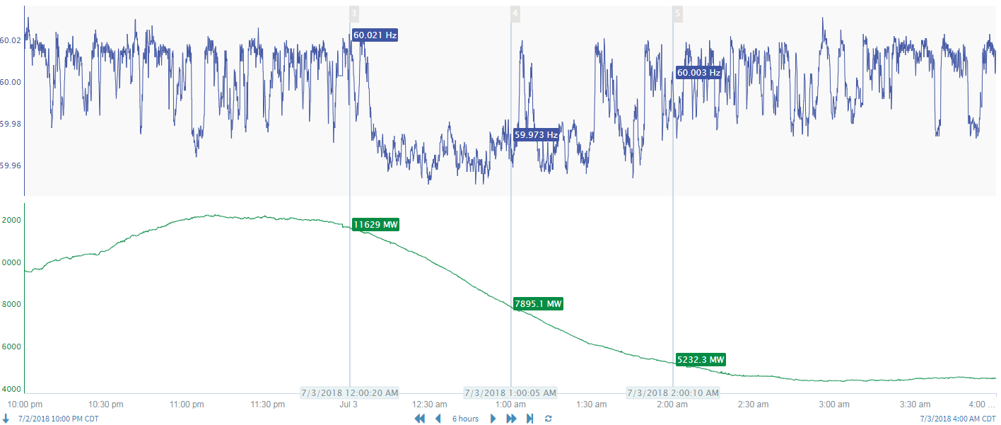
7/3/18 0:00 CPS1 Outlier
Frequency
Wind

Slide 5
7/3/18 0:00 CPS1 Outlier
GTBD error due to wind ramping is due to persistence logic, where wind is assumed to be doing in 5-min what it is doing currently (constant). During wind ramps, regulation used to make up lost or gained MW. PWRR via SCR795 reduces GTBD error in this specific CPS1 outlier.
Forecasted ramp calculated using intra-hour wind forecast (IHWF) that will be put into GTBD via SCR 795 (PWRR)

Slide 6
BAAL Exceedances & Violations
There were no BAAL exceedances

Slide 7
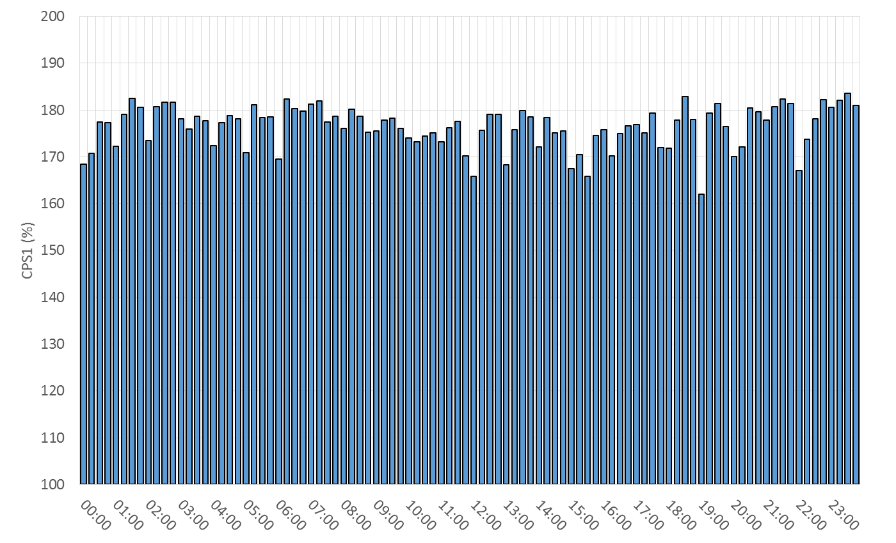
15-Minute Average CPS1%
July-18 CPS1 (%): 176.45

Slide 8
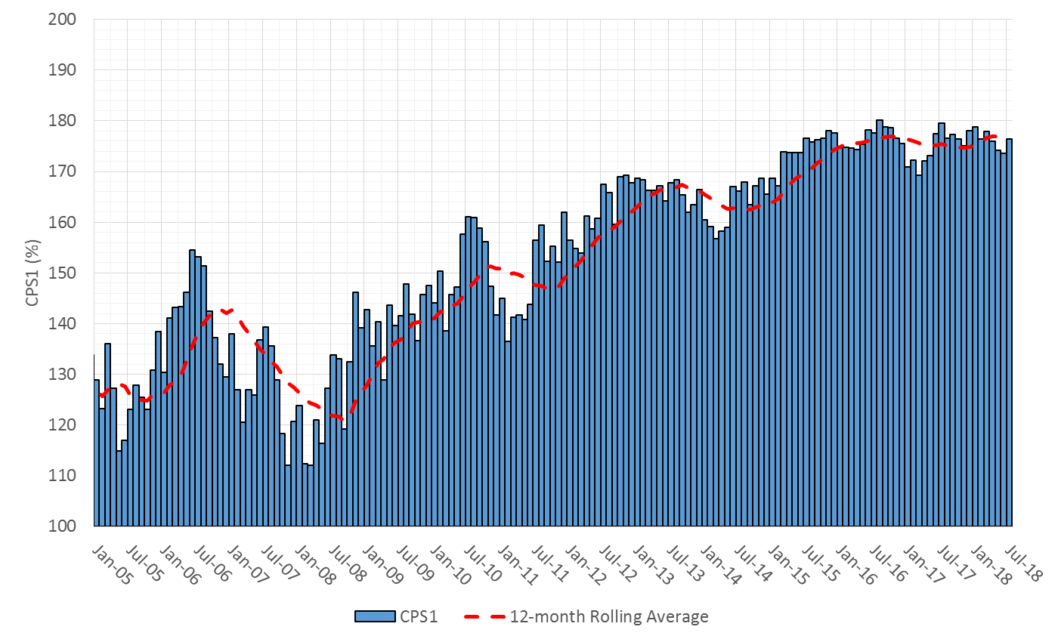
12-Month Rolling Average CPS1
Current 12-Month Rolling Average: 176.41%

Slide 9
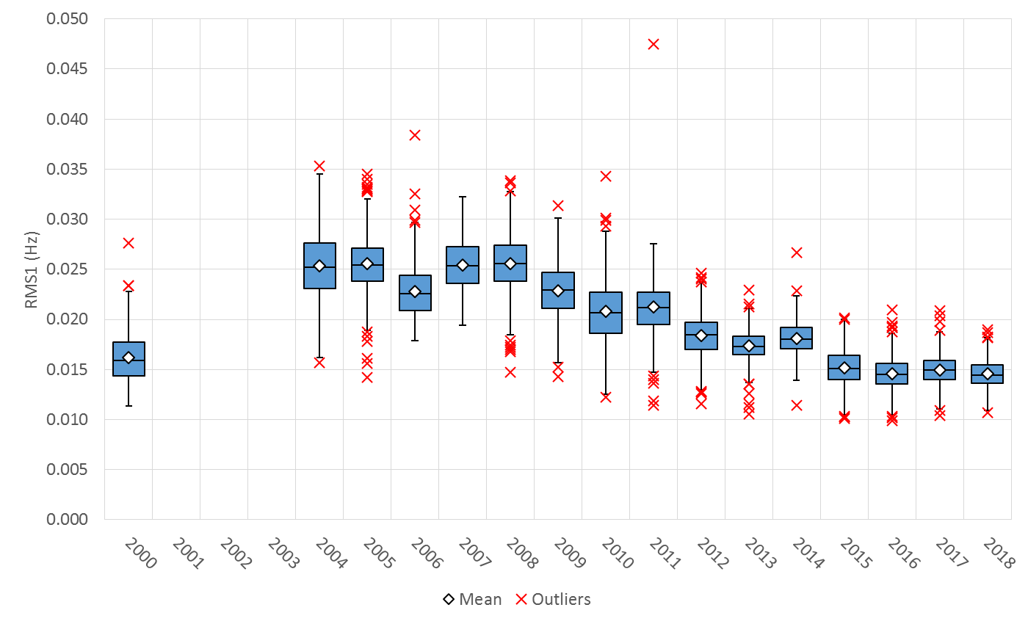
Daily RMS1 of ERCOT Frequency by Year
Notes:
Mean is 14.57 mHz

Slide 10
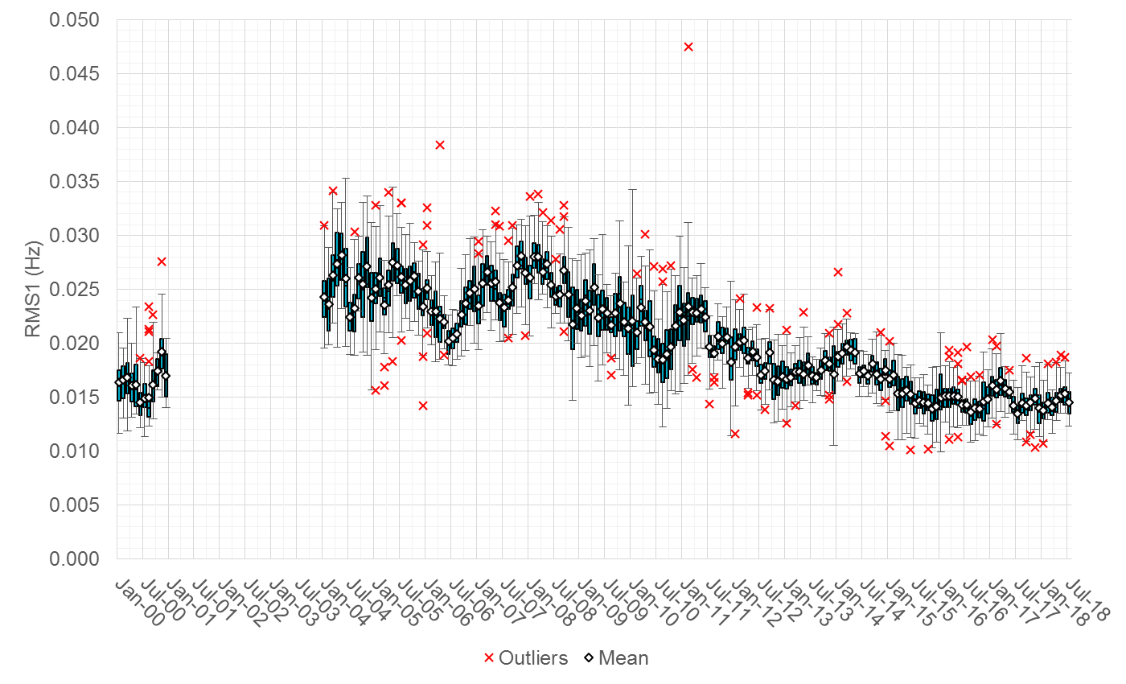
Daily RMS1 of ERCOT Frequency by Month

Slide 11
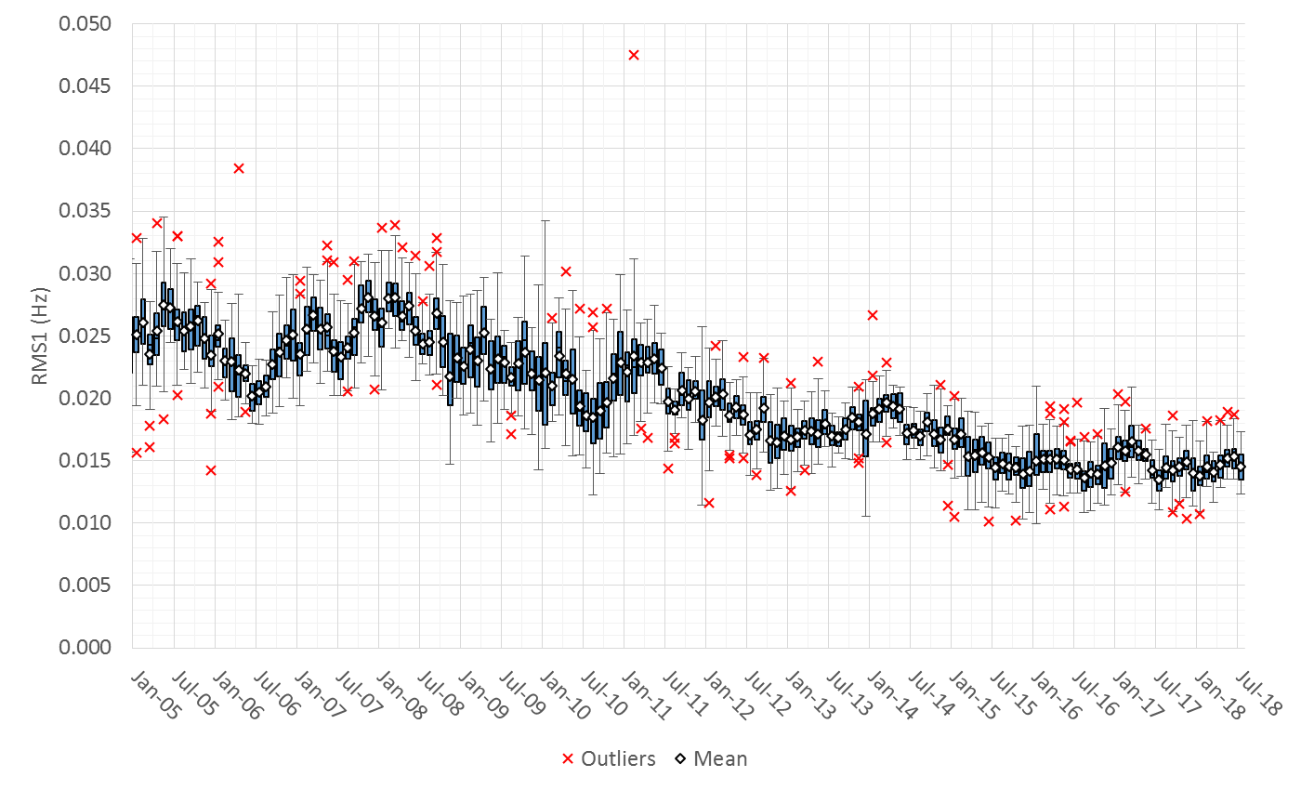
Daily RMS1 of ERCOT Frequency by Month

Slide 12
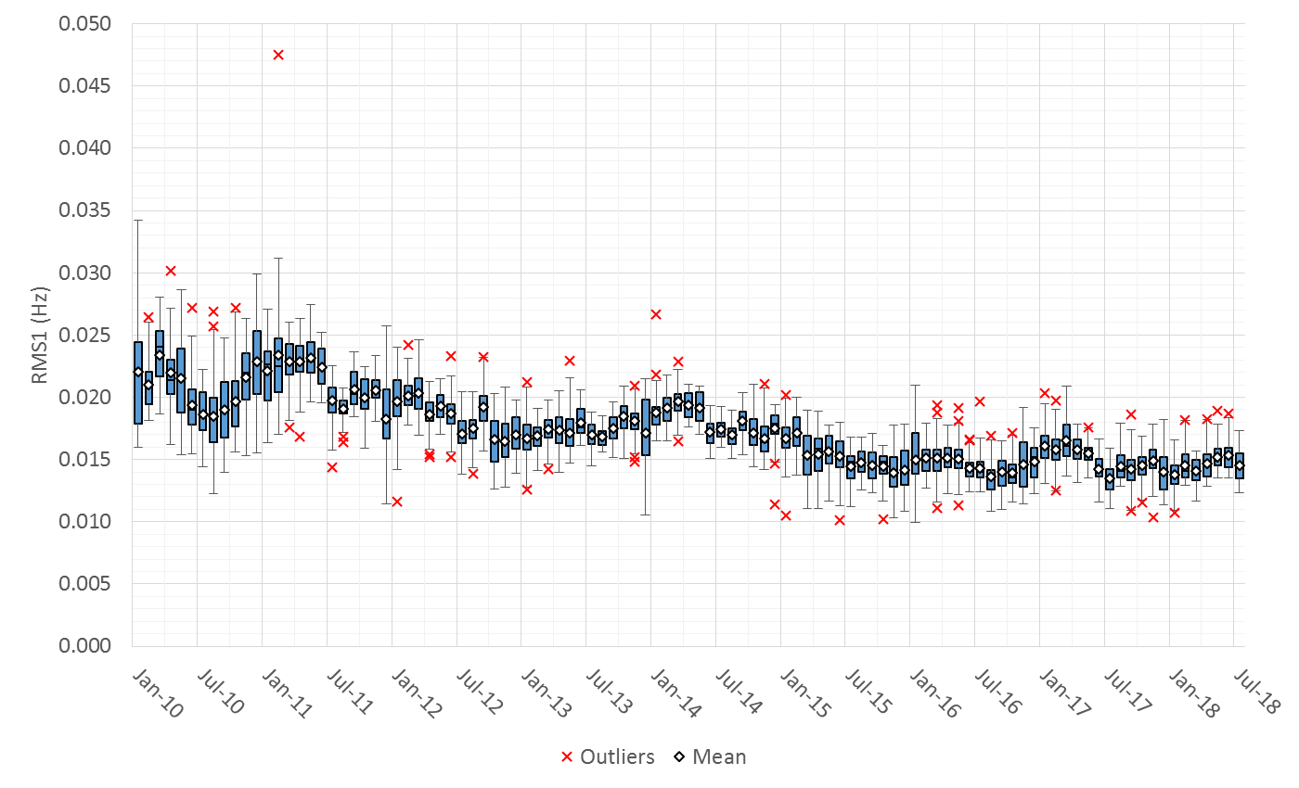
Daily RMS1 of ERCOT Frequency by Month
Notes:
Mean: 14.51 mHz
Min: 12.34 mHz
Max: 17.28 mHz

Slide 13
Frequency Profile Comparison

Slide 14
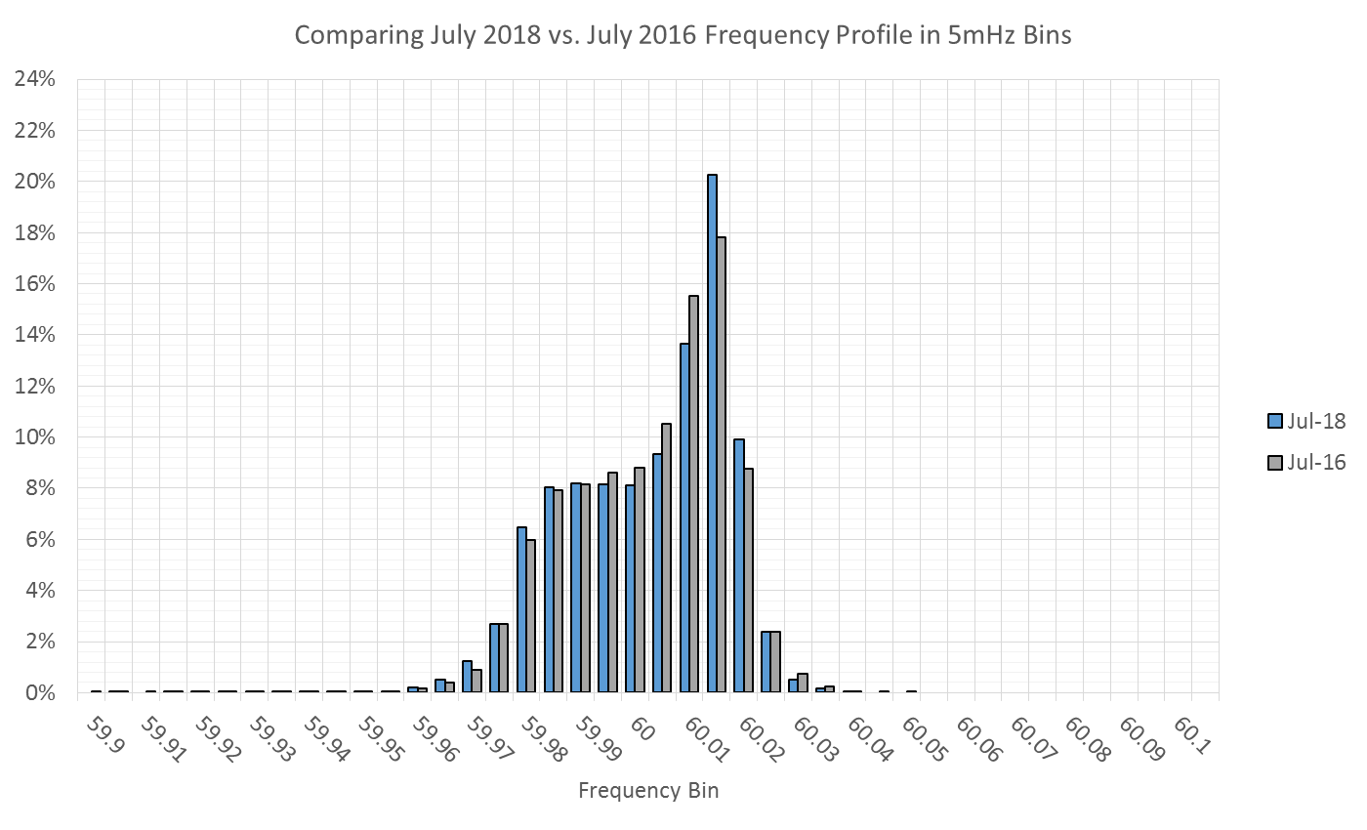
Frequency Profile Comparison

Slide 15
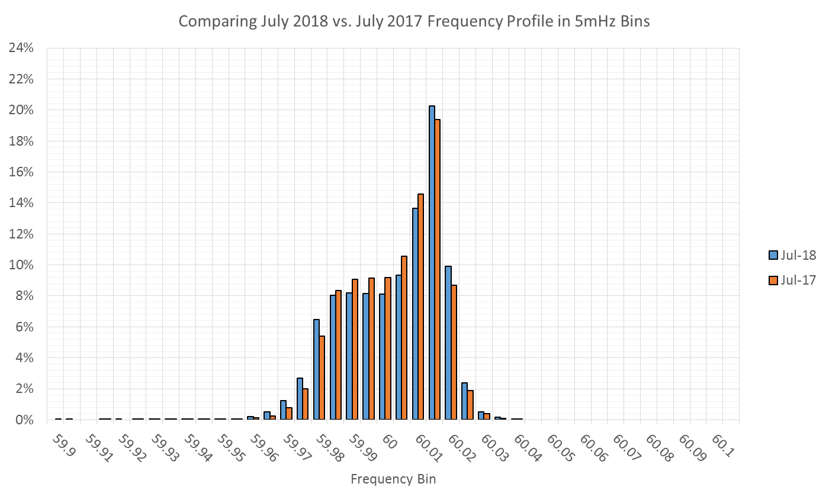
Frequency Profile Comparison

Slide 16
Time Error Correction

Slide 17
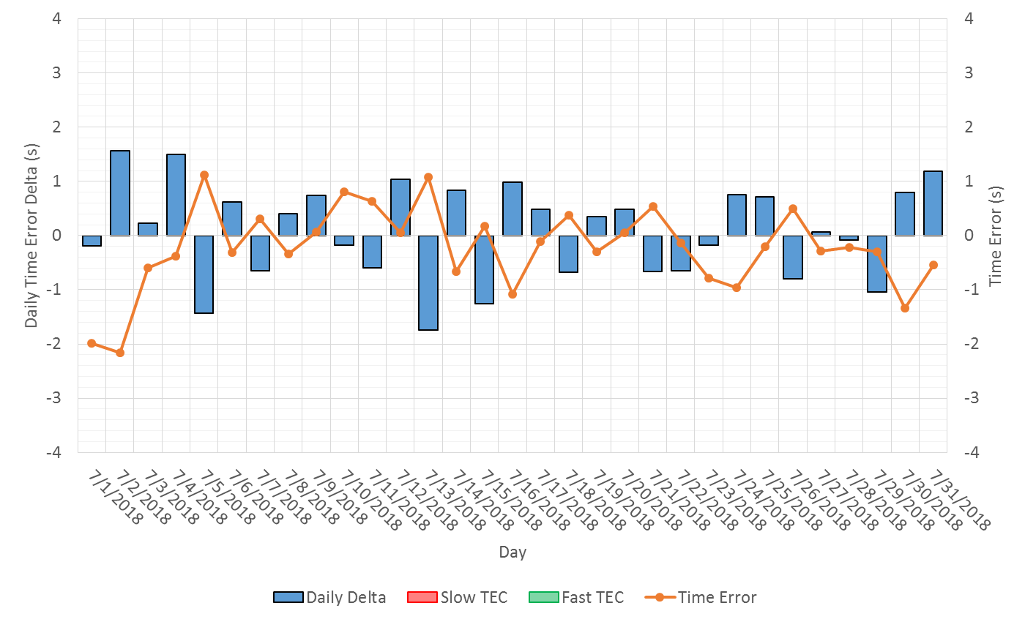
ERCOT Daily Time Error

Slide 18
Time Error Corrections Log Summary
There have been no time error corrections since December 2016

Slide 19
BAL-003 Performance

Slide 20
Op. Year 2018 BAL-003 Selected Events
 | BA |  | BA | BA | Value "A" Information (MW) |  | Value "B" Information (MW) |  | SEFRD (FRM) |  | Exclude
Date/Time (t-0) | Time | B to A |  | Bias |  |  |  |  | for Bias | for R1 | for data
BA Time | Zone | DelFreq | Time | DelFreq | Load Loss | Adjust | Load Loss | Adjust. | (MW/0.1Hz) | (MW/0.1Hz) | error *
2/5/2018 14:04:41 | CST | -0.098 | 14:04:46 | -0.098 | 0.0 | 0.0 | 816.0 | 0.0 | -829.9 | -829.9 | N
2/14/2018 06:30:17 | CST | -0.105 | 6:30:21 | -0.105 | 0.0 | 0.0 | 784.2 | 0.0 | -747.7 | -747.7 | N
3/5/2018 00:51:20 | CST | -0.033 | 6:51:20 | -0.033 | 0.0 | 0.0 | 513.5 | 0.0 | -1552.2 | -1552.2 | N
3/24/2018 15:47:15 | CDT | -0.085 | 20:47:15 | -0.085 | 0.0 | 0.0 | 797.3 | 0.0 | -943.3 | -943.3 | N
3/29/2018 10:09:40 | CDT | -0.041 | 16:09:40 | -0.041 | 0.0 | 0.0 | 434.1 | 0.0 | -1049.1 | -1049.1 | N
4/13/2018 20:02:08 | CDT | -0.076 | 2:02:08 | -0.076 | 0.0 | 0.0 | 438.0 | 0.0 | -577.9 | -577.9 | N
4/14/2018 19:11:25 | CDT | -0.048 | 1:11:25 | -0.048 | 0.0 | 0.0 | 349.0 | 0.0 |  |  | Y
4/28/2018 12:15:43 | CDT | -0.048 | 18:15:43 | -0.048 | 0.0 | 0.0 | 408.0 | 0.0 |  |  | Y
5/5/2018 10:19:04 | CDT | -0.095 | 16:19:04 | -0.095 | 0.0 | 0.0 | 536.3 | 0.0 | -563.5 | -563.5 | N
5/21/2018 02:06:23 | CDT | -0.081 | 8:06:23 | -0.081 | 0.0 | 0.0 | 460.5 | 0.0 | -568.4 | -568.4 | N
Maybe. Will be valuated at the end of the year.

Slide 21
Op. Year 2018 BAL-003 FRM Performance
FRM Performance Results for 2018
2018 | Current data year (December thru November)
-381.0 | Operating Year 2019 BA Frequency Response Obligation (FRO) for next year's FRM
-381.0 | Operating Year 2018 BA Frequency Response Obligation (FRO)
-788.77 | 2018 FRM - Median Estimated Frequency Response MW/0.1Hz for BA Compliance to R1, minimum Frequency Response
-854.0 | 2018 FRM - Average Estimated Frequency Response MW/0.1 Hz using SEFRD for R1
0.0 | 2018 FRM - Regression Estimated Frequency Response MW/0.1Hz using SEFRD for R1

Slide 22
ERCOT Energy Statistics

Slide 23
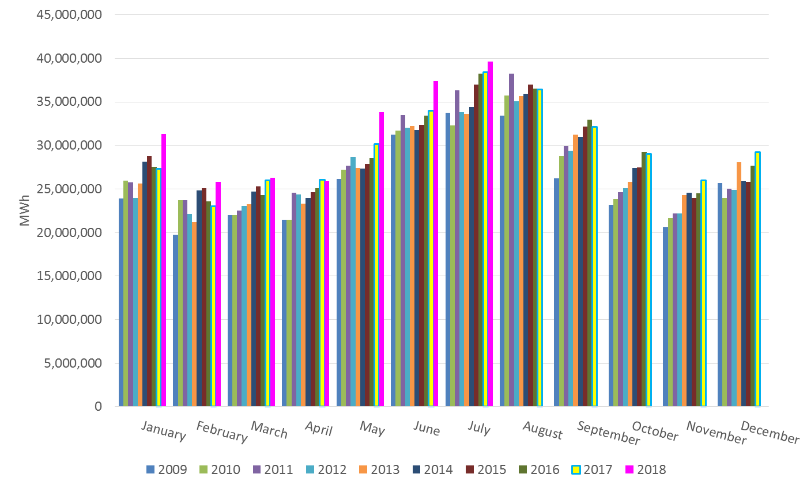
Total Energy
Notes:
39,656,104 MWh

Slide 24
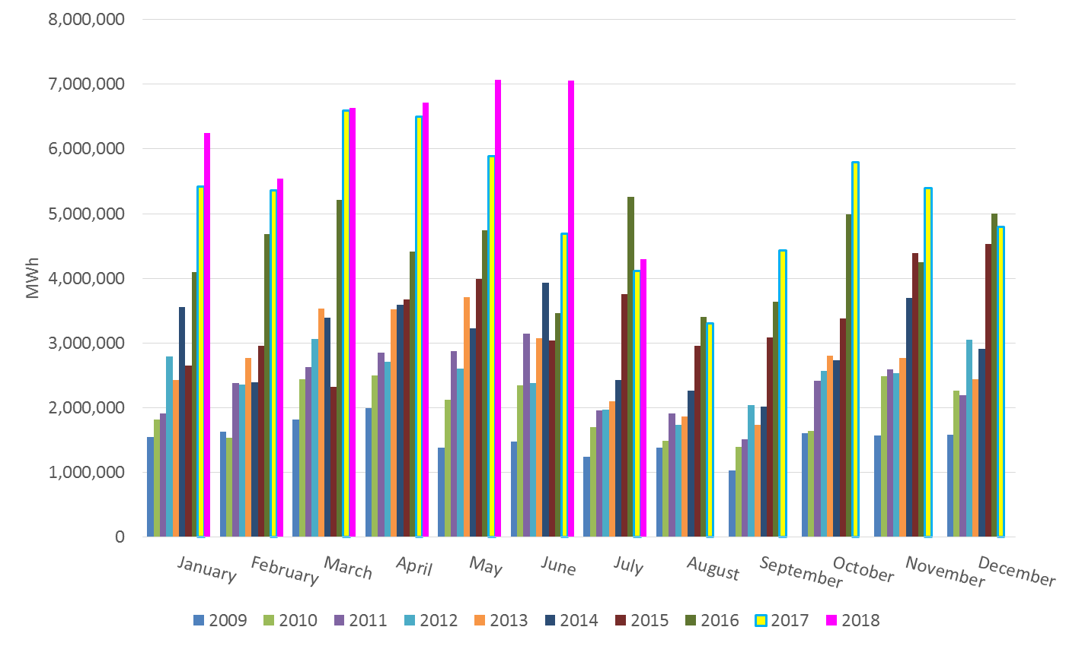
Total Energy from Wind Generation
Notes:
4,293,939 MWh

Slide 25
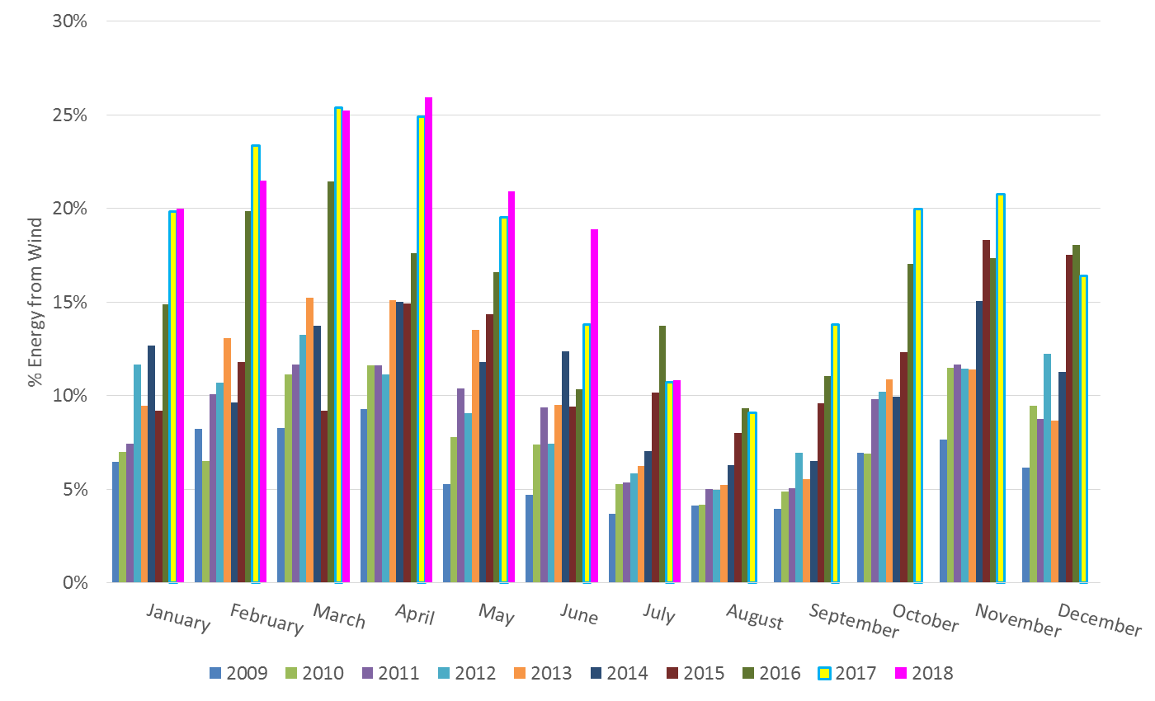
% Energy from Wind Generation
Notes:
10.83%

Slide 26
ERCOT System Inertia

Slide 27
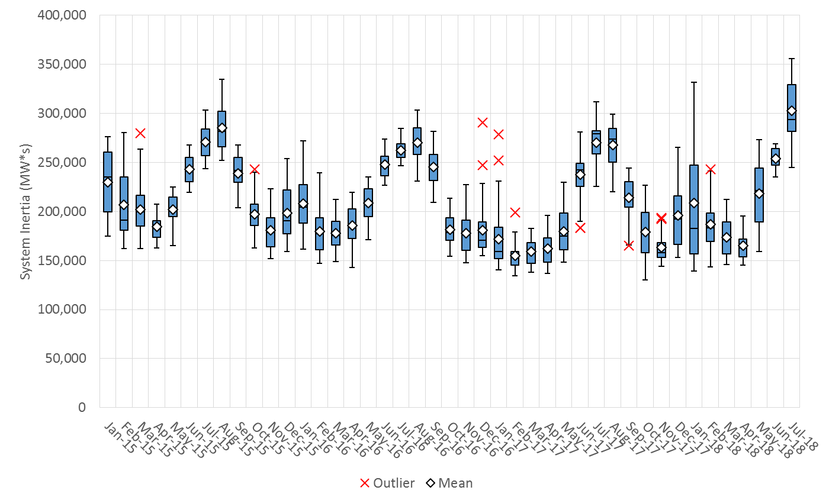
Daily Minimum System Inertia
Notes:
Minimum Inertia = 245,095 MW*s on 7/1/2018.
July
Mean: 302,996
Max: 355,780 on July 20th
Min: 245,095 on July 1st

Slide 28
Questions?
Thank you!

Slide 29
Op. Year 2017 BAL-003 Selected Events
Notes:
Frequency Bias updated from 764 to 759 in April

Slide 30
Op. Year 2017 BAL-003 FRM Performance

