Slide 1
PDCWG Report to ROS
Chair: Percy Galliguez, Brazos Electric Power Cooperative, Inc.
Vice Chair: Chad Mulholland, NRG
ROS
September 6th, 2018

Slide 2
Report Overview & Notes
Report Overview
  Meeting Minutes
  BAL-001-TRE-1 FMEs & IMFR
    2 FMEs in the month of July
  Frequency Control Report

Slide 3
Meeting Minutes
PDCWG Meeting 08/23/18
  SCT DC Tie Directive 9 – MSSC Whitepaper and Ancillary Service Requirements. Further presentation by ERCOT(overshoot on export) and discussions in September and November PDCWG Meetings.
  BAL-001-TRE-1 Performance Evaluation to check for pass/fail before scoring progress and No Evaluation of Resources below LSL especially for resources carrying RRS Responsibility Update
  Regulation & Frequency Control Reports
  Texas RE is working with ERCOT on the BAL-001-TRE-1 SAR relating to governor droop setting requirements for combined cycle units – particularly on steam units in a combined cycle.
  July 30 Frequency Disturbance not evaluated as an FME due to abnormal nadir(20 seconds as opposed to 6-10 seconds)

Slide 4
Frequency Measurable Events Performance

Slide 5
Frequency Measurable Events
There were 2 FMEs in July(Disturbances on 7/30
  7/6/2018 13:10:58
    Loss of 813 MW
    Interconnection Frequency Response:
    10 of 46 Evaluated Generation Resources(2 of 33 RRS Providers) had less than 75% of their expected Initial Primary Frequency Response.
    8 of 46 Evaluated Generation Resources(0 of 33 RRS Providers) had less than 75% of their expected Sustained Primary Frequency Response.
  7/18/2018 17:44:59
    Loss of 494 MW
    Interconnection Frequency Response:
    11 of 49 Evaluated Generation Resources(6 of 31 RRS Providers) had less than 75% of their expected Initial Primary Frequency Response.
    12 of 49 Evaluated Generation Resources(6 of 31 RRS Providers) had less than 75% of their expected Sustained Primary Frequency Response.

Slide 6
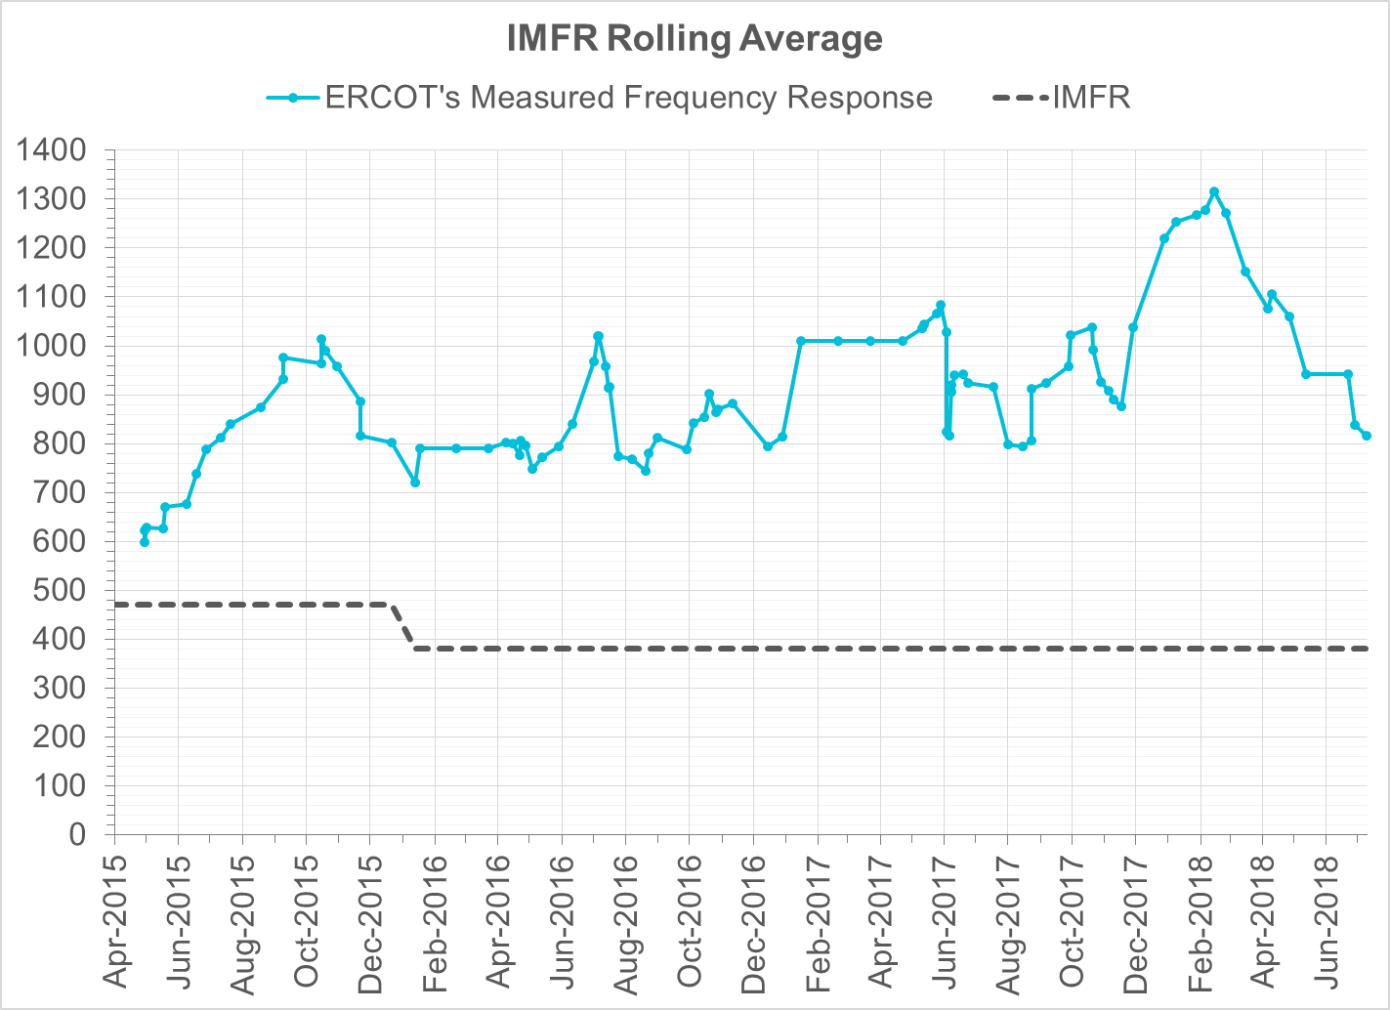
Interconnection Minimum Frequency Response (IMFR) Performance
IMFR Performance currently 815.90 MW/0.1Hz

Slide 7
Frequency Control Report
July 2018

Slide 8
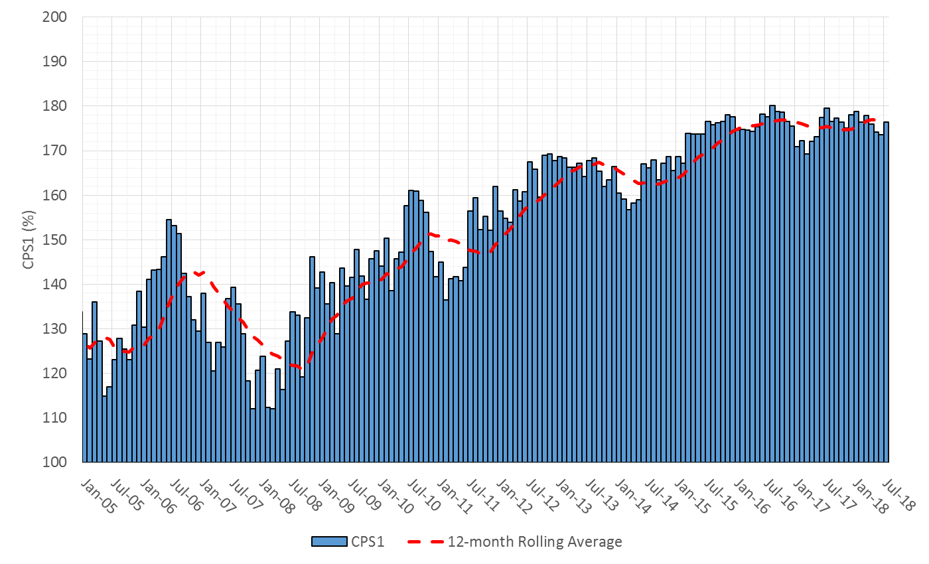

CPS1 Performance

Slide 9
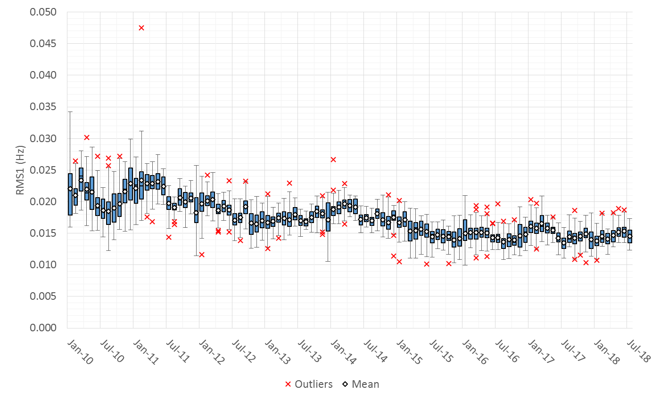
RMS1 Performance of ERCOT Frequency

Slide 10
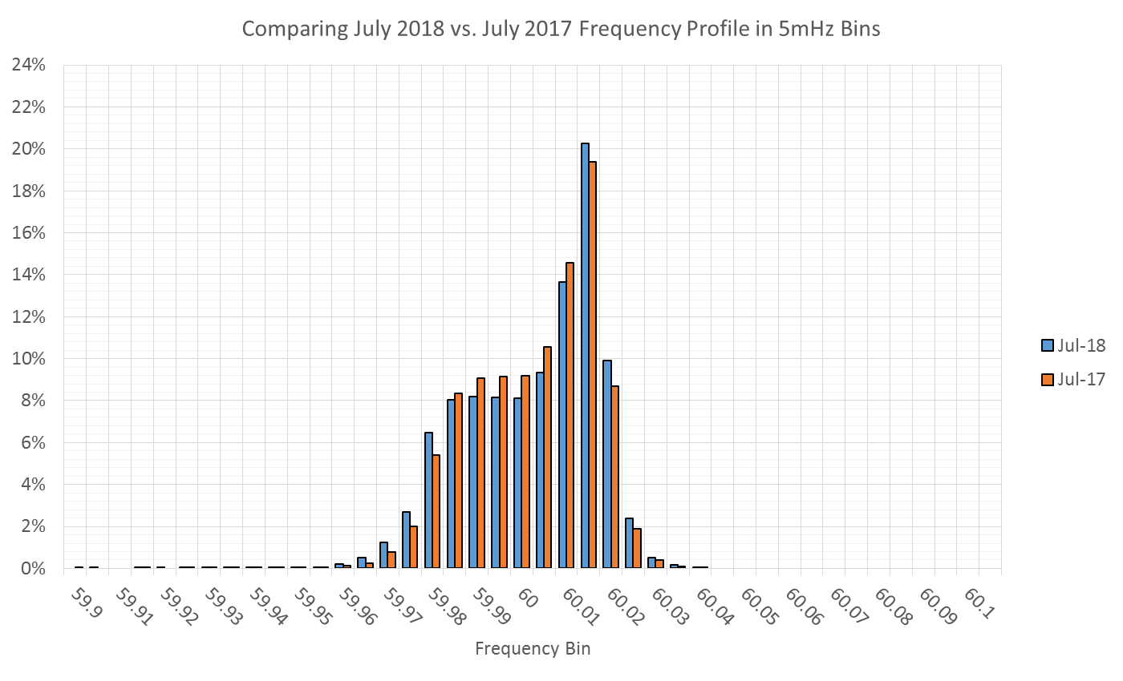
Frequency Profile Analysis

Slide 11
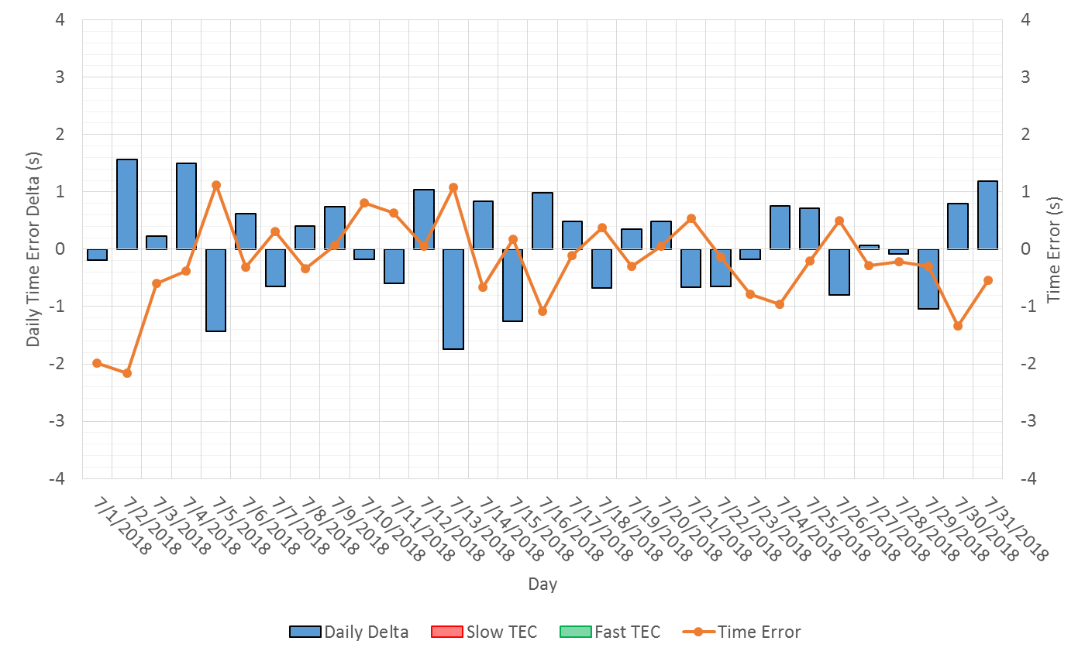
Time Error Corrections

Slide 12
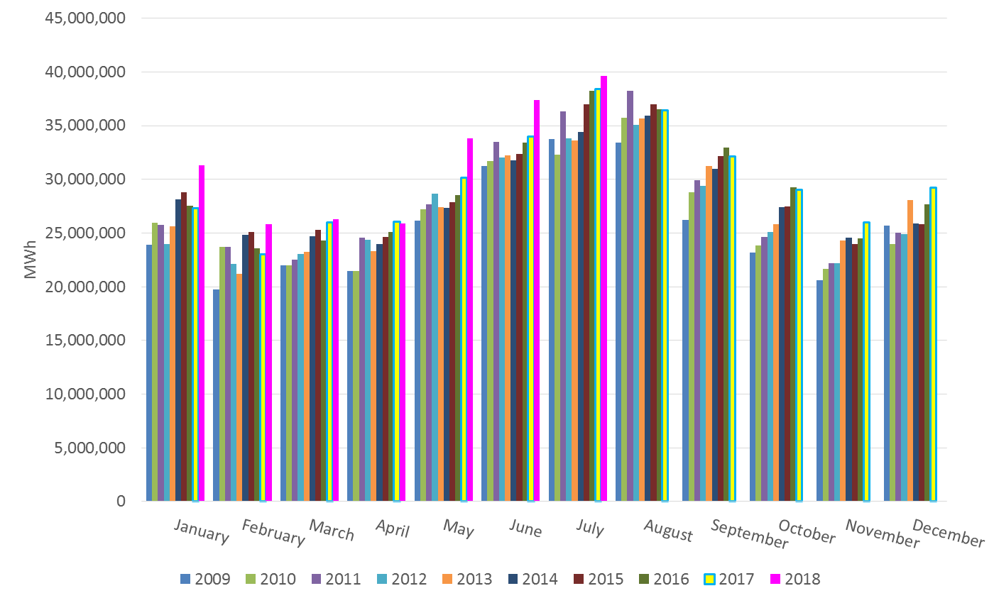
ERCOT Total Energy

Slide 13
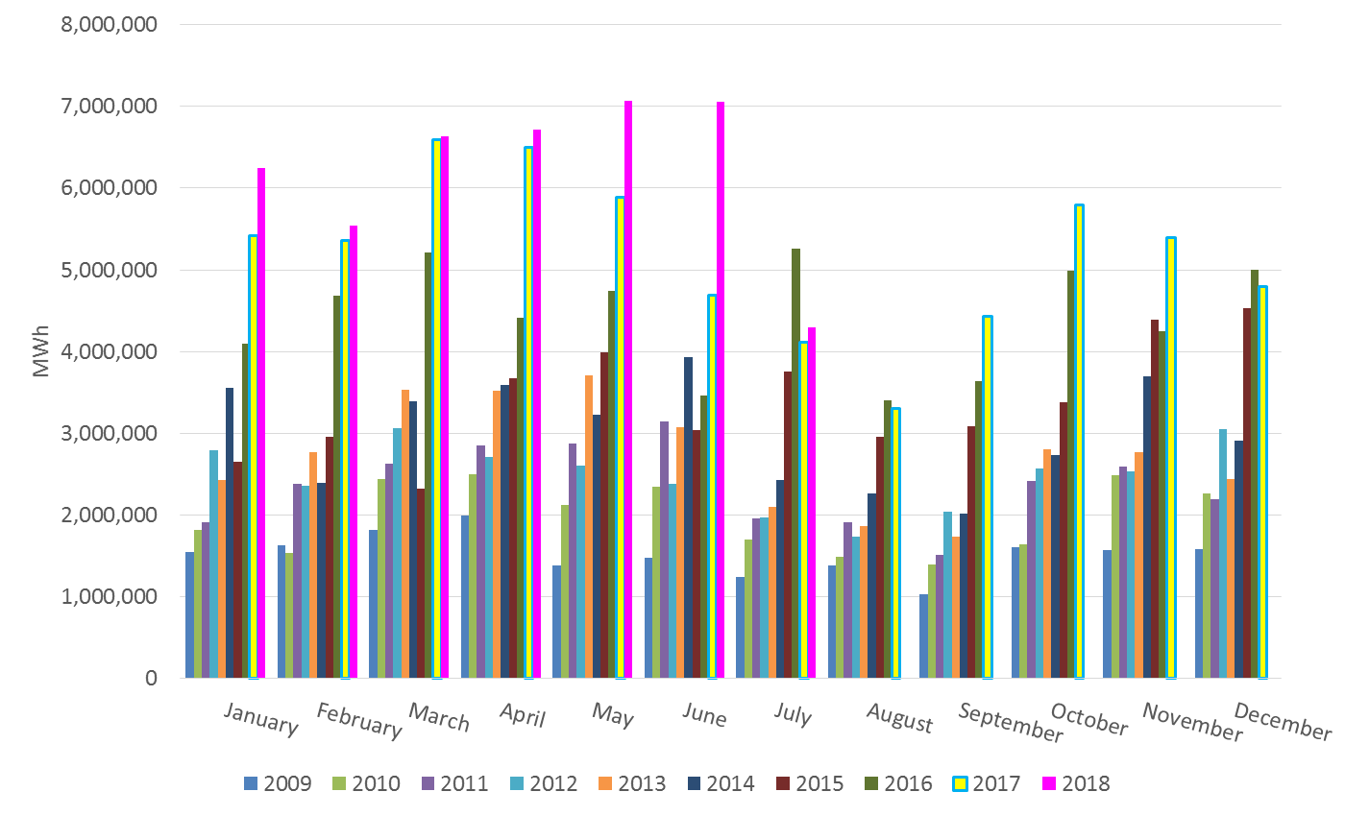
ERCOT Total Energy from Wind Generation

Slide 14
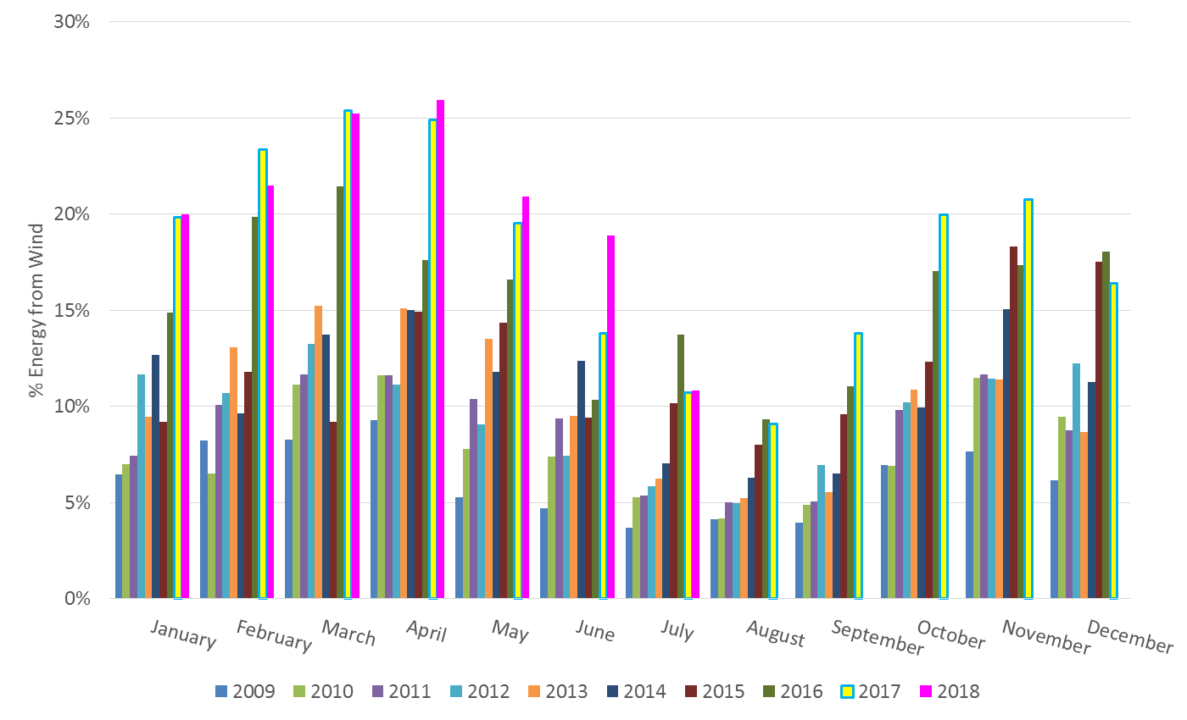
ERCOT % Energy from Wind Generation

Slide 15
Questions?

