Slide 1
ERCOT Frequency Control Report
July 2018
ERCOT
Operations Planning
PDCWG | September 12th, 2018

Slide 2
Frequency Control
CPS1, BAAL, & RMS1

Slide 3
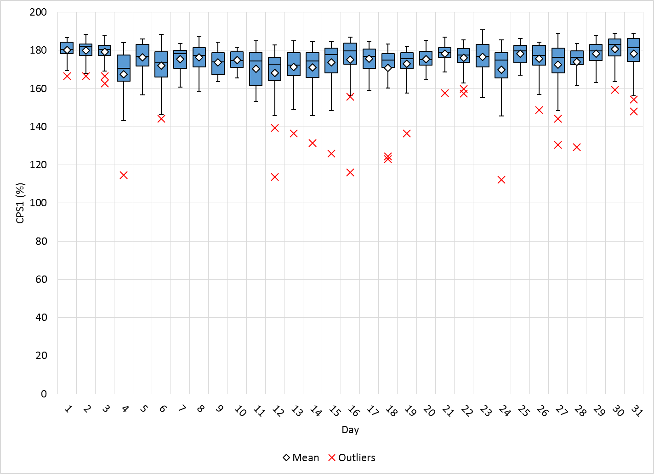
Hourly CPS1 by Day
August-18 CPS1 (%): 174.82
Notes:
Outliers:

Slide 4
BAAL Exceedances & Violations
There were 2 BAAL exceedances
  August 13, 2018
    FME at 22:59:57
    Loss of 1,198 MW
    Less than 59.91 Hz for 1 minute
  August 15, 2018
    Unit trip at 18:10:42
    Loss of 487 MW
    Less than 59.91 Hz for 1 minute

Slide 5
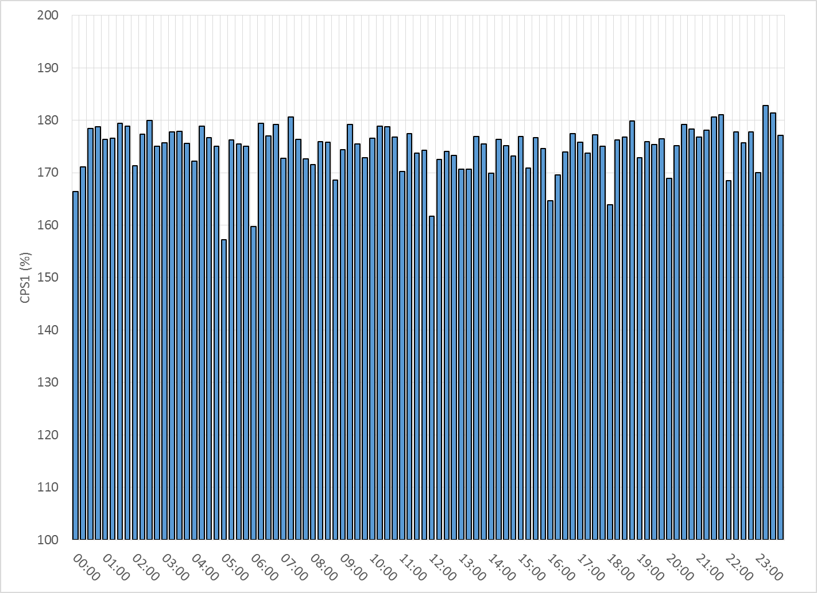
15-Minute Average CPS1%
August-18 CPS1 (%): 174.82

Slide 6
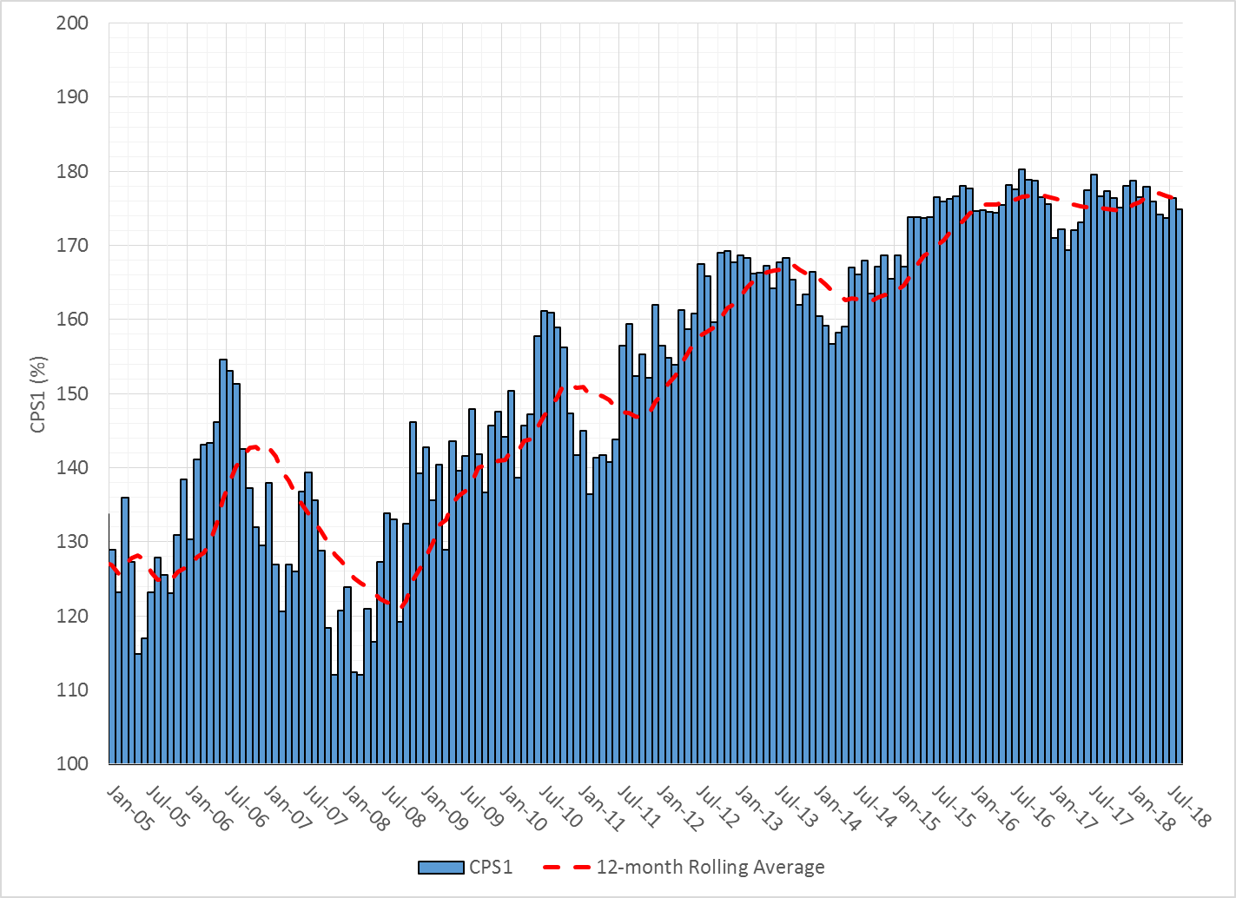
12-Month Rolling Average CPS1
Current 12-Month Rolling Average: 176.26%

Slide 7
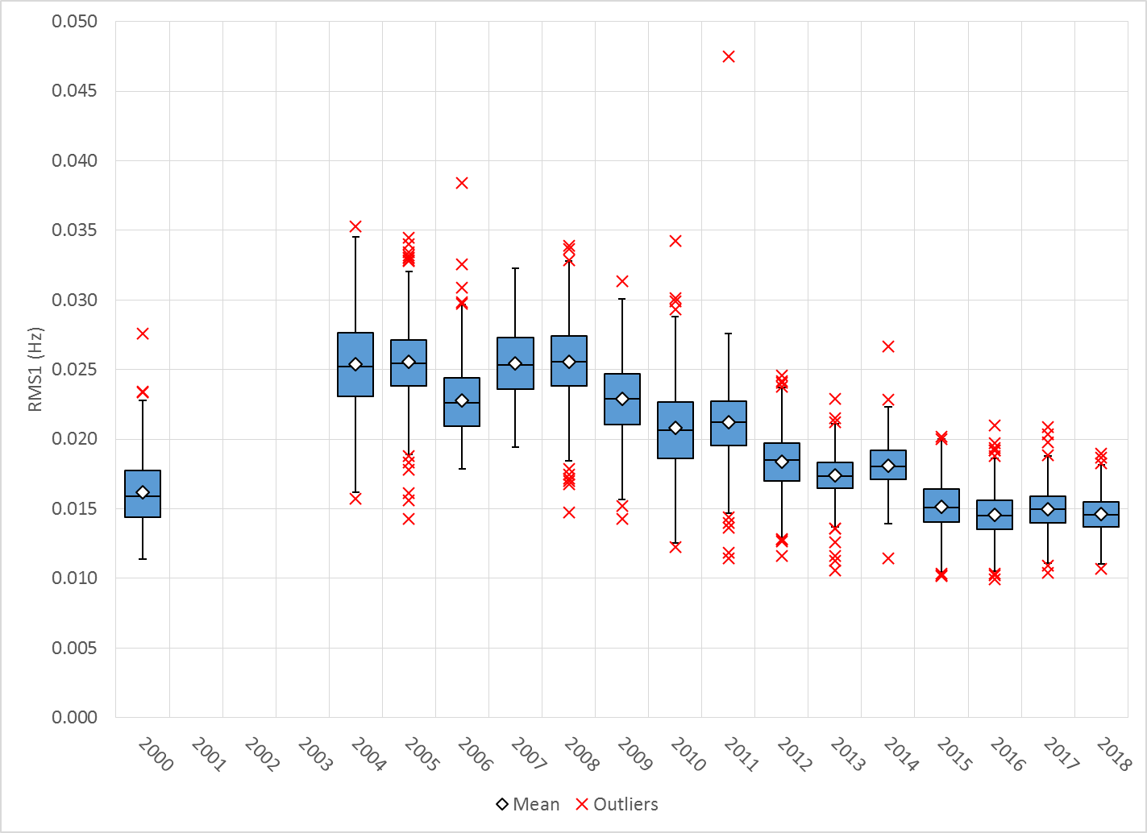
Daily RMS1 of ERCOT Frequency by Year
Notes:
Mean is 14.63 mHz

Slide 8
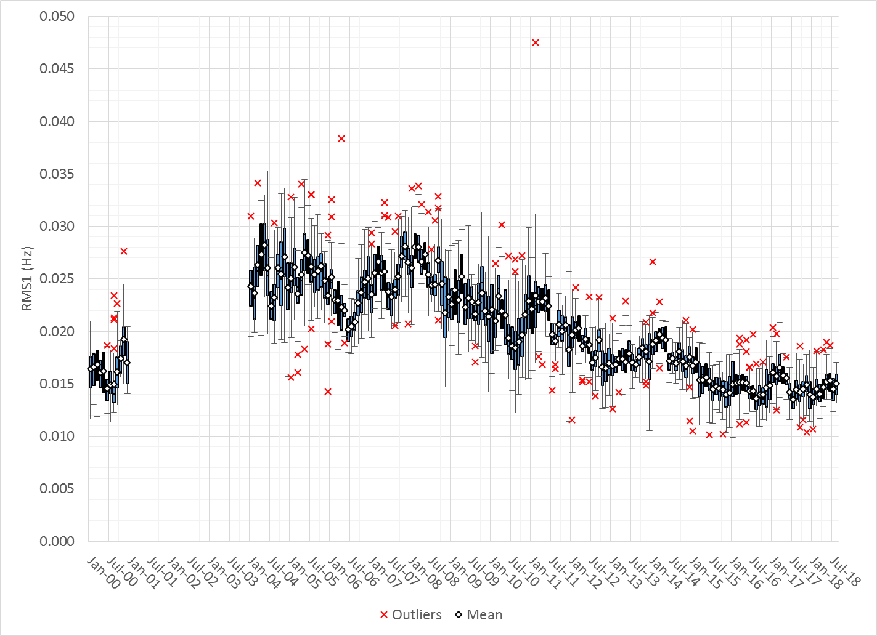
Daily RMS1 of ERCOT Frequency by Month

Slide 9
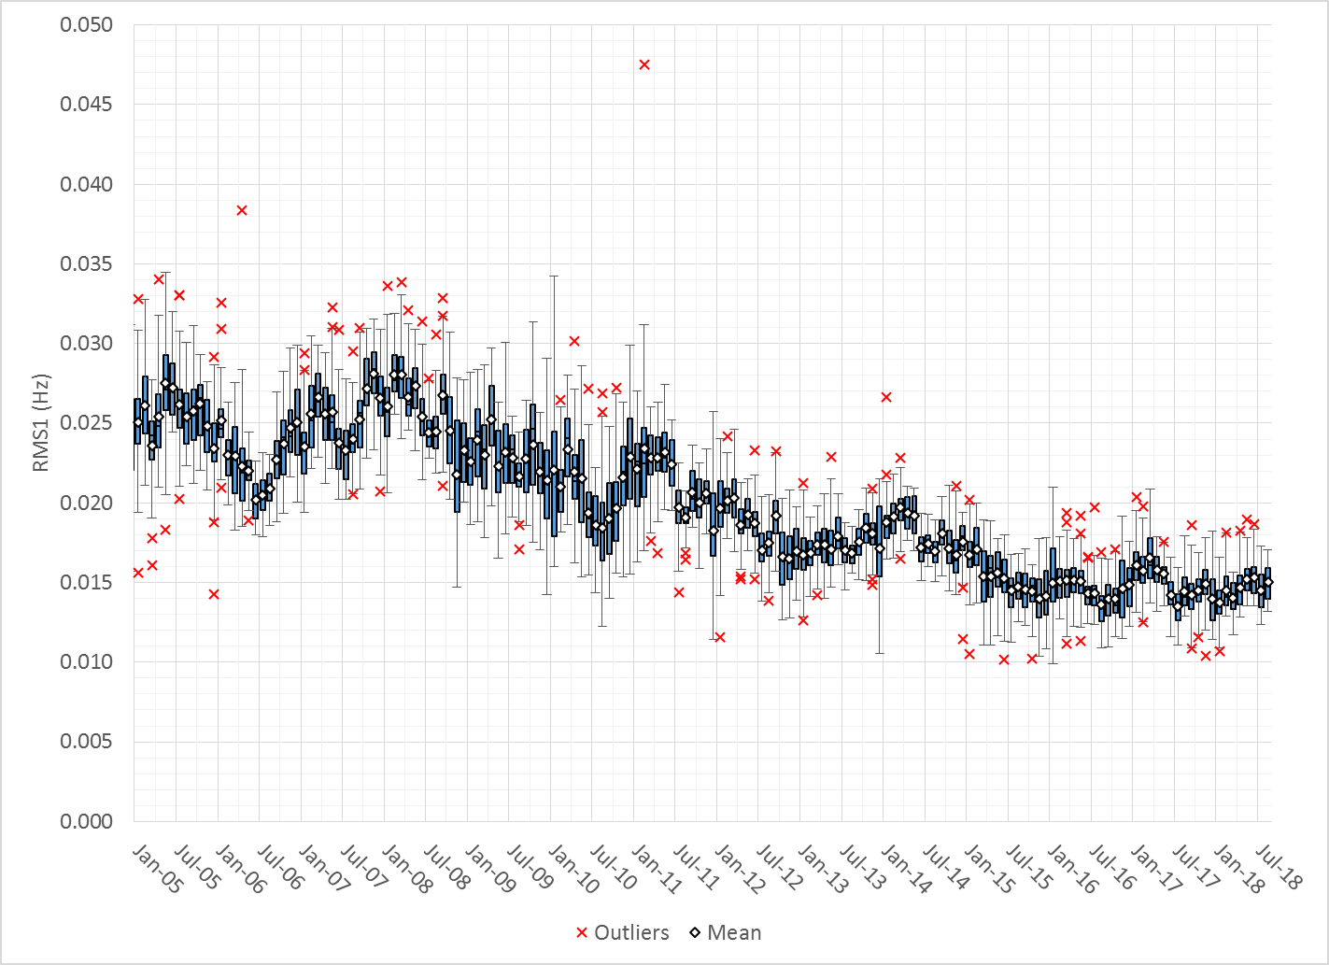
Daily RMS1 of ERCOT Frequency by Month

Slide 10
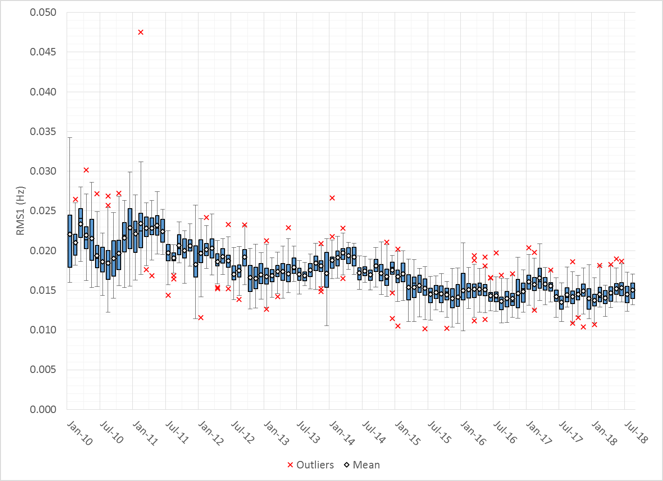
Daily RMS1 of ERCOT Frequency by Month
Notes:
Mean: 15.02 mHz
Min: 13.19 mHz
Max: 17.08 mHz

Slide 11
Frequency Profile Comparison

Slide 12
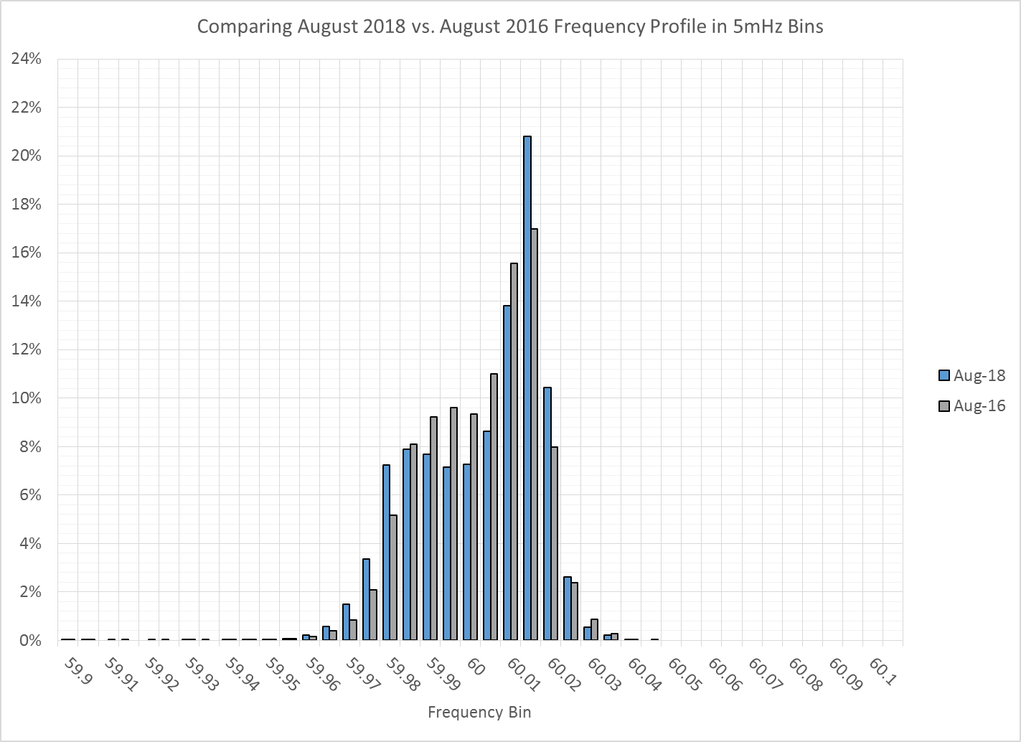
Frequency Profile Comparison

Slide 13
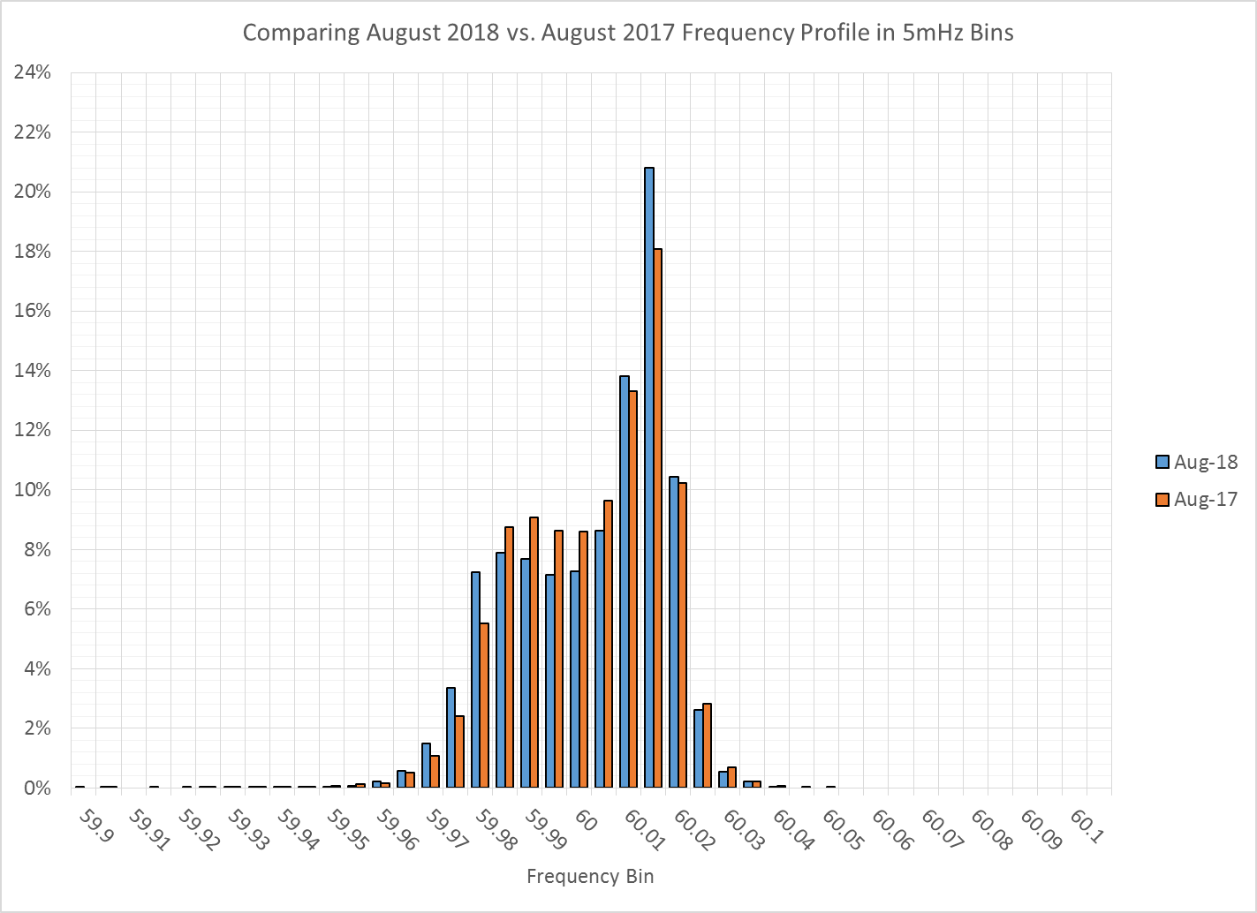
Frequency Profile Comparison

Slide 14
Time Error Correction

Slide 15
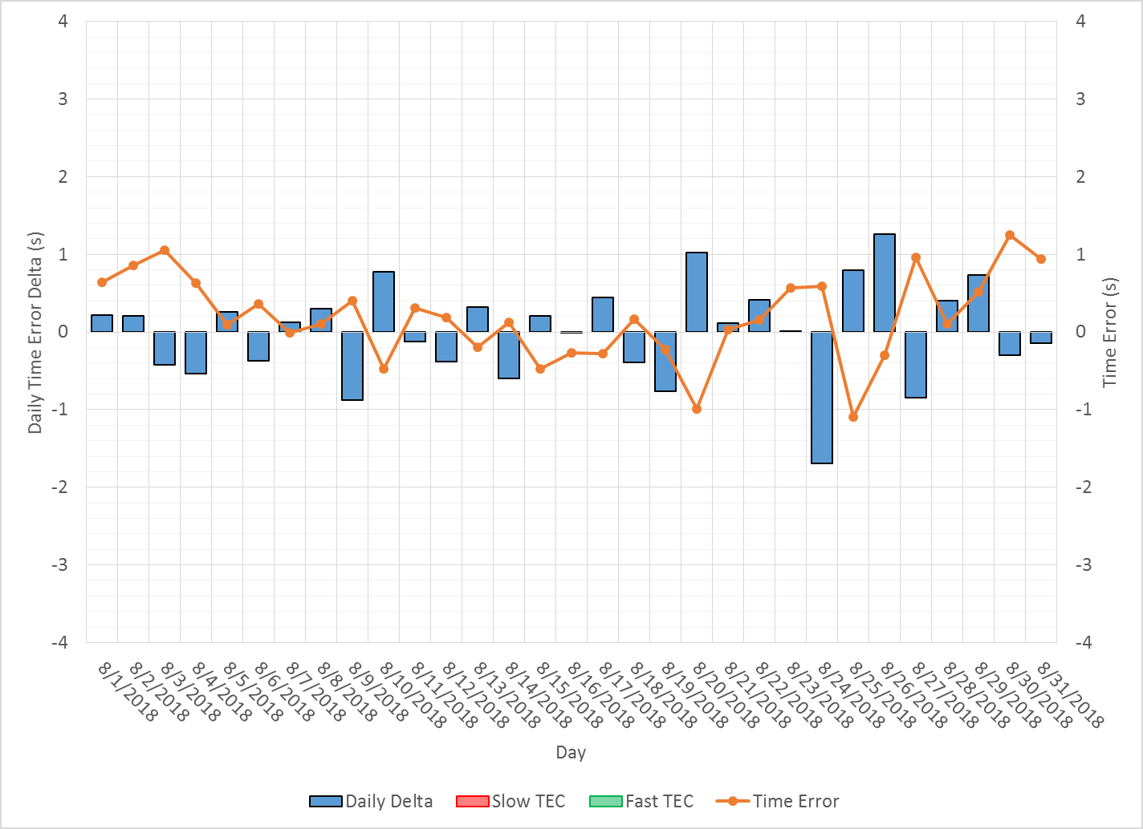
ERCOT Daily Time Error

Slide 16
Time Error Corrections Log Summary
There have been no time error corrections since December 2016

Slide 17
BAL-003 Performance

Slide 18
Op. Year 2018 BAL-003 Selected Events
 | BA |  | BA | BA | Value "A" Information (MW) |  | Value "B" Information (MW) |  | SEFRD (FRM) |  | Exclude
Date/Time (t-0) | Time | B to A |  | Bias |  |  |  |  | for Bias | for R1 | for data
BA Time | Zone | DelFreq | Time | DelFreq | Load Loss | Adjust | Load Loss | Adjust. | (MW/0.1Hz) | (MW/0.1Hz) | error *
2/5/2018 14:04:41 | CST | -0.098 | 14:04:46 | -0.098 | 0.0 | 0.0 | 816.0 | 0.0 | -829.9 | -829.9 | N
2/14/2018 06:30:17 | CST | -0.105 | 6:30:21 | -0.105 | 0.0 | 0.0 | 784.2 | 0.0 | -747.7 | -747.7 | N
3/5/2018 00:51:20 | CST | -0.033 | 6:51:20 | -0.033 | 0.0 | 0.0 | 513.5 | 0.0 | -1552.2 | -1552.2 | N
3/24/2018 15:47:15 | CDT | -0.085 | 20:47:15 | -0.085 | 0.0 | 0.0 | 797.3 | 0.0 | -943.3 | -943.3 | N
3/29/2018 10:09:40 | CDT | -0.041 | 16:09:40 | -0.041 | 0.0 | 0.0 | 434.1 | 0.0 | -1049.1 | -1049.1 | N
4/13/2018 20:02:08 | CDT | -0.076 | 2:02:08 | -0.076 | 0.0 | 0.0 | 438.0 | 0.0 | -577.9 | -577.9 | N
4/14/2018 19:11:25 | CDT | -0.048 | 1:11:25 | -0.048 | 0.0 | 0.0 | 349.0 | 0.0 |  |  | Y
4/28/2018 12:15:43 | CDT | -0.048 | 18:15:43 | -0.048 | 0.0 | 0.0 | 408.0 | 0.0 |  |  | Y
5/5/2018 10:19:04 | CDT | -0.095 | 16:19:04 | -0.095 | 0.0 | 0.0 | 536.3 | 0.0 | -563.5 | -563.5 | N
5/21/2018 02:06:23 | CDT | -0.081 | 8:06:23 | -0.081 | 0.0 | 0.0 | 460.5 | 0.0 | -568.4 | -568.4 | N
Maybe. Will be valuated at the end of the year.

Slide 19
Op. Year 2018 BAL-003 FRM Performance
FRM Performance Results for 2018
2018 | Current data year (December thru November)
-381.0 | Operating Year 2019 BA Frequency Response Obligation (FRO) for next year's FRM
-381.0 | Operating Year 2018 BA Frequency Response Obligation (FRO)
-788.77 | 2018 FRM - Median Estimated Frequency Response MW/0.1Hz for BA Compliance to R1, minimum Frequency Response
-854.0 | 2018 FRM - Average Estimated Frequency Response MW/0.1 Hz using SEFRD for R1
0.0 | 2018 FRM - Regression Estimated Frequency Response MW/0.1Hz using SEFRD for R1

Slide 20
ERCOT Energy Statistics

Slide 21
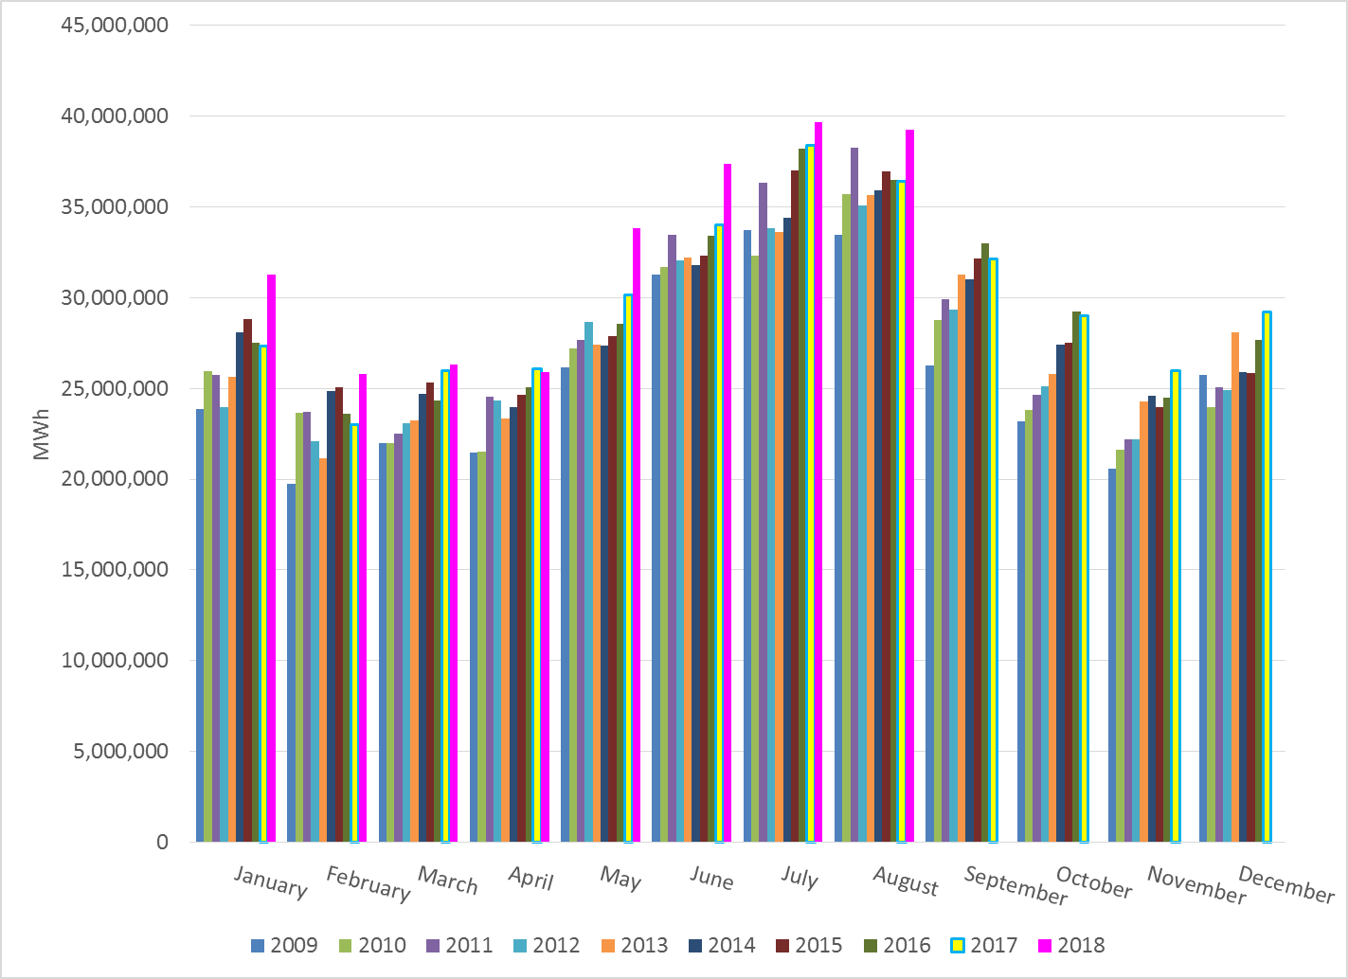
Total Energy
Notes:
39,226,907 MWh

Slide 22
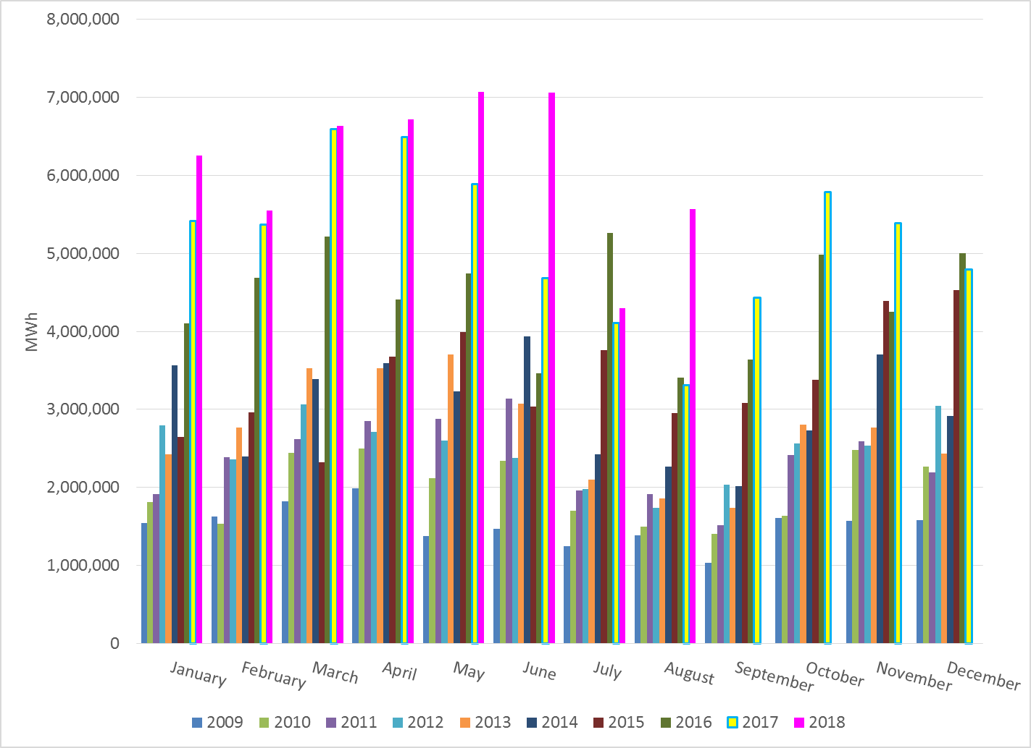
Total Energy from Wind Generation
Notes:
5,566,606 MWh

Slide 23
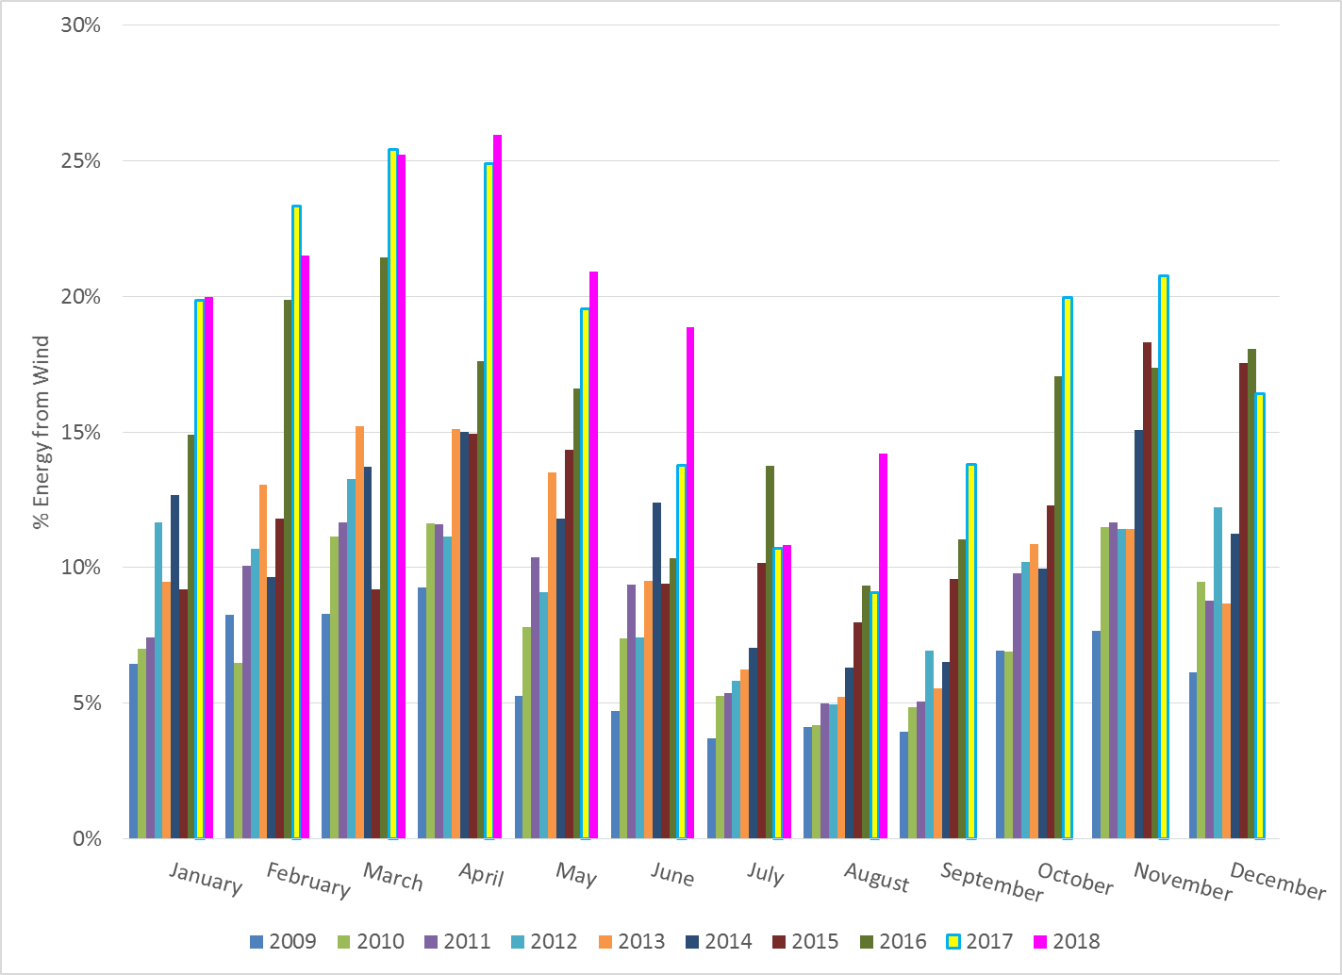
% Energy from Wind Generation
Notes:
14.19%

Slide 24
ERCOT System Inertia

Slide 25
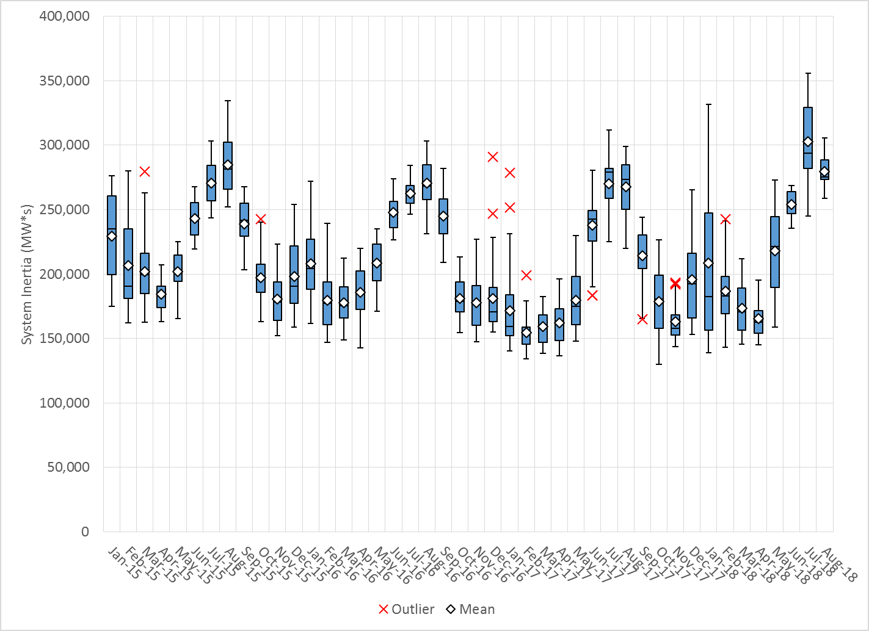
Daily Minimum System Inertia
Notes:
Minimum Inertia = 130,014 MW*s on 10/27/2017. This was also our record wind day.
August
Mean: 279,620
Max: 305,709 on August 21st
Min: 258,972 on August 4th

Slide 26
Questions?
Thank you!

Slide 27
Op. Year 2017 BAL-003 Selected Events
Notes:
Frequency Bias updated from 764 to 759 in April

Slide 28
Op. Year 2017 BAL-003 FRM Performance

