Slide 1
Market Credit Working Group update to the Wholesale Market Subcommittee
Bill Barnes NRG, Chair
Josephine Wan AE, Vice Chair
09/5/2018

Slide 2
MCWG update to WMS
General Update
August 15th Joint MCWG/CWG Meeting
NPRR850 - Market Suspension and Restart
ERCOT has drafted proposed language to handle collateral requests during the transition from pre- to post-market restart.
Based upon feedback from the CWG, ERCOT has added discretionary language to allow up to two additional days for Market Participants to make payment on any outstanding invoices / collateral calls during a Market Restart.
Credit Working Group will conduct review of NPRR850 after approved as per normal credit impact review process.

Slide 3
MCWG update to WMS
Letter of Credit Concentration Limit
CWG/MCWG will continue to discuss process changes to the LC concentration limit that doesn’t overly restrict access to LCs.
Surety Bonds
CWG/MCWG will continue to discuss the timing of when the Surety must pay ERCOT for obligations that Principle fails to meet.
CWG/MCWG will continue to discuss the issuer limits and aggregate limits placed on Surety bonds.
Credit Parameter Review
ERCOT will evaluate impact of setting M1a to the actual number of days prior to termination based on actual weekend days and holidays in the payment horizon.

Slide 4
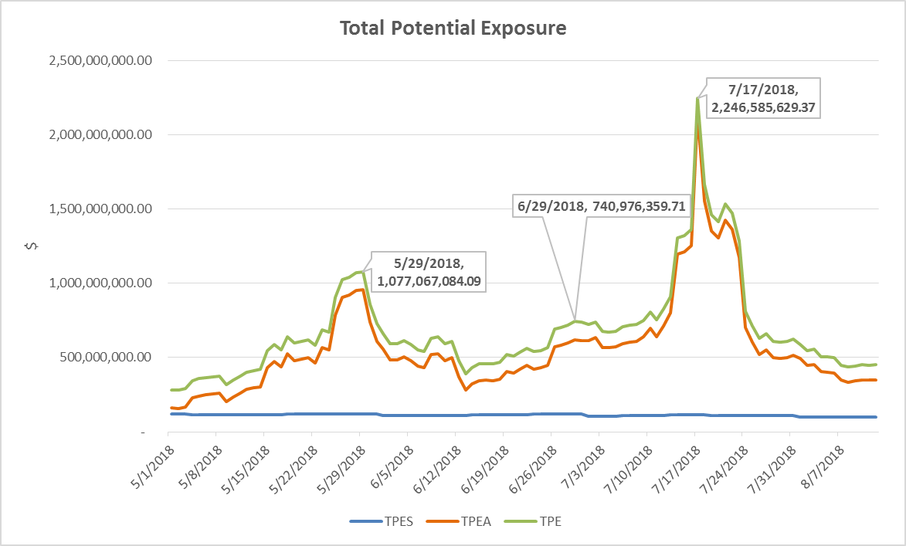
Credit Exposure Update

Slide 5
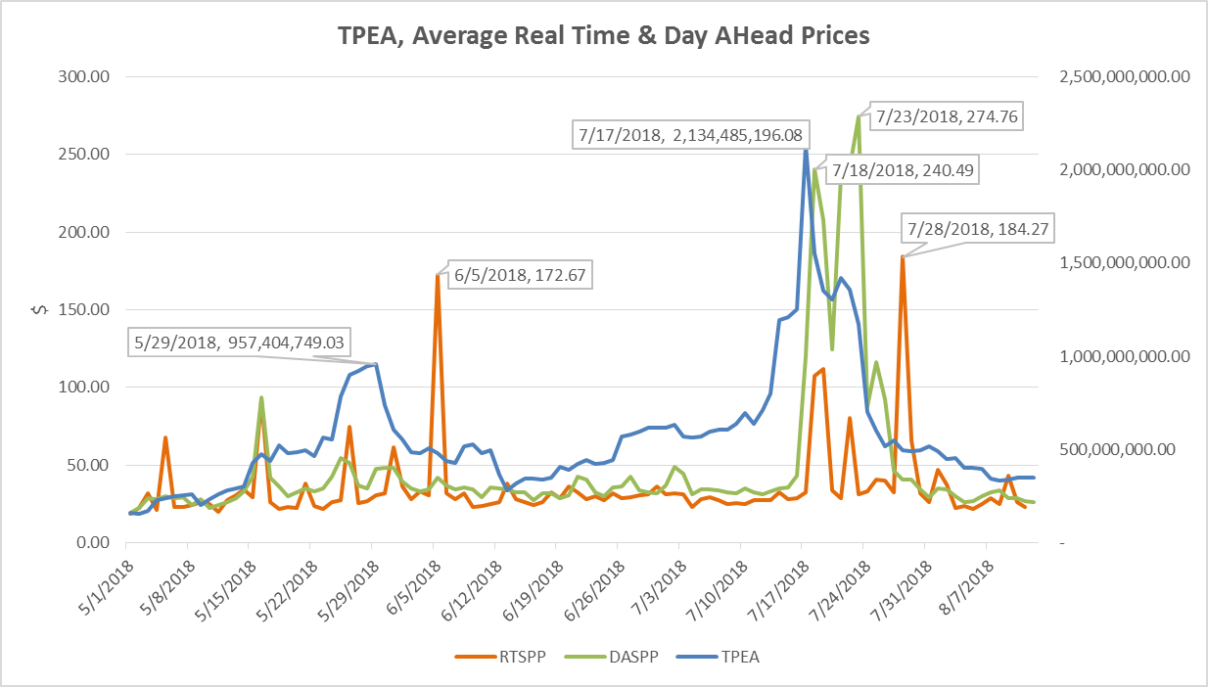
Credit Exposure Update

