Slide 1
PLWG Report to ROS
(September 6th, 2018)
PLWG Chair: Brad Myers, AEPSC
PLWG Vice Chair: Jennifer Rochelle, CES-LTD

Slide 2
NPRR-871 (Customer/RE Funded Transmission)
Referred by ROS to PLWG in June
Taken Up By PLWG: May – August
Status: Consensus at August PLWG
Consensus on ERCOT’s Original 4/17/2018 NPRR Language
Partial Funding Concept to be Taken Up Under Separate NPRR
Comments Pending: Addition of Tier 4 Project Exemption Paragraph
PLWG Also Amenable to Explicit Tier 4 Project Exemption
PLWG Requests That ROS Consider Vote

Slide 3
PGRR-065 (TPIT Process Updates - 1)
Referred to PLWG in July
Taken Up By PLWG: February – August
Status: Latest Comments Filed by ONCOR on 8/13/2018
No Consensus at August PLWG
PLWG Requests That ROS Consider Vote
2 Potential Versions of PGRR065
Both Versions Accept Reliant Comments that “A section summarizing cost information” Will Be Included in the TPIT Report
Oncor: Implied Requirement on TSPs to Provide Cost Information in TPIT
Aggregated Summary of Cost Included in TPIT Report
Reliant: Explicit Requirement on TSPs to Provide Cost Information in TPIT
Detailed Line Item Cost Included in TPIT Report
(Details Next Slide->)

Slide 4
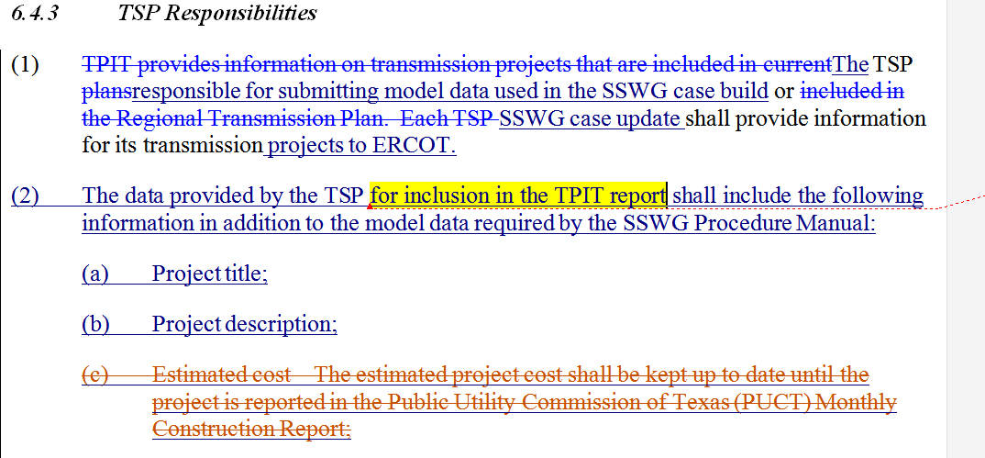
PGRR-065 (TPIT Process Updates - 2)
Oncor’s Comments:
Reliant’s Comments:

Slide 5
PGRR-066 (GINR Cancellation and Inactive Status)
Referred to PLWG in July
Taken Up By PLWG: July and August
Status: Additional Comments Pending
7/25 Discussion Highlights:
Expansion of FIS Restudy Time Frame for Generation Project Changes
Evidence of Project Progression Required: Post FIS Completion and SGIA Execution (SGIA -> NTP -> Security)
PLWG Requests That ROS Continue to Table

Slide 6
NPRR-882 / PGRR-067 (Re-Power Procedures)
Referred to PLWG in July
Taken Up By PLWG: July and August
July PLWG Discussion Highlights:
“Re-power” Definition
Flexibility/Discretion for Waiving FIS Study Elements Included
Status: PLWG Consensus
PLWG Consensus on August 22nd Meeting Edits to “Re-power” Definition
ERCOT Comments Pending for Formal Insertion of Defined Term
PLWG Requests That ROS Consider Vote
PGRR067-xx: Pending ERCOT Comments (if available)
NPRR882-xx: Pending ERCOT Comments (if available)

Slide 7
PGRR-068 (Addition of Proposed DC Tie to Planning Models)
Referred to PLWG: August 9th
Taken Up By PLWG: August 22nd
Status: PLWG Consensus on ERCOT 07/25/18 Submission
PLWG Requests That ROS Consider Vote

