Slide 1
NPRR664 Fuel Index Price for Resource Definition and Real-Time Make-Whole Payments for Exceptional Fuel Cost Events
Ino González
WMS
Sep 05, 2018

Slide 2
NPRR664 TAC Vote
On 11/20/14, TAC unanimously voted to recommend approval of NPRR664.
Recommended priority of 2015 and a rank of 1400.
Requested that ERCOT revisit with TAC the rank and priority of NPRR664 prior to project initiation.

Slide 3
NPRR664 Summary
Introduces a Resource specific Fuel Index Price, based on:
Gas Daily’s Waha index price
Gas Daily Houston Ship Channel (HSC) index price (default index price)
Impacts the following sections:
Startup, Minimum Offer and Make-Whole Payment Caps
Startup and minimum Offer Costs for Make Whole Payment
Mitigated Offer Floor
RMR Payment for Energy
Minimum and Maximum Resource Prices
Real-Time Mitigation
Introduces a Real-Time Mitigation Make-Whole Payment
For Exceptional fuel costs (Real-Time fuel purchases)

Slide 4
NPRR847 Exceptional Fuel Cost Included in the Mitigated Offer Cap
NPRR 847 Exceptional Fuel Cost Included in the Mitigated Offer Cap
Approved 8/7/2018
Replaced NPRR 664 Real-Time Mitigation Make-Whole Payment

Slide 5
NPRR664 Summary – cont’d
Remaining changes in NPRR 664 not addressed with NPRR847
Impacts on (Based on Waha or Houston Ship Channel fuel prices)
Startup, Minimum Offer and Make-Whole Payment Caps
Startup and Minimum Offer Costs for Make-Whole Payment calculations
Mitigated Offer Cap
Mitigated Offer Floor
RMR Payment for Energy calculations, and
Minimum and Maximum Resource Prices
Original Impact Analysis (IA) for NPRR664
Between $200k and $300k
IA for NPRR847
Between $60k and $80k

Slide 6
NPRR664 Summary – cont’d
Price Difference in Period: Jan 2011 – Aug 2018
# of days Waha > FIP by 10% or more:
10 days
# of days Waha < FIP by 10% or more:
386 days
# of days Waha < FIP by 50% or more:
6 days

Slide 7
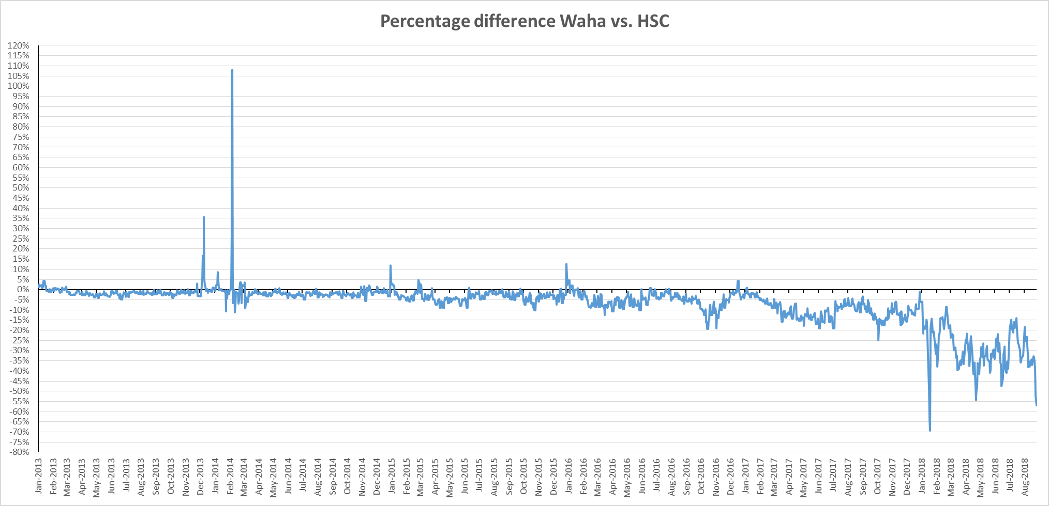
NPRR664 Summary – cont’d
% Diff = (Waha-HSC) / HSC

Slide 8
Potential Considerations
Switching to Waha is not required but optional for Resources
If gray-boxed NPRR 664 language is implemented ERCOT may build systems that are never used.
Prices in Waha could remain lower than HSC
If Resources do not switch to the appropriate index, the LMPs may not reflect correct fuel prices
However, NPRR847 addressed a market concern with the NPRR664 Make-Whole Payment by reflecting exceptional fuel costs in LMPs

Slide 9
NPRR664 Next Steps
Which option does WMS recommend:
Keep gray-boxed language with existing priority and rank
Keep gray-boxed language with updated priority and rank, or
Modify/remove gray-boxed language

Slide 10
Questions?
Notes:
https://castaylor.ercot.com/owa/redir.aspx?C=oPhl4_Wz9UCI7oVqJkGdaM-P4-MvhtMIRAMJFZ7-K5eOg6lo6esBMUiebAbXd4c8z8FTPzV8g8A.&URL=https%3a%2f%2ftheconversation.com%2fwhen-will-rooftop-solar-be-cheaper-than-the-grid-heres-a-map-54789%3futm_source%3dtwitter%26utm_medium%3dreferral%26utm_campaign%3dUTAustinNews
http://www.vox.com/2015/6/19/8808545/wind-solar-grid-integration
http://greeningthegrid.org/quick-reads
https://ec.europa.eu/energy/intelligent/projects/en/projects/pv-grid
http://energy.gov/eere/sunshot/systems-integration

