Slide 1
3. TAC Assignment: Review the Commercial Impacts of DC Tie Curtailments
QMWG
August 13, 2018
Market Analysis

Slide 2
Introduction
Stakeholders requested at TAC that the market impacts for DC Tie Curtailments reported at ROS be evaluated
Topic referred to WMS and then referred to QMWG

Slide 3
DC Tie Tag Curtailments
Since January 2018, 5 out of 15 DC Tie Tag curtailments were due to local congestion or transmission outages
Transmission watch declared during all 5 events

Slide 4
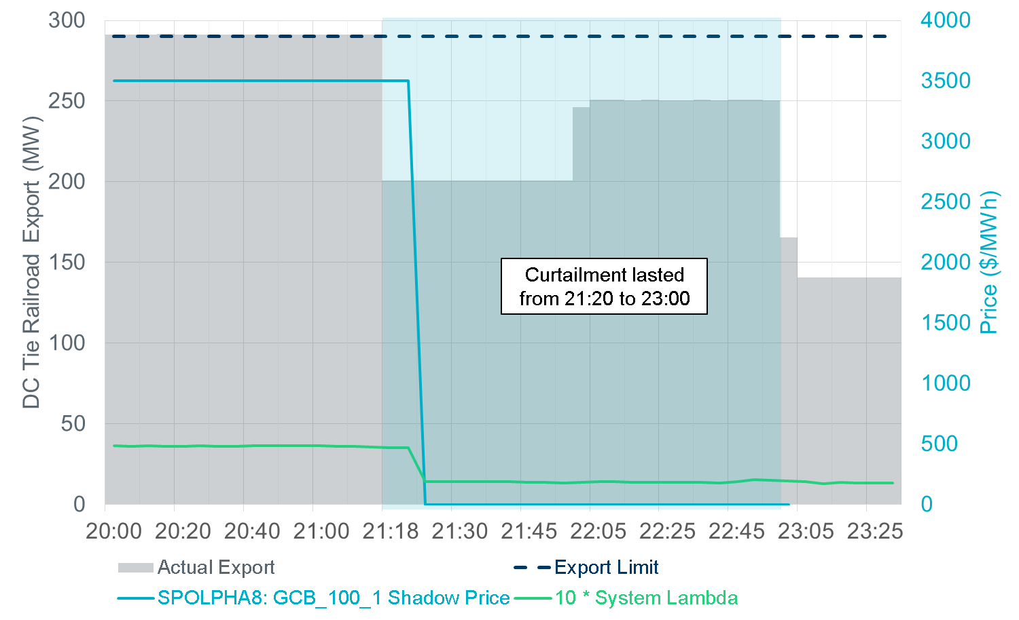
Impacts of 3/27/2018 Curtailment

Slide 5
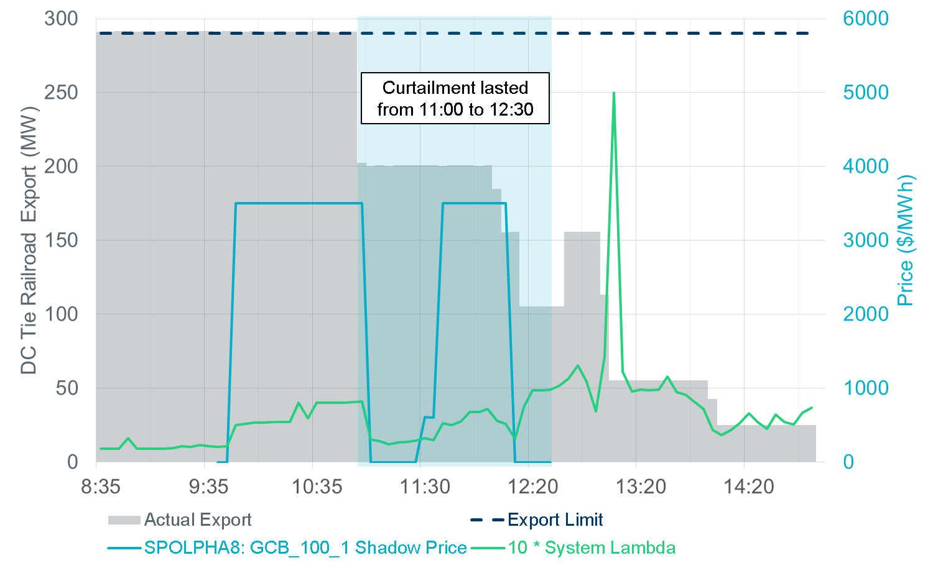
Impacts of 5/14/2018 Curtailment

Slide 6
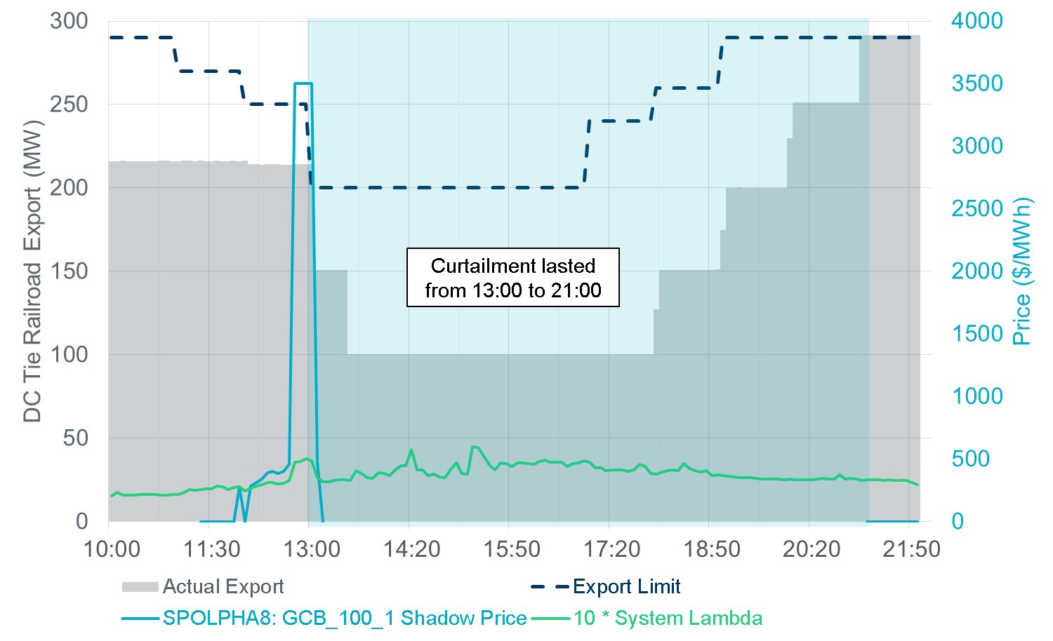
Impacts of 6/26/2018 Curtailment

Slide 7
Impacts of 6/27/2018 and 6/28/2018 Curtailment
Contingency SBENRAI8 was never activated
DC tie was the only point with a hurting shift factory to the constraint
Curtailment had no significant impact to active constraints in SCED

