Slide 1
Reporting on Statistics for
EPS Meter Activity
August 29, 2018

Slide 2
Notices issued May through July 2018
 | May | June | July
Total Notices Issued | 278 | 270 | 225
Total 6 Hours issued | 40 | 32 | 66
Total 12 Hours issued | 116 | 144 | 97
Total 5 days issued | 122 | 94 | 62
Total Notices Issued for IP | 4 | 9 | 40
Total Notices Issued for Phone Line | 274 | 261 | 185
TDSP | % OF METERS ON PHONE LINE | % OF METERS ON TCP/IP | % OF TOTAL NOTICES ISSUED FOR May | % OF TOTAL NOTICES ISSUED FOR June | % OF TOTAL NOTICES ISSUED FOR July*
TDSP A | 0% | 100% | 0.00% | 0.00% | 0.00%
TDSP B | 0% | 100% | 0.00% | 0.00% | 0.00%
TDSP C | 0% | 100% | 0.00% | 0.00% | 0.00%
TDSP D | 73% | 27% | 0.72% | 1.85% | 0.00%
TDSP F | 0% | 100% | 0.00% | 0.00% | 0.00%
TDSP G | 0% | 100% | 0.00% | 0.00% | 0.00%
TDSP J | 100% | 0% | 0.00% | 0.00% | 0.00%
TDSP L | 100% | 0% | 3.96% | 7.41% | 0.00%
TDSP S | 100% | 0% | 0.36% | 0.00% | 0.00%
TDSP T | 0% | 100% | 0.00% | 0.00% | 0.00%
TDSP U | 0% | 100% | 0.00% | 0.00% | 0.00%
TDSP V | 0% | 100% | 0.00% | 0.00% | 0.00%
TDSP K | 73% | 27% | 0.00% | 0.00% | 1.33%
TDSP M | 100% | 0% | 3.60% | 2.59% | 2.22%
TDSP H | 100% | 0% | 4.32% | 0.37% | 3.56%
TDSP R | 89% | 11% | 3.24% | 1.85% | 4.00%
TDSP N | 81% | 19% | 5.76% | 17.04% | 6.67%
TDSP Q | 100% | 0% | 8.99% | 15.19% | 7.11%
TDSP I | 61% | 39% | 0.72% | 6.30% | 8.44%
TDSP E | 100% | 0% | 33.09% | 31.85% | 14.67%
TDSP O | 0% | 100% | 0.36% | 0.37% | 18.22%
TDSP P | 76% | 24% | 34.89% | 15.19% | 33.78%
*Indicates sorted by this column in lowest to highest order

Slide 3
2018 Year to Date Notices – Total and Overdue
 |  | Issued | Overdue | % Overdue
January | 6-hour | 268 | 50 | 18.66%
 | 12-hour | 383 | 75 | 19.58%
 | 5-day | 257 | 15 | 5.84%
 | Total | 908 | 140 | 15.42%
February | 6-hour | 78 | 16 | 20.51%
 | 12-hour | 219 | 36 | 16.44%
 | 5-day | 243 | 16 | 6.58%
 | Total | 540 | 68 | 12.59%
March | 6-hour | 54 | 9 | 16.67%
 | 12-hour | 134 | 21 | 15.67%
 | 5-day | 196 | 5 | 2.55%
 | Total | 384 | 35 | 9.11%
April | 6-hour | 75 | 12 | 16.00%
 | 12-hour | 61 | 11 | 18.03%
 | 5-day | 98 | 3 | 3.06%
 | Total | 234 | 26 | 11.11%
Overdue timeframes:
6-hour = Open over 12 hours
12-hour = Open over 48 hours
5-day = Open over 10 days
 |  | Issued | Overdue | % Overdue
May | 6-hour | 40 | 21 | 52.50%
 | 12-hour | 116 | 25 | 21.55%
 | 5-day | 122 | 8 | 6.56%
 | Total | 278 | 54 | 19.42%
June | 6-hour | 32 | 16 | 50.00%
 | 12-hour | 144 | 24 | 16.67%
 | 5-day | 94 | 5 | 5.32%
 | Total | 270 | 45 | 16.67%
July | 6-hour | 66 | 52 | 78.79%
 | 12-hour | 97 | 20 | 20.62%
 | 5-day | 62 | 4 | 6.45%
 | Total | 225 | 76 | 33.78%
2018 Year to Date Total | 6-hour | 613 | 176 | 28.71%
 | 12-hour | 1154 | 212 | 18.37%
 | 5-day | 1072 | 56 | 5.22%
 | Total | 2839 | 444 | 15.64%

Slide 4
Temporary Exemptions 2015 through 2018 (year to date)
Count of Average Temporary Exemption Duration (Does not include exemptions for delayed cutovers)
TDSP | 0-3 months | 3-6 months | 6-9 months | 9-12 months | >12 months*
TDSP S | 0 | 0 | 0 | 0 | 0
TDSP A | 0 | 0 | 0 | 0 | 0
TDSP J | 1 | 0 | 0 | 0 | 0
TDSP K | 12 | 0 | 0 | 0 | 0
TDSP F | 6 | 1 | 0 | 0 | 0
TDSP M | 7 | 1 | 0 | 0 | 0
TDSP U | 1 | 6 | 0 | 0 | 0
TDSP Q | 22 | 17 | 0 | 0 | 0
TDSP V | 15 | 26 | 0 | 0 | 0
TDSP I | 15 | 2 | 1 | 0 | 0
TDSP H | 6 | 4 | 1 | 0 | 0
TDSP N | 19 | 4 | 3 | 0 | 0
TDSP G | 6 | 0 | 0 | 0 | 1
TDSP T | 7 | 0 | 0 | 0 | 1
TDSP L | 6 | 2 | 1 | 0 | 1
TDSP R | 26 | 7 | 17 | 4 | 1
TDSP P | 37 | 13 | 3 | 6 | 2
TDSP C | 3 | 0 | 1 | 0 | 4
TDSP B | 3 | 7 | 1 | 1 | 4
TDSP D | 19 | 24 | 9 | 1 | 5
TDSP O | 18 | 1 | 0 | 1 | 8
TDSP E | 21 | 18 | 14 | 4 | 28
Totals | 250 | 133 | 51 | 17 | 55
Meter's not in compliance with 6.5.4(1)(k) LOP on 8/10/2018
TDSP | %*
TDSP A | 0.0%
TDSP B | 0.0%
TDSP C | 0.0%
TDSP E | 0.0%
TDSP F | 0.0%
TDSP G | 0.0%
TDSP J | 0.0%
TDSP K | 0.0%
TDSP L | 0.0%
TDSP M | 0.0%
TDSP O | 0.0%
TDSP P | 0.0%
TDSP Q | 0.0%
TDSP R | 0.0%
TDSP S | 0.0%
TDSP T | 0.0%
TDSP U | 0.0%
TDSP V | 0.0%
TDSP D | 33.3%
TDSP H | 57.9%
TDSP N | 93.0%
TDSP I | 100.0%
Totals | 16.7%
*Indicates sorted by this column in lowest to highest order

Slide 5
Annual Meter Test/Meter Reprogram – Initial Submittals
Average Days to Receive |  |  |  |  | Percentage of documents submitted within protocol timeline
 |  |  |  |  | 2015 |  | 2016 |  | 2017 |  | 2018
TDSP | 2015 | 2016 | 2017 | 2018 | Received in ≤ 14 Days | Received in > 14 Days | Received in ≤ 14 Days | Received in > 14 Days | Received in ≤ 14 Days | Received in > 14 Days | Received in ≤ 14 Days | Received in > 14 Days*
TDSP C | 7 | 6 | 6 | 1 | 100.0% | 0.0% | 100.0% | 0.0% | 100.0% | 0.0% | 100.0% | 0.0%
TDSP S | 3 | 1 | 0 | 1 | 100.0% | 0.0% | 100.0% | 0.0% | 100.0% | 0.0% | 100.0% | 0.0%
TDSP B | 2 | 1 | 1 | 4 | 100.0% | 0.0% | 100.0% | 0.0% | 100.0% | 0.0% | 100.0% | 0.0%
TDSP J | N/A | 4 | 2 | 1 | N/A | N/A | 100.0% | 0.0% | 100.0% | 0.0% | 100.0% | 0.0%
TDSP V | 8 | 14 | 1 | 1 | 90.9% | 9.1% | 50.0% | 50.0% | 100.0% | 0.0% | 100.0% | 0.0%
TDSP Q | 15 | 27 | 3 | 3 | 71.4% | 28.6% | 35.0% | 65.0% | 100.0% | 0.0% | 100.0% | 0.0%
TDSP U | 24 | 15 | 6 | 9 | 0.0% | 100.0% | 16.7% | 83.3% | 100.0% | 0.0% | 100.0% | 0.0%
TDSP A | 3 | 77 | 4 | 5 | 100.0% | 0.0% | 0.0% | 100.0% | 100.0% | 0.0% | 100.0% | 0.0%
TDSP O | 4 | 4 | 4 | 2 | 97.1% | 2.9% | 91.7% | 8.3% | 88.9% | 11.1% | 100.0% | 0.0%
TDSP F | 22 | 17 | 15 | 11 | 0.0% | 100.0% | 57.1% | 42.9% | 75.0% | 25.0% | 100.0% | 0.0%
TDSP I | 5 | 10 | 23 | 3 | 100.0% | 0.0% | 91.3% | 8.7% | 73.9% | 26.1% | 100.0% | 0.0%
TDSP H | 39 | 27 | 26 | 2 | 11.8% | 88.2% | 5.9% | 94.1% | 23.1% | 76.9% | 100.0% | 0.0%
TDSP K | 32 | 28 | 37 | 3 | 20.0% | 80.0% | 22.2% | 77.8% | 0.0% | 100.0% | 100.0% | 0.0%
TDSP R | 7 | 12 | 5 | 6 | 90.6% | 9.4% | 94.7% | 5.3% | 98.4% | 1.6% | 96.0% | 4.0%
TDSP P | 17 | 27 | 11 | 6 | 53.8% | 46.2% | 23.4% | 76.6% | 78.8% | 21.2% | 95.1% | 4.9%
TDSP N | 2 | 2 | 4 | 3 | 100.0% | 0.0% | 100.0% | 0.0% | 95.1% | 4.9% | 94.0% | 6.0%
TDSP L | 2 | 3 | 2 | 3 | 100.0% | 0.0% | 96.3% | 3.7% | 100.0% | 0.0% | 93.3% | 6.7%
Average | 13 | 19 | 10 | 6 | 68.4% | 31.6% | 55.8% | 44.2% | 79.5% | 20.5% | 90.6% | 9.4%
TDSP G | 10 | 37 | 8 | 12 | 100.0% | 0.0% | 0.0% | 100.0% | 78.6% | 21.4% | 88.9% | 11.1%
TDSP M | 11 | 10 | 10 | 10 | 74.1% | 25.9% | 77.6% | 22.4% | 87.1% | 12.9% | 74.2% | 25.8%
TDSP T | 11 | 20 | 11 | 12 | 81.3% | 18.8% | 33.3% | 66.7% | 80.0% | 20.0% | 66.7% | 33.3%
TDSP D | 35 | 40 | 31 | 15 | 10.7% | 89.3% | 7.7% | 92.3% | 42.1% | 57.9% | 63.6% | 36.4%
TDSP E | 23 | 27 | 22 | 25 | 34.2% | 65.8% | 25.0% | 75.0% | 28.8% | 71.2% | 21.5% | 78.5%
*Indicates sorted by this column in lowest to highest order

Slide 6
Annual Meter Test/Meter Reprogram – Resubmittals
Average Days to Receive |  |  |  |  | Percentage of document resubmittals within a 14 day timeline
 |  |  |  |  | 2015 |  | 2016 |  | 2017 |  | 2018
TDSP | 2015 | 2016 | 2017 | 2018 | Received in ≤ 14 Days | Received in > 14 Days | Received in ≤ 14 Days | Received in > 14 Days | Received in ≤ 14 Days | Received in > 14 Days | Received in ≤ 14 Days | Received in > 14 Days*
TDSP G | 1 | 3 | 1 | 0 | 100.0% | 0.0% | 100.0% | 0.0% | 100.0% | 0.0% | 100.0% | 0.0%
TDSP L | 32 | 19 | 0 | 3 | 85.7% | 14.3% | 85.7% | 14.3% | 100.0% | 0.0% | 100.0% | 0.0%
TDSP C | 20 | 5 | 10 | 1 | 66.7% | 33.3% | 100.0% | 0.0% | 85.7% | 14.3% | 100.0% | 0.0%
TDSP N | 35 | 38 | 11 | 3 | 50.0% | 50.0% | 69.2% | 30.8% | 75.0% | 25.0% | 100.0% | 0.0%
TDSP Q | N/A | 39 | 23 | 3 | N/A | N/A | 71.4% | 28.6% | 57.1% | 42.9% | 100.0% | 0.0%
TDSP M | 3 | 6 | N/A | 2 | 100.0% | 0.0% | 100.0% | 0.0% | N/A | N/A | 100.0% | 0.0%
TDSP J | N/A | N/A | N/A | 5 | N/A | N/A | N/A | N/A | N/A | N/A | 100.0% | 0.0%
TDSP V | 19 | 37 | 10 | 12 | 33.3% | 66.7% | 0.0% | 100.0% | 82.4% | 17.6% | 83.3% | 16.7%
TDSP P | 8 | 39 | 10 | 5 | 100.0% | 0.0% | 25.0% | 75.0% | 100.0% | 0.0% | 80.0% | 20.0%
TDSP D | 76 | 18 | 27 | 23 | 15.4% | 84.6% | 60.0% | 40.0% | 50.0% | 50.0% | 66.7% | 33.3%
TDSP I | 42 | 73 | 90 | 18 | 50.0% | 50.0% | 0.0% | 100.0% | 16.7% | 83.3% | 66.7% | 33.3%
Average | 27 | 21 | 21 | 20 | 62.5% | 37.5% | 68.3% | 31.7% | 68.4% | 31.6% | 65.8% | 34.2%
TDSP R | 6 | 21 | 12 | 33 | 85.7% | 14.3% | 85.7% | 14.3% | 81.8% | 18.2% | 33.3% | 66.7%
TDSP E | 42 | 45 | 37 | 32 | 26.1% | 73.9% | 13.8% | 86.2% | 42.9% | 57.1% | 22.2% | 77.8%
TDSP T | 0 | 0 | 24 | 87 | 100.0% | 0.0% | 100.0% | 0.0% | 66.7% | 33.3% | 0.0% | 100.0%
TDSP F | 89 | N/A | N/A | 73 | 0.0% | 100.0% | N/A | N/A | N/A | N/A | 0.0% | 100.0%
TDSP B | N/A | N/A | N/A | 16 | N/A | N/A | N/A | N/A | N/A | N/A | 0.0% | 100.0%
TDSP A | 0 | 1 | 1 | N/A | 100.0% | 0.0% | 100.0% | 0.0% | 100.0% | 0.0% | N/A | N/A
TDSP H | 68 | 18 | 38 | N/A | 0.0% | 100.0% | 50.0% | 50.0% | 0.0% | 100.0% | N/A | N/A
TDSP O | 18 | 2 | N/A | N/A | 50.0% | 50.0% | 100.0% | 0.0% | N/A | N/A | N/A | N/A
TDSP K | N/A | 0 | N/A | N/A | N/A | N/A | 100.0% | 0.0% | N/A | N/A | N/A | N/A
TDSP U | 4 | N/A | N/A | N/A | 100.0% | 0.0% | N/A | N/A | N/A | N/A | N/A | N/A
TDSP S | N/A | N/A | N/A | N/A | N/A | N/A | N/A | N/A | N/A | N/A | N/A | N/A
*Indicates sorted by this column in lowest to highest order

Slide 7
Site Certifications – Initial Submittals
Average Days to Receive |  |  |  |  | Percentage of documents submitted within protocol timeline
 |  |  |  |  | 2015 |  | 2016 |  | 2017 |  | 2018
TDSP | 2015 | 2016 | 2017 | 2018 | Received in ≤ 60 Days | Received in > 60 Days | Received in ≤ 60 Days | Received in > 60 Days | Received in ≤ 60 Days | Received in > 60 Days | Received in ≤ 60 Days | Received in > 60 Days
TDSP U | N/A | N/A | N/A | N/A | N/A | N/A | N/A | N/A | N/A | N/A | N/A | N/A
TDSP J | 105 | N/A | N/A | N/A | 0.0% | 100.0% | N/A | N/A | N/A | N/A | N/A | N/A
TDSP S | N/A | 6 | N/A | N/A | N/A | N/A | 100.0% | 0.0% | N/A | N/A | N/A | N/A
TDSP F | 57 | 12 | N/A | N/A | 50.0% | 50.0% | 100.0% | 0.0% | N/A | N/A | N/A | N/A
TDSP K | 35 | 35 | 42 | N/A | 100.0% | 0.0% | 75.0% | 25.0% | 100.0% | 0.0% | N/A | N/A
TDSP T | 30 | 6 | 13 | 49 | 100.0% | 0.0% | 100.0% | 0.0% | 100.0% | 0.0% | 100.0% | 0.0%
TDSP G | 12 | 14 | 19 | 15 | 100.0% | 0.0% | 100.0% | 0.0% | 100.0% | 0.0% | 100.0% | 0.0%
TDSP B | 2 | 22 | 21 | 6 | 100.0% | 0.0% | 100.0% | 0.0% | 100.0% | 0.0% | 100.0% | 0.0%
TDSP C | N/A | 15 | 6 | 3 | N/A | N/A | 100.0% | 0.0% | 100.0% | 0.0% | 100.0% | 0.0%
TDSP N | 87 | 71 | 14 | 2 | 28.6% | 71.4% | 61.1% | 38.9% | 100.0% | 0.0% | 100.0% | 0.0%
TDSP D | 50 | 39 | 27 | 24 | 66.7% | 33.3% | 66.7% | 33.3% | 84.6% | 15.4% | 100.0% | 0.0%
TDSP I | 10 | 104 | 63 | 12 | 100.0% | 0.0% | 22.2% | 77.8% | 80.0% | 20.0% | 100.0% | 0.0%
TDSP E | 33 | 30 | 61 | 30 | 89.1% | 10.9% | 88.7% | 11.3% | 78.8% | 21.2% | 100.0% | 0.0%
TDSP P | 46 | 62 | 44 | 15 | 77.5% | 22.5% | 70.0% | 30.0% | 70.3% | 29.7% | 100.0% | 0.0%
TDSP H | 95 | 100 | 84 | 21 | 60.0% | 40.0% | 25.0% | 75.0% | 50.0% | 50.0% | 100.0% | 0.0%
TDSP Q | 84 | 21 | 126 | 4 | 0.0% | 100.0% | 100.0% | 0.0% | 40.0% | 60.0% | 100.0% | 0.0%
TDSP A | N/A | 111 | N/A | 6 | N/A | N/A | 0.0% | 100.0% | N/A | N/A | 100.0% | 0.0%
TDSP R | 8 | 54 | 99 | 30 | 100.0% | 0.0% | 85.7% | 14.3% | 66.7% | 33.3% | 88.9% | 11.1%
Average | 44 | 39 | 44 | 22 | 79.4% | 20.6% | 77.4% | 22.6% | 80.9% | 19.1% | 88.0% | 12.0%
TDSP V | 58 | 31 | 53 | 27 | 45.5% | 54.5% | 75.0% | 25.0% | 75.0% | 25.0% | 78.9% | 21.1%
TDSP O | 8 | 15 | 15 | 36 | 100.0% | 0.0% | 100.0% | 0.0% | 100.0% | 0.0% | 77.8% | 22.2%
TDSP M | 38 | 20 | 61 | 39 | 100.0% | 0.0% | 92.3% | 7.7% | 83.3% | 16.7% | 57.1% | 42.9%
TDSP L | 27 | 15 | 4 | 50 | 100.0% | 0.0% | 100.0% | 0.0% | 100.0% | 0.0% | 50.0% | 50.0%
*Indicates sorted by this column in lowest to highest order

Slide 8
Site Certifications – Resubmittals
Average Days to Receive |  |  |  |  | Percentage of documents submitted within a 45 day timeline
 |  |  |  |  | 2015 |  | 2016 |  | 2017 |  | 2018
TDSP | 2015 | 2016 | 2017 | 2018 | Received in ≤ 45 Days | Received in > 45 Days | Received in ≤ 45 Days | Received in > 45 Days | Received in ≤ 45 Days | Received in > 45 Days | Received in ≤ 45 Days | Received in > 45 Days
TDSP U | N/A | N/A | N/A | N/A | N/A | N/A | N/A | N/A | N/A | N/A | N/A | N/A
TDSP S | N/A | N/A | N/A | N/A | N/A | N/A | N/A | N/A | N/A | N/A | N/A | N/A
TDSP J | 40 | N/A | N/A | N/A | 100.0% | 0.0% | N/A | N/A | N/A | N/A | N/A | N/A
TDSP K | 46 | 4 | N/A | N/A | 66.7% | 33.3% | 100.0% | 0.0% | N/A | N/A | N/A | N/A
TDSP F | 6 | 165 | N/A | N/A | 100.0% | 0.0% | 0.0% | 100.0% | N/A | N/A | N/A | N/A
TDSP C | N/A | 6 | 3 | N/A | N/A | N/A | 100.0% | 0.0% | 100.0% | 0.0% | N/A | N/A
TDSP T | 4 | 1 | 5 | N/A | 100.0% | 0.0% | 100.0% | 0.0% | 100.0% | 0.0% | N/A | N/A
TDSP L | 20 | 3 | 3 | 1 | 66.7% | 33.3% | 100.0% | 0.0% | 100.0% | 0.0% | 100.0% | 0.0%
TDSP P | 96 | 29 | 10 | 5 | 70.0% | 30.0% | 75.0% | 25.0% | 92.9% | 7.1% | 100.0% | 0.0%
TDSP N | 46 | 32 | 10 | 0 | 75.0% | 25.0% | 64.3% | 35.7% | 85.7% | 14.3% | 100.0% | 0.0%
TDSP I | 226 | 159 | 17 | 1 | 50.0% | 50.0% | 36.4% | 63.6% | 85.7% | 14.3% | 100.0% | 0.0%
TDSP R | 4 | 31 | 22 | 9 | 100.0% | 0.0% | 70.0% | 30.0% | 80.0% | 20.0% | 100.0% | 0.0%
TDSP B | 6 | 35 | 54 | 6 | 100.0% | 0.0% | 75.0% | 25.0% | 66.7% | 33.3% | 100.0% | 0.0%
TDSP D | 25 | 24 | 49 | 7 | 66.7% | 33.3% | 75.0% | 25.0% | 60.0% | 40.0% | 100.0% | 0.0%
TDSP E | 55 | 60 | 46 | 29 | 63.6% | 36.4% | 73.5% | 26.5% | 57.1% | 42.9% | 100.0% | 0.0%
TDSP M | 12 | 36 | 104 | 2 | 100.0% | 0.0% | 75.0% | 25.0% | 50.0% | 50.0% | 100.0% | 0.0%
TDSP A | N/A | 40 | N/A | 1 | N/A | N/A | 100.0% | 0.0% | N/A | N/A | 100.0% | 0.0%
TDSP Q | 64 | 23 | 10 | 10 | 0.0% | 100.0% | 85.7% | 14.3% | 100.0% | 0.0% | 88.9% | 11.1%
Average | 42 | 42 | 25 | 17 | 72.7% | 27.3% | 73.3% | 26.7% | 77.1% | 22.9% | 85.7% | 14.3%
TDSP O | 3 | 57 | 16 | 15 | 100.0% | 0.0% | 80.0% | 20.0% | 80.0% | 20.0% | 75.0% | 25.0%
TDSP V | 43 | 36 | 23 | 24 | 71.4% | 28.6% | 73.3% | 26.7% | 100.0% | 0.0% | 70.0% | 30.0%
TDSP G | 9 | 9 | 2 | 39 | 100.0% | 0.0% | 100.0% | 0.0% | 100.0% | 0.0% | 50.0% | 50.0%
TDSP H | 50 | 47 | 24 | 104 | 60.0% | 40.0% | 66.7% | 33.3% | 75.0% | 25.0% | 0.0% | 100.0%
*Indicates sorted by this column in lowest to highest order

Slide 9
EPS Meter points to SCADA Telemetry Point Mapping
Project completed by Meter Engineering Summer Intern Quentin Duyck

Slide 10
EPS Meter to Telemetry Point Mapping
Mapping between SCADA telemetry information and each EPS metering point
High success rate in mapping
Opportunity to use proxy data for EPS meters when communications to the EPS meter is down and data retrieval by the TDSP is unfeasible
weather related events
unusual circumstances or conditions
Telemetry for some meter points requires investigation
Some meter points have no available telemetry

Slide 11
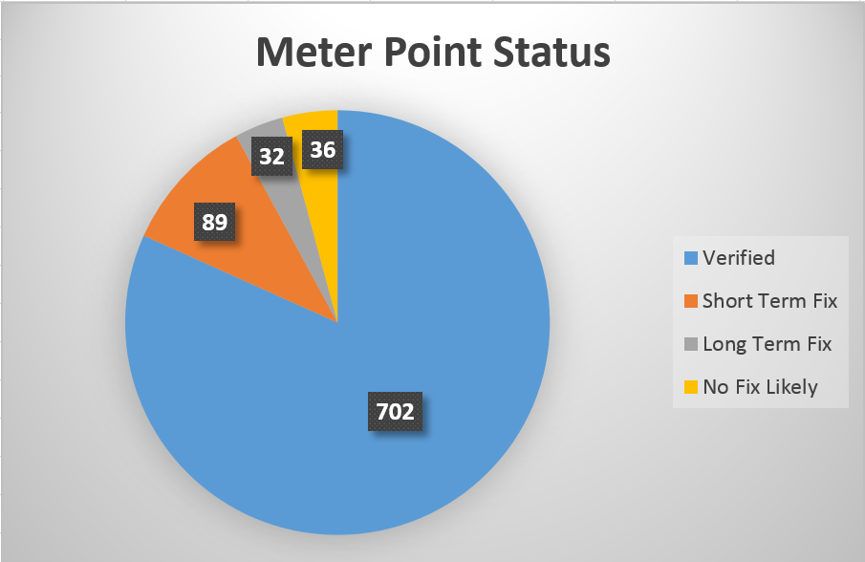
SCADA Strength Breakdown
Verified: Usable today Short Term Fix: SCADA that gives no usable data or relies on other SCADA that gives no usable data
Long Term Fix: Meter Points that have no available SCADA or haven’t had enough load to verify
No Fix Likely: Distributed Generation or similar meter points

Slide 12
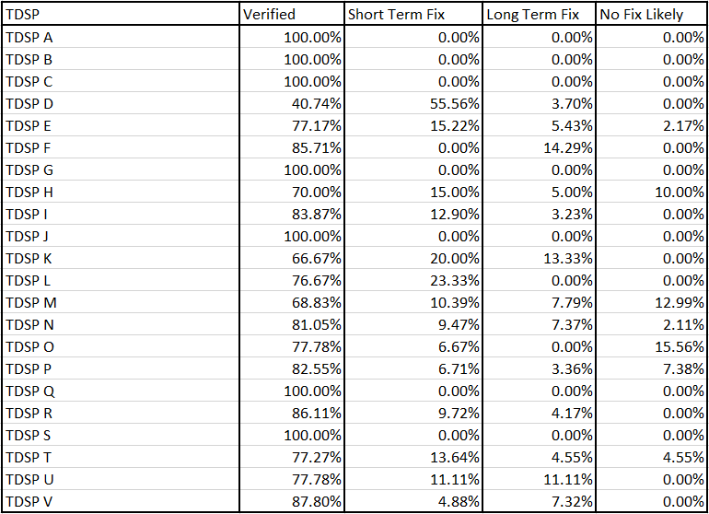
SCADA Strength Breakdown

