Slide 1
Credit Exposure Scenarios
Credit Work Group
August 15, 2018

Slide 2
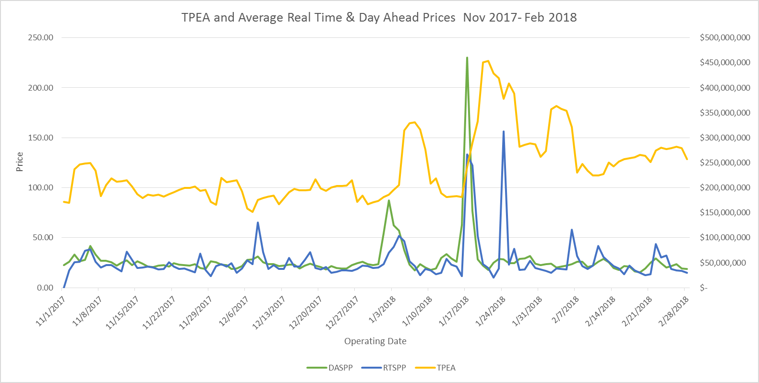
Credit Exposure Scenarios
Prior to implementation of NPRR800 in February 2018, computed Total Potential Exposure (TPE) lagged price movements.
NPRR800 go-live

Slide 3
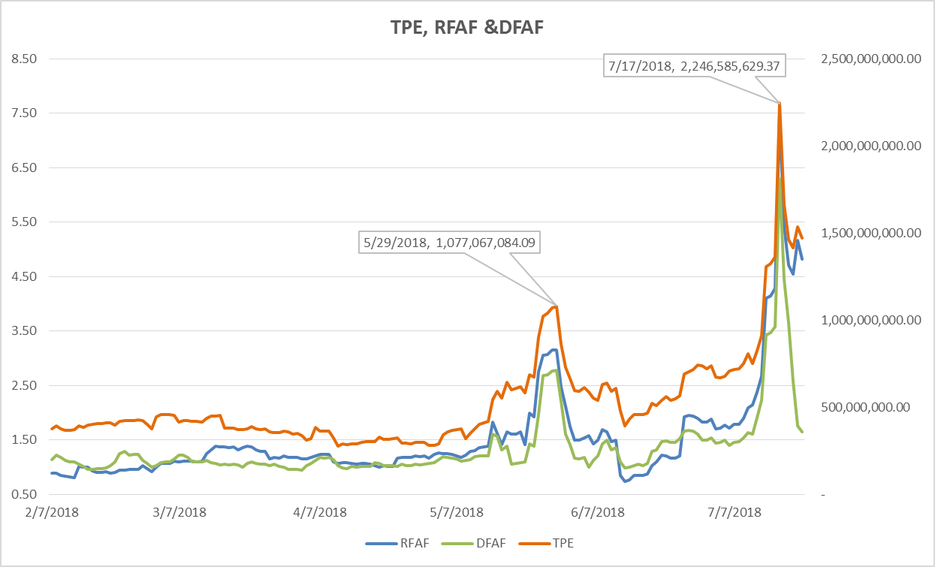
Credit Exposure Scenarios
Since implementation of NPRR800 in February 2018, computed Total Potential Exposure (TPE) has closely tracked the Real-Time (RFAF) and Day-Ahead (DFAF) adjustment factors based on forward ICE prices.

Slide 4
Credit Exposure Scenarios
Base case: Total Potential Exposure (TPE) on June 27th 2018
Scenarios
2011 Actual peak: Exposure adjusted based on forward prices as of August 1, 2011
2011 Medium stress: Base case exposure adjusted based on forward prices as of August 1, 2011, with prices on one day adjusted to $9000 peak and $3000 off-peak
2011 High stress: Base case exposure adjusted based on forward prices as of August 1, 2011, with two days at $9000 for both peak and off-peak
2017 Actual peak: Base case exposure adjusted based on forward prices as of July 21, 2017
2017 Stress: Base case exposure adjusted based on forward prices as of July 21, 2017, with the peak price for four consecutive weekdays increased to $2000
Low stress: Base case exposure adjusted to reflect theoretical very low forward prices
2018 Actual: Actual results on July 17, 2018

Slide 5
Credit Exposure Scenarios
Notes:
For each scenario ERCOT computed Total Potential Exposure (TPE) and excess collateral. Counter-Parties are required to post, at a minimum, their TPE in collateral.
Excess collateral above TPE is necessary for continued participation in Real-Time, Day-Ahead or CRR markets. Excess collateral posting is voluntary on the part of the Counter-Party.
Excess collateral in the base case was held constant in each scenario except 2018 Actual, which reflects additional collateral posted as TPE increased.
Within each scenario. TPE and excess collateral were computed for:
  All Counter-Parties
  Counter-Parties in the bottom quintile with respect to excess collateral posted
  Counter-Party segments: Load only, generation only, Load + generation, CRR only, and traders
  Counter-Party credit rating (or non-rated as applicable)

Slide 6
Credit Exposure Scenarios
Summary results
Scenario | Description | TPE ($m) |  | Excess Collateral ($m)
 |  | All Counter-Parties | Bottom Quintile | All Counter-Parties | Bottom Quintile
 | Base case | $700.71 | $4.3 | $3,077.1 | $2.7
1 | 2011 Actual peak | $527.2 | $3.8 | $3,178.3 | $3.2
2 | 2011 Medium stress | $2,458.7 | $1,287.5 | $1,319.8 | ($563.5)
3 | 2011 High stress | $5,522.9 | $4,615.8 | ($1,817.4) | ($2,940.1)
4 | 2017 Actual peak | $616.6 | $4.7 | $3,088.9 | $3.1
5 | 2017 Stress | $3,362.5 | $2,563.2 | $343.1 | ($1,158.7)
6 | Low stress | $317.9 | $3.0 | $3,387.7 | $3.4
7 | 2018 Actual | $2,242.1 | $315.5 | $3,176.3 | ($83.6)

Slide 7
Credit Exposure Scenarios
Summary results – All Counter-Parties
Total excess collateral remains positive in all scenarios but 2011 High stress.
However, when Counter-Parties are disaggregated by segment and by credit rating, some sub-groupings show negative collateral in the 2011 medium and high stress and 2017 stress cases
* Except in 2018 Actual scenario this assumes no additional posted amounts

Slide 8
Credit Exposure Scenarios
Scenario Outcomes
In terms of TPE, peak exposure in July 2018 (Scenario 7) was approximately equivalent to the 2011 medium stress scenario. However, excess collateral was much higher.
Negative excess collateral (collateral calls) first becomes apparent among lower-rated Counter-Parties with Load or Load and generation.
In the 2011 high stress case (Scenario 3), negative excess collateral is prevalent among Load, Load and generation, and trader Counter-Parties. In this scenario, negative collateral is observed among investment grade Load and generation Counter-Parties, but not in other investment grade classes.
In 2017 stress case, negative excess collateral is again concentrated in non-investment grade Load and generation Counter-Parties.
Among Counter-Parties with the bottom quintile of excess collateral, in Scenarios 2, 3 and 5 all Counter-Party categories and ratings classes showed negative excess collateral.

Slide 9
Credit Exposure Scenarios
Observations
ERCOT’s traditional credit collateralization methodology was based on past invoice amounts and therefore lagged price events. NPRR800 was designed to incorporate forward ERCOT North Prices so as to increase collateral requirements prior to market-anticipated price events.
While intended to anticipate price movements, NPRR800 was also designed to continue to maintain adequate collateral levels during changing market conditions.
In the July 2018 price event Market Participants responded to prices by posting large amounts of excess collateral prior to the highest price days.
Results
In general the scenarios show ERCOT maintaining sufficient collateral.

Slide 10
Credit Exposure Scenarios
Next Steps
ERCOT will incorporate initial feedback from F&A members. Revised scenarios will be previewed at the August CWG/MCWG meeting and shared with the F&A Committee at its October meeting.

Slide 11
Credit Exposure Scenarios
Appendix: Detailed Results

Slide 12
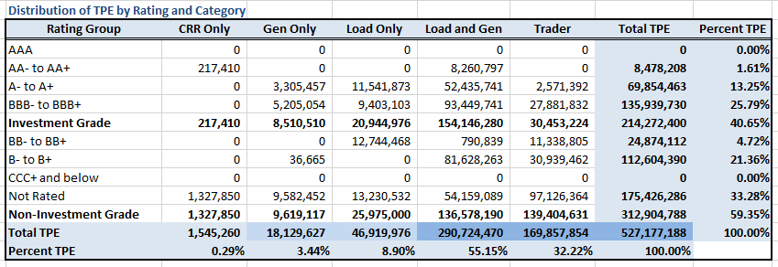
Credit Exposure Scenario 1
Distribution of TPE by Rating and Category

Slide 13
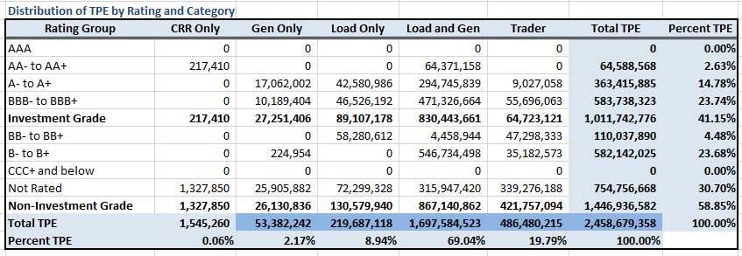
Credit Exposure Scenario 2
Distribution of TPE by Rating and Category

Slide 14

Credit Exposure Scenario 3
Distribution of TPE by Rating and Category

Slide 15
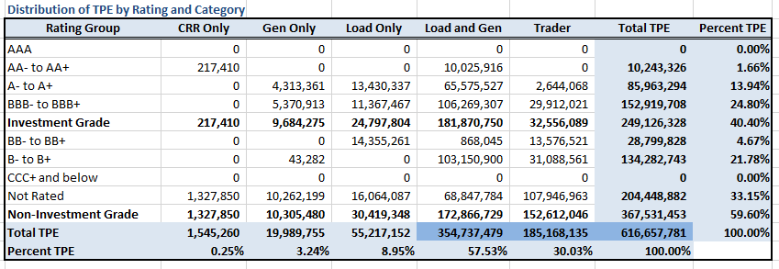
Credit Exposure Scenario 4
Distribution of TPE by Rating and Category

Slide 16
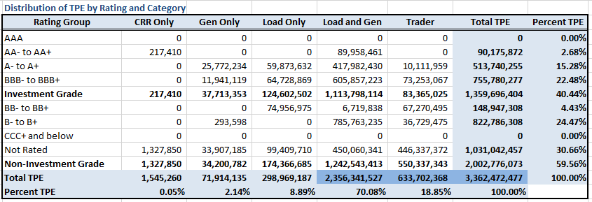
Credit Exposure Scenario 5
Distribution of TPE by Rating and Category

Slide 17
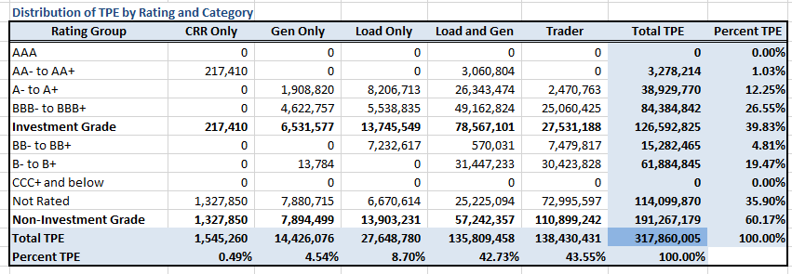
Credit Exposure Scenario 6
Distribution of TPE by Rating and Category

Slide 18
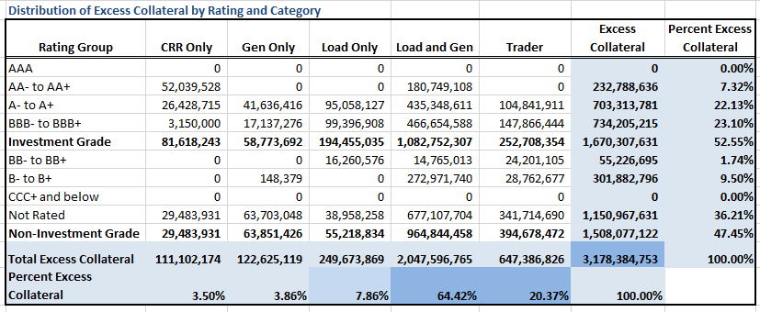
Credit Exposure Scenario 1
Distribution of Excess Collateral by Rating and Category
Notes:
By Jun 27 2018 Market Participants had posted increased amounts of collateral

Slide 19
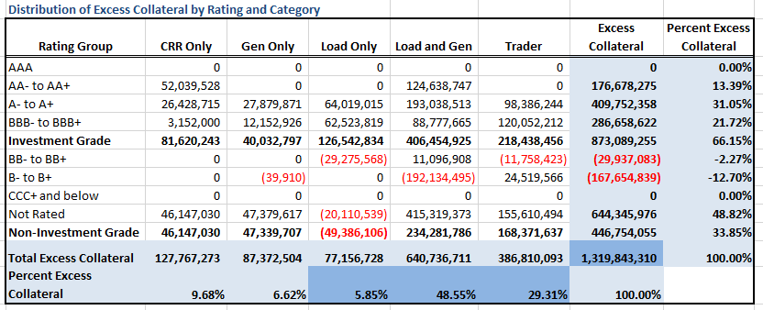
Credit Exposure Scenario 2
Distribution of Excess Collateral by Rating and Category

Slide 20
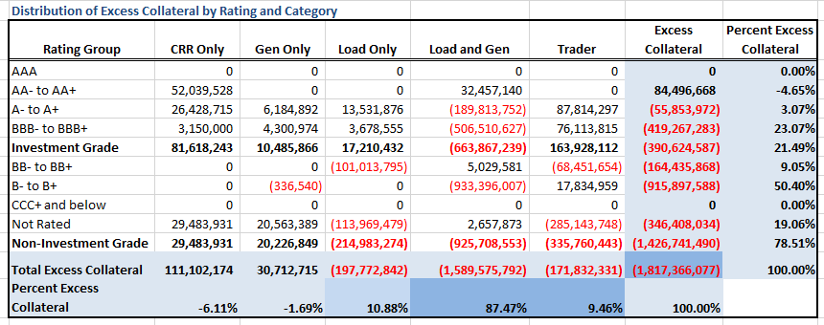
Credit Exposure Scenario 3
Distribution of Excess Collateral by Rating and Category

Slide 21
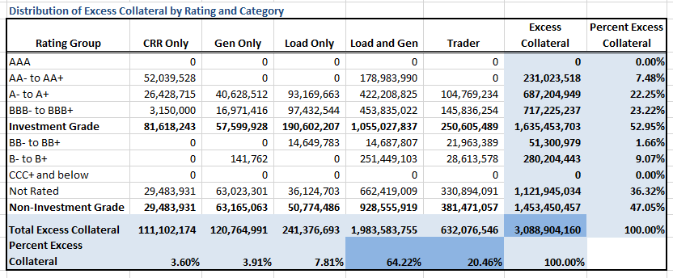
Credit Exposure Scenario 4
Distribution of Excess Collateral by Rating and Category

Slide 22
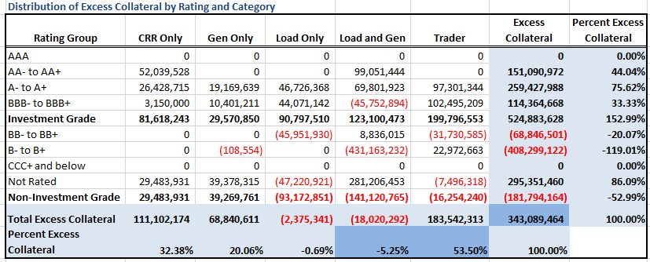
Credit Exposure Scenario 5
Distribution of Excess Collateral by Rating and Category

Slide 23
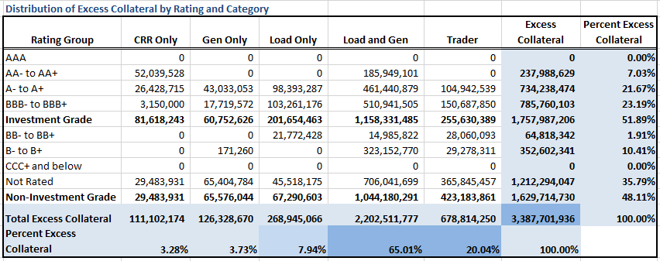
Credit Exposure Scenario 6
Distribution of Excess Collateral by Rating and Category

Slide 24
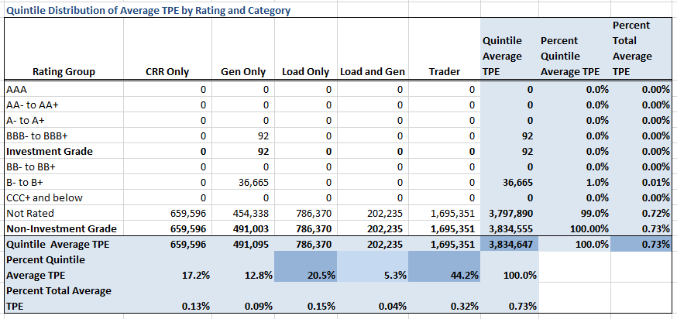
Credit Exposure Scenario 1
Distribution of TPE in the Bottom Quintile of Excess Collateral

Slide 25
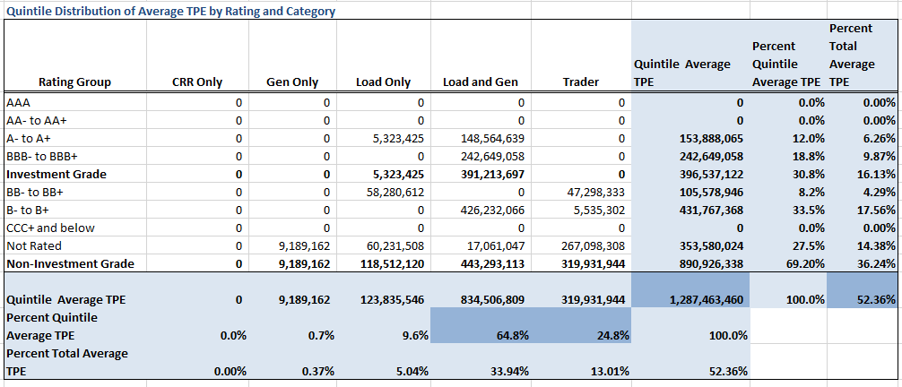
Credit Exposure Scenario 2
Distribution of TPE in the Bottom Quintile of Excess Collateral

Slide 26
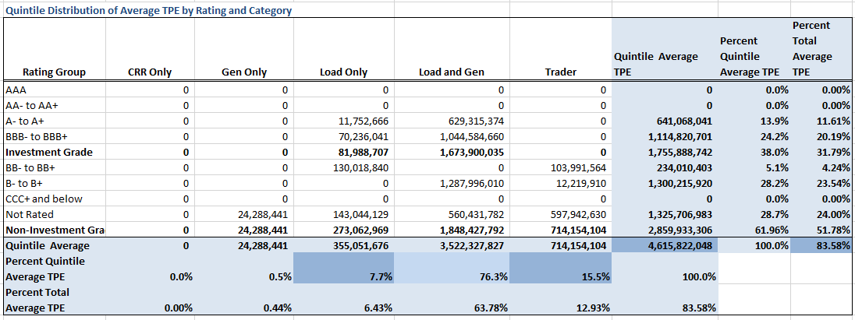
Credit Exposure Scenario 3
Distribution of TPE in the Bottom Quintile of Excess Collateral

Slide 27
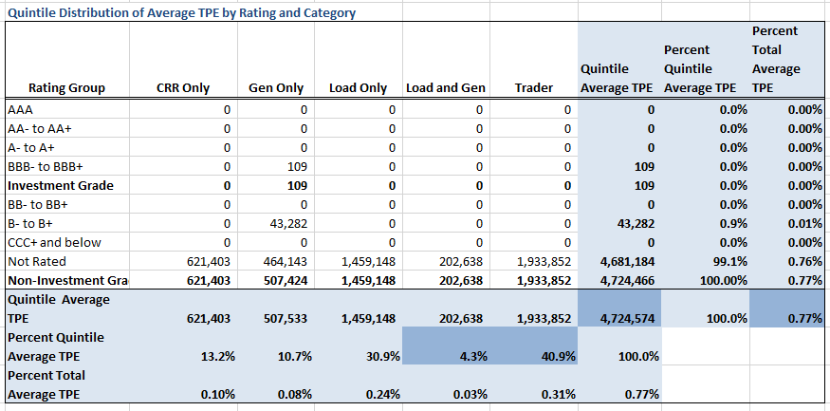
Credit Exposure Scenario 4
Distribution of TPE in the Bottom Quintile of Excess Collateral

Slide 28
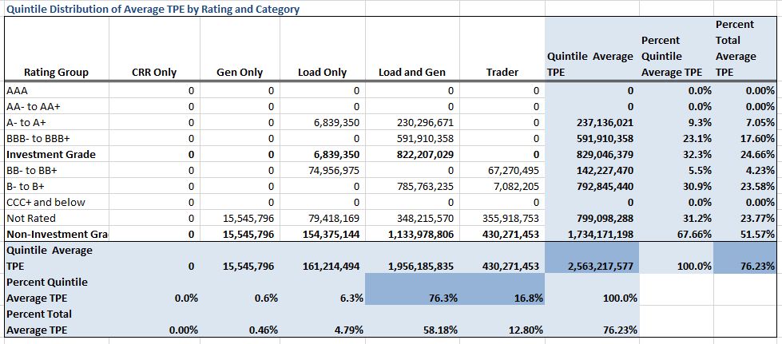
Credit Exposure Scenario 5
Distribution of TPE in the Bottom Quintile of Excess Collateral

Slide 29
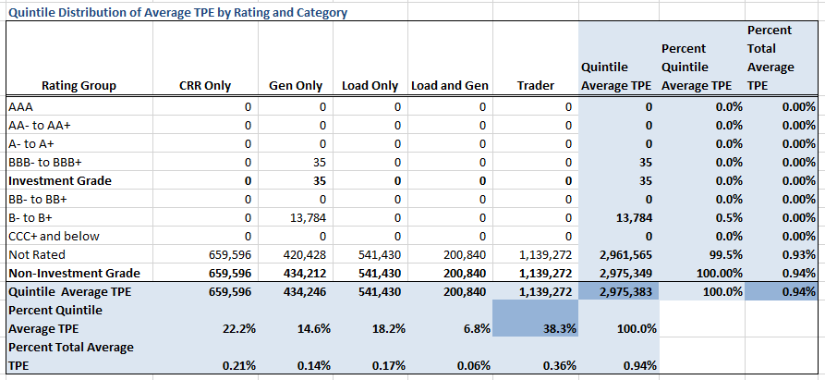
Credit Exposure Scenario 6
Distribution of TPE in the Bottom Quintile of Excess Collateral

Slide 30
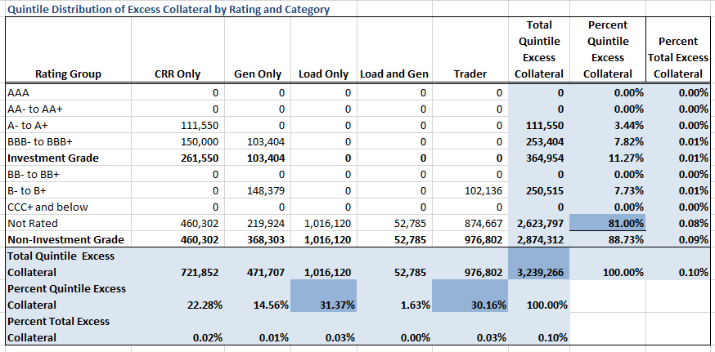
Credit Exposure Scenario 1
Distribution in the Bottom Quintile of Excess Collateral*
  *Excess Collateral is a voluntary posting by Counterparty

Slide 31
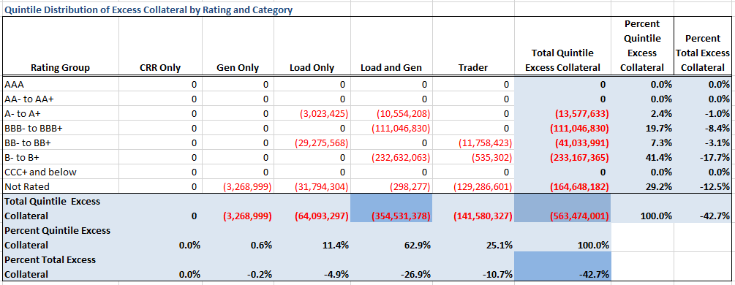
Credit Exposure Scenario 2
Distribution in the Bottom Quintile of Excess Collateral*
  *Excess Collateral is a voluntary posting by Counterparty

Slide 32
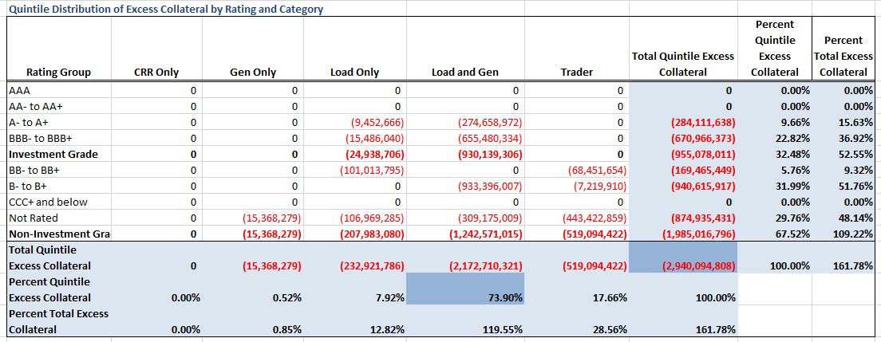
Credit Exposure Scenario 3
Distribution in the Bottom Quintile of Excess Collateral*
  *Excess Collateral is a voluntary posting by Counterparty

Slide 33
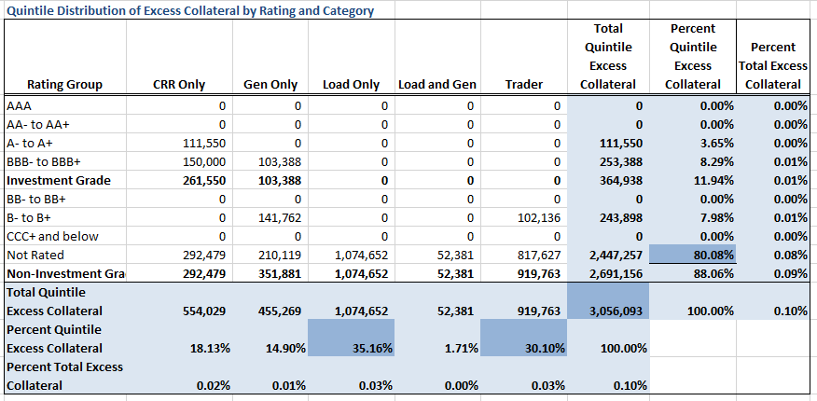
Credit Exposure Scenario 4
Distribution in the Bottom Quintile of Excess Collateral*
  *Excess Collateral is a voluntary posting by Counterparty

Slide 34
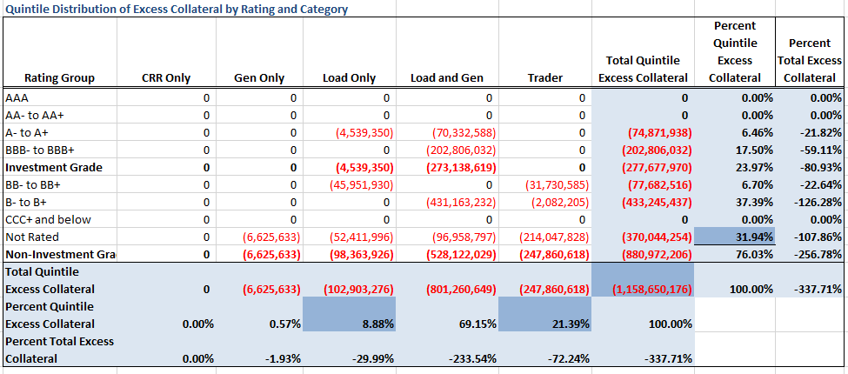
Credit Exposure Scenario 5
Distribution in the Bottom Quintile of Excess Collateral*
  *Excess Collateral is a voluntary posting by Counterparty

Slide 35
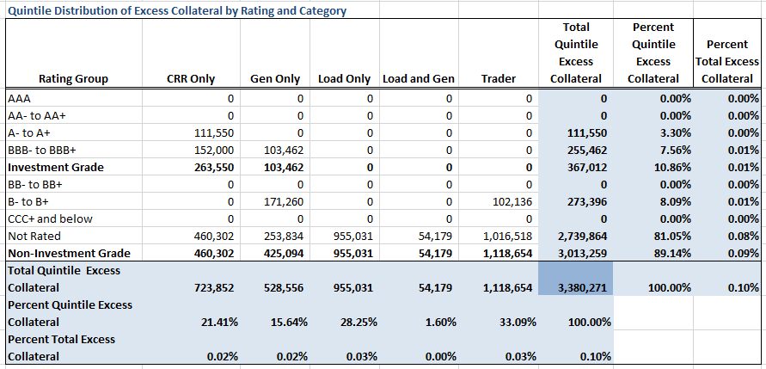
Credit Exposure Scenario 6
Distribution in the Bottom Quintile of Excess Collateral*
  *Excess Collateral is a voluntary posting by Counterparty

Slide 36
Credit Exposure Scenarios
Questions

