Slide 1
Credit Exposure Update
Spoorthy Papudesi
Credit Work Group
ERCOT Public
August 15, 2018

Slide 2
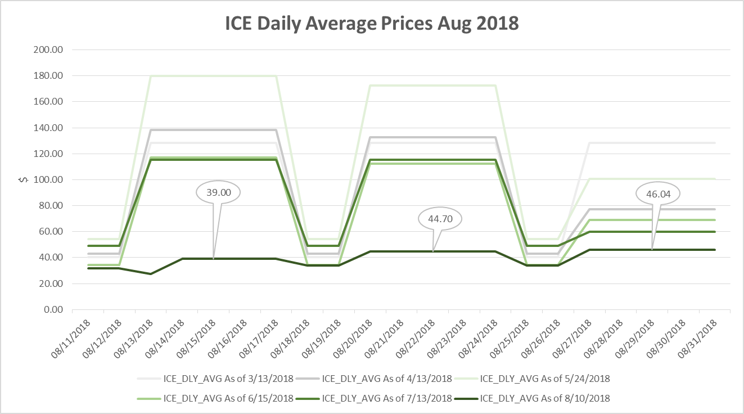
ICE Forward Curves August 2018

Slide 3
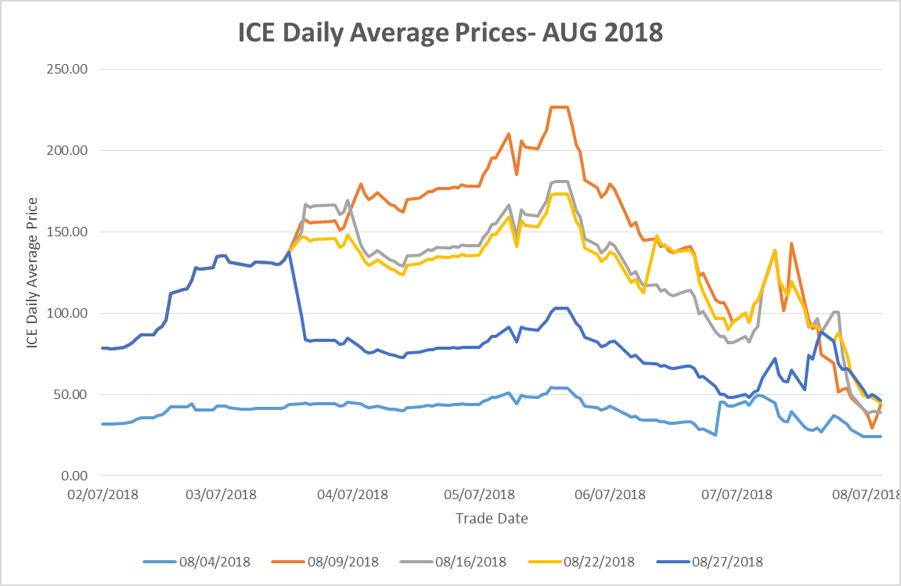
ICE Forward Curves August 2018
August ICE forward price evolution for weekdays and weekends.

Slide 4
Credit Exposure Update
Inputs and Assumptions:
Only Active Counter-Parties are included
Counter-Parties are classified by rating and market activity
TPE and collateral balances used are averages for June and July 2018
Counter-Parties that are subsidiaries of, or guaranteed by, rated entities are given the parent/guarantor’s rating, adjusted down one notch

Slide 5
Credit Exposure Update
July 2018 compared to June 2018
Market-wide average TPE increased from $570 million to $965.6 million.
TPE increased by $300.1 million for “Load and Gen” category.
TPE increased by $47.3 million for “Trader” category.
TPE increased by $43.3 million for “Load Only” category.
Excess collateral increased from $2,460 million to $2,989.5.
increased by $470.1 million for “Load and Gen” category
increased by $68.6 million for “Trader” category.
decreased by $10.5 million for “Load Only” category.
Number of active Counter-Parties decreased from 225 to 224.

Slide 6
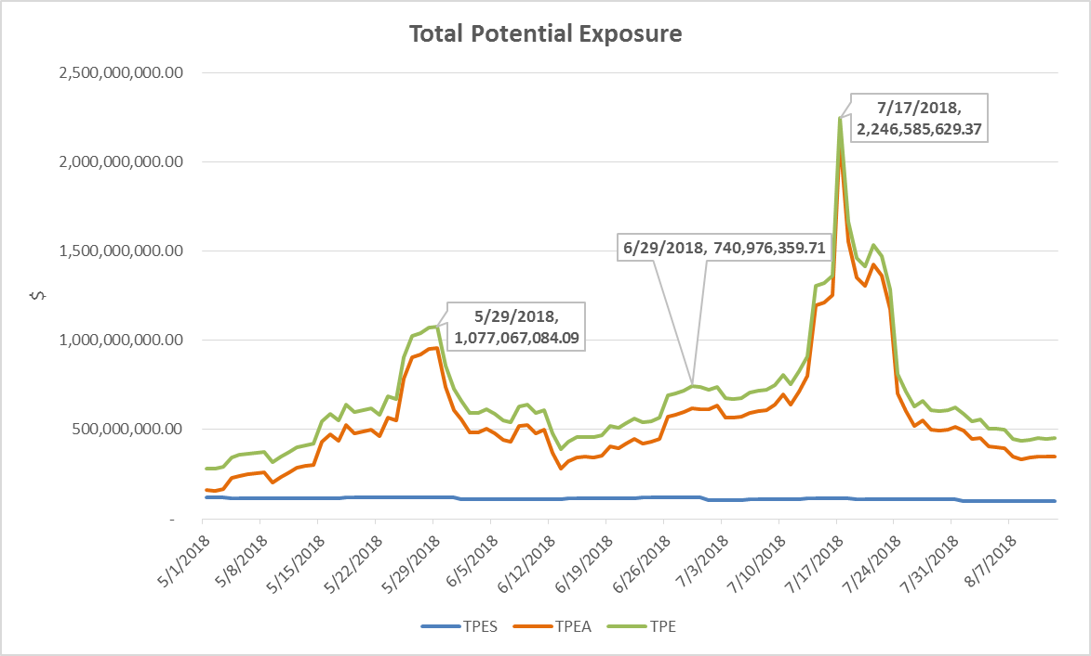
Credit Exposure Update

Slide 7
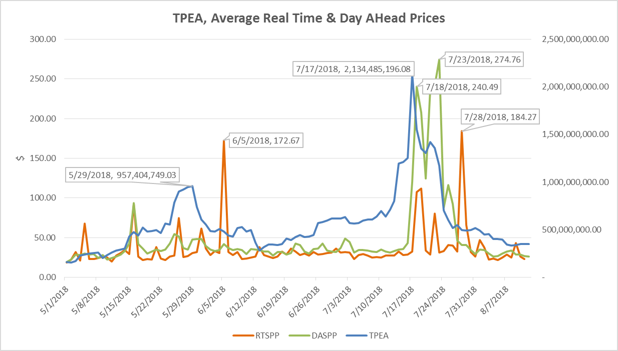
Credit Exposure Update

Slide 8
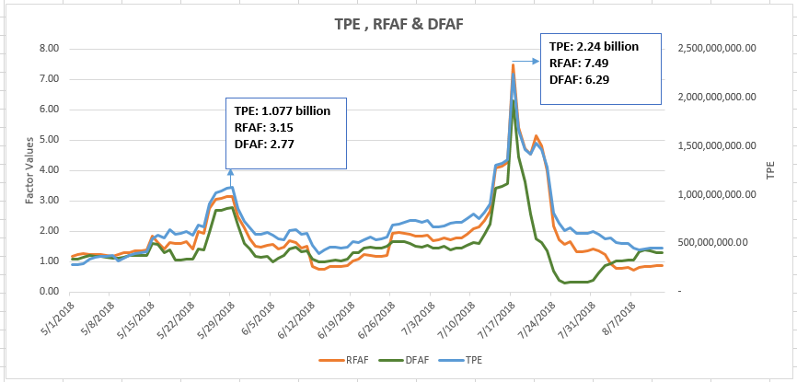
Credit Exposure Update

Slide 9
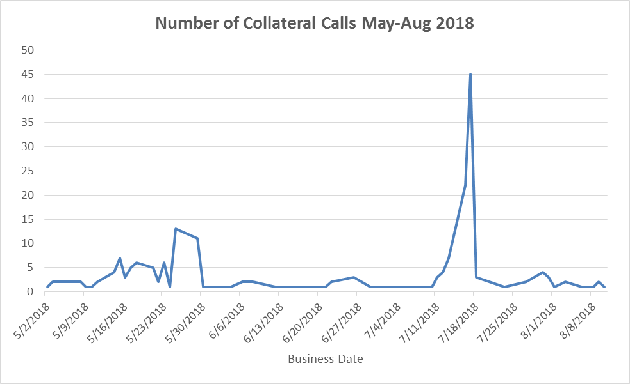
Credit Exposure Update

Slide 10
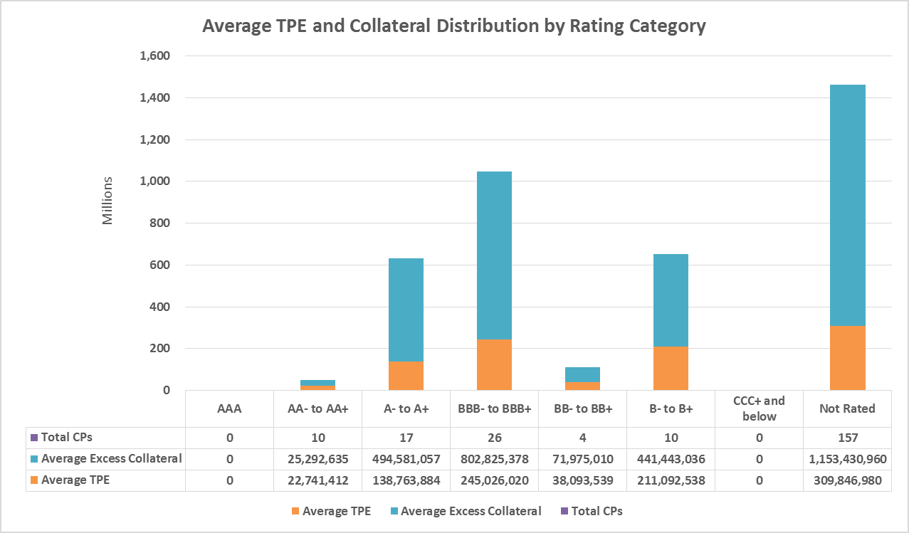
Credit Exposure Update

Slide 11
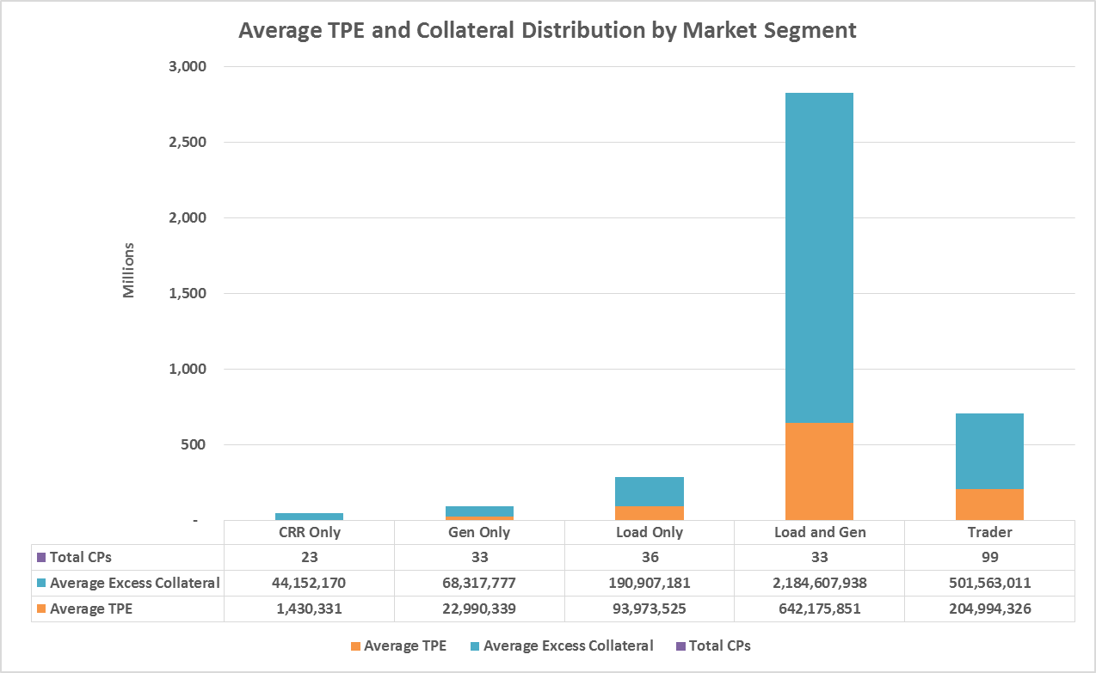
Credit Exposure Update

Slide 12
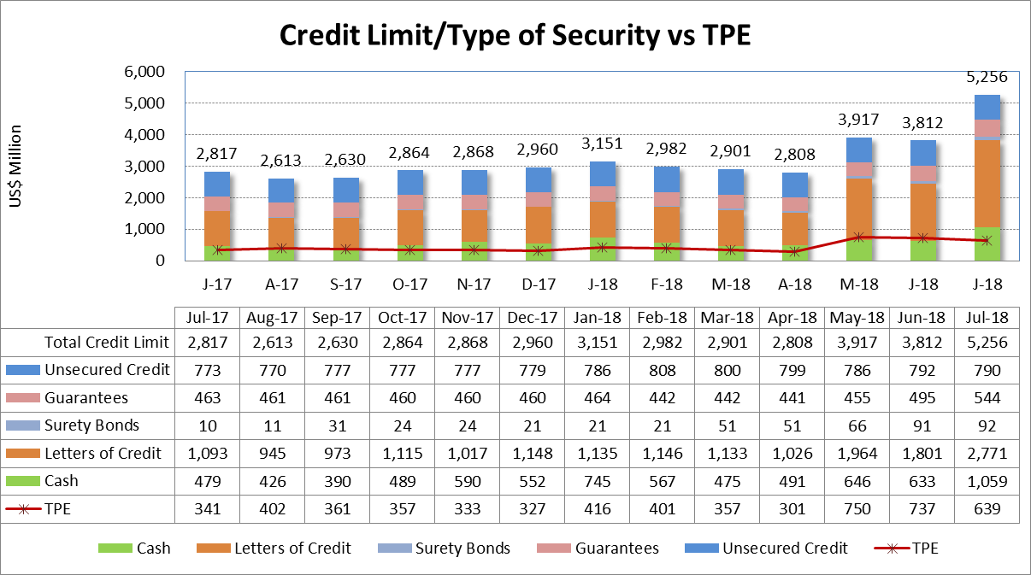
Credit Exposure Update

Slide 13
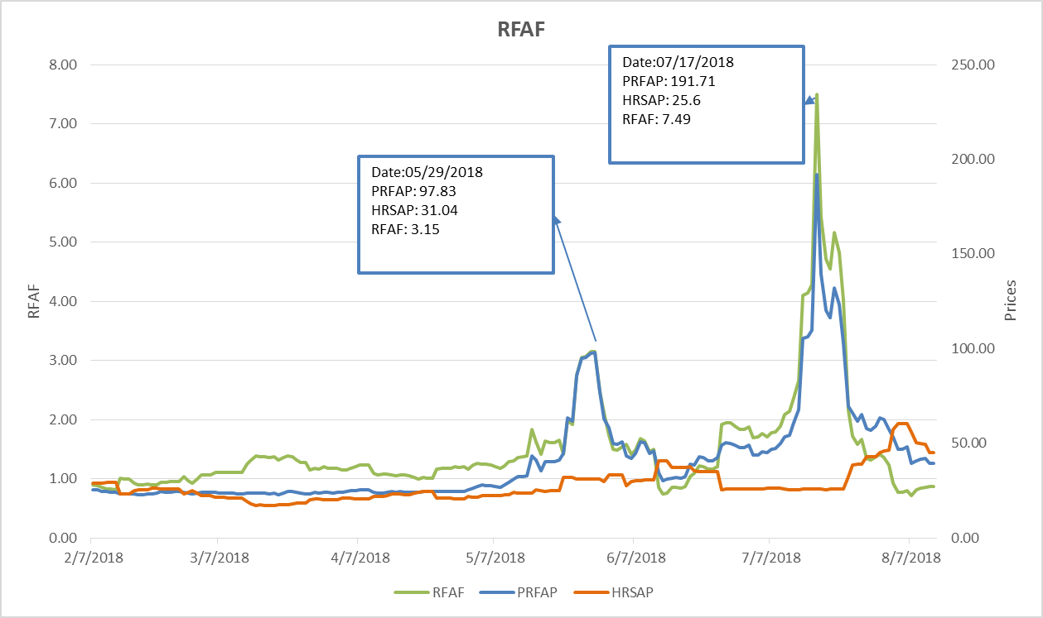
Credit Exposure Update
Real-Time Forward Adjustment Factor (RFAF)
RFAF is calculated using 21 days of ICE future prices and 14 days of ERCOT Real Time Settled Prices for HB_NORTH settlement point

Slide 14
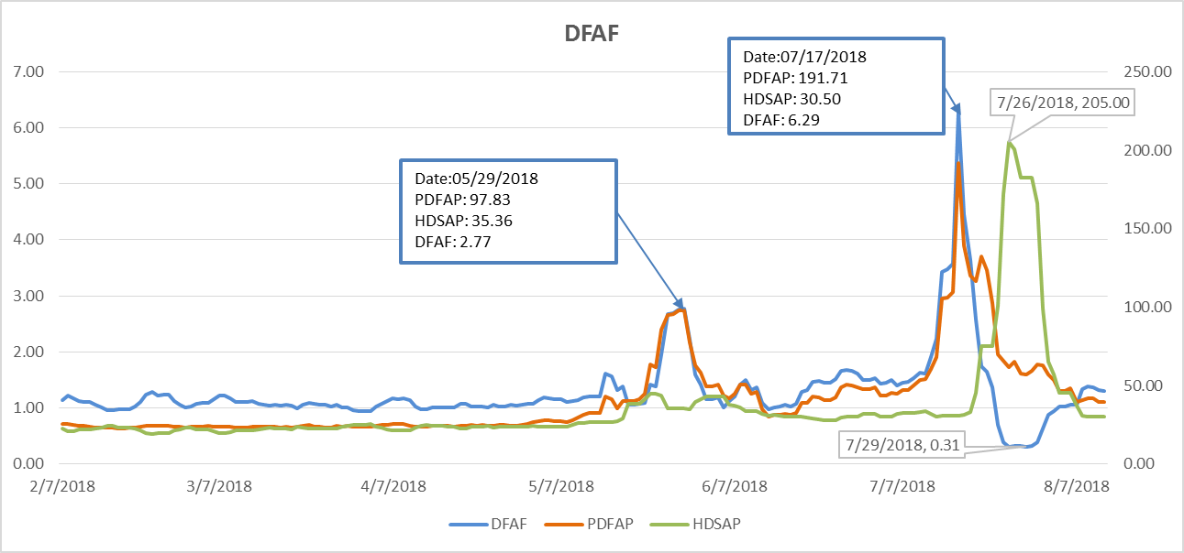
Credit Exposure Update
Day-Ahead Forward Adjustment Factor (DFAF)
DFAF is calculated using 21 days of ICE future prices and 7 days of ERCOT Day Ahead Settled Prices for HB_NORTH settlement point

Slide 15
Credit Exposure Update
Appendix

Slide 16
Credit Exposure Update
Summary statistics by Market Segment

Slide 17
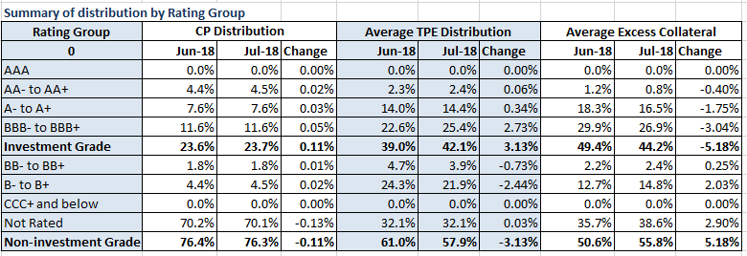
Credit Exposure Update
Summary statistics by Rating Group

Slide 18
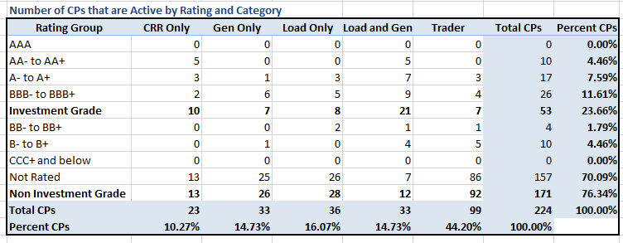
Credit Exposure Update
Active Counter-Parties distribution by rating and category- Jul 2018

Slide 19
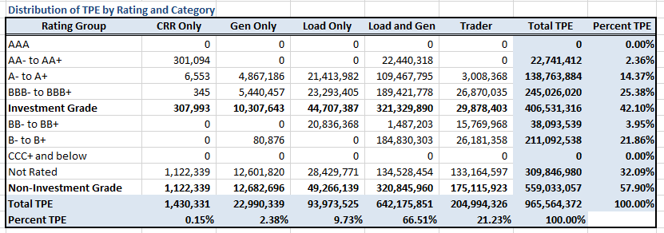
Credit Exposure Update
Average Total Potential Exposure distribution-Jul 2018

Slide 20
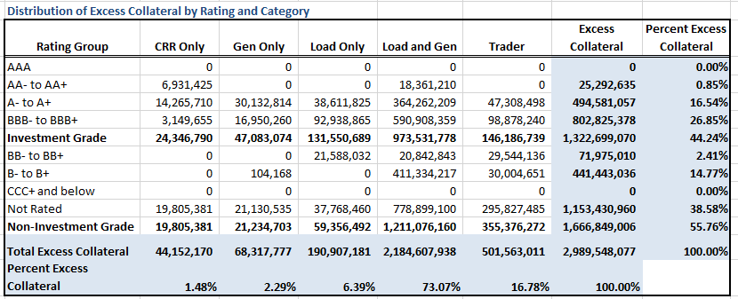
Credit Exposure Update
Average Excess Collateral distribution^{*-}Jul 2018
*Excess Collateral is a voluntary disposition by Counterparty

Slide 21
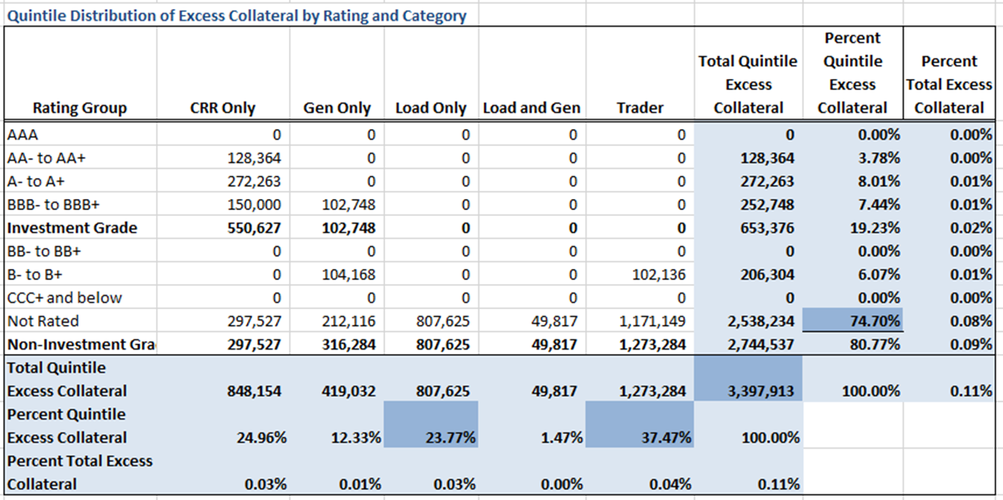
Credit Exposure Update
Distribution in the Bottom Quintile of Excess Collateral^{*-}Jul 2018
*Excess Collateral is a voluntary disposition by Counterparty

Slide 22
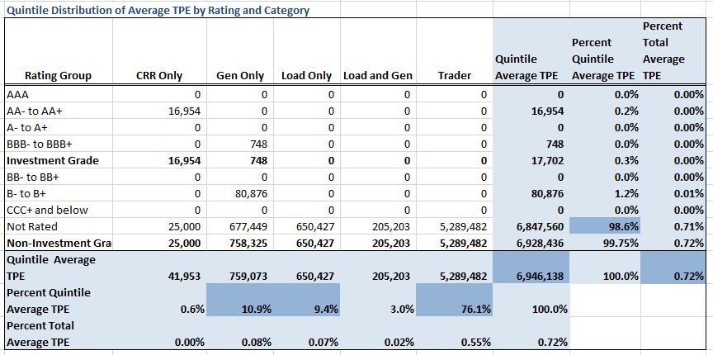
Credit Exposure Update
Distribution in the Bottom Quintile of Excess Collateral^{*-}Jul 2018
*Excess Collateral is a voluntary disposition by Counterparty

Slide 23
Credit Exposure Update
Questions

