Slide 1
West Texas Congestion Overview
Chad Thompson
Congestion Management Working Group
August 13, 2018

Slide 2
Outline
Overview of West Texas Topology
Operator Procedure language for
Phase Shifting Transformers
Duplicate Constraints
Violated Constraints
Shift Factor Cut Off

Slide 3
West Texas Congestion
ERCOT

Slide 4
Phase Shifting Transformers
Activate the constraint
Study the impact of the PST
Move the PST position
Deactivate the constraint if congestion is relieved

Slide 5
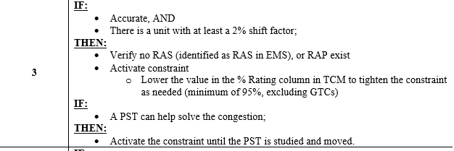
Phase Shifting Transformers
Procedure Language

Slide 6
Duplicate Constraints
In Series
Contingency A overloads Lines 1 and 2, which are in series with each other
Common Element
Contingencies A and B both overload Line 1
Typically activate the most heavily overloaded, or whichever constraint shows up in RTCA first
Notes:
Section 4.1 “Managing Constraints in SCED”
“Whichever is first” is important, because depending on the system conditions the same contingency does not always show up first; we have seen this in West Texas during outages inside the area as a result of the outages impacting flows (69 kV contingencies near Alpine is a good example).
In the case of West Texas, even though the constraints don’t specifically meet these criteria, the congestion is all the result of the same thing, which is loss of the ability to serve the load in the area, and that is where the labeling of the constraints as redundant has originated.

Slide 7
Duplicate Constraints
Procedure language

Slide 8
Violated Constraints
When a constraint is violated
If there is a RAP, make sure it’s properly modeled
Make sure base points are being followed
Remove Resources from ONTEST
Move AS
Deploy Non-Spin
RUC
Utilize reactive reserves where possible
Notes:
Section 4.1 “Managing Constraints in SCED”

Slide 9
Violated Constraints
When a constraint is violated
If, after all that, the constraint is still violated
Consider recalling a transmission outage, if that is a contributing factor
Develop a mitigation plan

Slide 10
Violated Constraints
Procedure language

Slide 11
Shift Factor Cut-Off
Shift Factors greater than the absolute value of 2 %
Regardless of Resource Status
Excludes generators not participating in SCED
Non-modeled generators
DC Tie “generators”

