Slide 1
NPRR 879
SCED Base Point and Performance Evaluation Changes for IRRs that Carry Ancillary Services
Operations Planning
8/13/2018

Slide 2
Background
Currently three IRRs are qualified to provide Regulation-Service
NPRR is needed because Protocols do not specify,
  metrics to score performance of IRRs when carrying Ancillary Service (A/S)
  Base Point Deviation charges for IRRs when carrying Ancillary Service (A/S)

Slide 3
Background
NPRR 879 proposes the following changes:
Generation Resource Energy Deployment Performance (GREDP) based performance metrics, analogous to conventional generators, to score IRR performance during intervals when carrying A/S
Base Point Deviation charges, analogous to conventional generators, for Intermittent Renewable Resources (IRRs) carrying Ancillary Service Resource Responsibilities
When carrying A/S, IRRs will receive and follow a SCED Base Point that is calculated using,
  telemetry sent by the Market Participant that indicates the five-minute out High Sustained Limit (HSL) of the IRR, or
  the five-minute intra-hour forecast of the Resource available in ERCOT systems

Slide 4
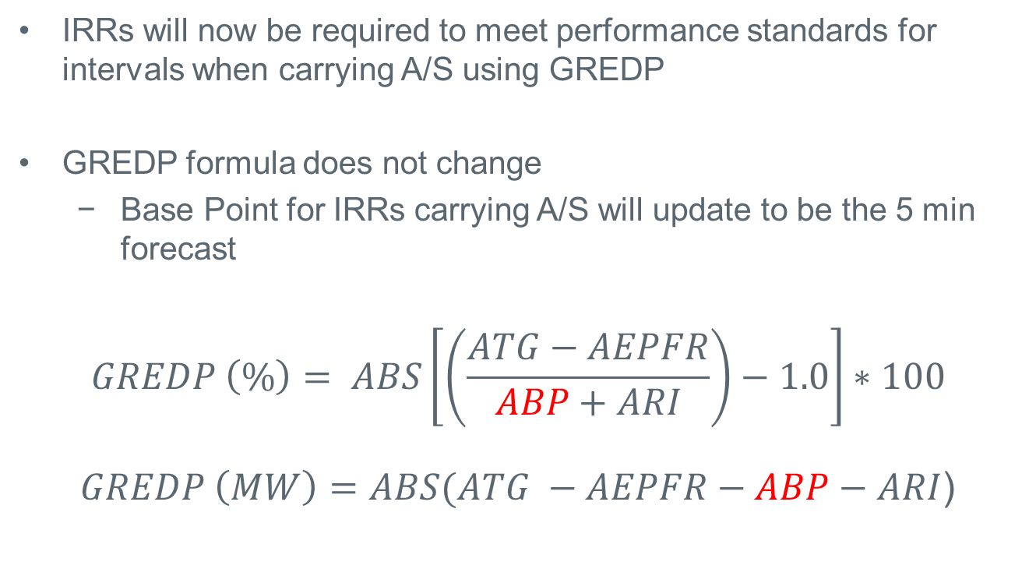
Scoring Performance for IRRs
IRRs will now be required to meet performance standards for intervals when carrying A/S using GREDP
GREDP formula does not change
  Base Point for IRRs carrying A/S will update to be the 5 min forecast
$$GREDP \left(\%\right)= ABS\left[\left(\frac{ATG−AEPFR}{ABP+ARI}\right)−1.0\right]∗100$$
$GREDP \left(MW\right)=ABS(ATG −AEPFR−ABP−ARI$)
Notes:
ATG = Average Telemetered Generation = the average telemetered generation of the Generation Resource or for the aggregate of the IRRs within a IRR Group for the five-minute clock interval
ARI = Average Regulation Instruction = the amount of regulation that the Generation Resource or IRR Group should have produced based on the LFC deployment signals, calculated by LFC, during each five-minute clock interval
∆frequency is actual frequency minus 60 Hz
EPFR = Estimated Primary Frequency Response (MW) = if │∆frequency│≤ Governor Dead-Band then EPFR = zero, if not then if ∆frequency > zero, EPFR = (∆frequency - Governor Dead-Band)/((droop value * 60) – Governor Dead-Band) * HSL * -1, if not then if ∆frequency < zero, EPFR = (∆frequency + Governor Dead-Band)/((droop value * 60) – Governor Dead-Band) * HSL * -1
AEPFR = Average Estimated Primary Frequency Response = the Estimated Primary Frequency Response (MW) will be calculated every four seconds using a Resource specific droop value where 5% droop = 0.05 the Governor Dead-Band (Hz) and Resource HSL (MW) provided by the Resource Entity, and the frequency deviation (Hz) from 60 Hz and averaged for the five-minute clock interval. For Combined Cycle Generation Resources, or Generation Resources that have been approved to telemeter Non-Frequency Responsive Capacity (NFRC), the HSL will be reduced by the telemetered NFRC MW to calculate the EPFR. For Combined Cycle Generation Resources, 5.78% Governor droop shall be used. The Resource-specific calculations will be aggregated for IRR Groups.
ABP = Average Base Point = the time-weighted average of a linearly ramped Base Point or sum of Base Points for IRR Groups, for the five-minute clock interval. The linearly ramped Base Point is calculated every four seconds such that it ramps from its initial value to the SCED Base Point over a five-minute period. The initial value of the linearly ramped Base Point will be the four-second value of the previous linearly ramped Base Point at the time the new SCED Base Point is received into the ERCOT Energy Management System (EMS). In the event that the SCED Base Point is received after the five-minute ramp period, the linearly ramped Base Point will continue at a constant value equal to the ending four-second value of the five-minute ramp.

Slide 5
Base Point Using Forecast
IRRs when carrying A/S will receive a 5-min out BP and will be expected to follow this BP.
6.5.7.2(3) For Generation Resources, HASL is calculated as follows:
HASL = Max (LASL, (HSLTELEM – (RRSTELEM + RUSTELEM + NSRSTELEM +NFRCTELEM)))
Variable | Description
HASL | High Ancillary Service Limit.
HSLTELEM | For IRRs carrying Ancillary Service Resource Responsibilities and all IRRs within an IRR Group where any IRR within the IRR Group is carrying an Ancillary Service Resource Responsibility, HSLTELEM shall be the five-minute intra-hour forecast for the Resource. For all other Resources, HSLTELEM shall be the Resource’s HSL provided to ERCOT via telemetry, in accordance with Section 6.5.5.2.
LASL | Low Ancillary Service Limit.
RRSTELEM | Responsive Reserve Ancillary Service Schedule provided by telemetry.
RUSTELEM | Reg-Up Ancillary Service Resource Responsibility designation provided by telemetry.
NSRSTELEM | Non-Spin Ancillary Service Schedule provided via telemetry.
NFRCTELEM | NFRC currently available (unloaded) and included in the HSL of the Generation Resource with non-zero Responsive Reserve Ancillary Service Schedule telemetry.

Slide 6
GREDP and Base Point Deviation for IRRs
When carrying A/S:
  No less than 85% of intervals,
    GREDP(%) <= X% OR
    GREDP(MW) <= Y MW
    X=8 and Y=8
  Base Point Deviation Charges for Over and Under Generation aligned with non-IRR generation
When not carrying A/S, GREDP performance and Base Point Deviation charges apply only when curtailed:
  Existing metrics. No Change.
Notes:
ATG = Average Telemetered Generation = the average telemetered generation of the Generation Resource or for the aggregate of the IRRs within a IRR Group for the five-minute clock interval
ARI = Average Regulation Instruction = the amount of regulation that the Generation Resource or IRR Group should have produced based on the LFC deployment signals, calculated by LFC, during each five-minute clock interval
∆frequency is actual frequency minus 60 Hz
EPFR = Estimated Primary Frequency Response (MW) = if │∆frequency│≤ Governor Dead-Band then EPFR = zero, if not then if ∆frequency > zero, EPFR = (∆frequency - Governor Dead-Band)/((droop value * 60) – Governor Dead-Band) * HSL * -1, if not then if ∆frequency < zero, EPFR = (∆frequency + Governor Dead-Band)/((droop value * 60) – Governor Dead-Band) * HSL * -1
AEPFR = Average Estimated Primary Frequency Response = the Estimated Primary Frequency Response (MW) will be calculated every four seconds using a Resource specific droop value where 5% droop = 0.05 the Governor Dead-Band (Hz) and Resource HSL (MW) provided by the Resource Entity, and the frequency deviation (Hz) from 60 Hz and averaged for the five-minute clock interval. For Combined Cycle Generation Resources, or Generation Resources that have been approved to telemeter Non-Frequency Responsive Capacity (NFRC), the HSL will be reduced by the telemetered NFRC MW to calculate the EPFR. For Combined Cycle Generation Resources, 5.78% Governor droop shall be used. The Resource-specific calculations will be aggregated for IRR Groups.
ABP = Average Base Point = the time-weighted average of a linearly ramped Base Point or sum of Base Points for IRR Groups, for the five-minute clock interval. The linearly ramped Base Point is calculated every four seconds such that it ramps from its initial value to the SCED Base Point over a five-minute period. The initial value of the linearly ramped Base Point will be the four-second value of the previous linearly ramped Base Point at the time the new SCED Base Point is received into the ERCOT Energy Management System (EMS). In the event that the SCED Base Point is received after the five-minute ramp period, the linearly ramped Base Point will continue at a constant value equal to the ending four-second value of the five-minute ramp.

Slide 7
Expectation for IRR Groups
If any IRR within an IRR Group is carrying A/S:
  Each IRR within the IRR Group will receive a BP using the 5-min forecast of the IRR
  GREDP will be scored at the IRR Group level by aggregating the MW output, Base Points, Estimated Primary Frequency Response, and Regulation Instructions of all IRRs in the IRR Group, per current Protocol language for IRR Group aggregation
  Base Point Deviation penalties will be determined for the IRR Group and evenly allocated and charged to each IRR within that IRR Group

Slide 8
Summary
NPRR creates GREDP performance requirements, Base Point Deviation Charges, and enhances dispatch efficacy for IRRs carrying Ancillary Service Resource Responsibilities

Slide 9
Appendix

Slide 10
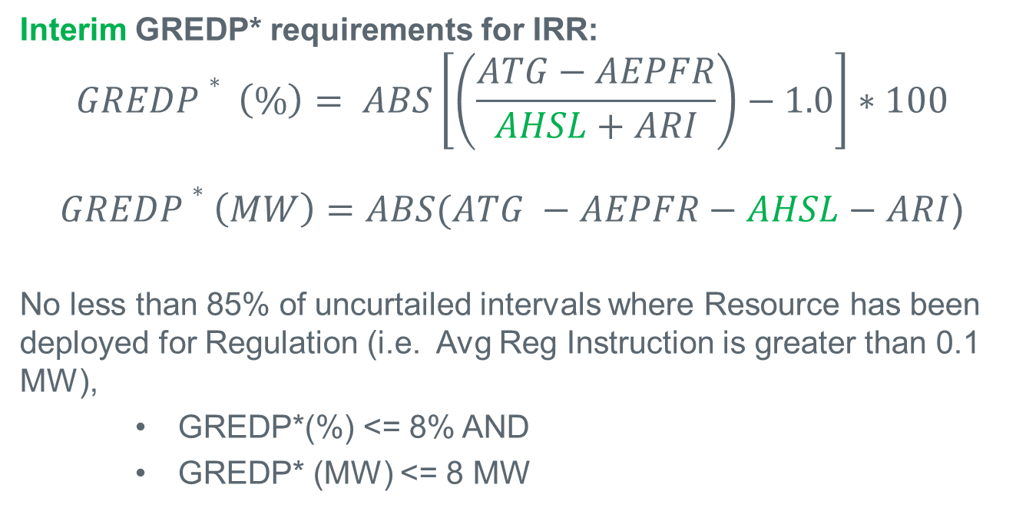
Interim Energy Deployment Performance Measure
Interim GREDP* requirements for IRR:
$$GREDP∗ \left(\%\right)= ABS\left[\left(\frac{ATG−AEPFR}{AHSL+ARI}\right)−1.0\right]∗100$$
$GREDP∗\left(MW\right)=ABS(ATG −AEPFR−AHSL−ARI$)
No less than 85% of uncurtailed intervals where Resource has been deployed for Regulation (i.e. Avg Reg Instruction is greater than 0.1 MW),
    GREDP*(%) <= 8% AND
    GREDP* (MW) <= 8 MW

