Slide 1
Resource Definition Task Force
2018

Slide 2
Proposed Resource Definition Framework
NPRR889 RTF-1
NPRRxxx RTF-2

Slide 3
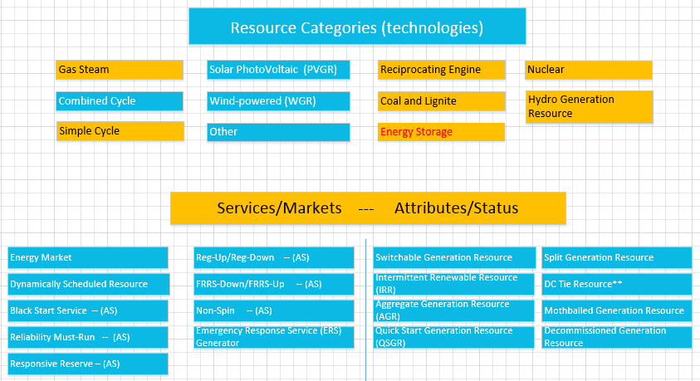
Resource Technology, Attributes and Services

Slide 4
Topics for Additional Discussion – Phase 2 (Transmission)
All transmission connected resources would be required to be registered and modeled, regardless of size.
Finish introduction of Resource Framework
Include definitions of all technologies
Energy Storage.
Develop definition
registration/modeling/market issues will not be a significant area of focus as part of this task force and will instead be included in the whitepaper for further discussion.

