Slide 1
PDCWG Report to ROS
Chair: Percy Galliguez, Brazos Electric Power Cooperative, Inc.
Vice Chair: Chad Mulholland, NRG
ROS
August 9th, 2018

Slide 2
Report Overview & Notes
Report Overview
  Meeting Minutes
  BAL-001-TRE-1 FMEs & IMFR
    0 FMEs in the month of June
  Frequency Control Report

Slide 3
Meeting Minutes
PDCWG Meeting 07/17/18
  NPRR863 – Separation of PFR and RRS Ancillary Service
  NPRR879, SCED Base Point and Performance Evaluation Changes for IRRs that Carry Ancillary Services
  NOGRR180, Exemption of Governor Dead-Band and Droop Setting Requirements for Steam Turbines of Combined Cycle Generation Resources
  Regulation & Frequency Control Reports

Slide 4
History-NPRR863
PDCWG has had extensive discussion regarding NPRR 863 at every meeting since February 2018
Reviewed NPRR863 language:
  STEC language of January 1, 2018
  STEC comments of April 26, 2018
  Apex comments of April 24, 2018
  ERCOT comments July 6, 2018
  CPS Energy comments of July 16, 2018

Slide 5
Findings-NPRR863
PDCWG observes the following:
  Widening the deadbands for resources not providing FRS or URS provides an acceptable level of reliability. Prior to BAL-001-TRE-01 transition, ERCOT region had a period of time in 2013 when ERCOT fleet was operating with dual deadbands without reliability degradation.
  The proposed protocol revisions provides the following benefits to the ERCOT system
    Generation Resource requirement of 1150MW remains unchanged for FRS
    Inclusion of 15-cycle FFR will help lower current critical system inertia level, 100GW-s, by as much as 9GW-s.
    Part of the current NSRS quantities are moving to the 10-minute service, ECRS. This improves recovery from frequency deviations with the separation of FRS and ECRS formerly RRS.
    Provides ERCOT the ability to specify the AS requirements with more clarity
    Provides additional tools for ERCOT operators to call upon
      Increases the effective number of AS products under the same volume
      More detailed AS products provide for better inclusion of new technologies
    Better positions ERCOT to respond to a changing resource fleet with new technologies to provide quicker response
    Allows for more Resources to qualify and provide the various Ancillary Services as long as resource can meet the requirements.
    Limits AS Responsibility quantities based on past performance which improves transparency for ERCOT to adjust needs based on actual performance of the fleet
  There is no increase in the total volume of AS
PDCWG consensus to recommend ROS endorsement of NPRR863 as revised by CPS Energy comments. RRS recent name change to ECRS in NPRR per ERCOT and STEC was not reviewed by PDCWG but aware of AS name change.

Slide 6
NPRR879
There are 3 IRRs qualified for ancillary services in ERCOT. So this NPRR is intended to address design performance measurement criteria for such resources.
There were no concerns or questions from the PDC.

Slide 7
NOGRR180
This change brings the Operating Guides into agreement with the actual design of steam turbines of combined cycle generation resources, as well as aligning with the SAR that has been submitted to change the BAL-001-TRE-1 NERC standard.
There were no questions or concerns raised by members of the PDC with regard to this NOGRR.

Slide 8
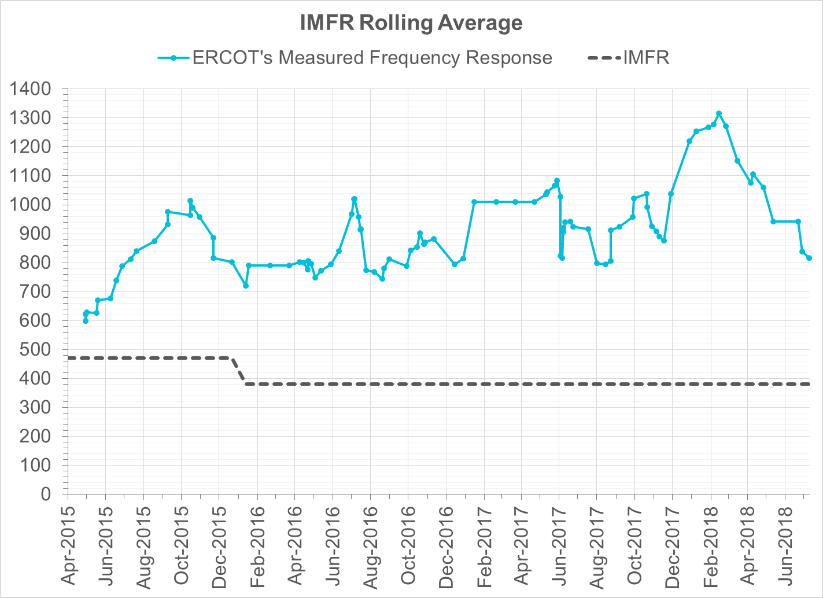
Interconnection Minimum Frequency Response (IMFR) Performance
IMFR Performance currently 815.90 MW/0.1Hz

Slide 9
Frequency Control Report
June 2018

Slide 10
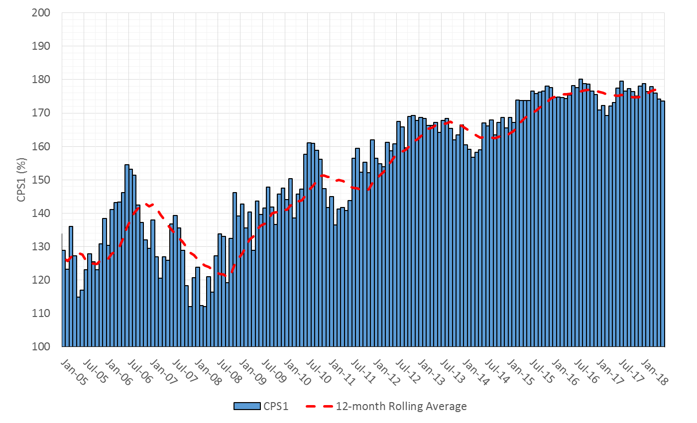

CPS1 Performance

Slide 11
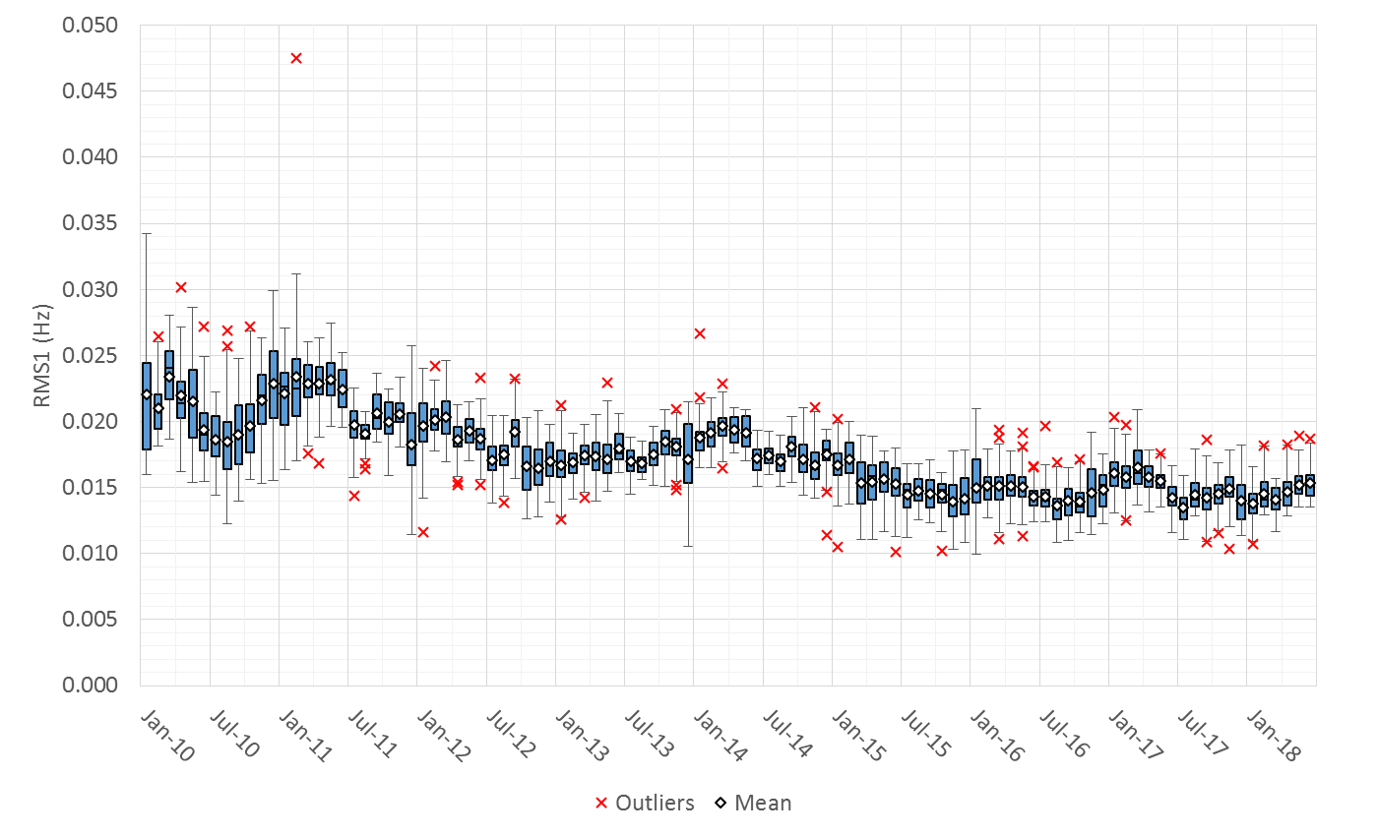
RMS1 Performance of ERCOT Frequency

Slide 12
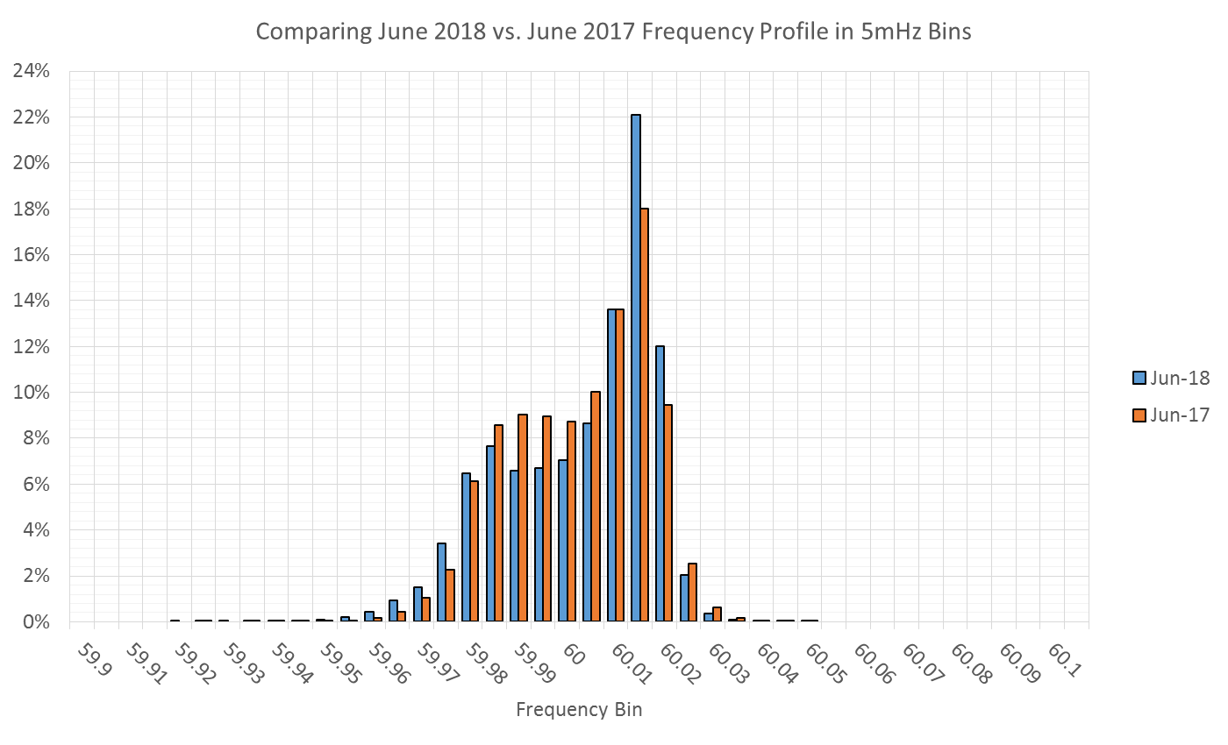
Frequency Profile Analysis

Slide 13
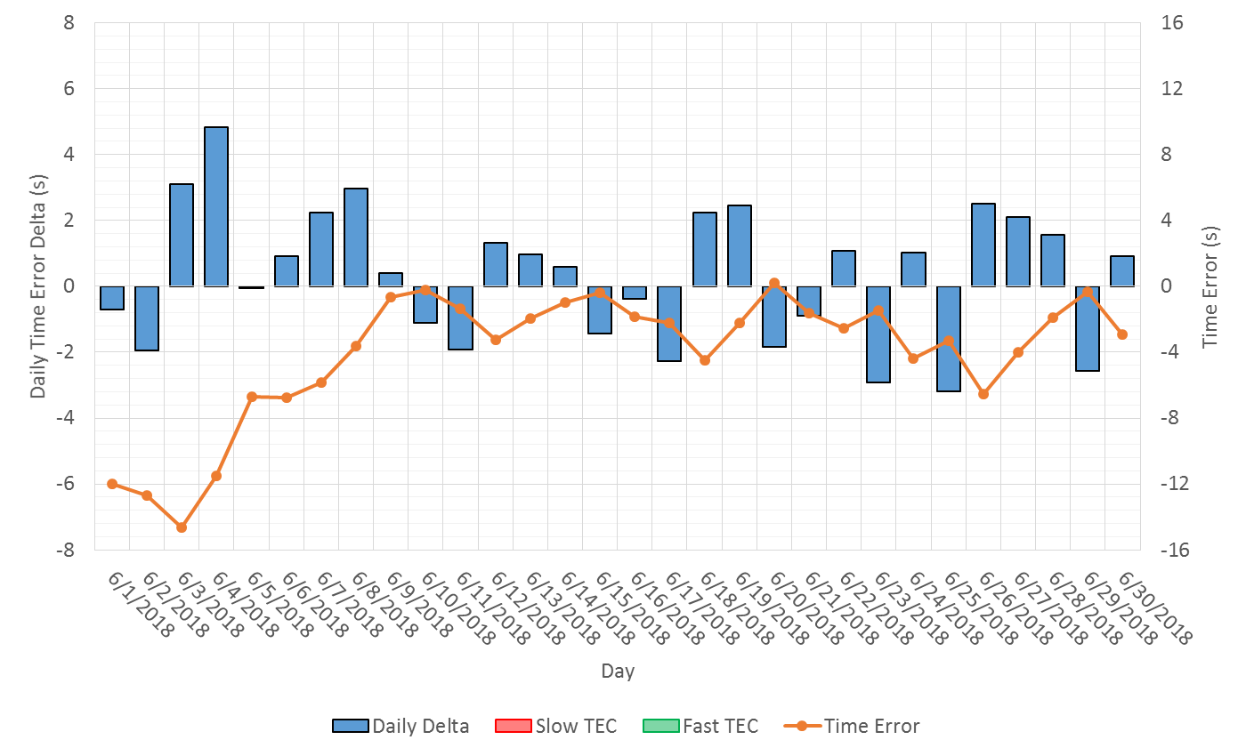
Time Error Corrections

Slide 14
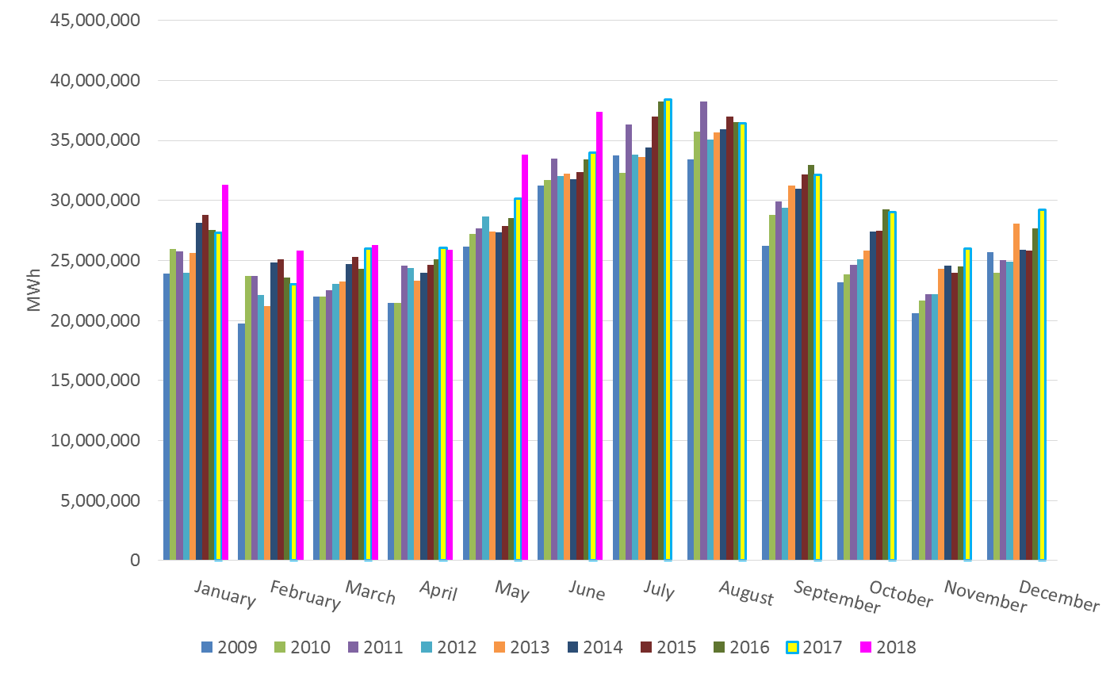
ERCOT Total Energy

Slide 15
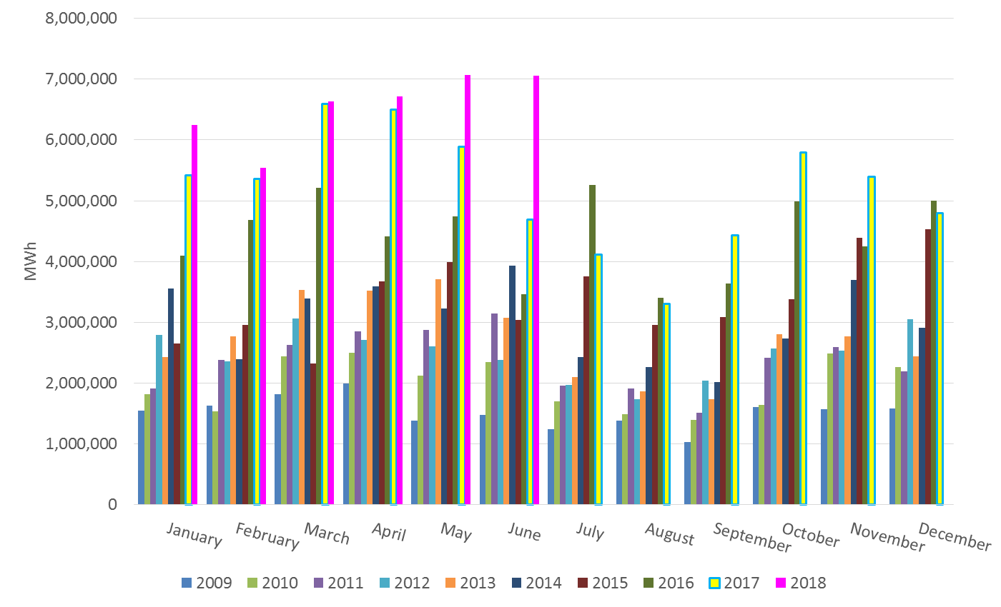
ERCOT Total Energy from Wind Generation

Slide 16
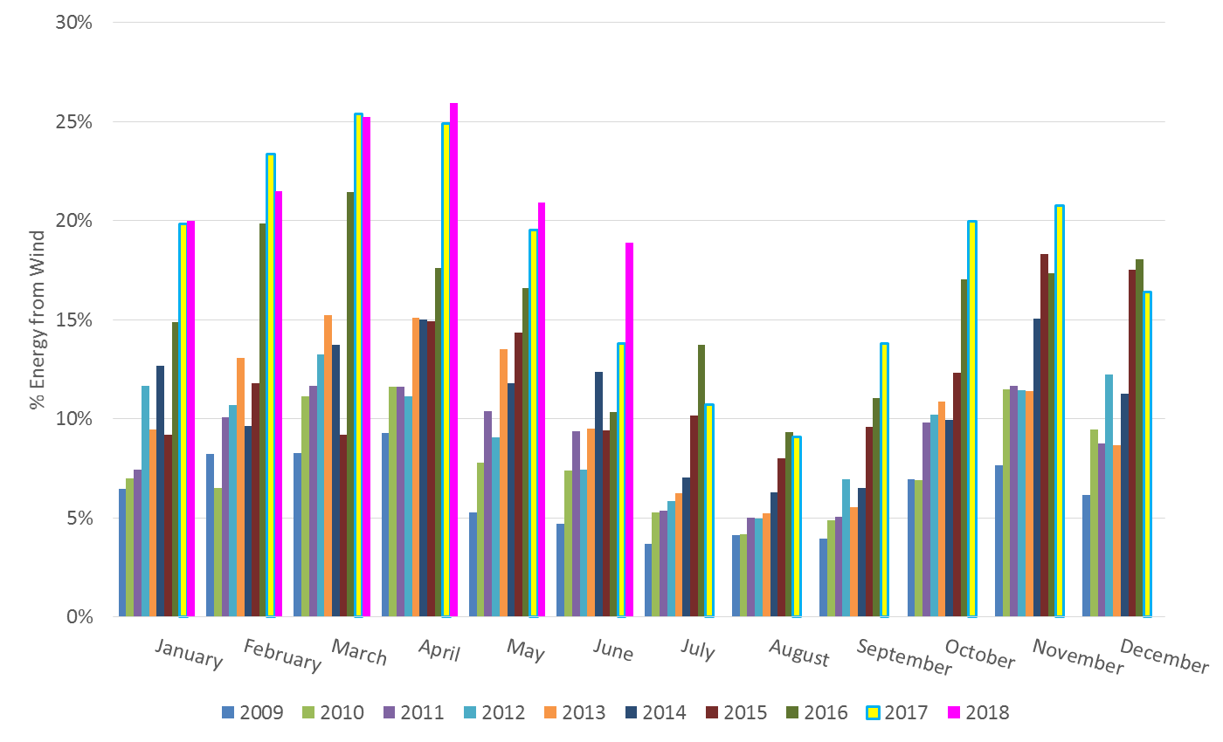
ERCOT % Energy from Wind Generation

Slide 17
Questions?

