Slide 1
MSWG
Update to WMS
08/8/2018

Slide 2
MSWG Meeting 8/8/2018
CRR Balancing Account
    Drivers
      Far west Congestion
      June Model Created in April
      Use of HOT LDF from Last Summer
        Did not reflect Individual Load Growth.
        High Shadow prices

Slide 3
MSWG Meeting 8/8/2018
CRR Balancing Account
18 out of 92 Months Shortfall occurred if Funded from December 2010
Balancing Fund Start Date January 2015
Recommend continuing to Monitor for reoccurrences
Row Labels | # | Shortfall | Sum of Total Paid Out
2010 | 0 |  | $ (3,463,177.97)
2011 | 2 | $ 2,393,920.87 | $ (58,023,230.03)
2012 | 0 | $ - | $ (85,216,933.42)
2013 | 5 | $ 15,787,345.58 | $ 10,549,874.83
2014 | 10 | $ 33,490,658.83 | $ 20,579.85
2015 | 0 | $ - | $ 31,550,530.29
2016 | 0 | $ - | $ 35,236,919.74
2017 | 0 | $ - | $ 95,047,560.55
2018 | 1 | $ 9,325,686.33 | $ 42,038,679.74
Grand Total | 18 | $ 60,997,611.61 | $ 67,740,803.58

Slide 4
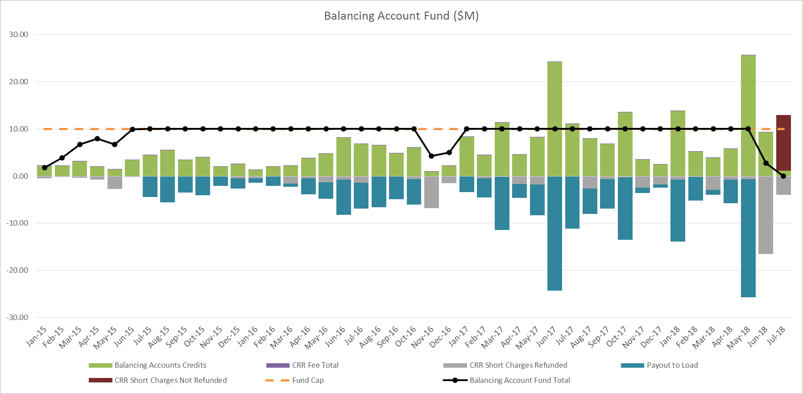
MSWG Meeting 8/8/18

Slide 5
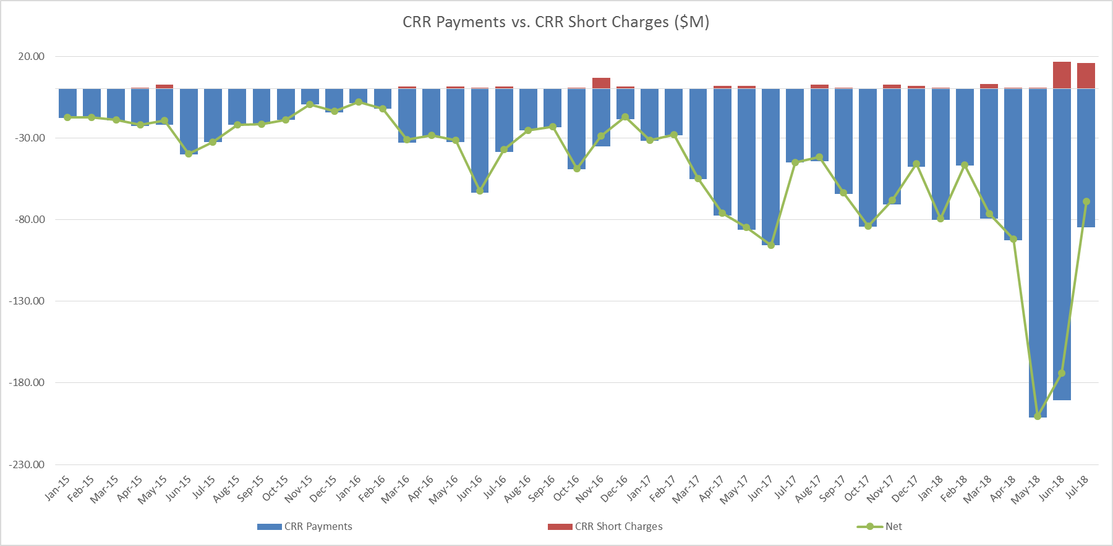
MSWG Meeting 8/8/18
* Data for July 2018 is from July 1-14, 2018

Slide 6
MSWG Meeting 8/8/18
        ON Going Activities
        CRR Balancing Account
          Finalize Language for NPRR.
          Nodal Handbook
          Settlement Stability Report ?
          NPRR884 – Adjustments to Pricing and Settlement for RUC’s of On-line Combined Cycle Generation Resource

Slide 7

Questions?
Next Meeting 8/15/2018 WebEx only

