Slide 1
Market Credit Working Group update to the Wholesale Market Subcommittee
Bill Barnes NRG, Chair
Josephine Wan AE, Vice Chair
08/8/2018

Slide 2
MCWG update to WMS
General Update
July 18th Joint MCWG/CWG Meeting
NPRR850 - Market Suspension and Restart
ERCOT has drafted proposed language to handle collateral requests during the transition from pre- to post-market restart.
Based upon feedback from the CWG, ERCOT has added discretionary language to allow up to two additional days for Market Participants to make payment on any outstanding invoices / collateral calls during a Market Restart.
Credit Working Group is awaiting further comments or feedback from other ERCOT stakeholder working groups prior to filing additional comments.

Slide 3
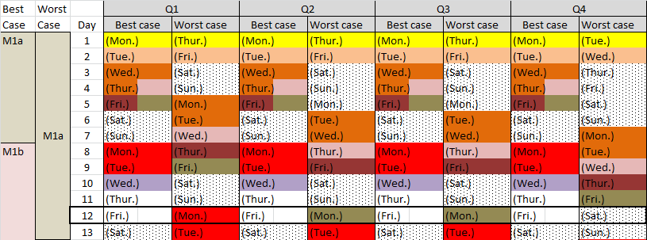
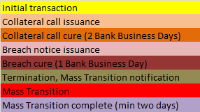
MCWG update to WMS
Credit Parameter Review
Proposed approach:
Decompose M1 into two components:
M1a – Time period required to cover any termination event (12)
M1b – Time period to cover mass transitions only
M1a applicable to all entities; M1b applicable only to Counter-Parties with Load
In M1b, adjust the mass transition days to reflect the decline in potential exposure during the transition period

Slide 4
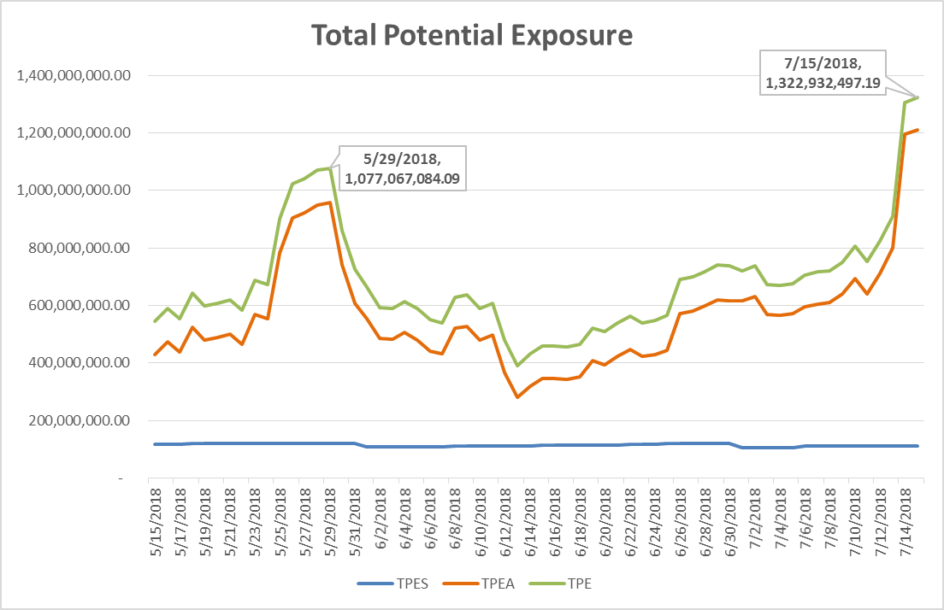
Credit Exposure Update

Slide 5
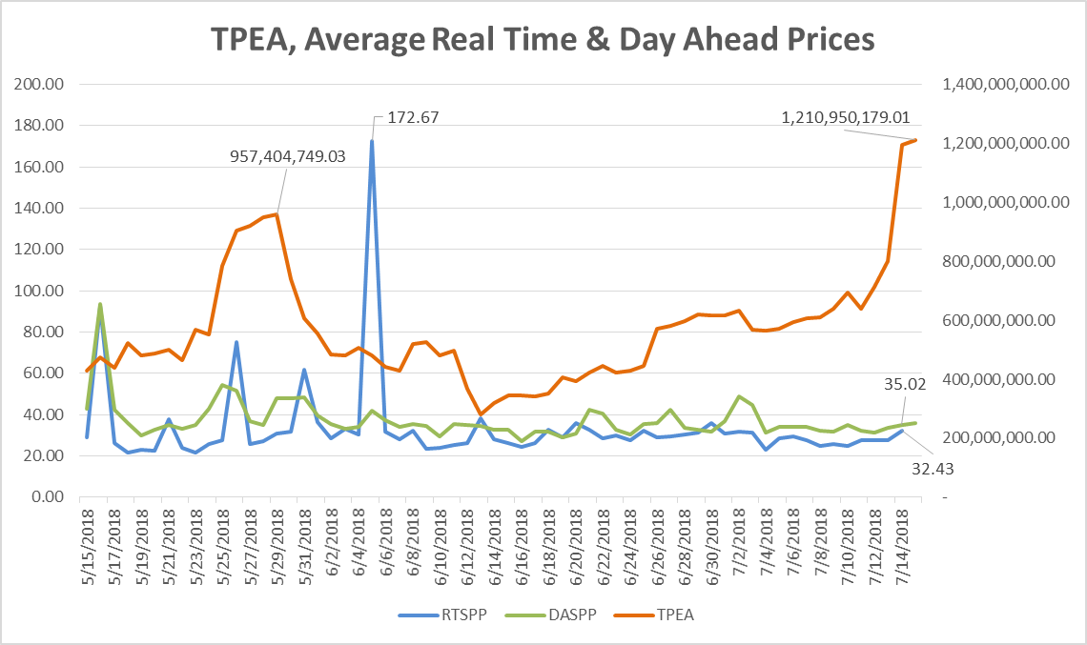
Credit Exposure Update

Slide 6
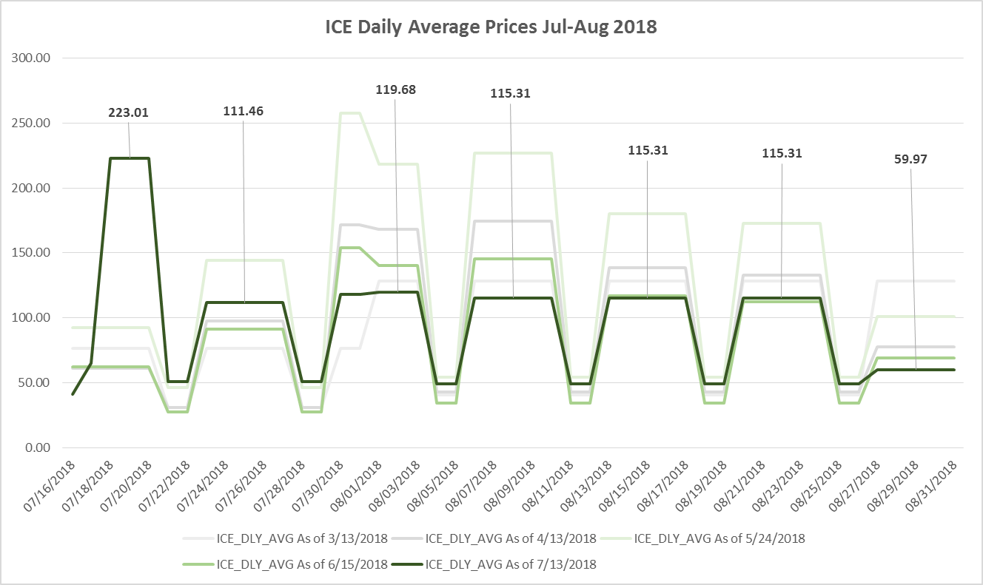
Credit Exposure Update

Slide 7
MCWG update to WMS
Surety Bonds
16.11.3 (c) The Counter-Party may give a surety bond naming ERCOT as the beneficiary.
(i) The surety bond must be signed by a surety acceptable to ERCOT, in its sole discretion and must be in the form of ERCOT’s standard surety bond form approved by the ERCOT Board. No modifications to the form are permitted.
(ii) The surety bond must be issued by an insurance company with a minimum rating of A- with S&P or Fitch or A3 with Moody’s.
(iii) Surety bonds are subject to a limit of $10 million per Counter-Party per insurer and an overall limit of $100 million per insurer for all ERCOT Counter-Parties.
Why limit Surety Bonds?

