Slide 1
Texas
Standard
Electronic
Transactions
Introduction to TX SET

Slide 2

Housekeeping
Restrooms
Refreshments
Attendance sheet
Questions
  Please silence smart phones & other electronics

Slide 3
Antitrust Admonition

Slide 4
Course Objectives
What is TX SET
Where do I find Tools/References
Ho does TX SET work
How is TX SET managed
Notes:
The term Texas SET can refer to two different things.
TX SET (Standard Electronic Transactions) are a set of ANSI EDI transaction guidelines customized by the TX SET Working Group for the ERCOT Retail Market.
These standardized transactions support retail processes as documented in the various ERCOT Market rules.
TX SET is an ERCOT Working group comprised of stakeholders participating in the development and maintenance of TX SET EDI transactions .
The Working Group reports to the Retail Market Subcommittee (RMS) and analyzes the need for new electronic transactions or modifications to existing electronic transactions based upon changes that occur within the retail electric market that affect EDI (electronic data interchange) transaction processing.

Slide 5
1: Introduction

Slide 6
What is TX SET?
Texas Standard Electronic Transactions
Set of ANSI EDI transaction guidelines
facilitates retail business processes
maintained by TX SET working group
Notes:
The term Texas SET can refer to two different things.
TX SET (Standard Electronic Transactions) are a set of ANSI EDI transaction guidelines customized by the TX SET Working Group for the ERCOT Retail Market.
These standardized transactions support retail processes as documented in the various ERCOT Market rules.
TX SET is an ERCOT Working group comprised of stakeholders participating in the development and maintenance of TX SET EDI transactions .
The Working Group reports to the Retail Market Subcommittee (RMS) and analyzes the need for new electronic transactions or modifications to existing electronic transactions based upon changes that occur within the retail electric market that affect EDI (electronic data interchange) transaction processing.

Slide 7
Benefits of TX SET
    Standardization of automated processes
    Improves data quality and efficiency
    Greater transparency
    Improved security
    Allows reporting flex flexibility
    Increased cost savings
Notes:
Why do we have it?
Can you imagine the volumes of transactions per day? (Average daily volume for ERCOT, inbound and outbound, is in excess of 150,000)
Standardization is key!

Slide 8
When are TX SETs used?
To execute Retail market processes
  Move In
  Move Out
  Switch
  Disconnects
  Reconnects
  Updates to premise information
  Updates to customer information
Notes:
TX SET transactions should be used when needing to execute a Retail Market
Process supported by TX SET EDI.
In the event a process cannot be supported by TX SET EDI transactions, the
Market standard method should be used. Please consult the ERCOT Retail Market Guide.
Some of these processes include:
The Safety Net Spreadsheet
MarkeTrak

Slide 9
How are TX SET Delivered
NAESB EDM v1.6
North American Energy Standards Board
Electronic Delivery Mechanism
  Version 1.6 is a National Standard
  Secured computer to computer data protocol
  Modified to fit ERCOT Market
Notes:
TX SET EDI Transactions are securely transmitted through
servers from sender to receiver with the NAESB EDM (Electronic Delivery Mechanism) v1.6 Protocol installed on each server.
This is a protocol with specialized technical enhancements modified to fit the ERCOT retail market.
The NAESB EDM v1.6 is a National Standard maintained by the North American Energy Standards Board.
The ERCOT NAESB EDM v1.6 guideline is managed by the ERCOT Working Group TDTMS (Texas Data Transport and MarkeTrak System).

Slide 10


Transaction Flows
REP’s Customer Information System
TDSP’s Customer Information System
Notes:
TX SET Transactions could potentially follow two paths.
Point to point (REP – TDSP)
Flow through ERCOT

Slide 11
Acronyms
TX SET – Texas Standard Electronic Transactions
PURA – Public Utilities Regulatory Act
PUCT – Public Utility Commission of Texas
ERCOT – Electric Reliability Council of Texas
NAESB – North American Energy Standards Board
MP – Market Participant
ESI ID – Electric Service Identifier

Slide 12
Acronyms
LSE Load Serving Entity
REP Retail Electric Provider
ROR REP of Record
CR Competitive Retailer
TDSP Transmission & Distribution Service Provider
TDU Transmission & Distribution Utility

Slide 13
2: Governing Documents

Slide 14



Hierarchy of Rules
Public Utility Regulatory Act (PURA)
PUCT Substantive Rules
ERCOT Protocols

Slide 15
ERCOT Protocols
Rules/Policies/Standards that govern the ERCOT market
  Created through collaborative efforts
  Outline procedures used by ERCOT and Market Participants (MPs)
  MPs, ERCOT and Independent Market Monitor (IMM) bound by Protocols
Notes:
The Electric Reliability Council of Texas (ERCOT) Protocols, created through the collaborative efforts of representatives of all segments of Market Participants, as amended from time to time, that contains the scheduling, operating, planning, reliability, and Settlement (including Customer registration) policies, rules, guidelines, procedures, standards, and criteria of ERCOT.
These Protocols outline the procedures and processes used by ERCOT and Market Participants for the orderly functioning of the ERCOT system and nodal market.
Market Participants, the Independent Market Monitor (IMM), and ERCOT shall abide by these Protocols.

Slide 16
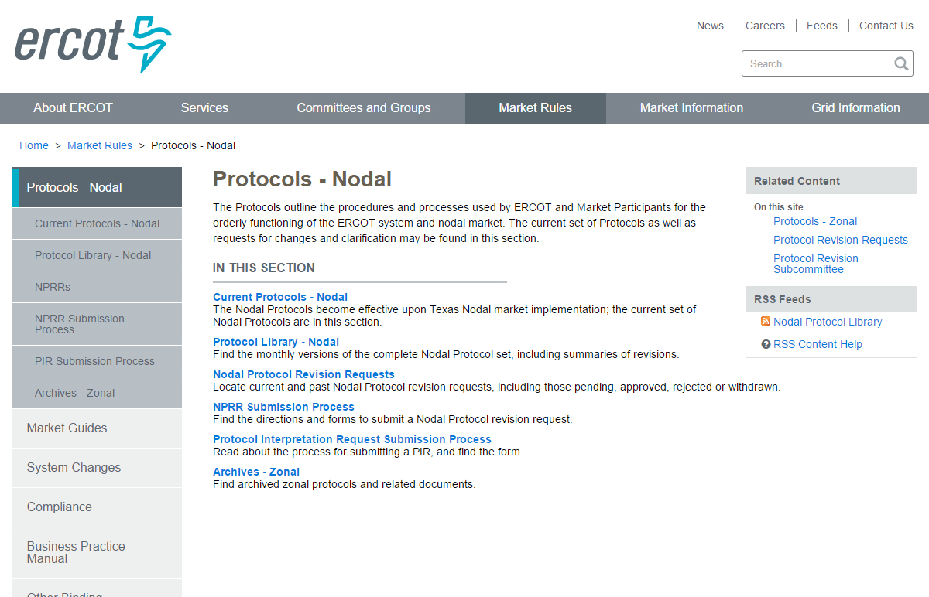
ERCOT Protocols

Slide 17
Relevant ERCOT Protocol Sections
Section 2 – Definitions and Acronyms
Section 9 – Settlements and Billing
Section 10 – Metering
Section 12 – Market Information System
Section 15 – Customer Registration
Section 18 – Load Profiling
Section 19 – Texas Standard Electronic Transaction
Section 21 – Revision Request Process
Section 24 – Retail Point to Point Communications

Slide 18
Section 15 - Customer Registration
ERCOT is the Registration Agent for the Retail Electric Market
ERCOT maintains the Registration Database of all ESI IDs
All Competitive Retailers operating in ERCOT register their customers via TX SET
Notes:
This section provides Market Participants and ERCOT with the market rules and transactional timing when operating in ERCOT’s Retail Electric Market and providing Customer Choice, for example:
ERCOT shall maintain a registration database of all metered and unmetered Electric Service Identifiers (ESI IDs) in Texas for Customer Choice.
All Customer registration processes will be conducted using the appropriate Texas Standard Electronic Transactions (TX SETs). Definitions of all TX SET codes referenced in this Section can be found in Section 19, Texas Standard Electronic Transaction.
All CRs with Customers in Texas, whether operating inside the ERCOT Region or not, shall be required to register their Customers in accordance with this Section.

Slide 19
Section 19 – Texas Standard Electronic Transaction
Transactions between Competitive Retailers (CRs), ERCOT, and Transmission and Distribution Service Providers (TDSPs)
Validation process
TX SET change control process
Retail market testing process
Notes:
Provides the mechanism that enables and facilitates the retail business processes in the deregulated Texas electric market. The Texas SET Implementation Guides shall serve as the standard for the applicable TX SETs among all Market Participants and ERCOT.
This Section shall cover:
Transactions between Transmission and/or Distribution Service Providers (TDSPs) (refers to all TDSPs unless otherwise specified), Competitive Retailers (CRs) and ERCOT;
Technical Advisory Committee (TAC) subcommittee and ERCOT responsibilities; and
Texas SET Change Control process.

Slide 20
Section 24 – Retail Point to Point Communications
Transactions that do not flow through ERCOT
Transactions that go between CRs and TDSPs
  Disconnect/Reconnect
  Suspension of delivery
  Remittance information
Notes:
Point to point communications include transactions flowing directly between Competitive Retailers (CRs), and Transmission and/or Distribution Service Providers (TDSPs) and do not flow through ERCOT. These point to point transactions may be Customer requested service orders and CR/TDSP invoicing and remittance advise transactions.

Slide 21
ERCOT Market Guides
ERCOT Protocols
ERCOT
Market Guides
Other Binding Documents (OBDs)

Slide 22
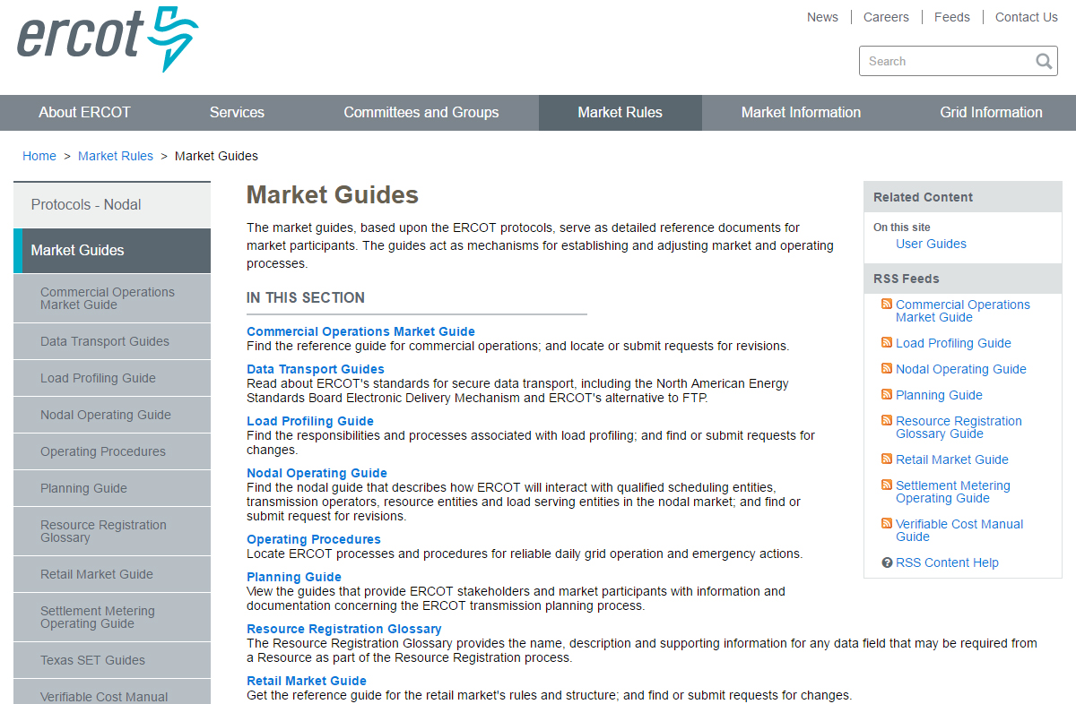
ERCOT Market Guides

Slide 23
ERCOT Retail Market Guide
Section 1 – Purpose
Section 2 – Definitions and Acronyms
Section 3 – Retail Market Guide Revision Process
Section 4 – Public Utility Commission of Texas
Section 5 – Electric Reliability Council of Texas
Section 6 – Retail Market Subcommittee Working Group
Section 7 – Market Processes
Section 8 – Municipally Owned Utilities and Electric Cooperatives
Section 9 – Appendices
Section 10 – Competitive Metering
Section 11 – Solution to Stacking

Slide 24
Section 7 – Market Processes
Section 7.3 – Inadvertent Gain Process
Section 7.4 – Safety Nets
Section 7.5 – Standard Historical Usage Requests
Section 7.6 – Disconnect and Reconnect for Non-Payment Process
Section 7.7 – Transaction Timing Matrix
Section 7.16 – Business Processes and Communications Related to Meter Tampering
Section 7.17 - Business Processes and Communications for Switch Holds Related to Deferred Payment

Slide 25
Appendicies
Section 9 Appendix D1 – Transaction timing Matrix
Section 9 Appendix D3 – TDSP’s Discretionary Service Timelines Matrix
Notes:
Reference protocals section 15

Slide 26
Section 11- Solution to Stacking
  Section 11.1 - Overview of Solution to Stacking
  Section 11.2 - ERCOT Operating Rules
  Section 11.2.2 - Cancellation Rules
    .
  Section 11.2.3 - Concurrent Processing Rules
  Section 11.2.4 - Pending Transaction Rules
  Section 11.3 - Transmission and/or Distribution Service Provider Operating Rules
Section 11.4 - Retail Electric Provider Operating Rules
Notes:
Section 11.1 - Overview of Solution to Stacking
This Section 11, Solution to Stacking, provides the processes and guidelines for Market Participants operating in the Texas retail market to handle multiple non-sequential Texas Standard Electronic Transactions (TX SETs) on a single Electric Service Identifier (ESI ID).
Section 11.2 - ERCOT Operating Rules
The ERCOT Operating Rules describe the process and guidelines utilized by ERCOT to process multiple, non-sequential transactions concurrently on a single Electric Service Identifier (ESI ID).
Section 11.2.2 - Cancellation Rules
These rules detail the circumstances under which ERCOT will cancel existing orders.
Section 11.2.3 - Concurrent Processing Rules
The concurrent processing rules detail the circumstances in which transactions are allowed to complete after being processed concurrently.
Section 11.2.4 - Pending Transaction Rules
These rules detail the methods used for Pending REP Notification Transactions. These rules were developed to ensure that these transactions are sent only when the appropriate recipient can be positively identified.
Section 11.3 - Transmission and/or Distribution Service Provider
Operating Rules
The business rules Transmission and/or Distribution Service Providers (TDSPs) will follow in order to process multiple, non-sequential transactions concurrently on a single Electric Service Identifier (ESI ID).
Section 11.4 - Retail Electric Provider Operating Rules
Retail Electric Providers (REPs), like the Transmission and/or Distribution Service Providers (TDSPs) and ERCOT, will be required to handle multiple, non-sequential transactions on an Electric Service Identifier (ESI ID).

Slide 27
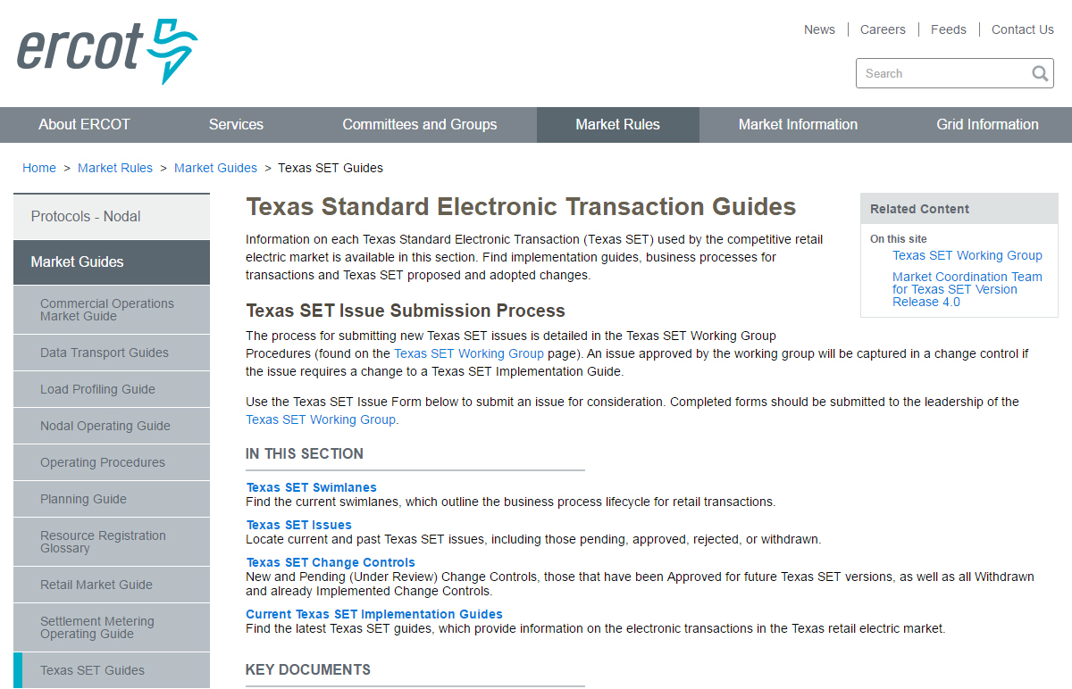
TX SET Guides
Notes:
But for quick reference, there is also a Transaction Name Inventory posted on ERCOT.com, complete with a handy pocket card. We printed and laminated pocket cards to give you here today. We hope that you will find them as useful as we do. We also hope that you will use them in the upcoming class scenarios!

Slide 28

Texas SET Swimlanes
Texas Standard Electronic Transaction (SET) swimlanes are reference documents that outline the business process lifecycle for transactions used in the competitive retail electric market in Texas.
http://ercot.com/mktrules/guides/txset/sw

Slide 29
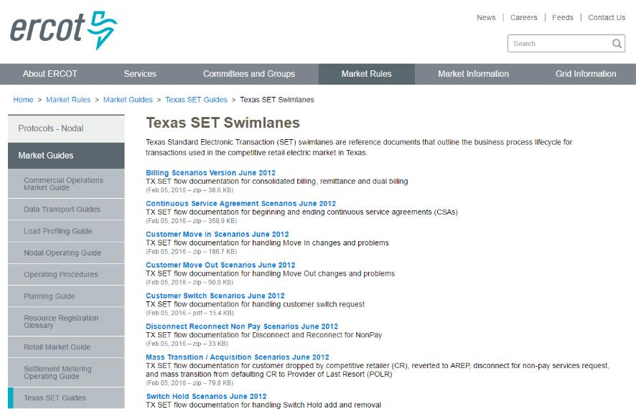
TX SET Swimlanes

Slide 30
Texas SET Implementation Guides (IG)
Provide details of information contained within the electronic transactions used in the competitive retail electric market in Texas.
The current Version 4.0 of the Texas SET Implementation Guides contains updates to retail transactions to support update to PUC Substantive Rules and Outstanding Change Controls
http://ercot.com/mktrules/guides/txset/current

Slide 31
3: Transactions

Slide 32

Overview of transaction flow
824
810
TDSP
CR
814
814
824
824
867
867
650
820
650 – Service Orders
814 – Customer Information (Switches)
824 – Application Advice
810 – Invoice
820 – Payment Order/Response or
Confirmation Advice
867 – Usage
Notes:
Moved up two slides

Slide 33
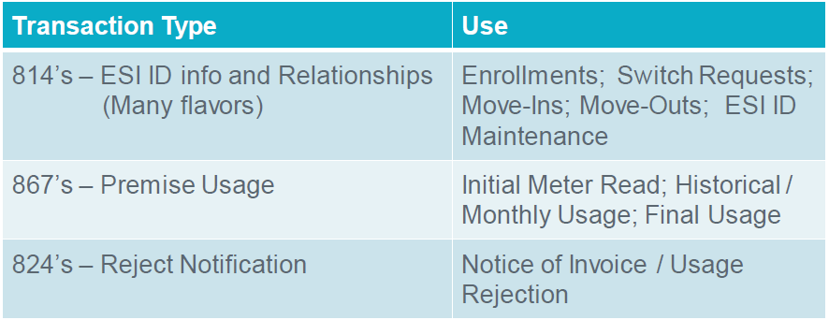
Texas Standard Electronic Transactions (TX SET) – Interactive
Many transactions involve ERCOT
These transactions flow through the ERCOT clearinghouse as the registration agent.

Slide 34
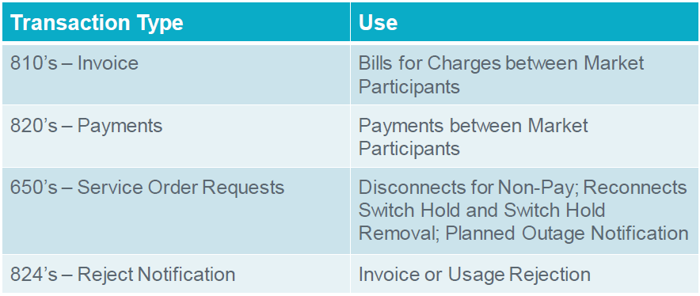
Texas Standard Electronic Transactions (TX SET) – Interactive
Some transactions may not involve ERCOT
These are called Point-to-Point transactions and flow between TDSPs and REPs

Slide 35
Transaction Names
TX SET Version 4.0 – Transaction Names Inventory
  Refer to handout
  Defines the transaction name for each transaction
  Describes how the document flows

Slide 36
Transaction Names
TX SET Version 4.0 – Transaction Names Inventory

Slide 37
Transaction Names
TX SET Version 4.0 – Transaction Names Inventory

Slide 38
Transaction Names
TX SET Version 4.0 – Transaction Names Inventory

Slide 39
Checkpoint Questions – Exercise #1
Which transactions are customer initiated transactions? Select all that apply.
  814_16 ____________
  814_01 ____________
  814_08 ____________
  814_24 ____________
Response transactions can only be Rejects (True/False) _____________________
A point-to-point transaction is sent only to ERCOT. (True/False) ___________________

Slide 40
Checkpoint Questions – Exercise #1 – continued
Historical Usage (867_02) can be obtained by sending which transactions? Select all that apply.
  814-01 _____________
  814-16 _____________
  814-22 _____________
  814-26 _____________
What transaction is used to determine the actual start date for a customer? Select only one.
  814_04 ______________
  814_16 ______________
  867_04 ______________
  814_01 ______________

Slide 41
4: Transaction Process Flow

Slide 42
Move In – Reject
814_16 (MVI)
New CR
1
ERCOT
814_17 (only a reject)
2

Slide 43
Move In – Accept
814_16
814_03
New CR
1
ERCOT
2
TDSP
814_05
814_04
4
3
867_02
867_02
6
5
867_04
867_04
8
7

Slide 44
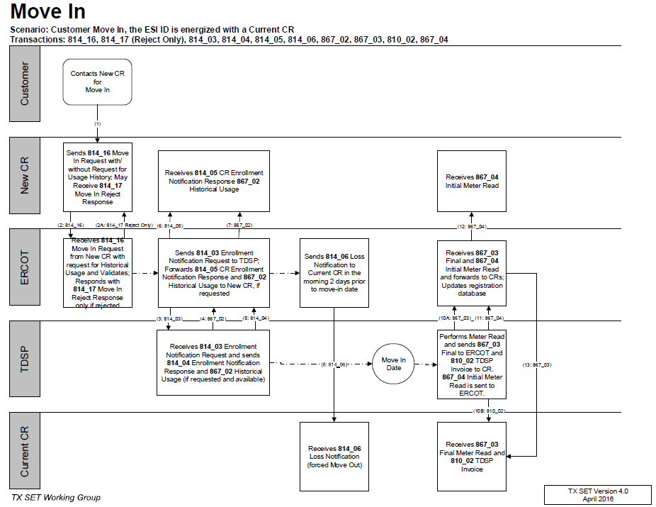
TxSET Swimlanes
Move In w/ Accept/Reject

Slide 45
Move In w/ Permit Required – New Installation
814_16
814_03
New CR
1
ERCOT
2
TDSP
814_28
814_28
4
3
Customer sends permit to TDSP
814_05
814_04
6
5
867_04
867_04
8
7

Slide 46
Move In w/ Permit Not Received
814_16
814_03
New CR
1
ERCOT
2
TDSP
814_28
814_28
4
3
Customer does not send permit to TDSP within 20 days
814_08
5
814_08
814_09
7
6

Slide 47
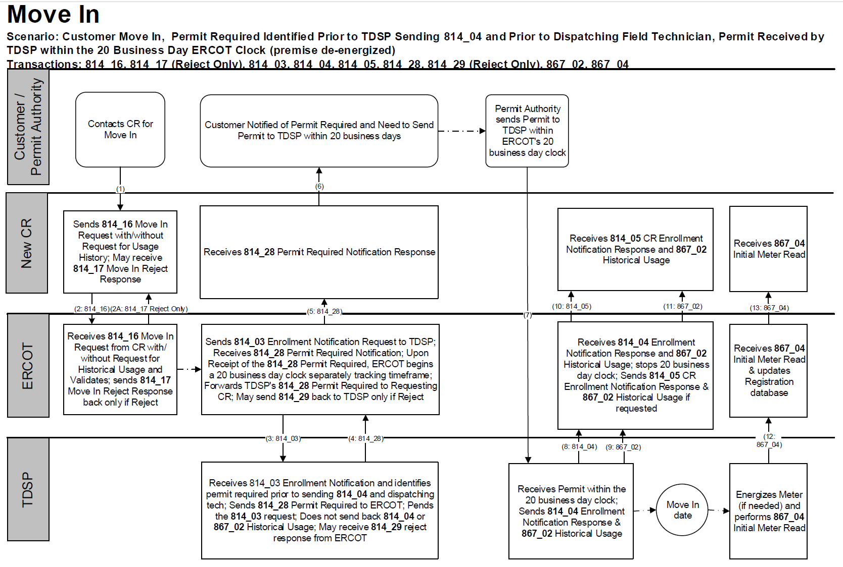
TxSET Swimlanes
Move In w/ Permit Required

Slide 48
Move In w/ Date Change followed by Cancel
814_16 7/5
814_03
New CR
1
ERCOT
2
TDSP
814_05 7/5
814_04 7/5
4
3
867_02
11
14
867_02
6
5
814_12 7/7
814_12 7/7
SPLIT INTO TWO
7
8
814_13 7/7
814_13 7/7
10
9
814_08
814_18
12
13
814_06
Current CR
814_08

Slide 49
Move In w/ Cancel
814_16
814_03
New CR
1
ERCOT
2
TDSP
814_05
814_04
4
3
867_02
867_02
6
5
814_08
814_08
Customer cancels MVU
7
8
814_09
814_09
10
9
Current CR

Slide 50
Move In w/ Date Change
814_16
814_03
New CR
1
ERCOT
2
TDSP
814_05
814_04
4
3
867_02
11
15
867_02
16
6
5
814_12
814_12
Customer changes MVI date
7
8
814_13
814_13
10
9
867_04
867_04
13
12
867_03
14
814_06
Current CR
867_03
810_02

Slide 51
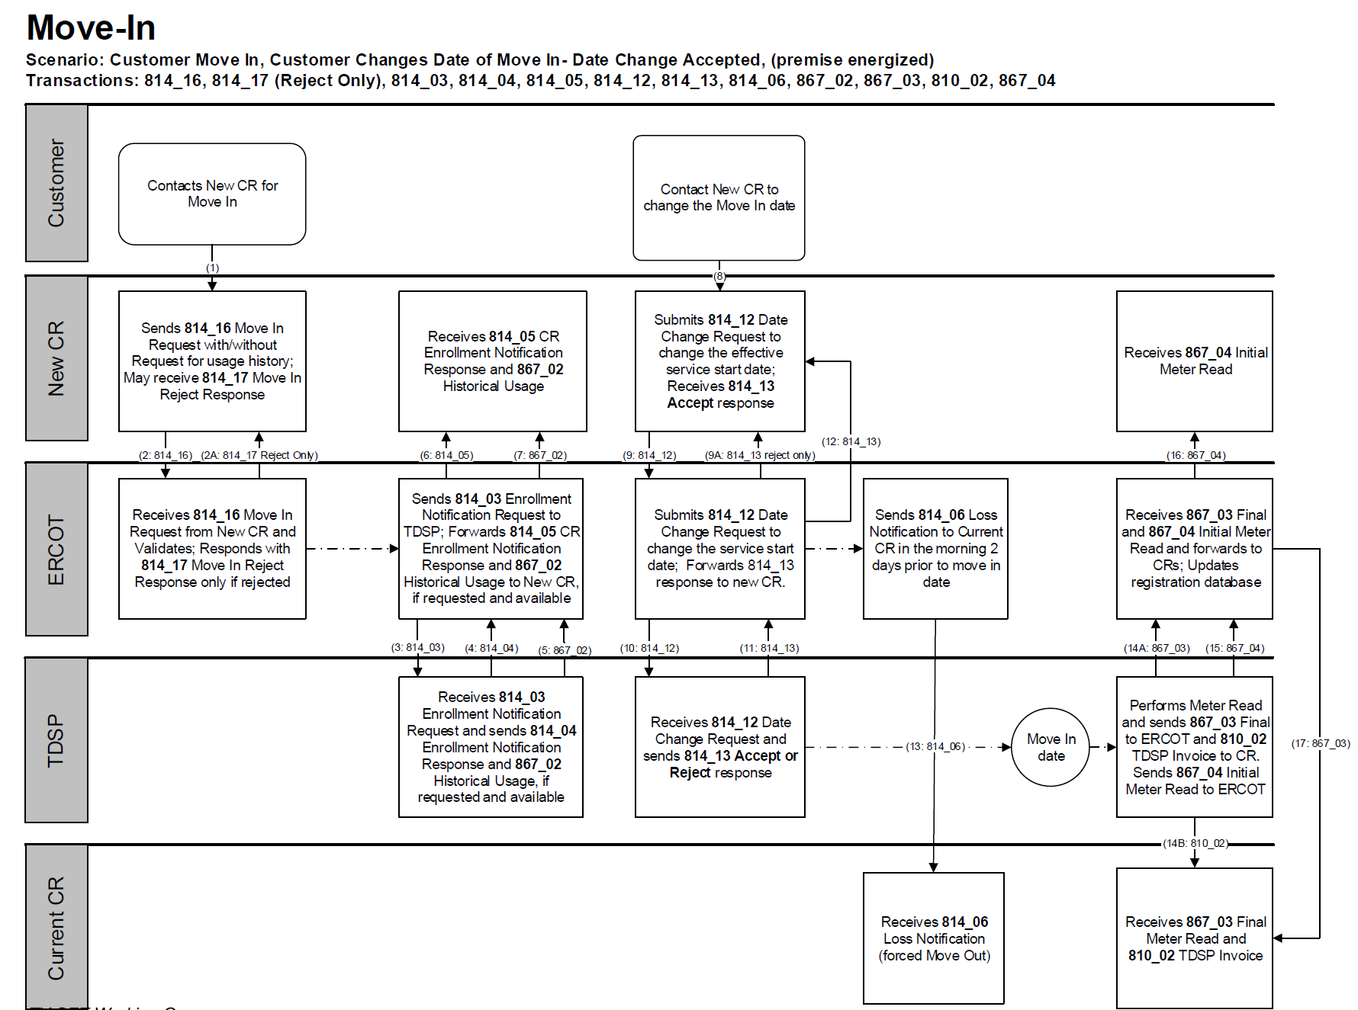
TxSET Swimlanes
Move In w/ Date Change & Cancel

Slide 52
Checkpoint Exercise #2
A date change transaction (814_12) is sent to change the date for which transactions? Select all that apply.
  814_08 __________ d) 867_03F ______________
  814_24 __________ e) 814_05 ______________
  814_18 __________ f) 814_16 ______________
What transaction does the TDSP receive when an 814_01 or 814_16 is initiated? Select only one.
  867_04 _____________
  814_03 _____________
  867_03 _____________
  814_04 _____________

Slide 53
Checkpoint Exercise #2 - continued
A Customer Loss (814_06) transaction can “forced move out” or “customer switch” an existing customer. (True/False) ___________________
If a MVI order is submitted and an 814_28 PR is received, does it cancel the original MVI order? (Yes/No) ____________________
If a MVI order is submitted and an 814_28 PR is received and then later an 814_08 is received should we receive an 867_04? (Yes/No) ______________________
Based on the scenario in item 13, should we expect this customer to be with the submitting CR? (Yes/No) ____________________

Slide 54
Switch – Approved
814_01
814_03
New CR
1
ERCOT
2
TDSP
814_05
814_04
4
3
867_02
5
11
867_02
12
7
6
867_04
867_04
9
8
867_03F
10
814_06
Current CR
867_03F
810_02

Slide 55
Switch – Rejected
814_01
New CR
1
ERCOT
TDSP
814_02
2
Current CR

Slide 56
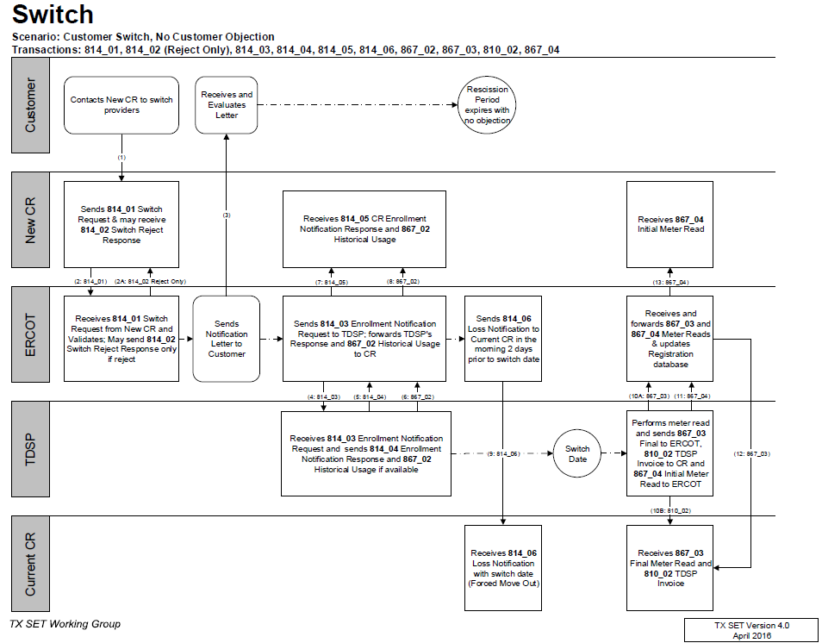
TxSET Swimlanes
Switch – Reject & Accept

Slide 57
Switch Hold – Add – Deferred Payment Plan (DPP)
650_01 (add)
650_02 (acknowledgement)
1
814_20
814_20
2
Current CR
4
ERCOT
3
TDSP
814_21
5

Slide 58
Switch Hold – Remove – DPP / Tampering
650_01 (remove)
650_02 (acknowledgement)
1
814_20
814_20
2
Current CR
4
ERCOT
3
TDSP
814_21
5

Slide 59
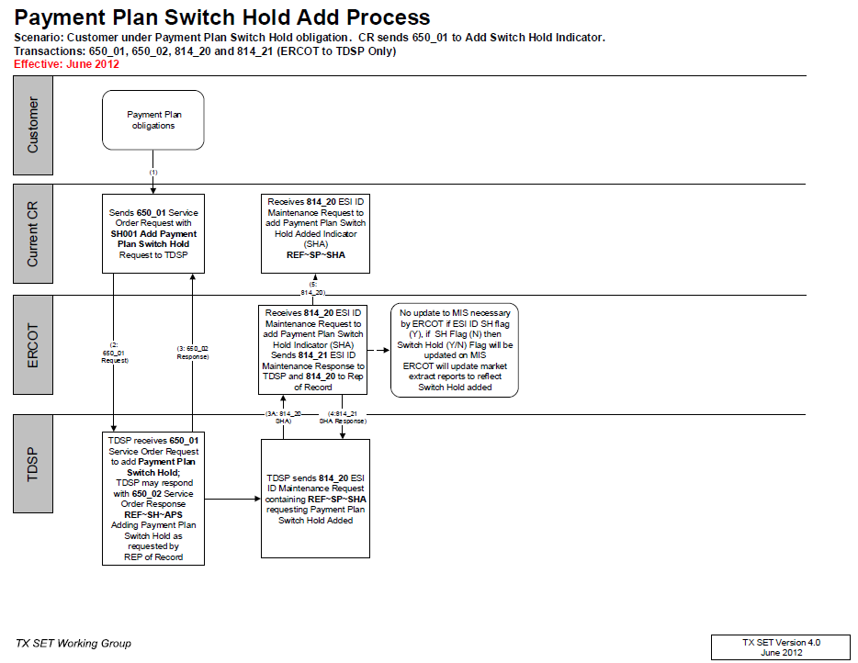
TxSET Swimlanes
Switch Hold – Add DPP

Slide 60
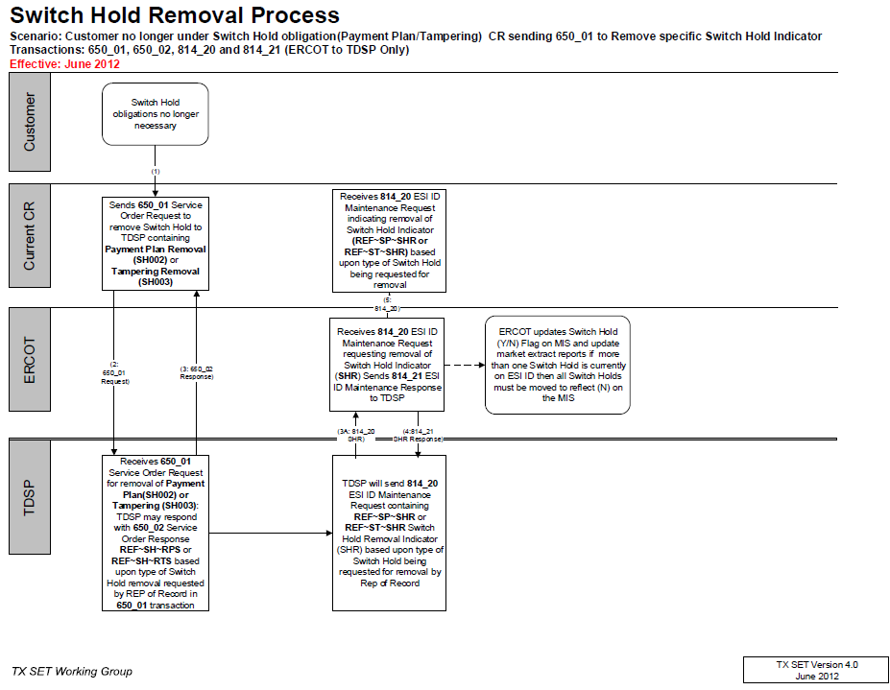
TxSET Swimlanes
Switch Hold – Remove - DPPs

Slide 61
Switch Hold – Add - Tampering
650_02 (tampering)
814_20
814_20
4
Current CR
2
ERCOT
1
TDSP
814_21
3

Slide 62
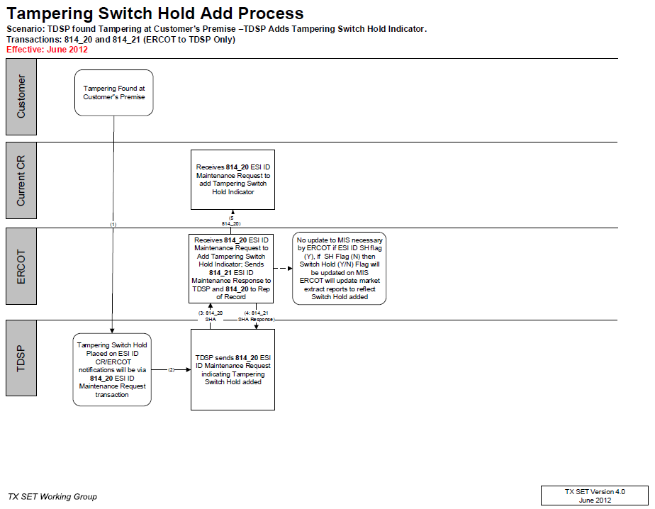
TxSET Swimlanes
Switch Hold – Add - Tampering

Slide 63
Switch w/ Switch Hold
814_01
814_03
New CR
1
ERCOT
2
TDSP
814_05R
814_04R
4
3

Slide 64
Checkpoint Questions – Exercise #3
A Customer Loss (814_06) transaction is sent to which entity? Select only one.
  Current Rep of Record _______________
  TDSP _______________
  ERCOT _______________
  New CR _______________
The 814_04 / 814_05 provides meter details and scheduling. (True/False) _________________

Slide 65
Move Out – Reject
814_24
Current CR
1
ERCOT
TDSP
814_25R
2

Slide 66
Move Out – Accept
810_02
814_24
814_24
7
Current CR
1
ERCOT
2
TDSP
814_25
814_25
4
3
867_03F
867_03F
6
5

Slide 67
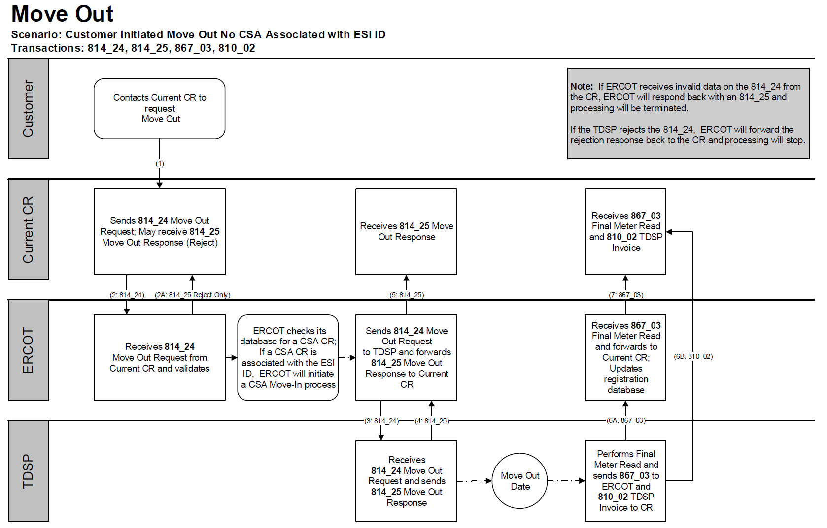
TxSET Swimlanes
Move Out – Reject & Accept (ERCOT)

Slide 68
Transaction Solution to Stacking
11.4.1 REP Operating Rule 1: Cancel Move Out
REPs who have a Pending move out and submit a move in (same REP) with an earlier Requested Date are responsible for canceling the Pending move out if that is what the Customer requires (REP manages Customer expectations). If the REP does not cancel the move out, the move out will be allowed to effectuate.
10/5 MVI
New Customer
10/9 MVO Existing Customer
10/8
10/7
10/6
MVO transaction from existing customer has left new customer in the dark.
If a REP enrolls a new customer at the same premise and an existing customer has a future dated MVO, if the REP fails to cancel the future dated MVO, the MVO will be executed leaving the new customer in the dark.

Slide 69
Transaction Solution to Stacking
MVO Trumps SWI
ERCOT will reject a Switch Request if the ESI ID is scheduled to be De-energized at ERCOT on the Requested Date.
12/1 MVO
CR A
12/2
12/4 SWI
CR B
12/3
CR B will need to submit a MVI (814_16) in order to enroll their customer.

Slide 70
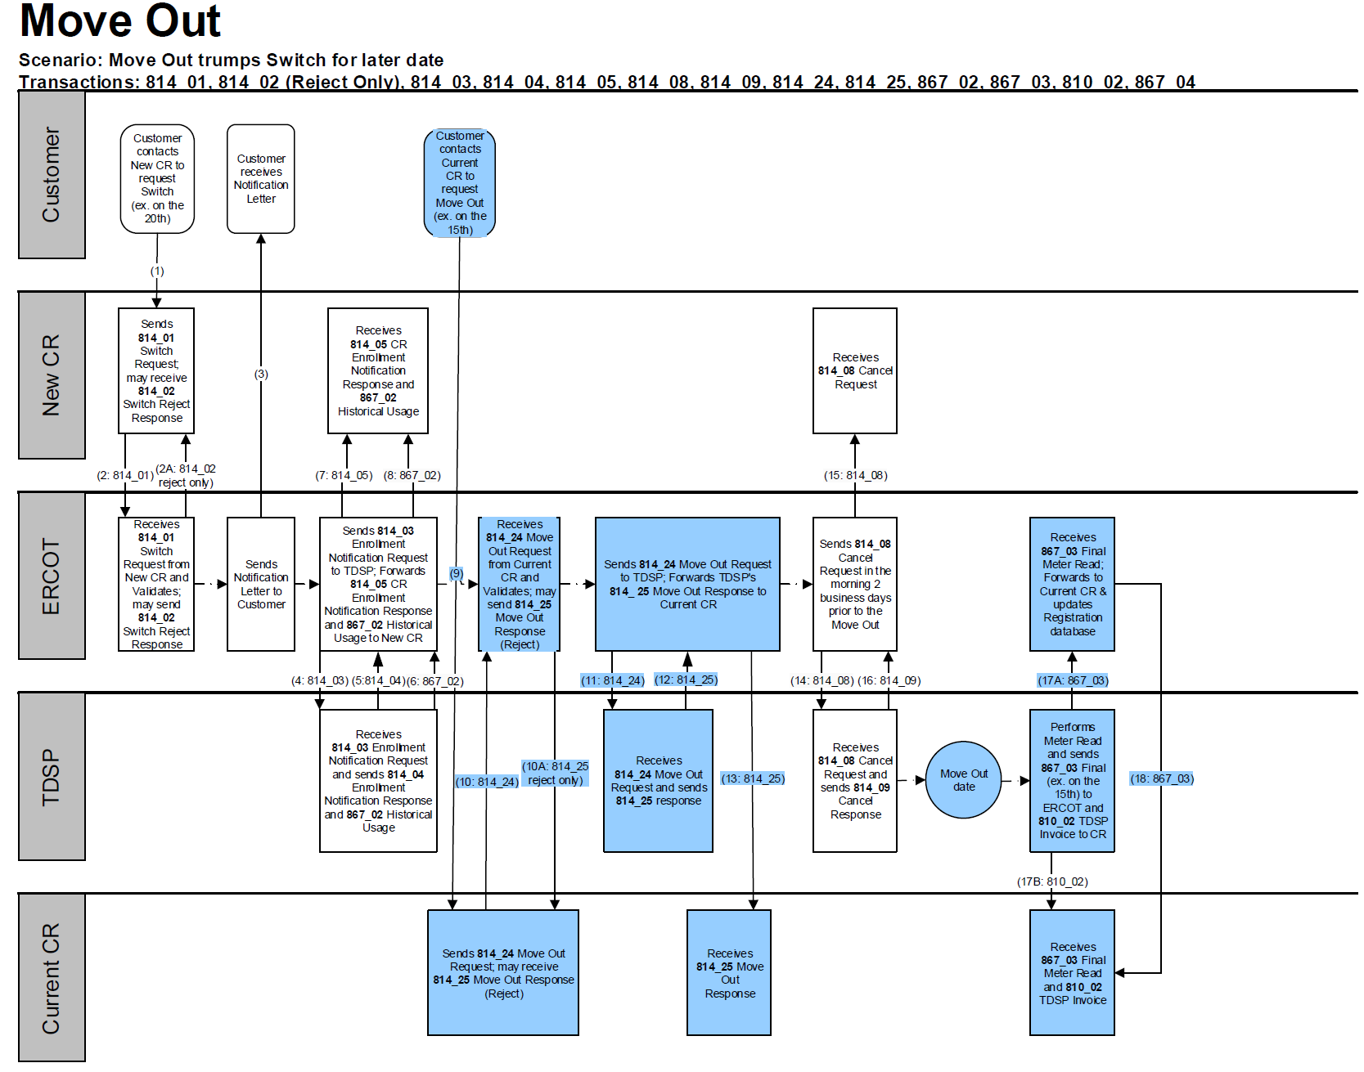
TxSET Swimlanes
Move Out w/ Future dated Switch

Slide 71
Checkpoint Exercise #4
Which entity would receive an 814_17 Not First In (NFI) reject after a same day MVI is submitted in the morning by CR “A” and then another same day MVI is submitted in the afternoon by CR “B”?
  TDSP ______________
  ERCOT ______________
  CR A ______________
  CR B ______________

Slide 72
Checkpoint Exercise #4 - continued
If a Switch Hold exists on an ESIID, a MVO transaction (814_24) will automatically reject (True/False) ________
If a MVO order is submitted and an 814_28 CU is received from the TDSP, does the customer receive a final bill? (Yes/No) ____________________
An 814_16 MVI trumps an 814_24 MVO for the same day when they are from two different REPs. (True/False) _______________________________
An 814_16 MVI trumps an 814_24 MVO for the same day when they are from the same REP. (True/False) _______________________________
An 814_24 MVO trumps an 814_01 Switch. (True/False) ___________________

Slide 73
Checkpoint Exercise #4 - continued
Which entity is responsible for sending an 814_08 cancel when there is a MVO for customer “A” pending for 5/5 and a MVI for customer “B” pending for 5/1, both with the current REP? Select only one.
  TDSP ______________
  ERCOT ______________
  Current REP ______________
  Another REP __________

Slide 74
Checkpoint Exercise #4 - continued
Which entity is responsible for sending an 814_08 cancel when there is a MVO for customer “A” pending for 5/5 and a MVI for customer “B” pending for 5/5 both with different REPs? Select only one.
  TDSP ______________
  ERCOT ______________
  Current REP ___________
  Another REP __________

Slide 75
Checkpoint Exercise #4 - continued
What transaction is used to determine the actual end date of a customer? Select only one.
  814_24 ______________
  814_01 ______________
  867_03F ______________
  814_22 ______________

Slide 76
Move Out to CSA
814_22
814_03
5
ERCOT
2
TDSP
CSA CR
867_04
814_04
9
3
4
7
10
867_03
6
867_04
8
814_25
814_24
Current CR
1
867_03
810_02

Slide 77
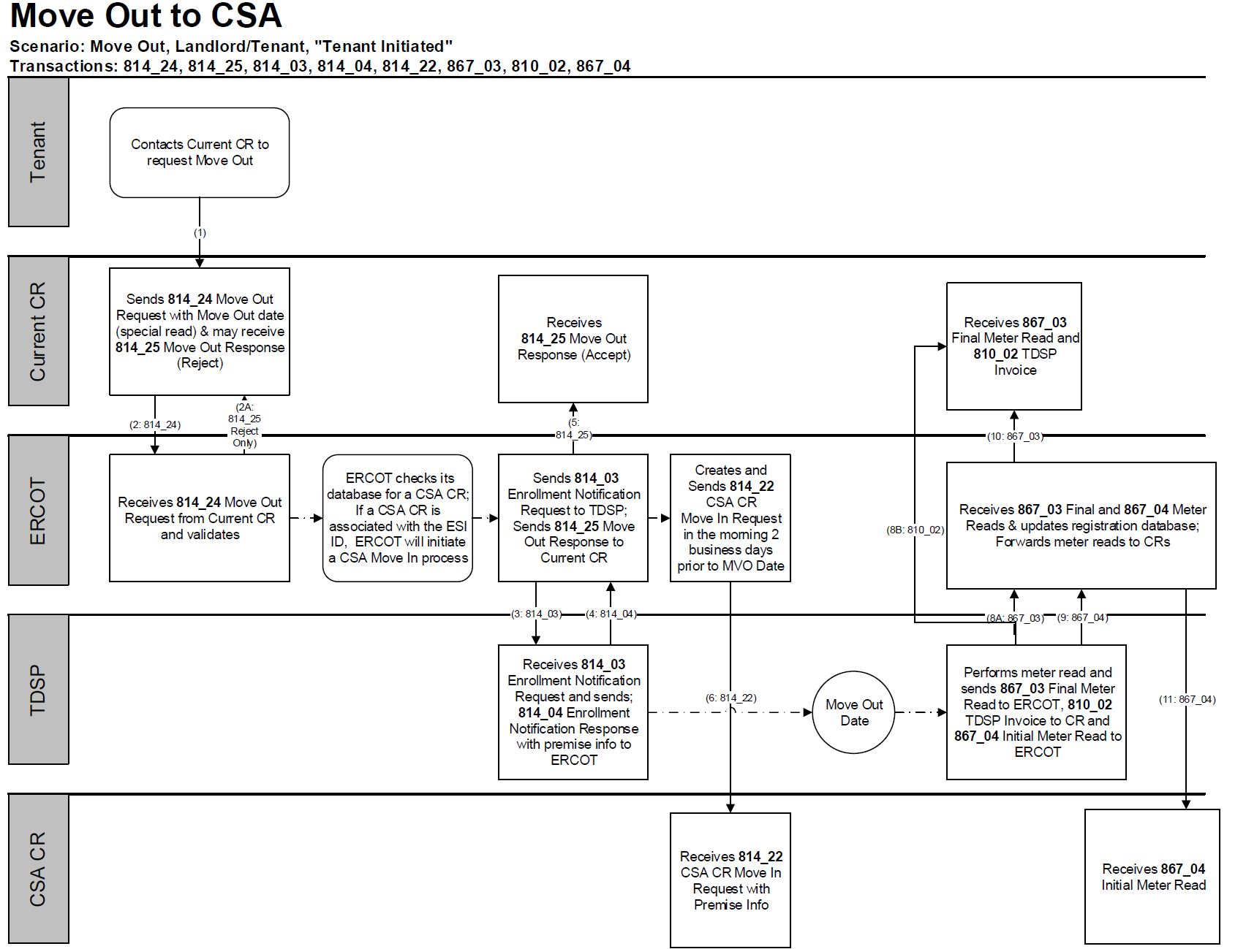
TxSET Swimlanes
Move Out to CSA

Slide 78
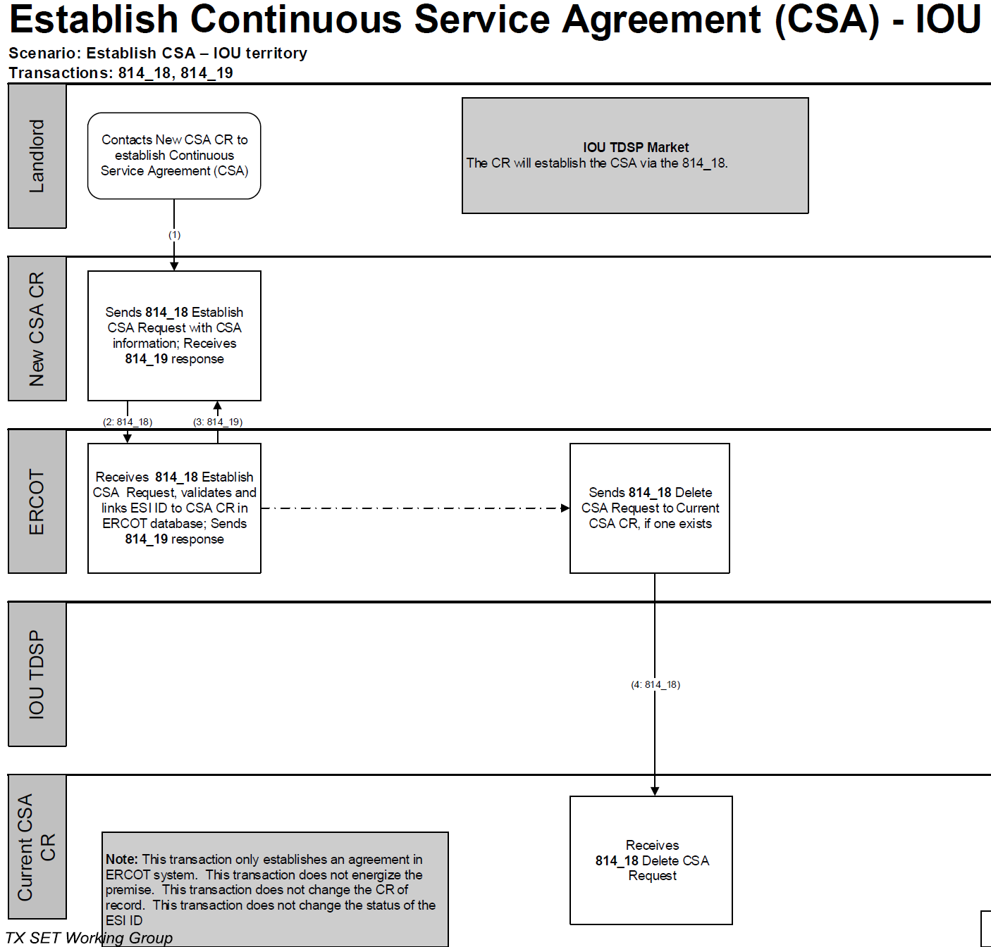
TxSET Swimlanes
Continuous Service Agreement (CSA) – Add & Delete

Slide 79
Checkpoint Exercise #5
What does CSA mean? Select only one.
  Continuous Service Arrangement ____________
  Continued Service Arrangement ____________
  Continuous Service Agreement ____________
  Country Served Agreement ____________
If there is a Continuous Service Agreement and the customer moves out what transaction places the service back with the CSA? Select only one.
  867_04 ______________
  814_18 _______________
  814_01 _______________
  814_22 _______________

Slide 80
Disconnect for Non-Pay (DNP)*
650_01
650_02
1
2
Current CR
ERCOT
TDSP
* Applies to competitive area only

Slide 81
Reconnect after DNP*
650_01
650_02
1
2
Current CR
ERCOT
TDSP
* Applies to competitive area only

Slide 82
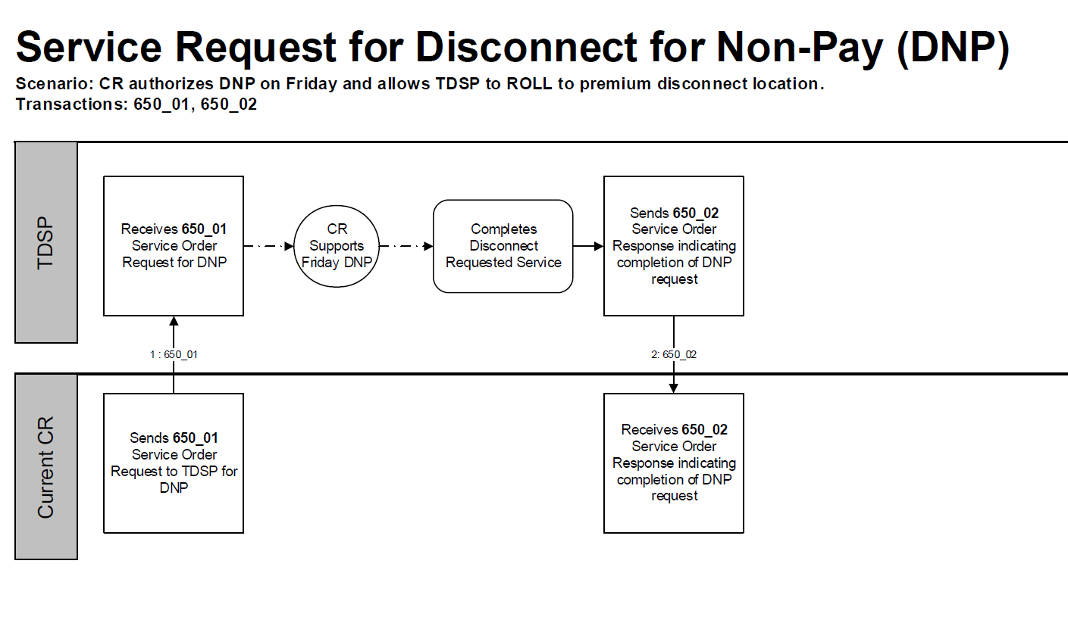
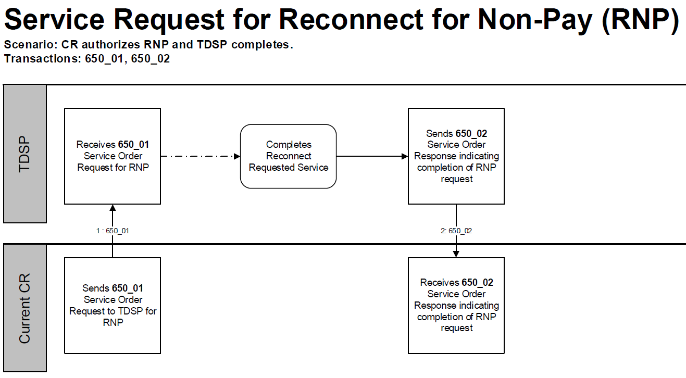
TxSET Swimlanes
Disconnect for Non-Pay (DNP)
Reconnect after DNP

Slide 83
Checkpoint Exercise #6
In order to cancel a DNP (650-01), which transaction is needed?
  650-02 ________________
  814-08 ________________
  650-01 ________________
  814-16________________

Slide 84
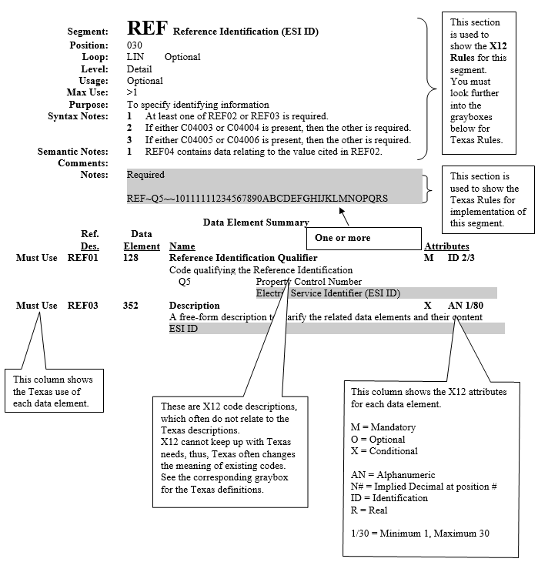
TX SET Implementation Guides w/ Examples
814_20 EDI transaction guide

Slide 85
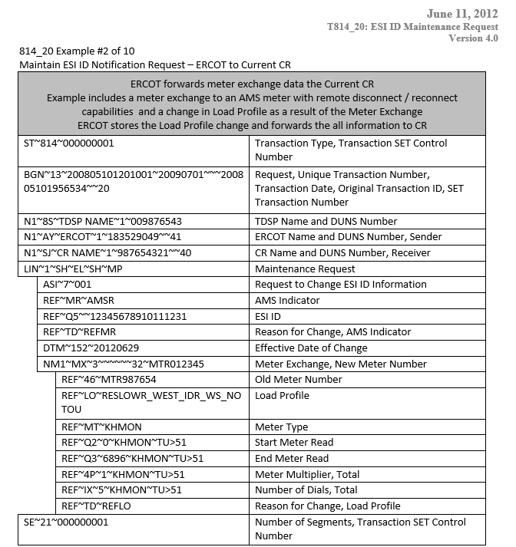
TX SET Implementation Guides w/ Examples
814_20 EDI transaction example – meter exchange

Slide 86
Electronic Data Interface (EDI) Transactions
Example of an 814_20 EDI transaction
EDI code is translated by each Market Participant’s system into a readable format.
One does not have to know the code to understand the transaction

Slide 87
Checkpoint Exercise #7
Which transaction changes the meter and/or meter information? Select only one.
  814_09 _______________
  814_18 _______________
  814_26 _______________
  814_20 _______________

Slide 88
5: MIS Portal

Slide 89
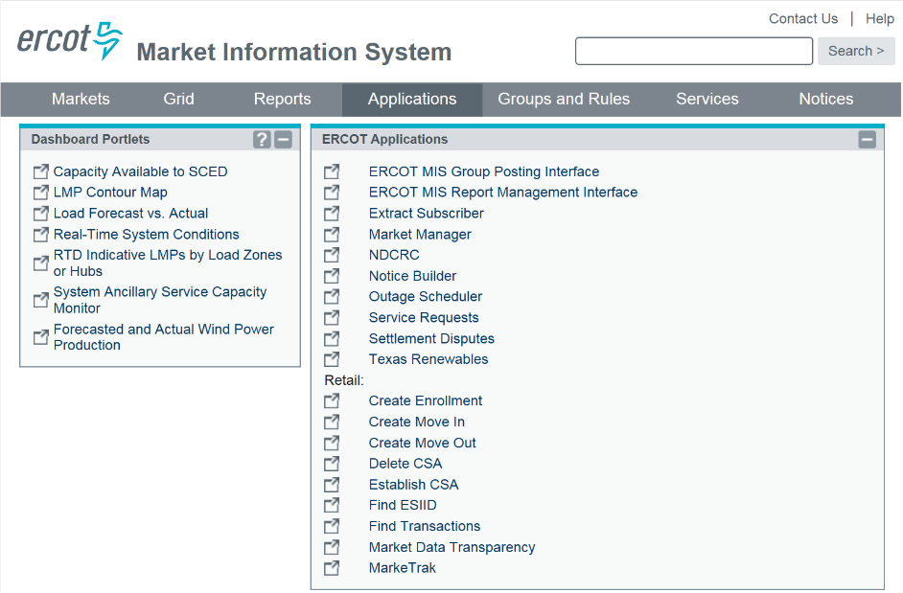
Market Information System

Slide 90
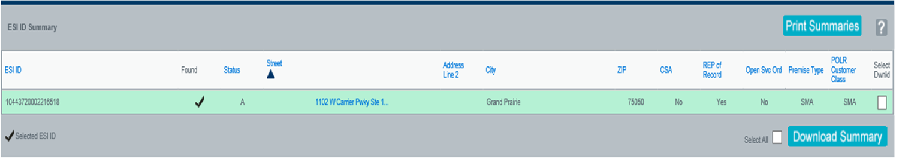
Find ESI ID
STATUS
A – Active
D – Deenergized
I - Inactive
REP of Record
Is the view the ROR?
Premise Type
RES – Residential
SMA – Small Non-Res
LAR – Large Non-Res
CSA
Does this ESI ID have a Continuous Service Agreement?
Open Svc Ord
Are there any current ‘open’ transactions on this ESI ID such as a pending MVO, MVI, etc?
POLR Customer Class
Calculated ERCOT POLR customer classes:
RES – Residential
SMA – Small Non-Res
MED – Medium Non-Res
LAR – Large Non-Res

Slide 91
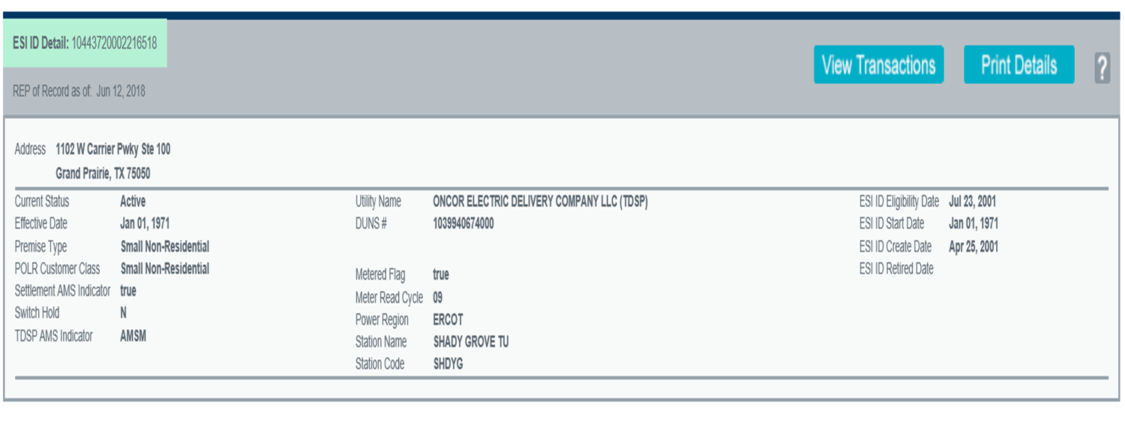

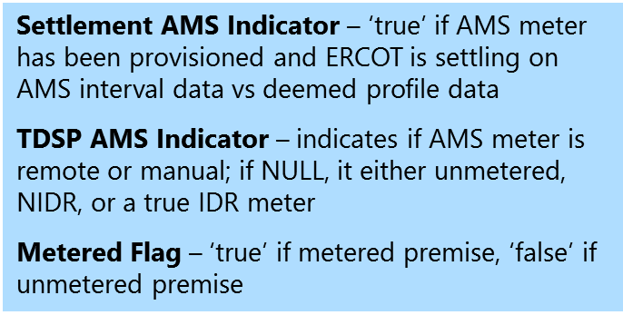
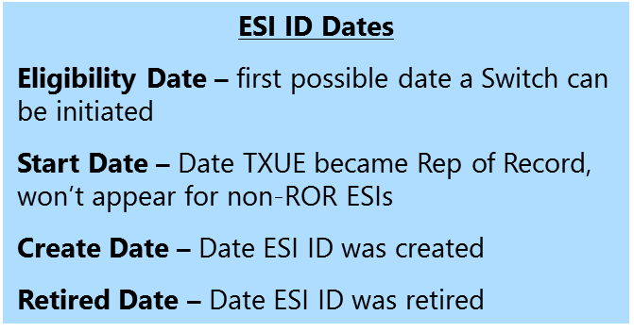
Find ESI ID – Additional information

Slide 92
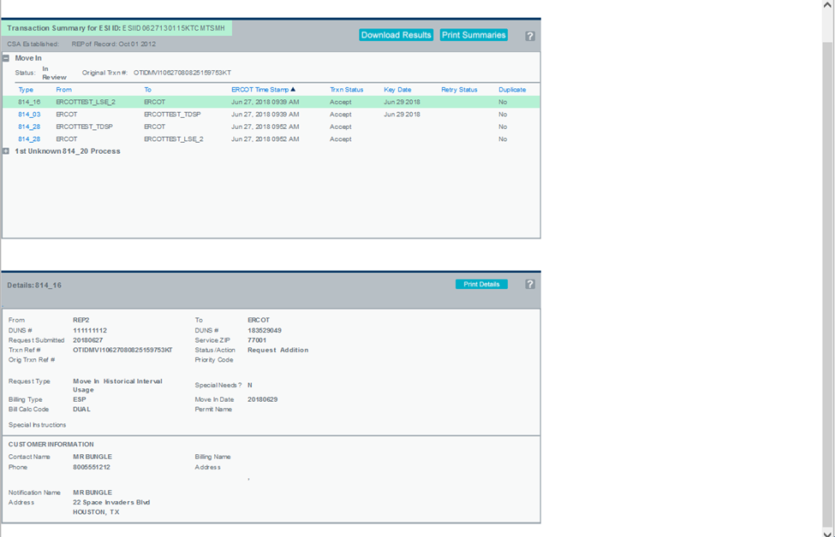
Find Transactions – MVI w/ permit required
Status will remain In Review until TDSP sends 814_04 to ERCOT scheduling the order
Customer information is contact information – not necessarily premise address

Slide 93
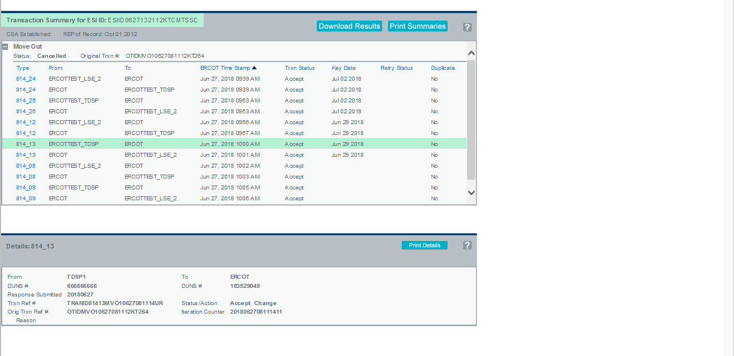
Find Transactions – MVO w/ date change & cancel
Customer requests to change the MVO date from 7/2 to 6/29 on 6/27. Both ERCOT & TDSP accept the change.

Slide 94
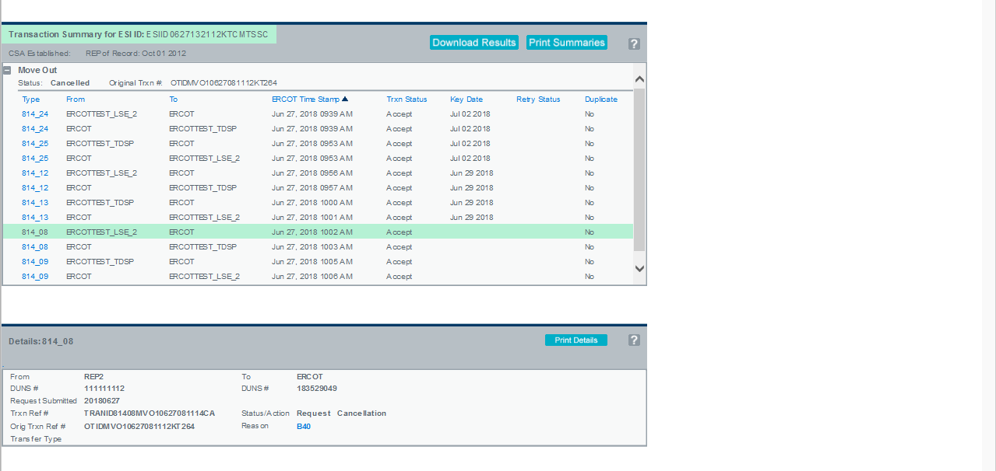
Find Transactions – MVO w/ date change & cancel – cont.
Customer now requests to cancel the the MVO scheduled for 6/29 on 6/27. Both ERCOT & TDSP accept the cancellation.
Reason for cancellation can be found in the hyperlink.

Slide 95
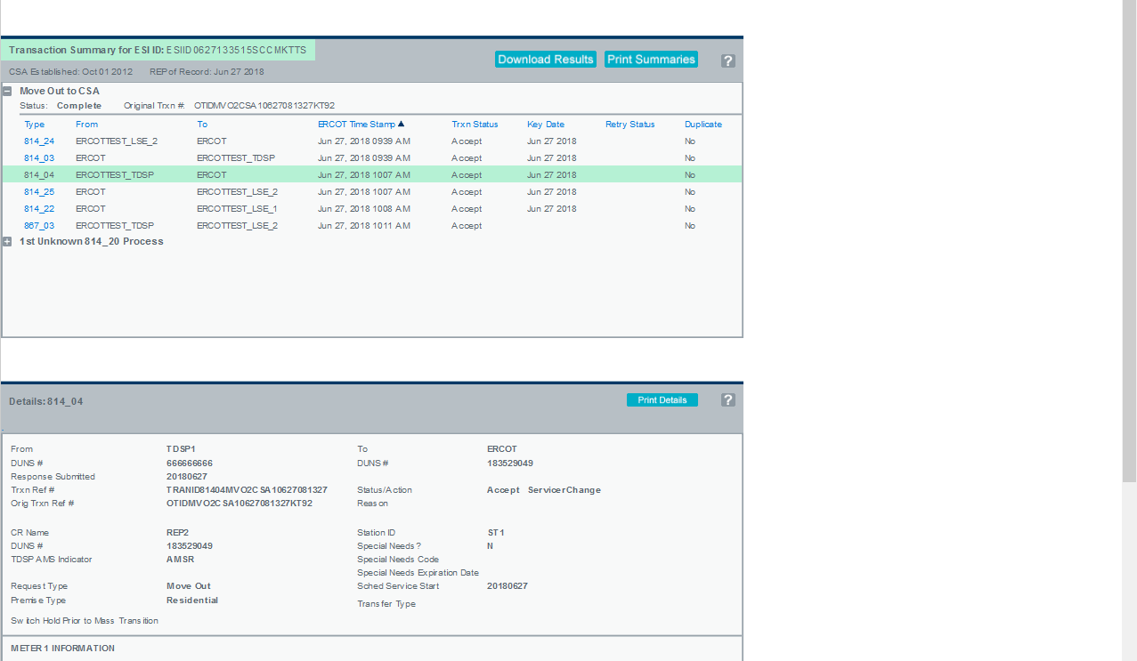
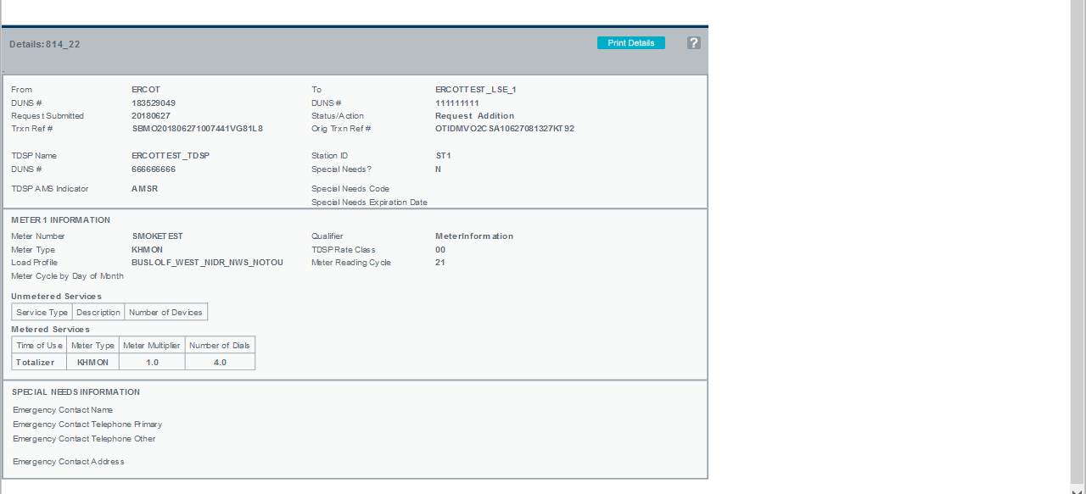
Find Transactions – MVO to CSA
Customer at premise issues a MVO which activates the CSA. Notification is sent to CSA holder (814_22).
Premise information is provided in the 814_04 and 814_22 including load profile, meter cycle, TDSP Rate Class, and meter information.

Slide 96
Checkpoint Exercise #8
Provide each transaction number, who the transaction is from and who it is going to, and at the end who the REP of Record is from the scenario flow listed below.
Customer calls REP B to enroll for service and REP A is the current REP of Record at that premise:

Slide 97
Checkpoint Exercise #8 - continued
From
To
REP B
Transaction Type
ERCOT
TDSP
REP A
REP B
ERCOT
TDSP
REP A
Switch request
814_01
Enrollment
Notification Request
814_03
Enrollment
Notification Response
814_04
CR Enrollment
Notification Response
814_05
Historical Usage
(If requested by REP)
2
1
1
2
867_02
Loss Notification
814_06

Slide 98
Checkpoint Exercise #8 - continued
From
To
Transaction Type
ERCOT
TDSP
REP A
REP B
ERCOT
TDSP
REP A
REP B
Cancel Request – submitting CR on same day as Switch schedule
814_08
Cancel Response
814_09
Final Usage
1
1
2
867_03
2
Initial Meter Read
2
1
1
2
867_04

Slide 99
Checkpoint Exercise #8 - continued
From the transaction flow, who is the REP of Record?
_________________________________________________
What is the situation described?
_________________________________________________

Slide 100
6: TX SET Working Group

Slide 101

TX SET Working Group
Texas Standard Electronic Transaction (TX SET) Working Group:
Reports to the Retail Market Subcommittee (RMS),
Analyzes the need for new or modifications to existing electronic transactions,
Recommends changes to retail market processes,
Works with the ERCOT Flight Administrator to ensure that testing processes and procedures are defined and administered,
Maintains the Texas SET Implementation Guides and the Texas Market Test Plan Guide, and
Collaborates with other Working Groups and Taskforces as directed by RMS.
http://ercot.com/committee/txset
Review & Recommend RMGRR153 & 2019 Test Flight

Slide 102
TX SET Issue Submission Process
Formal method to initiate review of issues
Notes:
This process provides Market Participants with a formal way to communicate transactional or market processing issues that should be reviewed and discussed by the Texas SET Working Group for a recommendation and/or resolution.
Issues brought forth through this process may be used by the Texas SET Working Group representatives to develop a Change Control(s) that may be implemented with a future TX SET version.
Market Participants submitting issues to be considered by the Texas SET Working Group should use the Texas SET Issue Form at this link:

Slide 103
Retail Market Testing
Flight Testing:
  All retail market participants are required for ERCOT certification
  Three Market flights per year
  End to End test scripts (i.e connectivity, penny test)
Notes:
The Texas Market Test Plan (TMTP) applies to Market Participants doing business in the Texas Electric Choice Market.
The purpose of this document is to define the market plan for testing commercial operations systems and business processes to support the Texas Electric Choice Market.
This document covers all testing requirements and procedures between ERCOT and the Market Participants and Point-to-Point testing between Market Participants.

Slide 104
Retail Market Testing
  Governed by Texas Market Test Plan:
  Supported by TX SET working group
  Outlines testing processes and requirements
All CRs must participate in and successfully complete testing as described in Protocol Section 19.8, retail Market Testing, prior to commencing operations with ERCOT.

Slide 105
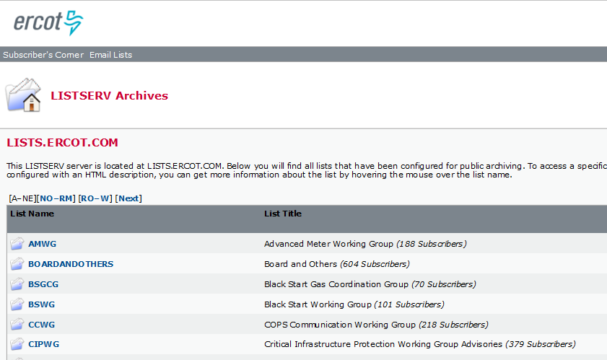
ListServe
http://lists.ercot.com

Slide 106
Appendix

Slide 107
ERCOT Retail Market Guide
Other Binding Documents List
File Name and Web Link To Documentation | Description
Commercial Operations Market Guide | Supplements the ERCOT protocols and describes the process through which ERCOT market data is translated into financial settlements in the ERCOT market.
Load Profiling Guide | A reference document used by market participants and ERCOT, expands upon and details the responsibilities and processes listed in the ERCOT protocols.
Retail Market Guide | A reference document for rules affecting the competitive retail electric market in Texas.
Texas Data Transport Guides | Provides information on secure data transport utilized by the Retail Electric Market and enabled by the North American Energy Standards Board (NAESB) Electronic Delivery Mechanism (EDM), ebXML and digital certificates.
Texas Market Test Plan | Defines the market plan for testing retail commercial operations systems and business processes to support the Texas Electric Choice Market.
Texas SET Implementation Guides | Provides details of information contained within the electronic transactions used in the competitive retail electric market in Texas.

Slide 108
ERCOT Retail Market Guide
Section 7- Market Processes Highlights
Sections | Description
7.3 | Inadvertent Gain Process This Section provides guidelines for ensuring that inadvertently gained Electric Service Identifiers (ESI IDs) are returned to the losing Competitive Retailer (CR) in a quick and efficient manner with minimal inconvenience to the Customer as required by P.U.C. Subst. R. 25.495, Unauthorized Change of Retail Electric Provider
7.4 | Safety Nets This Section provides guidelines for the Safety-Net Processes and explains the steps that Market Participants will follow when processing safety-net Move-In Requests. This document is not intended to override or in any way contradict P.U.C. Subst. R. 25.487, Obligations Related to Move-In Transactions. The safety-net process is a manual work-around process used by Market Participants in the Texas retail market when market transactions are delayed or not functional.
7.5 | Standard Historical Usage Request This Section provides guidelines for a Customer’s authorization to Competitive Retailer(s) (CR(s)) that may request the Customer’s historical data when they are not the Retail Electric Provider (REP) of record. This data includes the most recent 12 months of usage and is provided by the Transmission and/or Distribution Service Provider (TDSP) to the requesting CR. In order to provide the data to the CR, the TDSP must have written authorization (includes electronic authorization) from the Customer to allow the TDSP to provide the proprietary information.

Slide 109
ERCOT Retail Market Guide
Section 7- Market Processes Highlights
Sections | Description
7.6 | Disconnect and Reconnect for Non-Pay The Disconnect for Non-Pay (DNP) and Reconnect for Non-Pay (RNP) process provides Market Participants with market approved guidelines to support disconnect and reconnect transactions and business processes as allowed or prescribed by P.U.C. SUBST. R. 25.483, Disconnection of Service.
7.7 | Transaction Timing Matrix The Transaction Timing Matrix, is an abbreviated version of Protocol Section 15, Customer Registration, used to assist Market Participants in identifying the flow and timing of transactions between Market Participants and ERCOT.
7.16 | Business Processes and Communications Related to Meter Tampering This Section provides Market Participants with market approved guidelines to support the business processes as allowed or prescribed in P.U.C. Subst. R. 25.126, Adjustments Due to Non-Compliant Meters and Meter Tampering in Areas Where Customer Choice Has Been Introduced.
7.17 | Business Processes and Communications for Switch Holds Related to Deferred Payment This Section provides Market Participants with market approved guidelines to support the business processes as allowed or prescribed in P.U.C. Subst. R. 25.480, Bill Payment and Adjustments.

Slide 110
Texas SET Swimlanes
Texas SET Swimlanes Scenarios
Description | File Name and Web Link to Documentation
TX SET flow documentation for consolidated billing, remittance and dual billing | Billing Scenarios Version February 2017
TX SET flow documentation for beginning and ending continuous service agreements (CSAs) | Continuous Service Agreement Scenarios February 2017
TX SET flow documentation for handling Move In changes and problems | Customer Move In Scenarios June 2012
TX SET flow documentation for handling Move Out changes and problems | Customer Move Out Scenarios February 2017
TX SET flow documentation for handling customer switch request | Customer Switch Scenarios June 2012

Slide 111
Texas SET Swimlanes
Texas SET Swimlanes Scenarios
Description | File Name and Web Link to Documentation
TX SET flow documentation for Disconnect and Reconnect for Non-Pay | Disconnect Reconnect Non Pay Scenarios February 2017
TX SET flow documentation for customer dropped by Competitive Retailer (CR), disconnect for non-pay services request and Mass Transition from defaulting CR to Provider of Last Resort (POLR) | Mass Transition / Acquisition Scenarios June 2012
TX SET flow documentation for handling Switch Hold add and removal | Switch Hold Scenarios June 2012
TX SET flow documentation of how to report unplanned outages | Unplanned Outages Scenarios June 2012

Slide 112

TX SET Implementation Guides (IG)
The Texas Standard Electronic Transaction (SET) Implementation Guides provide details of information contained within the electronic transactions used in the competitive retail electric market in Texas.
The current Version 4.0 of the Texas SET Implementation Guides contains updates to retail transactions to support the following:
  PUCT Substantive Rule §25.493 Acquisition and Transfer of Customers from one Retail Electric Provider to Another
  PUCT Substantive Rule §25.480 Bill Payment and Adjustments
  PUCT Substantive Rule §25.483 Disconnection of Service
  PUCT Substantive Rule §25.497 Critical Care Customers
  PUCT Substantive Rule §25.126 Amendments Due to Non-Compliant Meters and Meter Tampering in Areas Where Customer Choice Has Been Introduced
  PUCT PROJECT 34610 Implementation Project Relating to Advanced Metering
  Outstanding Change Controls identified and recommended by the Texas SET Working Group
  http://ercot.com/mktrules/guides/txset/current

Slide 113
Texas SET Implementation Guides
Service Orders, Invoice and Remittance Transactions
Transaction and Version | Web Link to Documentation
Texas SET V4.0 650 Service Orders Point to Point | Guides (Jun 11, 2012 – zip – 162 KB) Examples (Jun 11, 2012 – zip – 42.8 KB)
Texas SET V4.0 810 TDSP’s Invoice Point to Point | Guides (Jun 11, 2012 – zip – 95.1 KB) Examples (May 18, 2017 – zip – 39.1 KB) SAC04 (Sep 19, 2016 – xls – 176 KB)
Texas SET V4.0 820 Remittance Advice Point to Point | Guides (Jun 11, 2012 – zip – 60.1 KB) Examples (Sep 22, 2017 – zip – 31.2 KB)

Slide 114
Texas SET Implementation Guides
Enrollments, Rejects and Usage Transactions
Transaction and Version | Web Link to Documentation
Texas SET V4.0 814 Enrollments, MVI, MVO, Create/Maintenance/Retire, Maintain Customer Information | Guides (Jun 11, 2012 – zip – 1.1 MB) Examples (Jun 11, 2012 – zip – 346.7 KB)
Texas SET V4.0 824 Invoice or Usage Reject Notification | Guides (Jun 11, 2012 – zip – 32.4 KB) Examples (Jun 11, 2012 – zip – 11.6 KB)
Texas SET V4.0 867 Monthly and Final Usage, Historical Usage | Guides (Jun 11, 2012 – zip – 176.3 KB) Examples (Jun 11, 2012 – zip – 71.6 KB)

Slide 115
Texas SET Implementation Guides
Functional Acknowledgement and CR Option 1 Outage Transactions
Transaction and Version | Web Link to Documentation
Texas SET V4.0 997 Functional Acknowledgement | Guides (Jun 11, 2012 – zip – 30.8 KB)
Texas SET V4.0 T-Series CR Option 1 Outage Transactions | Guides (Jun 11, 2012 – zip – 102.8 KB)

Slide 116
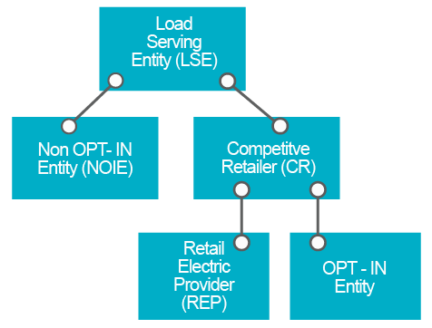
Load Serving Entities (LSE)
Notes:
Load serving entities (LSEs) provide electric service to end-users and wholesale customers.
LSEs include the competitive retailers (CRs) that sell electricity at retail in the competitive market.
A CR may be (1) a retail electric provider (REP), which contracts with qualified scheduling entities to provide scheduling services for their load customers, or (2) a municipally owned utility or co-operative that opts to offer customer choice (an opt-in entity).
LSEs also include non-opt-in entities (NOIEs), which are electric cooperatives and municipally owned utilities that do not operate as CRs and do not plan to offer customer choice.

Slide 117
Registration and Qualification/Certification
Registration
  Register with ERCOT as a CR (a REP or an opt-in entity) or a NOIE with the form below.
Qualification/Certification
  CRs must be certified by ERCOT. Please read more about Texas Retail Market Testing and the latest test flight.
  REPs must also be certified by the Public Utility Commission of Texas (PUCT). More information on that certification process may be found on the PUCT website at Retail Electric Providers Certification and Reporting .
  http://ercot.com/services/rq/lse/index.html

Slide 118

Retail Market Testing
Key Documents
Description | File Name and Web Link to Documentation
Flight status and agenda for conference calls | Daily Agenda
Repository of Market Participants technical and business testing information | Testing Worksheet
Mechanism for recording and tracking flight testing progress. Market Participants update the checklist as transactions/tasks are sent and received | Checklist

Slide 119
Retail Market Testing
Key Documents
Description | File Name and Web Link to Documentation
Testing scenarios to be executed during flight tests. Ability to download script workbook | Scripts
Document repository | File Cabinet
Business and technical contact information for all Market Participants that is populated from each respective Testing Worksheet | Contacts

Slide 120
Retail Market Testing
Key Documents
Description | File Name and Web Link to Documentation
The ERCOT Retail Testing Website is used by Market Participants to become certified in conducting retail market processes within the ERCOT market. | Texas Retail Testing https://etod.ercot.com/
Retail Market Testing Orientation Weblink | Retail Market Testing Orientation
Retail Market Test Environment User Guide | Retail Market Test Environment User Guide
Retail Market Testing Environment ESI IDs | Retail Market Testing Environment ESI IDs

