Slide 1
Process Improvements:
Dynamic Stability and PSCAD Models
Resource Integration Workshop
July 31, 2018

Slide 2
Outline
DMTF, DWG, and the need for an improved process
Introducing: Dynamic Model Guidelines
Introducing: PSCAD Model Guidelines
Introducing: Dynamic Model Templates
Implementation

Slide 3
Background
The DYNAMIC MODEL TASK FORCE was created to improve process of collecting and using dynamic models
  Participants included TSPs, REs, and OEMs
  Had a major workshop in January.
  Task Force is now wrapped up. Recommendations presented to ROS 7/12/2018.

Slide 4
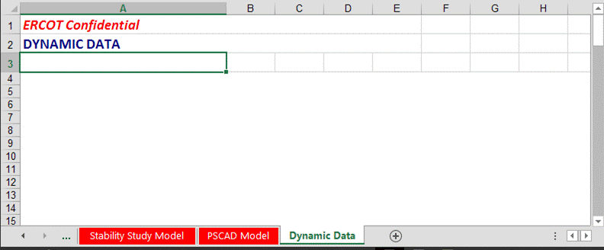
Background: Dynamic Model Challenges
“How can I receive immediate feedback on the dynamic models I submit in the RARF?”
Communication Challenges: ERCOT/TSP ←→ IE ←→ OEM
Current “Process” is a blank form in RARF:
No Guidance of what’s Required
No standard format

Slide 5
DMTF
Proposals

Slide 6
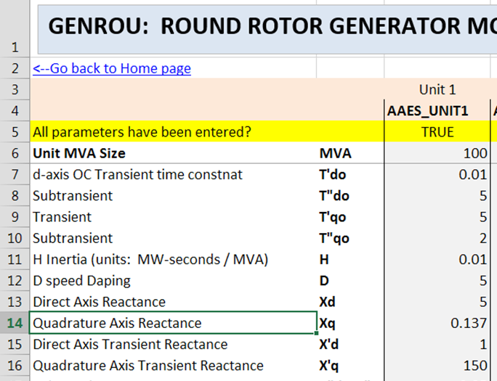
#1
Dynamic Model Templates

Slide 7
Introducing Dynamic Model Templates
Fill-in-the-blank excel form specific to your type of generator model (improvement over empty RARF tab)
Provides guidance
No new data being requested, just a better format
Template
RARF
Save completed Template into RARF (compatible w/ existing RARF Process)

Slide 8




Envisioned Process for RE
1.
2.
3.
REQUEST
Model template from ERCOT specific to your type of generator
FILL OUT
(no new data is being requested over old method)
Attach to dynamic data tab of your RARF
Send to TSP for
FIS
MOD 26/27 review.
Submit to ERCOT
Advantages: Better Guidance.
More structure.

Slide 9
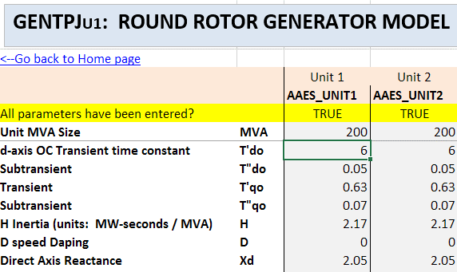
Template Demonstration

Slide 10

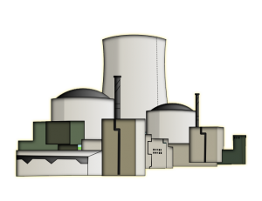

Benefits of Templates
Better communication with OEM, ERCOT, and TSP
Some basic error checking (completeness)
Avoid transcription & formatting errors in .dyr files
Easier to understand model parameters
Easy to extract data for studies
  Better communication prior to a study?
  Faster feedback of model issues?
OEM
RE
TSP / ERCOT

Slide 11
Rolling out templates
ERCOT will maintain, update, and create new templates.
Template does not request any new information. Requests only what is already needed.
Plan to require templates for new / updated models
  Will add to RARF glossary requirements
  Not currently required but please give them a try; should make the process easier!

Slide 12
Templates and RIOO
(RIOO will replace RARFs with an online portal)
To submit the dynamic model in RIOO, simply upload the Template. (Thus no change.)

Slide 13
UDM Model Quality
Issues and Solutions

Slide 14


Engaging OEMs to Make Models Easy to Use
As presented at DMTF workshop…
Make integrating models into PSSE as simple as possible
  For UDMs, .dll only
  Provide documentation
Better Communication:
  Communication chain to update the models
  Ensuring model represents as-built plant
.dll

Slide 15

PSSE Dynamic Model Guidelines
Identify previously observed issues and promote usable models
Can help meet the MOD-026/-027 usability requirements. Also help studies.
http://www.ercot.com/calendar/2017/10/9/122658-DMTF
  http://www.ercot.com/content/wcm/key_documents_lists/122659/ERCOT_User_Defined_Model_Submittal_Guideline_draft_10052017.docx
DWG to finalize and maintain guidelines per DMTF recommendation

Slide 16
PSCAD Model Quality
Issues and Solutions

Slide 17
PSCAD Model Guidelines
Identify previously observed issues and promote usable models
Can facilitate FIS-SSR studies
Reduce future model support issues
http://www.ercot.com/content/wcm/key_documents_lists/120960/ERCOT_PSCAD_Model_Submittal_Guideline_2018.docx
Completed checklist should be included when submitting PSCAD models
Formalization of PSCAD model guidelines subject to stakeholder processes per DMTF recommendation

Slide 18

Questions

