Slide 1
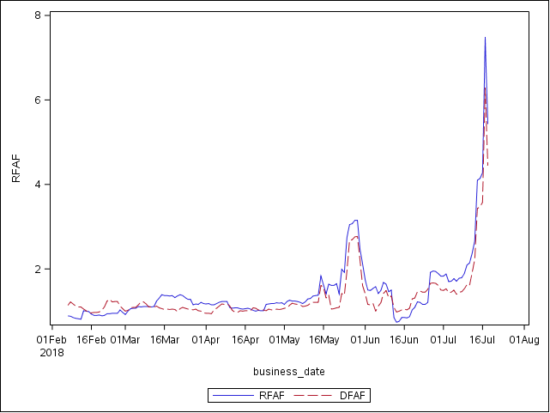
Forward Adjustment Factors

