Slide 1
Annual Validation Process
PWG Meeting
04.25.2018

Slide 2
RESHI/RESLO Profile Counts by Weather Zone

Slide 3
BUS NIDR Profile Counts

Slide 4
AV 2018 BUS NIDR Change Count Summary

Slide 5
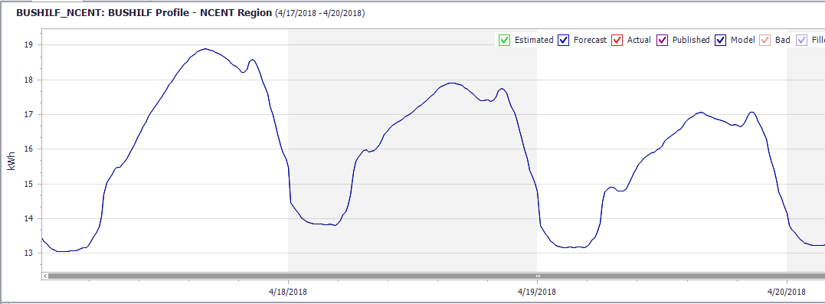
Example of a BUSHILF Load Shape

Slide 6
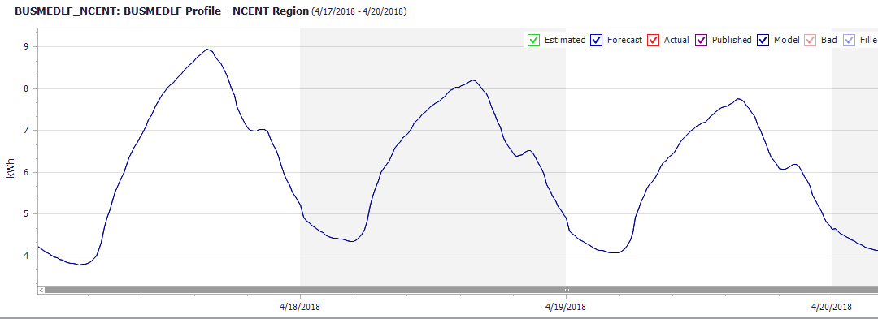
Example of a BUSMEDLF Load Shape

Slide 7
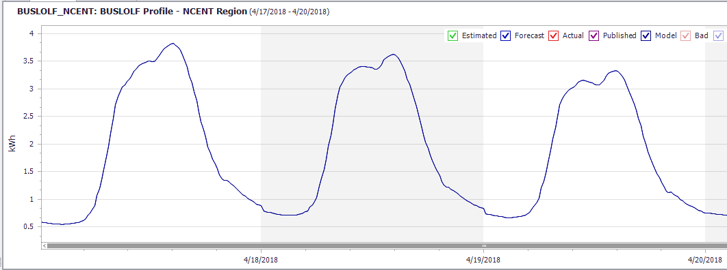
Example of a BUSLOLF Load Shape

