Slide 1
NDSWG – July 17, 2018
Joe Weatherly
Network Modeling Manager
ERCOT Public
July 17, 2018

Slide 2
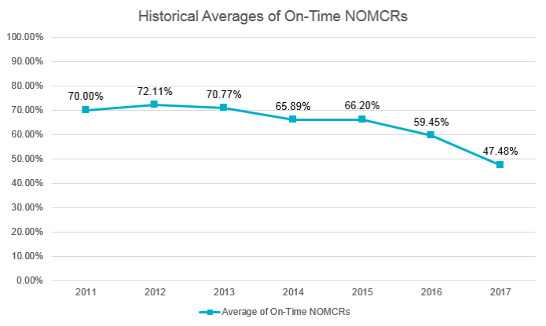
Interim restrictions
Reason for change:
Submittals meeting Protocol timelines have decreased to levels that negatively impact several key ERCOT functions.
Model validation
Outage Coordination
CRR auction accuracy
When: Oct 1, 2018

Slide 3
Interim restrictions
5 items removed from interim updates***:
New substations with Line-Breakers (or substation Breaker/Line reconfiguration) and Contingencies
New physical Lines and Contingencies
New Transformers and Contingencies
New Generation & Synchronous Condenser (already enforced)
Items requiring ResourceNode additions/modifications
3 Interim items considered for processing if meeting 65 Calendar Days prior to Database Load:
New Tap Station (No Line controlling Breakers)
New Shunt Compensator
New SVCs
2 Interim items considered for processing if meeting 20 Calendar Days prior to Database Load
Field vs Model Cleanup (Only Deletes)
New Loads (with controlling Breaker if applicable)

Slide 4
Interim restrictions
***Exceptions:
If needed for reliability of the ERCOT grid, the MP shall provide the ERCOT form for ERCOT’s consideration along with powerflow study(ies) that demonstrate the change relieves a reliability concern.
In an ERCOT declared Emergency, Interim Update restrictions may be temporarily waived.

