Slide 1
Credit Exposure Scenarios
Credit Work Group
ERCOT Public
July 18, 2018

Slide 2
Credit Exposure Scenarios
Stress Test Inputs
Exposures on June 27th 2018 are used as base case
RFAF of 8.16 and DFAF of 6.36 are applied to the base case
-Factors are based on August 1st 2011 ICE prices with the peak of 21st day tweaked to $9000 and off-peak to $3000.
Key Takeaway
Market-wide average TPE increased from $700.7 million to $2.4 billion.

Slide 3
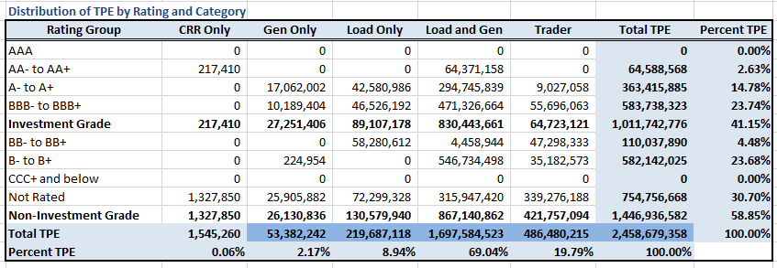
Credit Exposure Scenarios
Distribution of TPE by Rating and Category

Slide 4
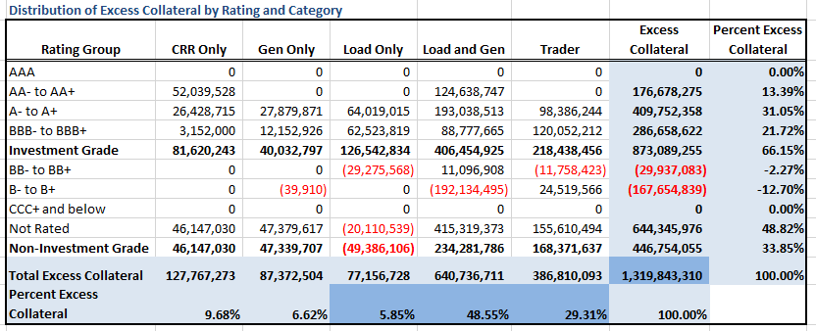
Credit Exposure Scenarios
Distribution of Excess Collateral by Rating and Category

Slide 5
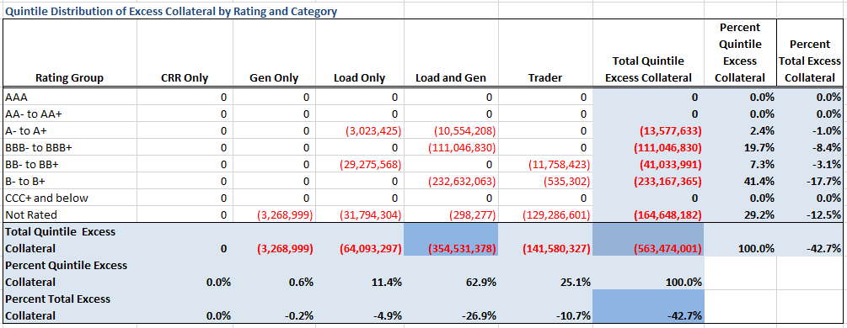
Credit Exposure Scenarios
Distribution in the Bottom Quintile of Excess Collateral*
*Excess Collateral is a voluntary disposition by Counterparty

Slide 6
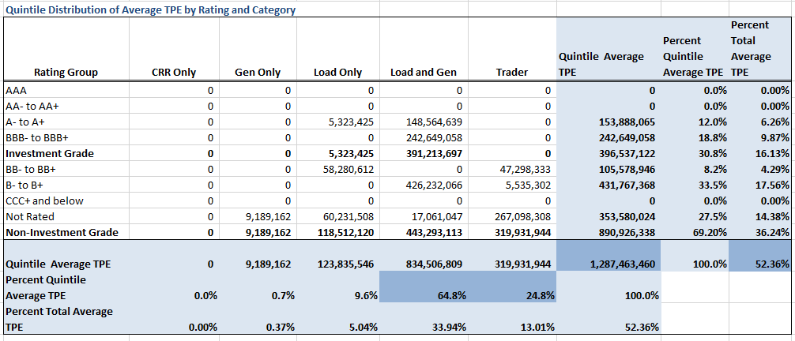
Credit Exposure Scenarios
Distribution of TPE in the Bottom Quintile of Excess Collateral

Slide 7
Credit Exposure Scenarios
Questions

