Slide 1
RTF
Progress Report to PRS 07/19/2018
Bob Wittmeyer Co-Chair

Slide 2
Draft NPRR #1
Removes Non-Modeled wording from the protocols
Establishes Settlement Only Generation
Rearranges current language in the protocols.
RTF will meet 15 minutes following Todays PRS Meeting to discuss the draft NPRR and the draft White Paper.

Slide 3
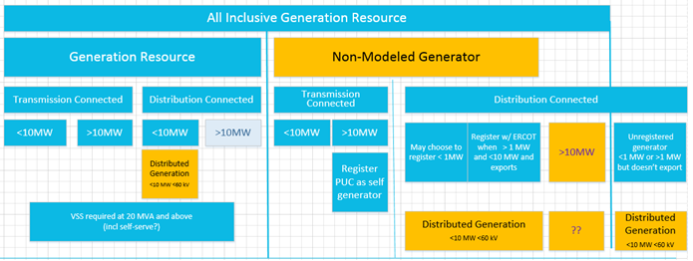
Today
After NPRR#1

Slide 4
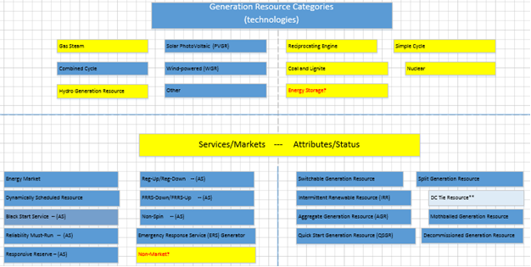
Future NPRRs
Cleanup of “All Inclusive Generation Resource”
Define Technologies & Attributes

