Slide 1
CRR Balancing Account Overview for MSWG
Austin Rosel
ERCOT
July 18, 2018

Slide 2
CRR Balancing Account Fund
CRR Balancing Account ($M) | June 2018 | July 2018* MTD
Monthly Day-Ahead Congestion Rent | $183.22 | $70.06
Monthly Day-Ahead CRR Settlements | ($190.51) | ($84.59)
Monthly Day-Ahead CRR Short -Charges | $16.52 | $15.67
CRR Balancing Account Credit Total | $9.23 | $1.15
Beginning Fund Balance for the Month | $10.00 | $2.75
CRR Balancing Account Credit Total | $9.23 | $1.15
Day-Ahead CRR Short-Charges Refunded | ($16.52) | ($3.94)
CRR PTP Option Award Charges | $0.04 | $0.04
Load-Allocated CRR Amount | $0.00 | $0.00
Total Fund Amount | $2.75 | $0.00
Day-Ahead CRR Short-Charges Not Refunded | $0.00 | $11.74
* Data for July 2018 is from July 1-14, 2018

Slide 3
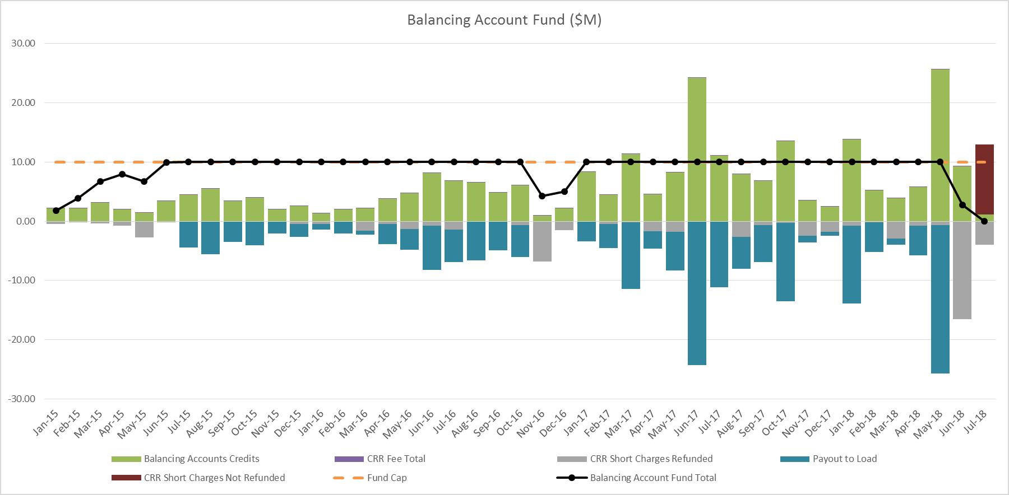
CRR Balancing Account Fund
* Data for July 2018 is from July 1-14, 2018

Slide 4
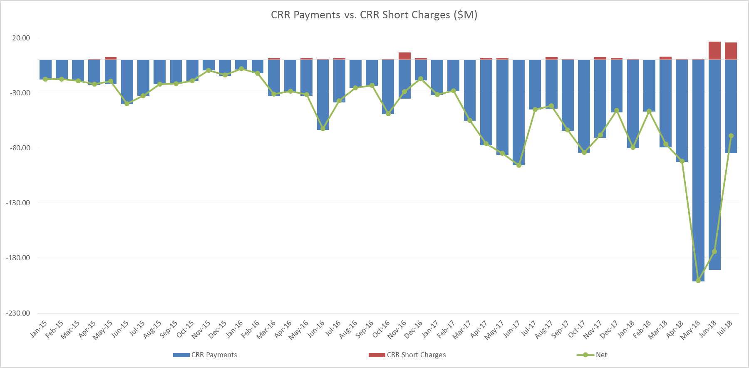
CRR Balancing Account Fund
* Data for July 2018 is from July 1-14, 2018

