Slide 1
Project Update and Summary of
Project Priority List (PPL) Activity
July 19, 2018

Slide 2
Project Update Agenda
Project Portfolio Update p. 3-8
  Recent / Upcoming Project Implementations
    NPRR833 Update
  2018 Release Targets
  Planned Project Starts
  2018 Project Spending Forecast
  Revision Request Funding Placeholder Status
  Priority/Rank Options for Revision Requests with Impacts
Appendix
  Project Portfolio Gantt Chart p. 9-16
Location of Project Priority List (PPL): http://www.ercot.com/services/projects/index

Slide 3
Recent / Upcoming Project Implementations
2018 August Release – 8/7/2018 – 8/9/2018 In Flight
  NPRR819 – Modification of Non-Price Error Resettlement Thresholds and Resettlement Clean-Ups
  NPRR844 – Clarification to Outage Report
  SCR791 – Correction of 60-day SCED GRD Disclosure Report
Release TBD In Flight
  NPRR833 – Modify PTP Obligation Bid Clearing Change
    Due to delayed CRR Upgrade, ERCOT proposes a two phase delivery approach to NPRR833
      Proceed with MMS changes
        Target release to be communicated when it becomes available
      Defer CRR changes until CRR Upgrade completes
Note: Projected Go-Live dates are subject to change.
Please watch for market notices as the effective dates approach.

Slide 4
2018 Release Targets – Board Approved NPRRs / SCRs / xGRRs
February 2/6 – 2/8 | April 4/5 – 4/9 | May 5/29 – 5/31 | August 8/7 – 8/9 | October 10/23 – 10/25 | December 12/11 – 12/13
NPRR659 NPRR683 NPRR743 NPRR760 NPRR800 NPRR810 PGRR042 NPRR846 | NPRR562(b) SCR792 | NPRR768 NPRR815 OBDRR002 NPRR776 NOGRR167 | NPRR819 NPRR825(a) NPRR844 SCR791 GINR Go-Live (Interconnecting Entities only) | NPRR843 NPRR854 NPRR864 RRGRR015 RRGRR016 SCR795 | NPRR519 NPRR620 NPRR741 NPRR755 PGRR057 NPRR809(b) NPRR842 SCR794
8 | 2 | 5 | 3 | 6 | 8
ü
ü
ü
ü
ü
ü
ü
ü
ü
ü
ü
ü
ü
E
E
E
P
E
E
NS
NS
P
E
E
E
E
E
E
NS
NS
CMM Release 1a
CMM Release 1b
1/1 & 2/1
6/1
8/30
1/1
ü
ü
2/1
TBD Items (and point at which they became “TBD”)
2014 | 2015 | 2016 | 2017
NPRR664 | None | SCR781 P | NPRR702 P, SCR777, NPRR831(b), NPRR749 E, NPRR833 E, NPRR825(a)
Go-live dates can differ from Protocol effective dates – Please refer to market notices for more details
APPENDIX
Red Text: New additions and target release changes
Strike-Through Text: Previous target release changes
(a), (b), etc. indicates multiple phases
Project Status Codes
NS = Not Started
I = Initiation
P = Planning
E = Execution
H = On Hold
Release targets are subject to change
NPRR825(a) – NoticeBuilder changes
NPRR562(b) – Reporting/posting system changes
NPRR809(b) – Reporting/posting system changes
NPRR831(b) – CRR system changes

Slide 5
Approved Revision Requests “Not Started” – Planned to Start in Future Months
Revision Request | Target Start Date | Release Target | Cost Estimate | Author
NPRR842 – Study Area Load Information | July 2018 | 2018-R6 | $60k-$80k | ERCOT
RRGRR015 – Additional Guidance for Transformer and Station Data RRGRR016 – Additional Guidance for Solar Data | July 2018 | 2018-R5 | $10k-$15k <$10k | RDWG
SCR794 – Update SCED Limit Calculation | Aug 2018 | 2018-R6 | $25k-$35k | ERCOT
NPRR817 – Create a Panhandle Hub | Sept 2018 | 2019-R2 | $150k-$200k | DC Energy
NPRR858 – Provide Complete Current Operating Plan (COP) Data | Oct 2018 | 2019-R1 | $25k-$45k | Citigroup Energy
NPRR865 – Publish RTM Shift Factors for Hubs, Load Zones, and DC Ties | Oct 2018 | 2019-R1 | $30k-$40k | DC Energy
SCR793 – SSR Related Telemetry for Transmission Service Provider (TSP) Operators | Oct 2018 | 2019-R1 | $40k-$50k | Cross Texas Transmission
Potential to start in August
Project Initiations – Next 3 Months
Aging Items Report | Last Action | Status
NPRR664 – Fuel Index Price for Resource Definition and Real-Time Make-Whole Payments for Exceptional Fuel Cost Events | Board approved on 12/9/2014 | Pending approval of NPRR847

Slide 6
2018 Project Spending
2018 PPL Budget = $20.0M
“Potential Demand” represents internal ERCOT projects that have not been fully approved

Slide 7
Revision Request Funding Placeholder Status
In 2018 and 2019, ERCOT forecasted $4.0M for Revision Request work
Yearly Revision Request Spending Forecast Summary
Project Status | 2018 | 2019
YTD Actuals | $1.00M
Approved – In-Flight / Complete | $1.81M | $0.20M
Approved – On Hold | $0.00M | $0.00M
Approved – Not Started | $0.32M | $0.30M
Remaining Funding | $1.87M | $3.50M
Total Allocation | $4.00M | $4.00M
As of 6/30/2018
SCR789

Slide 8
Priority / Rank Options for Revision Requests with Impacts
Options for…
Revision Request | Description |  | Priority | Rank | Comments
NPRR845 | RMR Process and Agreement Revisions |  | 2018 | 2280 | Add to end of 2018 list and work into the plan without disrupting in-flight projects
NPRR866 | Mapping Registered DG and Load Resources to Transmission Loads in the Network Operations Model |  | 2018 | 2270 | Group these items for concurrent implementation Add to end of 2018 list and work into the plan without disrupting in-flight projects ROS supported this approach
PGRR061 | Related to NPRR866, Mapping Registered DG and Load Resources to Transmission Loads in the Network Operations Model
RRGRR017 | Related to NPRR866, Mapping Registered DG and Load Resources to Transmission Loads in the Network Operations Model
NPRR877 | Use of Actual Interval Data for IDR ESI IDs for Initial Settlement | Phase I | 2018 | 2290 | Add to end of 2018 list and work into the plan without disrupting in-flight projects
 |  | Phase II | 2019 | 2540 | Begin work in 2019 in order to accommodate 1/1/2020 effective date
VCMRR022 | Determination of Fuel Adder Price for Coal & Lignite |  | 2018 | 2260 | Add to end of 2018 list and work into the plan without disrupting in-flight projects
PPL Rank Information
Next available 2018 Rank in Business Strategy = 2260
Next available 2019 Rank in Business Strategy = 2540
Next available Rank in Regulatory = 220

Slide 9
Appendix
  7/1/2018 Project Gantt
    In-flight items sorted by Project End Date
    “Not Started” items sorted by Project Start Date

Slide 10
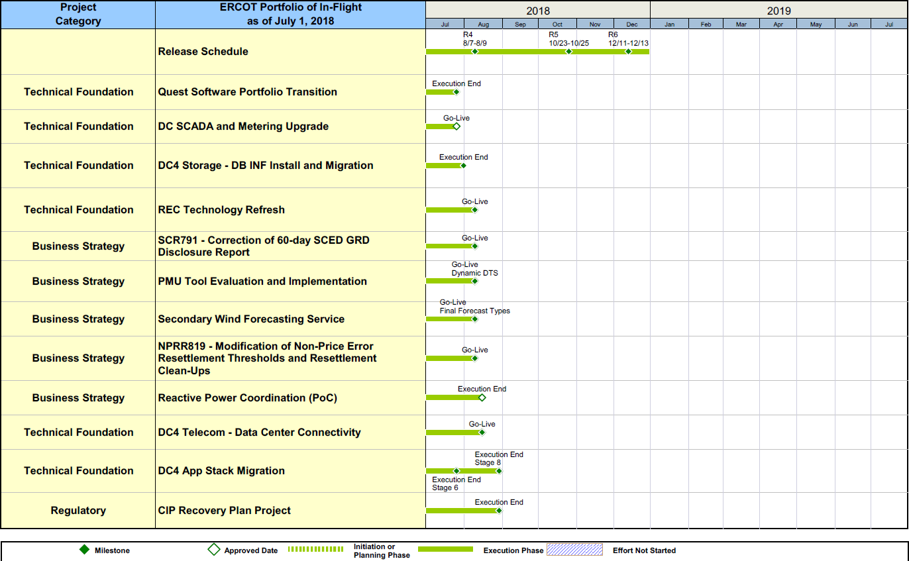
Project Portfolio Status – as of 7/1/2018

Slide 11
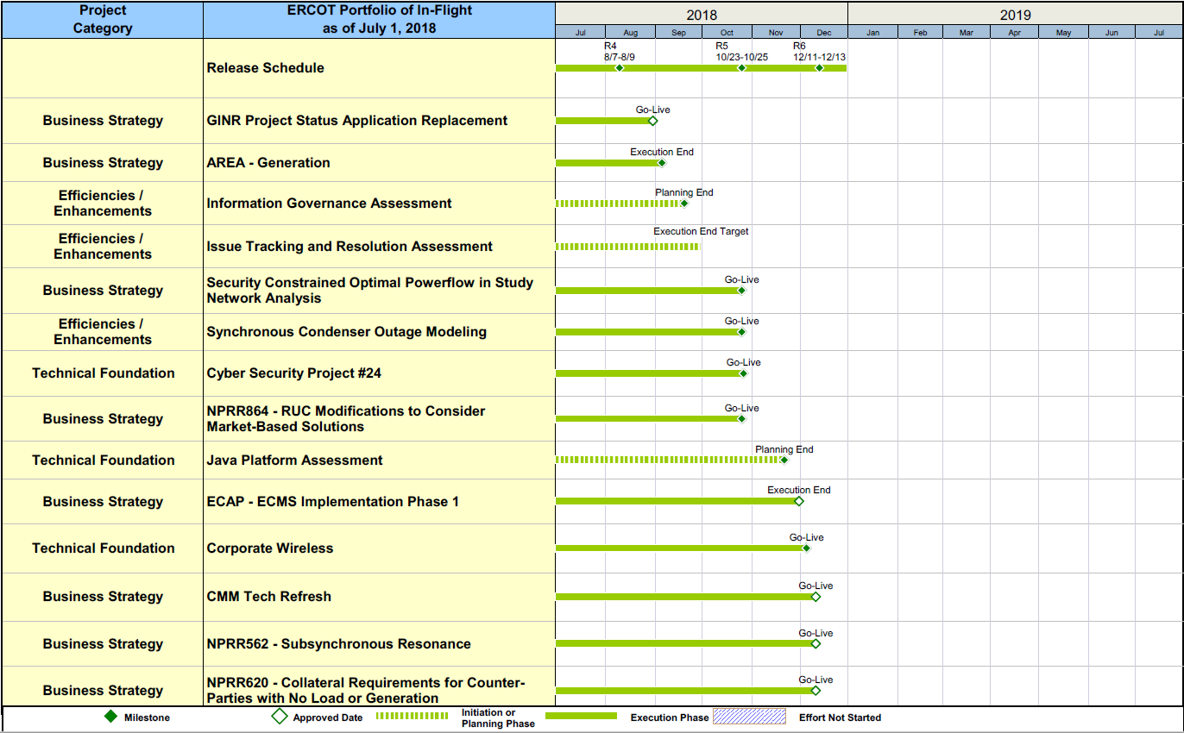
Project Portfolio Status – as of 7/1/2018

Slide 12
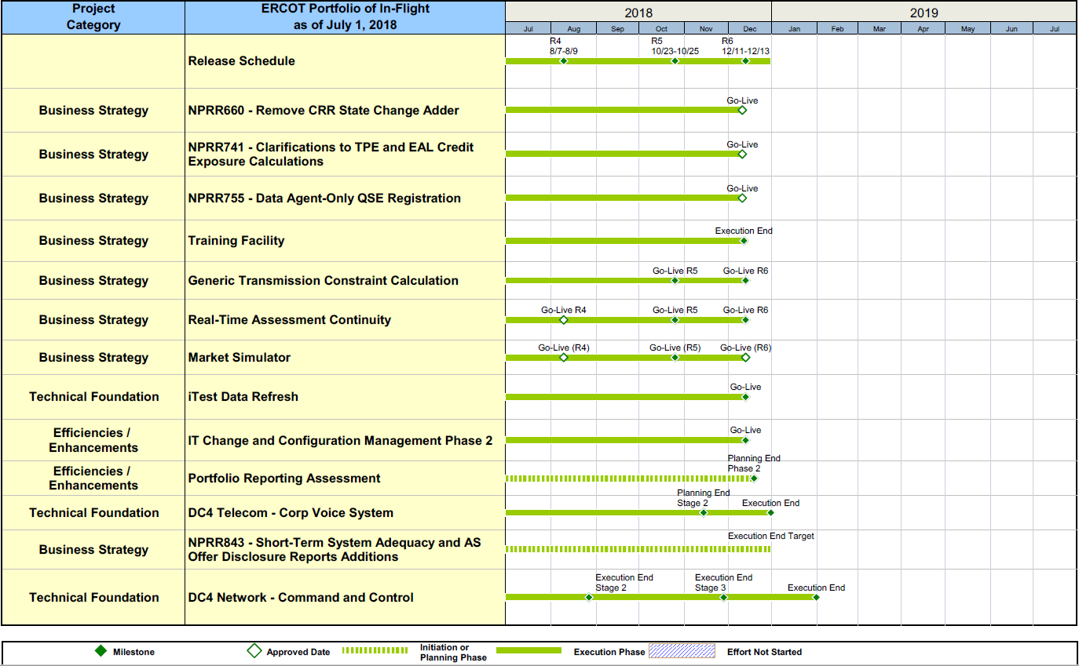
Project Portfolio Status – as of 7/1/2018

Slide 13
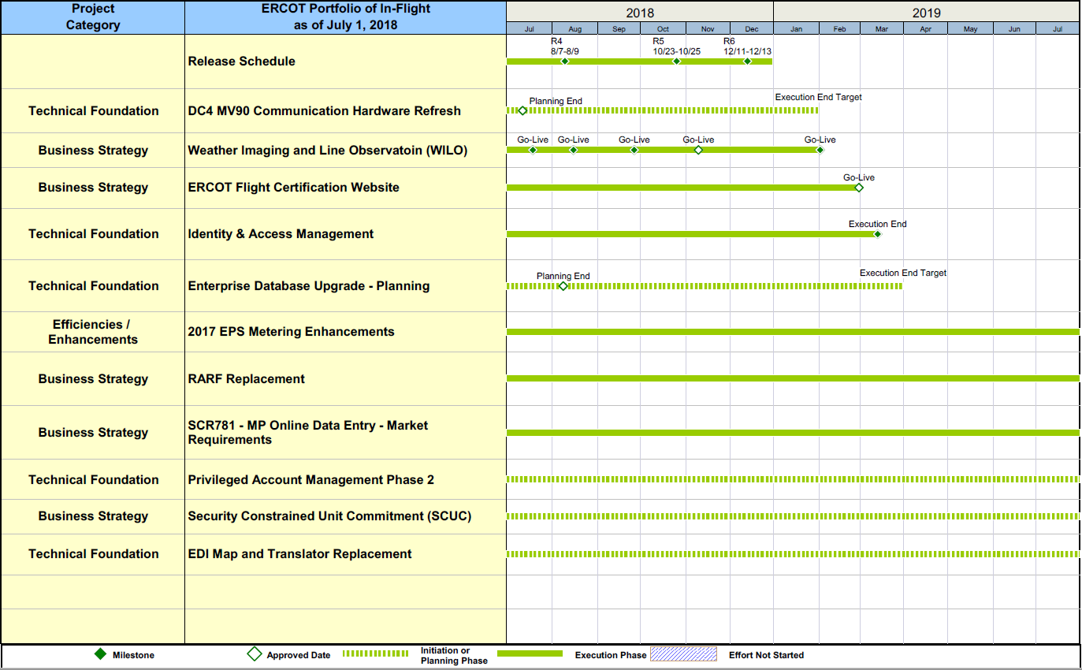
Project Portfolio Status – as of 7/1/2018

Slide 14
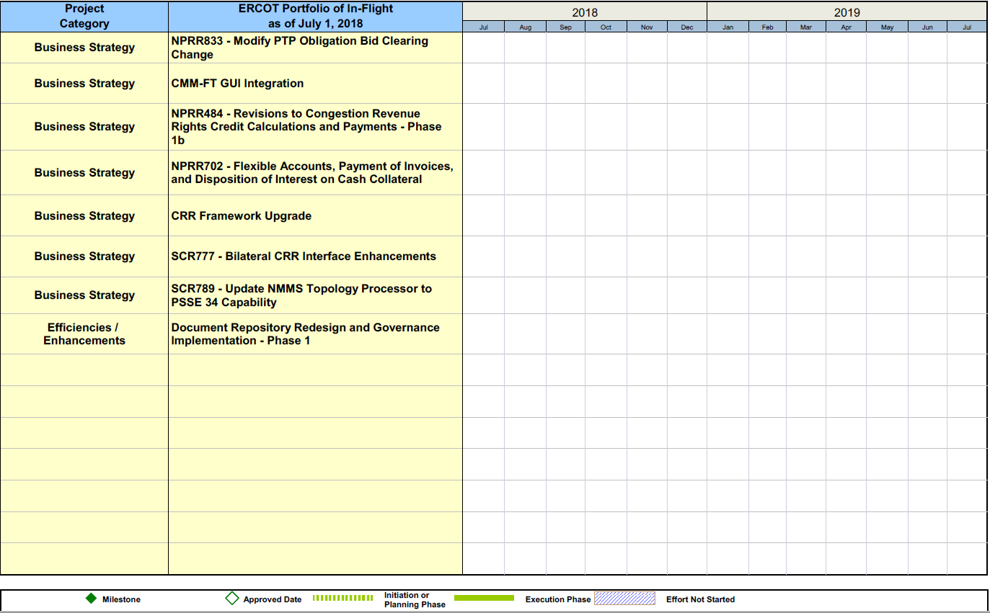
Project Portfolio Status – as of 7/1/2018

Slide 15
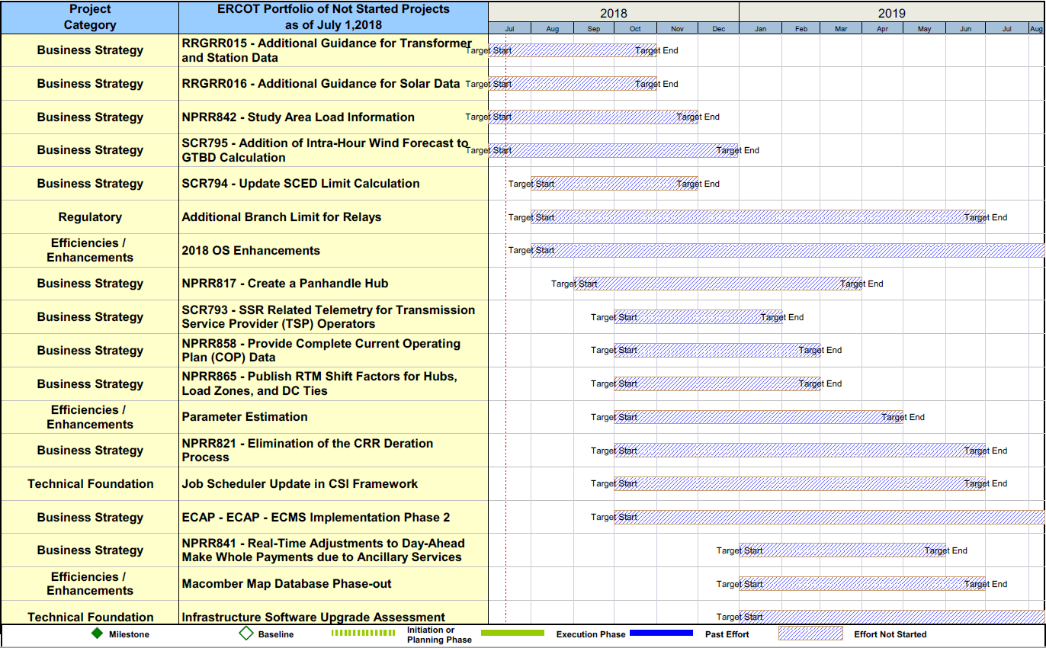
Project Portfolio Status – as of 7/1/2018 – On Hold

Slide 16
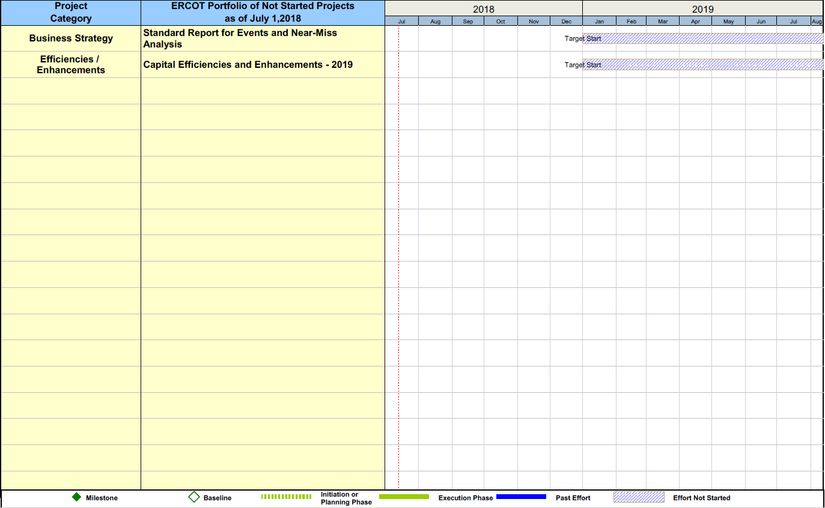
Project Portfolio Status – as of 7/1/2018 – On Hold

