Slide 1
5-min Intra-hour Wind Forecast Performance - June 2018
Operations Analysis Staff
ERCOT
July 9, 2018
QMWG

Slide 2
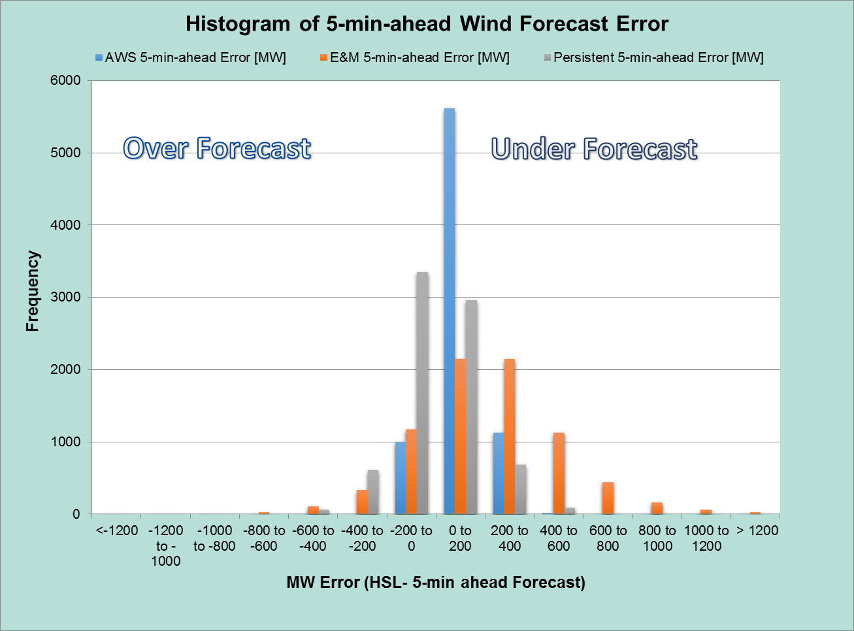
5-min-ahead Wind Forecast Error
 | AWS | E&M | Persistent
MAE (MW) | 114 | 287 | 123

Slide 3
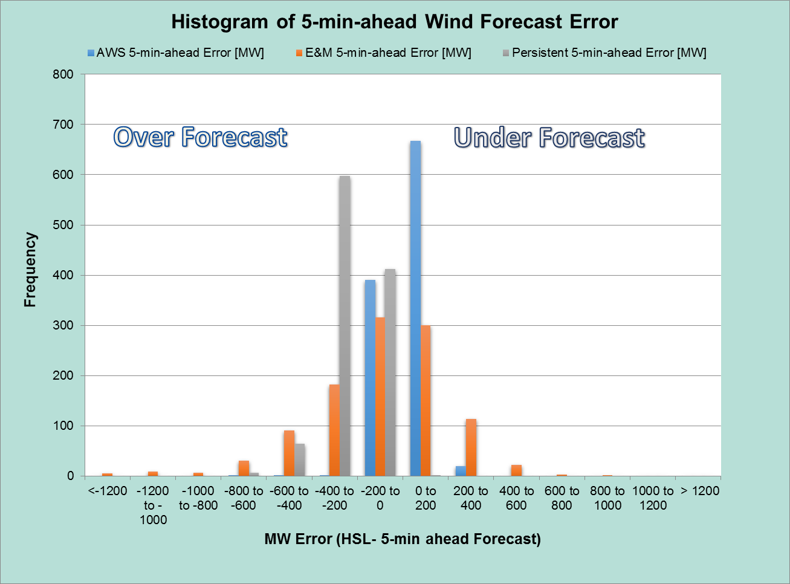
5-min-ahead Wind Forecast Error for Large Wind Ramp Down Events*
 | AWS | E&M | Persistent
MAE (MW) | 69 | 226 | 241
*Wind ramp < -100 MW/5-min

Slide 4
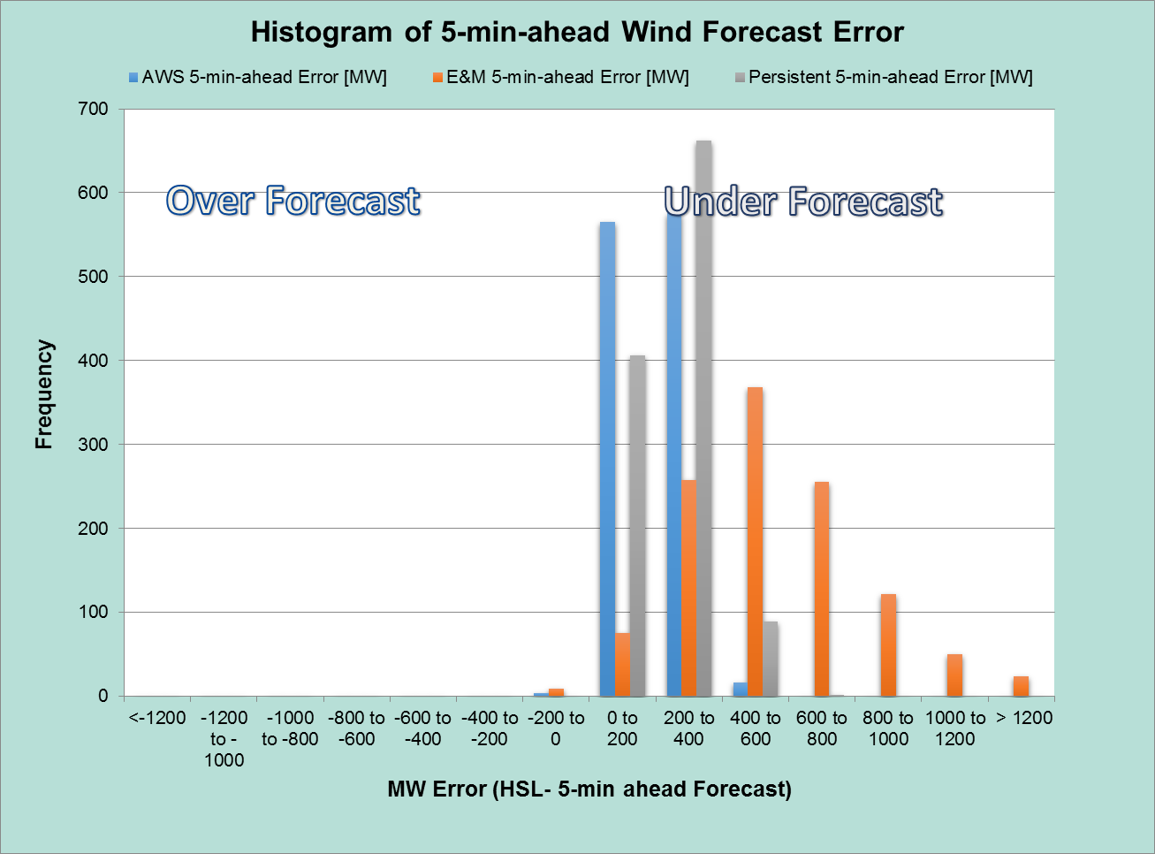
5-min-ahead Wind Forecast Error for Large Wind Ramp Up Events*
 | AWS | E&M | Persistent
MAE (MW) | 206 | 559 | 252
*Wind ramp > 100 MW/5-min

Slide 5
Questions?

