Slide 1
Impact of PTP Obligations with links to Options on RT Revenue
Jian Chen
Market Analysis and Validation
CMWG
July 9th, 2018

Slide 2
Background
Presentations were given in the previous CMWG meetings regarding the causes of RENA during January 2018 event.
One of the findings in the previous discussion was that the DAM Point-to-Point Obligations with links to Options could cause missing RT revenue, only when there are negative difference between the sink and source prices in RT Market.
Settling the PTP Obligation w link to Options in DAM and RTM as options contributes extra DAM congestion, but the amount was relatively lower than the missing RT revenue.

Slide 3
Review of Impact of PTP w links to Options
Days with high impact from PTP w links to Options
Year | > 2 mil (day) | 1~2 mil (day) | 500k~ 1mil (day) | 100k~ 500k (day) | 0~ 100k (day) | Daily average missing RT revenue ($)
2013* | 0 | 2 | 3 | 23 | 292 | 47,556
2014 | 2 | 2 | 5 | 27 | 329 | 68,881
2015 | 2 | 1 | 0 | 23 | 339 | 45,234
2016 | 0 | 3 | 5 | 43 | 315 | 65,560
2017 | 2 | 4 | 9 | 70 | 280 | 110,762
2018** | 4 | 1 | 6 | 33 | 122 | 220,002
Total | 10 | 13 | 28 | 219 | 1677
* The study period for 2013 is from 2/15/2013 to 12/31/2013
** The study period for 2018 is from 1/1/2018 to 6/15/2018

Slide 4
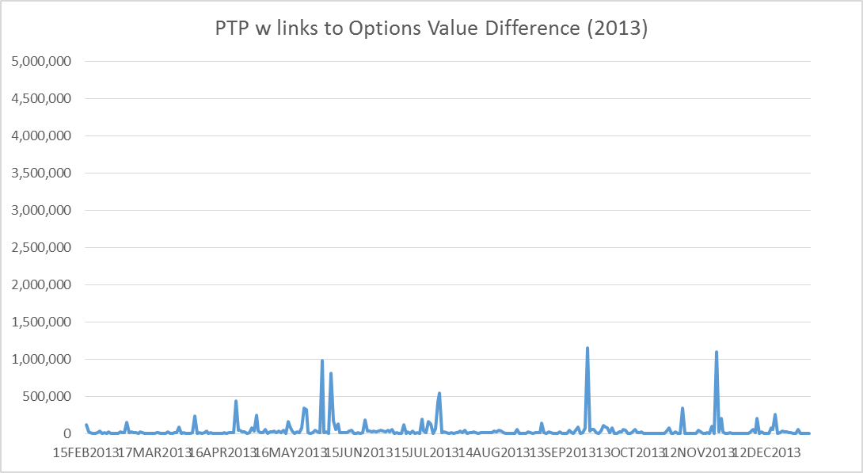
Review of Impact of PTP w links to Options (2013)

Slide 5
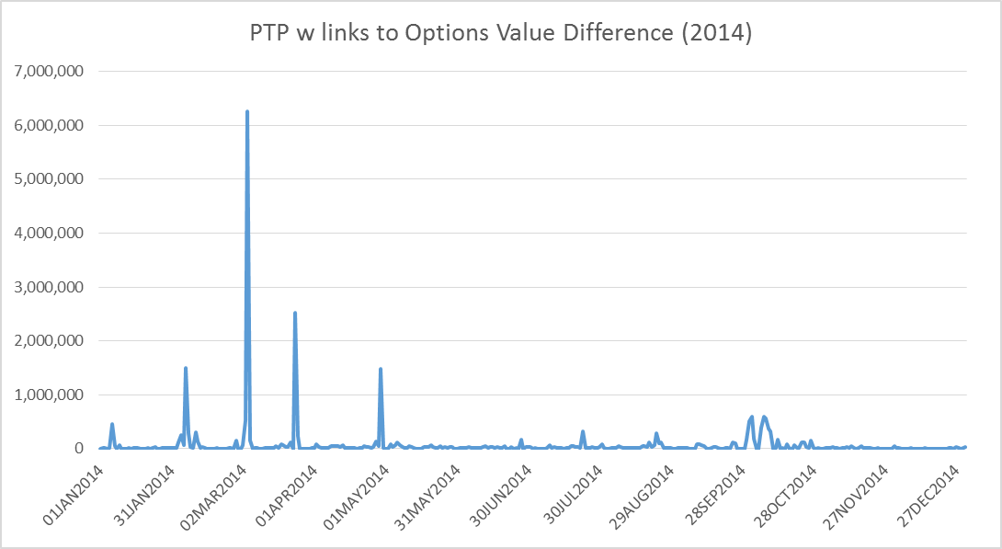
Review of Impact of PTP w links to Options (2014)

Slide 6
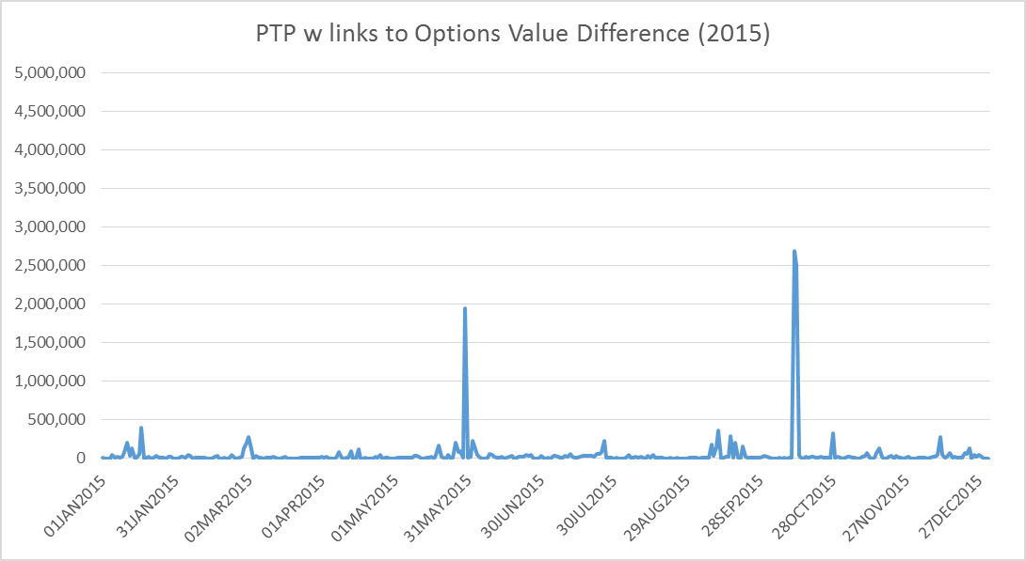
Review of Impact of PTP w links to Options (2015)

Slide 7
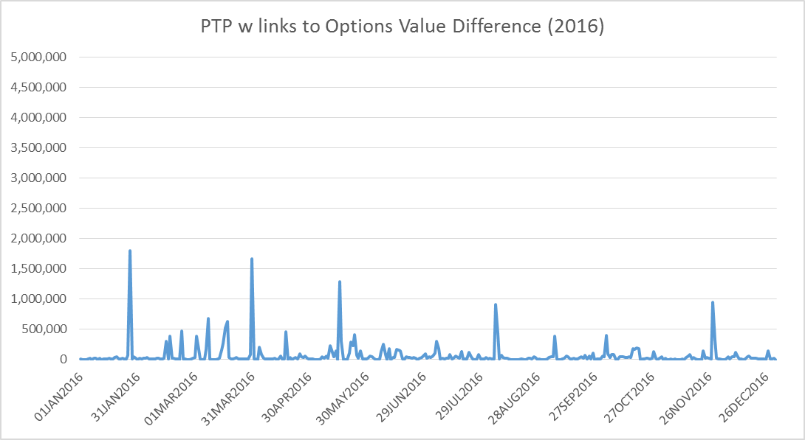
Review of Impact of PTP w links to Options (2016)

Slide 8
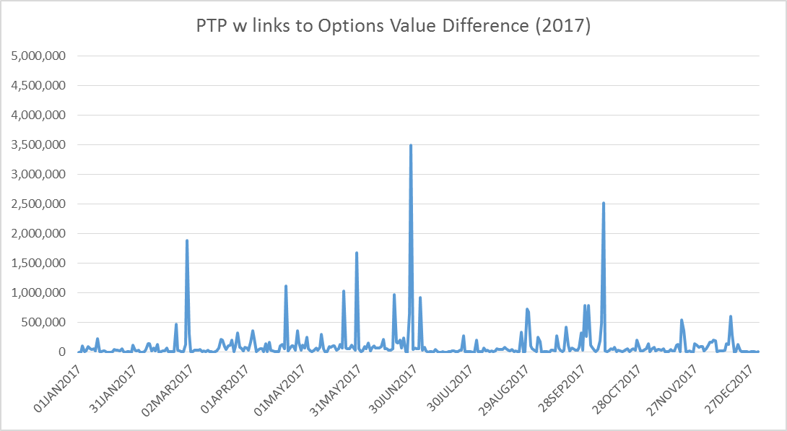
Review of Impact of PTP w links to Options (2017)

Slide 9
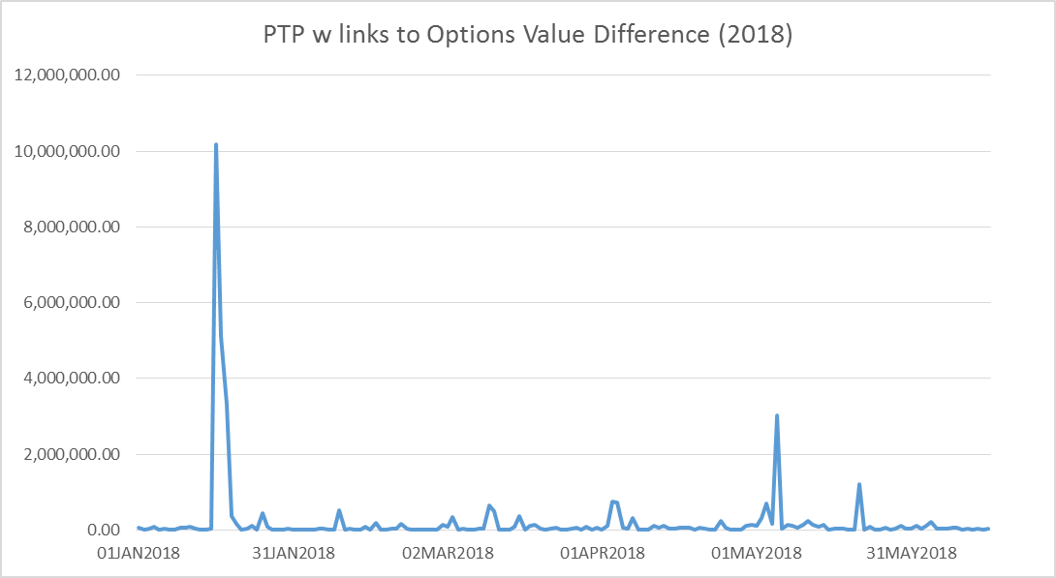
Review of Impact of PTP w links to Options (2018)

Slide 10
Review on Some of Events (03/04/2014)
Major RT congestion on 3/4/2014
The PTPs w link to Options with most negative values were sourced from the Resource Nodes in Valley.
Total missing RT Revenue: $ 6.3 million
CONTINGENCY_NAME | CONSTR_NAME | CONG_RENT ($mil)
BASE CASE | VALIMP | 10.7
SNEDLON5 | RIOHONDO_AT1L | 2.3

Slide 11
Review on Some of Events (03/24/2014)
Major RT congestions on 3/24/2014
The PTPs w link to Options with most negative values were sourced from the Resource Nodes in Valley.
Total missing RT Revenue: $ 2.5 million
CONTINGENCY_NAME | CONSTR_NAME | CONG_RENT ($mil)
SN_SLON5 | KINGSV_LON_HI1_1 | 2.9
BASE CASE | VALIMP | 1.6
SN_SLON5 | KINGSV_KLEBER1_1 | 1.0

Slide 12
Review on Some of Events (10/12/2015)
Major RT congestion on 10/12/2015
The PTPs w link to Options with most negative values were sourced from the Resource Nodes in Valley.
Total missing RT Revenue: $ 2.7 million
Similar situation on the next day 10/13/2015
CONTINGENCY_NAME | CONSTR_NAME | CONG_RENT ($mil)
BASE CASE | VALIMP | 7.6

Slide 13
Review on Some of Events (6/28/2017)
Major RT congestion on 6/28/2017
The PTPs w link to Options with most negative values were sourced from the Resource Nodes in Valley.
Total missing RT Revenue: $ 3.5 million
CONTINGENCY_NAME | CONSTR_NAME | CONG_RENT ($mil)
XNED258 | NEDIN_138H | 5.8
BASE CASE | PNHNDL | 2.4
DJFSCRN8 | GBYGP_17_A | 1.4
SMARZOR5 | 419T419_1 | 1.2

Slide 14
Review on Some of Events (10/9/2017)
Major RT congestion on 10/9/2017
The PTPs w link to options with most negative values were sourced from the Resource Nodes in South and Central Texas with helping shift factor to the constraint DJEWSNG5: JK_TOKSW_1.
Total missing RT Revenue: $ 2.5 million
CONTINGENCY_NAME | CONSTR_NAME | CONG_RENT ($mil)
JK_TOKSW_1 | DJEWSNG5 | 23.0
EXNLH_03_A | SPHRCTR5 | 4.4
PNHNDL | BASE CASE | 4.2
COLETO_VICTOR1_1 | SVICCOL8 | 3.1
IR_SO_05_A | SMDOOAS5 | 2.9
6270__C | DHCKRNK5 | 2.6

Slide 15
Review on Some of Events (Jan 2018)
Daily with high impact from PTP w links to options
The events in January has been reviewed in previous CMWG meeting, which were related to the constraints around Valley area.
DELIVERY_DATE | Missing RT Revenue
16JAN2018 | 10.2
17JAN2018 | 5.1
18JAN2018 | 3.3
05MAY2018 | 3.0

Slide 16
Review on Some of Events (5/5/2018)
Major RT congestion on 5/5/2018
The PTPs w link to Options with most negative values were sourced from the Resource Nodes in South Texas.
Total missing RT Revenue: $ 2.5 million
CONTINGENCY_NAME | CONSTR_NAME | CONG_RENT ($mil)
DELMSAN5 | PAWNEE_SPRUCE_1 | 6.3
SCLETE25 | 6345__B | 1.9
SCOLLON5 | VICTO_WARBU_1A_1 | 1.7
SPLUPIN8 | 154T176_1 | 1.1

Slide 17
CRROPT/PCRROPT
PTP w links to options must link to awarded CRR options, which could be normal CRR options or PCRR options.
Year | Missing RT Revenue ($ million) | Related to CRROPT | Related to PCRROPT
2013* | 15.2 | 3.8 | 11.4
2014 | 25.1 | 5.3 | 19.9
2015 | 16.5 | 2.7 | 13.9
2016 | 24.0 | 3.3 | 20.7
2017 | 40.4 | 10.1 | 30.4
2018** | 36.5 | 10.2 | 26.3
Total | 157.7 | 35.3 | 122.5
* The study period for 2013 is from 2/15/2013 to 12/31/2013
** The study period for 2018 is from 1/1/2018 to 6/15/2018

Slide 18
Weekday/Weekend
Year | Daily average for weekdays($) | Daily average for weekends($) | Overall daily average
2013* | 54,772 | 29,671 | 47,556
2014 | 86,428 | 24,846 | 68,881
2015 | 45,703 | 44,059 | 45,234
2016 | 76,096 | 39,717 | 65,560
2017 | 123,538 | 78,702 | 110,762
2018** | 241,130 | 166,507 | 220,002
Total | 91,868 | 54,069 | 81,055
* The study period for 2013 is from 2/15/2013 to 12/31/2013
** The study period for 2018 is from 1/1/2018 to 6/15/2018

Slide 19
Summary
Since 2013, PTP Obligations with links to Options caused significant missing RT revenue.
The high amount of missing RT revenue only happened occasionally, when there was high congestion in RTM and also the congestion caused high LMPs on the Resource Nodes.
Among the missing RT revenue related to the PTP w links to options, most of them were linked back to the PCRR options.

