Slide 1
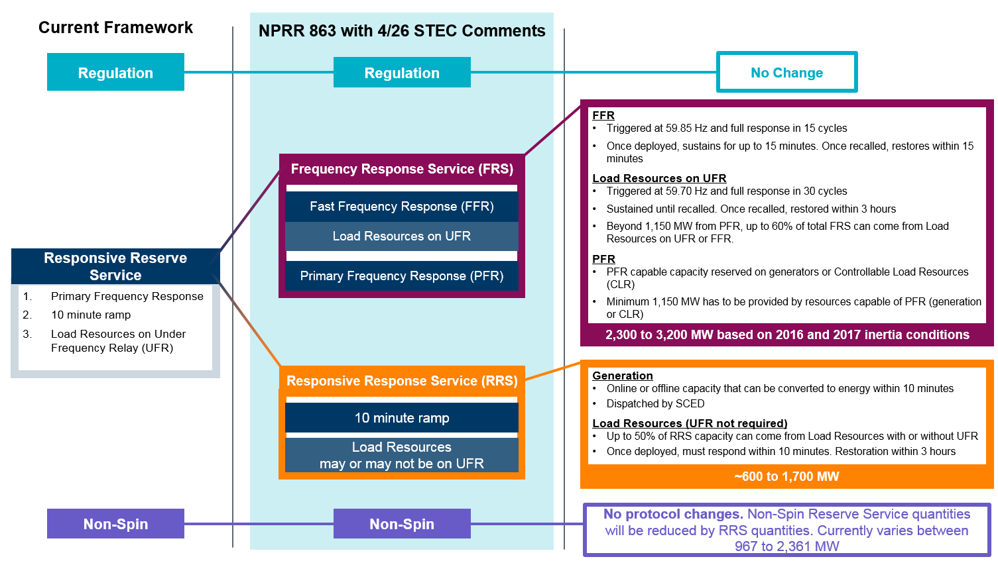
Proposed NPRR 863 Ancillary Service Framework Changes

