Slide 1
Market Credit Working Group update to the Wholesale Market Subcommittee
Bill Barnes NRG, Chair
Josephine Wan AE, Vice Chair
07/11/2018

Slide 2
MCWG update to WMS
General Update
June 20th Joint MCWG/CWG Meeting
6 NPRRS reviewed for their credit impacts
877 NPRR Use of Actual Interval Data for IDR ESI IDs for Initial Settlement – CWG comments on credit improvement
Rest operational without any credit impact

Slide 3
MCWG update to WMS
Review process for Posting of Transaction/Acquisition Business Contact Information (Defaults & Mass Transition)
A potential Retail Market Guide Revision Request (RMGRR) introduces a process for a Competitive Retailer to provide Transition/Acquisition Business contact information be posted publically.
To better facilitate the sale of Retail Electric Provider’s (REP) portfolio and make the possible REP contact list available for this summer, ERCOT is considering a temporary approach to develop a list and REPs can voluntarily supply a contact info to be available 24x7 to respond to REPs who wish to quickly sell their books prior to a possible credit default/mass transition.
COMPLETE

Slide 4
MCWG update to WMS
Review of Mass Transition Timeline
Discussions at RMS, Texas SET, and CWG considered options for revisions to mass transition timing:
Reduce two hours notice between ERCOT notification and the coordination meeting, especially on a day before a weekend or ERCOT holiday (RMGRR).
Reduce two day window between current date and scheduled meter read date (RMGRR, NPRR).
Other operational issues unrelated to credit taken up by RMS/TX SET.
Discussion will continue at RMS and upcoming CWG/MCWG meetings.
Credit Parameter Review
Proposed approach:
Decompose M1 into two components:
M1a – Time period required to cover any termination event
M1b – Time period to cover mass transitions only
M1a applicable to all entities; M1b applicable only to Counter-Parties with Load
In M1b, adjust the mass transition days to reflect the decline in potential exposure during the transition period
Give credit against M1b to Counter-Parties meeting ERCOT Creditworthiness Standards

Slide 5
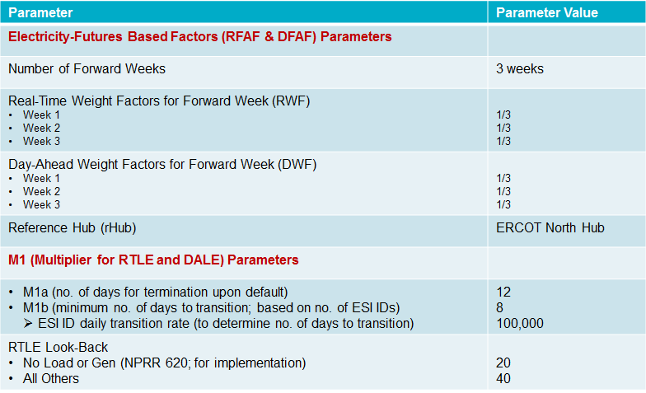
MCWG update to WMS
Credit Parameter Review

Slide 6
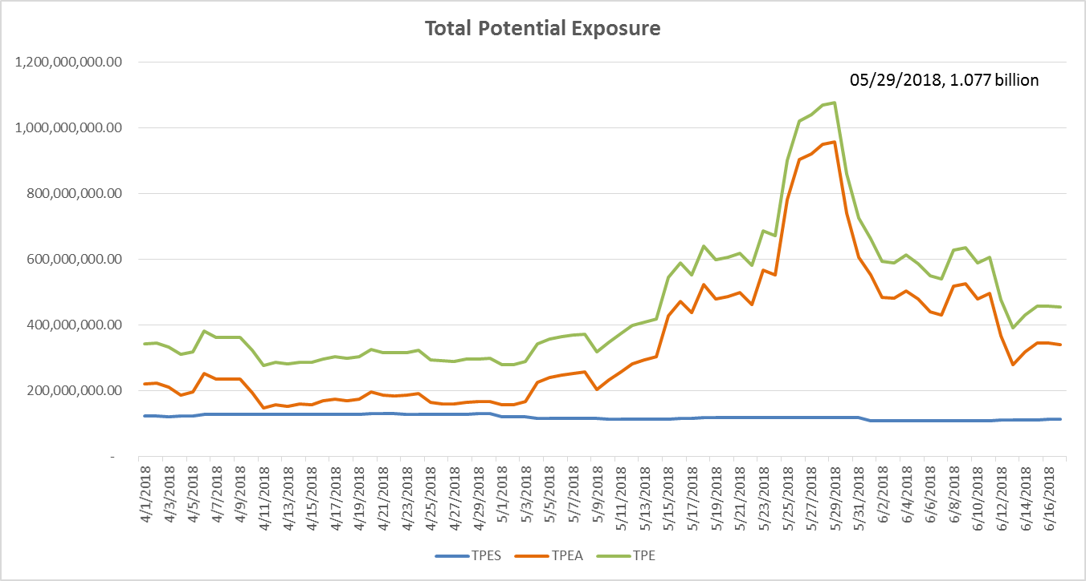
Credit Exposure Update

Slide 7
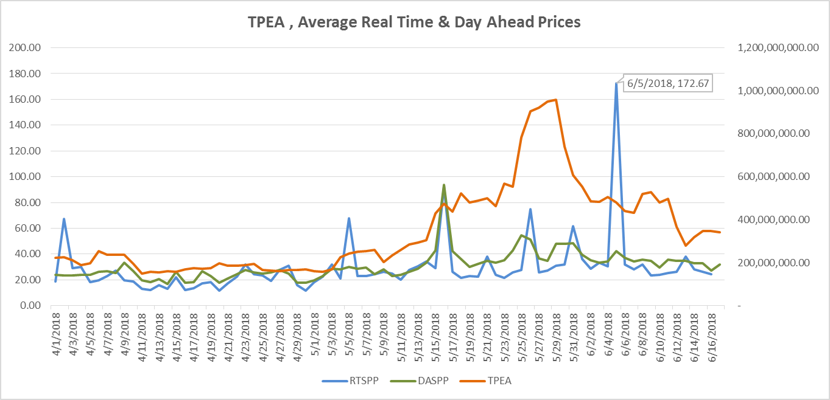
Credit Exposure Update

Slide 8
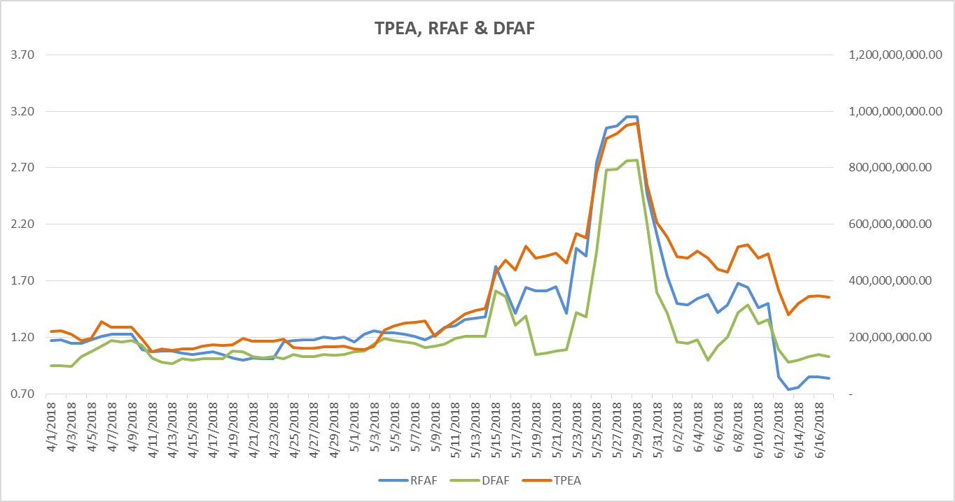
Credit Exposure Update

Slide 9
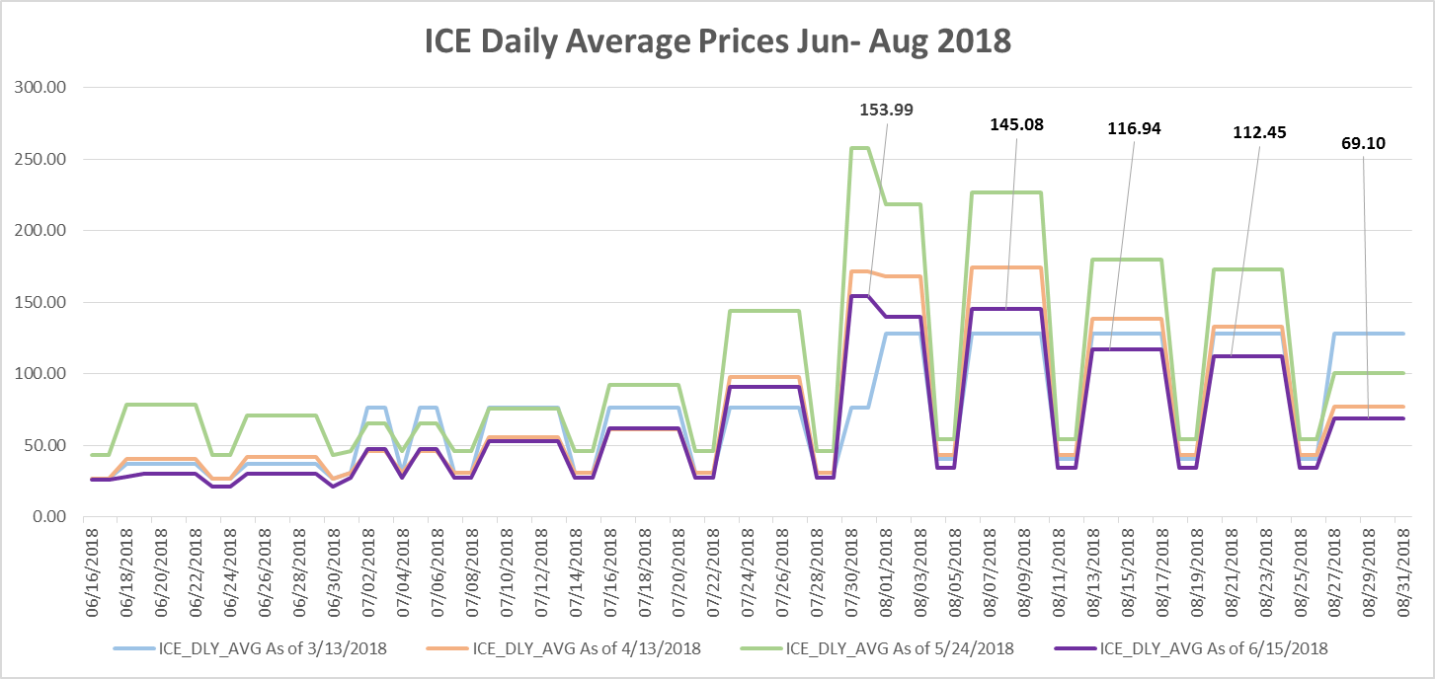
Credit Exposure Update

Slide 10
MCWG update to WMS
Letter of Credit Concentration Limit
Current Process
Each letter of credit issuer limit is subject to an overall limit of $750 million per issuer.
The limit is based on Long-Term or Issuer Rating and Tangible Net Worth
If a letter of credit issuer limit is breached, Counter-Parties utilizing that issuer will be notified and no new letters of credit from the issuer will be accepted while the limit remains breached.
After four months of the limit in breach, ERCOT will no longer accept new letters of credit or amendments to existing letters of credit from that issuer.
Letters of credit held as collateral at the time of an issuer limit breach will not be rejected.
ERCOT in its sole discretion may authorize exceptions to these limits.
Proposed Process
If a letter of credit issuer limit is breached due to a downgrade in the issuer’s credit rating, Counter-Parties utilizing that issuer will be notified and no new letters of credit from the issuer will be accepted while the limit remains breached.
After four months of the limit in breach following the downgrade, ERCOT will no longer accept new letters of credit or amendments to existing letters of credit from that issuer. Letters of credit held as collateral at the time of such breach will:
Option 1
not be rejected.
Option 2
be rejected on a pro-rata basis
Option 3
be rejected based on the order in which it was received

