Slide 1
PDCWG Report to ROS
Chair: Percy Galliguez, Brazos Electric Power Cooperative, Inc.
Vice Chair: Chad Mulholland, NRG
ROS
July 17th, 2018

Slide 2
Report Overview & Notes
Report Overview
Meeting Minutes
BAL-001-TRE-1 FMEs & IMFR
2 FMEs in the month of May
Frequency Control Report

Slide 3
Meeting Minutes
PDCWG Meeting 05/9/18
NPRR863 – Separation of PFR and RRS Ancillary Service; Review by PDCWG Members on updated language to be discussed at next meeting
NPRR872 – Modify the SASM Shadow Price CAP. NPRR wording clearly does not improve ERCOT reliability; however, whether there is a material decrease in reliability is difficult to ascertain.
NERC Reliability Guideline: Generating Unit Operations During Complete Loss of Communications
Regulation & Frequency Control Reports
BAL-001-TRE-001
ERCOT document for Operating Condition Guidelines for PFR Performance
ERCOT preparing LCRA-Combined Cycle Steam Droop SAR
ERCOT to determine Performance Evaluation to check for pass/fail before scoring and
No Evaluation of Resources below LSL

Slide 4
Frequency Measurable Events Performance

Slide 5
Frequency Measurable Events
There were 2 FMEs in May
5/5/2018 16:19:03
Loss of 536 MW(IMFR=603MW/0.1Hz)
Interconnection Frequency Response:
7 of 43 Evaluated Generation Resources(1 of 24 RRS Providers) had less than 75% of their expected Initial Primary Frequency Response.
9 of 43 Evaluated Generation Resources(3 of 24 RRS Providers) had less than 75% of their expected Sustained Primary Frequency Response.
5/21/2018 8:06:22
Loss of 560 MW(IMFR=561MW/0.1Hz)
Interconnection Frequency Response:
5 of 24 Evaluated Generation Resources(1 of 24 RRS Providers) had less than 75% of their expected Initial Primary Frequency Response.
5 of 24 Evaluated Generation Resources(1 of 24 RRS Providers) had less than 75% of their expected Sustained Primary Frequency Response.

Slide 6
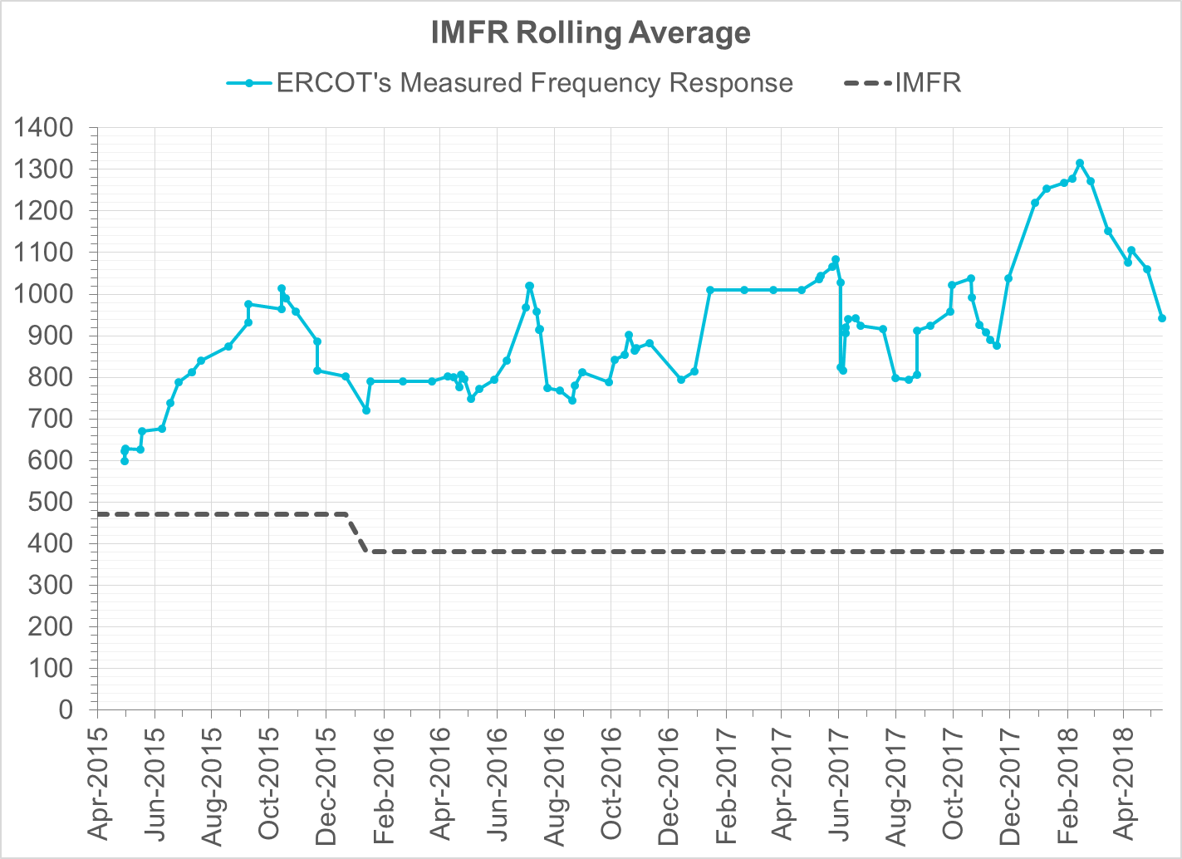
Interconnection Minimum Frequency Response (IMFR) Performance
IMFR Performance currently 943.16 MW/0.1Hz

Slide 7
Frequency Control Report
May 2018

Slide 8
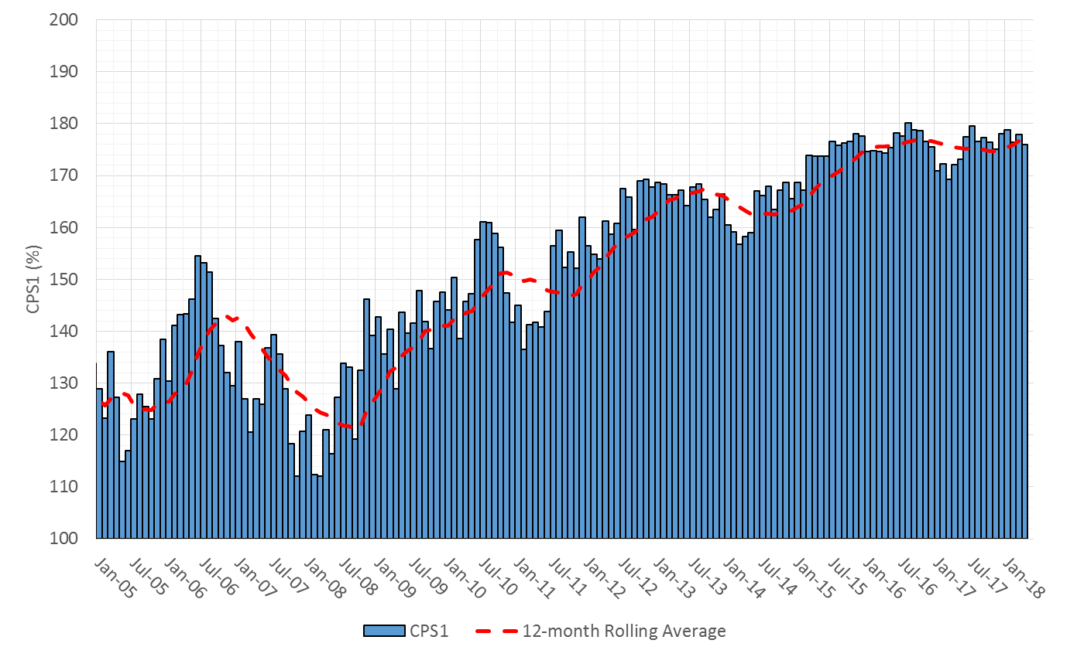
CPS1 Performance

Slide 9
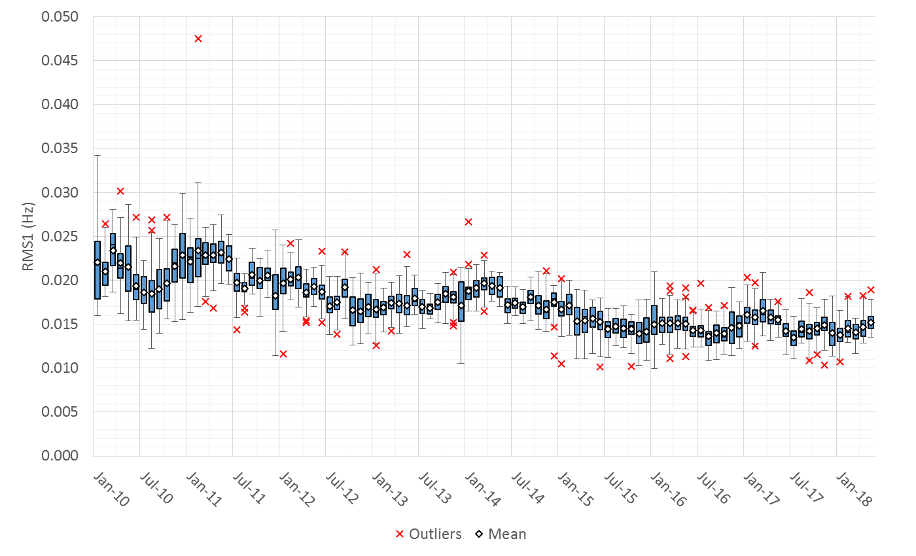
RMS1 Performance of ERCOT Frequency

Slide 10
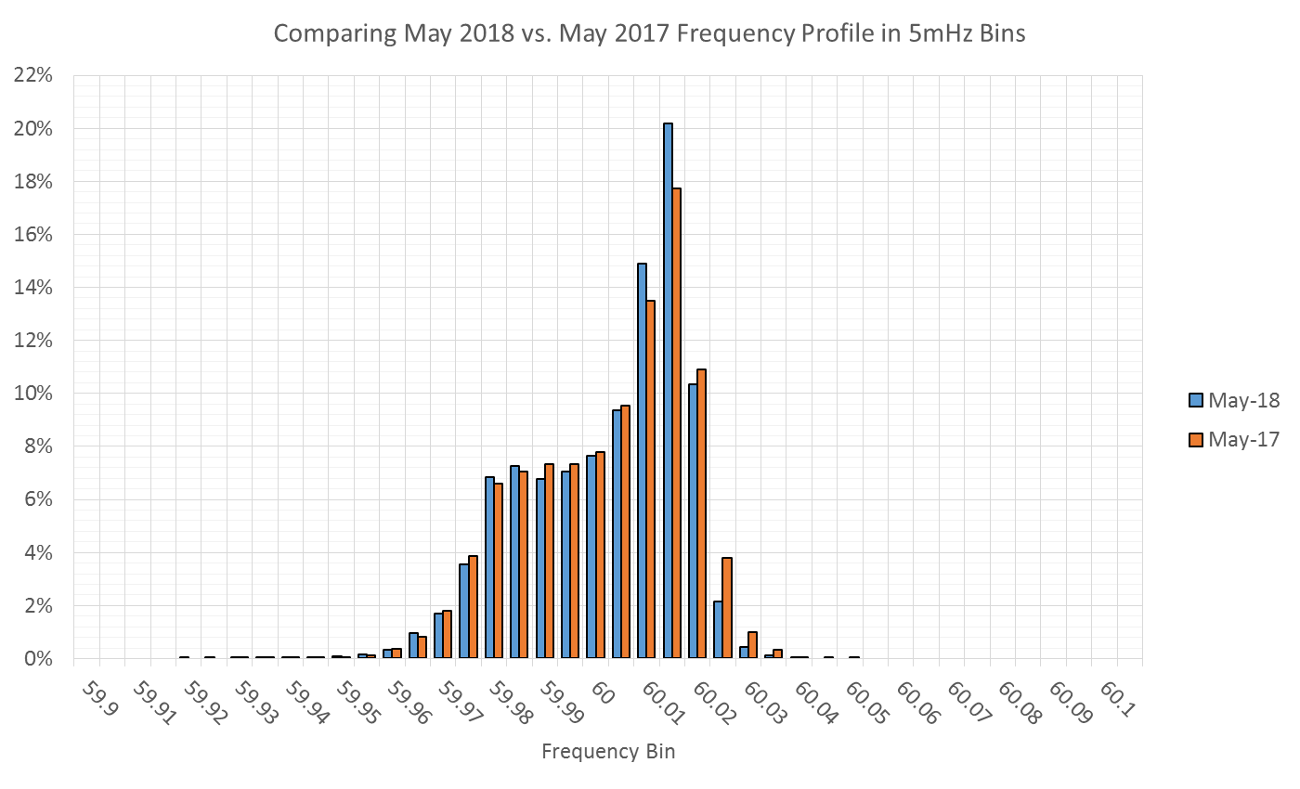
Frequency Profile Analysis

Slide 11
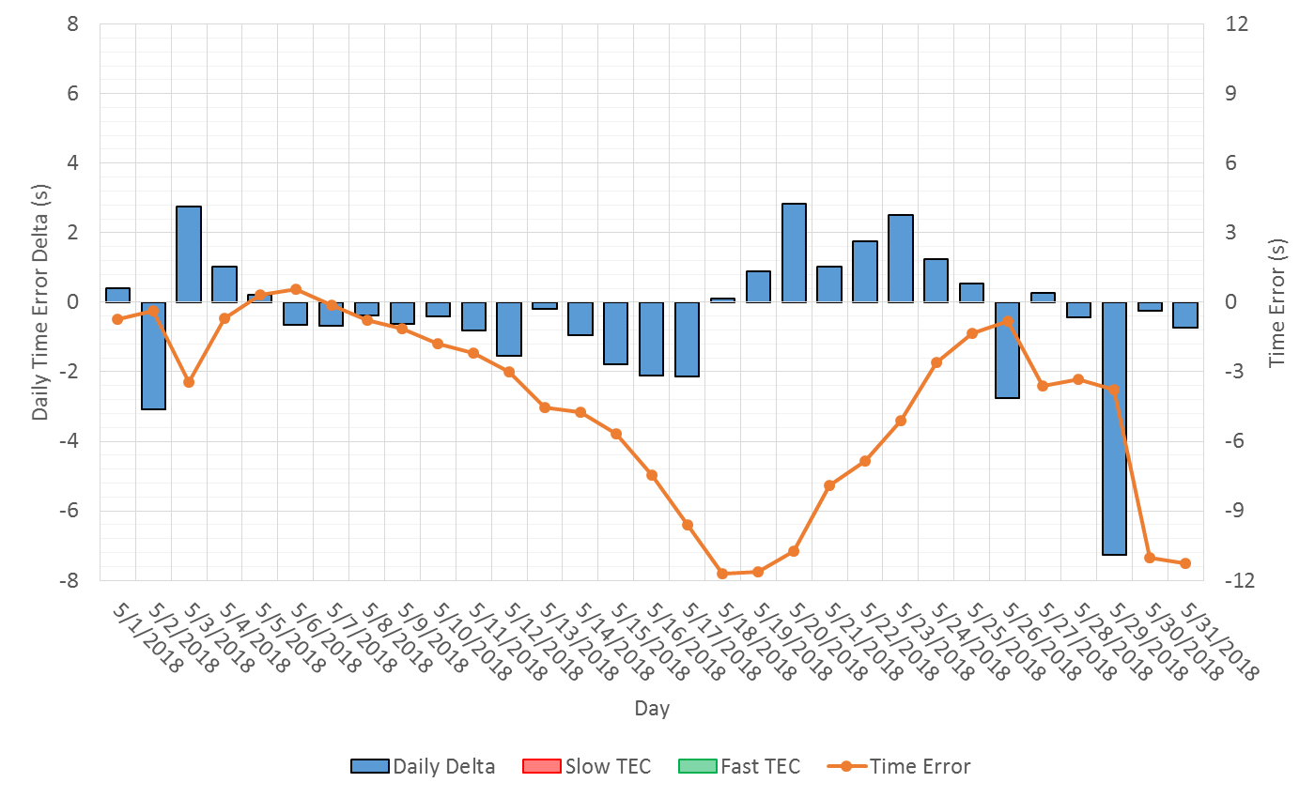
Time Error Corrections
There were no Time Error Corrections (TEC) in March

Slide 12
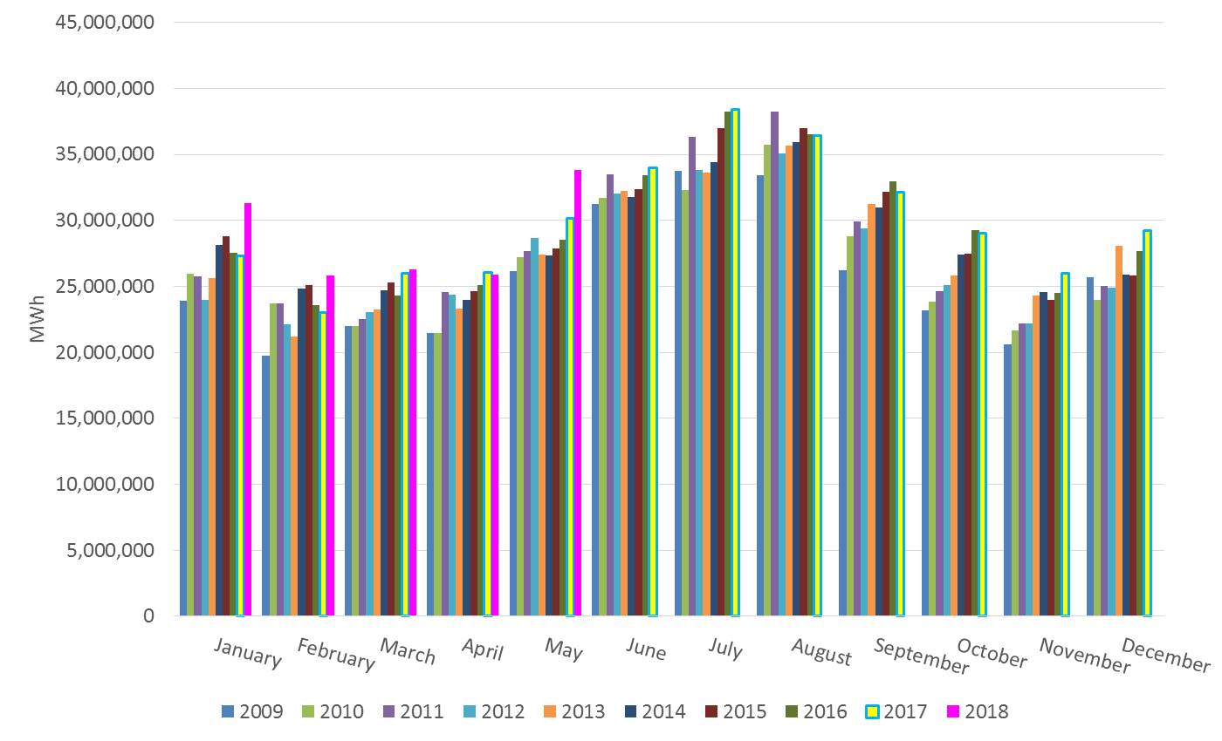
ERCOT Total Energy

Slide 13
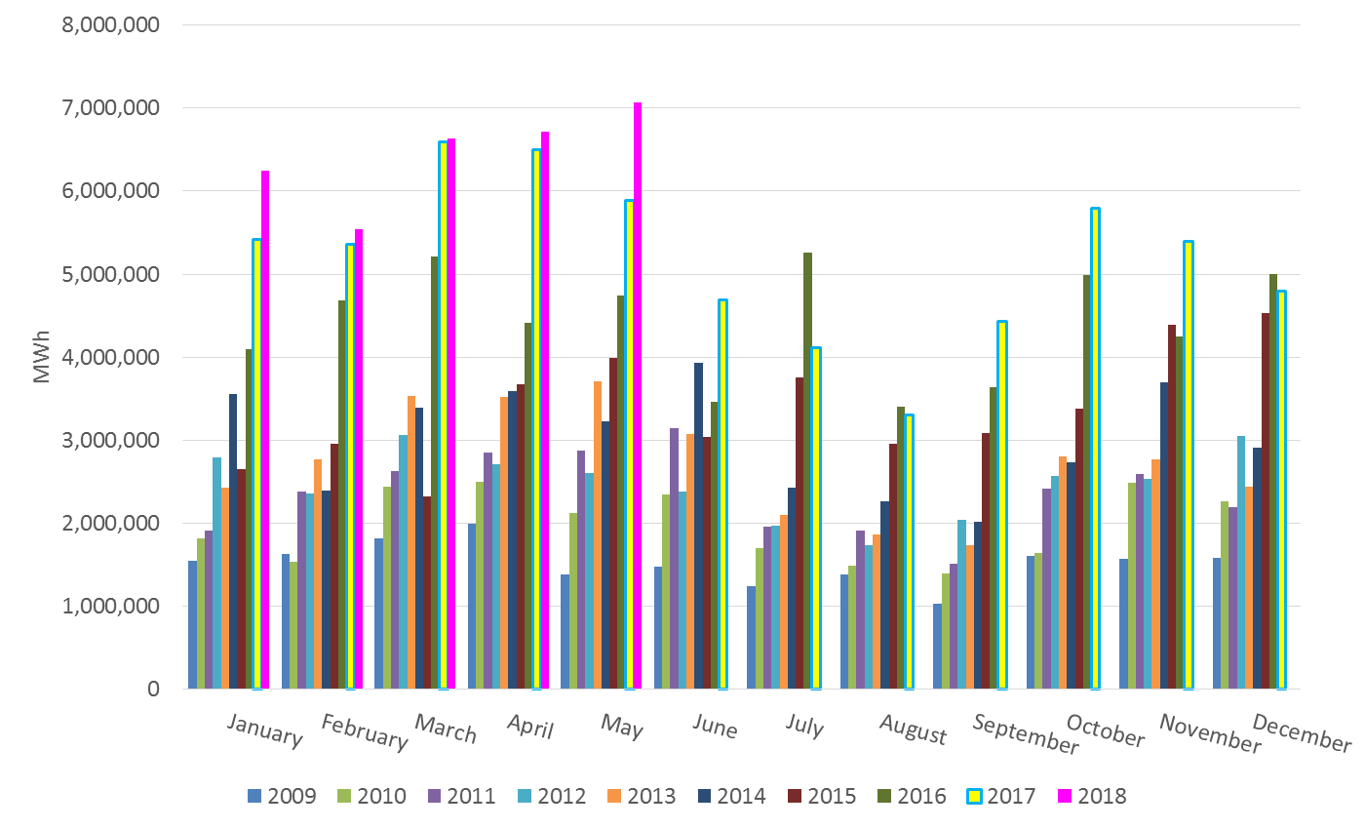
ERCOT Total Energy from Wind Generation

Slide 14
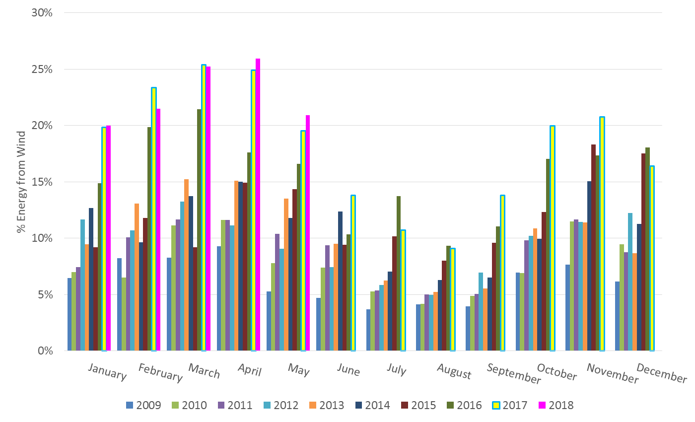
ERCOT % Energy from Wind Generation

Slide 15
Questions?

