Slide 1
Texas
Standard
Electronic
Transactions
Introduction to TxSET

Slide 2
Administrative Info

Slide 3
1: Introduction

Slide 4
What is TxSET?
TX SET TRANSACTIONS
TX SET (Standard Electronic Transactions) are a set of ANSI EDI transaction guidelines customized by the TX SET Working Group for the ERCOT Retail Market.
These standardized transactions support retail processes as documented in the various ERCOT Market rules.
TX SET WORKING GROUP
TX SET is an ERCOT Working group comprised of stakeholders participating in the development and maintenance of TX SET EDI transactions .
The Working Group reports to the Retail Market Subcommittee (RMS) and analyzes the need for new electronic transactions or modifications to existing electronic transactions based upon changes that occur within the retail electric market that affect EDI (electronic data interchange) transaction processing.

Slide 5
Why do we have TxSET transactions?
Why do we have it?
  Can you imagine the volumes of transactions per day?
Standardization is key!
  What are some of the major benefits?
    Increased cost savings
    Improved accuracy
    Reduction in errors
    Improved efficiency
    Additional transparency and visibility
    Greater security
    Environment-friendly

Slide 6




Transaction Routing
TX SET Transactions could potentially follow two paths.
Point to point (REP – TDSP)
Flow through ERCOT
814_01
814_02
814_16
814_17
814_03
814_04
814_24
814_25
867_03
867_04
REG TXNs
REG TXNs
P2P TXNs
REP’s Customer Information System
650_01
650_02
810_02
TDSP’s Customer Information System

Slide 7
NAESB Protocol
TX SET EDI Transactions are securely transmitted through
servers from sender to receiver with the NAESB EDM (Electronic Delivery Mechanism) v1.6 Protocol installed on each server.
This is a protocol with specialized technical enhancements modified to fit the ERCOT retail market.
The NAESB EDM v1.6 is a National Standard maintained by the North American Energy Standards Board.
The ERCOT NAESB EDM v1.6 guideline is managed by the ERCOT Working Group TDTMS (Texas Data Transport and MarkeTrak System).

Slide 8
When should TxSET Transactions be used?
TX SET transactions should be used when needing to execute a Retail Market
Process supported by TX SET EDI.
In the event a process cannot be supported by TX SET EDI transactions, the
Market standard method should be used. Please consult the ERCOT Retail Market Guide.
Some of these processes include:
The Safety Net Spreadsheet
MarkeTrak

Slide 9
2: Understanding Retail Market Processes

Slide 10



Hierarchy of Rules
Public Utility Regulatory Act (PURA)
PUCT Substantive Rules
ERCOT Protocols

Slide 11
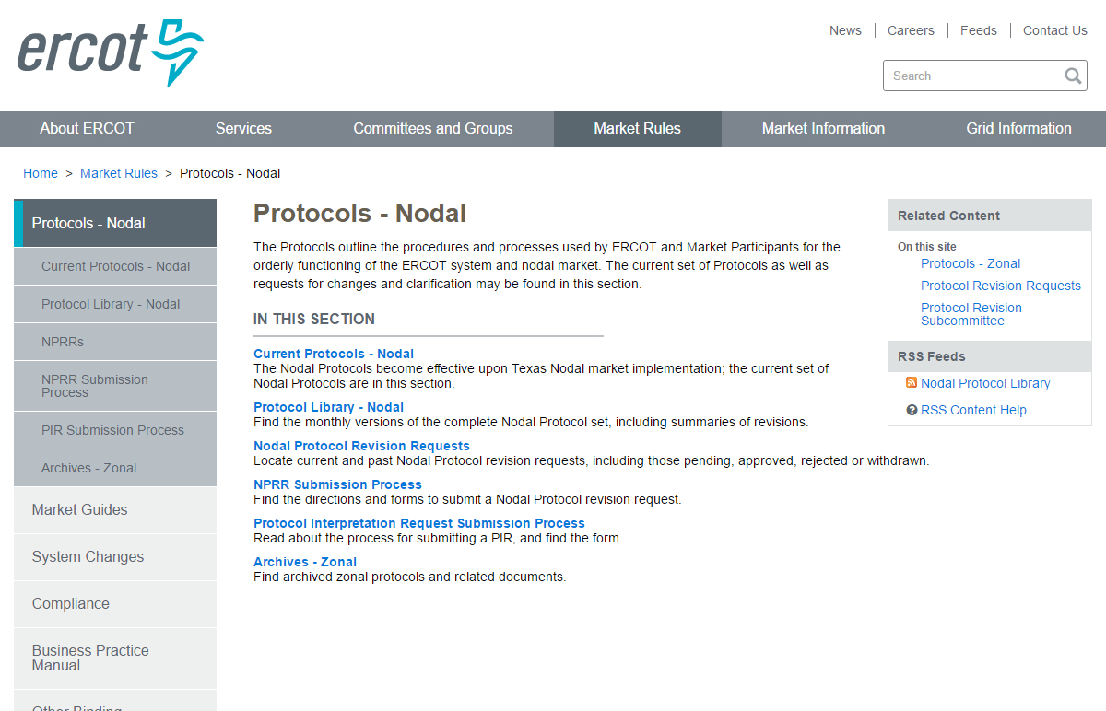
ERCOT Protocols

Slide 12
What Are ERCOT Protocols?
The Electric Reliability Council of Texas (ERCOT) Protocols, created through the collaborative efforts of representatives of all segments of Market Participants, as amended from time to time, that contains the scheduling, operating, planning, reliability, and Settlement (including Customer registration) policies, rules, guidelines, procedures, standards, and criteria of ERCOT.
These Protocols outline the procedures and processes used by ERCOT and Market Participants for the orderly functioning of the ERCOT system and nodal market.
Market Participants, the Independent Market Monitor (IMM), and ERCOT shall abide by these Protocols.

Slide 13
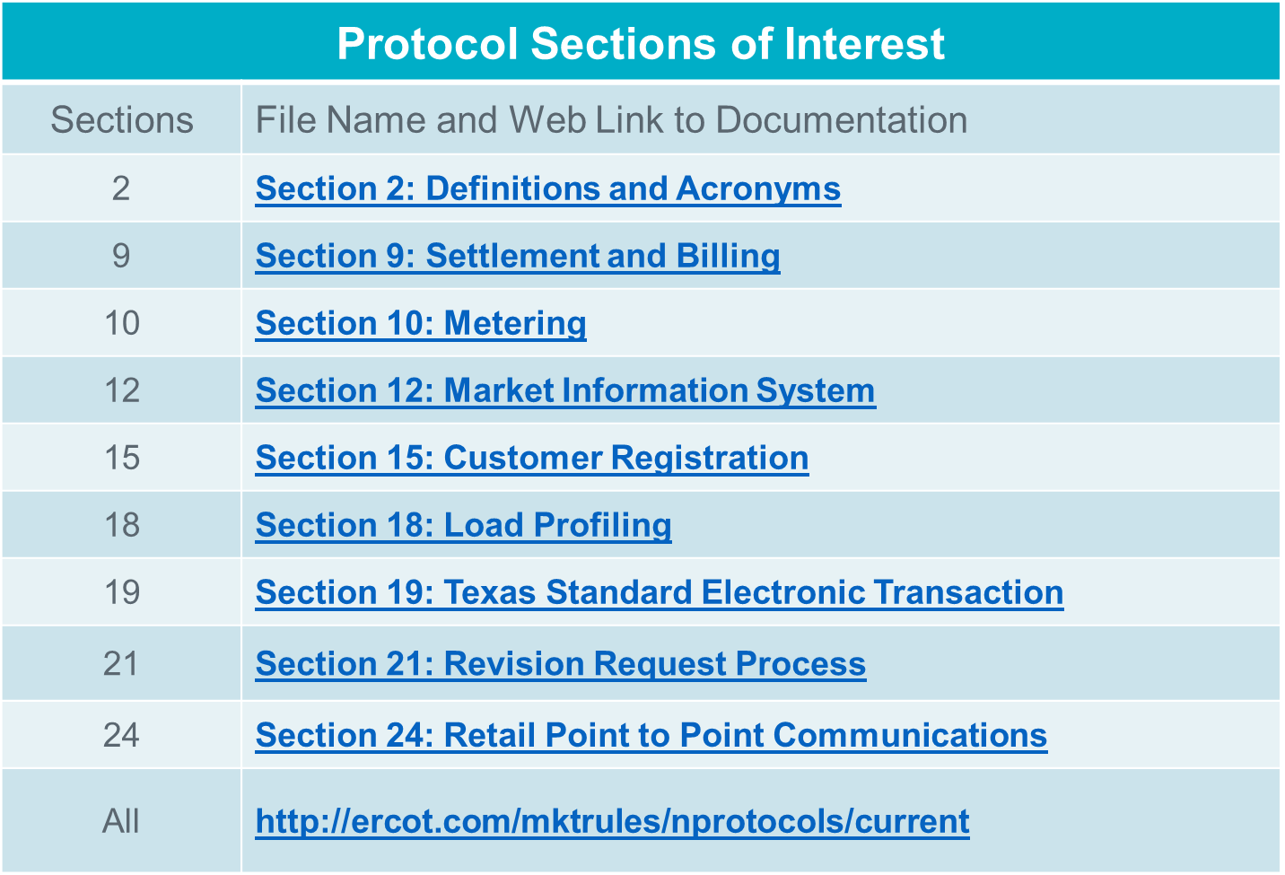
ERCOT Protocols

Slide 14
ERCOT Protocol Section 15
Customer Registration
This section provides Market Participants and ERCOT with the market rules and transactional timing when operating in ERCOT’s Retail Electric Market and providing Customer Choice, for example:
  ERCOT shall maintain a registration database of all metered and unmetered Electric Service Identifiers (ESI IDs) in Texas for Customer Choice.
  All Customer registration processes will be conducted using the appropriate Texas Standard Electronic Transactions (TX SETs). Definitions of all TX SET codes referenced in this Section can be found in Section 19, Texas Standard Electronic Transaction.
  All CRs with Customers in Texas, whether operating inside the ERCOT Region or not, shall be required to register their Customers in accordance with this Section.

Slide 15
ERCOT Protocol Section 15
Section 15.1.1 Customer Switch of Competitive Retailer
Section 15.1.2 Response Transaction from ERCOT
Section 15.1.3 Transition Process, includes Mass Transition and Acquisition(s)
Section 15.1.4 Move-In (No Construction)
Section 15.1.5 Service Termination aka “Move-Out”
Section 15.1.6 Concurrent Processing aka Solution to Staking Logic
Section 15.1.7 Move-In or Move-Out Date Change
Section 15.1.8 Cancellation of Registration Transaction
Section 15.1.9 Continuous Service Agreement (CSA CR) Processing
Section 15.1.10 CSA CR Processing in MOU or EC Service Territory
Section 15.2 Database Queries
Section 15.3 Monthly Meter Reads
Section 15.4 Electric Service Identifier (ESI ID) and ESI ID Formatting

Slide 16
ERCOT Protocol Section 19
Texas Standard Electronic Transactions (TX SETs)
Provides the mechanism that enables and facilitates the retail business processes in the deregulated Texas electric market. The Texas SET Implementation Guides shall serve as the standard for the applicable TX SETs among all Market Participants and ERCOT.
This Section shall cover:
  Transactions between Transmission and/or Distribution Service Providers (TDSPs) (refers to all TDSPs unless otherwise specified), Competitive Retailers (CRs) and ERCOT;
  Technical Advisory Committee (TAC) subcommittee and ERCOT responsibilities; and
  Texas SET Change Control process.

Slide 17
ERCOT Protocol Section 19
Section 19.1 Overview
Section 19.2 Methodology
Section 19.3 Texas Standard Electronic Transaction Definitions
Section 19.3.1 Defined Texas Standard Electronic Transactions
Section 19.4 Texas Standard Electronic Transaction Change Control Process
Section 19.5 Texas Standard Electronic Transaction Acceptable Character Set
Section 19.5.1 Alphanumeric Field(s)
Section 19.6 Texas Standard Electronic Transaction Envelop Standards
Section 19.6.1 ERCOT Validation
Section 19.7 Advanced Meter Interval Data Format and Submission
Section 19.8 Retail Market Testing

Slide 18
ERCOT Protocol Section 24
Retail Point to Point Communications
Point to point communications include transactions flowing directly between Competitive Retailers (CRs), and Transmission and/or Distribution Service Providers (TDSPs) and do not flow through ERCOT. These point to point transactions may be Customer requested service orders and CR/TDSP invoicing and remittance advise transactions.

Slide 19
ERCOT Protocol Section 24
Section 24.1 Maintenance Service Order Request
Section 24.1.1 Disconnect/Reconnect
Section 24.1.2 Suspension of Delivery Service
Section 24.1.3 Switch Hold Indicator
Section 24.1.3.1 Tampering Switch Hold
Section 24.1.3.2 Bill Payment Switch Hold
Section 24.2 TDSP to Competitive Retailer Invoice
Section 24.3 Remittance Advice
Section 24.4 MOU/EC TDSP to CR Remittance Advice
Section 24.5 Maintain Customer Information Request
Section 24.6 MOU/EC TDSP to CR Maintain Customer Information Request

Slide 20
Hierarchy of Rules
ERCOT Protocols
ERCOT
Market Guides
Other Binding Documents (OBDs)

Slide 21
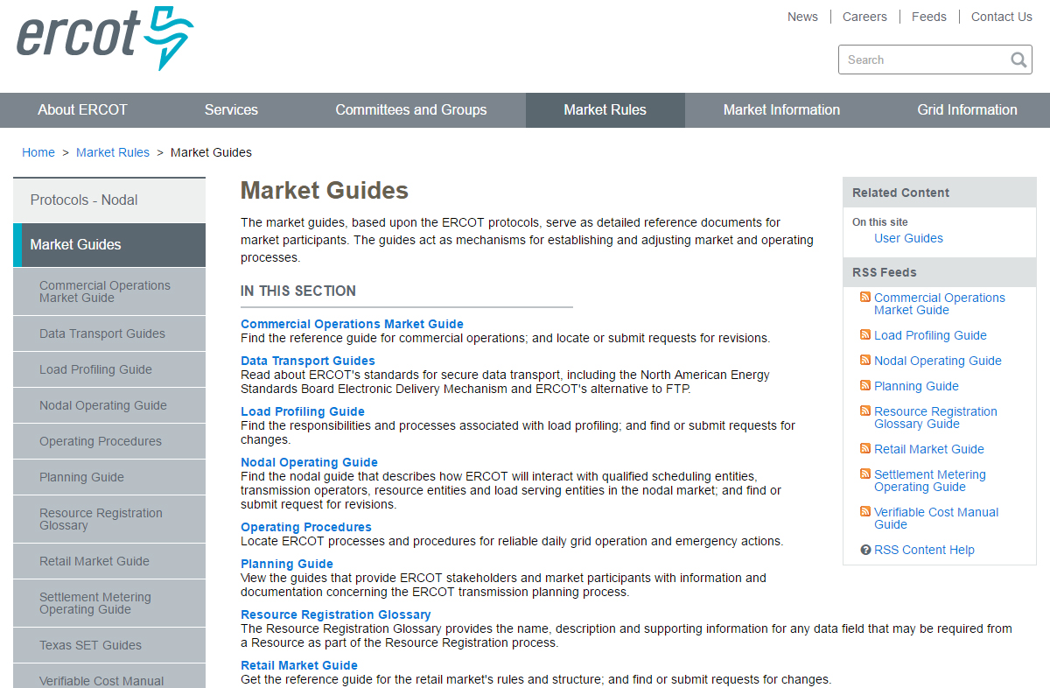
ERCOT Market Guides

Slide 22
ERCOT Retail Market Guide
Other Binding Documents List
File Name and Web Link To Documentation | Description
Commercial Operations Market Guide | Supplements the ERCOT protocols and describes the process through which ERCOT market data is translated into financial settlements in the ERCOT market.
Load Profiling Guide | A reference document used by market participants and ERCOT, expands upon and details the responsibilities and processes listed in the ERCOT protocols.
Retail Market Guide | A reference document for rules affecting the competitive retail electric market in Texas.
Texas Data Transport Guides | Provides information on secure data transport utilized by the Retail Electric Market and enabled by the North American Energy Standards Board (NAESB) Electronic Delivery Mechanism (EDM), ebXML and digital certificates.
Texas Market Test Plan | Defines the market plan for testing retail commercial operations systems and business processes to support the Texas Electric Choice Market.
Texas SET Implementation Guides | Provides details of information contained within the electronic transactions used in the competitive retail electric market in Texas.

Slide 23
ERCOT Retail Market Guide
Retail Market Guide Overview
Sections | Description
1-2 | Purpose; Definitions; Acronyms
3 | Retail Market Guide Revision Process
4-5 | PUCT & ERCOT
6 | RMS Working Groups
7 | **Market Processes**
8 | Municipally Owned Utilities & Co-ops
9 | **Appendices**
10 | Competitive Metering
11 | **Solution to Stacking**

Slide 24
ERCOT Retail Market Guide
Section 7- Market Processes Overview
Sections | Description
7.1 | Overview and Assumptions
7.2 | Market Synchronization
7.3 | **Inadvertent Gain Process**
7.4 | **Safety-Nets**
7.5 | **Standard Historical Usage Request**
7.6 | **Disconnect and Reconnect for Non-Payment Process**
7.7 | **Transaction Timing Matrix**
7.8 | Formal Invoice Dispute Process for Competitive Retailers and TDSPs
7.9 | No Retail Electric Provider of Record or Left in Hot

Slide 25
ERCOT Retail Market Guide
Section 7- Market Processes Overview
Sections | Description
7.10 | Emergency Operating Procedures for Extended Unplanned System Outages
7.11 | Transition Process
7.12 | Estimated Meter Readings
7.13 | Interval Data Recorder Meter Removal and Installation Process
7.14 | Out-flow Energy from Distributed Generation Facilities
7.15 | Advanced Meter Interval Data File Format and Submission
7.16 | **Business Processes and Communications Related to Meter Tampering**
7.17 | **Business Processes and Communications for Switch Holds Related to Deferred Payment**
7.18 | Business Process for When a Customer Elects to Receive Non-Standard Metering Services.

Slide 26
ERCOT Retail Market Guide
Section 7- Market Processes Highlights
Sections | Description
7.3 | Inadvertent Gain Process This Section provides guidelines for ensuring that inadvertently gained Electric Service Identifiers (ESI IDs) are returned to the losing Competitive Retailer (CR) in a quick and efficient manner with minimal inconvenience to the Customer as required by P.U.C. Subst. R. 25.495, Unauthorized Change of Retail Electric Provider
7.4 | Safety Nets This Section provides guidelines for the Safety-Net Processes and explains the steps that Market Participants will follow when processing safety-net Move-In Requests. This document is not intended to override or in any way contradict P.U.C. Subst. R. 25.487, Obligations Related to Move-In Transactions. The safety-net process is a manual work-around process used by Market Participants in the Texas retail market when market transactions are delayed or not functional.
7.5 | Standard Historical Usage Request This Section provides guidelines for a Customer’s authorization to Competitive Retailer(s) (CR(s)) that may request the Customer’s historical data when they are not the Retail Electric Provider (REP) of record. This data includes the most recent 12 months of usage and is provided by the Transmission and/or Distribution Service Provider (TDSP) to the requesting CR. In order to provide the data to the CR, the TDSP must have written authorization (includes electronic authorization) from the Customer to allow the TDSP to provide the proprietary information.

Slide 27
ERCOT Retail Market Guide
Section 7- Market Processes Highlights
Sections | Description
7.6 | Disconnect and Reconnect for Non-Pay The Disconnect for Non-Pay (DNP) and Reconnect for Non-Pay (RNP) process provides Market Participants with market approved guidelines to support disconnect and reconnect transactions and business processes as allowed or prescribed by P.U.C. SUBST. R. 25.483, Disconnection of Service.
7.7 | Transaction Timing Matrix The Transaction Timing Matrix, is an abbreviated version of Protocol Section 15, Customer Registration, used to assist Market Participants in identifying the flow and timing of transactions between Market Participants and ERCOT.
7.16 | Business Processes and Communications Related to Meter Tampering This Section provides Market Participants with market approved guidelines to support the business processes as allowed or prescribed in P.U.C. Subst. R. 25.126, Adjustments Due to Non-Compliant Meters and Meter Tampering in Areas Where Customer Choice Has Been Introduced.
7.17 | Business Processes and Communications for Switch Holds Related to Deferred Payment This Section provides Market Participants with market approved guidelines to support the business processes as allowed or prescribed in P.U.C. Subst. R. 25.480, Bill Payment and Adjustments.

Slide 28
ERCOT Retail Market Guide
Section 9- Appendices Highlights
Appendix | File Name and Web Link to Documentation
A2 | Section 9 Appendix A2: Transmission and/or Distribution Service Provider Move-in Safety Net Response
B1 | Section 9 Appendix B1: Letter of Authorization for the Request of Historical Usage Information Form (English)
B3 | Section 9 Appendix B3: Requesting Historical Usage from Multiple Transmission and/or Distribution Service Providers
B4 | Section 9 Appendix B4: Transmission and/or Distribution Service Provider Response to Request for Historical Usage
C2 | Section 9 Appendix C2: Emergency Reconnect Request Data Requirements
D1 | Section 9 Appendix D1: Transaction Timing Matrix
D3 | Section 9 Appendix D3: TDSP’s Discretionary Service Timelines Matrix
F6 | Section 9 Appendix F6: Customer Billing Contact Information
G | Section 9 Appendix G: ERCOT Specified File Format for Submission of Interval Data for Advanced Metering Systems

Slide 29
ERCOT Retail Market Guide
Section 11- Solution to Stacking Highlights
Sections | Description
Link to All Sections | Section 11: Solution to Stacking
11.1 | Overview of Solution to Stacking This Section 11, Solution to Stacking, provides the processes and guidelines for Market Participants operating in the Texas retail market to handle multiple non-sequential Texas Standard Electronic Transactions (TX SETs) on a single Electric Service Identifier (ESI ID).
11.2 | ERCOT Operating Rules The ERCOT Operating Rules describe the process and guidelines utilized by ERCOT to process multiple, non-sequential transactions concurrently on a single Electric Service Identifier (ESI ID).
11.2.2 | Cancellation Rules These rules detail the circumstances under which ERCOT will cancel existing orders.

Slide 30
ERCOT Retail Market Guide
Section 11- Solution to Stacking Highlights
Sections | Description
11.2.3 | Concurrent Processing Rules The concurrent processing rules detail the circumstances in which transactions are allowed to complete after being processed concurrently.
11.2.4 | Pending Transaction Rules These rules detail the methods used for Pending REP Notification Transactions. These rules were developed to ensure that these transactions are sent only when the appropriate recipient can be positively identified.
11.3 | Transmission and/or Distribution Service Provider Operating Rules The business rules Transmission and/or Distribution Service Providers (TDSPs) will follow in order to process multiple, non-sequential transactions concurrently on a single Electric Service Identifier (ESI ID).
11.4 | Retail Electric Provider Operating Rules Retail Electric Providers (REPs), like the Transmission and/or Distribution Service Providers (TDSPs) and ERCOT, will be required to handle multiple, non-sequential transactions on an Electric Service Identifier (ESI ID).

Slide 31

TxSET
Texas Standard Electronic Transaction (Texas SET) Working Group:
Reports to the Retail Market Subcommittee (RMS),
Analyzes the need for new or modifications to existing electronic transactions,
Recommends changes to retail market processes,
Works with the ERCOT Flight Administrator to ensure that testing processes and procedures are defined and administered,
Maintains the Texas SET Implementation Guides and the Texas Market Test Plan Guide, and
Collaborates with other Working Groups and Taskforces as directed by RMS.
http://ercot.com/committee/txset
Review & Recommend RMGRR153 & 2019 Test Flight

Slide 32
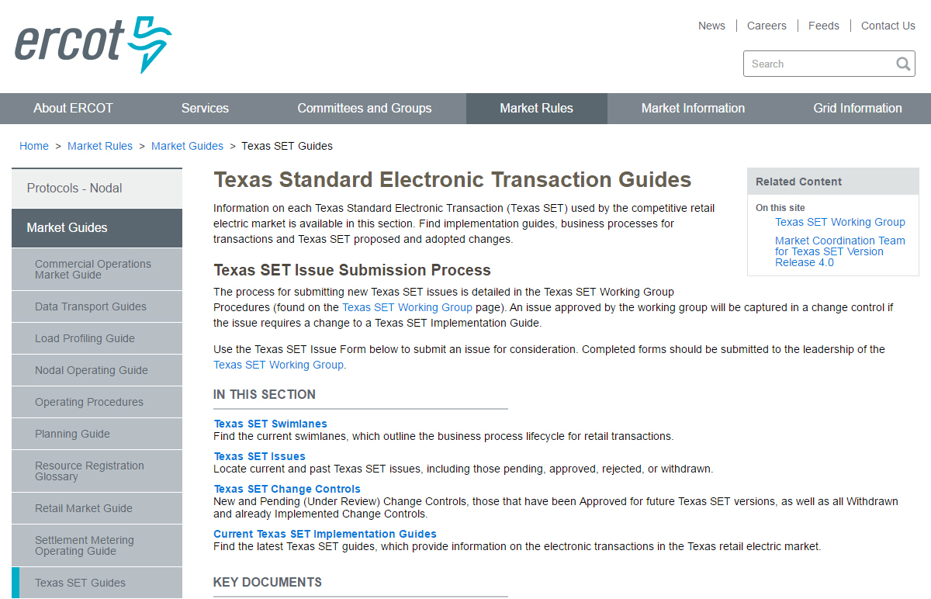
Texas Standard Electronic Transactions (TX SET)
Notes:
But for quick reference, there is also a Transaction Name Inventory posted on ERCOT.com, complete with a handy pocket card. We printed and laminated pocket cards to give you here today. We hope that you will find them as useful as we do. We also hope that you will use them in the upcoming class scenarios!

Slide 33

Texas SET Swimlanes
Texas Standard Electronic Transaction (SET) swimlanes are reference documents that outline the business process lifecycle for transactions used in the competitive retail electric market in Texas.
http://ercot.com/mktrules/guides/txset/sw

Slide 34
Texas SET Swimlanes
Texas SET Swimlanes Scenarios
Description | File Name and Web Link to Documentation
TX SET flow documentation for consolidated billing, remittance and dual billing | Billing Scenarios Version February 2017
TX SET flow documentation for beginning and ending continuous service agreements (CSAs) | Continuous Service Agreement Scenarios February 2017
TX SET flow documentation for handling Move In changes and problems | Customer Move In Scenarios June 2012
TX SET flow documentation for handling Move Out changes and problems | Customer Move Out Scenarios February 2017
TX SET flow documentation for handling customer switch request | Customer Switch Scenarios June 2012

Slide 35
Texas SET Swimlanes
Texas SET Swimlanes Scenarios
Description | File Name and Web Link to Documentation
TX SET flow documentation for Disconnect and Reconnect for Non-Pay | Disconnect Reconnect Non Pay Scenarios February 2017
TX SET flow documentation for customer dropped by Competitive Retailer (CR), disconnect for non-pay services request and Mass Transition from defaulting CR to Provider of Last Resort (POLR) | Mass Transition / Acquisition Scenarios June 2012
TX SET flow documentation for handling Switch Hold add and removal | Switch Hold Scenarios June 2012
TX SET flow documentation of how to report unplanned outages | Unplanned Outages Scenarios June 2012

Slide 36

Texas SET Implementation Guides (IG)
The Texas Standard Electronic Transaction (SET) Implementation Guides provide details of information contained within the electronic transactions used in the competitive retail electric market in Texas.
The current Version 4.0 of the Texas SET Implementation Guides contains updates to retail transactions to support the following:
  PUCT Substantive Rule §25.493 Acquisition and Transfer of Customers from one Retail Electric Provider to Another
  PUCT Substantive Rule §25.480 Bill Payment and Adjustments
  PUCT Substantive Rule §25.483 Disconnection of Service
  PUCT Substantive Rule §25.497 Critical Care Customers
  PUCT Substantive Rule §25.126 Amendments Due to Non-Compliant Meters and Meter Tampering in Areas Where Customer Choice Has Been Introduced
  PUCT PROJECT 34610 Implementation Project Relating to Advanced Metering
  Outstanding Change Controls identified and recommended by the Texas SET Working Group
  http://ercot.com/mktrules/guides/txset/current

Slide 37
Texas SET Implementation Guides
Service Orders, Invoice and Remittance Transactions
Transaction and Version | Web Link to Documentation
Texas SET V4.0 650 Service Orders Point to Point | Guides (Jun 11, 2012 – zip – 162 KB) Examples (Jun 11, 2012 – zip – 42.8 KB)
Texas SET V4.0 810 TDSP’s Invoice Point to Point | Guides (Jun 11, 2012 – zip – 95.1 KB) Examples (May 18, 2017 – zip – 39.1 KB) SAC04 (Sep 19, 2016 – xls – 176 KB)
Texas SET V4.0 820 Remittance Advice Point to Point | Guides (Jun 11, 2012 – zip – 60.1 KB) Examples (Sep 22, 2017 – zip – 31.2 KB)

Slide 38
Texas SET Implementation Guides
Enrollments, Rejects and Usage Transactions
Transaction and Version | Web Link to Documentation
Texas SET V4.0 814 Enrollments, MVI, MVO, Create/Maintenance/Retire, Maintain Customer Information | Guides (Jun 11, 2012 – zip – 1.1 MB) Examples (Jun 11, 2012 – zip – 346.7 KB)
Texas SET V4.0 824 Invoice or Usage Reject Notification | Guides (Jun 11, 2012 – zip – 32.4 KB) Examples (Jun 11, 2012 – zip – 11.6 KB)
Texas SET V4.0 867 Monthly and Final Usage, Historical Usage | Guides (Jun 11, 2012 – zip – 176.3 KB) Examples (Jun 11, 2012 – zip – 71.6 KB)

Slide 39
Texas SET Implementation Guides
Functional Acknowledgement and CR Option 1 Outage Transactions
Transaction and Version | Web Link to Documentation
Texas SET V4.0 997 Functional Acknowledgement | Guides (Jun 11, 2012 – zip – 30.8 KB)
Texas SET V4.0 T-Series CR Option 1 Outage Transactions | Guides (Jun 11, 2012 – zip – 102.8 KB)

Slide 40
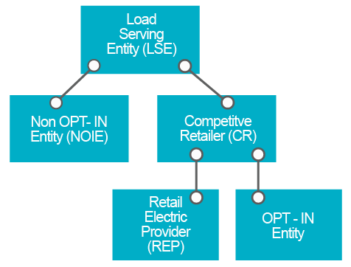
Load Serving Entities (LSE)
Load serving entities (LSEs) provide electric service to end-users and wholesale customers.
LSEs include the competitive retailers (CRs) that sell electricity at retail in the competitive market.
A CR may be (1) a retail electric provider (REP), which contracts with qualified scheduling entities to provide scheduling services for their load customers, or (2) a municipally owned utility or co-operative that opts to offer customer choice (an opt-in entity).
LSEs also include non-opt-in entities (NOIEs), which are electric cooperatives and municipally owned utilities that do not operate as CRs and do not plan to offer customer choice.

Slide 41
Registration and Qualification/Certification
Registration
  Register with ERCOT as a CR (a REP or an opt-in entity) or a NOIE with the form below.
Qualification/Certification
  CRs must be certified by ERCOT. Please read more about Texas Retail Market Testing and the latest test flight.
  REPs must also be certified by the Public Utility Commission of Texas (PUCT). More information on that certification process may be found on the PUCT website at Retail Electric Providers Certification and Reporting .
  http://ercot.com/services/rq/lse/index.html

Slide 42
Retail Market Testing
Key Documents
Description | File Name and Web Link to Documentation
The Texas Market Test Plan (TMTP) applies to Market Participants doing business in the Texas Electric Choice Market. The purpose of this document is to define the market plan for testing commercial operations systems and business processes to support the Texas Electric Choice Market. This document covers all testing requirements and procedures between ERCOT and the Market Participants and Point-to-Point testing between Market Participants. | Texas Market Test Plan (TMTP) 020216

Slide 43
Retail Market Testing
Key Documents
Description | File Name and Web Link to Documentation
The ERCOT Retail Testing Website is used by Market Participants to become certified in conducting retail market processes within the ERCOT market. | Texas Retail Testing https://etod.ercot.com/
Retail Market Testing Orientation Weblink | Retail Market Testing Orientation
Retail Market Test Environment User Guide | Retail Market Test Environment User Guide
Retail Market Testing Environment ESI IDs | Retail Market Testing Environment ESI IDs

Slide 44

Retail Market Testing
Key Documents
Description | File Name and Web Link to Documentation
Flight status and agenda for conference calls | Daily Agenda
Repository of Market Participants technical and business testing information | Testing Worksheet
Mechanism for recording and tracking flight testing progress. Market Participants update the checklist as transactions/tasks are sent and received | Checklist

Slide 45
Retail Market Testing
Key Documents
Description | File Name and Web Link to Documentation
Testing scenarios to be executed during flight tests. Ability to download script workbook | Scripts
Document repository | File Cabinet
Business and technical contact information for all Market Participants that is populated from each respective Testing Worksheet | Contacts

Slide 46
3: Transactions

Slide 47
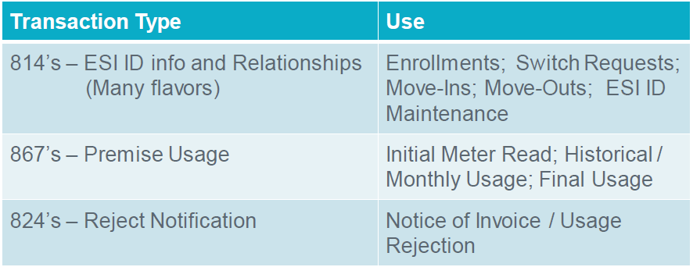
Texas Standard Electronic Transactions (TX SET) – Interactive
Many transactions involve ERCOT
These transactions flow through the ERCOT clearinghouse as the registration agent.

Slide 48
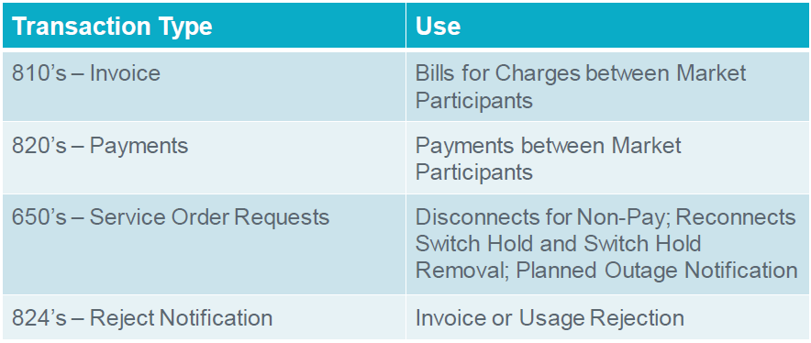
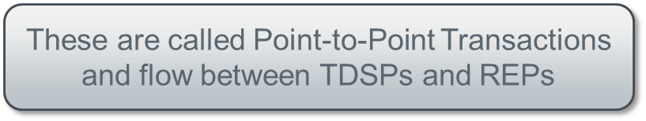
Texas Standard Electronic Transactions (TX SET) – Interactive
Some transactions do not involve ERCOT

Slide 49
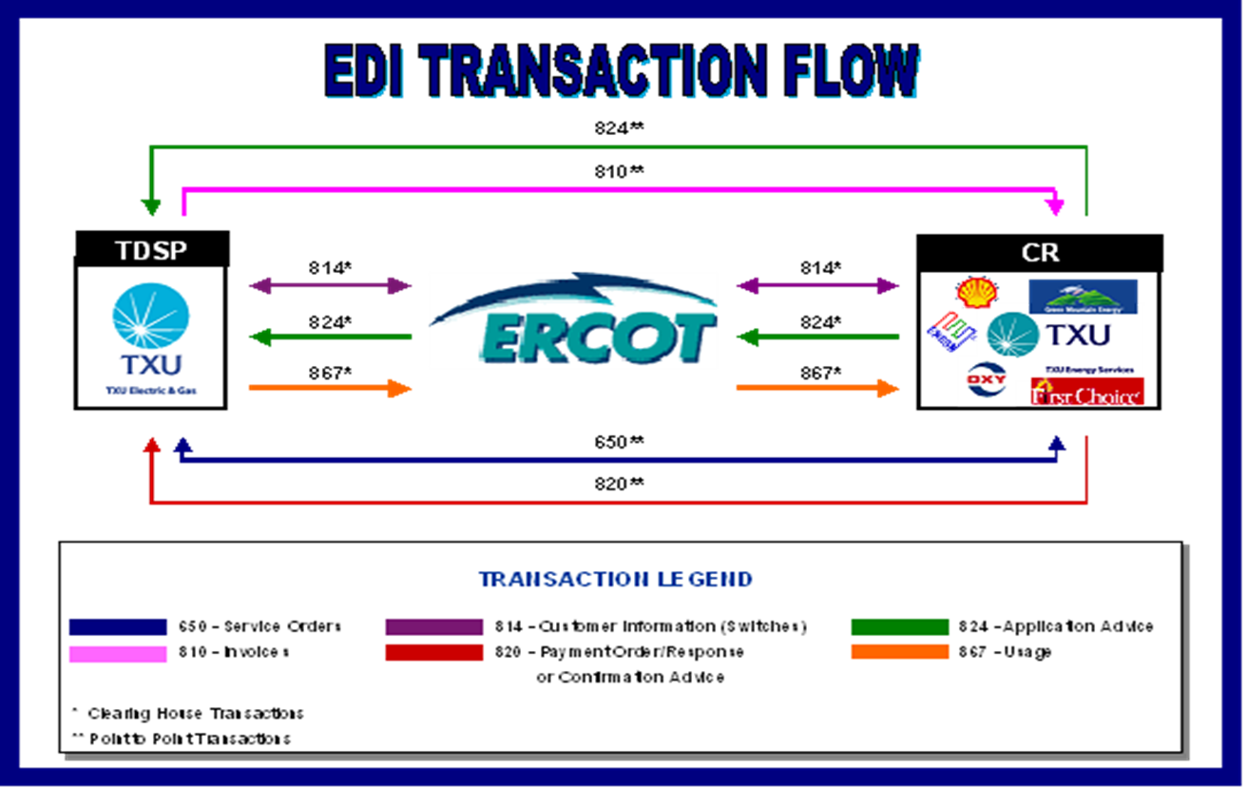
Texas Standard Electronic Transactions (TX SET) – Interactive
Overview of transaction flow

Slide 50
Transaction Names
TX SET Version 4.0 – Transaction Names Inventory

Slide 51
Transaction Names
TX SET Version 4.0 – Transaction Names Inventory

Slide 52
Transaction Names
TX SET Version 4.0 – Transaction Names Inventory

Slide 53
Checkpoint Questions – Exercise #1
Which transactions are customer initiated transactions? Select all that apply.
  814_16 ____________
  814_01 ____________
  814_08 ____________
  814_24 ____________
Response transactions can only be Rejects (True/False) _____________________
A point-to-point transaction is sent only to ERCOT. (True/False) ___________________

Slide 54
Checkpoint Questions – Exercise #1 – continued
Historical Usage (867_02) is associated to what? Select only one.
  Meter _____________
  Permit _____________
  Date Change _____________
  CSA _____________
What transaction is used to determine the actual start date for a customer? Select only one.
  814_04 ______________
  814_16 ______________
  867_04 ______________
  814_01 ______________

Slide 55
4: Transaction Process Flow

Slide 56


Transaction Flows
Switch – Accept
New CR
Current CR

Slide 57
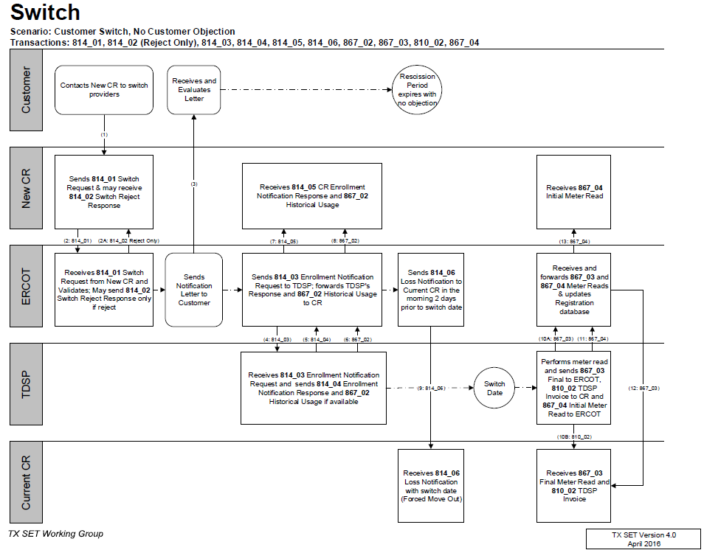
TxSET Swimlanes
Switch – Reject & Accept

Slide 58
Transaction Flows
Switch Hold – Add – Deferred Payment Plan (DPP)
Current CR
Switch Hold – Remove – DPP / Tampering

Slide 59
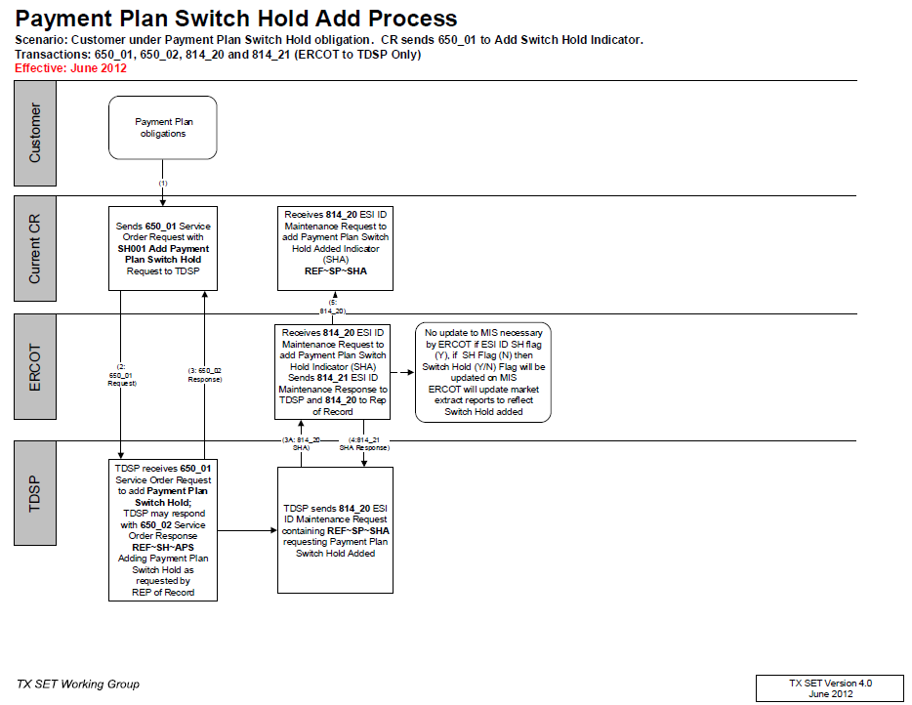
TxSET Swimlanes
Switch Hold – Add DPP

Slide 60
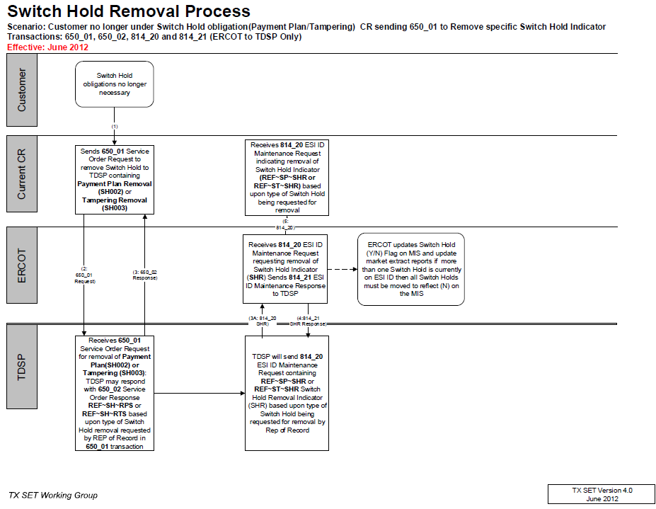
TxSET Swimlanes
Switch Hold – Remove - DPPs

Slide 61
Transaction Flows
Switch Hold – Add - Tampering
Current CR

Slide 62
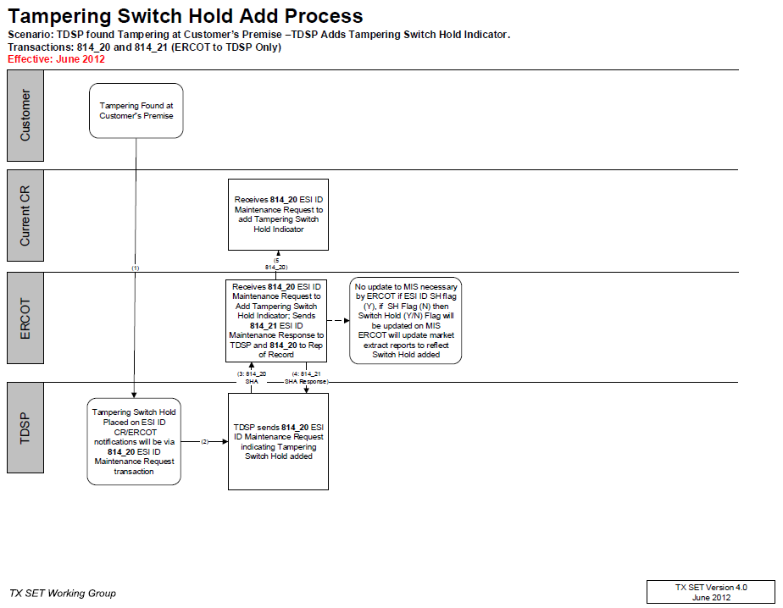
TxSET Swimlanes
Switch Hold – Add - Tampering

Slide 63
Transaction Flows
Switch w/ Switch Hold
New CR
Current CR

Slide 64
Checkpoint Questions – Exercise #2
A Customer Loss (814_06) transaction is sent to which entity? Select only one.
  Current Rep of Record _______________
  TDSP _______________
  ERCOT _______________
  New CR _______________
The 814_04 / 814_05 provides meter details and scheduling. (True/False) _________________
If a Switch Hold exists on an ESI, a MVO transaction (814_24) will automatically reject (True/False) ________

Slide 65
Transaction Flows
Move In – Accept
New CR
Current CR

Slide 66
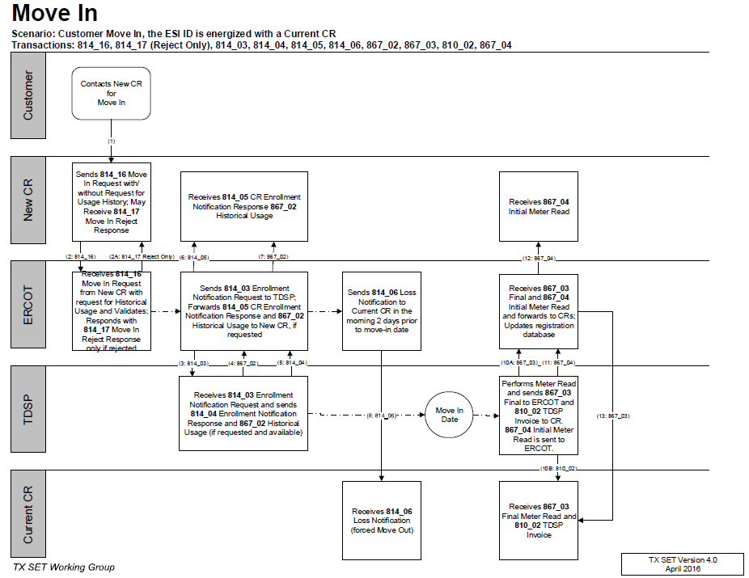
TxSET Swimlanes
Move In w/ Accept/Reject

Slide 67
Transaction Flows
Move In w/ Permit Required
New CR

Slide 68
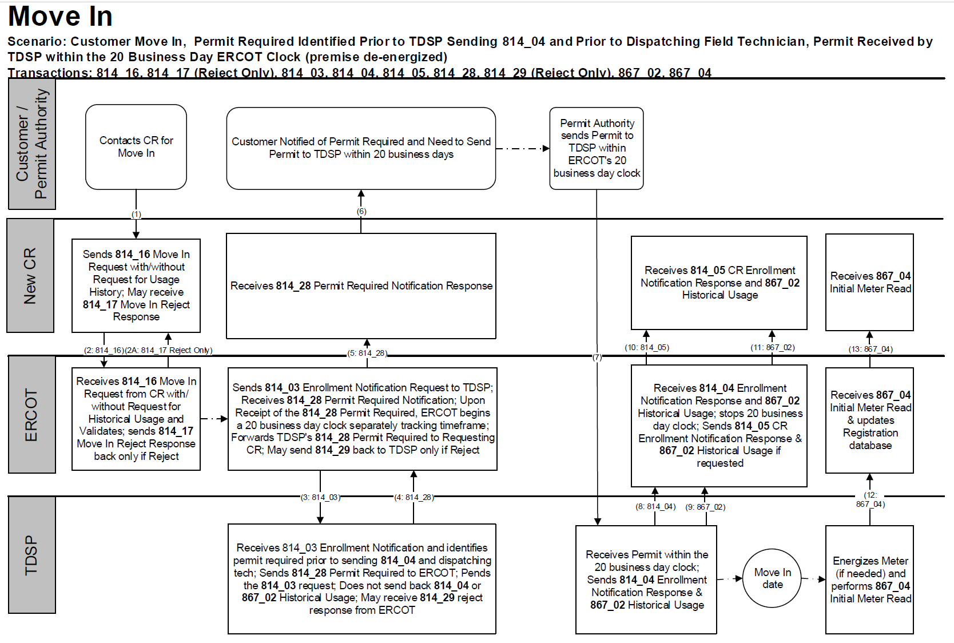
TxSET Swimlanes
Move In w/ Permit Required

Slide 69
Transaction Flows
Move In w/ Date Change followed by Cancel
New CR
Current CR

Slide 70
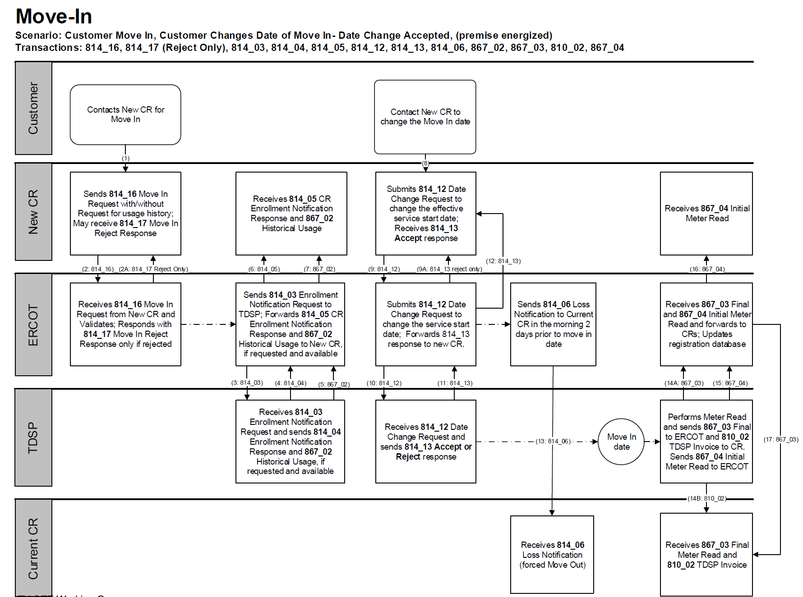
TxSET Swimlanes
Move In w/ Date Change & Cancel

Slide 71
Checkpoint Exercise #3
A date change transaction (814_12) is sent to change the date for which transactions? Select all that apply.
  814_08 __________ d) 867_03F ______________
  814_24 __________ e) 814_05 ______________
  814_18 __________ f) 814_16 ______________
What transaction does the TDSP receive when an 814_01 or 814_16 is initiated? Select only one.
  867_04 _____________
  814_03 _____________
  867_03 _____________
  814_04 _____________

Slide 72
Checkpoint Exercise #3 - continued
A Customer Loss (814_06) transaction can “force out” or “switch out” an existing customer. (True/False) ___________________
If a MVI order is submitted and an 814_28 PR is received, does it cancel the original MVI order? (Yes/No) ____________________
If a MVI order is submitted and an 814_28 PR is received and then later an 814_08 is received should we receive an 867_04? (Yes/No) ______________________
Based on the scenario in item 13, should we expect this customer to be with the submitting CR? (Yes/No) ____________________

Slide 73
Checkpoint Exercise #3 - continued
Which entity would receive an 814_17 Not First In (NFI) reject after a same day MVI is submitted in the morning by CR “A” and then another same day MVI is submitted in the afternoon by CR “B”?
  TDSP ______________
  ERCOT ______________
  CR A ______________
  CR B ______________

Slide 74
Transaction Flows
Move Out – Accept
Current CR

Slide 75
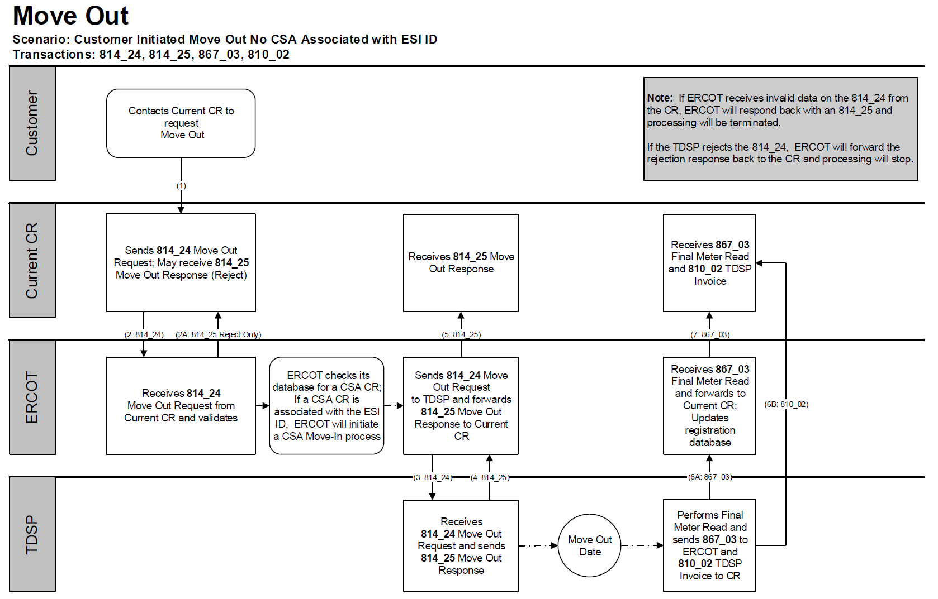
TxSET Swimlanes
Move Out – Reject & Accept (ERCOT)

Slide 76
Transaction Solution to Stacking
MVO Trumps SWI
ERCOT will reject a Switch Request if the ESI ID is scheduled to be De-energized at ERCOT on the Requested Date.
12/1 MVO CR A
12/2
12/4 SWI CR B
12/3
CR B will need to submit a MVI (814_16) in order to enroll their customer.

Slide 77
Transaction Solution to Stacking
11.4.1 REP Operating Rule 1: Cancel Move Out
REPs who have a Pending move out and submit a move in (same REP) with an earlier Requested Date are responsible for canceling the Pending move out if that is what the Customer requires (REP manages Customer expectations). If the REP does not cancel the move out, the move out will be allowed to effectuate.
MVI Customer A REP A
MVI Customer B REP A
MVO Customer A REP A
MVO transaction from Customer A has left Customer B in the dark.
If Customer A issues a MVI and a future dated MVO, and REP A enrolls Customer B at the same premise, if the REP A fails to cancel the future dated MVO, the MVO will be executed leaving Customer B in the dark.

Slide 78
Transaction Flows
Move Out w/ Future dated Switch
New CR
Current CR

Slide 79
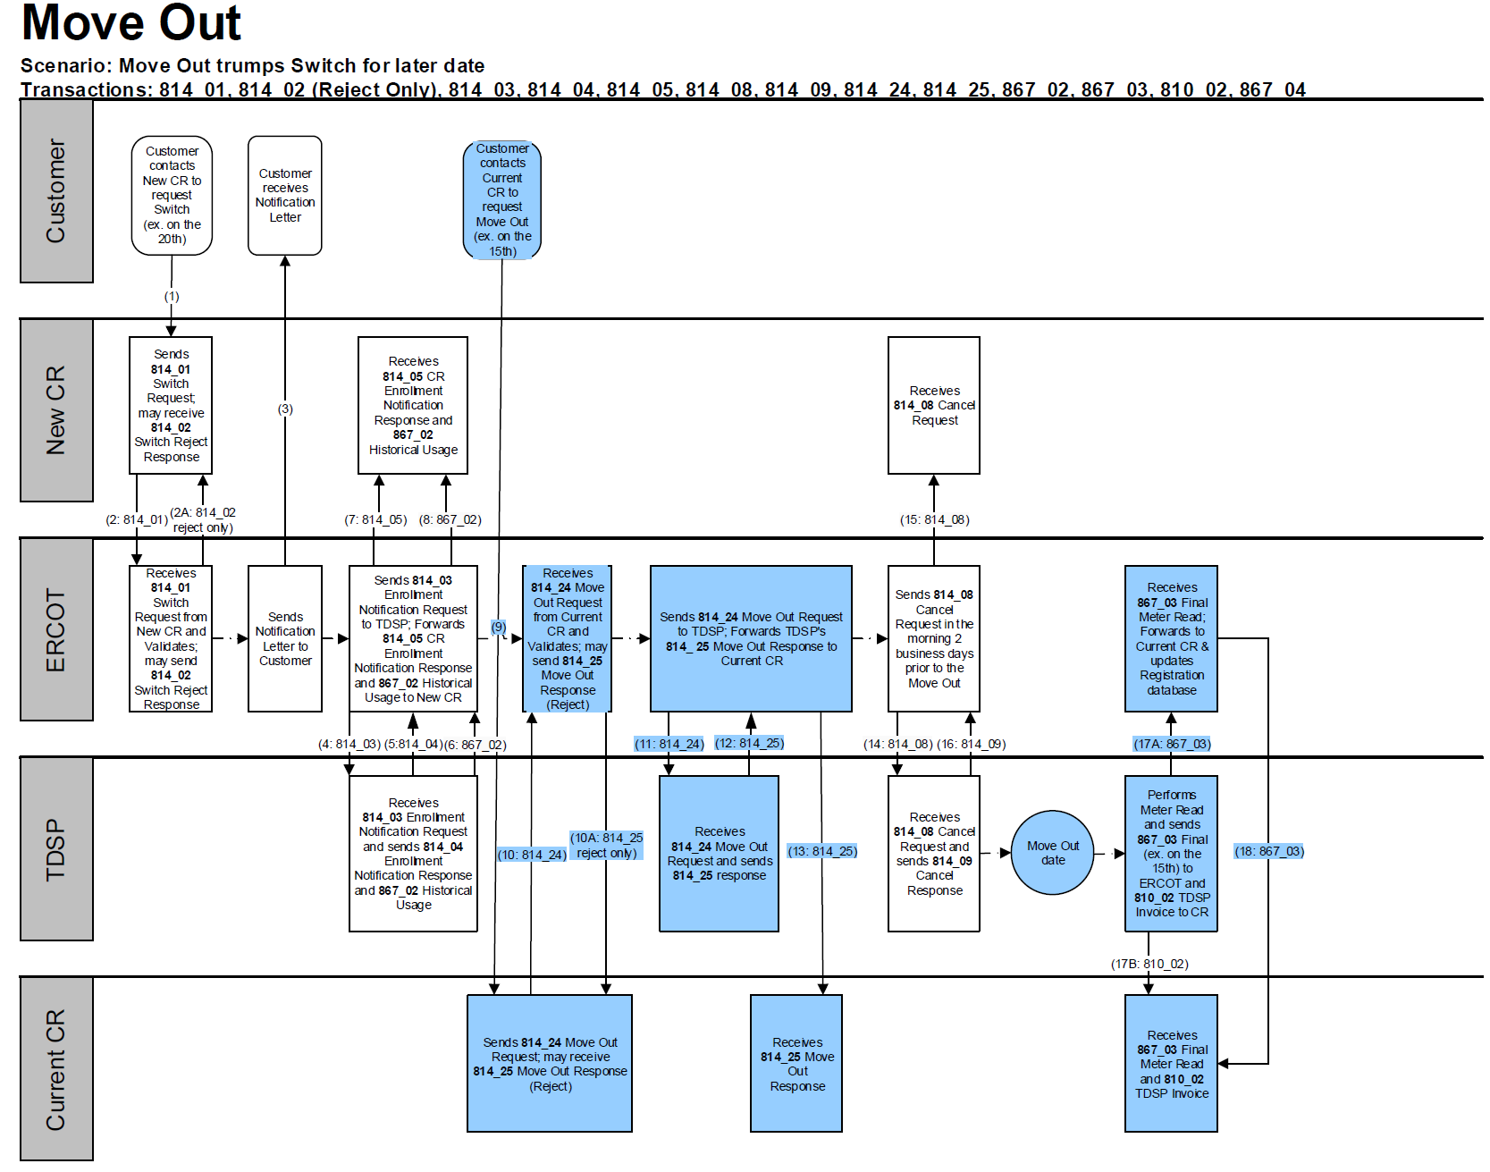
TxSET Swimlanes
Move Out w/ Future dated Switch

Slide 80
Checkpoint Exercise #4
If a MVO order is submitted and an 814_28 CU is received from the TDSP, does the customer receive a final bill? (Yes/No) ____________________
An 814_16 MVI trumps an 814_24 MVO for the same day when they are from two different REPs. (True/False) _______________________________
An 814_16 MVI trumps an 814_24 MVO for the same day when they are from the same REP. (True/False) _______________________________
An 814_24 MVO trumps an 814_01 Switch. (True/False) ___________________

Slide 81
Checkpoint Exercise #4 - continued
Which entity is responsible for sending an 814_08 cancel when there is a MVO for customer “A” pending for 5/5 and a MVI for customer “B” pending for 5/1, both with the current REP? Select only one.
  TDSP ______________
  ERCOT ______________
  Current REP ______________
  Another REP __________

Slide 82
Checkpoint Exercise #4 - continued
Which entity is responsible for sending an 814_08 cancel when there is a MVO for customer “A” pending for 5/5 and a MVI for customer “B” pending for 5/5 both with different REPs? Select only one.
  TDSP ______________
  ERCOT ______________
  Current REP ___________
  Another REP __________

Slide 83
Checkpoint Exercise #4 - continued
What transaction is used to determine the actual end date of a customer? Select only one.
  814_24 ______________
  814_01 ______________
  867_03F ______________
  814_22 ______________

Slide 84
Transaction Flows
Continuous Service Agreement (CSA) – Add & Delete
New CSA CR
Current CSA CR

Slide 85
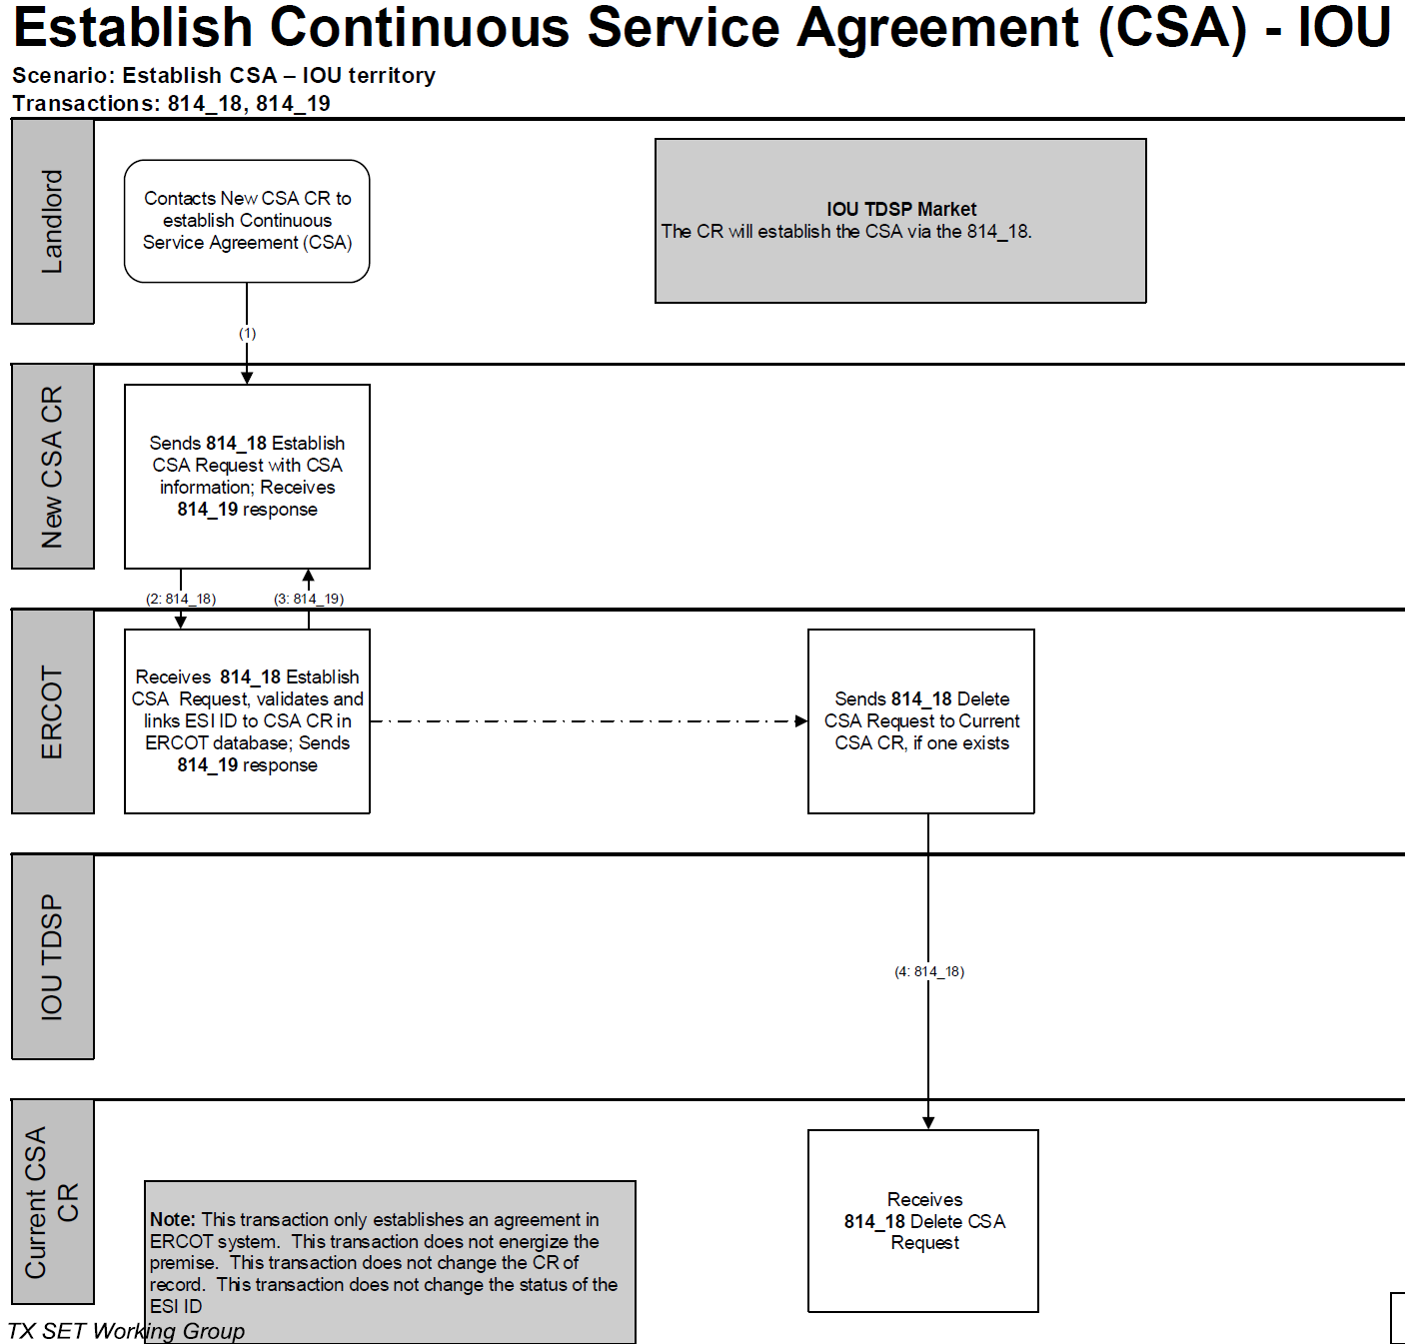
TxSET Swimlanes
Continuous Service Agreement (CSA) – Add & Delete

Slide 86
Transaction Flows
Move Out to CSA
CSA CR
Current CR

Slide 87
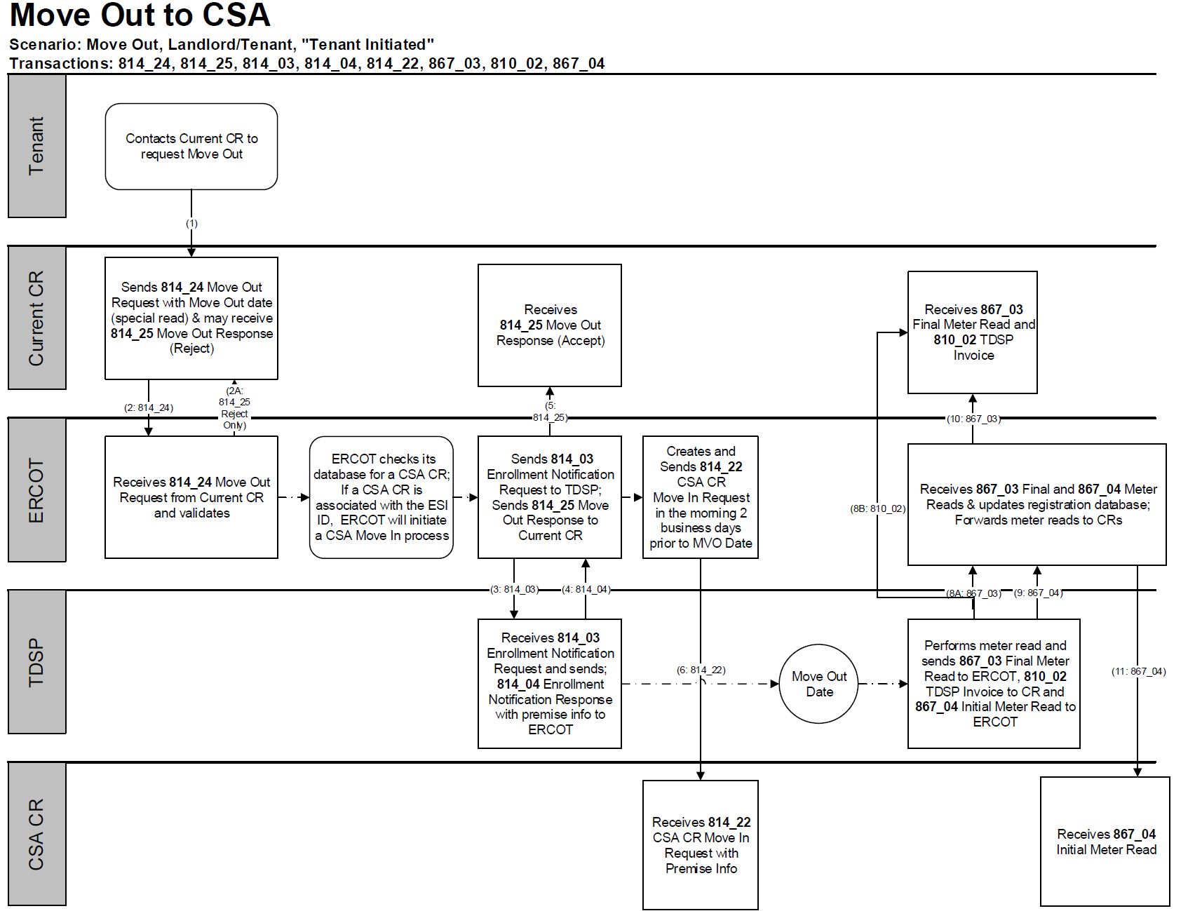
TxSET Swimlanes
Move Out to CSA

Slide 88
Checkpoint Exercise #5
What does CSA mean? Select only one.
  Continuous Service Arrangement ____________
  Continued Service Arrangement ____________
  Continuous Service Agreement ____________
  Country Served Agreement ____________
When a tenant moves out what transaction places the service back in the apartment’s name, if there is a CSA active at ERCOT? Select only one.
  867_04 ______________
  814_18 _______________
  814_01 _______________
  814_22 _______________

Slide 89
Checkpoint Exercise #5 - continued
What is the business process called that uses the 814_22 transaction, as it is seen in ERCOT MIS Portal? Select only one.
  Move-Out _______________
  Move-In _______________
  CSA _______________
  Move-out to CSA _______________

Slide 90
Transaction Flows
Disconnect for Non-Pay (DNP)
Current CR
Reconnect after DNP
Current CR

Slide 91
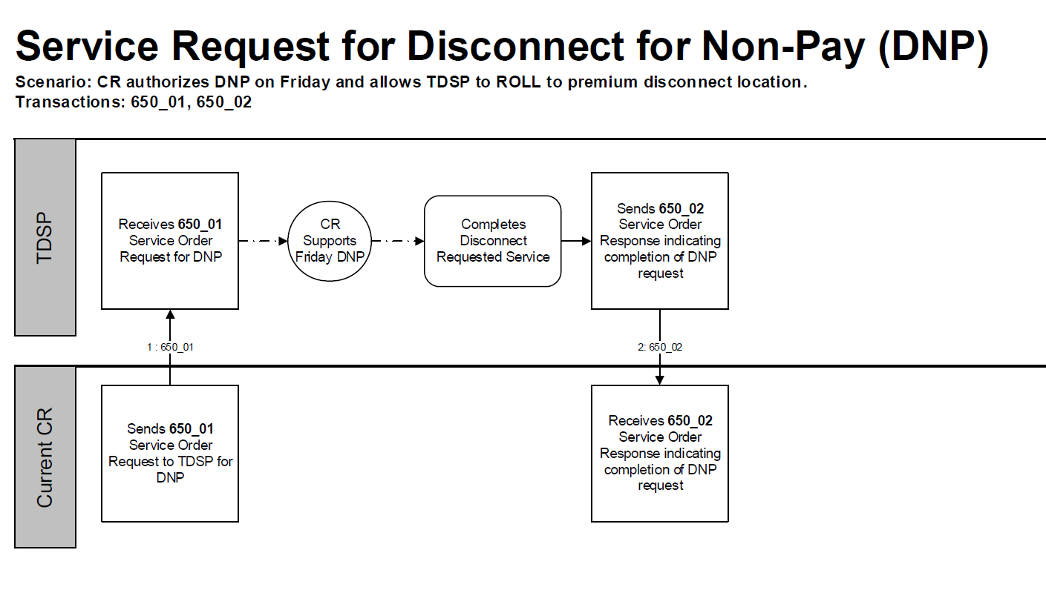
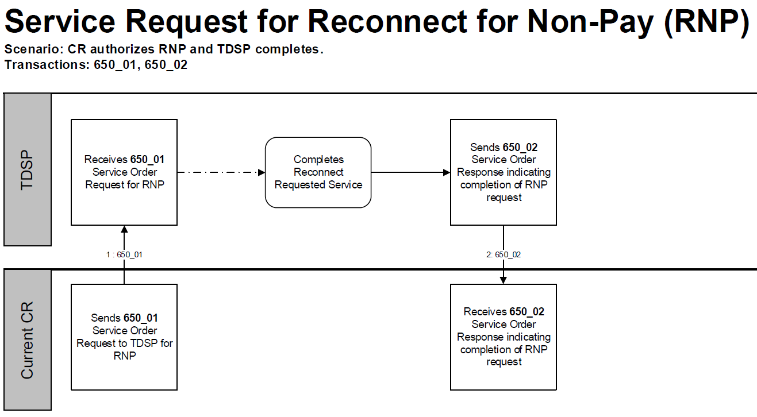
TxSET Swimlanes
Disconnect for Non-Pay (DNP)
Reconnect after DNP

Slide 92
Checkpoint Exercise #6
Which transactions are point-to-point? Select all that apply.
  820 ________________
  814 ________________
  650 ________________
  810 ________________

Slide 93
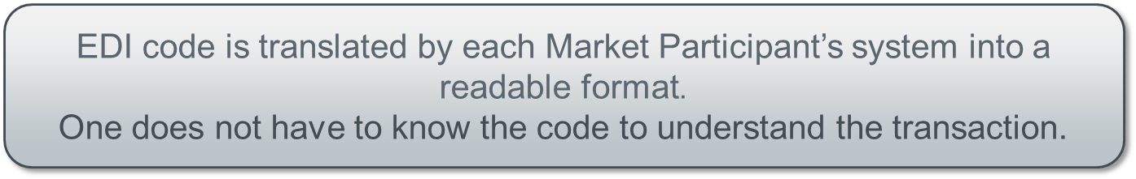
Electronic Data Interface (EDI) Transactions
Example of an 814_20 EDI transaction

Slide 94
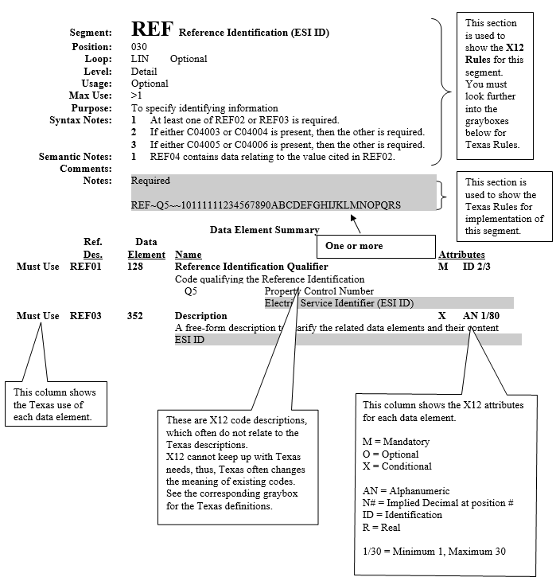
TX SET Implementation Guides w/ Examples
814_20 EDI transaction guide

Slide 95
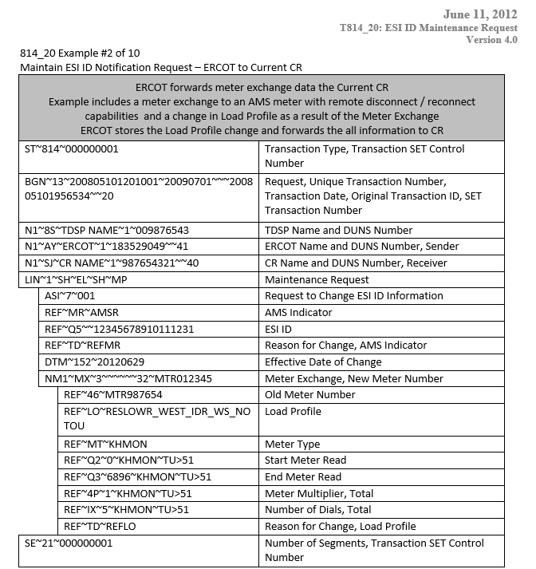
TX SET Implementation Guides w/ Examples
814_20 EDI transaction example – meter exchange

Slide 96
Checkpoint Exercise #7
Which transaction changes the meter and/or meter information? Select only one.
  814_09 _______________
  814_18 _______________
  814_26 _______________
  814_20 _______________

Slide 98
5: MIS Portal

Slide 99
ERCOT’s Market Information System (MIS)
Find ESI ID
Point out key attributes-
status, premise type, Switch Hold, AMS Indicator, metered flag, MRU, dates
Link to “View Transactions” for past 7 months

Slide 100
ERCOT’s Market Information System (MIS)
Find Transactions
Learning “how to read ERCOT”
Key points:
Transaction status, key dates
Review some examples of ESIs with the following:
MVI, no CSA
MVI on retired ESI ID
MVI with permit pending
MVI with permit required
Switch and customer loss
MVO to CSA, with date change
MVI energized, no other CR, metered premise - MVO trumped by MVI - MVI with another CR - CSA Addition - MVO to CSA - MVI with another CR > customer loss for TXUE on CSA

Slide 101
Checkpoint Exercise #7 – FINAL EXAM
Provide each transaction name, who the transaction is from and who it is going to, and at the ends who the REP of Record is from the scenario flow listed below.
Customer calls REP B to enroll for service and REP A is the current REP of Record at that premise:
814_01
814_03
814_04
814_05
867_02
814_06
814_08 from submitting CR on same day as MVI requested date
814_09
867_03F
867_04
Switch Request
Enrollment Notification Request
Enrollment Notification Response
CR Enrollment Notification Response
Historical Usage
Loss Notification
Cancel Request
Cancel Response
Final Usage
Initial Meter Read
ERCOT
CR/REP A
TDSP
CR/REP B

Slide 102
Checkpoint Exercise #7 – FINAL EXAM - continued
From the transaction flow, who is the REP of Record?
_________________________________________________
What is the situation described?
_________________________________________________

Slide 104
6: Change Management

Slide 105
Texas SET Issues Process
This process provides Market Participants with a formal way to communicate transactional or market processing issues that should be reviewed and discussed by the Texas SET Working Group for a recommendation and/or resolution.
Issues brought forth through this process may be used by the Texas SET Working Group representatives to develop a Change Control(s) that may be implemented with a future TX SET version.
Market Participants submitting issues to be considered by the Texas SET Working Group should use the Texas SET Issue Form at this link:
Texas SET Issue Form
Completed form should be sent to this email address: txsetchangecontrol@ercot.com

Slide 106
Texas SET Change Control Request Process
Texas Standard Electronic Transactions (TX SETs) will be expanded and modified on an ongoing basis to accommodate market changes and regulatory requirements.
The Change Control Request Process allows updates or modifications to the production version of the TX SET to be discussed, reviewed and recommended by TX SET for a future implementation.
  ERCOT oversees the Change Control request activities.
  Change Control requests are reviewed by the Texas SET Working Group.
  All Change Control requests are presented to RMS for consideration with the recommended action(s) from the Texas SET Working Group.
RMS approved Change Control requests will be slated for a future TX SET version release based upon the Texas SET Working Group’s recommendation to RMS.
Texas SET Change Controls
Texas SET Implementation Guide Change Control Process

Slide 107
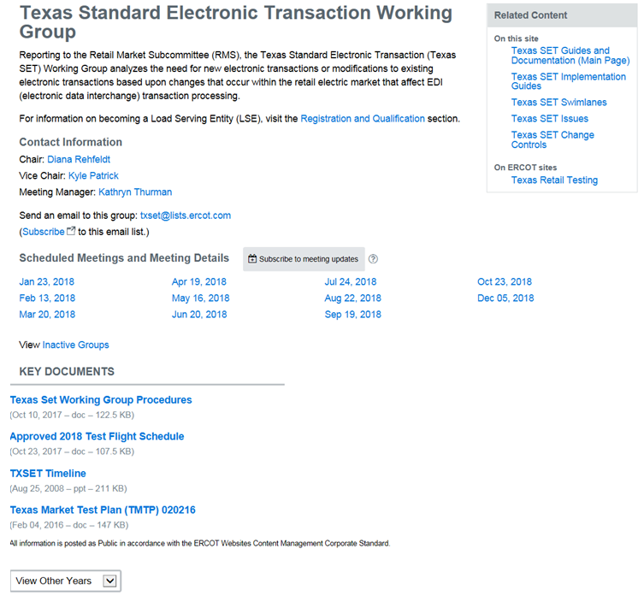
What is the Texas SET Working Group?
TX SET is an ERCOT Working group comprised of stakeholders participating in the development and maintenance of TX SET EDI transactions .
Texas Standard Electronic Transaction (Texas SET) Working Group, reporting to the Retail Market Subcommittee (RMS), analyzes the need for new or modifications to existing electronic transactions, recommends changes to retail market processes, works with the ERCOT Flight Administrator to ensure that testing processes and procedures are defined and administered, maintains the Texas SET Implementation Guides and the Texas Market Test Plan Guide, and collaborates with other working groups and task forces as directed by RMS.
http://www.ercot.com/committee/txset

Slide 108
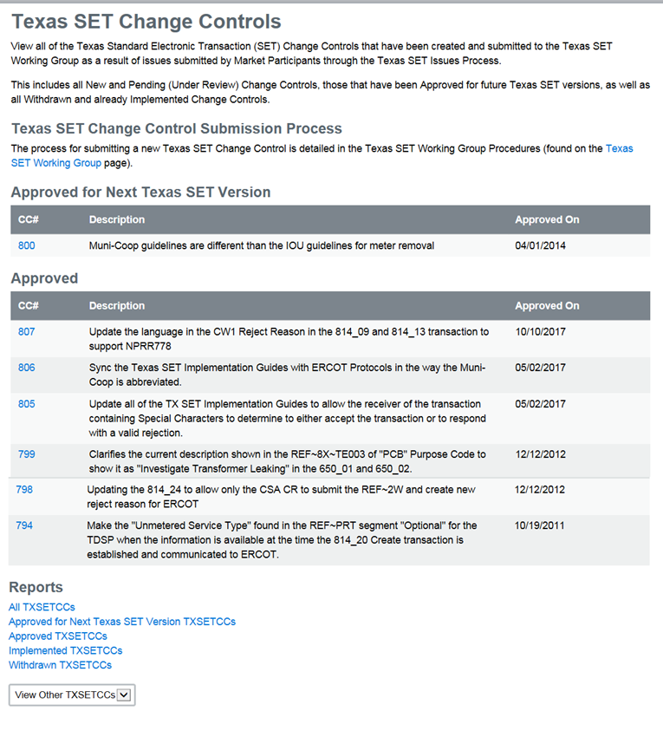
What is Tx SET Working Group?
Change Controls
http://www.ercot.com/mktrules/issues/txsetcc

Slide 109
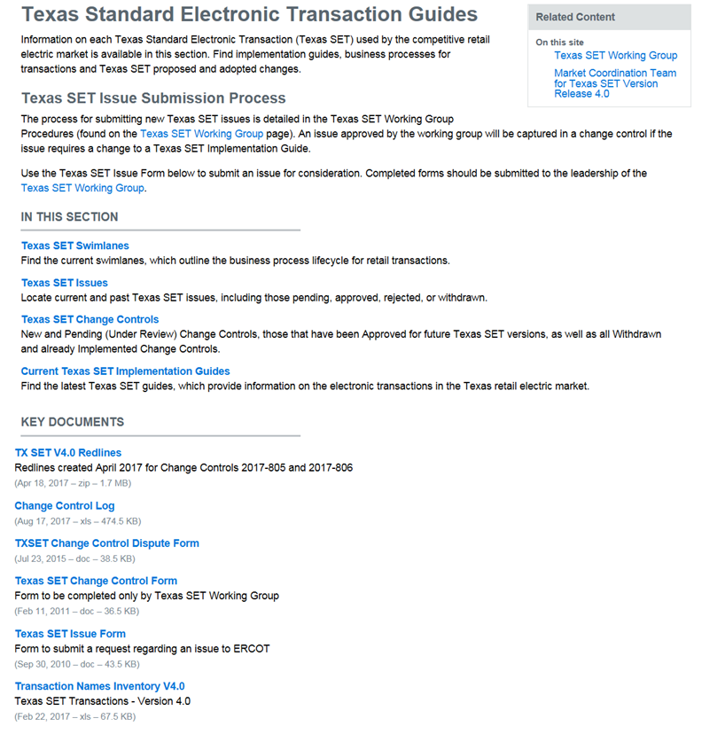
What is Tx SET Working Group?
Other Information
Texas SET Swimlanes
Texas SET Issues
  Current Texas SET IGs
http://www.ercot.com/mktrules/guides/txset

