Slide 1
Credit Exposure Update
Credit Work Group
ERCOT Public
June 20, 2018

Slide 2
Credit Exposure Update
Inputs and Assumptions:
Only Active Counter-Parties are included
Counter-Parties are classified by rating and market activity
TPE and collateral balances used are averages for April and May 2018
Counter-Parties that are subsidiaries of, or guaranteed by, rated entities are given the parent/guarantor’s rating, adjusted down one notch

Slide 3
Credit Exposure Update
May 2018 compared to April 2018
Market-wide average TPE increased from $312.9 million to $569.7 million.
TPE increased by $204.9 million for “Load and Gen” category.
TPE increased by $34.6 million for “Load Only” category.
TPE increased by $31.4 million for “Trader” category.
Excess collateral increased from $1,718 million to $1,802 million.
increased by $120.6 million for “Load and Gen” category
increased by $10.0 million for “Trader” category.
decreased by $47.1 million across all other categories.
Number of active Counter-Parties increased from 222 to 224.

Slide 4
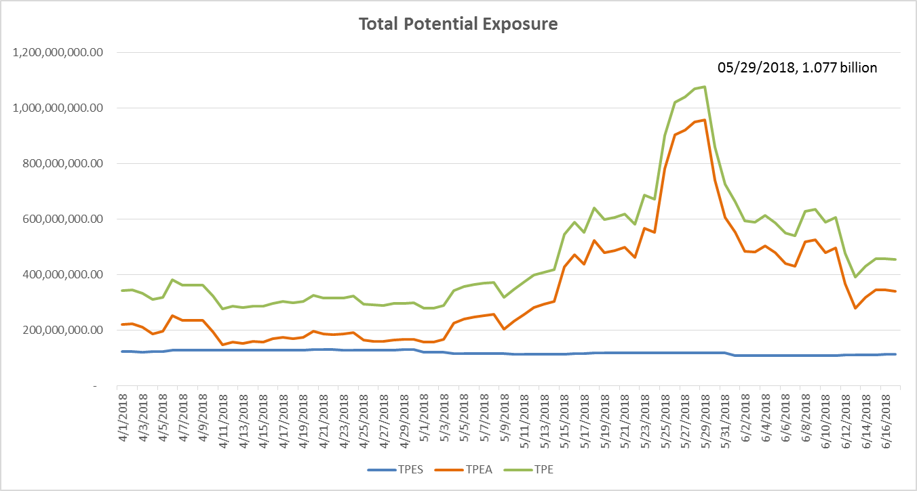
Credit Exposure Update

Slide 5
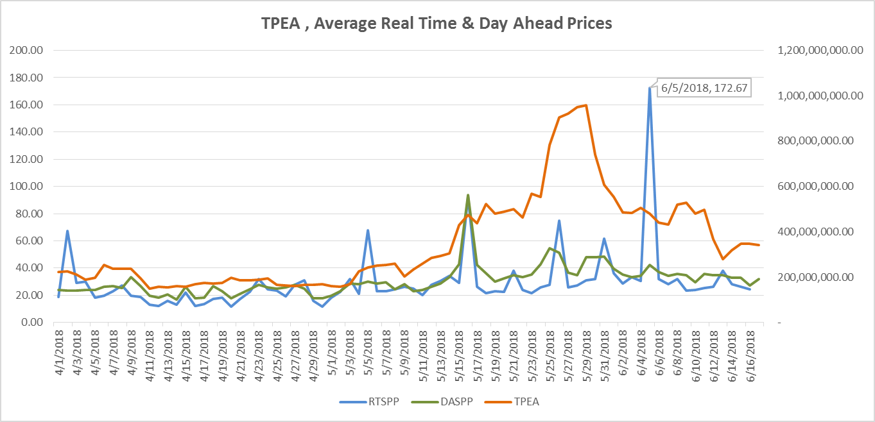
Credit Exposure Update

Slide 6
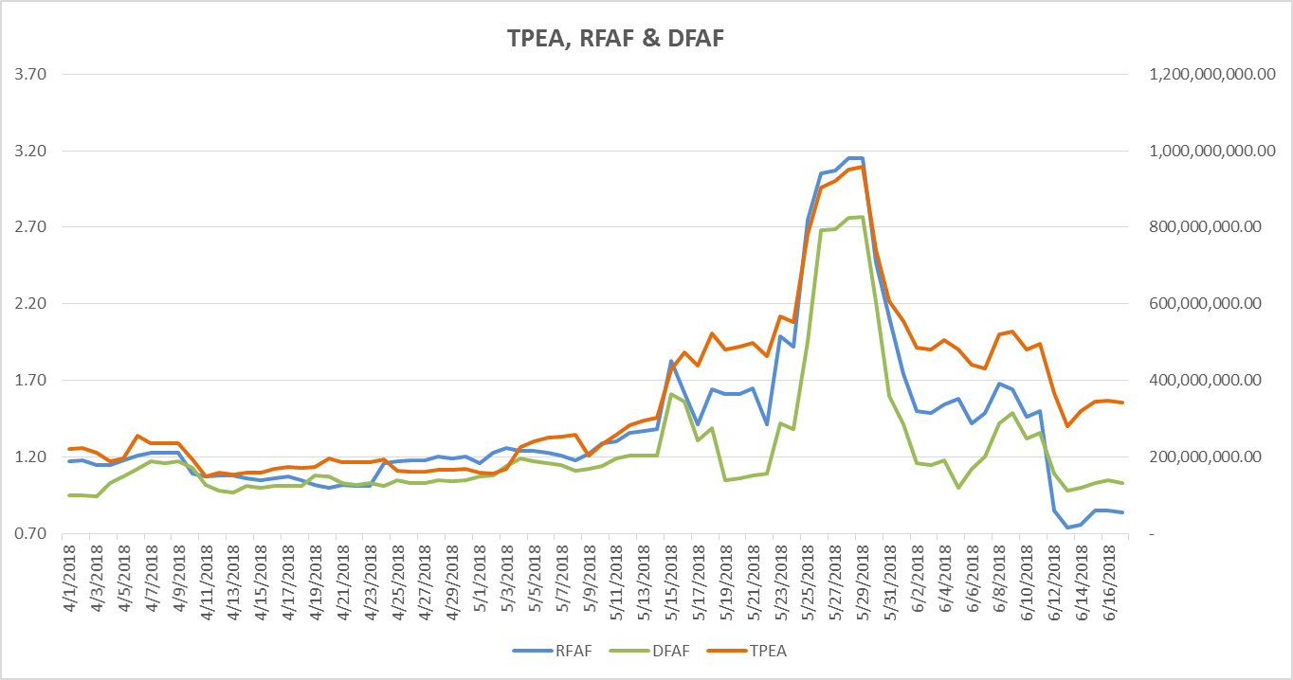
Credit Exposure Update
TPE : 1.077 billion
RFAF: 3.15
DFAF: 2.77

Slide 7
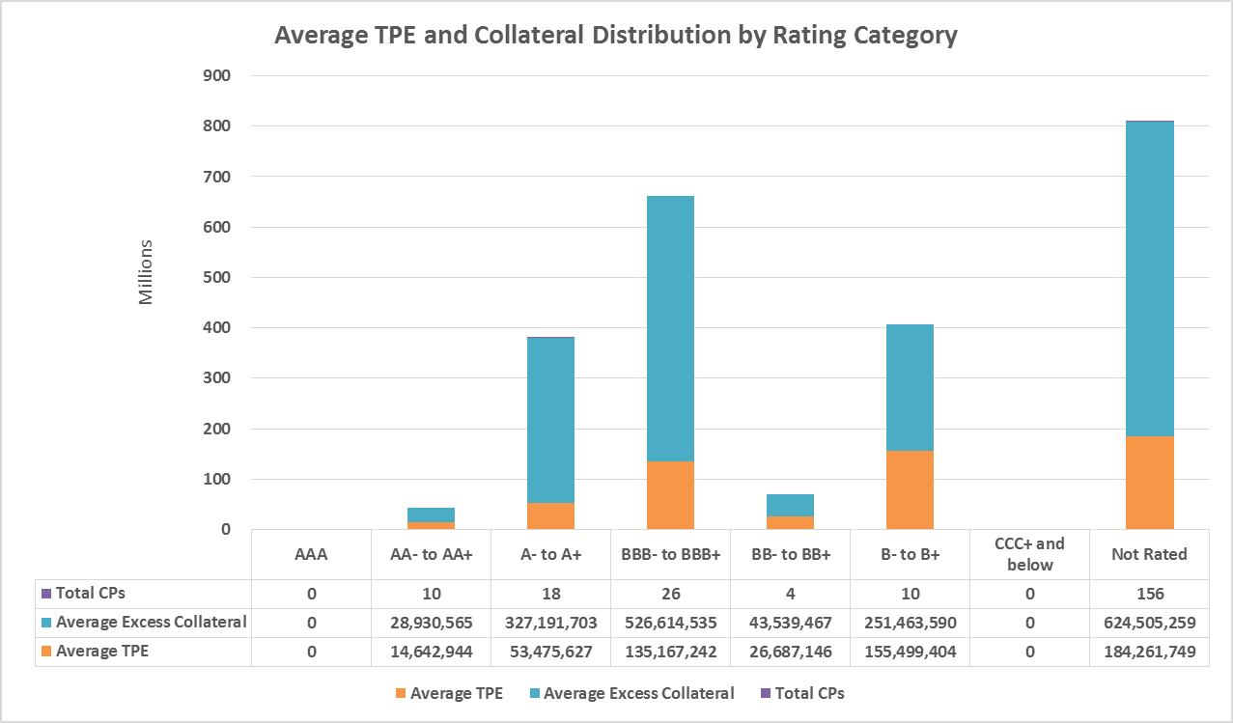
Credit Exposure Update

Slide 8
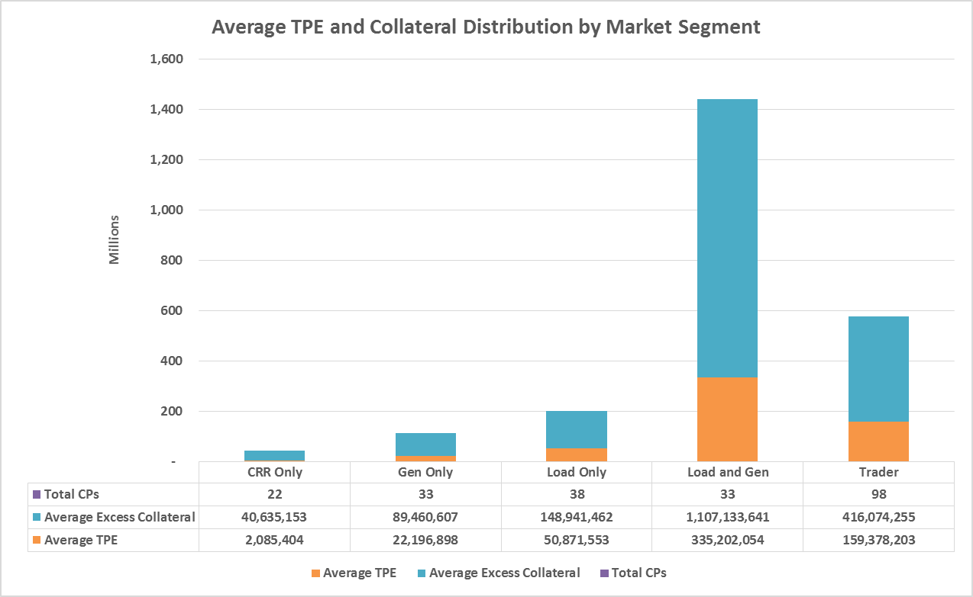
Credit Exposure Update

Slide 9
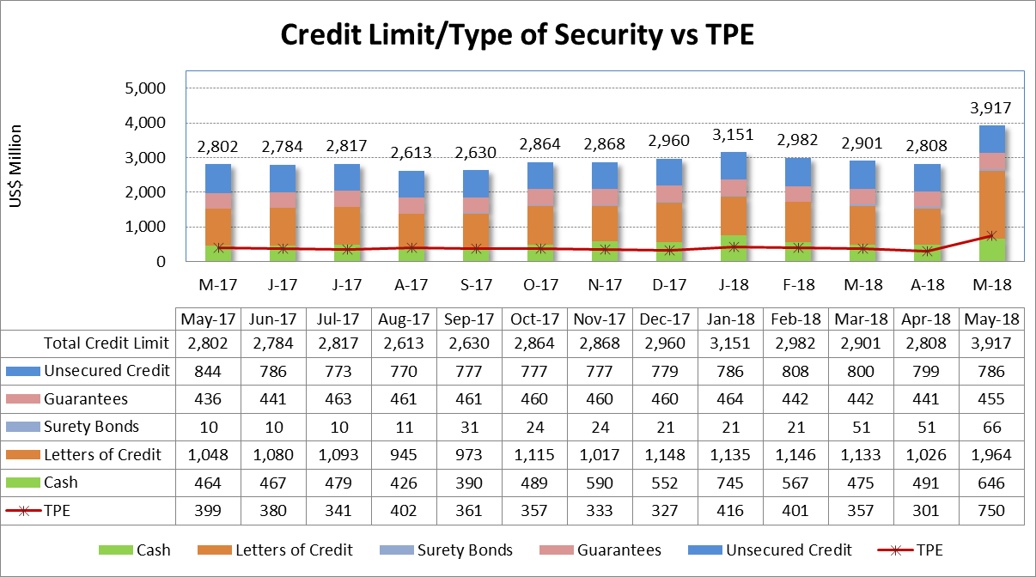
Credit Exposure Update

Slide 10
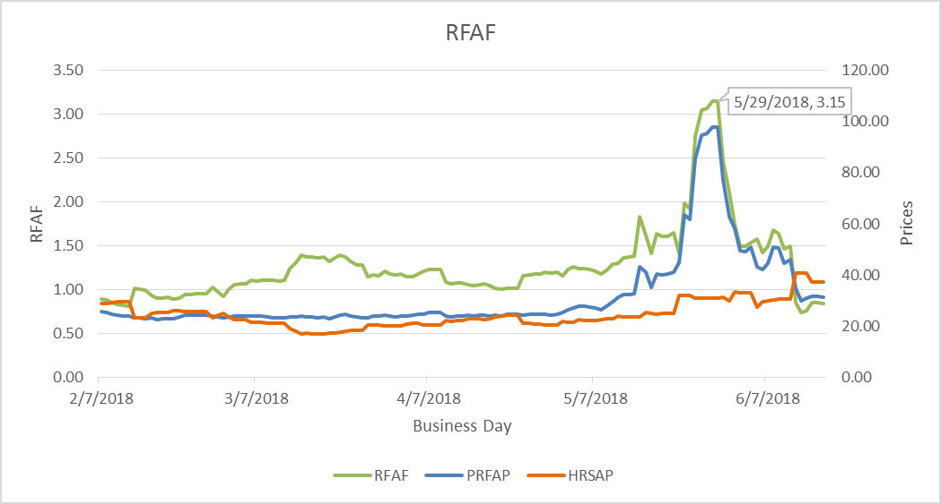
Credit Exposure Update
Real-Time Forward Adjustment Factor (RFAF)
RFAF is calculated using 21 days of ICE future prices and 14 days of ERCOT Real Time Settled Prices for HB_NORTH settlement point

Slide 11
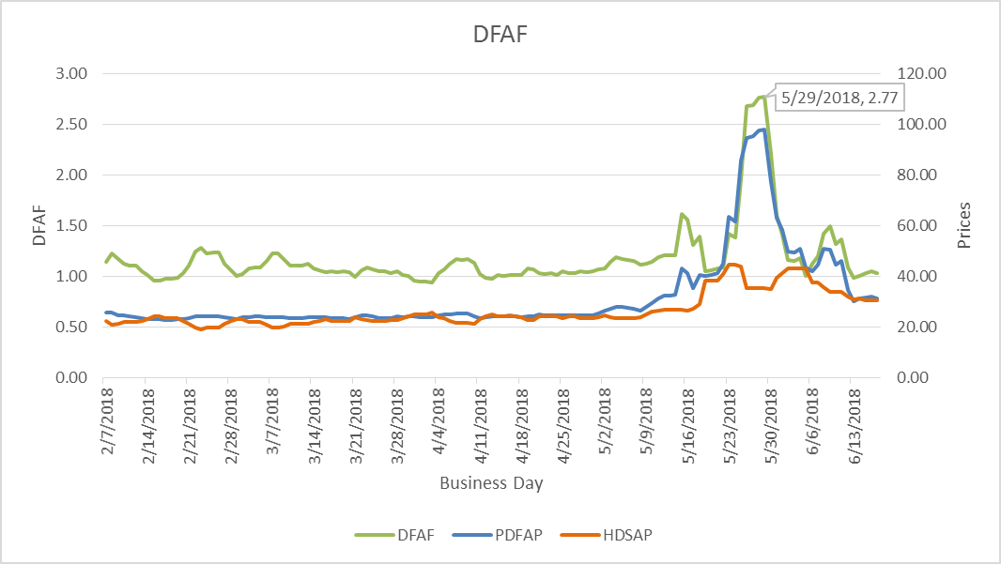
Credit Exposure Update
Day-Ahead Forward Adjustment Factor (DFAF)
DFAF is calculated using 21 days of ICE future prices and 7 days of ERCOT Day Ahead Settled Prices for HB_NORTH settlement point

Slide 12
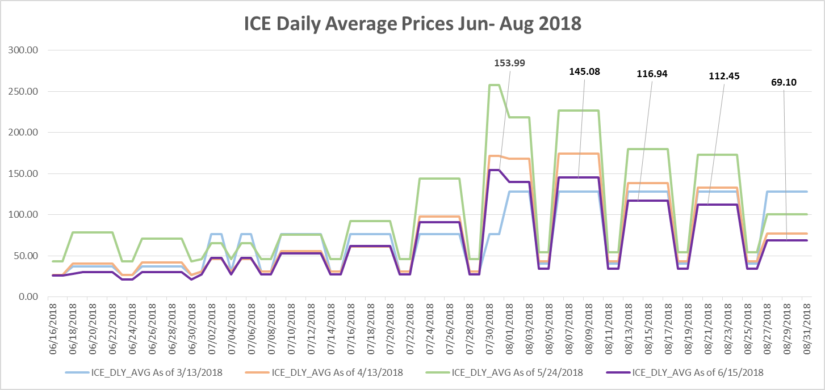
ICE Forward Curves June – August 2018

Slide 13
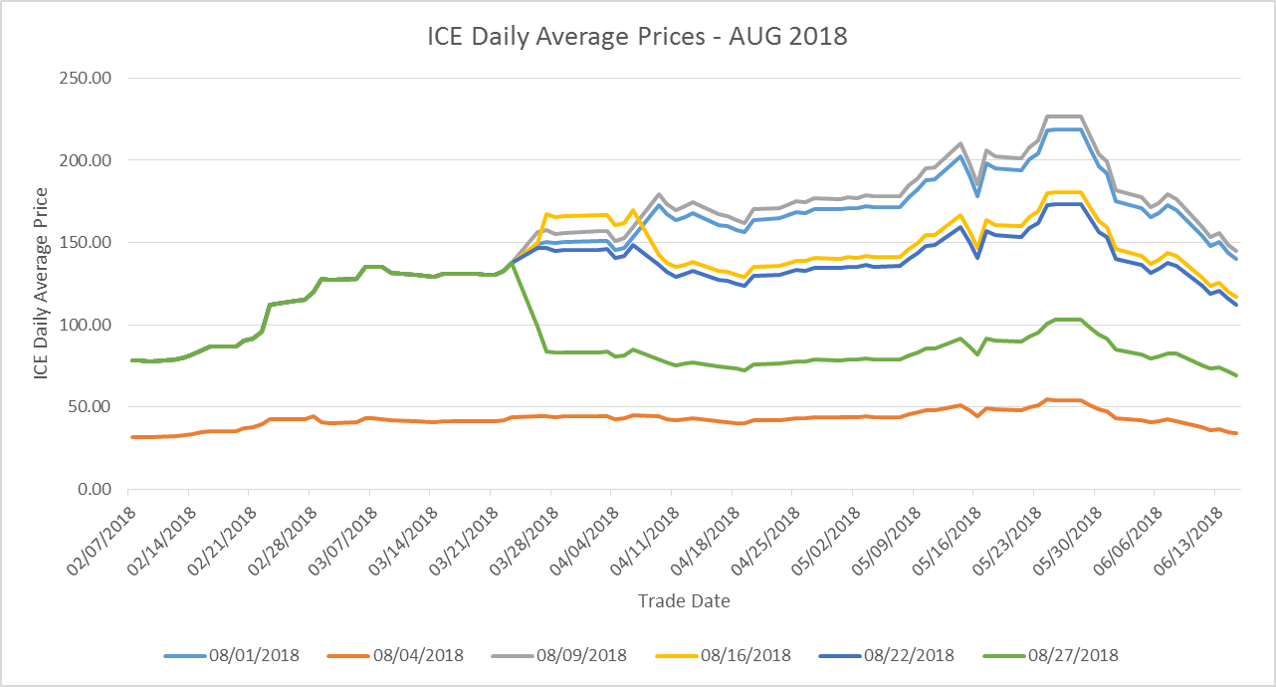
ICE Forward Curves August 2018
August ICE forward price evolution for weekdays and weekends.

Slide 14
Credit Exposure Update
Appendix

Slide 15
Credit Exposure Update
Summary statistics by Market Segment

Slide 16
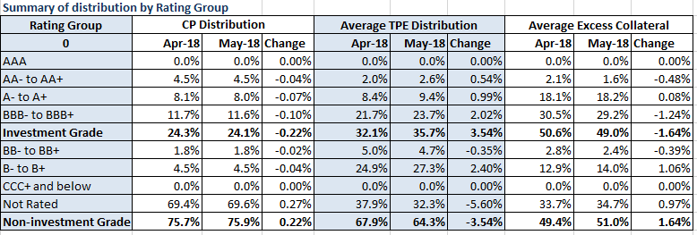
Credit Exposure Update
Summary statistics by Rating Group

Slide 17
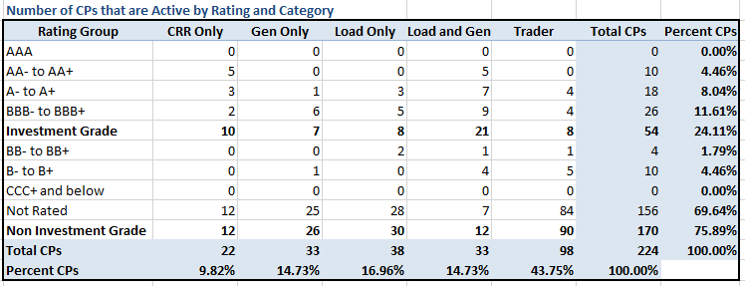
Credit Exposure Update
Active Counter-Parties distribution by rating and category- May 2018

Slide 18
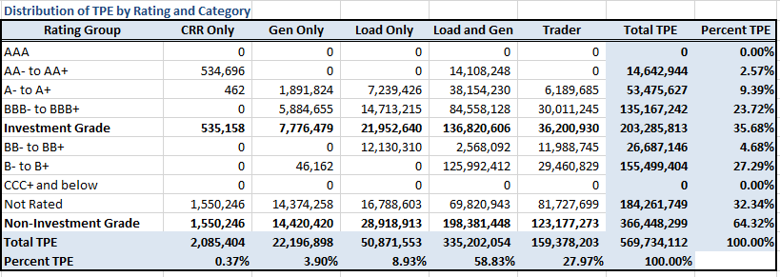
Credit Exposure Update
Average Total Potential Exposure distribution-May 2018

Slide 19
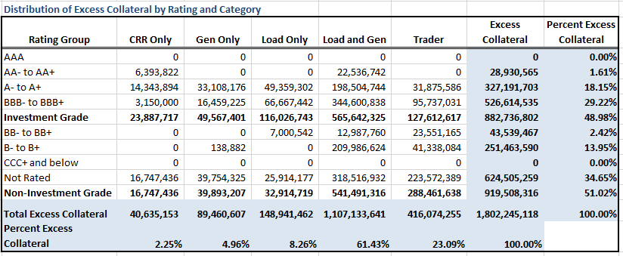
Credit Exposure Update
Average Excess Collateral distribution^{*-}May 2018
*Excess Collateral is a voluntary disposition by Counterparty

Slide 20
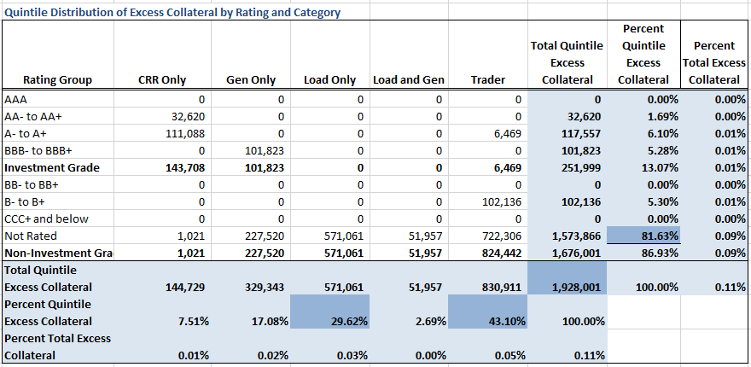
Credit Exposure Update
Distribution in the Bottom Quintile of Excess Collateral^{*-}May 2018
*Excess Collateral is a voluntary disposition by Counterparty

Slide 21
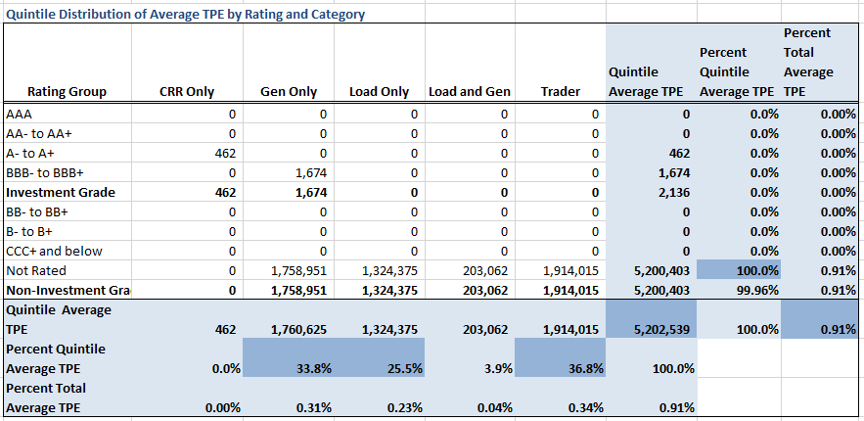
Credit Exposure Update
Distribution in the Bottom Quintile of Excess Collateral⁻May 2018

Slide 22
Credit Exposure Update
Questions

