Slide 1
SMT Update To AMWG
May 2018

Slide 2
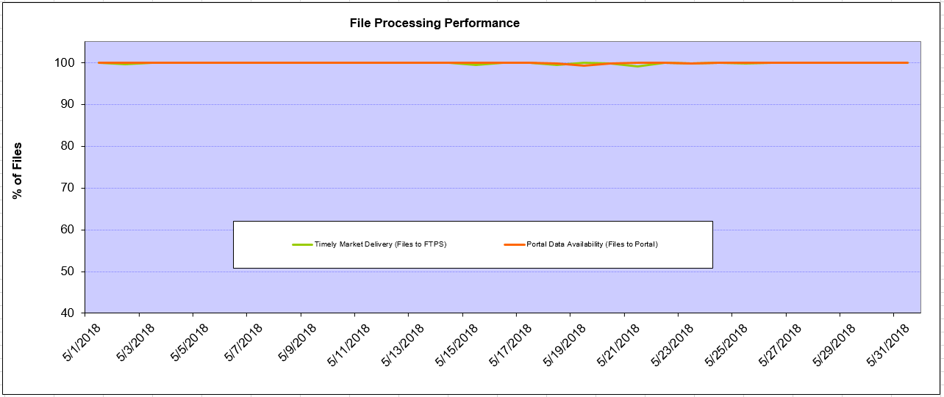
Monthly SMT Data Timelines AMWG CR 2014 002 End to End File Processing Completeness – May 2018
% Timely Market Delivery - % of files posted to market (FTPS) by 11:00pm out of # of files received by SMT by 11:00pm.
% Portal Data Availability - % of files loaded to the database for data availability on portal by 6:00am next day for the files received by 11:00pm
A LSE file includes usage data for up to 50,000 ESIIDs.
2

Slide 3
SMT API and FTPS Services Availability – May 2018
The service availability is measured as a percentage of number of minutes the service was available out of the total number of minutes in a month, excluding planned outages.
Observed Anomalies:
Mar-Apr 2015: SMT outage and subsequent recovery/catch-up impacted API availability. FTPS was available for most of the part except on 03/21-03/22 for 36 hours.
26 Jul 2015: Services were unavailable for 12 hours due to Flash storage issue
25 Jan 2016: Services were unavailable for 19 hours due to storage configuration issue
07 Mar 2016: API Services were unavailable for 7hours due to Oracle archiver issue.
12 Jul 2017: Due to network Outage FTP & API services are down for 20 minutes. FTPS & API availability is 99.95%.
Notes:
3

Slide 4
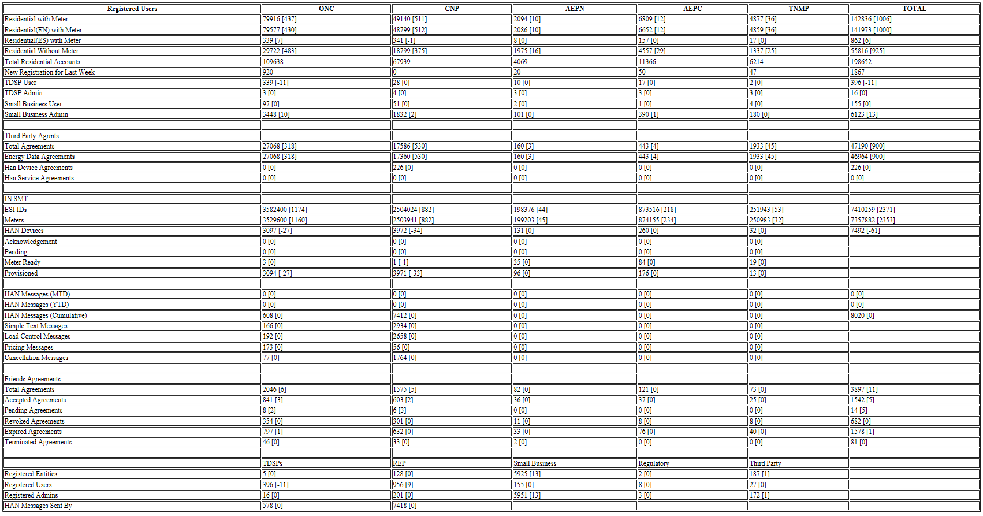
SMT Number of Accounts by Type AMWG CR 2014 009 – May 2018

Slide 5
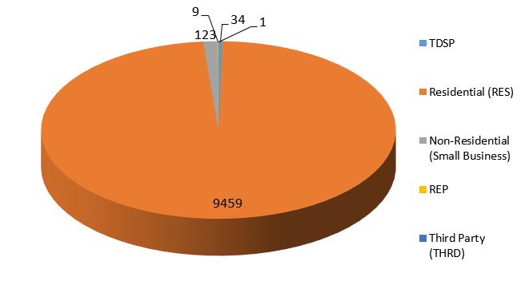
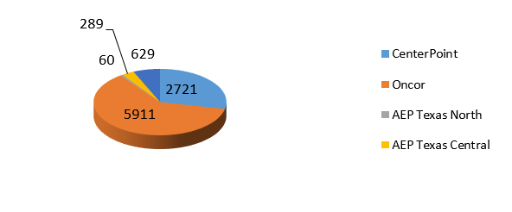
SMT ODR Details – May 2018
Total ODR Requests TDSP wise statistics:
Total ODR Requests User type statistics:

