Slide 1
Synchronous Inertia Discussion
Nitika Mago
ERCOT Operations Analysis
Demand Side Working Group (DSWG)
June 15, 2018

Slide 2
Inertia Background
Only synchronous machines provide inertia to the system
Everything else provides a response, but does not provide system inertia
The level of Inertia on the system is solely a function of the synchronously-connected machines online on the System and their characteristics
However, because the synchronously-connected machines that are online at a particular point in time are related to the load and wind generation on the system at that point in time, the system inertia may be correlated with the load and wind generation

Slide 3
Inertial Effect
Initial rate of change of frequency (RoCoF) prior to any resource response is solely a function of inertia

Slide 4
Inertial Effect
Slope of the RoCoF line changes due to resources’ response

Slide 5
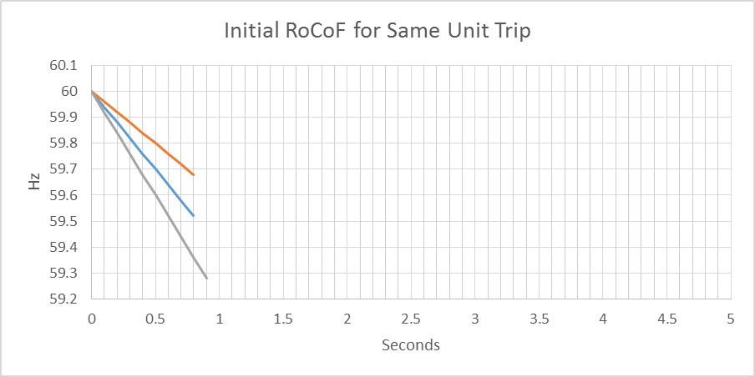
Inertial Effect
Higher Inertia
Lower Inertia

Slide 6
Critical Inertia Concept
The level of inertia which causes the frequency to drop below the UFLS trigger before the “fastest” resources can provide sufficient frequency response (for the two STP trip) is the “Critical Inertia”
0.4 Hz
0.5 s

Slide 7
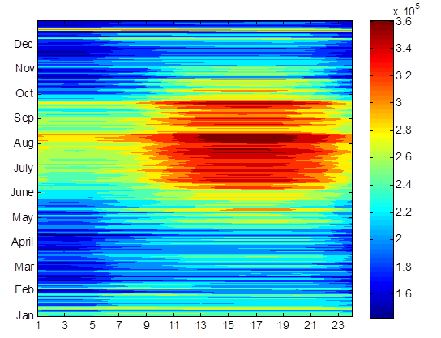
Responsive Reserve Service (RRS)
System Inertia 2016
RRS is procured to ensure sufficient capacity is available to respond to frequency excursions during unit trips.
To consistently meet BAL-003 Interconnection Frequency Response Obligation, ERCOT must plan not to activate UFLS for loss of 2750 MW of generation.
  UFLS relays will shed firm load if frequency drops to 59.3 Hz (5% of total ERCOT load).
  ERCOT plans to maintain frequency nadir at or above 59.4 Hz for loss of 2750 MW (0.1 Hz margin).
Responsive Reserve Requirements 2017

Slide 8
Critical Inertia Definition
Minimum level of system inertia that will ensure LRs will have sufficient time to respond before Frequency hits 59.3 Hz (UFLS threshold)
Tf = LRs Response time

Slide 9

Critical Inertia for ERCOT
$$T=f \left(Inertia\right) =3×{10}^{−5}×{Inertia}^{2}+0.0016×Inertia+0.0048$$
Critical Inertia: 94 GW*s
LR Response Time
0.42s

Slide 10
Current Critical Inertia for ERCOT
Currently, the Critical Inertia Level for ERCOT appears to be around 100 GW-s (based on current operations and response characteristics of current resources)
  Simulation results have shown that below this level RoCoF is high enough that frequency would drop below 59.3 Hz for the two STP trip before LRs start providing response
  Simulation results have also shown wide-area voltage oscillations at inertia below this level; this is a separate but somewhat related issue as identified in the Panhandle region as weak grid

Slide 11
RRS Study Methodology
A set of recent cases at varying inertia levels are selected to represent a wide range of expected future inertia conditions. Following assumptions are applied to each case/study,
    Model 1150 MW of PFR from Generation Resources.
      Generation mix when,
        Inertia < 250 GW·s: 30% Coal + 70% Gas
        Inertia ≥ 250 GW·s: 15% Coal + 85% Gas
    Load Resources providing RRS will trip at 59.7 Hz, with a delay of 0.416 s (relay delay = 0.333 s; breaker action = 0.083 s).
    Load damping factor was assumed to be 2% at the system level.
Trip 2750 MW of generation simultaneously and identify the amount of LR needed to maintain frequency at 59.4 Hz.

Slide 12
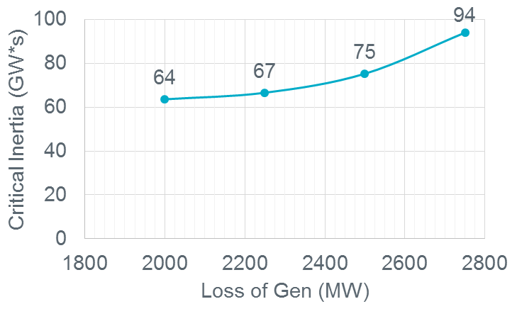
Potential Parameters Changes
Faster Response
Changing UFLS Settings
Critical Contingency
 | UFLS @59.3Hz
0.42s LR Response Time
UFLS @59.1Hz
94 GW*s
71 GW*s
0.25s LR Response Time
68 GW*s
52 GW*s

Slide 13
Potential Parameters Changes - Faster Response
Faster response from the Load Resources on high-set under-frequency relays will aid in reducing Critical Inertia
  ERCOT wants to discuss viability of obtaining response within 15 cycles with various DR providers
    ERCOT recognizes that the option of faster response is dependent on the types of Load Resources and is probably not viable for all Load Resources
  ERCOT may allow LRs that meet the 15 cycle response requirement to move their trip setting from 59.7 Hz to 59.69 Hz.
UFLS @59.3Hz | LR @59.7Hz
0.42s LR Response Time
0.25s LR Response Time
94 GW*s
68 GW*s
Since 2011, 14 under frequency events triggered some response from Load Resource providing RRS.
  12 events for frequency near 59.7 Hz.
  2 events in 2011, 2012 frequency went below 59.7 Hz.
    In both events frequency was below 59.7Hz for about 26 cycles.

Slide 14
Discussion

Slide 15
Current RRS Table
 | Scenario 1 | Scenario 2 | Scenario 3 | Scenario 4 | Scenario 5 | Scenario 6 | Scenario 7 | Scenario 8 | Scenario 9 | Scenario 10 | Scenario 11 | Scenario 12
LR/PFR | 2.25:1 | 2.11:1 | 1.99:1 | 1.87:1 | 1.77:1 | 1.69:1 | 1.61:1 | 1.54:1 | 1.47:1 | 1.41:1 | 1.36:1 | 1.3:1
Inertia (GW∙s) | 130 | 140 | 150 | 160 | 170 | 180 | 190 | 200 | 210 | 220 | 230 | 240
PFR Req. (no LR) (MW) | 5246 | 4916 | 4620 | 4361 | 4132 | 3927 | 3743 | 3576 | 3424 | 3285 | 3157 | 3040
RRS 50% Lim (MW) | 3229 | 3162 | 3090 | 3039 | 2984 | 2920 | 2868 | 2815 | 2772 | 2726 | 2676 | 2643
RRS 60% Lim (MW) | 2998 | 2951 | 2898 | 2867 | 2835 | 2793 | 2760 | 2725 | 2697 | 2664 | 2626 | 2604
 | Scenario 13 | Scenario 14 | Scenario 15 | Scenario 16 | Scenario 17 | Scenario 18 | Scenario 19 | Scenario 20 | Scenario 21 | Scenario 22 | Scenario 23 | Scenario 24 | Scenario 25
LR/PFR | 1.26:1 | 1.22:1 | 1.17:1 | 1.14:1 | 1.1:1 | 1.07:1 | 1.04:1 | 1.01:1 | 1.00:1 | 1.00:1 | 1.00:1 | 1.00:1 | 1.00:1
Inertia (GW∙s) | 250 | 260 | 270 | 280 | 290 | 300 | 310 | 320 | 330 | 340 | 350 | 360 | 370
PFR Req. (no LR) (MW) | 2932 | 2831 | 2737 | 2650 | 2569 | 2492 | 2421 | 2353 | 2290 | 2230 | 2173 | 2119 | 2068
RRS 50% (MW) | 2594 | 2550 | 2523 | 2477 | 2446 | 2408 | 2373 | 2342 | 2290 | 2230 | 2173 | 2119 | 2068
RRS 60% (MW) | 2564 | 2528 | 2507 | 2466 | 2440 | 2405 | 2372 | 2341 | 2290 | 2230 | 2173 | 2119 | 2068
RRS 50% Lim (MW) - quantity is calculated with limit of 50% limit on LRs.
RRS 60% Lim (MW) - quantity is calculated using language approved in NPRR 815.
Red font in table above identifies study scenario where RRS needed < 2300 MW. 2300 MW floor will be used in RRS requirement determination.
Generation mix (CCs, Gas, SC, Coal, Steam) providing 1150 MW of PFR has been aligned with actual historic system operations.
Inertia < 250 GW·s: 30% Coal + 70% Rest. Inertia ≥ 250 GW·s: 15% Coal + 85% Rest

Slide 16
Under-Frequency Events Impacting Load Resources
2011
Date | Time | Duration (min) | Amount of Response (MW) | Type of Deployment
3/23/2011 | 14:46 | 31 | 393 | UF Event for frequency near 59.7 Hz that caused some Load Resources to trip offline
4/5/2011 | 22:02 | 6 | 75 | UF Event for frequency near 59.7 Hz that caused some Load Resources to trip offline
5/19/2011 | 14:08 | 9 | 114 | UF Event for frequency near 59.7 Hz that caused some Load Resources to trip offline
11/29/2011 | 3:29 | 15 | 739 | UF Event for frequency < 59.7 Hz but of uncertain duration. (C-point 59.690003 Hz, below 59.7 Hz for ~26 cycles)
2012
Date | Time | Duration (min) | Amount of Response (MW) | Type of Deployment
7/10/2012 | 20:46 | 14 | 198 | UF Event for frequency near 59.7 Hz that caused some Load Resources to trip offline
7/30/2012 | 16:03 | 13 | 324 | UF Event for frequency near 59.7 Hz that caused some Load Resources to trip offline
11/2/2012 | 1:41 | 11 | 882 | UF Event for frequency < 59.7 Hz but of uncertain duration. (C-point 59.694003 Hz, below 59.7 Hz for ~27 cycles)
2013
Date | Time | Duration (min) | Amount of Response (MW) | Type of Deployment
1/4/2013 | 9:41 | 20 | 572 | UF Event for frequency near 59.7 Hz that caused some Load Resources to trip offline
1/8/2013 | 16:40 | 10 | 974 | UF Event for frequency near 59.7 Hz that caused some Load Resources to trip offline
11/1/2013 | 21:47 | 10 | 463 | UF Event for frequency near 59.7 Hz that caused some Load Resources to trip offline

Slide 17
Under-Frequency Events Impacting Load Resources
2014
Date | Time | Duration (min) | Amount of Response (MW) | Type of Deployment
1/18/2014 | 8:41 | 59 | 850 | UF Event for frequency near 59.7 Hz that caused some Load Resources to trip offline; resulted in EEA Level 1 event.
2015
Date | Time | Duration (min) | Amount of Response (MW) | Type of Deployment
7/29/2015 | 18:16 | 10 | 22 | UF Event for frequency near 59.7 Hz that caused some Load Resources to trip offline (C-point 59.723003 Hz)
2016
Date | Time | Duration (min) | Amount of Response (MW) | Type of Deployment
5/1/2016 | 20:20 | 4 | 927 | UF Event for frequency near 59.7 Hz that caused some Load Resources to trip offline (C-point 59.700003 Hz)
2018
Date | Time | Duration (min) | Amount of Response (MW) | Type of Deployment
4/21/2018 | 17:11 | 19 | 546 | UF Event for frequency near 59.7 Hz that caused some Load Resources to trip offline (C-point 59.711003 Hz)

Slide 18
Whitepaper on Inertia
A paper titled Inertia: Basic Concepts and Impacts on the ERCOT Grid was published on Apr 4, 2018.
This paper document’s the initiatives ERCOT has undertaken
  to track the trends of historical inertia on the ERCOT system
  to develop tools and methods to mitigate negative impacts of low inertia conditions that could arise in the future.
Any comments or feedback on this paper should be sent via email to Sandip Sharma (ssharma@ercot.com).

