Slide 1

NPRR 863
June 2018 DSWG

Slide 2
Key Changes
Established two governor deadband requirements
Changed from Primary Frequency Response Service to Frequency Response Service (FRS)
Load Resource Participation restored in FRS
RRS remains a 10 minute product, but is open to broader participation
FFR allowed to participate in either FRS or RRS
2

Slide 3
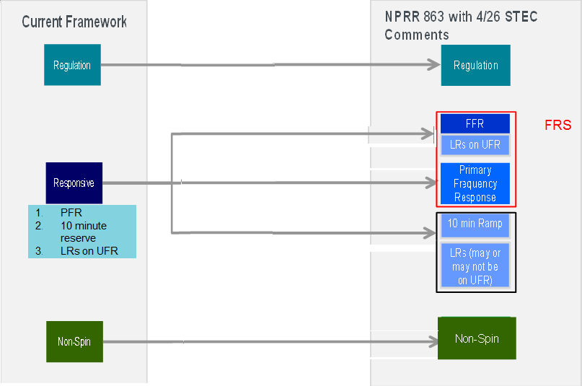
Framework
RRS
3

Slide 4
Frequency Response Service
Purpose: Arrest and stabilize frequency following a disturbance
Very similar to today’s RRS
Generator governor deadband at +/- 0.017 Hz
Load Resource participation at 59.70 Hz and during EEA and DCS events
Fast Frequency Response Resource participation enabled
  Must maintain response for 15 minutes
  Must restore capability within 15 minutes of recall
  Automatically deployed at 59.85 Hz and recalled at 59.98 Hz
Synchronous condenser participation at 59.80 Hz
ERCOT to determine quantities subject to 1,150 MW PFR min.
4

Slide 5
Responsive Reserve Service
Purpose: Restore FRS within 10 minutes of a deviation, and to provide energy prior to or during an EEA
10 minute product that can be provided by Generation Resources (including FFR), QSGRs, Generation Resources in Synchronous Condenser mode, & Load Resources with or without UFRs
  LRs limited to 50% of ERCOT total requirement
Individual Resource quantity limited to the Resource’s telemetered Emergency Ramp Rate
Deployable prior to or during an EEA event – triggers to be defined in Operating Guides
Quantities to be determined by ERCOT.

Slide 6
Other
Generation Resources not providing FRS allowed to increase governor deadband to +/-.036 Hz
  Will likely require changes to BAL-001-TRE-1 regional standard
No changes to other AS
FRS can be later expanded for over-frequency events if Southern Cross or other asynchronous ties are connected

