Slide 1
Resource Definition Task Force Progress Update
June 2018

Slide 2
Background
This task force is intended to resolve issues with the resource definitions.
  It is anticipated that multiple NPRRs will be developed to address existing issues.
Intent is only to resolve confusing definitions, NOT to change any registration, responsibilities, or market issues.
The first NPRR is intended to eliminate the term “non-modeled” and introduce the framework organized around resource technologies, attributes, and services.

Slide 3
Existing Resource Definition Framework

Slide 4
Existing Resource Definition Framework
All Inclusive Generation Resource
Generation Resource
Non
Unregistered Distributed Generation
-
Modeled Generator
0
*
Registered Distributed
-
10
MW
>
10
MW
0
-
10
MW
>
10
MW
Generation Definition is
0
Distributed Generation
Distributed Generation
0
–
10
MW
–
1
MW
>
1
MW doesn’t export
<
=
Register PUC
60
kV
20
Register ERCOT
>
=
1
MW
(
incl self
-
?
)
May Provide ERS
Transmission Connected
Transmission Connected
Implied by
3
.
10
.
7
.
2
Distribution Connected
Distribution Connected
*Represents the bulk of ERCOT resources

Slide 5
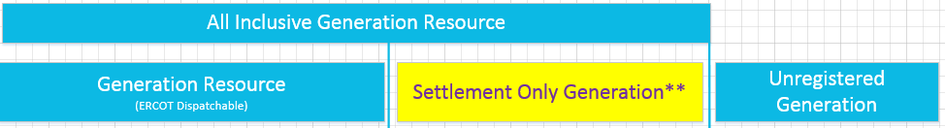
Proposed Resource Definition Framework
**Settlement Only generator means that they may not participate in Ancillary Services Market, RUC, SCED, or make Energy Offers.

Slide 6
Proposed Resource Definition Framework
All Inclusive Generation Resource
Generation Resource
Settlement Only Generation
Unregistered
**
Generation
(
ERCOT Dispatchable
)
Transmission Connected
Distribution Connected
Transmission Generation
Distribution Generation
Resource
Resource
<
10
MW
>
10
MW
<
10
MW
>
10
MW

Slide 7
Proposed Resource Definition Framework

Slide 8
Proposed Resource Definition Framework
Second NPRR(s) ( Fall 2018)
First NPRR(s) (July 2018)
Third NPRR(s) (2H2018/1H2019)

Slide 9
Resource Technology, Attributes and Services
Resource Categories
(
technologies
)
Gas Steam
Solar PhotoVoltaic
(
PVGR
)
Reciprocating Engine
Nuclear
Combined Cycle
Wind
Hydro Generation
-
powered
(
WGR
)
Coal and Lignite
Resource
Simple Cycle
Other
Energy Storage
Services
/
Markets
---
Attributes
/
Status
Energy Market
Reg
Switchable Generation Resource
Split Generation Resource
-
Up
/
Reg
-
Down
--
(
AS
)
Dynamically Scheduled Resource
FRRS
Intermittent Renewable Resource
DC Tie Resource
**
-
Down
/
FRRS
-
Up
--
(
AS
)
(
IRR
)
Black Start Service
Aggregate Generation Resource
Mothballed Generation Resource
--
(
AS
)
Non
-
Spin
--
(
AS
)
(
AGR
)
Emergency Response Service
Decommissioned Generation
(
ERS
Reliability Must
)
Quick Start Generation Resource
-
Run
--
(
AS
)
Generator
(
Resource
QSGR
)
Responsive Reserve
–
(
AS
)

Slide 10
Topics for Additional Discussion – Phase 2 (Transmission)
All transmission connected resources would be required to be registered and modeled, regardless of size.
Finish introduction of Resource Framework
  Include definitions of all technologies
  Energy Storage.
    Develop definition
    registration/modeling/market issues will not be a significant area of focus as part of this task force and will instead be included in the whitepaper for further discussion.

Slide 11
Topics for Additional Discussion – Phase 3 (Distribution)
  Clarify Implicit Definitions in Protocols for Distribution connected resources 10 MW and greater. Generators > 10 MW output would register as Generation Resources.
  Develop explicit definition of what “export” means for requiring registration of distribution resources > 1 MW.
  Develop definition for generators < 1 MW.
    “Microgenerator” is specific to renewable technologies.
  How to handle Aggregations of distribution connected generators that want to register as Generation Resources ?

Slide 12
Additional Material

Slide 13
Proposed Category Nomenclature – using existing requirements
Transmission Generation Resource (TGR) Transmission-connected Registered with ERCOT as GR Participates in the market SCED A/S Modeled in ERCOT systems Telemetry, etc. Settled Nodally I |  | Settlement Only Transmission Generator (SOTG) Transmission-connected less than 10 MW Registered with ERCOT as SOG Settled for exported energy only Intermittent sources will typically export based on fuel availability. Self-dispatched may choose to export based on prices Modeled in ERCOT systems Reliability systems only Not scheduled/dispatchable Settled - Load Zone II | Settlement Only Transmission Self-Generator (TSG) Transmission-connected Registered with PUC as a Self-Generator and registered with ERCOT as SOG May occasionally export, but does not generate with the intent to sell at wholesale If it exports, then settled for exported energy only Continuous exports will be re-evaluated for TGR Modeled in ERCOT systems Reliability systems only Not scheduled/dispatchable Settled - Load Zone III
Distribution Generation Resource (DGR) Distribution connected Registered with ERCOT as GR >10 MW require to register as GR Participates in the market SCED A/S Pseudo-Modeled in ERCOT systems Future--Modeling light? Telemetry, etc. Settled Nodally IV |  | Settlement Only Distribution Generator (SODG) Distribution connected but less than 10 MW Registered with ERCOT as SOG Settled for exported energy only Intermittent sources will typically export based on fuel availability. Self-dispatched may choose to export based on prices Mapped in ERCOT systems Not scheduled/dispatchable Telemetry not required Settled - Load Zone V | Unregistered Distribution Self-Generator (UDSG) Distributed generation greater than 1 MW co-located with larger load, but smaller than minimum facility load. Registered with PUC as a Self-Generator but not registered with ERCOT May not export—otherwise must register with ERCOT as SODG. Neither Mapped nor modeled in ERCOT systems (future mapping?) No ERCOT settlement policy since no exports. VI | Unregistered Distributed Microgenerator* (UDMG) Distribution connected less than 1 MW No requirement for registration Reported by DSP per PUCT 25.211(n) (competitive choice) Reported by NOIEs per ERCOT protocol 10.2.2.1.b(ii) for 50kW -1 MW Not reported by NOIEs for <50kW Neither Mapped nor modeled in ERCOT systems (future mapping of accumulations?) ERCOT settles as negative load in competitive choice areas once meter configuration updated to DG No ERCOT settlement policy for NOIE areas. VII
 | **Settlement Only means that the generator may not participate in Ancillary Services Market, RUC, SCED, or make Energy Offers Note: Transmission connected resources are required to be modeled in ERCOT NMMS systems. Studies are determined based on requirements for size and resource category type. *Microgenerator definition may need resolution with PUC

Slide 14
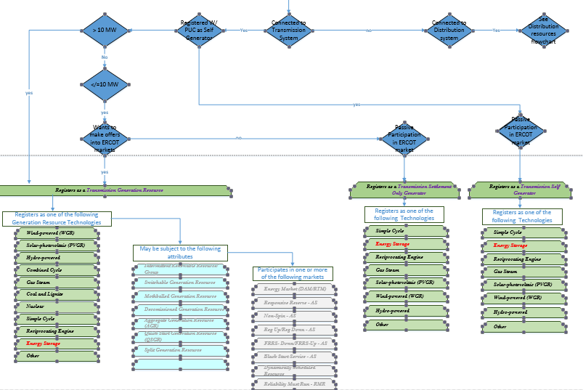
Example Registration Flowchart page 1

Slide 15
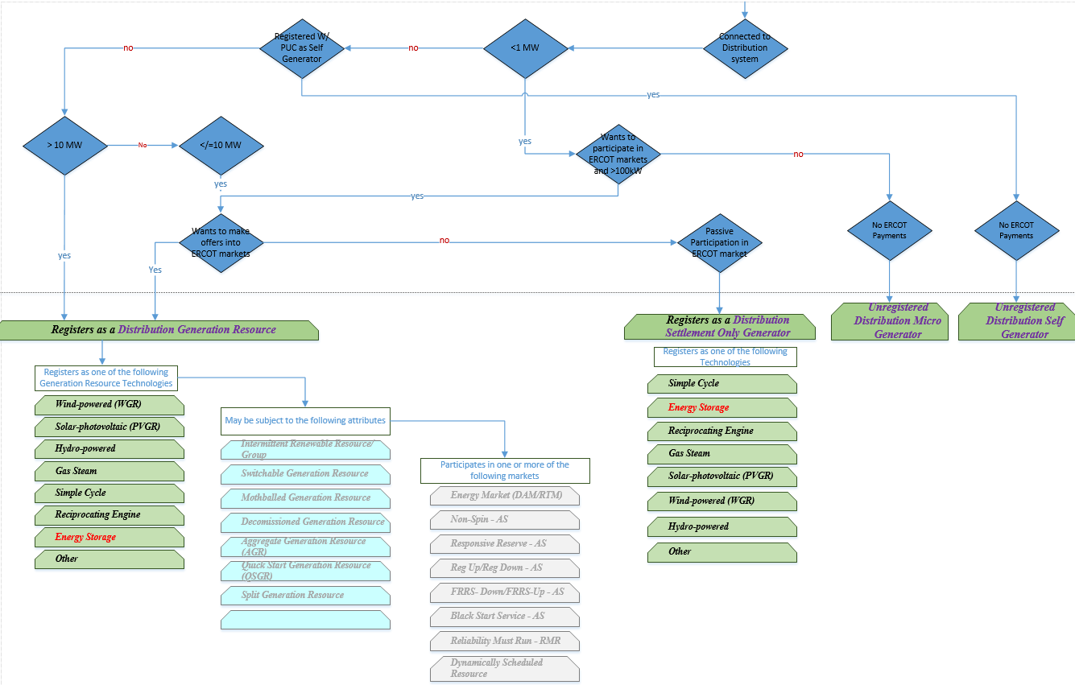
Example Registration Flowchart page 2

Slide 16
3 Stages of Activities
Stage 1 - Align definitions to identify differences
Status
  Framework developed/proposed
  Draft Whitepaper posted.

Slide 17
Stages of Activities (cont)
Stage 2 – Clarify Definitions for Transmission connected resources
  Revise/replace “Non-modeled” term per new definitions
  Recommend/Submit first NPRR.
Estimated Duration 6 months
Status
  First draft NPRR(s) to remove non-modeled posted for discussion.
    Preferred selection will be submitted to PRS
    Will also require RRGRR and RMGRR.
  Additional issues to be addressed identified in whitepaper

Slide 18
Stages of Activities (cont)
Stage 3 – Clarify definitions for Distribution connected resources
  Generate new categories addressing multiple configurations
  Utilize definitions established in step 1 where possible.
  Include current and proposed future DG categories together, or address in separate NPRRs?
  Submit NPRR(s).
Estimated duration 6-8 months
Status
  June meeting to kickoff this stage.
  Preliminary list of additional issues to be addressed in whitepaper

