Slide 1
Project Update and Summary of
Project Priority List (PPL) Activity
June 14, 2018

Slide 2
Project Update Agenda
Project Portfolio Update p. 3-8
Recent Project Implementations
2018 Release Targets
Planned Project Starts
2018 Project Spending Forecast
Revision Request Funding Placeholder Status
Priority/Rank Options for Revision Requests with Impacts
Appendix
Project Portfolio Gantt Chart p. 9-15
Location of Project Priority List (PPL): http://www.ercot.com/services/projects/index

Slide 3
Recent Project Implementations
2018 May Release – 5/29/2018 – 5/31/2018 Complete
NPRR768 – Revisions to Real-Time On-Line Reliability Deployment Price Adder Categories
OBDRR002 – ORDC OBD Revisions for PUCT Project 47199
NPRR815 – Revise the Limitation of Load Resources Providing RRS
Includes OBD – Methodologies for Determining Minimum AS Requirements
June 1 Release Complete
NPRR776 – Voltage Set Point Communication
NOGRR167 – Alignment with NPRR776, Voltage Set Point Communication
Note: Projected Go-Live dates are subject to change. Please watch for market notices as the effective dates approach.

Slide 4
2018 Release Targets – Board Approved NPRRs / SCRs / xGRRs
February 2/6 – 2/8 | April 4/5 – 4/9 | May 5/29 – 5/31 | August 8/7 – 8/9 | October 10/23 – 10/25 | December 12/11 – 12/13
NPRR659 NPRR683 NPRR743 NPRR760 NPRR800 NPRR810 PGRR042 NPRR846 | NPRR562(b) SCR792 | NPRR768 NPRR815 OBDRR002 NPRR776 NOGRR167 | NPRR819 NPRR825(a) NPRR844 SCR791 GINR Go-Live | NPRR843 NPRR854 NPRR864 RRGRR015 RRGRR016 SCR793 SCR794 SCR795 | NPRR519 NPRR620 NPRR741 NPRR755 PGRR057 NPRR809(b) NPRR842 SCR794
8 | 2 | 5 | 4 | 6 | 8
ü
ü
ü
ü
ü
ü
ü
ü
ü
ü
ü
ü
ü
E
E
E
P
E
P
NS
NS
NS
E
E
E
E
E
E
NS
NS
CMM Release 1a
CMM Release 1b
1/1 & 2/1
6/1
8/30
1/1
ü
ü
2/1
TBD Items (and point at which they became “TBD”)
2014 | 2015 | 2016 | 2017
NPRR664 | None | SCR781 P | NPRR702 P, SCR777, NPRR831(b), NPRR749 E, NPRR833 E, NPRR864, RRGRR015, RRGRR016, NPRR858, NPRR865
Go-live dates can differ from Protocol effective dates – Please refer to market notices for more details
APPENDIX
Red Text: New additions and target release changes
Strike-Through Text: Previous target release changes
(a), (b), etc. indicates multiple phases
Project Status Codes
NS = Not Started
I = Initiation
P = Planning
E = Execution
H = On Hold
Release targets are subject to change
NPRR825(a) – NoticeBuilder changes
NPRR562(b) – Reporting/posting system changes
NPRR809(b) – Reporting/posting system changes
NPRR831(b) – CRR system changes

Slide 5
Approved Revision Requests “Not Started” – Planned to Start in Future Months
Revision Request | Target Start Date | Release Target | Cost Estimate | Author
SCR795 – Addition of Intra-Hour Wind Forecast to GTBD Calculation | June 2018 | 2018-R5 | $30k-$40k | ERCOT
NPRR842 – Study Area Load Information | July 2018 | 2018-R6 | $60k-$80k | ERCOT
RRGRR015 – Additional Guidance for Transformer and Station Data RRGRR016 – Additional Guidance for Solar Data | July 2018 | 2018-R5 | $10k-$15k <$10k | RDWG
SCR794 – Update SCED Limit Calculation | Aug 2018 | 2018-R6 | $25k-$35k | ERCOT
NPRR817 – Create a Panhandle Hub | Sept 2018 | 2019-R2 | $150k-$200k | DC Energy
NPRR858 – Provide Complete Current Operating Plan (COP) Data | Oct 2018 | 2019-R1 | $25k-$45k | Citigroup Energy
NPRR865 – Publish RTM Shift Factors for Hubs, Load Zones, and DC Ties | Oct 2018 | 2019-R1 | $30k-$40k | DC Energy
SCR793 – SSR Related Telemetry for Transmission Service Provider (TSP) Operators | Oct 2018 | 2019-R1 | $40k-$50k | Cross Texas Transmission
Project Initiations – Next 3 Months
Aging Items Report | Last Action | Status
NPRR664 – Fuel Index Price for Resource Definition and Real-Time Make-Whole Payments for Exceptional Fuel Cost Events | Board approved on 12/9/2014 | Pending approval of NPRR847

Slide 6
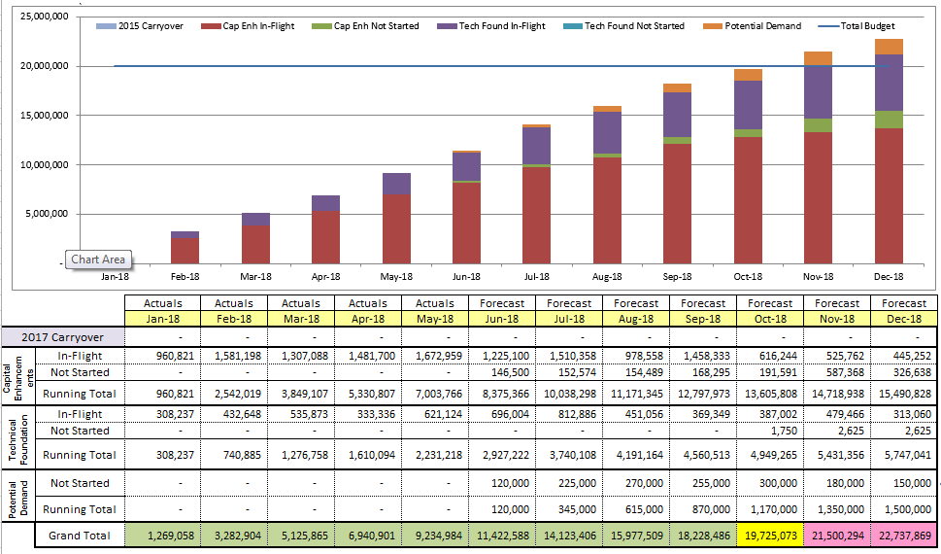
2018 Project Spending
2018 PPL Budget = $20.0M
“Potential Demand” represents internal ERCOT projects that have not been fully approved

Slide 7
Revision Request Funding Placeholder Status
In 2018 and 2019, ERCOT forecasted $4.0M for Revision Request work
Yearly Revision Request Spending Forecast Summary
Project Status | 2018 | 2019
YTD Actuals | $0.89M
Approved – In-Flight / Complete | $1.68M | $0.20M
Approved – On Hold | $0.09M | $0.00M
Approved – Not Started | $0.33M | $0.33M
Remaining Funding | $1.89M | $3.47M
Total Allocation | $4.00M | $4.00M
As of 5/31/2018
NPRR833
SCR789

Slide 8
Priority / Rank Options for Revision Requests with Impacts
Options for…
Revision Request | Description | Priority | Rank | Comments
NOGRR174 | AVR and PSS Testing Requirements | 2018 | 210 | REGULATORY ROS recommended Priority/Rank
NPRR856 | Treatment of OFFQS Status in Day-Ahead Make Whole and RUC Settlements | 2018 | 2230 | Work into the 2018 project plan without disrupting in-flight projects
NPRR873 | Posting of the ERCOT Wide Intra-Hour Wind Power and Load Forecast on MIS Public | 2018 | 2240 | Work into the 2018 project plan without disrupting in-flight projects
SCR796 | Change Validation Rules to Preclude Certain Transactions at Resource Nodes within Private Use Networks | 2018 | 2250 | Work into the 2018 project plan without disrupting in-flight projects
PPL Rank Information
Next available 2018 Rank in Business Strategy = 2230
Next available 2019 Rank in Business Strategy = 2540
Next available Rank in Regulatory = 220

Slide 9
Appendix
6/1/2018 Project Gantt
In-flight items sorted by Project End Date
“On Hold” projects listed separately
“Not Started” items sorted by Project Start Date

Slide 10
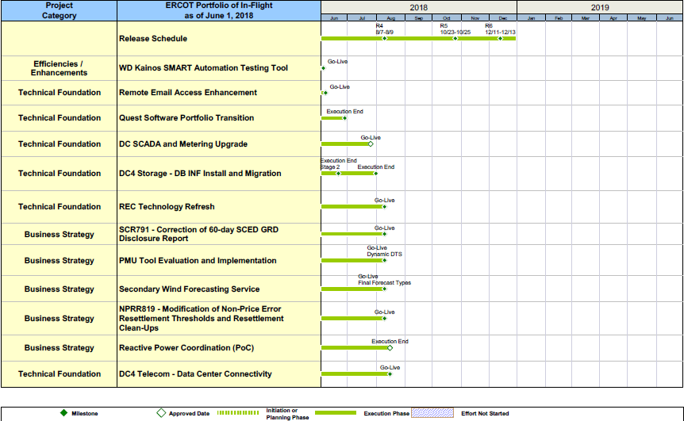
Project Portfolio Status – as of 6/1/2018

Slide 11
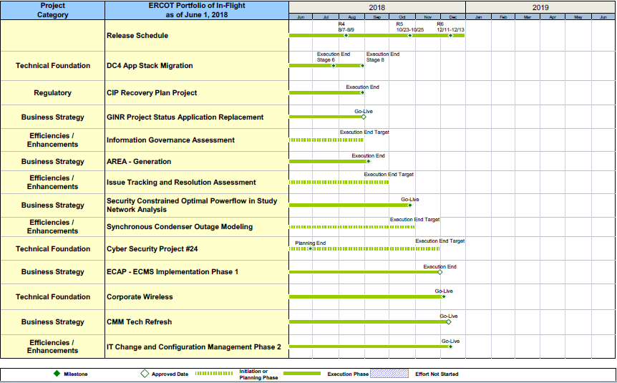
Project Portfolio Status – as of 6/1/2018

Slide 12
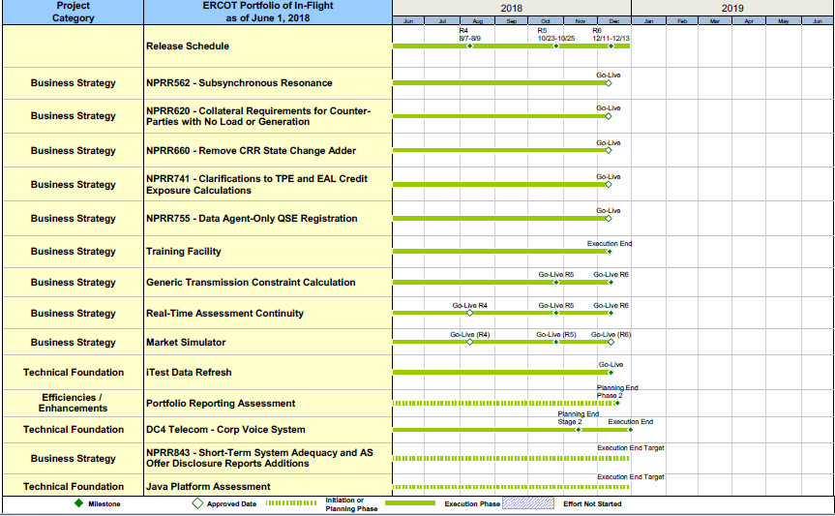
Project Portfolio Status – as of 6/1/2018

Slide 13
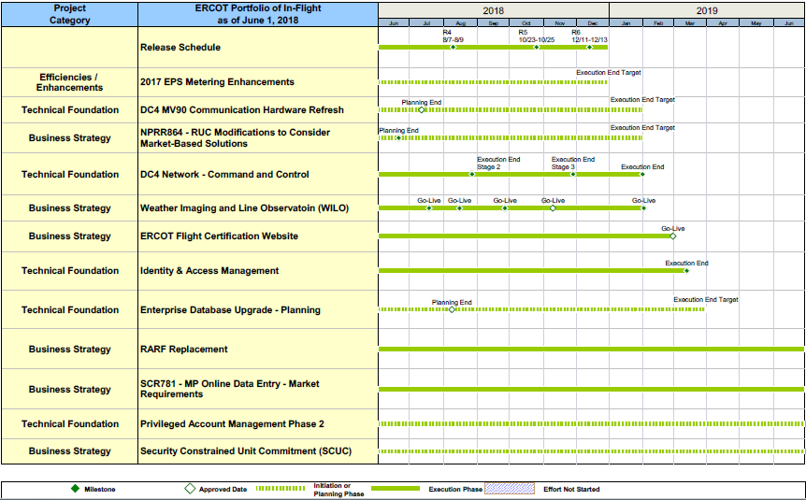
Project Portfolio Status – as of 6/1/2018

Slide 14
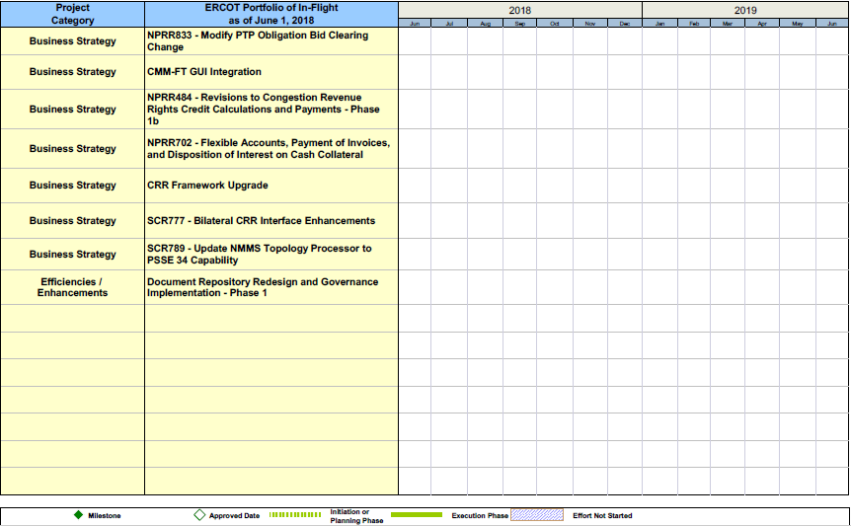
Project Portfolio Status – as of 6/1/2018

Slide 15
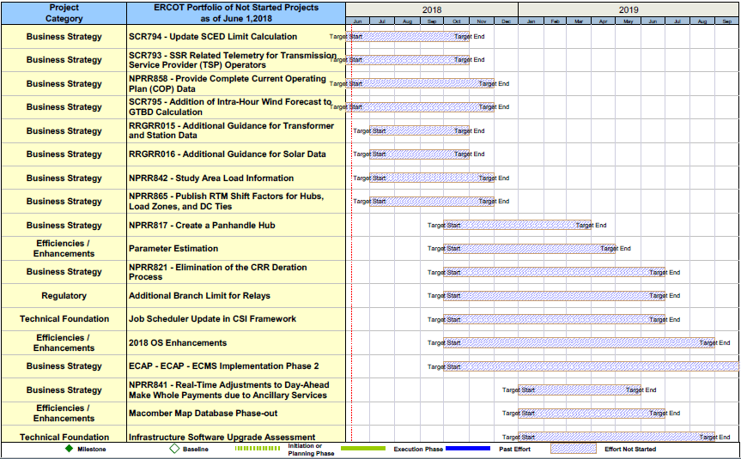
Project Portfolio Status – as of 6/1/2018 – On Hold

