Slide 1
CEO Perspectives
Bill Magness
President & CEO
ERCOT
2018 ERCOT Operations Training Seminar
March, April & May 2018

Slide 2
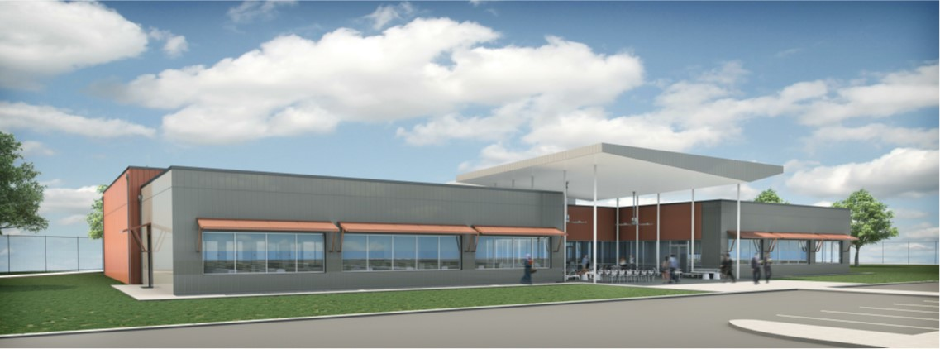
New Training Facility Coming to Taylor
Construction is underway for a new training facility on the Taylor campus.
Tentative completion date is October 2018.
Black Start training in 2019 will occur in new building.
Key Features
22,000 square feet of space with state-of-the-art technology
Mock control room for simulations and tours
Observation room for viewing control room while training

Slide 3
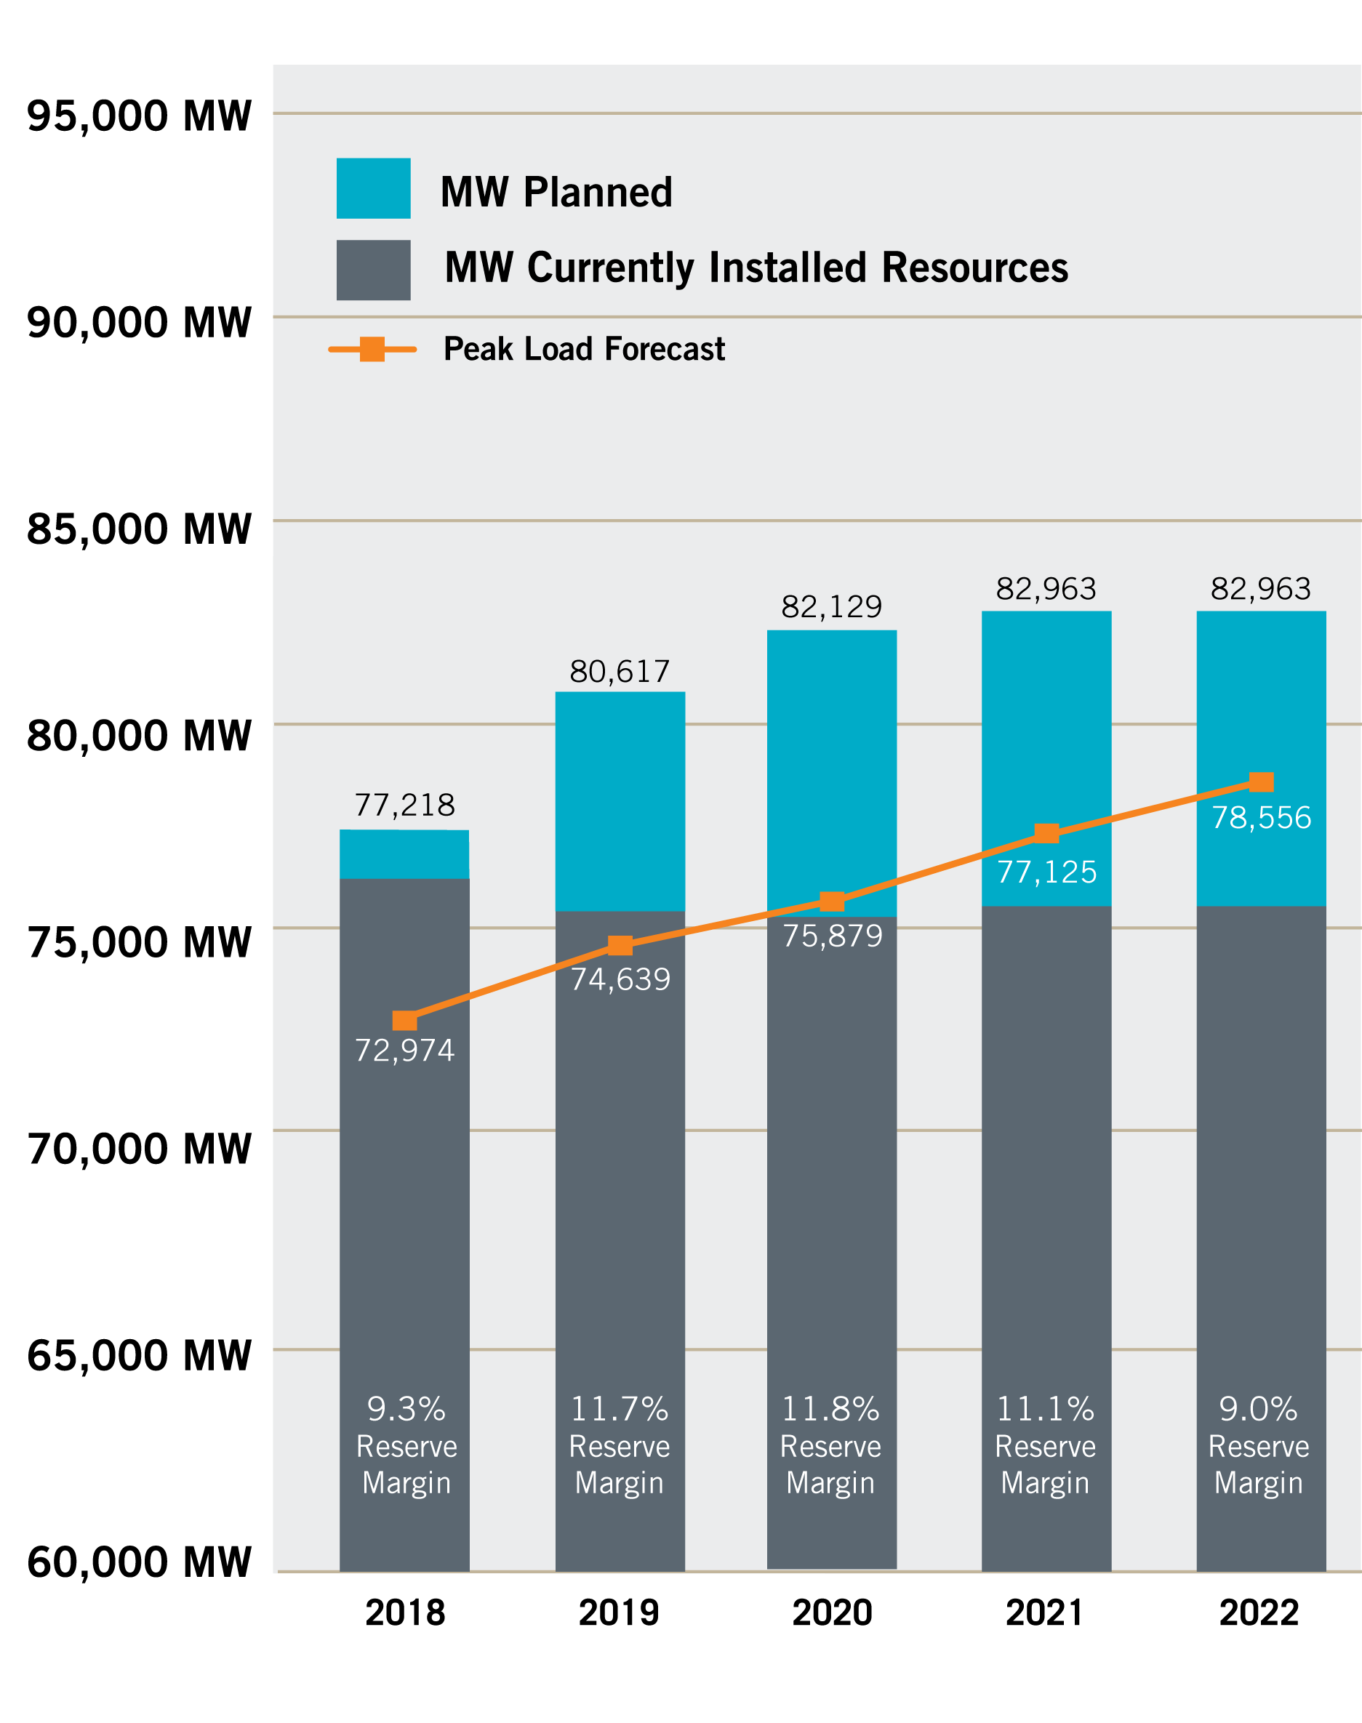
Capacity, Demand & Reserves Report – December 2017
Reserve margins 9.3% - 11.8% in next five years
Changing resource mix
Continued load growth forecast

Slide 4
2018 Summer Reserve Margin Changes
Load Forecast
Resources

Slide 5
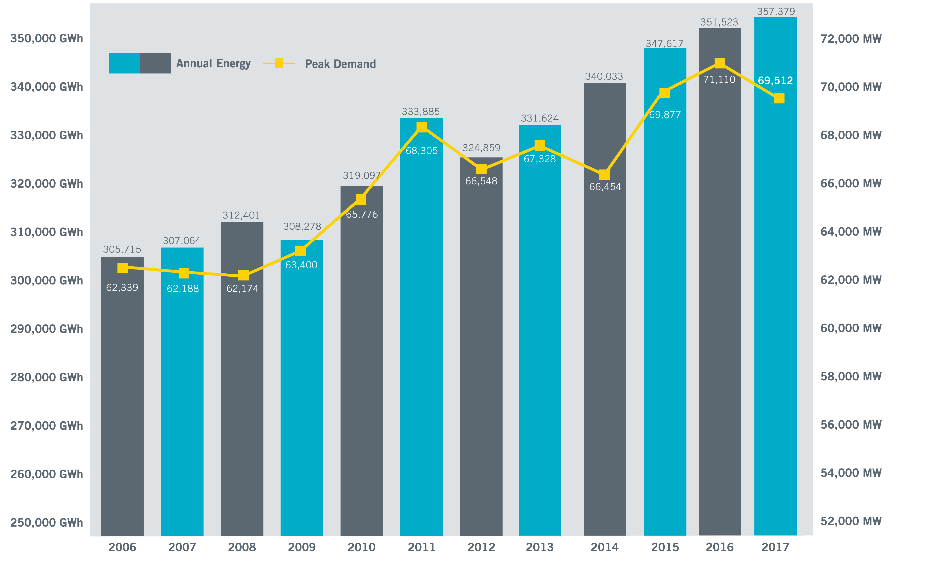
Annual Energy and Peak Demand (2006-2017)

Slide 6
Load Forecast Shows Growth in Peak Demand
Previous Forecast
Current Forecast
Compared to December 2016 forecast, December 2017 CDR shows smaller peak demands from 2018 to 2021 and greater peak demands thereafter.
Where possible, growth forecasts based on premise counts in each customer class
Strong economic forecast drove increased demand, especially Far West and Coast

Slide 7
Current Records
Recent Monthly Peak Demand Records
2018
January: 65,750* MW (Jan. 17, 7-8 a.m.)
2017
April: 53,486 MW (April 28, 4-5 p.m.)
May: 59,264 MW (May 26, 4-5 p.m.)
June: 67,633 MW (June 23, 4-5 p.m.)
July: 69,512 MW (July 28, 4-5 p.m.)
October: 62,333 MW (Oct. 9, 4-5 p.m.)
2016
August: 71,110 MW (Aug. 11, 4-5 p.m.)
(All-time record)
September: 66,949 MW (Sept. 19, 4-5 p.m.)
December: 57,932 MW (Dec. 19, 7-8 a.m.)
Peak Demand Record: 71,110 megawatts (MW)
Aug. 11, 2016, 4-5 p.m.
Weekend Peak Demand Record: 68,368 MW
Saturday, July 29, 2017, 4-5 p.m.
Winter Peak Demand Record: 65,750* MW
Jan. 17, 2018, 7-8 a.m.
Wind Generation Records (instantaneous)
Output: 17,541 MW
  Feb. 19, 2018, 10:05 p.m.
Penetration (load served): 54%
  Oct. 27, 2017, 4 a.m.
  Total Load = 28,416 MW
*New records are preliminary, subject to change in final settlement

Slide 8
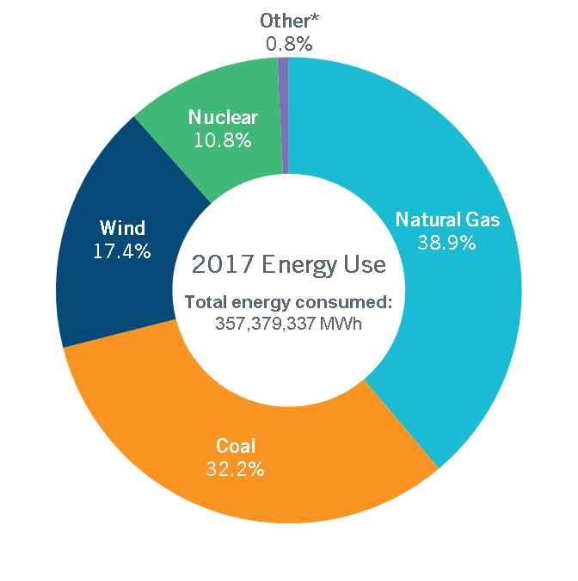
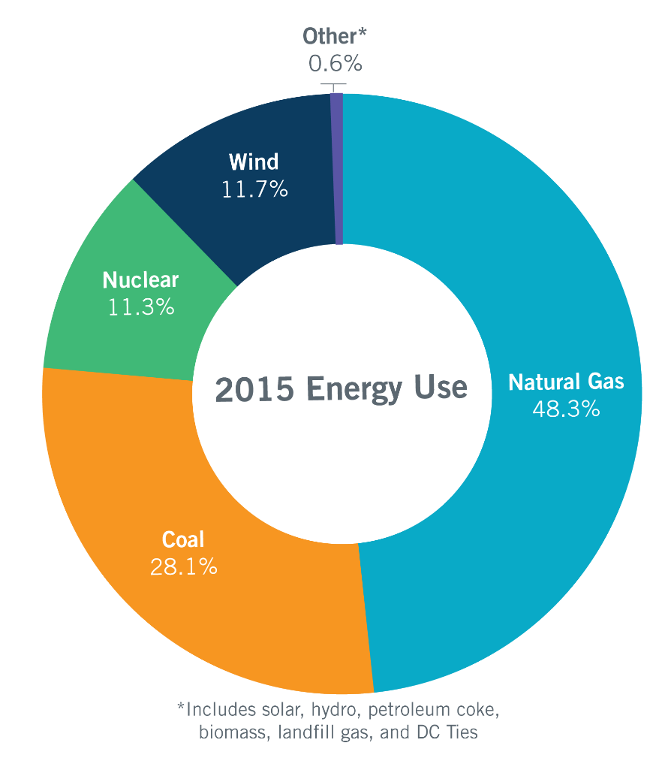
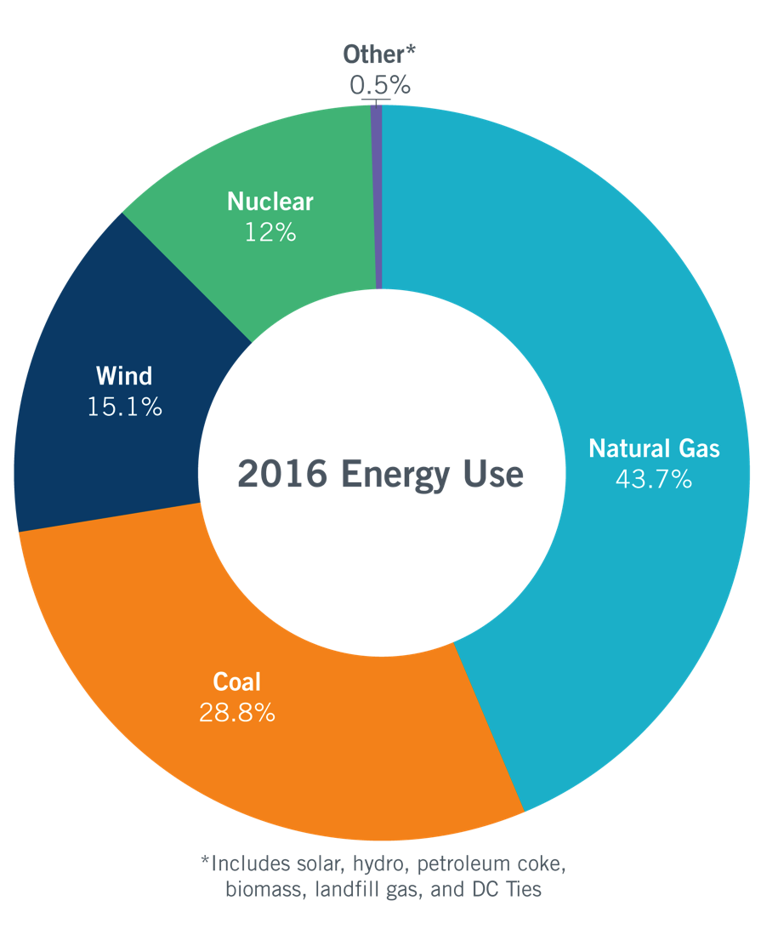
Energy Use Comparison
Total energy consumed:
347,617,436 MWh
Total energy consumed:
351,523,351 MWh
*includes solar, hydro, petroleum coke, biomass, landfill gas, distillate fuel oil, net DC Tie and Block Load Transfer imports/exports, and an adjustment for Wholesale Storage Load
Notes:
Updated slide 2.22.18

Slide 9
Installed Generating Capacity in ERCOT
2016
Generating
Capacity
Capacity available:
91,195 MW
2018
Generating
Capacity
Capacity available:
94,626 MW
2017
Generating
Capacity
Capacity available:
93,546 MW
Summer generation capacity information provided by December CDR Reports for 2015, 2016 and 2017.
Reflects operational installed capacity ― excludes units designated as indefinitely mothballed or under extended outage, and accounts for rating changes reported by resource owners.
Other category includes hydro, biomass-fired units and DC ties.

Slide 10
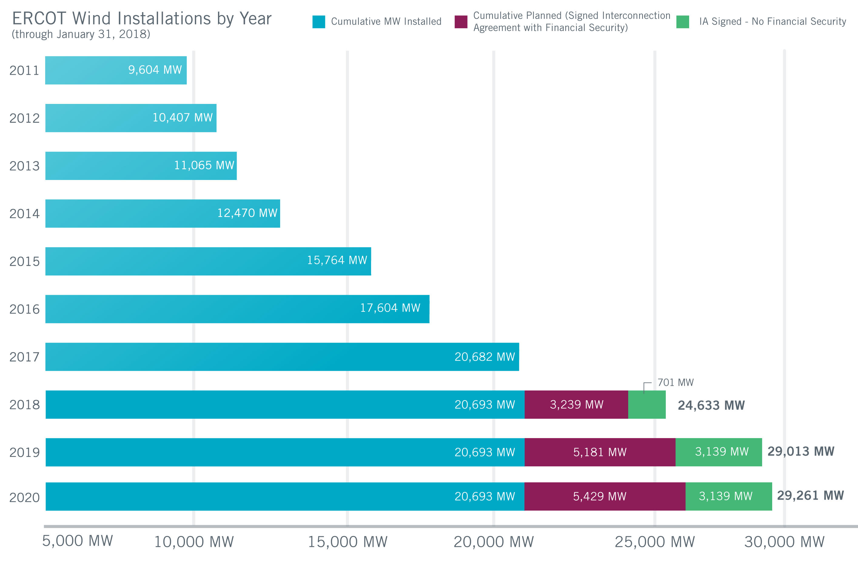
Wind Generation Capacity – January 2018
Steady growth continues, with some spikes.
Largest annual increase: 3,294 MW in 2015
(A close second: 3,220 MW in 2008)
Incentives, uncertainty and other factors affect construction decisions and schedules.
Not all planned projects will get built.
Texas continues to lead U.S. in wind capacity.
Future outcomes uncertain

Slide 11
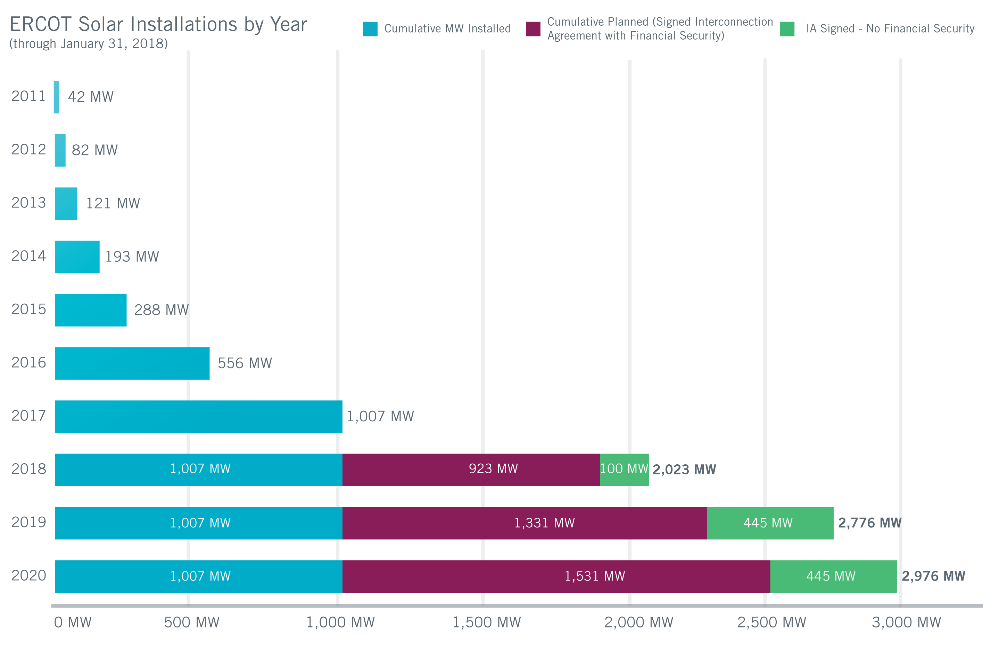
Utility Scale Solar Generation Capacity – January 2018
Future outcomes uncertain
Notes:
I’d like the “cumulative planned” bar to be the maroon color it is in the wind slide rather than yellow. Would like the look of wind and solar slides to match.

Slide 12
Focus On: Resource and Load Forecasting
Resource Forecasting: Wind Generation
ERCOT continues to refine renewable resource output forecasting.

Slide 13
Focus On: Resource and Load Forecasting
A 168-hour rolling forecast; hourly resolution for all wind and solar resources
  Wind forecasting since 2009; changed from 48-hour to 168-hour in 2015
  Secondary wind forecast added in late 2017
  Solar forecasting since 2015
Primary Inputs
  Site geo-location, met tower geo-location
  Telemetered site specific output, meteorological data, status, turbine/inverter availability
  Scheduled outages & de-rates
  Generic power curves
  Weather variables like wind speed/direction, irradiance, cloud cover, climatology
  Numerical weather prediction
Wind and solar operators are required to report their planned operating capability to ensure the most recent forecasts are factored into all look-ahead reliability analyses conducted.

Slide 14
Load Forecasting
Previous models
Find matching days
Conduct simple regression models
Limited number of predictive variables
2014: ERCOT adopts
neural network models
Determines sophisticated relationships between predictive variables
Advances in computer processing speed allows for quick solutions.
Many predictive variables: temperature, wind speed, cloud cover, solar irradiance, dew point, hours of sunlight, heat index, wind chill, relative humidity, wet bulb, heating degree days, cooling degree days, day of week, holiday, season … shall I go on?

Slide 15
Load Forecast Performance
Neural network models significantly improved forecast accuracy.

Slide 16
Load Forecast Performance Next Steps
Monthly Average
Mid-Term Load Forecast MAPE
Chart shows monthly average performance of previously selected load forecasts compared to the new option, an average of options based on neural network learning.

Slide 17

Transmission Planning Summary
As of Jan. 31, tracking 335 active generation interconnection requests totaling 66,927 MW (includes 31,420 MW of wind)
Endorsed transmission projects totaling $890 million in 2017 (up from $653 million in 2016)
Projects in engineering, routing, licensing and construction total about $6.9 billion.
Projects energized in 2017 total about $805.4 million.
Notes:
I’m not sure who was the source for this info in Nov., but Jay Teixeira provided the information to me today 1.29.18:
For the last two bullets;
For ROS and BOD Reports
·All Projects (in engineering, routing, licensing and construction): $6,903,176,607.00
·Transmission Projects Energized in 2017: $805,376,196.00
These numbers are as of October 1, 2017. We won’t have new numbers until the end of February.

Slide 18
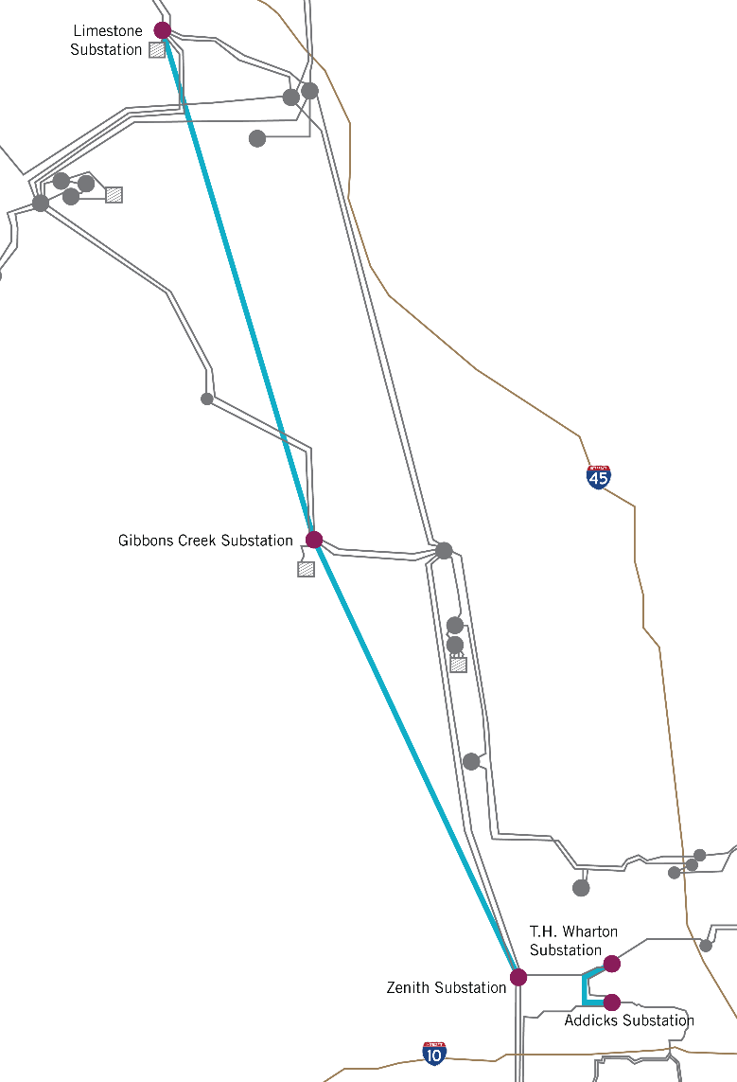
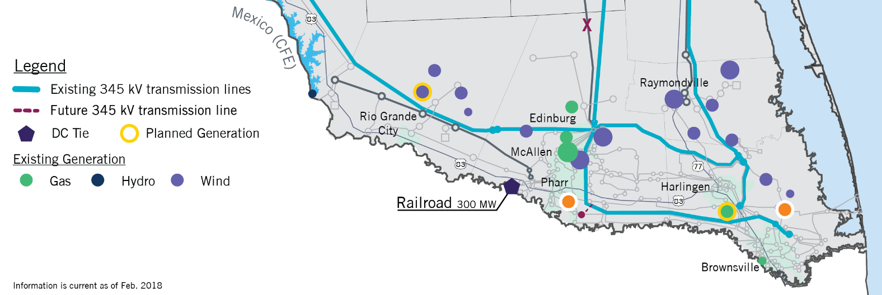
Major Transmission System Improvements
Houston Import Project
Scheduled for completion in spring 2018
Addresses constraint north of Houston
Houston Import Project
Lower Rio Grande Valley
Addition of two dynamic reactive devices in late 2018
Addresses load growth

Slide 19
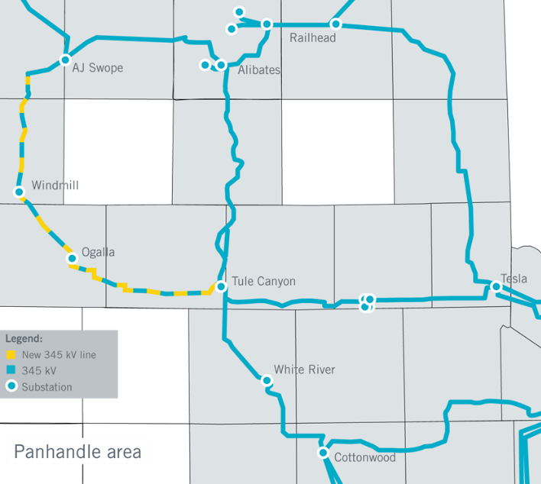
Major Transmission System Improvements
Panhandle Projects
Scheduled for completion in 2018
Address export capacity for growing wind resources and weak grid conditions
1
Map Index | Transmission Improvement
1 | Alibates Synchronous Condenser In service: Feb. 19
2 | Tule Canyon Synchronous Condenser In service: April 6
3 | Alibates-AJ Swope-Windmill Ogalalla-Tule Canyon 345 kV Circuit Addition In service: March 1
3
2

Slide 20
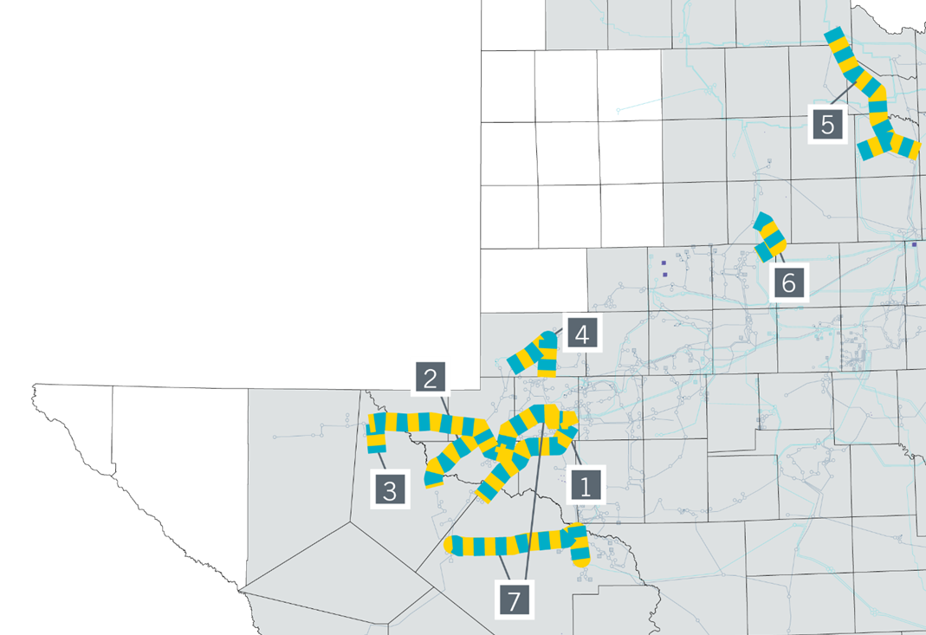
Major Transmission System Improvements
West Texas Projects
Endorsed by the ERCOT Board and the Regional Planning Group in 2016 and 2017 to address growth associated with oil and gas activity and solar generation development
Map Index | Transmission Improvement
1 | Barilla Junction Area Improvement Project
2 | Line 69H Rebuild and 138 kV Conversion Project
3 | Riverton-Sand Lake Project
4 | Andrews County South – Holt – Andrews North Upgrade Project
5 | Katz to Tardis Transmission Project
6 | Salt Creek Project
7 | Far West Texas Project

Slide 21
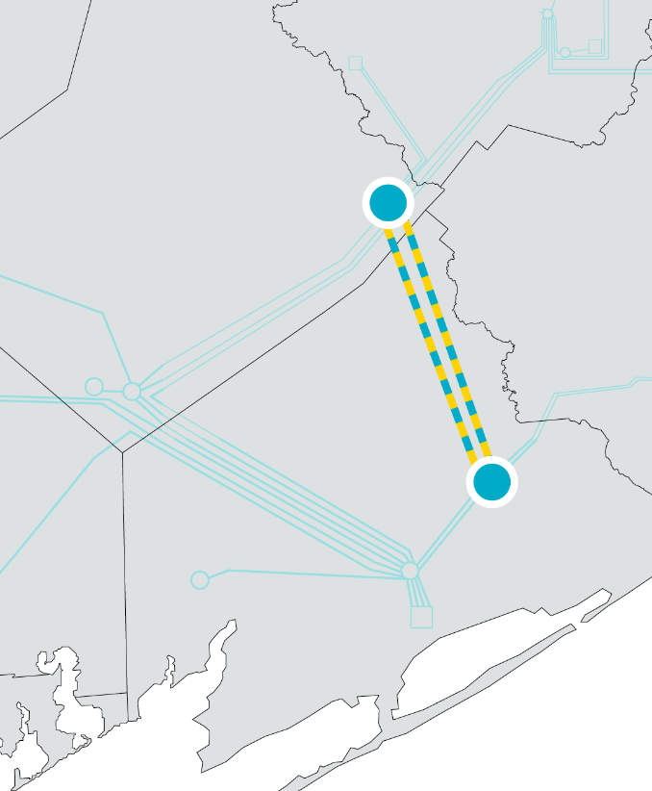
Major Transmission System Improvements
Freeport Master Plan Project
ERCOT Board endorsed project on Dec. 12, 2017.
Bridge the Gap upgrades will occur by 2020.
Long-term improvements by 2022:
  New 48-mile, 345-kV transmission line
  Circuit upgrades along existing 345-kV line
Addresses growth in Freeport area (i.e., highly industrialized location)

Slide 22

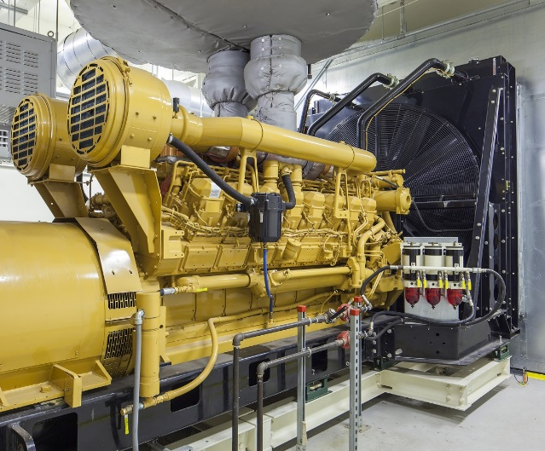
Focus On: Distributed Energy Resources ( DER)
Inverter-based generation
  Typically solar PV
Fuel-based generation (typically synchronous)
  Gas turbines, Internal Combustion Engines, Biogas
Energy storage
  Batteries, pumped hydro, compressed air
Small wind turbines
Small hydro turbines
Geothermal
Some DERs will be capable of providing fast-acting, flexible services to the grid.

Slide 23
ISO DER Visibility Today
DER >1 MW must register with ERCOT
  If it injects to the grid; and
  Is not registered with PUC as Self-Generation
Investor-owned TDSPs submit
  Annual DER interconnection reports to PUC
    Includes units that never inject to the grid
  Regular updates to ERCOT Profile Codes
Munis and Co-ops (NOIEs) report:
  Aggregated data on units >50 kW that inject energy to the grid
  Some anecdotal summaries to City Councils, etc.

Slide 24


Estimates of DER Penetration in ERCOT
Given the caveats just noted, we estimate:
  Units <1 MW
    About 30,000 units (mainly rooftop solar)
    About 250 MW
  Units >1 MW
    140 units (~90% diesel or natural gas)
    More than 850 MW
This is a different picture from what you’ll find in other regions.
  Example: California reports over 5,000 MW of rooftop solar, not including LADWP.

Slide 25
ERCOT Goals for Managing DERs on the Grid
Improved reporting
Mapping of larger DERs to the transmission grid
  Requires cooperation among TSPs, DSPs, REs and the ISO
  Will improve situational awareness
  Underway now
Nodal pricing for larger DERs
  Registered DGs (>1 MW) currently
  are paid Load Zone price
  Local price signals would
  enhance reliability and would
  align DER behavior with overall
  market design.

Slide 26
Focus on: ERCOT Borders & Boundaries
Wholesale Markets
FERC’s Role in ERCOT
Reliability
Federal Power Act
Grants FERC broad jurisdiction over transmission and sale of electric energy in interstate commerce, including rates.
ERCOT
Not subject to broad interstate commerce jurisdiction like other ISOs/RTOs because
electric energy in ERCOT is not sold or transmitted in interstate commerce.
Federal
Power Act
FERC may designate an entity (NERC) to establish and enforce reliability standards for entire bulk-power system.
ERCOT
Subject to NERC reliability standards and enforcement as part of the bulk-power system. FERC maintains authority over NERC.
Notes:
Federal Power Act grants FERC broad jurisdiction over:
(1) transmission of electric energy in interstate commerce (from one state and consumed in another state in the United States), (2) sale of electric energy at wholesale in interstate commerce (sale for resale), and (3) all facilities for such transfer or sale of electric energy in interstate commerce.
ERCOT not subject to FERC “interstate commerce” jurisdiction
Electric energy generated in the ERCOT Region is not generally transmitted or sold in interstate commerce (except in limited circumstances FERC acknowledges do not trigger jurisdiction).
North American Electric Reliability Corporation (NERC)
After the 2003 Northeast Blackout Congress amended the Federal Power Act to enable FERC to certify an “Electric Reliability Organization” tasked with establishing and enforcing reliability standards applicable to the entire bulk-power system—FERC subsequently certified NERC.
FERC maintains jurisdiction over NERC, regional entities, and all users, owners and operators of the bulk-power system (including ERCOT) for purposes of (1) approving standards and (2) enforcing compliance.

Slide 27
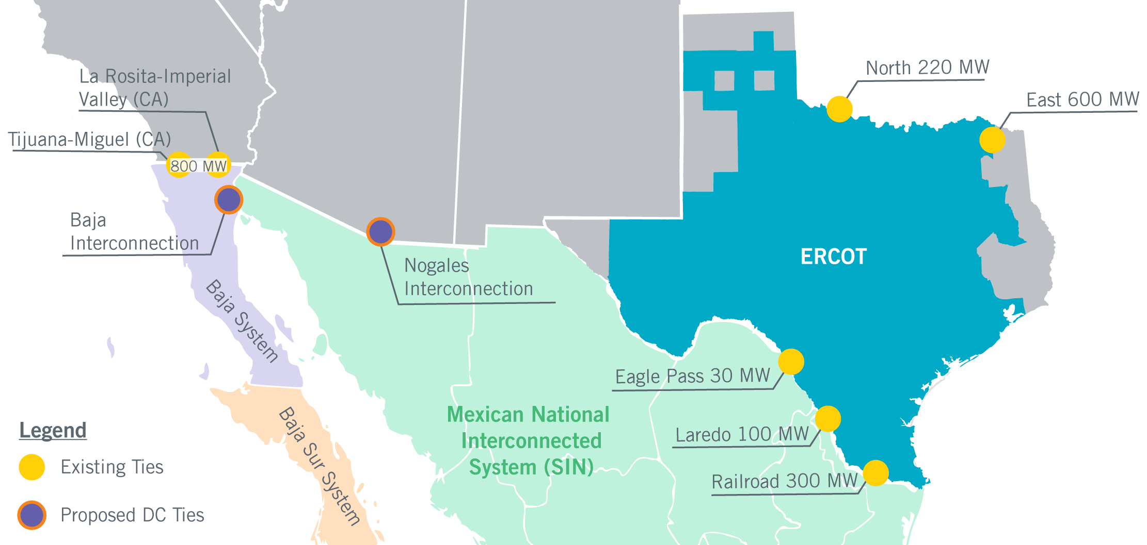
Maintaining ERCOT’s Jurisdictional Status
ERCOT is connected to primary Mexican grid via 3 DC Ties
Proposed interconnection projects involving Mexico
  Nogales Interconnection in Arizona
  Interconnection of Baja California to primary Mexican grid
For first time, Nogales and/or Baja Interconnections would allow power flow between ERCOT and another state via Mexico
ERCOT will protect jurisdictional status quo (existing Protocols and NPRR 861)
Notes:
Proposed Interconnection Projects Involving Mexico
Nogales Interconnection—connection of the primary national Mexican electric grid with the Western Electricity Coordinating Council (WECC) via Nogales, Arizona (estimated completion 2019).
Baja Interconnection—connection of the primary national Mexican electric grid with the currently isolated Baja California, Mexico electric grid, which is already connected with WECC via California (estimated completion April 2021).
Possible FERC Jurisdiction based on Changed Circumstances?
The ERCOT Region is connected with the primary Mexican grid via three DC Ties.
Nogales and/or Baja Interconnections would for the first time allow for the flow of electric energy between ERCOT and another state in the United States via Mexico (North and East DC Ties already exempt from triggering jurisdiction under existing FERC orders).
FERC has not squarely addressed jurisdiction based on these potential changed circumstances—it could (1) issue an order broadly disclaiming jurisdiction or (2) approve jurisdictional exemptions.
ERCOT’s Obligation to Protect the Jurisdictional Status Quo
Standard Form Market Participant Agreement provides Market Participants “shall not take any action [that would trigger plenary FERC jurisdiction], without first providing written notice to ERCOT and reasonable time for ERCOT and Market Participants to respond.”
NPRR 861 clarifies and confirms that ERCOT shall take any action—including ordering the disconnection of transmission facilities and denying or curtailing e-Tags—necessary to maintain the jurisdictional status quo.

Slide 28

Potential Additions to ERCOT
Lubbock Power & Light
  Approximately 490 MW of summer peak load
  Network of primarily 115-kV lines connected by multiple 345-kV lines (115-kV is new voltage class for ERCOT)
  PUC proceeding complete
  Anticipated date: June 2021
Rayburn Country Electric Cooperative
  Approximately 122 MW of summer peak load
  Network of 138-kV lines
  ERCOT/SPP filed joint study on March 1
  Next step is PUC approval
  Anticipated date: 2019
East Texas Electric Cooperative
  Approximately 35 MW of summer peak load connecting to Oncor system
  Initial project opened at PUC
  Anticipated date: 2018

Slide 29
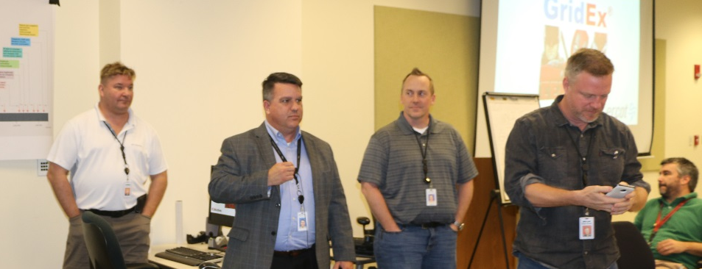
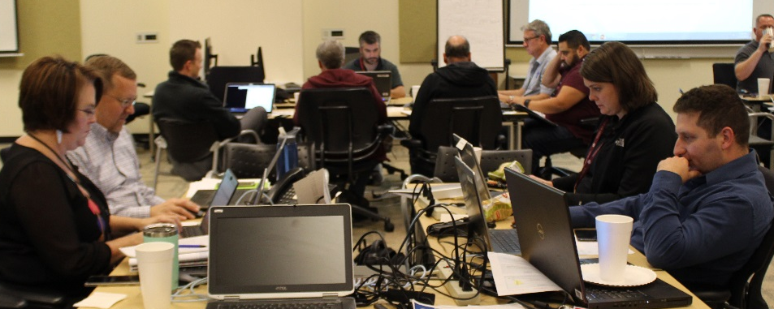
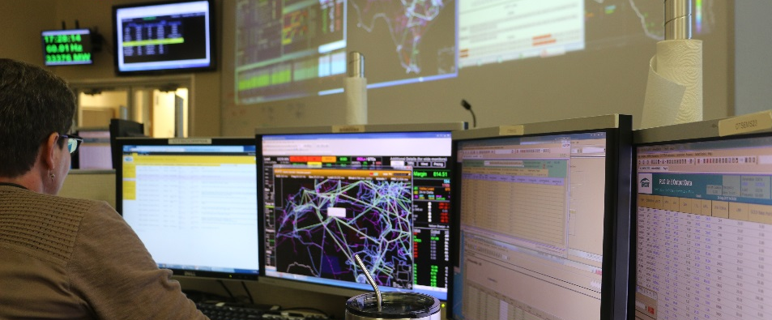
Focus On: Grid Security
GridEx IV
GridEx is a disaster management and recovery simulation organized by NERC.
Scenarios included widespread physical and cyber attacks.
More than 80 internal participants from throughout ERCOT, Inc.
More than 20 external participants
on-site, including regulatory, law enforcement, emergency management and gas industry
Eight market participant companies, represented by more than 240 individuals, also enacted scenarios.
Participated in NERC executive tabletop

Slide 30

Focus On: CyberSecurity
CyberSecurity
National Institute of Standards and Technology (NIST) has developed a framework that provides standards, guidelines and best practices to manage cyber security related risk.
NIST Cyber Security Framework
  Identify/Protect
    Security Architects
    Security Engineering and Administration
  Detect/Respond
    Security Operations Center (SOC) Analysts
  Recover
    IT and Security
Recover
Identify
Security Framework
Respond
Protect
Detect
Notes:
NIST Cybersecurity Framework for Critical Infrastructure
The framework helps organizations understand, structure, manage, and reduce cybersecurity risks. Cybersecurity violations can cause substantial financial losses, damage reputation, or cause outages to critical infrastructure and services.
The framework assists in identifying the most important activities to assure critical operations and service delivery. It helps prioritize investments and provides a common language inside and outside the organization for cybersecurity and risk management.
Implementation of the framework is currently voluntary. It is based on well-known standards and practices and represents the best current practice in cybersecurity.
Identify, Protect, Detect, Respond, Recover
Cybersecurity is realized as technical controls, monitoring, and planned responses. The processes are reviewed and improved based on experience. The framework provides core controls and processes in several areas essential to cybersecurity. It defines the five concurrent functions Identify, Protect, Detect, Respond, Recover. Several of these functions relate to processes and policies.

Slide 31





















Grid Security Collaboration
Federal/National
State
Industry
National Labs
Critical Infrastructure Protection Working Group (CIPWG)
Grid Resilience Working Group (GRWG)

Slide 32
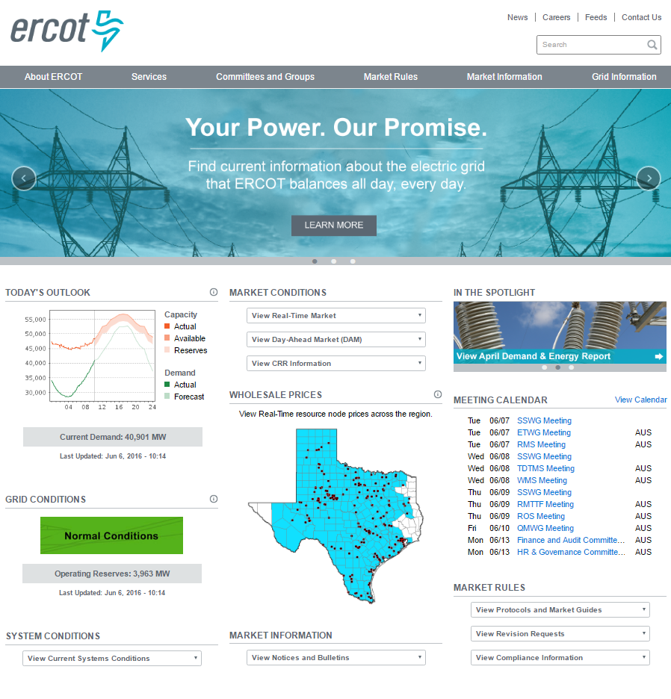
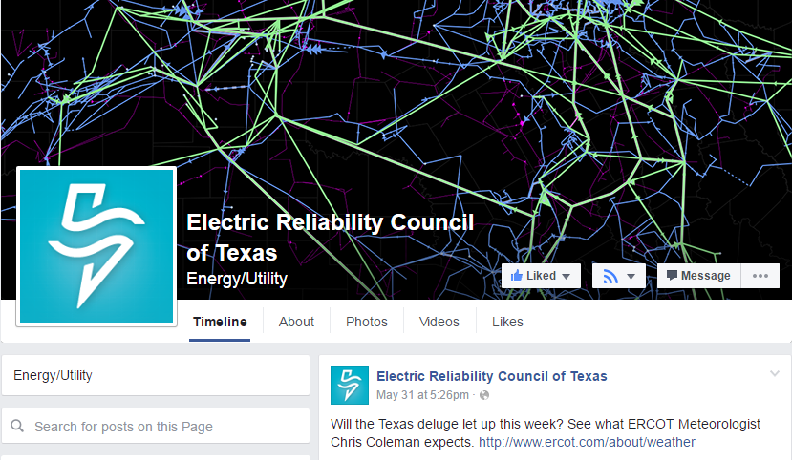


ERCOT Communication Channels
ERCOT website – www.ercot.com
Today’s Outlook and grid conditions
Daily and seasonal weather
Market information, prices and more
Social media
Twitter: @ERCOT_ISO
Facebook: Electric Reliability Council of Texas
YouTube: ERCOTISO
ERCOT mobile app
Real-time updates
Wholesale pricing
Information sharing

