Slide 1
Grid Scale Renewables
Planning, Operations & Forecasting
Nick Steffan, Nitika Mago
Operations Planning
ERCOT
Operator Training Seminar 2018

Slide 2
Discussion Outline
Expected Growth Potential for Renewables
Forecasting Renewable Generation Potential
  Impacts of Weather on Forecast
  Impacts of Unit Operator Actions
  Secondary Provider for Wind Forecasting
Renewable Resource Operations
Recent Operational Events
  Blue Cut Fire
  Operations During the Solar Eclipse

Slide 3
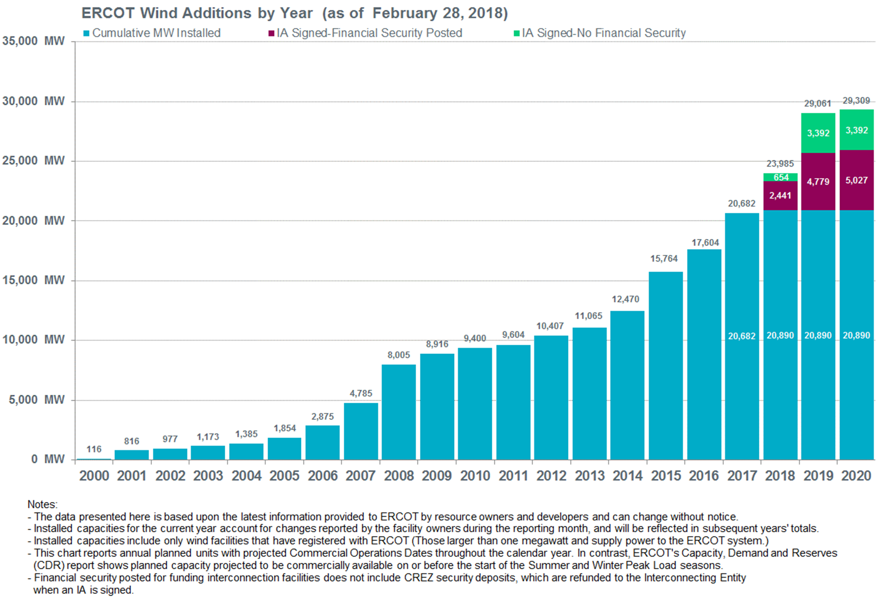
Growth Potential - Wind Generation

Slide 4
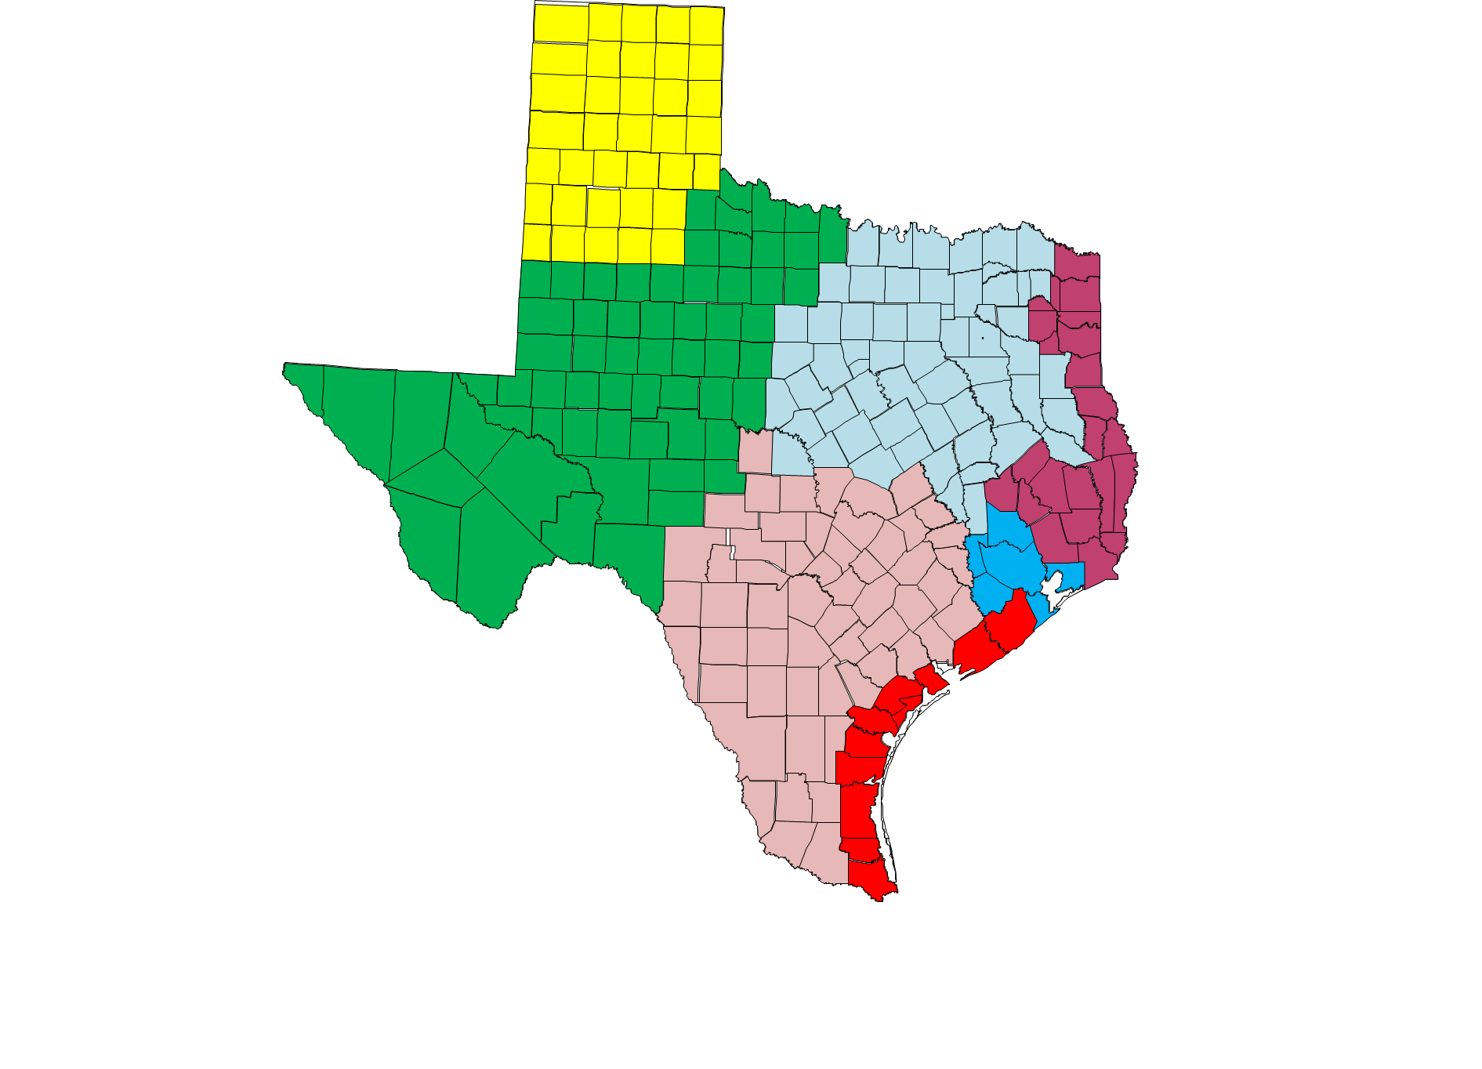
Wind Capacity By Region
Panhandle
4,196 MW
North
1,139 MW
West
11,093 MW
South
1,628 MW
Coast
2,613 MW
As of Nov 30, 2017

Slide 5
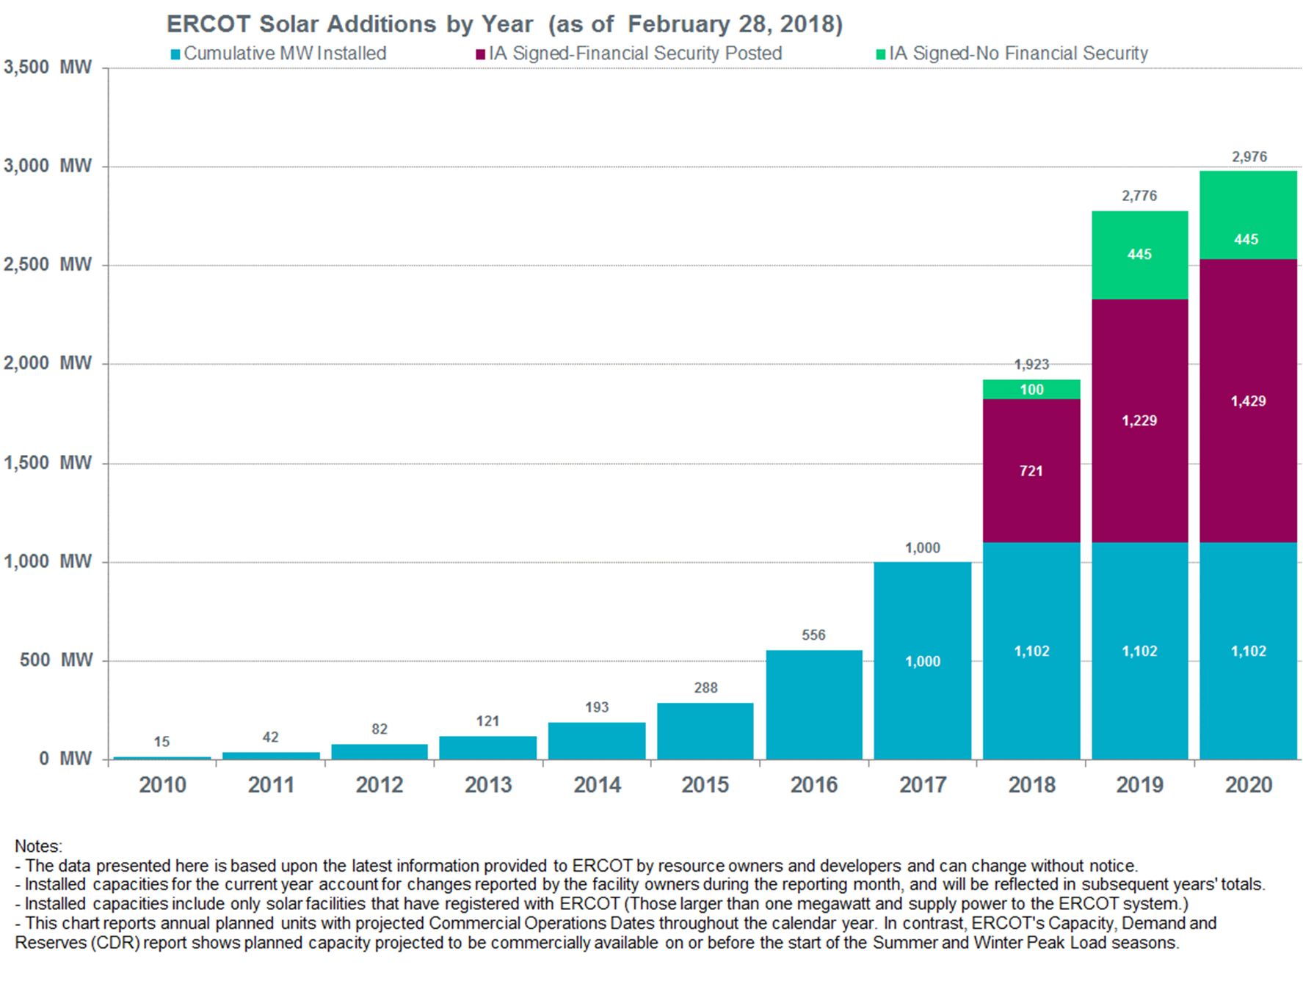
Growth Potential - Solar Generation

Slide 6
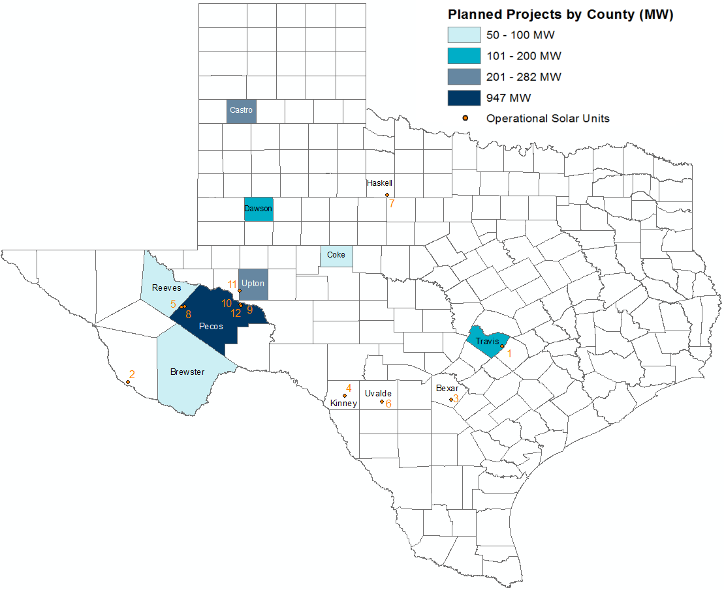
Operational and Planned Grid-Scale Solar Resources
* with signed Interconnection Agreements
** including 933 MW already operational
As of Nov 2017

Slide 7
Current Records
Peak Demand Record: 71,110 megawatts (MW)
Aug. 11, 2016, 4-5 p.m.
Weekend Peak Demand Record: 68,368 MW
Saturday, July 29, 2017, 4-5 p.m.
Winter Peak Demand Record: 65,750* MW
Jan. 17, 2018, 7-8 a.m.
Wind Generation Records (instantaneous)
Output: 17,541 MW
  Feb. 19, 2018, 10:05 p.m.
Penetration (load served): 54%
  Oct. 27, 2017, 4 a.m.
  Total Load = 28,416 MW
Recent Monthly Peak Demand Records
2018
January: 65,750* MW (Jan. 17, 7-8 a.m.)
2017
January: 59,650 MW (Jan. 6, 6-7 p.m.)
April: 53,486 MW (April 28, 4-5 p.m.)
May: 59,264 MW (May 26, 4-5 p.m.)
June: 67,633 MW (June 23, 4-5 p.m.)
July: 69,512 MW (July 28, 4-5 p.m.)
October: 62,333 MW (Oct. 9, 4-5 p.m.)
*New records are preliminary, subject to change in final settlement
Notes:
requirements?

Slide 8
Divider Slide
Divider Slide (optional)
Forecasting Renewable Generation Potential

Slide 9
Wind & Solar Forecast
A 168-hour rolling forecast; hourly resolution; for all Wind/Solar Resources.
Wind Forecasting since 2009; changed from 48-hour to 168-hour in 2015.
Solar Forecasting since 2015.
Primary Inputs,
  site geo-location, met tower geo-location
  Telemetered site output, meteorological data, status, turbine/inverter availability
  Scheduled outages & de-rates
  Generic power curves
  Weather variables like wind speed/direction, irradiance, cloud cover, climatology
  Numerical weather prediction
ERCOT updates the planned operating capability (in Market tools) for Wind/Solar resources with their most recent forecast.
  Wind/Solar operators can reduce this capability if operating conditions so dictate.

Slide 10
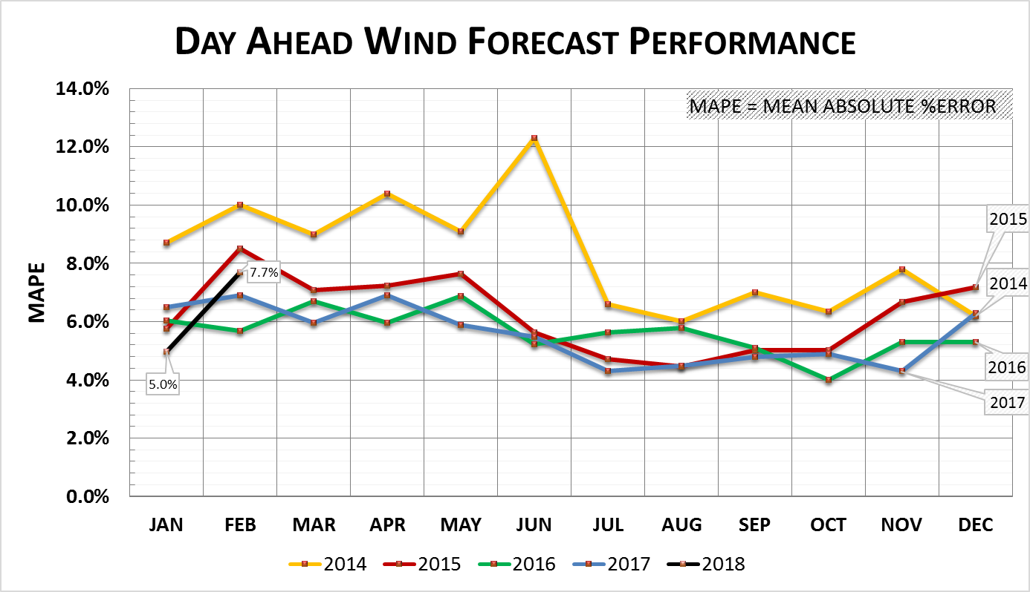
Wind Forecast Performance (Day-Ahead)

Slide 11
How Forecasting Impacts Operations
Current Operating Plans (COP) for Wind & Solar resources are limited to their most recent forecast.
COPs are used in ERCOT’s Look Ahead studies (e.g. Day Ahead Market (DAM), Day Ahead Reliability Unit Commitment (DRUC), Hourly Reliability Unit Commitment (HRUC), etc.).
When renewables are over-forecast, there is a potential for insufficient resources being committed for real-time operations.
When renewables are under-forecast, there is a potential of over commitment of resources, which can lead to curtailments and other market inefficiencies.

Slide 12
Wind Turbine Icing and Forecasting Impact
Outages went Unreported or were late creating over 3000 MW of forecasting error

Slide 13
Thunderstorm Effects on Solar Forecasting

Slide 14
Solar High Wind Speed “Cutout”
Solar units “Stow” (go flat), output decreases
Wind speed increases

Slide 15
Solar High Wind Speed “Cutout” (continued)
Very rapid drop in output
Notice the complete change in output profile shape

Slide 16
Bad Outage Timing Effecting Forecasting
Unreported Outages

Slide 17
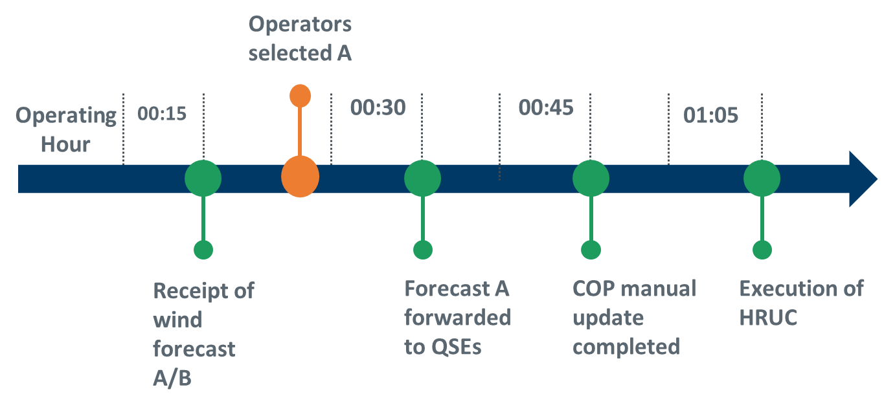
Secondary Wind Forecasting
Secondary Wind Forecast products include
  Short Term Wind Power Forecast
  Extreme weather conditions Forecast
  Intra-hour Wind forecast
ERCOT Operators will "select" which Wind Forecast will be actively used in the Current Operating Plans (COPs) and in all look ahead studies.

Slide 18
Renewable Resource Operations

Slide 19
Grid Code for Renewable Resources
Frequency Response
Voltage & Frequency Ride-Through
Voltage Support
Ramp Rate Limitations

Slide 20
Bad Operations Under Curtailment Example
Unit not following basepoints

Slide 21
Good Response to Curtailment
Unit tracking down to basepoint instruction

Slide 22
Numbers of Inverters
Number of Inverters Online goes off at night – Should correspond to number available regardless of weather/sunlight.
Offline = Unknown. This is incorrect.

Slide 23
Estimated Wind Curtailments

Slide 24
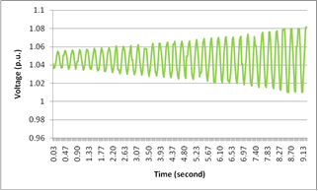
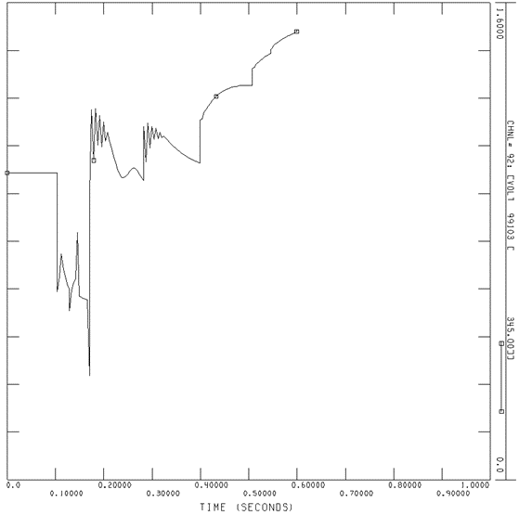
Weak System (ex. Panhandle Area)
The Panhandle Issue
  No conventional generation, very little load
  Far from the rest of system (synchronous units)
  Dynamics dominated by power electronics (wind plants, SVC.)
  A large amount of wind units.
Disturbances occurring when the WSCR is below 1.5 can cause control system instability for inverter-connected resources.
A Generic Transmission Constraint (GTC) is being used to maintain generation levels in the Texas Panhandle region such that Weighted Short Circuit Ration of the area is greater than or equal to 1.5.

Slide 25
Voltage Control
Solar facilities operate in voltage control mode. Most solar facilities use “integrated control” with the dynamic circuits in their control system for VAR support. Some do have automated capacitors.
Certain problems related to voltage regulation that have been discussed at the Voltage Profile Working Group (VPWG) include,
  Plants absorbing, rather than providing VARs
  Plants not producing enough VARs to compensate losses plant MW creates
  Plants not holding Set Points requested by the TOs (reach then drift)
  Plants hitting their VAR limits (TO coordination with nearby plants)
Close coordination between Solar Facility Operators & Transmission Operators is key to support and make local area voltage control stronger.

Slide 26
Far West Transmission Expansion
Oncor has projected annual load growth rates as high as 11% over the next five years on the Culberson loop (Wink – Culberson – Yucca Drive 138 kV transmission loop).
Over 1,600 MW of solar resources are expected to come online in Pecos and Southwest Upton Counties between 2016 and 2020.
On June 14th, 2017 The ERCOT Board of Directors endorsed a project that includes two new 345 kV lines in Far West Texas.
  The project will include a new, 101 mile long 345-kV transmission line that connects the Odessa and Riverton substations.
  The second 68 mile 345 kV line will be located further south in Pecos County, connecting the Bakersfield and Solstice substations.
*based on data available as of May 2017

Slide 27
Blue Cut Fire
& ERCOT Risk

Slide 28
Blue Cut Fire – Background
On August 16, 2016, at 10:36 a.m. Pacific, the Blue Cut fire began in the Cajon Pass, just east of Interstate 15.
The fire quickly moved toward an important transmission corridor that is comprised of three 500 kV lines owned by Southern California Edison (SCE) and two 287 kV lines owned by Los Angeles Department of Water and Power (LADWP).
  By the end of the day, the SCE transmission system experienced thirteen 500 kV line faults, and the LADWP system experienced two 287 kV faults as a result of the fire.
Four of these fault resulted in the loss of nearly 1,200 MW solar PV generation.
  There were no solar PV facilities de-energized as a direct consequence of the fault event; rather, the facilities ceased output as a response to the fault on the system.

Slide 29
NERC Finding/Recommendation 1
Finding
  Inverters that trip instantaneously based on near instantaneous frequency measurements are susceptible to erroneous tripping during transients generated by faults on the power system.
Recommendation
  Inverter manufacturers that experienced this type of tripping during the Blue Cut fire event have recommended changes to their inverter settings to avoid this erroneous tripping; this change will add a time delay to inverter frequency tripping that will allow the inverter to “ride through” the transient/distorted waveform period without tripping.
  Solar development owners and operators involved in this event are working with their inverter manufacturers, California Independent System Operator (CAISO), and SCE to develop a corrective action plan for implementation of changes to inverter parameters.
ERCOT Risk/Action
  One Solar plant in ERCOT had Inverters that had a narrow frequency operating range and would trip instantaneously when frequency was outside a certain threshold.
    Firmware changes were implemented in Q3, 2017 to widen the frequency operating range and to include time delay before trip.

Slide 30
NERC Finding/Recommendation 2
Finding
  Inverters that momentarily cease output for voltages outside their continuous operating range should be configured to restore output with a delay no greater than five seconds. NERC should review PRC-024-2 to determine if it needs to be revised to indicate that momentary cessation of inverter connected resources is not allowed within the no-trip area of the voltage curves.
Recommendation
  Inverters that momentarily cease output for voltages outside their continuous operating range should be configured to restore output with a delay no greater than five seconds.
  NERC should review PRC-024-2 to determine if it needs to be revised to indicate that momentary cessation of inverter connected resources is not allowed within the no-trip area of the voltage curves.
ERCOT Risk/Action
  All Solar plants in ERCOT have inverters that will restore output within 5 seconds. Upon restoring output these plants are subject to the ramp rate limitations that have been enforced by ERCOT protocols.

Slide 31
Operations During Solar Eclipse

Slide 32
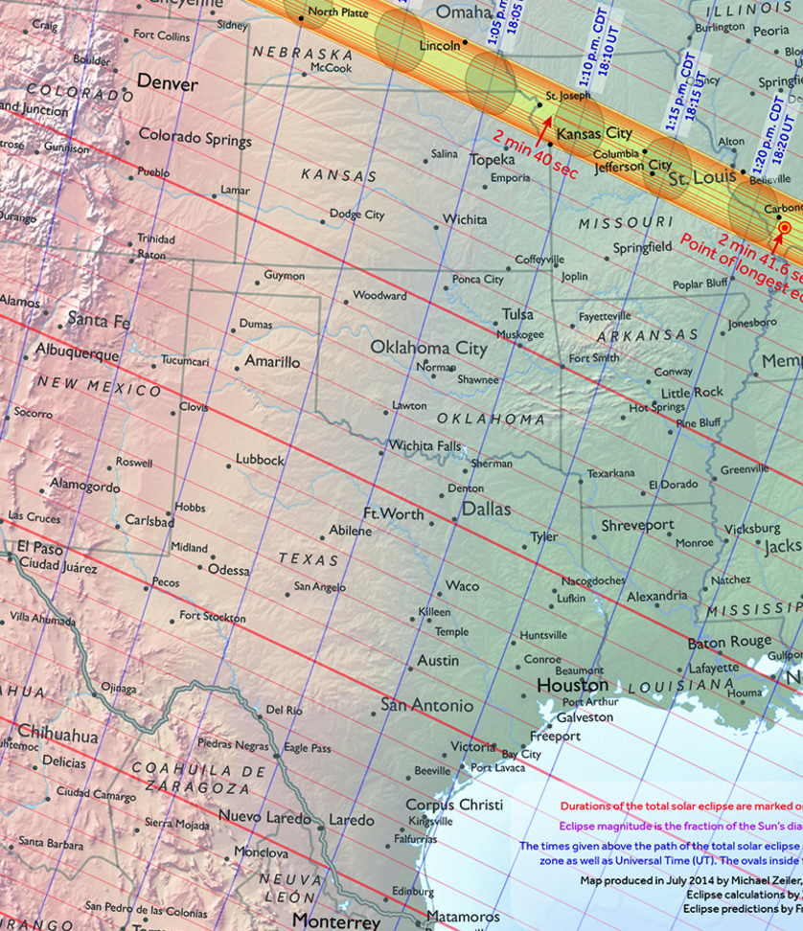
Aug 21, 2017 Eclipse
Peak eclipse covered roughly 65-75% of the sun’s disk for ERCOT solar farms.
Began roughly at 11:30, ending at 2:00.
  Peak Obscuration time was around 1 pm CDT.
Eclipse reached far east TX around 30 minutes later than far west TX
  Difference ~15 minutes for solar farm locations
1pm
80%
70%

Slide 33

Solar Eclipse in ERCOT Region
Solar generation in ERCOT
Solar nameplate capacity
  1,035 MW (transmission)
  ~250 MW (distribution)
Peak load 71,110 MW
Eclipse impact
Solar generation decreased by 461 MW over an hour and minutes duration.
System load decreased ~661 MW over a 30 minutes duration.
No reliability issues.

Slide 34
ERCOT Solar Generation on Aug. 21

Slide 35
ERCOT Solar Forecast Performance on Aug. 21

Slide 36
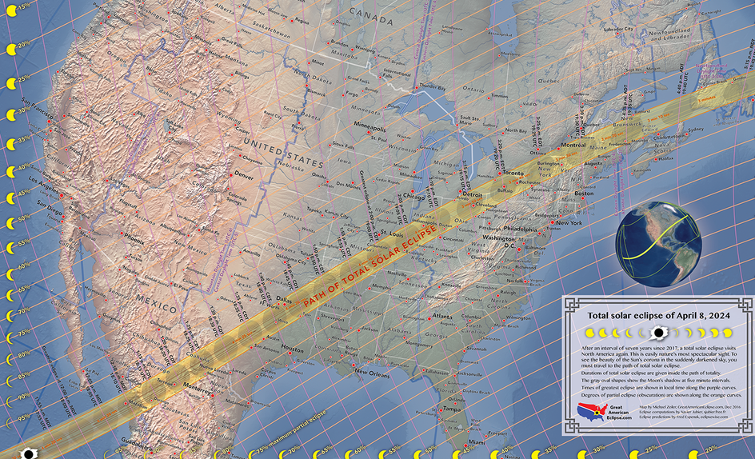
2024 Solar Eclipse
The next total solar eclipse in the Americas will be on April 8, 2024.
The Majority of Texas will be within 90% Obscuration
90%
90%

