Slide 1
Hurricane Harvey: Weather Perspectives from the ERCOT Meteorologist
Chris Coleman
Senior Meteorologist
2018 ERCOT Operations Seminar

Slide 2
Introduction
Today’s presentation will focus on hurricanes. Hurricane Harvey, in particular.
Today’s Presentation:
Review of the 2017 Hurricane Season
Hurricane Harvey: Forecast review, actions taken, post-storm analysis
Early thoughts on the 2018 Hurricane Season
Texas Summer Weather Outlook

Slide 3
Objectives
  Identify weather forecast and preparation for Hurricane Harvey
  Identify common hurricane-related events that impact ERCOT
  Identify what notifications were made for Hurricane Harvey
  Understand what made Hurricane Harvey unique

Slide 4
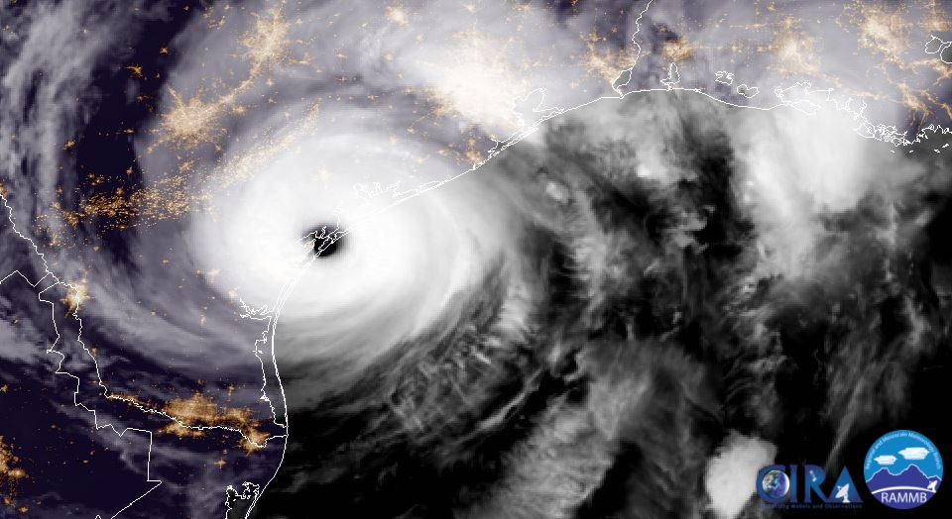
2017 Hurricane season
Reviewing the

Slide 5
2017 Hurricane Season Review: Forecasts
ERCOT FORECAST TIMELINE:
January 17, 2017: “The average from those historical years: 13/6/4. 13 named storms, 6 hurricanes, 4 major hurricanes. This would be more than an average hurricane season (12/6/2)”
March 13, 2017: “The average from those historical years is my forecast: 12/5/2. 12 named storms, 5 hurricanes, 2 major hurricanes. Forecast for Gulf is 3-4 named storms”
May 25, 2017: “There are increasing indications of a greater number of tropical storms and hurricanes than currently forecast. The updated, revised number is 14 total named storms, 7 of those hurricanes, and of the hurricanes, 4 are forecast to be major hurricanes”
OTHER FORECASTS, June 1, 2017:
Colorado State: 14/6/2
NOAA: 11-17/4-9/2-4 (Avg: 13.5/6.5/3)
The Weather Channel: 14/7/3
Tropical Storm Risk: 14/6/3
UK Met Office: 13/8/n/a

Slide 6
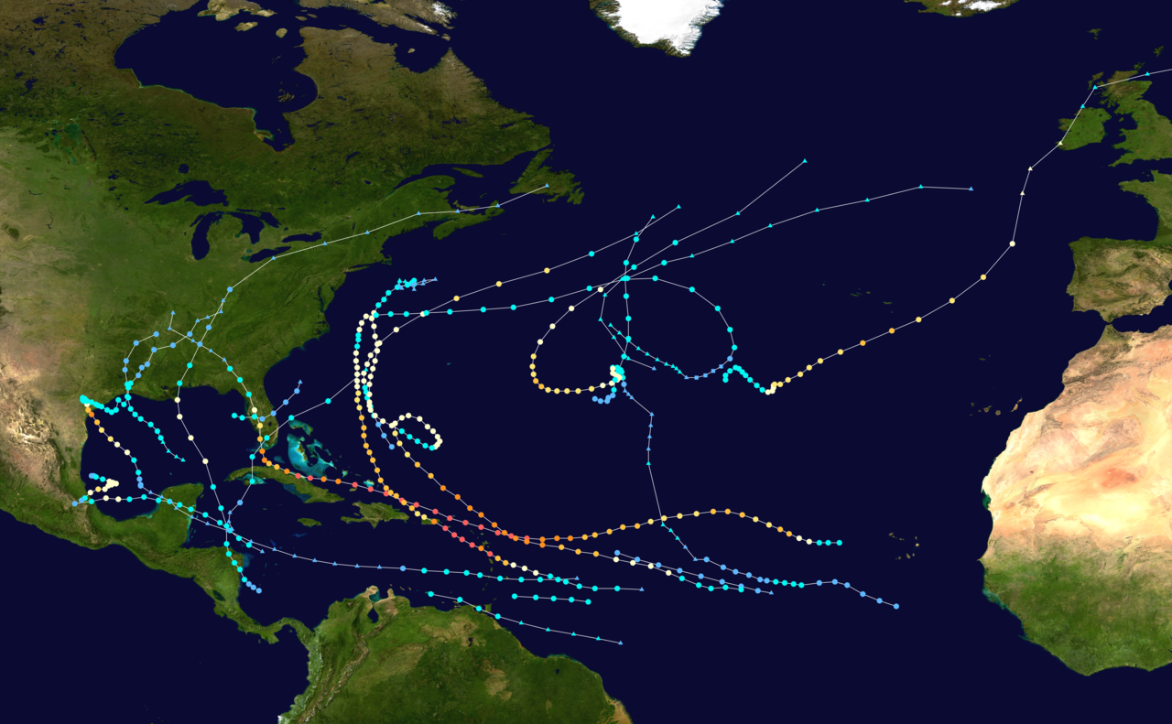
2017 Hurricane Season Review
2017 Atlantic Basin Hurricanes: 17/10/6. 17 named storms, 10 hurricanes, 6 major hurricanes
8 named storms in the Gulf of Mexico

Slide 7
2017 Hurricane Season Review: The Cyclones
Arlene (TS): April 19-21
Bret (TS): June 19-20
Cindy (TS): June 20-23
Don (TS): July 17-19
Emily (TS): July 31-August 2
Franklin (C1): August 7-10
Gert (C2): August 13-17
Harvey (C4): August 17-September 1
Irma (C5): August 30-September 12
Jose (C4): September 5-22
Katia (C2): September 5-9
Lee (C3): September 15-30
Maria (C5): September 16-30
Nate (C1): October 4-9
Ophelia (C3): October 9-16
Philippe (TS): October 28-29
Rina (TS): November 6-9

Slide 8
2017 Hurricane Season Review: Statistics
17 named storms is tied for 5th most active (since 1850)
Most named storms since 2005
10 consecutive hurricanes – most in satellite era
One of six seasons with multiple Category 5 hurricanes (1932, 1933, 1961, 2005, 2007)
Highest ACE since 2005 and 7th highest ever recorded (since 1850)
  ACE (Accumulated Cyclone Energy) is a calculation of wind energy used by a tropical cyclone over its lifetime

Slide 9
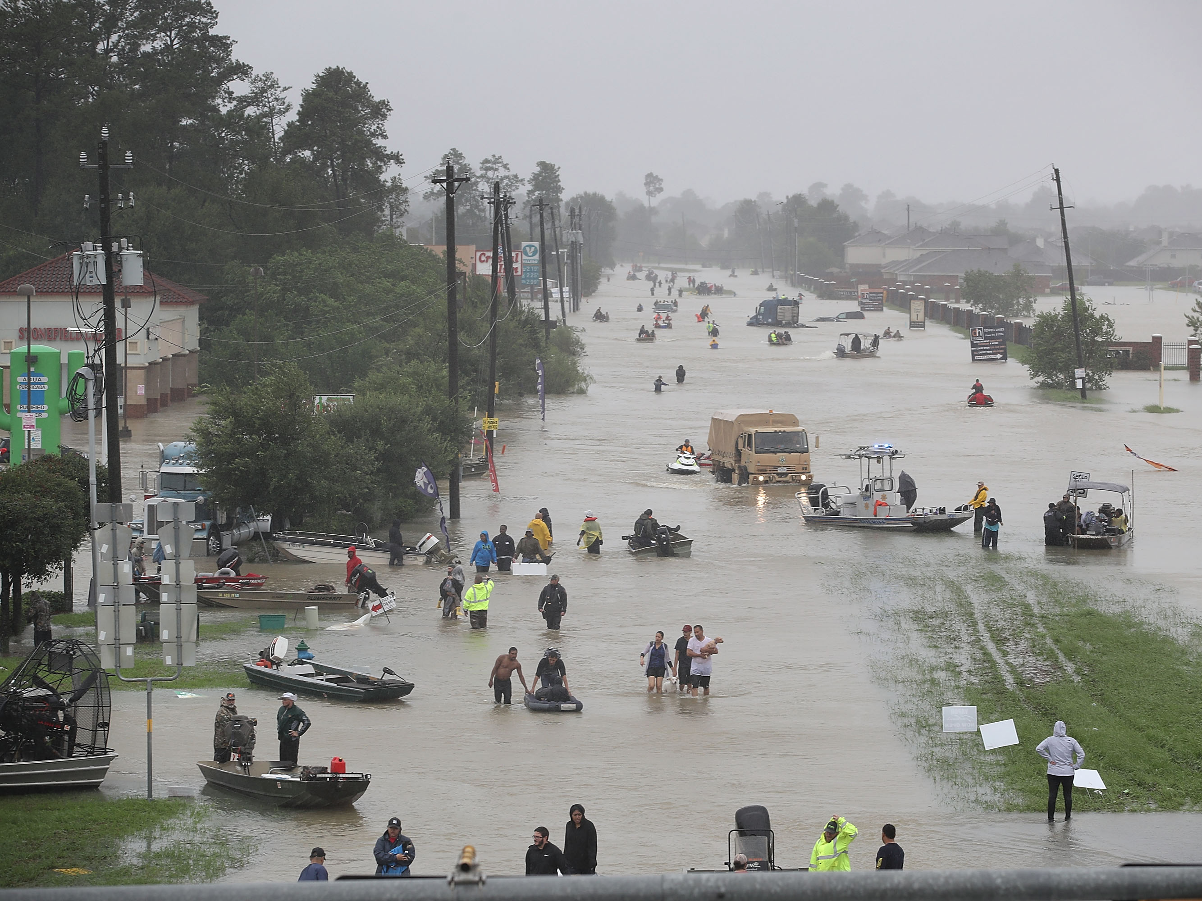
Hurricane harvey

Slide 10
My Role as the ERCOT Meteorologist
The initial key to forecasting is to read and consume as much information as possible
Monitor many computer models, National Hurricane Center, hurricane blogs
Watch ocean temperatures, wind shear, troughs and ridges – to help determine intensification and steering
Understand model biases
Fine tune the forecast with knowledge/experience learned from past hurricanes

Slide 11
My Role as the ERCOT Meteorologist
Initially, provided long-lead forecasts to system operations and outage coordination to alert them of the potential well in-advance (first mentioned Texas landfall potential on 8/17 – 8 days in advance)
Regular updates provided through emails and morning meetings in the control room
As Harvey approached (1-2 days prior to landfall), internal email distribution increased to include many ERCOT teams and executives
Updates on Harvey increased in frequency. Several email updates per day 8/24-8/30 (8/25 PM – 8/27 was weekend)
Also spoke directly with management as needed

Slide 12
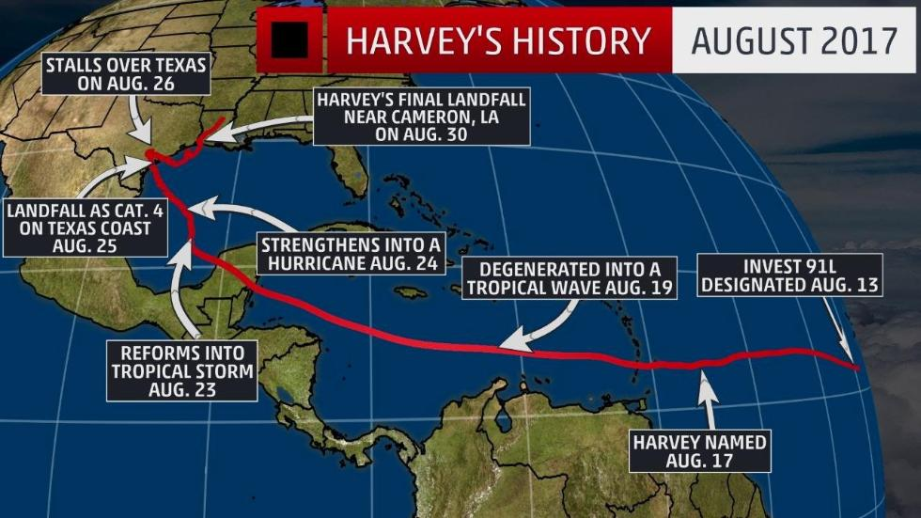
Hurricane Harvey

Slide 13

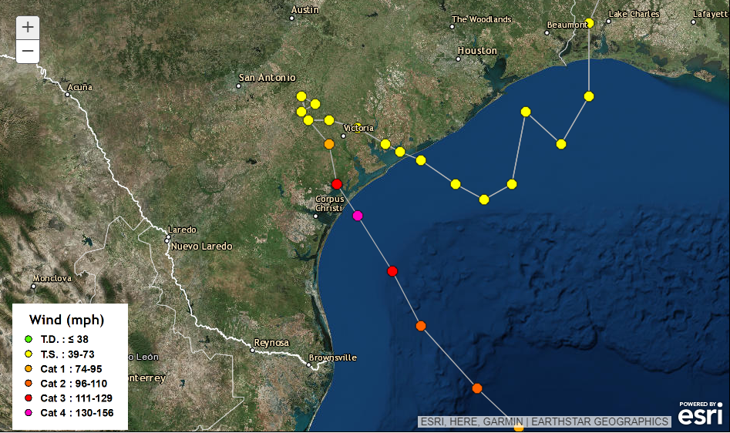
Hurricane Harvey: Track
https://youtu.be/qGmAMW4MqFI

Slide 14
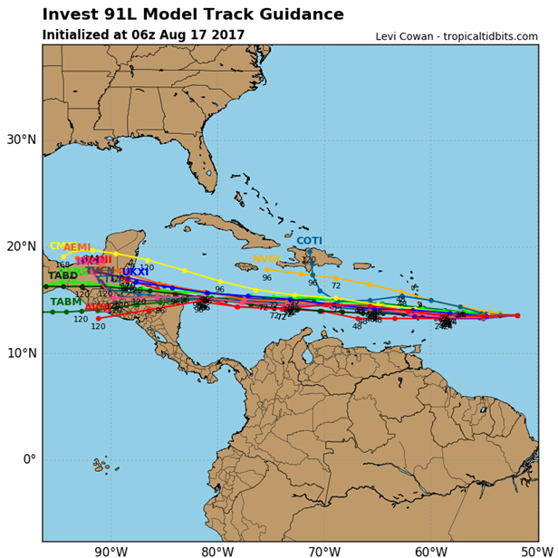
Hurricane Harvey: First Forecast
Hurricane computer models at midnight on the start of Aug 17 were mostly tracking what would soon be Harvey toward Central America or the Yucatan within 4 to 5 days. And unlikely to reemerge over the Gulf. No hint of a track toward Texas.

Slide 15
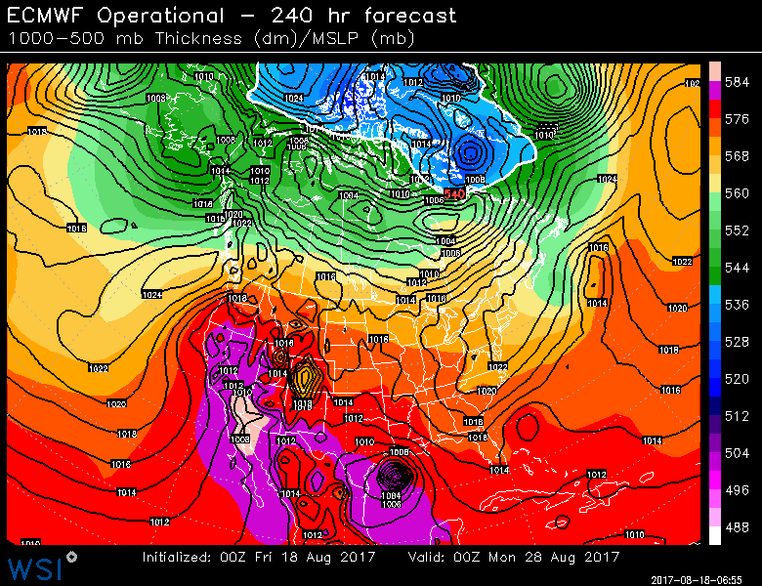
Hurricane Harvey: First Forecast
I distributed an email to operations on Friday August 18 at 10:49AM:
The European model is taking what is now Tropical Storm Harvey in the Caribbean toward Texas in about ten days. To note, none of the models designed specifically for hurricanes are projecting this track. However, the European model has a history of forecasting tropical systems with some level of accuracy. Thus, this forecast track can’t – at this point – be completely ignored. Even if it’s far from likely.
At this point, the European model was the lone model giving any hint of Harvey approaching Texas

Slide 16
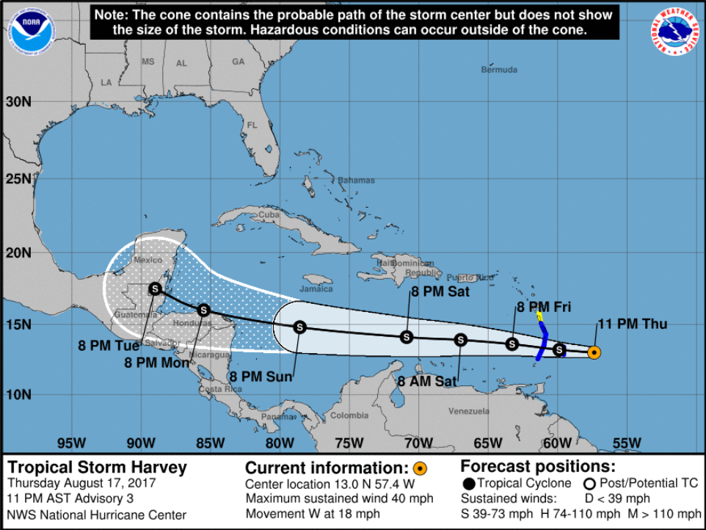
Hurricane Harvey: First Forecast
This was the National Hurricane Center’s (NHC) first forecast, issued 11PM AST (9PM CDT) on August 17

Slide 17
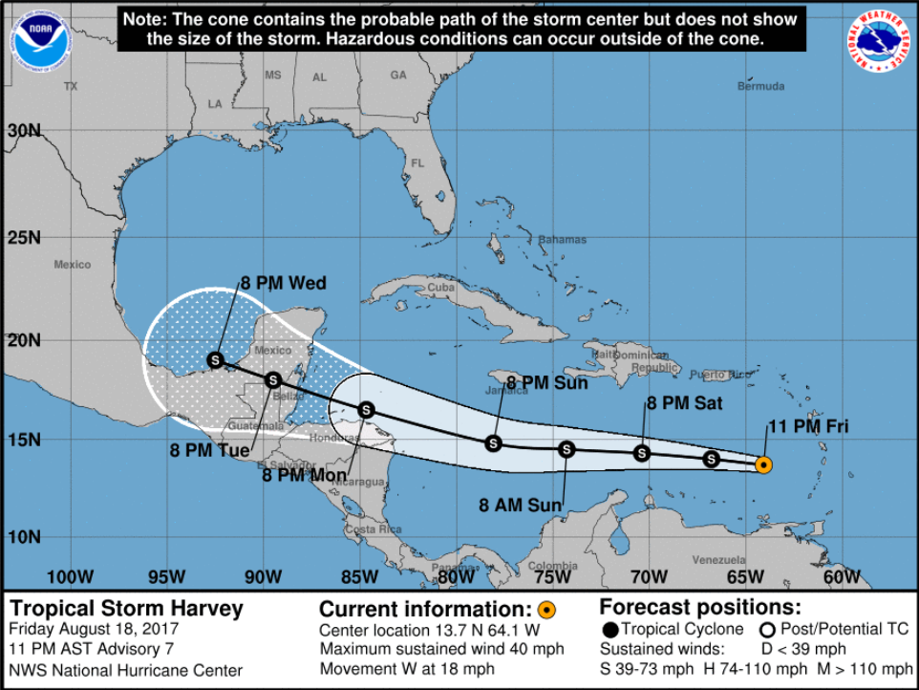
Hurricane Harvey: Forecast
Friday, August 18. 24 hours later, the NHC shifted the track slightly northward

Slide 18
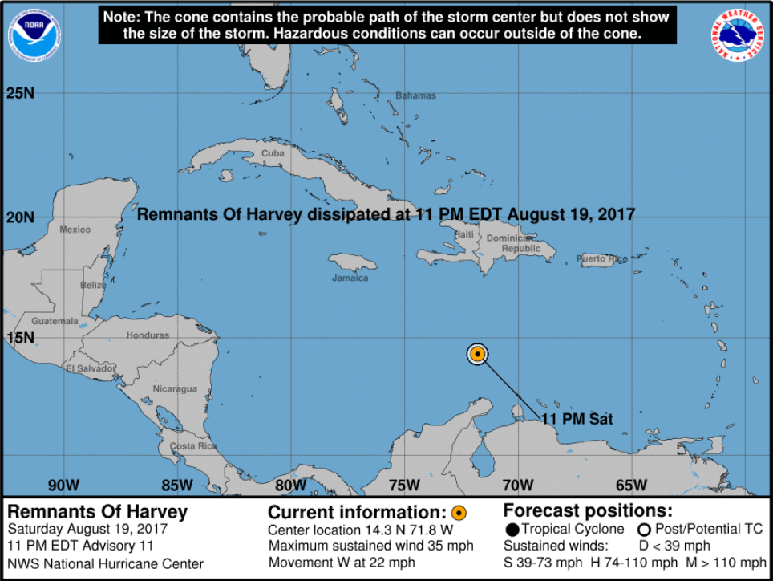
Hurricane Harvey: Forecast
24 hours later, Harvey had dissipated. Saturday night, August 19.

Slide 19
Hurricane Harvey: Forecast
Email to ERCOT operations, sent 8/21:
I mentioned Tropical Storm Harvey with an update late last week. At that time, the European model was the outlier, bringing it to Texas. Now, roughly one-half of computer models are tracking it into Texas. Friday time frame. Currently, it's not a named storm. Having dissipated over the weekend. However, models are suggesting a regeneration. Most keep it no stronger than a tropical storm. A couple suggest a relatively weak hurricane is possible.

Slide 20
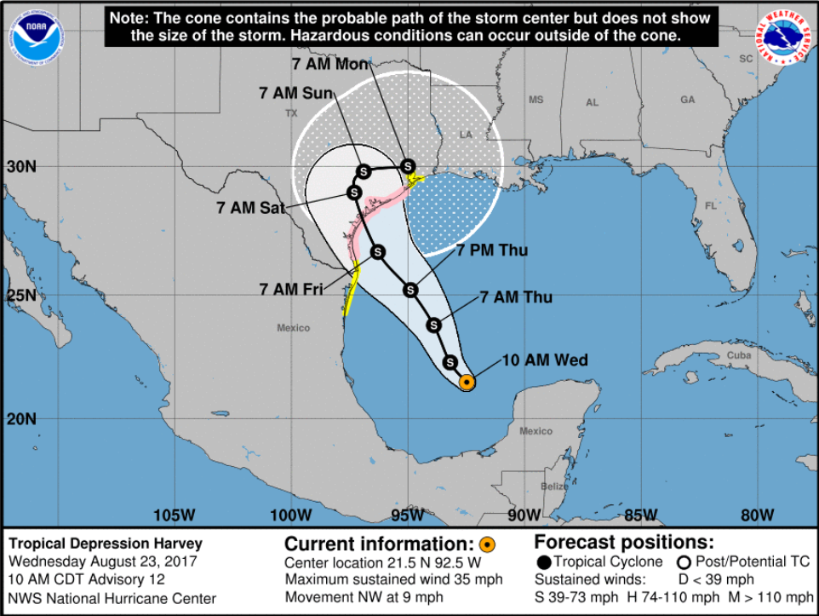
Hurricane Harvey: Forecast
NHC did not issue new forecast tracks from August 19 until Harvey re-intensified into a tropical depression at 10AM August 23

Slide 21
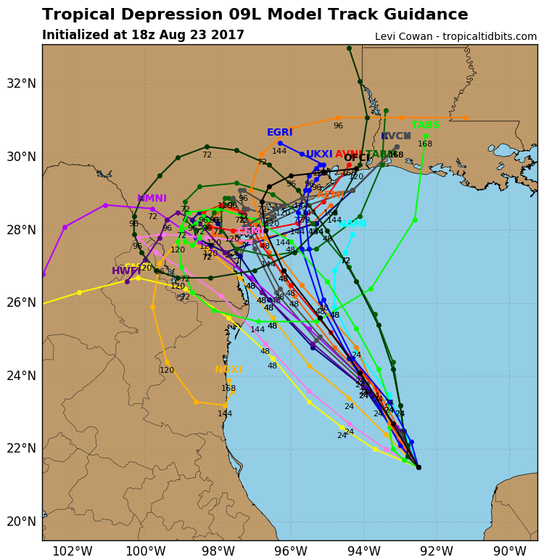
Hurricane Harvey: Forecast
Emails sent to operations on 8/23:
The latest GFS model is hot off the presses. While it’s only one model (and typically not highly-reliable), it takes Harvey into South Texas on Friday and parks it there through Monday. This would mean the Valley up to Corpus (and likely further up the Coast) would be deluged with rain. It then tracks Harvey along the Coast Tuesday and Wednesday. Not departing Texas until Thursday morning. This path would keep the heavy rain totals south and east of Austin. But again, this is one solution of a still-developing situation.
Below is the latest track of several hurricane models.
Note, many of these models track Harvey in a loop. Ashore and then back out to sea before making a second landfall. This is entirely possible.
The latest European model (not pictured below) brings Harvey into the RGV on Friday PM, parks it there through Sunday, and then moves it back offshore where it intensifies again. Possibly into a hurricane. And then tracks it just off the Texas Gulf Coast, northeast to a second landfall just east of the TX-LA border.
A meteorology friend spotted a model that is projecting 30 inches of rainfall in some locations.
It’s becoming increasingly clear that some locations in the South and/or Coast zones are going to have some major problems to contend with. Can’t yet rule out South Central Texas as well.

Slide 22
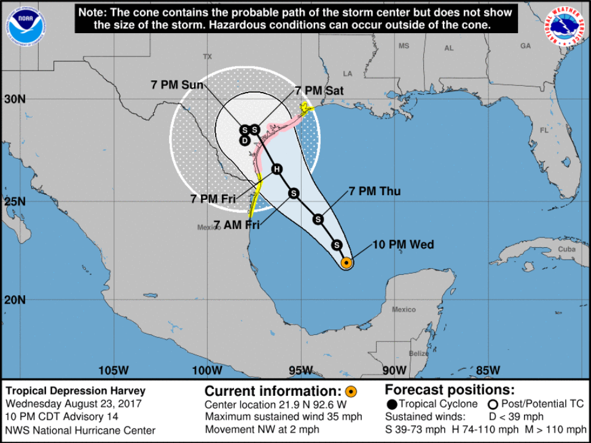
Hurricane Harvey: Forecast
12 hours later. 10PM on August 23.
Note: now forecasting a hurricane.

Slide 23
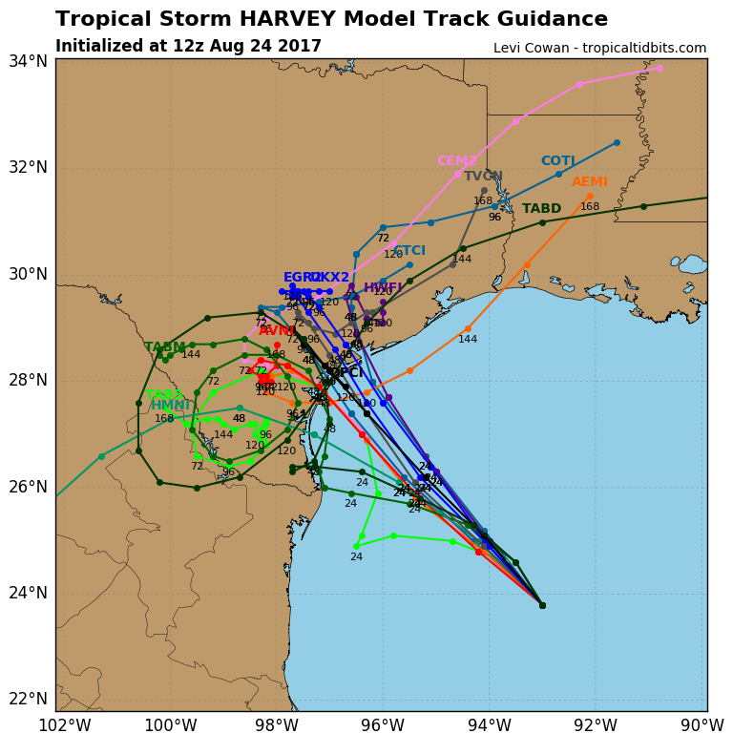
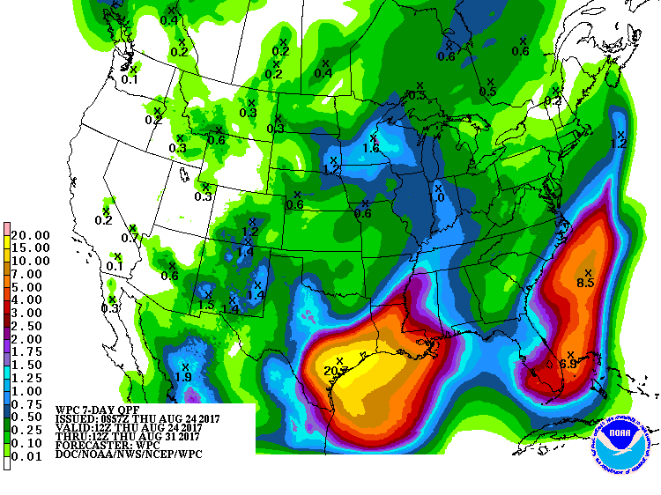
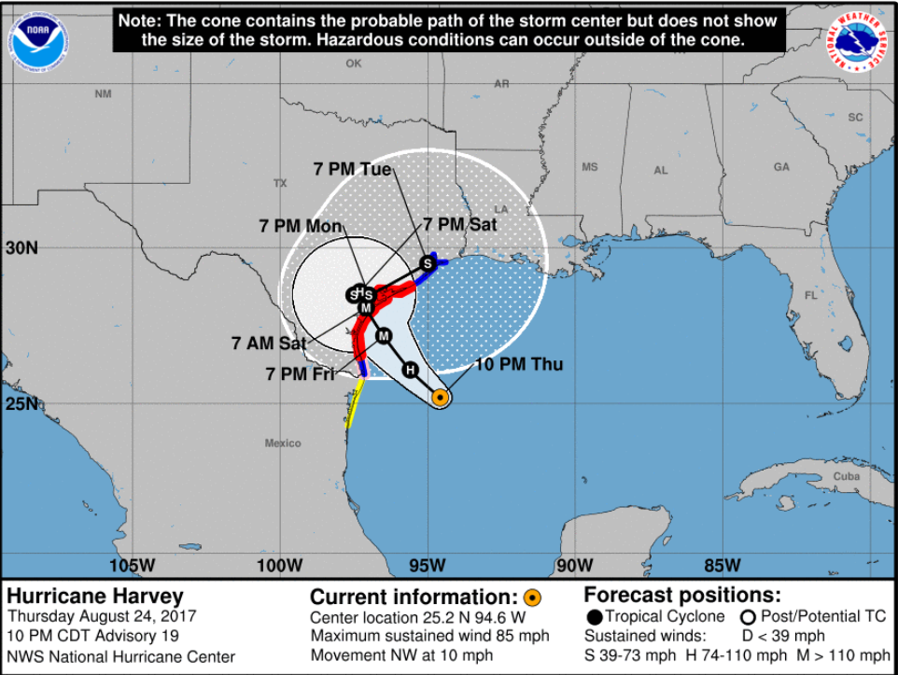
Hurricane Harvey: Forecast
August 24, day prior to landfall

Slide 24
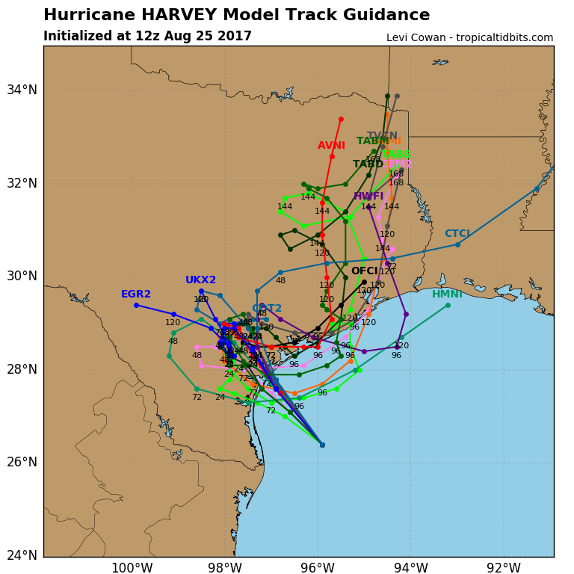
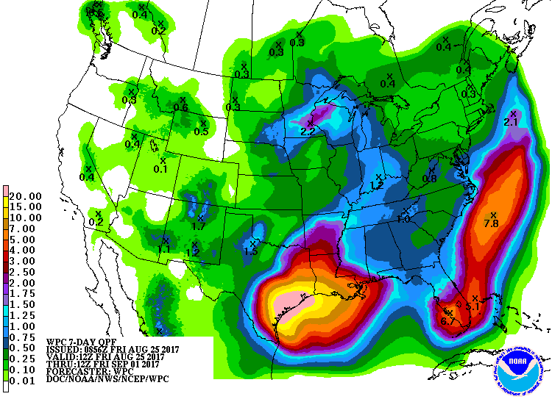
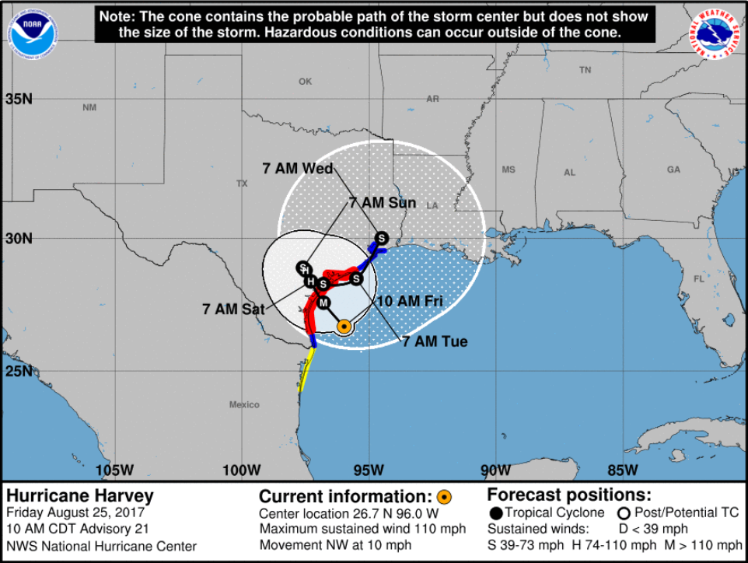
Hurricane Harvey: Forecast
Morning of August 25
(day of landfall)

Slide 25
Hurricane Harvey: Forecast
EMAIL sent Friday afternoon, 8/25:
As of 2PM CDT, Hurricane Harvey has intensified to Category 3 status. Officially a Major Hurricane. Sustained winds near the center have been measured at 120 MPH. Further intensification is possible prior to landfall tonight. Can’t completely rule out the Harvey becoming a Category 4 hurricane.
Harvey’s main impact will continue to be flooding rain. And with each computer model, that situation only looks worse. Models are increasingly suggesting over 40 inches of rain in some regions near the Coast. And the trend with these models has been to slow down the system and keep it over Texas longer.
It appears Harvey will make landfall a bit faster than previously projected. It will likely come ashore prior to midnight tonight. Somewhere between 8 and 11PM. Still looking like near or just north of Port Aransas.

Slide 26
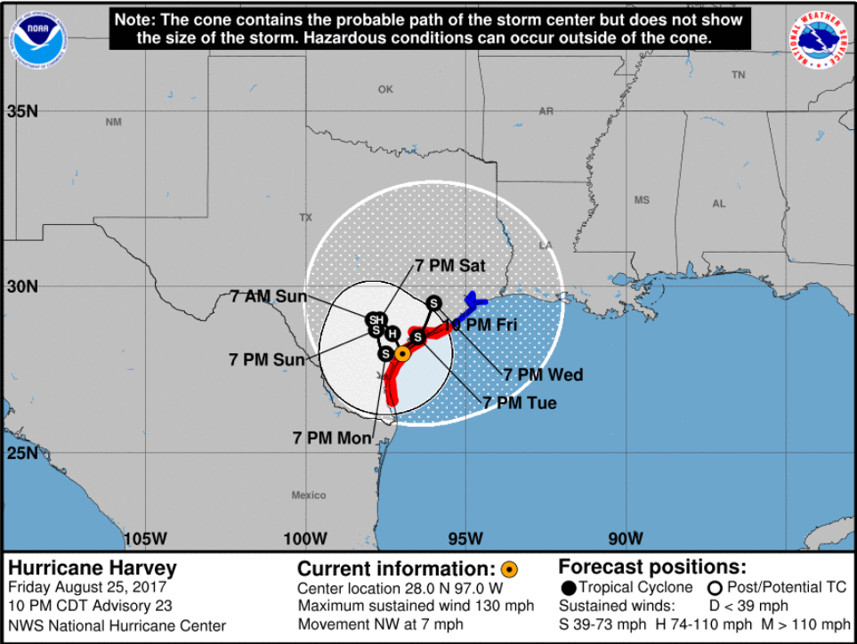
Hurricane Harvey: Forecast
12 hours later. Landfall. 10PM on Friday, August 25

Slide 27
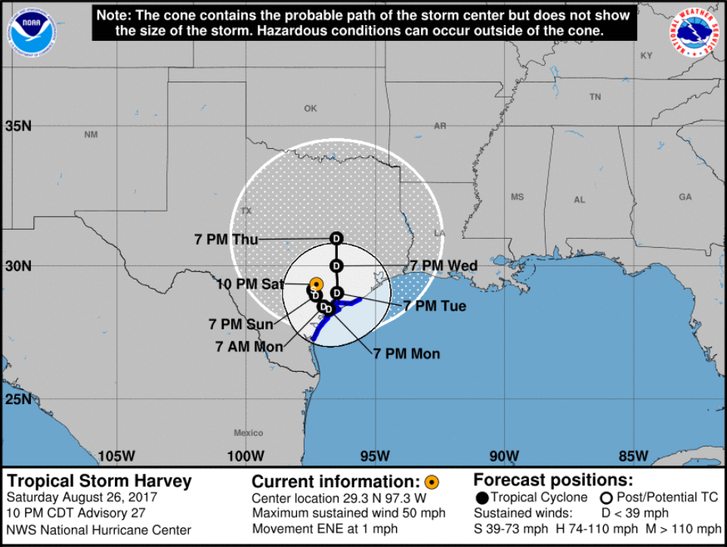
Hurricane Harvey: Forecast
24 hours later. 10PM on August 26
At this point, NHC was keeping Harvey over Texas for at least six days (longer than what actually happened).

Slide 28
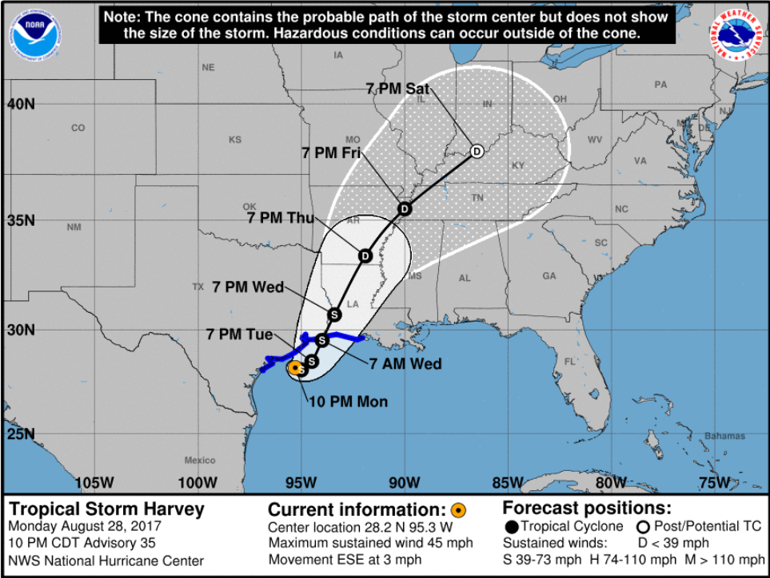
Hurricane Harvey: Forecast
48 hours later. 10PM on August 28

Slide 29
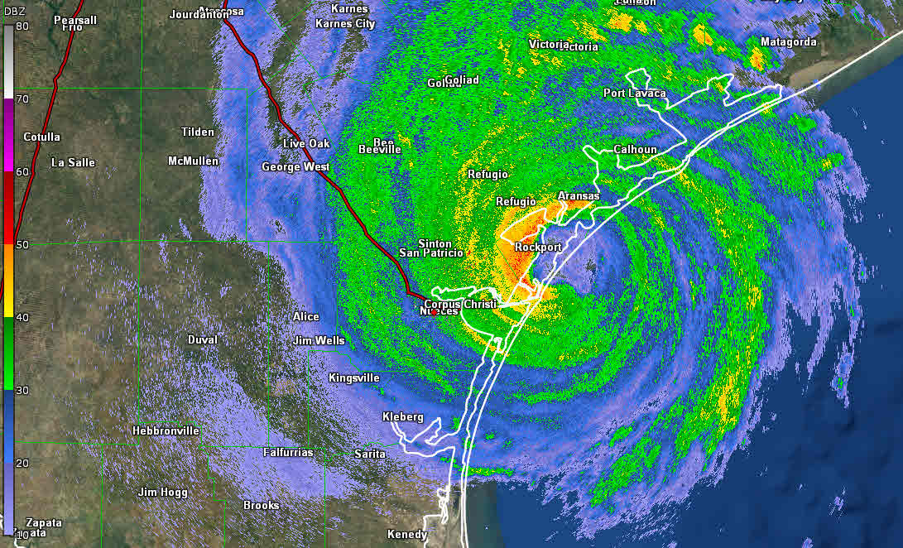
Hurricane Harvey: Landfall
Harvey made landfall on
Friday, August 25 at 10PM
CDT.
Harvey initially struck San Jose
Island just prior to landfall at
Rockport
Peak wind gust of 132 MPH
Recorded 2mi ENE of Port
Aransas
First hurricane with Texas landfall
Since Ike in 2008 (second-longest span minus a TX hurricane)
Strongest hurricane with U.S. landfall
Since Charley (FL) in 2004.
Strongest hurricane to hit Texas since Carla in 1961

Slide 30
Hurricane Harvey: Devastation at landfall
Rockport, TX
https://youtu.be/i8ti0_cZ5Go

Slide 31
Hurricane Harvey: Satellite and Radar
https://youtu.be/0nLE0Xi4_VY
https://youtu.be/Dzn309lDKBs
Two major rounds of rain for Houston
AM hours of the 26th and 27th

Slide 32
Hurricane Harvey: Before and After
https://youtu.be/iZrLVDoDep4

Slide 33
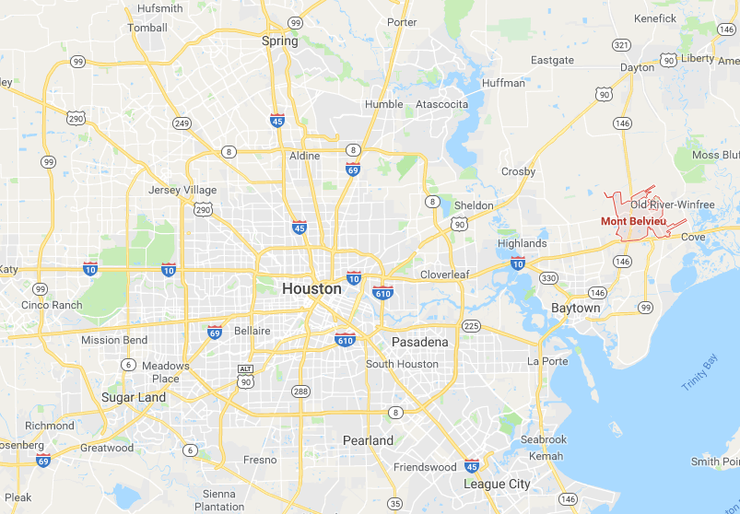
Hurricane Harvey: Rainfall Record
INITIAL RECORD:
Cedar Bayou rain gauge:
51.88 inches.
All-time record for rainfall from a tropical cyclone in the continental U.S.
The old record was 48 inches in Medina, Texas (Hill Country, west of San Antonio) due to Tropical Storm Amelia in 1978.
BUT ……..

Slide 34
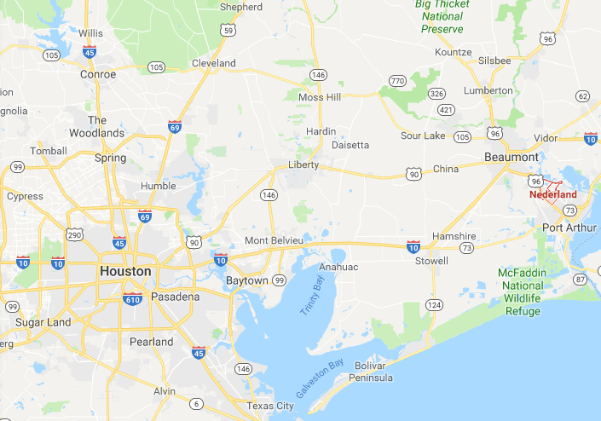
Hurricane Harvey: Rainfall Records
A new, all-time U.S. record (50 states) was confirmed in late-September …
Many rain gauges broke during Harvey. Later determined at least seven locations topped 51 inches
64.58 inches in Nederland, TX.
This shattered Hawaii’s record of 52 inches in 1950.

Slide 35
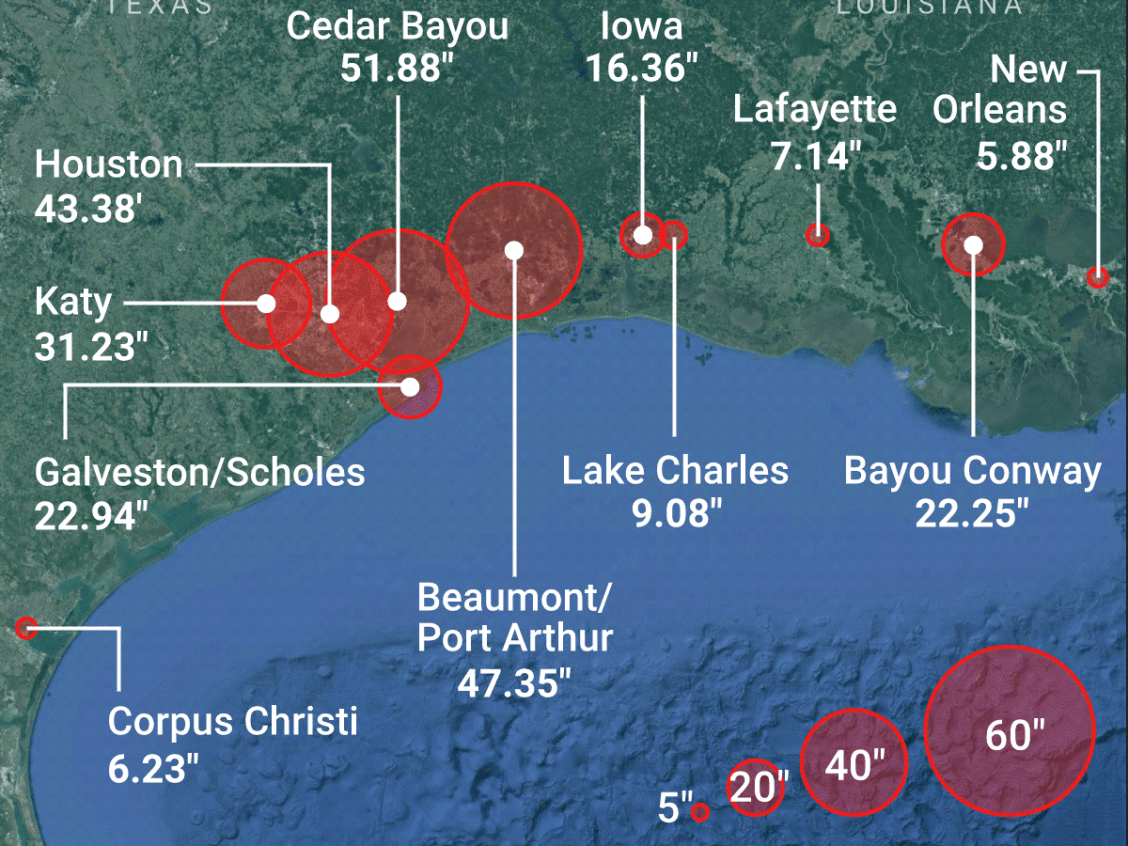
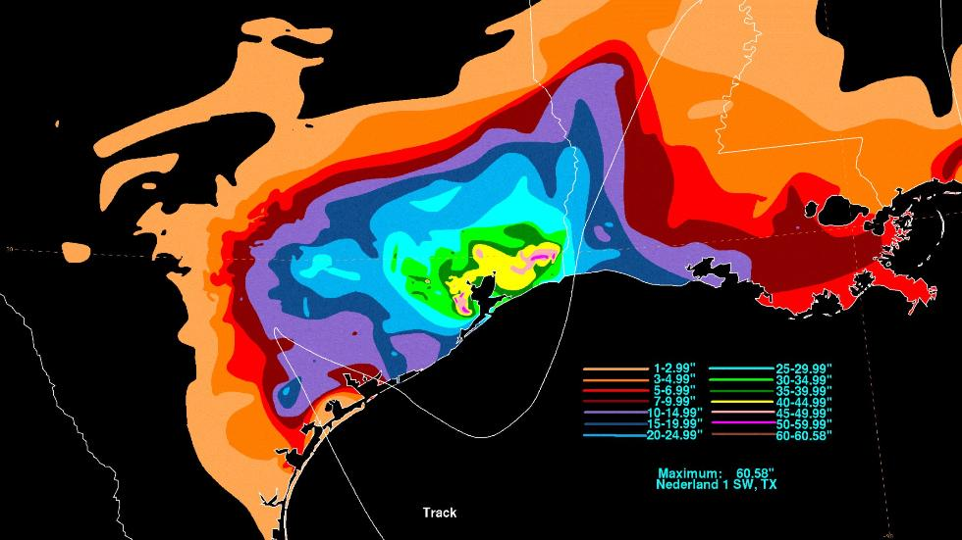
Hurricane Harvey: Rainfall Records
Other locations:
Austin: 10.28”
San Antonio: 1.94”
Victoria: 15.60”
College Station: 19.64”
Brenham: 25.41”
La Grange: 15.49” (Colorado River crested at 54.1ft – 3rd highest ever. Flood stage is 37ft. 10% of town’s homes were destroyed)

Slide 36
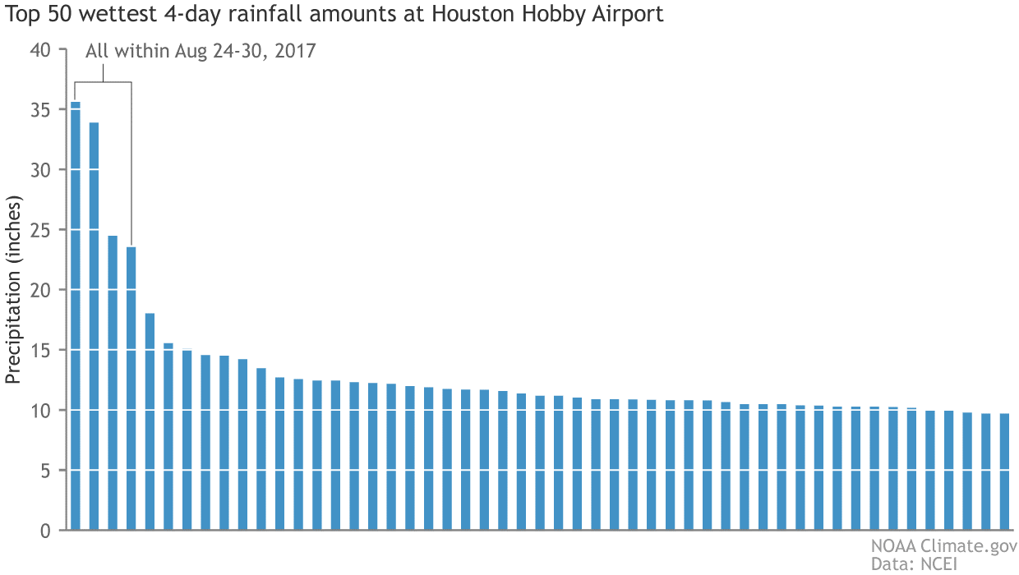
Hurricane Harvey: Rainfall Records
At Houston’s Hobby airport, the three-day rainfall from August 26-28 was larger than the previous record for wettest 65-day period. Three of the airport’s 5 wettest days since 1930 happened during Harvey (August 26, 27, and 28). Not surprisingly, August was the wettest month on record for the city (39.11 inches), more than double the previous wettest month (19.21 inches).

Slide 37
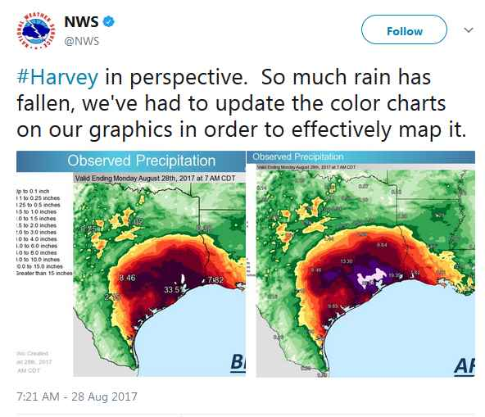
Hurricane Harvey: Rainfall Records

Slide 38
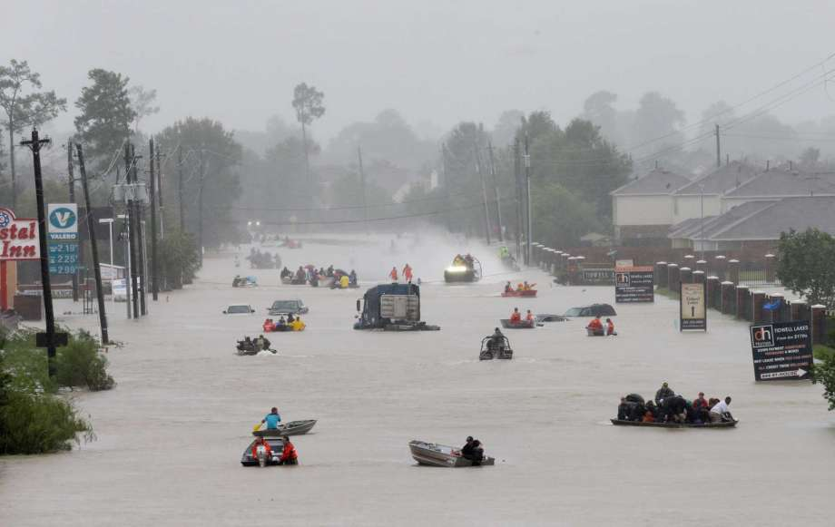
Hurricane Harvey: Rainfall Records
Based on assessments by the National Weather Service and analyses by various meteorologists, Harvey rained down more water on a metro area than any storm in U.S. history. The estimated 34 trillion gallons of rainfall across East Texas and western Louisiana is about the same as Tropical Storm Allison in 2001, 2015’s Memorial Day floods and last year’s Tax Day floods — combined.

Slide 39
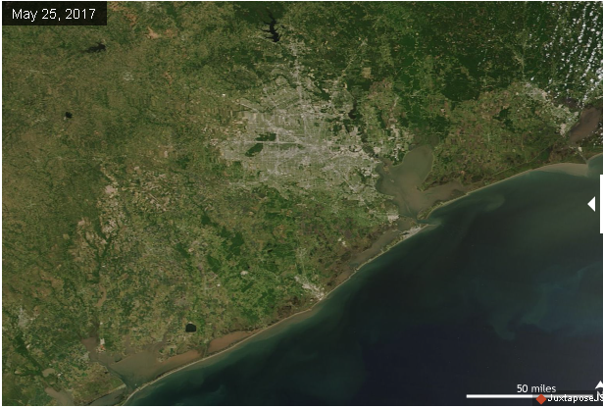
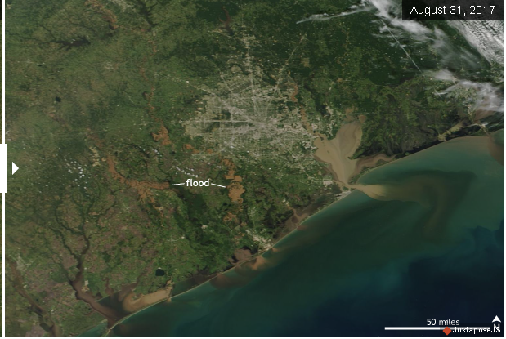
Hurricane Harvey: Rainfall Records
Analysis of the five-day rainfall amounts by the company MetSat found that five-day rainfall totals on par with Harvey’s had a 0.004% to 0.0002% chance of occurring in any given year.

Slide 40
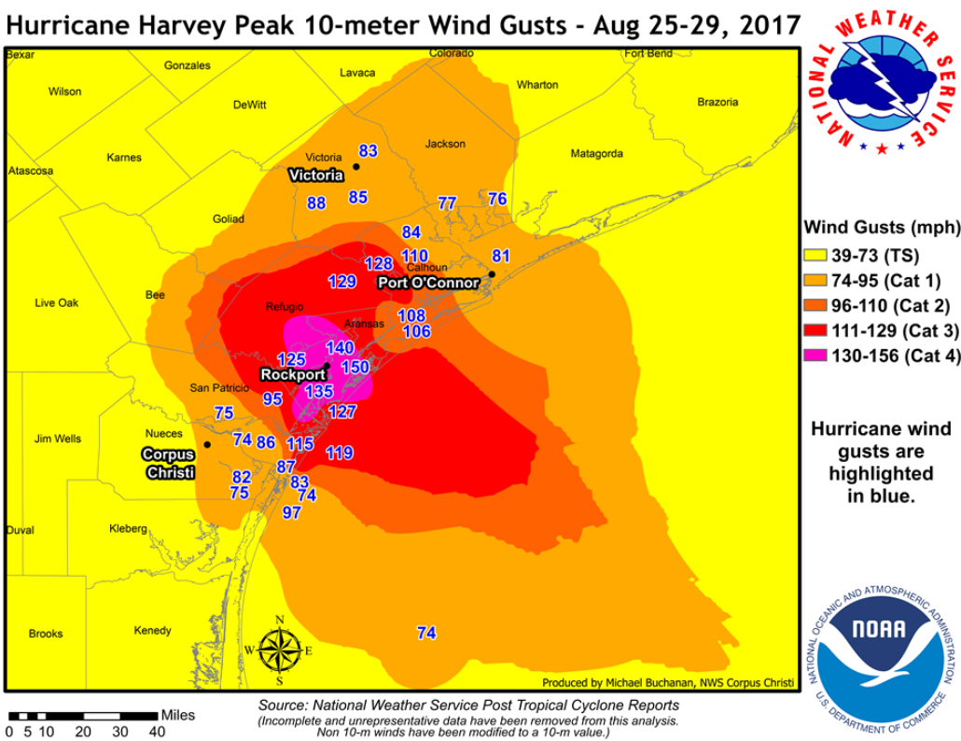
Hurricane Harvey: Wind Analysis

Slide 41
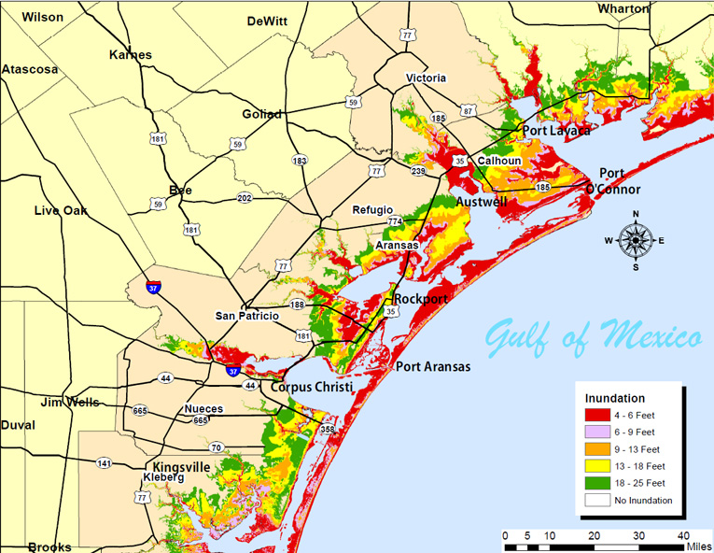
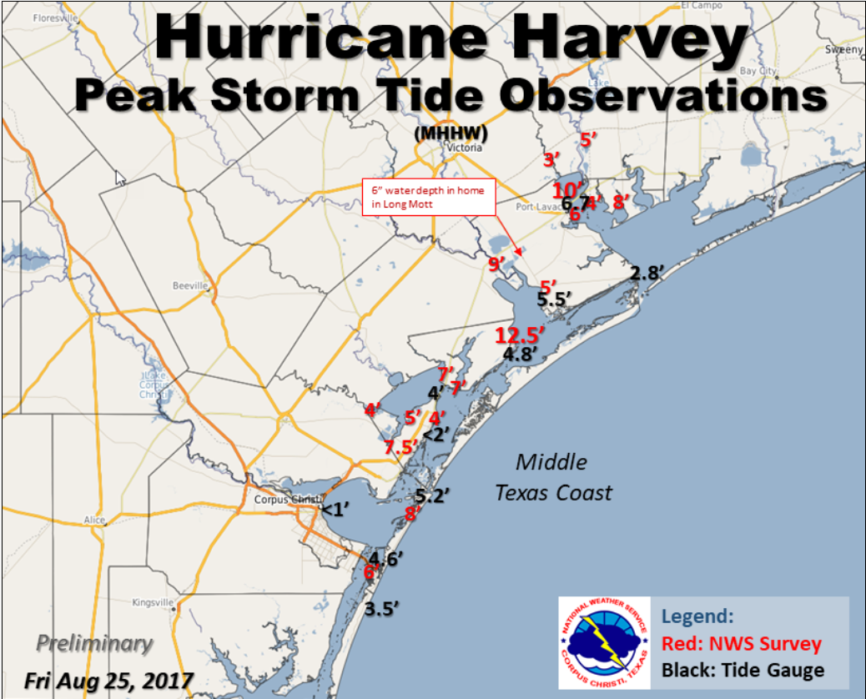
Hurricane Harvey: Storm Surge

Slide 42
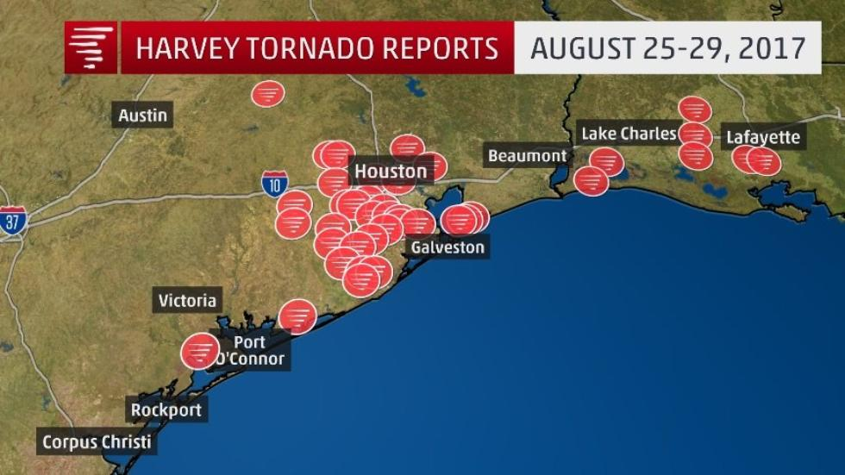
Hurricane Harvey: Tornadoes
37 Tornadoes touched down in Texas (EF0: 31; EF1: 6)
NWS Houston issued 156 Tornado warnings – more than any year since
warnings were tallied beginning in 1986
(Right-front quadrant is most common for tornadic development)

Slide 43
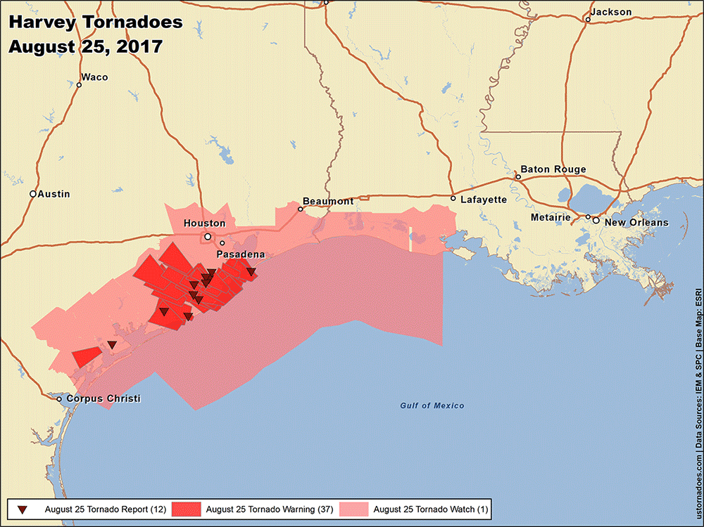
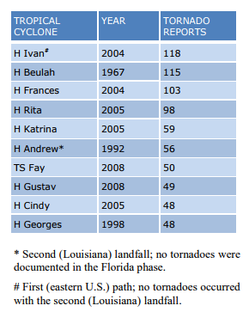
Hurricane Harvey: Tornadoes
(37)
No EF5 tornadoes have ever been recorded associated with
a tropical cyclone (and only two EF4)

Slide 44
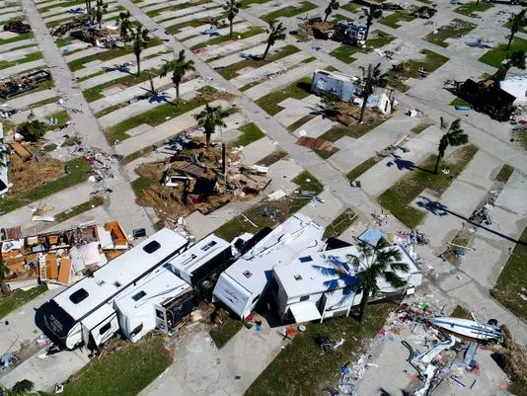
Hurricane harvey
Forecast analysis

Slide 45
What went right
Track:
On August 17, the forecast track was generally due west, through the
Caribbean and to the Yucatan
On August 18, the European model was hinting at possible landfall over
Texas around August 27
Upon re-intensification on Aug 23, NHC forecasting Texas landfall
Track over Texas:
Models/NHC on August 23 were forecasting Harvey to come ashore in
Texas then linger for an extended period
Rainfall projections:
Computer models were projecting over 20 inches of rainfall
Coast/Southeast TX as early as August 22. Some 40-50 inch
bullseyes were appearing on models by August 23 (even while
forecasting a non-major hurricane).

Slide 46
What went wrong
Intensity:
On August 19, Harvey dissipated over the Caribbean. NHC did not
provide forecast updates again until August 23 – after Harvey
re-emerged over the Gulf of Mexico and regained tropical storm
intensity. (There were computer models forecasting re-intensification
to hurricane strength.)
As of 10AM on August 23 (60 hours prior to Texas landfall), NHC
was forecasting Harvey to not intensify beyond tropical storm strength.

Slide 47
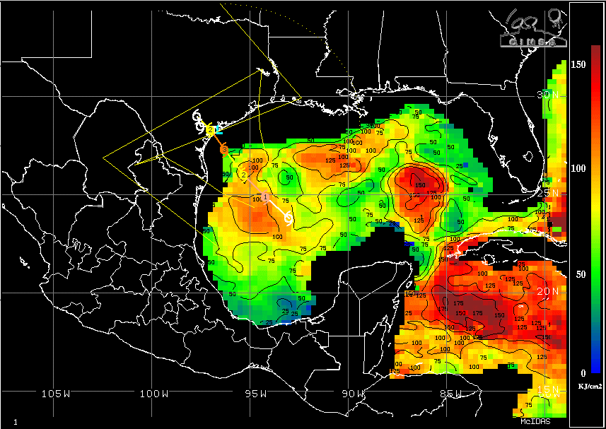
Rapid Intensification
Harvey intensified from a tropical depression into
a Category 4 hurricane in 57 hours.
Very low wind shear in Western Gulf (nothing to diminish intensification,
outflow of Harvey is able to expand
High pressure aloft, allowed warm air at lower levels to rise
High Oceanic Heat Content (temperatures hundreds of feet below surface)
1-2 tropical cyclones
per year go through
rapid intensification
(increase of 35+ MPH
in a 24-hour period).
In 2017, four cyclones
went through rapid
Intensification.
Harvey moved
across a warm
eddy Friday AM
and intensified
from 967mb of
pressure at 4AM
to 952mb at 6AM
(landfall Friday night
at 938mb)

Slide 48
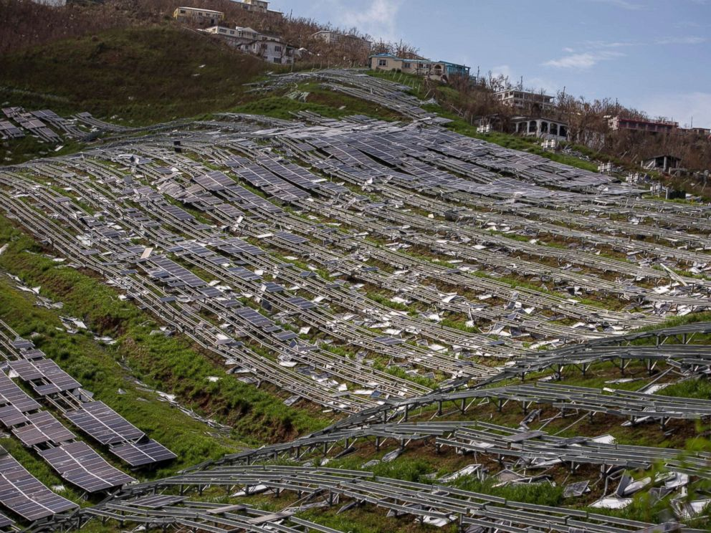
2018 Hurricane season
Forecasting the

Slide 49
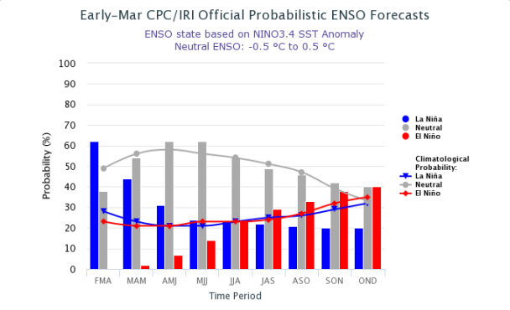
2018 Hurricane Forecast
Patterns in both the atmosphere and oceans surrounding North America
have recently shown strong similarities with a historical period from the past
20 years: 1996-2006
1999 included Hurricane Bret (landfall at Padre)
The 2005 season included Katrina and Rita
La Niña (or lingering post-La Niña) is typically supportive of an active season

Slide 50
2018 Hurricane Forecast
The forecast for the 2018 Atlantic hurricane season is:
11-15/5-9/3-6
11 to 15 total named storms; 5 to 9 hurricanes; 3 to 6 of those, major hurricanes.
Forecast is for 2-5 named storms in the Gulf of Mexico
(Last year, 17/10/6 – with 8 named storms in Gulf. Normal is 12/6/2)
Overall numbers (all cyclones) may be less than last year but projecting more than
typical to intensify into hurricanes
As with last year, this forecast is likely to be adjusted as the 2018 hurricane
season approaches (June 1)
Potential for both greater numbers and lesser numbers
Final forecast will be posted prior to June 1 on the ERCOT website weather page

Slide 51

SUMMER 2018 TEMPERATURE & Precipitation outlook
Preliminary

Slide 52
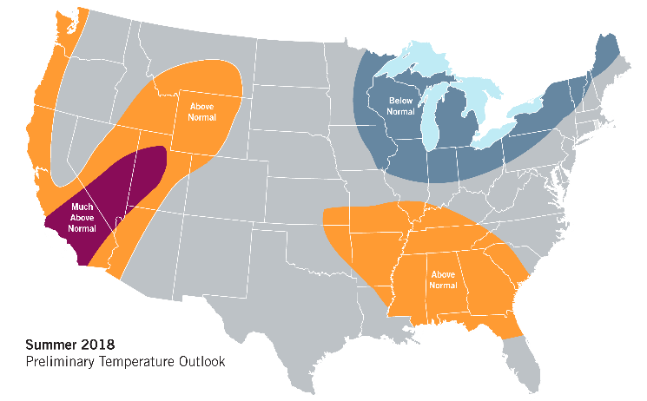
Summer 2018 Preliminary Temperature Forecast

Slide 53
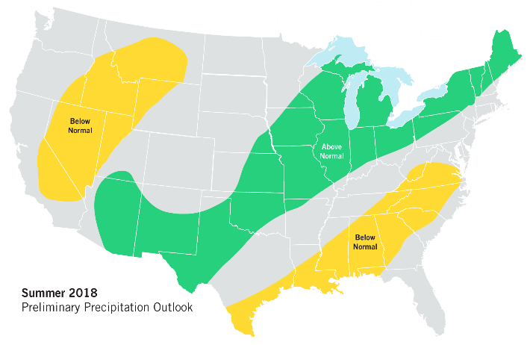
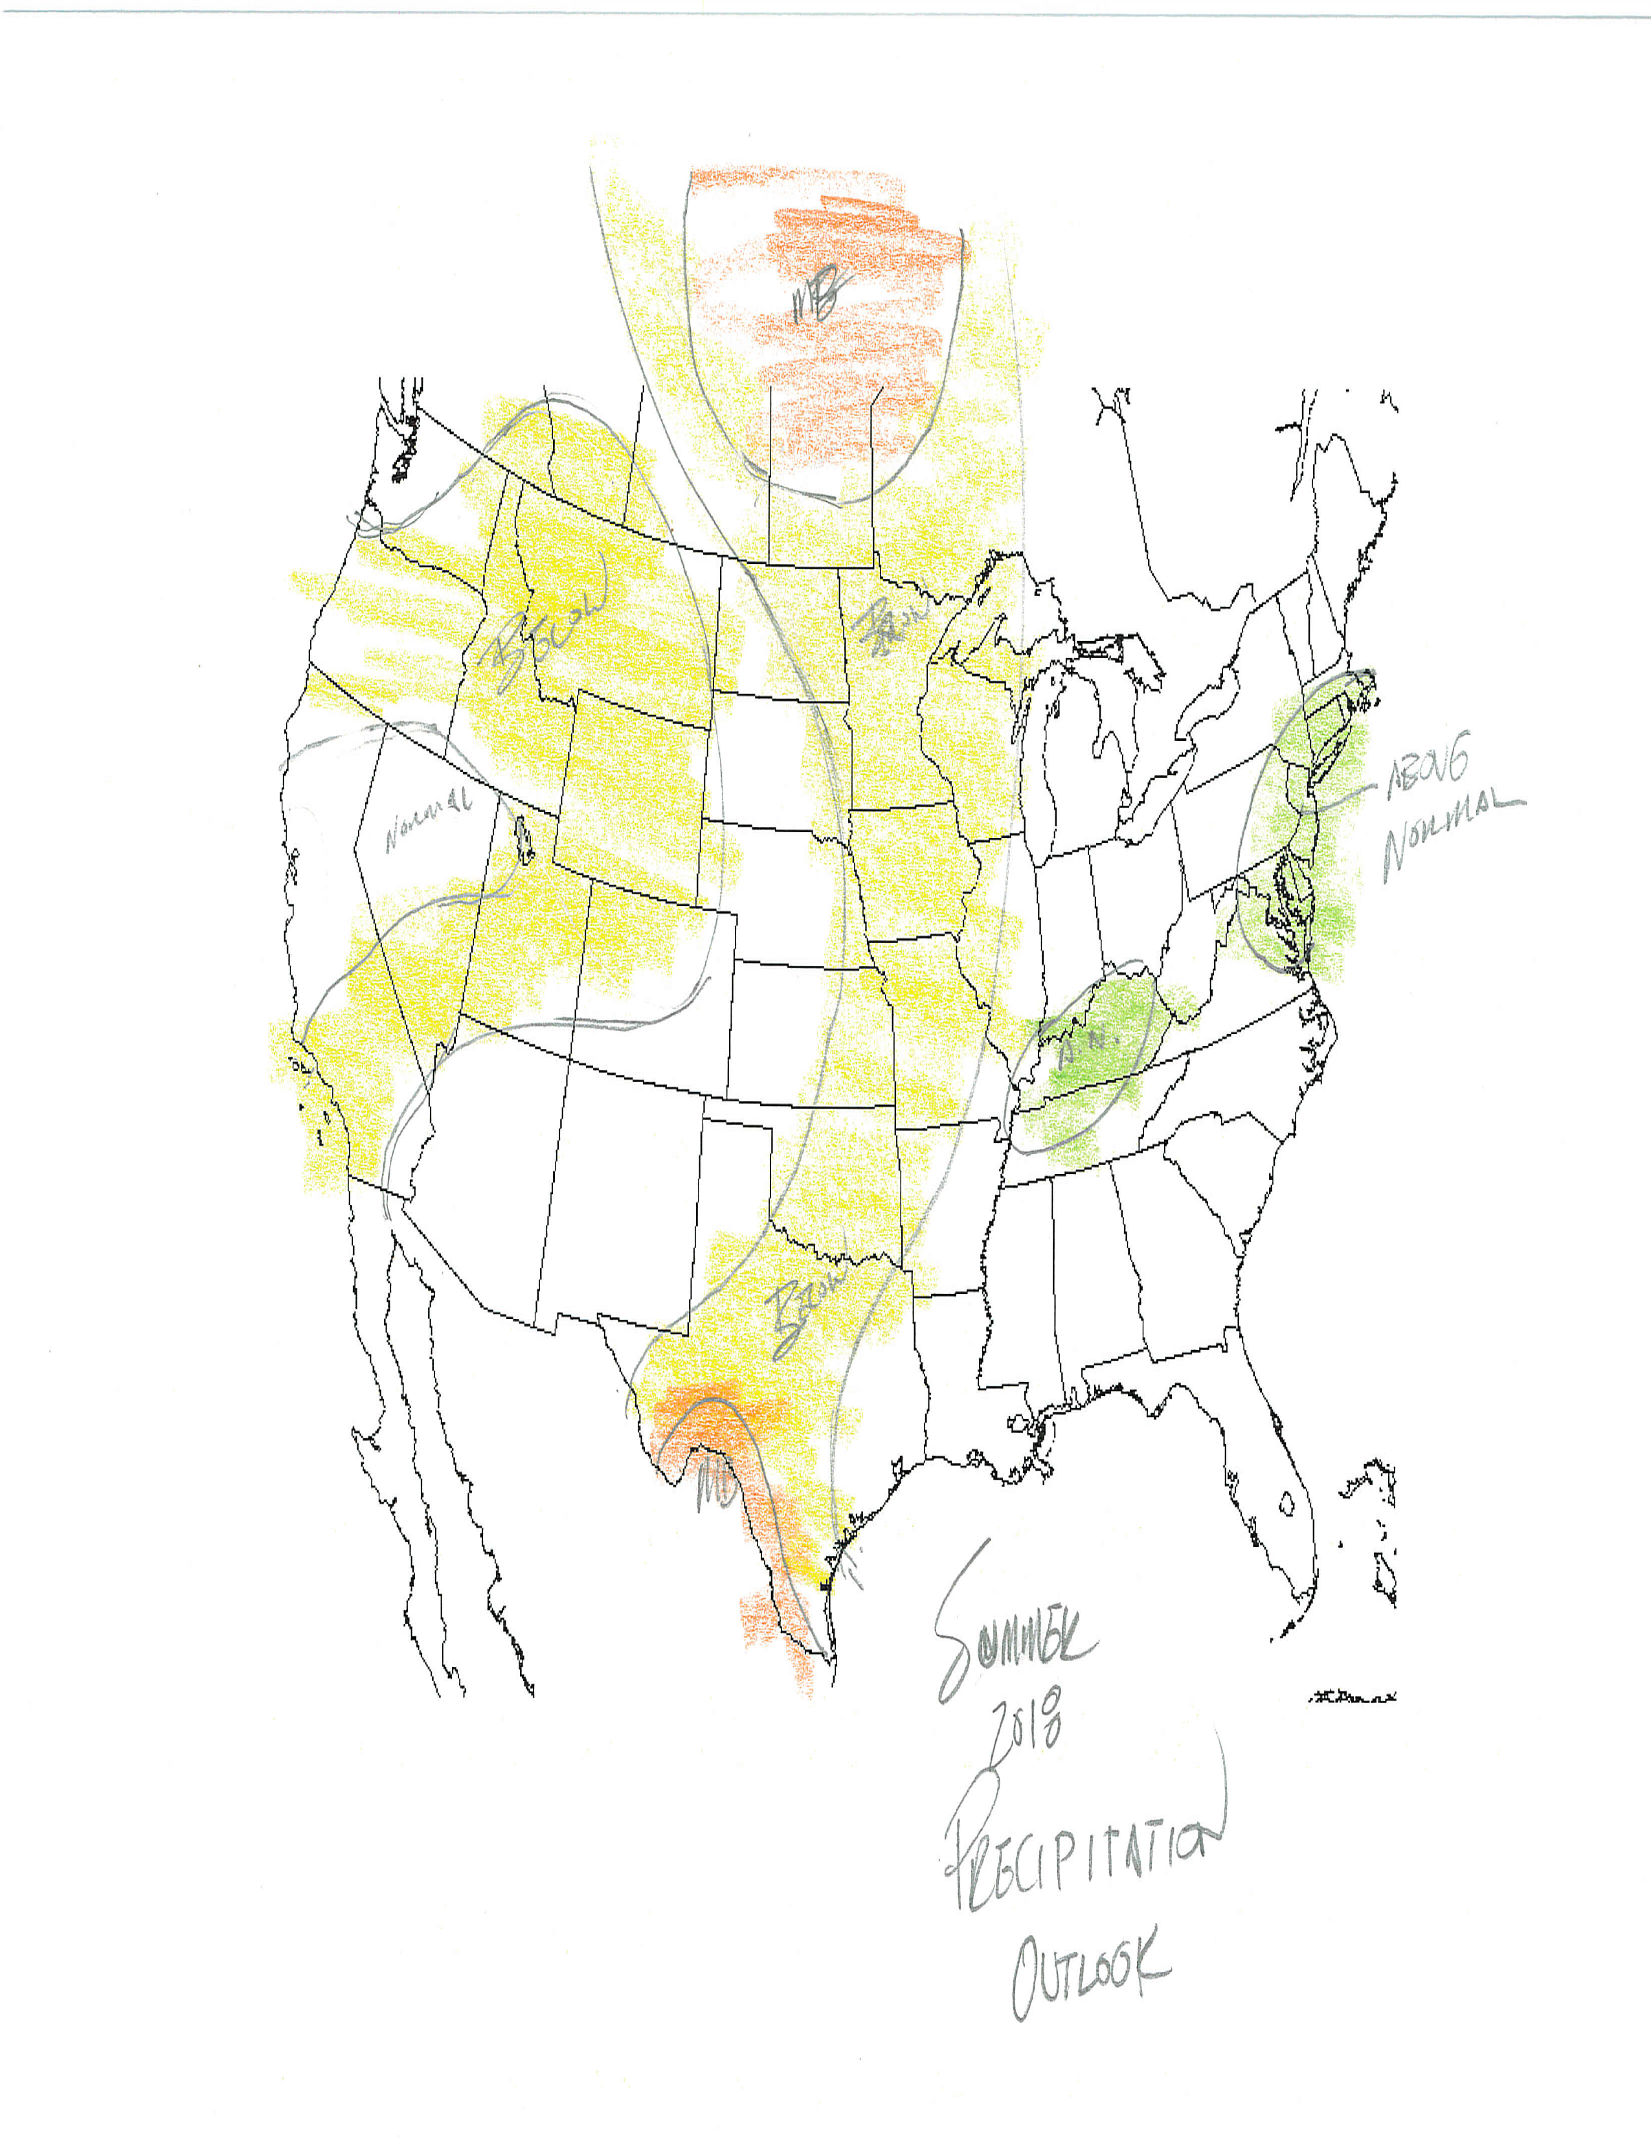
Summer 2018 Preliminary Precipitation Forecast

Slide 54
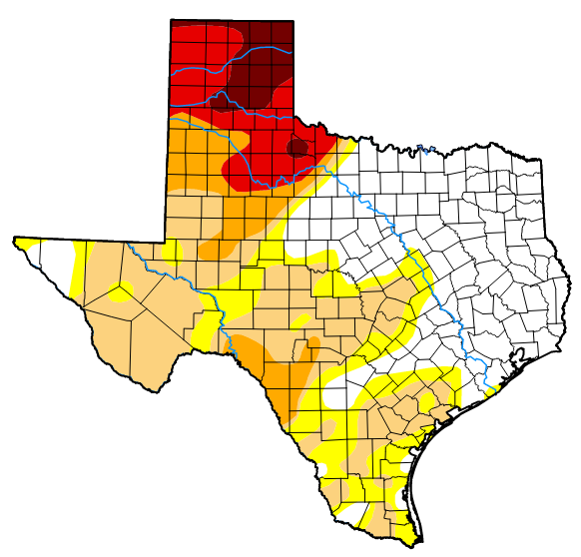
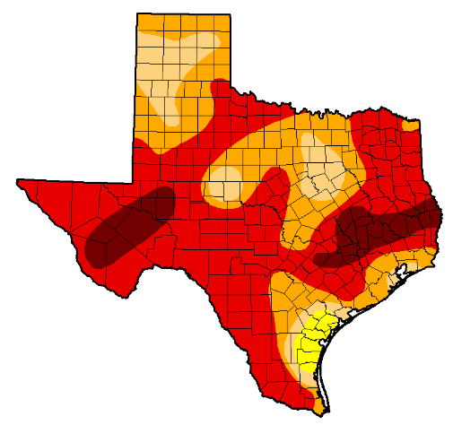
Summer 2018 Preliminary Precipitation Forecast
Drought April 2018
Drought April 2011

