Slide 1
Resource Integration Impacts
John Bernecker
Supervisor, Resource Integration

Slide 2
Learning Objectives
Identify the types of studies done prior to allowing a unit connect to include:
Sub Synchronous Oscillation
Angle and voltage stability
Short Circuit
Identify how often studies are performed
Recognize Generic Transmission Constraint and the impact of a resource’s ability to connect and generate to the system
Recall the process for a Resource to connect to the System
Identify the tool used to track a resource’s progress to connect to the system
Recognize future projects and the challenges associated with them

Slide 3
Resource Integration Process
Guide Generation Resource Interconnection or Change Requests (GINR) from initial submission to commercial operation
Process applies to:
New resources ≥10MW interconnecting to the transmission system
Existing resources upgrading by 10MW or more in a single year or changing their Point of Interconnection (POI)
Repowers
Three main phases of process:
Planning Studies
Resource Registration
Resource Commissioning

Slide 4
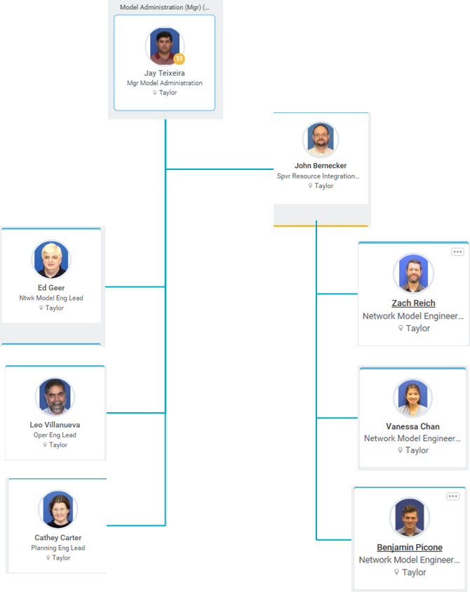
Resource Integration Team

Slide 5
Planning Studies Milestones
GINR Request
Screening Study
FIS / SSR*
Reactive Study
QSA
*If required

Slide 6
Full Interconnection Studies (FIS)
Governed by Planning Guide §5.4.2
Four parts of every FIS
Steady state study
Short circuit study
Dynamic (stability) study
Facilities study
Studies conducted by TSP and reviewed by ERCOT
Must be approved prior to a planned new All-Inclusive Generation Resource’s inclusion in a Quarterly Stability Assessment (QSA)

Slide 7
Sub-synchronous Resonance (SSR)
Governed by Nodal Protocols §3.22
ERCOT performs a topology-check for SSR vulnerability as part of the Screening Study
If the resource is fewer than N-14 outages to being radial with a series capacitor, a detailed SSR study is required
Study performed by TSP and reviewed by ERCOT
Any issues identified in studies must be mitigated prior to synchronization
ERCOT recommends that SSR studies be performed one year in advance of synchronization

Slide 8
Reactive Study
Demonstrates that resources are prepared to comply with Nodal Protocols §3.15
Does not take the place of reactive testing performed during commissioning
Performed by the Interconnecting Entity (IE)
Must be approved prior to inclusion in a Quarterly Stability Assessment (QSA)

Slide 9
Static vs. Dynamic Reactive Capability
The total gross amount of dynamic reactive capability must meet or exceed 32.8% of the plant’s net real power rating at the POI
Corresponds to 0.95 pf at the POI
Main reactive power capability must come from dynamic sources (generators, STATCOMS, SVCs, etc.)
Switched shunts may not be counted towards dynamic reactive capability
Switched shunts may be used to make up for losses, but must be on Automatic Voltage Regulation (AVR) if needed to meet Voltage Support Service (VSS) requirements
Notes:
Shunts may be considered movable if there is an automatic control scheme for adjusting switched shunts in response to voltage, and the scheme operates quickly (e.g. tens of seconds)

Slide 10
Reactive Requirement Curve
Notes:
Be clear about axes and units. Describe differences for wind and solar in detail.

Slide 11
Reactive Power Requirement vs. POI Voltage
Notes:
Be very clear about units and expectations.

Slide 12
QSA
ERCOT conducts a Quarterly Stability Assessment (QSA) every three months to assess the impact of planned new All-Inclusive Generation Resources connecting to the ERCOT system as required by Planning Guide §5.9
Used to identify operating limits necessary to maintain system stability
Informs the development of Generic Transmission Constraints (GTCs)
Reports posted to MIS Secure

Slide 13
QSA Prerequisites
Planning Guide §6.9 requirements met
All Planning Model data provided in the Resource Asset Registration Forms (RARF)
Air permits (if necessary)
Water rights (if necessary)
Signed Interconnection Agreement (IA)
Notice to proceed and financial security
FIS studies approved
Reactive study approved
System improvements or mitigation plans identified (if required)

Slide 14
QSA Deadlines
All-Inclusive Generation Resource Initial Synchronization Date | Last Day for an IE to Meet Prerequisites | Completion of Quarterly Stability Assessment
Upcoming January, February, March | Prior August 1 | End of October
Upcoming April, May, June | Prior November 1 | End of January
Upcoming July, August, September | Prior February 1 | End of April
Upcoming October, November, December | Prior May 1 | End of July

Slide 15
Resource Registration Milestones
Registration of RE
Identify MRD
Submit Full RARF
EPS Meter / Telemetry Set Up

Slide 16
Registration as a Resource Entity
Signed IA must be completed and Planning Guide §6.9 requirements must be met prior to registration
PUCT registration is also required
Registration is required to submit the full RARF used for including a resource in the Network Operations Model
The Resource Entity (RE) must designate a Qualified Scheduling Entity (QSE)

Slide 17
Model Ready Date
The Model Ready Date (MRD) should precede the desired initial proposed energization date by at least 15-30 days
MRDs adhere to the Network Operations Model Change Schedule
On the MRD, ERCOT systems will link together the following key components:
Metering and Meter Data Acquisition (MDAS)
ERCOT market settlement information and pricing location
SCADA and ICCP communication points
QSE and RE relationship status and contact information

Slide 18
TSP Responsibilities
Submit Network Operations Model Change Request(s) (NOMCR) for equipment it owns
Submit EPS Meter Design Proposal
Verify meter communication with ERCOT meter polling systems

Slide 19
QSE Responsibilities
Submit outage(s) through the Outage Scheduler starting at the MRD
Ensures that the resource is not dispatched by ERCOT prior to energization
Outage status is updated throughout final verification and testing
Provide a list of proposed ICCP Points at least 30 days prior to the MRD
Required telemetry points are listed in the Nodal ICCP Communication Handbook

Slide 20
RE Responsibilities
Submit a RARF including all required fields under the Full Registration column of the Resource Registration Glossary at least 90 days prior to the 1st of the month of the MRD
Verify the Generation Node and Meter Mapping package (GENMAP)
Update RARF data if any parameters change

Slide 21
Commissioning Milestones
Part 1: Energization
Part 2: Synchronization
Part 3: Full Commissioning
Submit Commissioning Plan

Slide 22
Commissioning Plan
Provides details on how a facility will be operated during commissioning
Includes a plan for meeting commissioning milestones and a detailed commissioning schedule
Should be submitted 30 days prior to when the RE intends to submit Part 1 of the ERCOT New Generator Commissioning Checklist
Commissioning Plans are reviewed and approved by ERCOT

Slide 23
Part 1: Energization of POI
Part 1 of the New Generator Commissioning Checklist should be submitted at least 7 business days prior to the planned energization date
Should not be submitted before the interconnecting transmission switchyard facilities are modeled, constructed, energized, and operational
ERCOT will verify the network model and SCADA telemetry

Slide 24
Part 2: Synchronization
Part 2 of the New Generator Commissioning Checklist should be submitted at least 7 business days prior to the planned synchronization date
Verifies dates that Automatic Voltage Regulators (AVR), Power System Stabilizers (PSS), Governors, and reactive controls will be in place
ERCOT will verify the network model and telemetry

Slide 25
Requirements Prior to Initial Synchronization
Required meteorological data for wind resources must be available
A phasor measurement unit (PMU) must be installed for new generating facilities over 20 MVA aggregated at a single site
Resource must have been included in a QSA
Any issues identified during stability studies (FIS or QSA) must be mitigated or have a developed GTC
SSR study must be approved by ERCOT at least 90 days before synchronization
Any issues identified during SSR studies must be mitigated

Slide 26
Part 3: Full Commissioning
Part 3 of the New Generator Commissioning Checklist verifies unit testing
Reactive performance tests must be submitted and approved
AVR, PSS, and primary frequency response (PFR) tests must be submitted and approved

Slide 27
Reactive Testing
Testing requirements are laid out in Nodal Operating Guides §3.3.2
Lagging tests are recommended to take place during high load conditions
Leading tests are recommended to take place during low load conditions
Performance criteria differ for conventional and Intermittent Renewable Resources (IRR)

Slide 28
Lagging Tests
Lagging Test 1 (15 minute test)
Non-IRR units test at or above 95% of the unit’s High Sustained Limit (HSL)
IRR units test at or above 60% of their HSL
Test is passed if the unit achieves at least 90% of its most recent Corrected Unit Reactive Limits (CURL)
Lagging Test 2 (1 hour test)
Non-IRR units test at the unit’s HSL
IRR units test with at least 90% of photovoltaic inverters or wind turbines on-line
Test is passed if the unit achieves at least 50% of its CURL
Lagging Test 3 (1 minute test)
Test at the unit’s normally expected minimum real power output during system light load conditions
IRR and nuclear units are exempt
Test is passed if the unit achieves at least 50% of its CURL

Slide 29
Leading Tests
Leading Test 1 (15 minute test)
Non-IRR units test at their normally expected maximum real power output during system light load conditions
IRR units test at or below 60% of their HSL
Test is passed if the unit achieves at least 90% of its CURL
Leading Test 2 (1 minute test at HSL)
IRR units are exempt
Test is passed if the unit achieves at least 50% of its CURL
Leading Test 3 (1 minute test at low output)
Test at the unit’s normally expected minimum real power output during system light load conditions
IRR and nuclear units are exempt
Test is passed if the unit achieves at least 50% of its CURL

Slide 30
AVR Test
All reactive devices required to meet the requirements of Nodal Protocols §3.15 should be included in the AVR control system
All reactive devices included in the AVR control system should be included in the AVR test
All reactive devices in the AVR control system should be set to regulate the transmission-level voltage at the POI
ERCOT expects to see full response within 1-minute or less

Slide 31
RIOO
Resource Integration & On-going Operations (RIOO) Application
GINR Online
RARF
Replacement
TBD
Notes:
Phase 1 – GINR tool built to handle on-line submissions of generation interconnection requests.
Phase 2 – RARF replacement effort to remove dependence on spreadsheets.

Slide 32
GINR Features
On-line submission of interconnection requests (INR)
On-line payment capability for ERCOT fees
On-going management of projects submitted
Document management
E-sign capability
Project lifecycle tracking
Contact updates
Submit project data modifications

Slide 33
GINR Perks
Paperless generation interconnection request submissions
Quicker project request submissions
Reduced mail expenses
On-line payment option easily identified to projects
Continuous transparency of project status
One stop shop for INR project submissions

Slide 34
Learning Objectives
Identify the types of studies done prior to allowing a unit connect to include:
Sub Synchronous Oscillation
Angle and voltage stability
Short Circuit
Identify how often studies are performed
Recognize Generic Transmission Constraint and the impact of a resource’s ability to connect and generate to the system
Recall the process for a Resource to connect to the System
Identify the tool used to track a resource’s progress to connect to the system
Recognize future projects and the challenges associated with them

