Slide 1
Improving Resiliency – What can be done?
ERCOT Staff
Notes:
Most of content from “Enhancing the Resilience of the Nation's Electricity System” THE NATIONAL ACADEMIES PRESS A Consensus Study Report of
Enhancing the Resilience of the Nation's Electricity System
Copyright 2017 by the National Academy of Sciences. All rights reserved
AND
Build Back Better: Reimagining and Strengthening the Power Grid of Puerto Rico
Puerto Rico Energy Resiliency Working Group. December 2017

Slide 2
Objectives
Identify types of events and lessons learned from the following events:
  Hurricanes
  Tornados
  High Winds
  Freezing Conditions
  Wildfires
  Physical Attacks
  EMP
  Cyber Attacks
Recognize the types of Infrastructure improvements and operational practices that are currently used and future practices that may be implemented.

Slide 3
RESILIENCE IS BROADER THAN RELIABILITY
Resilience is not just about lessening the likelihood that these outages will occur. It is also about limiting the scope and impact of outages when they do occur, restoring power rapidly afterwards, and learning from these experiences
  Reliability Metrics:
  SAIFI - “System Average Interruption Frequency Index (Interruptions/customer)
  SAIDI - System Average Interruption Duration Index (minutes)
  CAIDI - Customer Average Interruption Duration Index (minutes)
  CAIFI – Customer Average Interruption Frequency Index
  MAIFI – Momentary Average Interruption Frequency Index
Notes:
SAIFI
“System Average Interruption Frequency Index (Sustained Interruptions)—This is defined as the average number of times that a customer is
interrupted during a specified time period. It is determined by dividing the total number of customers interrupted in a time period by the average
number of customers served. The resulting unit is ‘interruptions per customer’” (APPA, 2014).
SAIDI
“System Average Interruption Duration Index—This is defined as the average interruption duration for customers served during a specified time
period. It is determined by summing the customer minutes off for each interruption during a specified time period and dividing the sum by the
average number of customers served during that period. The unit is minutes. This index enables the utility to report how many minutes customers
would have been out of service if all customers were out at one time” (APPA, 2014).
CAIDI
“Customer Average Interruption Duration Index—This is defined as the average length of an interruption, weighted by the number of customers
affected, for customers interrupted during a specific time period. It is calculated by summing the customer minutes off during each interruption in
the time period and dividing this sum by the number of customers experiencing one or more sustained interruptions during the time period. The
resulting unit is minutes. The index enables utilities to report the average duration of a customer outage for those customers affected” (APPA, 2014).
CAIFI
“Customer Average Interruption Frequency Index—The average frequency of sustained interruptions for those customers experiencing sustained
interruptions” (APPA, 2014).
MAIFI
“Momentary Average Interruption Frequency Index—Total number of momentary customer interruptions (usually less than five minutes) divided by
the total number of customers served” (APPA, 2014).

Slide 4
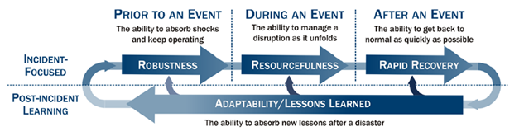
RESILIENCE IS BROADER THAN RELIABILITY
FERC definition of resilience:
The ability to withstand and reduce the magnitude and/or duration of disruptive events, which includes the capability to anticipate, absorb, adapt to, and/or rapidly recover from such an event.^{[1]}
^{[1]} Generally based on the National Infrastructure Advisory Council’s Critical Infrastructure Resilience Final Report and Recommendations at 8 (Sept. 8, 2009).
Notes:
SAIFI
“System Average Interruption Frequency Index (Sustained Interruptions)—This is defined as the average number of times that a customer is
interrupted during a specified time period. It is determined by dividing the total number of customers interrupted in a time period by the average
number of customers served. The resulting unit is ‘interruptions per customer’” (APPA, 2014).
SAIDI
“System Average Interruption Duration Index—This is defined as the average interruption duration for customers served during a specified time
period. It is determined by summing the customer minutes off for each interruption during a specified time period and dividing the sum by the
average number of customers served during that period. The unit is minutes. This index enables the utility to report how many minutes customers
would have been out of service if all customers were out at one time” (APPA, 2014).
CAIDI
“Customer Average Interruption Duration Index—This is defined as the average length of an interruption, weighted by the number of customers
affected, for customers interrupted during a specific time period. It is calculated by summing the customer minutes off during each interruption in
the time period and dividing this sum by the number of customers experiencing one or more sustained interruptions during the time period. The
resulting unit is minutes. The index enables utilities to report the average duration of a customer outage for those customers affected” (APPA, 2014).
CAIFI
“Customer Average Interruption Frequency Index—The average frequency of sustained interruptions for those customers experiencing sustained
interruptions” (APPA, 2014).
MAIFI
“Momentary Average Interruption Frequency Index—Total number of momentary customer interruptions (usually less than five minutes) divided by
the total number of customers served” (APPA, 2014).

Slide 5
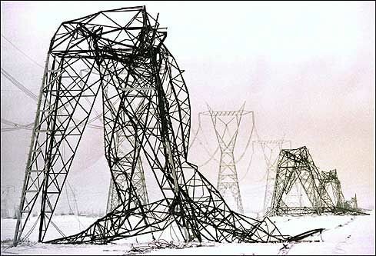
Examples of disruptions
New England/Canada Ice Storm (1998)
Between January 4 and January 10, 1998, a storm remarkable for its long duration (> 80 hours), large extent, and extraordinary freezing rain totals, with an accumulation of freezing rain greater than 3.1 in thick, stretched from Ontario and New York into Québec. The tremendous weight of ice resulted in collapse of 770 electric transmission towers, the replacement of more than 26,000 distribution poles and 4,000 pole-top transformers, and the re-stringing of
1,800 miles of transmission and
distribution circuits. At its peak, more
than 5.2 million customers in the
Eastern Canada, New York, and New
England were without power. Three
weeks after the storm, hundreds of
thousands of customers still had no
power, with some customers not
restored until more than 1 month
later .Storm damage was estimated to
be approximately $4 billion

Slide 6

Examples of disruptions
Northeast Blackout (2003)
The August 2003 blackout is the single largest loss of power in U.S. history. A combination of software and operator errors occurring at FirstEnergy and MISO greatly reduced the ability of the grid to withstand a reliability event. The RTO experienced diminished situational awareness, limiting its ability to assure reliability. Loss of generation capacity resulted in key transmission lines operating at higher loading than usual, but not enough to cause failure itself. But other factors then triggered outages: contact with overgrown trees in transmission easements tripped several 345 kV lines out of service, and FirstEnergy and MISO were unable to effectively monitor and respond to these losses of electric supply. The resulting power flows then redistributed from EHV to lower-voltage lines, leading 16 lines to trip in a 30-minute period, which caused a cascading collapse of the bulk power system across eight states and two Canadian provinces. The cascading failure left more than 50 million people without power. parts of the outage area, power was not restored for 4 days.
The blackout is estimated to have cost between
$4 billion and $10 billion and contributed to 11
deaths

Slide 7
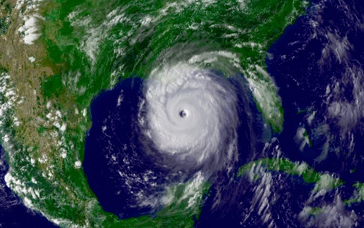
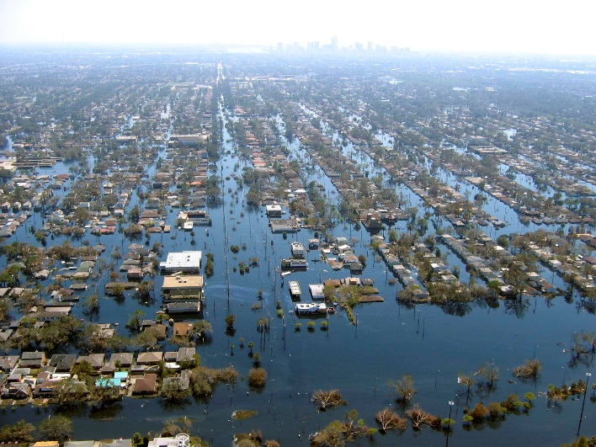
Examples of disruptions
Hurricane Katrina (2005)
Hurricane Katrina—the most costly weather-related event in the United States—first hit land in Florida as a Category 1 storm, grew to a Category 5 before weakening to a strong Category 3 storm at second landfall, with severe storm surges along Alabama, Mississippi, and Louisiana coasts. New Orleans experienced devastating flooding and widespread electricity outages. Damaging storm impacts were felt in eight states. Katrina’s impacts included loss of electric service to 2.7 million. 4 weeks after the storm, ~250,000 electric customers remained without service. The storm destroyed 72,447 utility poles, 8,281 transformers, and 1,515 transmission structures; it took 300 substations offline, and multiple power plants. The flooding in New Orleans prevented full restoration of power for several months. At Mississippi Power, every customer lost power, “nearly two-thirds of the transmission and distribution system was damaged or
destroyed, and all but three of the company’s 122
transmission lines were out of service. Katrina’s
estimated damage ranges from $84.8 billion to $157.5
billion. (http://densitykatrina.wordpress.com)

Slide 8
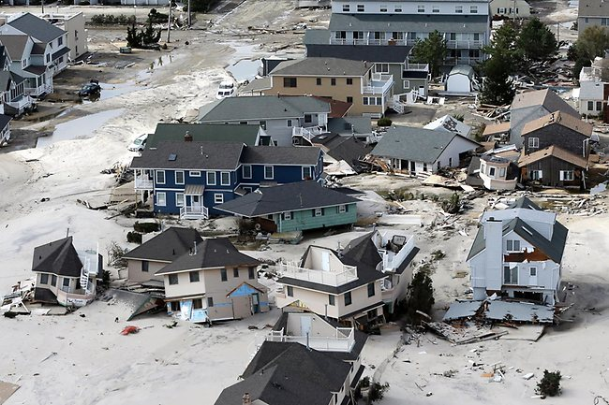
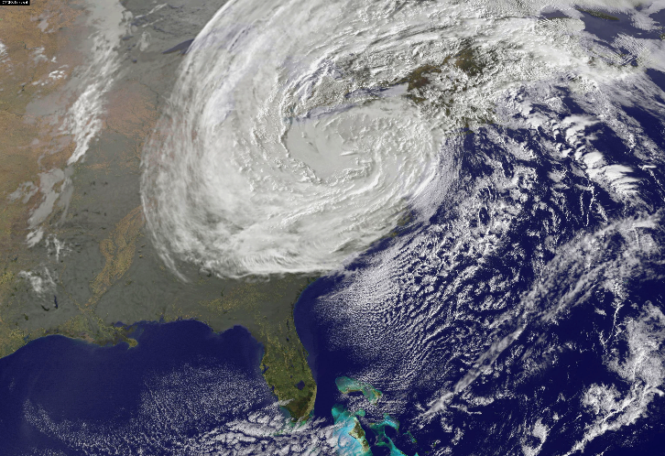
Examples of disruptions
Superstorm Sandy (2012)
In October 2012, Superstorm Sandy struck the eastern
United States, impacting 24 states in its path. During the 7
days from Sandy’s formation to its dissipation, the storm caused swells in excess of 3 meters, flooding in densely populated centers, and extensive damage to infrastructure, with a majority of the damage occurring in New York and New Jersey. Considerable advance notice of the storm allowed electric utilities to take steps to mitigate damages, including requests for more assistance from teams from other utility systems, for tree trimming along transmission lines, and for increased readiness of utility outage repair teams. It has been estimated that 8 million customers lost power. Restoration services reported that 10 to 11 percent of customers in New York and New Jersey remained without power 10 days following the storm. During the outages, 50 deaths were
attributed to the lack of electricity, with causes including
hypothermia and improperly operated generators. The
cost from the post-Sandy power outages has been
estimated between $14 billion and $26 billion.

Slide 9
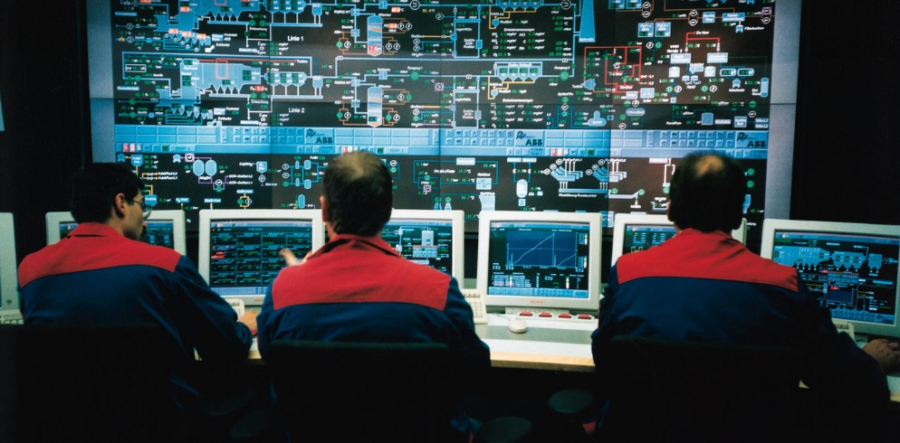
Examples of disruptions
Cyber Attack on Ukrainian Grid (2015)
In December 2015, a synchronized multi-target cyber attack was executed on three electric grid control centers in eastern Ukraine. Months previously, the attackers had used “spear-phishing” tactics on employees via a Microsoft Office document to access the corporate networks. The attackers spent the following months to gain credentials to remotely access SCADA networks. In December 2015, the attackers began the intrusion by shutting down power to the control center. With that response capability compromised, the cyber attackers took control of the electric-system substations and opened substation breakers to shut down power. Simultaneously, they executed a “denial of service attack” on customer support facilities, which made support unavailable to customers and released malicious software targeted at the master boot record. The attack left approximately 225,000 people without electricity for up to 6 hours. The release of malicious software wiped out personnel computers, servers, and remote terminal units (RTUs), which delayed restoration of service and increased the time required to bring control systems back online. Several substations suffered damage due to the attacks..
The attackers executed a well thought out strategy, including the following:
• Creating virtual workstations inside SCADA systems that were trusted to issue system commands;
• Co-opting remote terminal units within SCADA systems to issue commands to breakers at substations;
• Severing communications by targeting firmware in serial-to-Ethernet devices, making most unrecoverable;
• Installing and running a modified KillDisk program that
deleted information on what was occurring while making
recovery reboots nearly impossible;
• Shutting down uninterruptible power supplies at control
centers; and Executing a large denial-of-service attack

Slide 10
Examples of disruptions
2013 – Metcalf Substation Attack.
  Transmission Substation outside of San Jose, California, was attacked by one or more gunmen. The attack was well planned and executed, with the attacker(s) severing several fiber-optic cables to disrupt local communications prior to beginning the attack with military-style rifles. In the hour between when communications lines were cut and the first law enforcement officers arrived, 17 transformers had been seriously damaged as oil leaked from bullet holes allowing electric components to overheat.
2017 – Hurricanes Harvey, Irwin, Maria, devastate Texas, Florida & Puerto Rico; Wildfires devastate California.

Slide 11
Anticipating and Preparing for Disruption
While the possibility of large-area, long-duration blackouts cannot be totally eliminated, there is much that can be done to decrease their likelihood and reduce their magnitude.
  Anticipation, Planning, and building in resistance (i.e. capital projects)
  Operations mitigation

Slide 12
Types of Disruptions
Hurricane
Tornado
High Winds
Flood & Storm Surge
Ice Storms/Severe cold weather
Wildfires
Natural Gas Disruption
Physical Attack
Cyber Attack
Drought
Earthquake
Major Operations errors
Electromagnetic
Volcanic Events

Slide 13
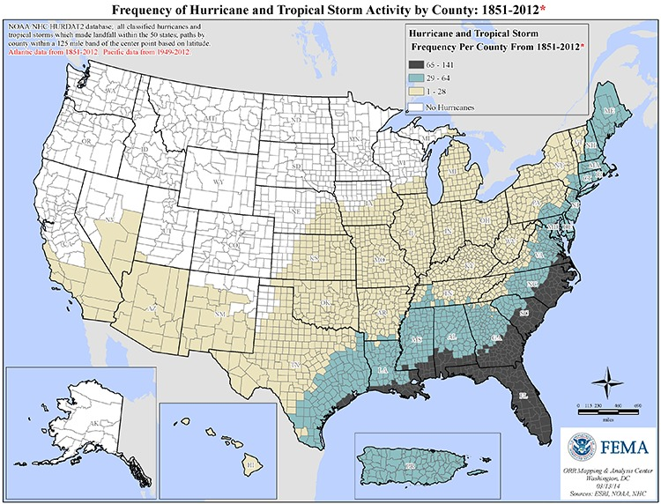
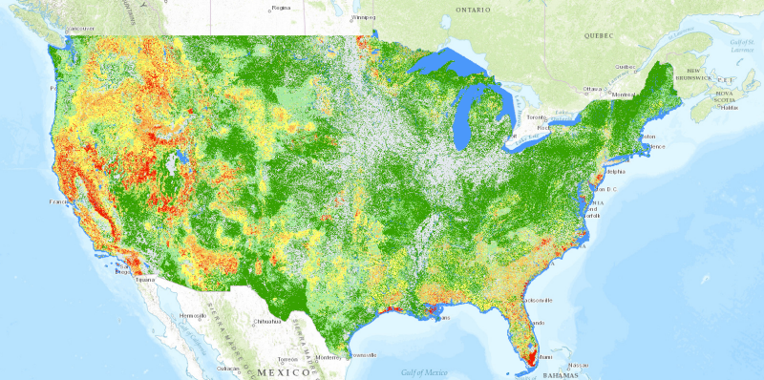
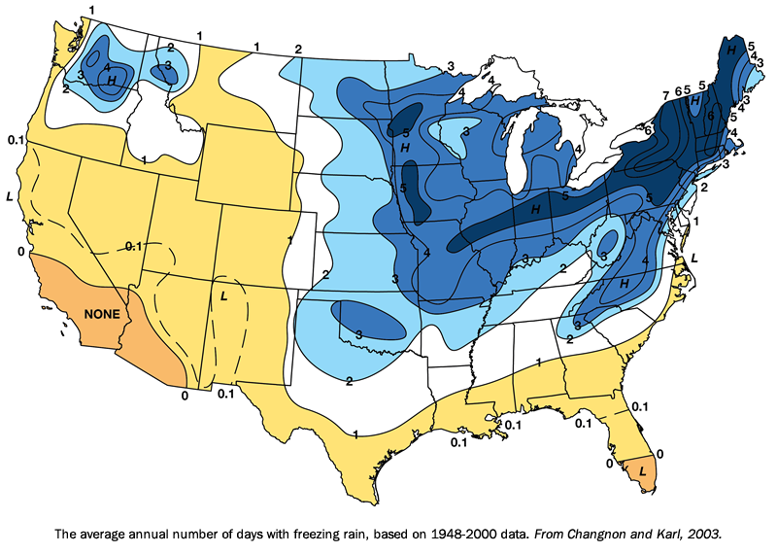
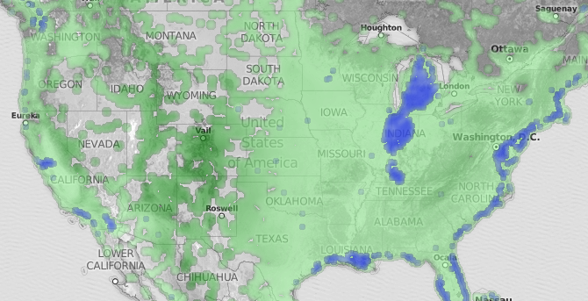
Focus on greatest risk for your locality
Frederick the Great – He who defends everything, defends nothing.
Hurricane
Wildfire Potential
Freezing Rain
Flood Risk

Slide 14
A major power outage divided into stages

Slide 15
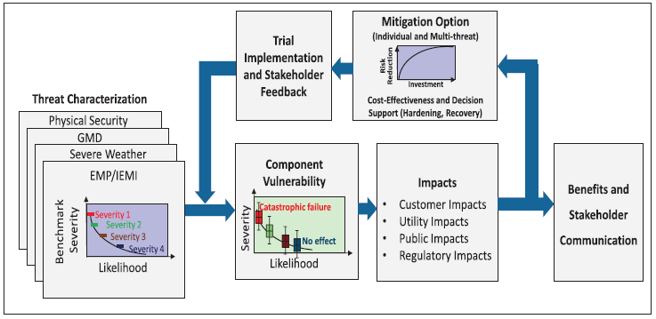
Mitigation process

Slide 16
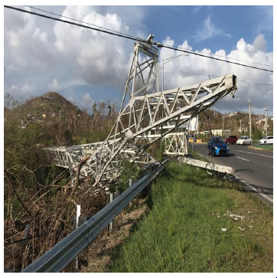
Hurricanes
Hurricane Maria Damage – Puerto Rico 2017
Region of Hurricane Risk

Slide 17
Hurricane & Flood Mitigation
Planning and Design
Finding of National Academy of Science : Design choices based on economic efficiency using only classical reliability metrics are typically insufficient for guiding investment in hardening and mitigation strategies targeted toward resilience. Such choices will typically result in too little attention to system resilience. If adequate metrics for resilience are developed, they could be employed to achieve socially optimal designs
  Component Hardening
    Wind & flood resistant towers & poles i.e. High strength insulators, structures and conductor spacing designed for high wind loading. Dead End Structures every 4 miles instead of 10…
    Water Protection
      Dikes, Levees, elevating components, Flood barriers, pumps w elevated backup generators, perimeter flood walls, fiber control cabling for flood resistance where possible. Standardized; containerized substation design in a water-tight container for flood prone areas.
    Siting inland and out of flood prone areas
  Plan for recovery period
    Plan for rapid restoration of critical services. (Water, Waste treatment, Hospitals, Emergency shelters) Possible micro grids.
    Pre-plan for extra personnel & siting during recovery period

Slide 18
Hurricane & Flood Mitigation
Operations
  Vegetation Management
  Spare parts & pre-positioning
  Mutual Assistance Agreements
  Pre-positioning of specialized recovery equipment
  Recovery plans
  Possible electrical Islanding plans

Slide 19
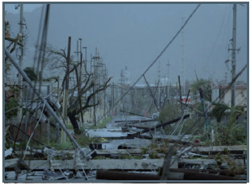
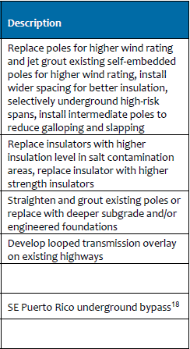
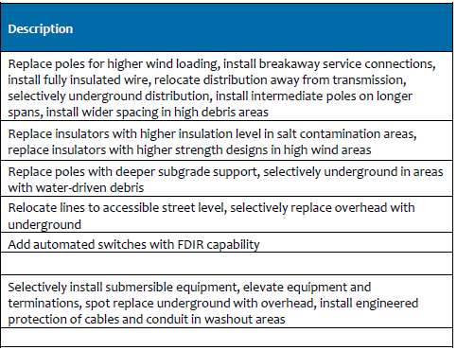
Report recommendations Puerto Rico
Transmission
Distribution

Slide 20
Cyber Attack
Risks
  Penetration of control computers allowing malicious control actions resulting in damage to equipment
  Denial of service attacks, shutting down markets
  Penetration of communications security allowing malicious control of SCADA
  Theft of data, allowing losses to participants and ERCOT
  Infection of computer networks with malicious software

Slide 21
Cyber Attack mitigation
Planning and Design
  Have a cyber security team protecting your infrastructure
  Design for cyber security
  Apply security patches in a timely fashion
  Implement & try to exceed NERC CIP requirements
  Isolate Operational/control systems from internet and commercial systems as much as practical
Operations
  Implement programs to protect against Phishing
  Disable USB connections as much as possible
  Conduct frequent cyber-security training exercises for all employees and try to create a friendly “game-like” atmosphere among all employees regarding getting caught by exercises.

Slide 22
Physical Attack Risks
Damage to Transformers
Damage to Towers/Poles
Attack on Substations
Attack on Control Centers
Attack on communications
Deliberate damage to equipment

Slide 23
Physical Attack Risk mitigation
Screen substations from external visibility (i.e. reduce target availability) Deploy barriers & protect information about critical components.
Minimize Towers/Poles adjacent roadways
Secure substations, monitor & respond to intrusions, outside fence monitoring & vegetation clearing.
Avoid publication of critical locations. Provide security & security response plans for critical equipment.
Provide redundant communications. Maintain security on paths & formats
Maintain employee controls. Monitor and investigate damage.

Slide 24
Ice Storms and severe cold weather
Generator forced outages due to freezing equipment
Vegetation collapse into distribution
Broken conductor due to ice weight
Galloping conductors
Collapsed towers

Slide 25
Mitigation Ice Storms and severe cold weather
ERCOT performs annual generator winter preparedness inspections for Generators to reduce forced outages due to freezing
Vegetation management can prevent many potential outages
Hydrophilic coatings can help conductors shed ice, also helping avoid galloping conductors and tower collapse.

Slide 26
Consideration of Alternatives
Budget resources are always limited
  First meet and exceed requirements
  Determine highest risks
  Consider Alternatives
    Capital improvements
    Operational recovery plan
      Preparation and practice
      Develop Metrics to measure readiness
  Analyze risk/benefit

Slide 27
Risk based cost-performance optimization
He who defends everything, defends nothing
From the Report of Committee on Enhancing the Resilience of the
Nation’s Electric Power Transmission and Distribution System
In most cases, an electricity system that is designed, constructed, and
operated solely on the basis of economic efficiency to meet standard reliability criteria will not be sufficiently resilient
  If some comprehensive quantitative metric of resilience becomes available, it should be combined with reliability metrics to select a socially optimal level of investment. In the meantime, decision makers must employ heuristic procedures to choose a level of additional investment they believe will achieve a socially adequate level of system redundancy, flexibility, and adaptability.

Slide 28
Objectives
Identify types of events and lessons learned from the following events:
  Hurricanes
  Tornados
  High Winds
  Freezing Conditions
  Wildfires
  Physical Attacks
  EMP
  Cyber Attacks
Recognize the types of Infrastructure improvements and operational practices that are currently used and future practices that may be implemented.

Slide 29
Wrap-up
Questions?

