Slide 1
Markets and Reliability: Operating Reserve and Reliability Deployment Price Adders
David Maggio and Kevin Hanson
Market Analysis and Validation
ERCOT Public
2018 ERCOT Operator Training Seminar

Slide 2
Objectives
Describe how the operating reserve and reliability deployment prices adders are incorporated into real-time prices
Explain the purpose of the prices adders
Recognize system conditions under which there is a potential for non-zero price adders
Identify what the historical, typical prices adders have been

Slide 3
Agenda
Real-Time On-Line Price Adders and Off-Line Reserve Price Adders (RTORPA and RTOFFPA)
Refresher on Ancillary Services and how do they compare to operating reserves
What are they and why were they implemented?
How are they calculated?
The Real-Time On-Line Reliability Deployment Price Adder (RTORDPA)
What do we mean by reliability deployments?
What is it and why was it implemented?
How it is calculated?
What have the historical results of the price adders been?

Slide 4
Ancillary Services
An Ancillary Service (AS) is a reliability service procured by ERCOT and is capacity that is reserved on Resources to allow ERCOT to respond quickly to changing system conditions.
Capacity Reserved for AS
The primary types of AS are:
Regulation Service (Reg-Up and Reg-Down)
Responsive Reserve Service (RRS)
Non-Spinning Reserve Service (Non-spin)
System Capacity
System Demand

Slide 5
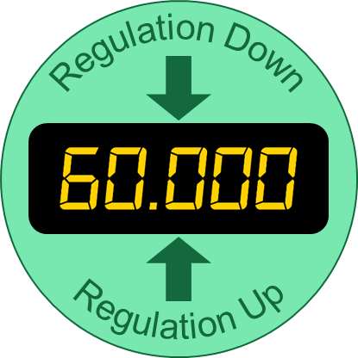
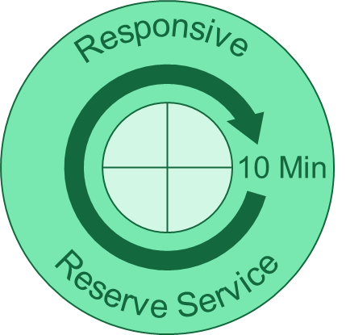
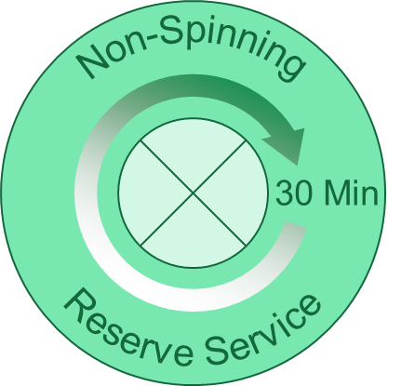
Ancillary Service Products by Resource Type
Who carries what?
On-line Generation Resources
Controllable Load Resources
Wholesale Storage Loads
On-line Generation Resources
Controllable Load Resources
Load Resources on Under-Frequency Relay
Off-line Generation Resources
On-line Generation Resources
Controllable Load Resources

Slide 6
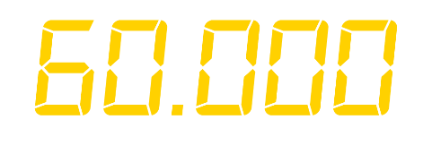
Regulation Service
Provides capacity that can respond to signals from ERCOT within seconds to maintain system frequency
Two Types of Regulation Service
Reg-Up
Reg-Down
Regulation Down
Regulation Up
Must be capable of ramping through reserved capacity in 5 minutes

Slide 7
Responsive Reserve Service
Provides capacity reserves intended to:
Respond to significant frequency deviations
Serve as backup Regulation
Provide additional capacity during an Energy Emergency Alert (EEA)
Must be capable of ramping through reserved capacity in 10 minutes
Responsive Reserve Service
10 Min

Slide 8
Non-Spinning Reserve Service
Provides additional capacity reserves that can be utilized within 30 minutes
Uses
System-Wide capacity needs
Local capacity needs
Recover Responsive Reserve Service in a timely manner
Non-Spinning Reserve Service
30 Min

Slide 9
Ancillary Services vs. Operating Reserves
These AS are cleared in the DAM or Supplemental AS Market (SASM) and have specific rules on how they are utilized.
Operating reserves refers more generally to the extra capacity that is available in real-time and includes:
AS that has not been deployed
Headroom on Resources that are not providing AS
Extra headroom on Resources that are providing AS
We’ll come back to the definition and categories of operating reserves later.

Slide 10
Scarcity Pricing
ERCOT is an energy-only market
Energy pricing must support an appropriate level of investment in Resources
When operating reserves are low, the probability of having a scarcity event increases.
If the scarcity event is severe, ERCOT may need to shed load.
System prices should reflect the value of available reserves, since reserves reduce the chance that ERCOT will have to shed load.
System-Wide Offer Cap (SWCAP)
Price of Energy ($/MWh)
Security-
Constrained
Economic Dispatch
(SCED) can set scarcity prices under the right conditions
Time

Slide 11
The Value of Operating Reserves
In the early years of the Nodal Market, higher prices during times of scarcity had to be driven by higher priced Energy Offer Curves.
This dependency on higher priced Energy Offer Curves can fail to recognize the value that diminishing real-time reserves provide in avoiding potential load-shedding events on the system.
RTORPA and RTOFFPA are intended to better represent this value of the real-time reserves.
After the addition of RTORPA, energy prices approximate the outcome of real-time energy and AS co-optimization.

Slide 12
The Value of Operating Reserves
The overall goal is to improve scarcity pricing
System-Wide Offer Cap (SWCAP) =
Value of Lost Load (VOLL)
Reserve price adder improves scarcity pricing
SWCAP is a cap on the offers submitted to ERCOT, but individual prices may go higher.
Price of Energy ($ MWh)
SCED can set scarcity prices under the right conditions
Time

Slide 13
Real-Life Example from 2011
System prices did go to the SWCAP for a number of intervals.
Electricity prices include both an energy component and a congestion component. System Lambda is the energy component of the price.
Were prices properly reflecting the value of reserves during these other intervals?
But some firm load was being shed until after 13:00.

Slide 14
The Value of Operating Reserves
RTORPA
Represents the value of the Real-Time On-Line Reserve Capacity (RTOLCAP) being provided by Qualified Scheduling Entities (QSEs)
Capacity able to respond immediately following an event
RTOFFPA
Represents the value of the Real-Time Off-Line Reserve Capacity (RTOFFCAP) being provided by QSEs
Capacity not currently available but could be in 30 minutes

Slide 15
How Do You Determine that Value?
Sufficient real-time reserves help avoid load-shedding events
There is value in avoiding load-shedding events
Value of real-time reserves = Value of avoiding load-shed

Slide 16
The Operating Reserve Demand Curve
ERCOT implemented an Operating Reserve Demand Curve (ORDC) on June 1, 2014.
Reserve prices should be based on:
VOLL
The probability of shedding load
VOLL is administratively set to 9,000 $/MWh.
VOLL-λ
The price of reserves increases to reflect the increased risk

Slide 17
Creating the Operating Reserve Demand Curve
ORDC constructed as the product of:
The probability of reserves falling below the minimum contingency level (PBMCL)
The difference between VOLL and System Lambda
The distribution of errors used for PBMCL is determined using historical values of:
Reserve capacity projected in the hour-ahead
Reserve capacity observed in real-time
Any firm load that was shed
Hours are split into groups based on the Season and time of day

Slide 18
Calculating the Reserve Price Adders
With reserves broken up into two categories (RTOLCAP and RTOFFCAP), two separate prices have to be calculated.
First is the calculation RTOFFPA:
Based on the probability of reserves falling below a minimum contingency level over an hour given the amount of reserves available in the latter 30 minutes of the hour.
Amount of reserves is the sum of RTOLCAP and RTOFFCAP
The probability value is multiplied by .5 x (VOLL-System Lambda), reflecting that the reserves are only available for half of the hour.
The minimum contingency value is administratively set at 2,000 MW.

Slide 19
Calculating the Reserve Price Adders
Once RTOFFPA is known, then calculate the RTORPA:
Based on the probability of reserves falling below a minimum contingency level over 30 minutes given the total amount of reserves available in the first 30 minutes of the hour.
Amount of reserves is only RTOLCAP
The probability value is the multiplied by .5 x (VOLL-System Lambda), reflecting that 30 minute period
This product is then added to RTOFFPA to determine the final RTORPA
Idea is that RTOLCAP contributes to preventing load shedding in both halves of the hour.

Slide 20
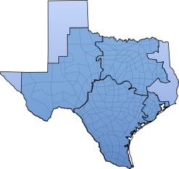
Real-Time Pricing Methodology
These price adders are determined during each SCED interval, however the impact still needs to be incorporated into the energy price.
Locational Marginal Prices (LMPs) from SCED are then combined with the price adders to form real-time Settlement Point Prices (SPPs).
QSEs will also be paid or charged for AS imbalances in real-time.
Resource Nodes
Load Zones
While LMPs are location-specific, the value of reserves is ERCOT-wide
Hubs

Slide 21
But Wait, There’s One More Adder
Reserves need to be properly valued during times of scarcity.
It’s also important to account for price distorting actions that may occur during energy scarce conditions, specifically those taken by ERCOT to maintain reliability.
These “reliability deployments” could be suppressing prices at the exact moment that more Resource production is needed

Slide 22
What are the Reliability Deployments?
The commitment of Resources through Reliability Unit Commitment (RUC)
This would also include Reliability Must Run (RMR) Resources or Resources contracted for capacity.
Relaxes the low limits to negate the impact of the “price-taking” capacity
Deployment of Load Resources other than Controllable Load Resources
Deployment of Emergency Response Service (ERS)
Additional types of reliability deployments will be added as part of Nodal Protocol Revision Request (NPRR) 768

Slide 23
One Example of Price Suppression - RUCs
System Demand

Slide 24
One Example of Price Suppression - RUCs
The aggregate curve shift is driven by the “0 – LSL” energy from the RUC-committed Resource.
System Demand

Slide 25
One Example of Price Suppression - RUCs
System Demand

Slide 26
One Example of Price Suppression - RUCs
The impact is dependent on where system demand is on the aggregate Energy Offer Curve.
System Demand

Slide 27
Another Example of Price Suppression – Load Resource Deployment
System Demand without the Load Resource Deployment

Slide 28
Another Example of Price Suppression – Load Resource Deployment
The 200 MW deployment changes the amount of energy that needs to be dispatched through SCED.
System Demand with the Load Resource Deployment

Slide 29
The Reliability Deployment Price Adder
The RTORDPA was implemented on June 1, 2015 to counteract the price suppressing effect of reliability deployments.
This effect is estimated by executing the SCED process a second time with the inputs changed to simulate the scenario in which the reliability deployments hadn’t taken place.
The impact is calculated by taking the difference between the System Lambda resulting this second execution of the SCED process and the System Lambda from the first execution of the SCED process (before the inputs were changed)

Slide 30
Back to the Real-Time Pricing Methodology
Like the reserve price adders, the RTORDPA also needs to be incorporated into the SPPs
RTORDPA is also applied ERCOT-wide.
Settlement Point Prices
= Avg. LMPs +
Avg. RTORPA +
Avg. RTORDPA
RTORDPA does not account for the potential local impacts of reliability deployments.

Slide 31
Historic Results – Reserve Price Adders

Slide 32
Summer 2017 On-Line Reserve Price Adders

Slide 33
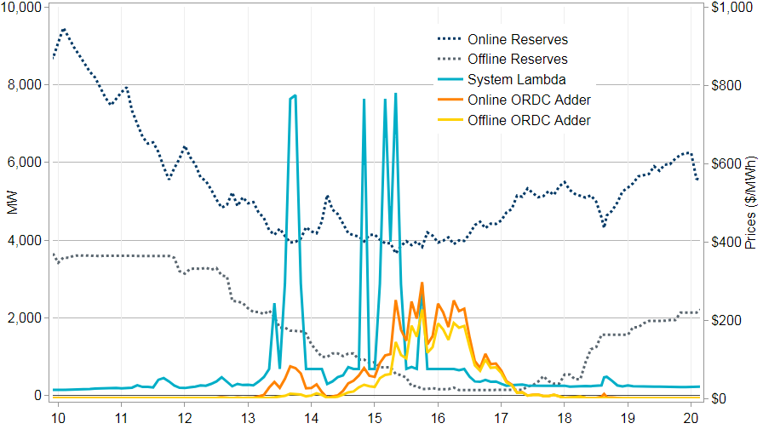
A Closer Look at August 9th, 2017
RTOLCAP
RTOFFCAP
System Lambda
RTORPA
RTOFFPA
MW
Prices ($/MWh)
Time

Slide 34
Historic Results – Reliability Deployment Price Adders

Slide 35
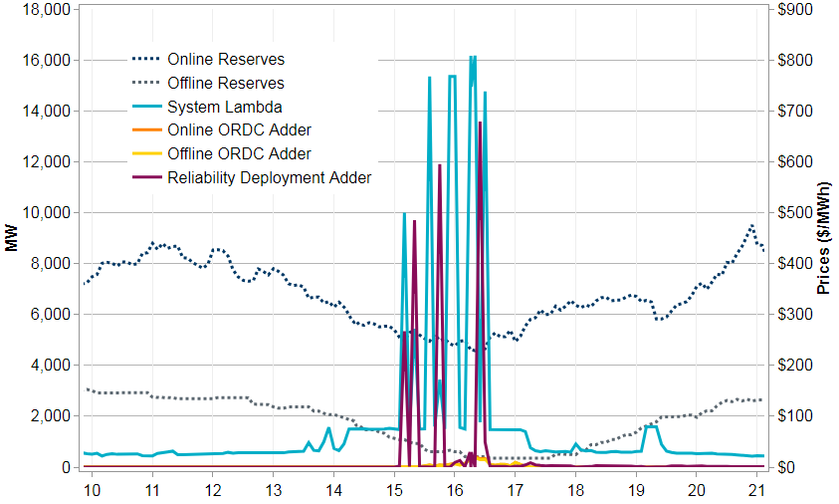
A Closer Look at October 4th, 2017
RTOLCAP
RTOFFCAP
System Lambda
RTORPA
RTOFFPA
RTORDPA
MW
Prices ($/MWh)
Time

Slide 36
Questions?
Describe how the operating reserve and reliability deployment prices adders are incorporated into real-time prices
Explain the purpose of the prices adders
Recognize system conditions under which there is a potential for non-zero price adders
Identify what the historical, typical prices adders have been

