Slide 1
QSE/Generator Hurricane Harvey
Kevin Matt
Operations Coordinator
NRG Texas Power

Slide 2
Objectives
  List preparation steps for approaching hurricane conditions
  Identify common events impacting system equipment, facilities, customers and topography
  Identify post hurricane activities to restore the system to steady-state operations
  Identify what notifications were made for Hurricane Harvey
  Identify which procedures were followed during Hurricane Harvey

Slide 3
Safety First
Safety always comes first!
  Personnel safety
  Security of family members
  Protection of equipment

Slide 4
Preparation Steps
Track weather closely
  Determine if storm is expected to impact your area.

Slide 5
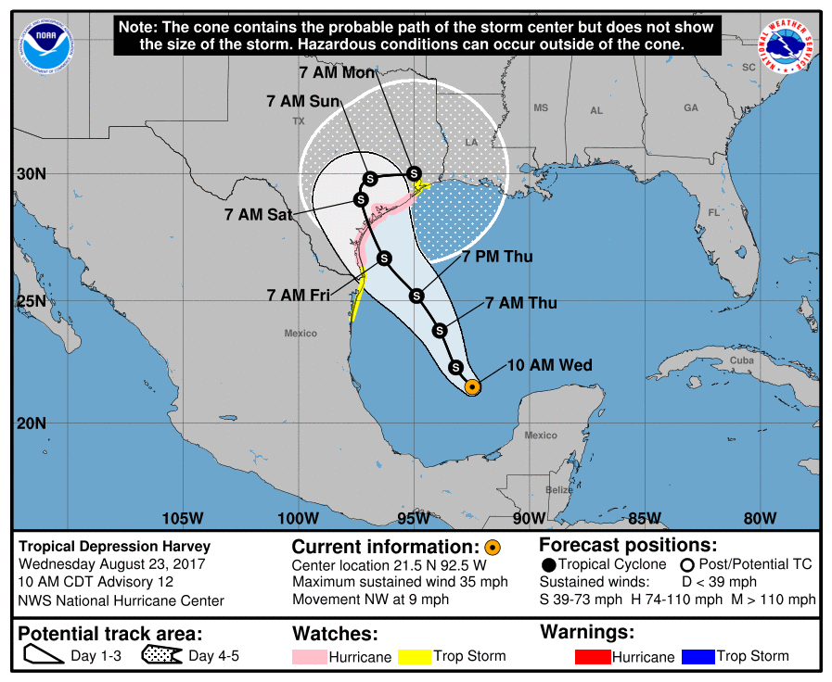
Harvey Forecast Track
Notes:
Forecast track indicated potential landfall near Houston area, with projected movement towards Houston after landfall. This was an earlier forecast prior to the storm stalling.

Slide 6
Preparation Steps-cont.
Activate Hurricane Emergency Operations Plan
  Establish Regional Hurricane Readiness Coordinator
  Begin hurricane readiness calls
  Test satellite phones
Activate QSE Hurricane Plan
  Develop Storm Rosters
  Procure Wireless Priority Service for cell phones
  Test QSE satellite phone
Activate individual Plant Hurricane Procedures
Activate Corporate Business Continuity Plan
Notes:
Regional Coordinator-NRG has non-ERCOT facilities on the gulf coast, therefore hurricane plans are inclusive of all gulf coast region plants.

Slide 7
Preparation Steps-cont.
Finalize decision on evacuation/activation of Backup Center- (QSE remained in normal control center)
Procure storm supplies
Secure equipment at plants in preparation of high winds
Ensure sufficient equipment and supplies ready at plants (Example: Hydrogen)
Notes:
Harvey was forecast as a flooding event. Had the storm been forecast as a wind event, NRG would have relocated to the backup center.

Slide 8
South Texas Project Nuclear Plant
Required to be shutdown 2 hours prior to the arrival of Hurricane Force winds.
Numerous calls and discussions between plant, meteorologists, senior management, ERCOT.
Plant did not see winds high enough to force a shutdown.
Nuclear unit shutdown requirements are mandated by the Nuclear Regulatory Commission and are established to ensure safe shutdown conditions of Nuclear Generators.

Slide 9
Issues
FLOODING!
  Wind damage to unit near Corpus Christi
  8/27-loss of simple cycle GT complex
  8/28 (morning) wet coal issues start
  8/28 (evening) 2 coal units forced out due to issues with wet coal/fuel delivery
  8/29 3 large units forced out due to rising water and potential site evacuation. (Site did not flood)

Slide 10
Actions during the event
Hurricane Readiness Coordinator conducted daily calls with all plants and QSE to provide updates on plant status.
QSE conducted daily calls during the event with all staff to ensure personnel and their families were safe.
Corporate Business Continuity team conducted calls with all business units and senior management.
The Market did not stop! QSE/Commercial Groups/Plant Operations all continued to operate the business.

Slide 11
Recovery Actions
Repairs to fuel handling equipment took approximately 2 days to complete
Coal units returned to service on 8/31 and 9/1.
Wet coal issues and unit limits continued until 9/6.
  Approximately 9 days total dealing with wet coal issues.
GT complex remains Forced Out due to flooding damage.

Slide 12
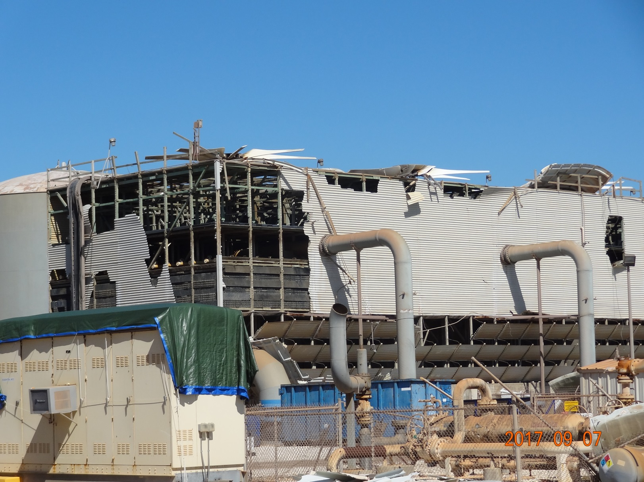
Pictures

Slide 13
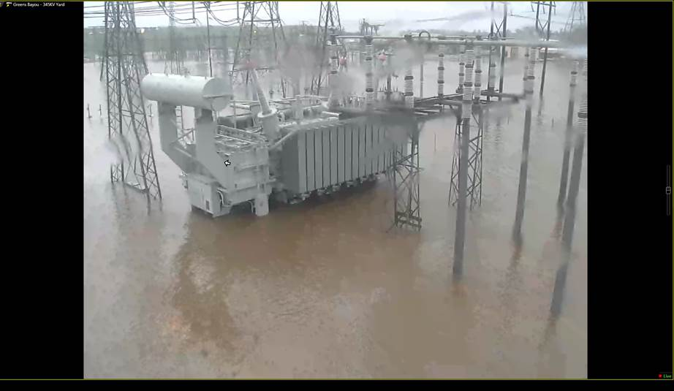
Pictures

Slide 14
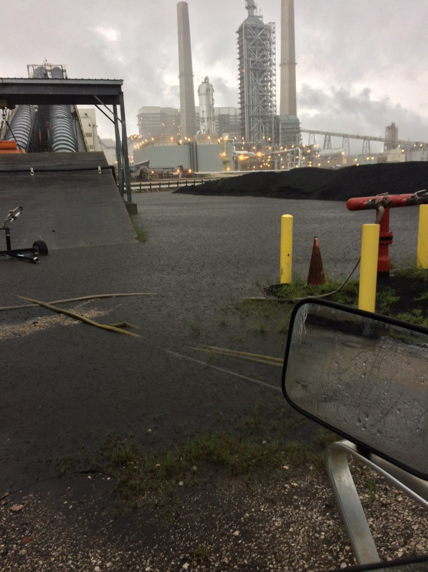
Pictures

Slide 15
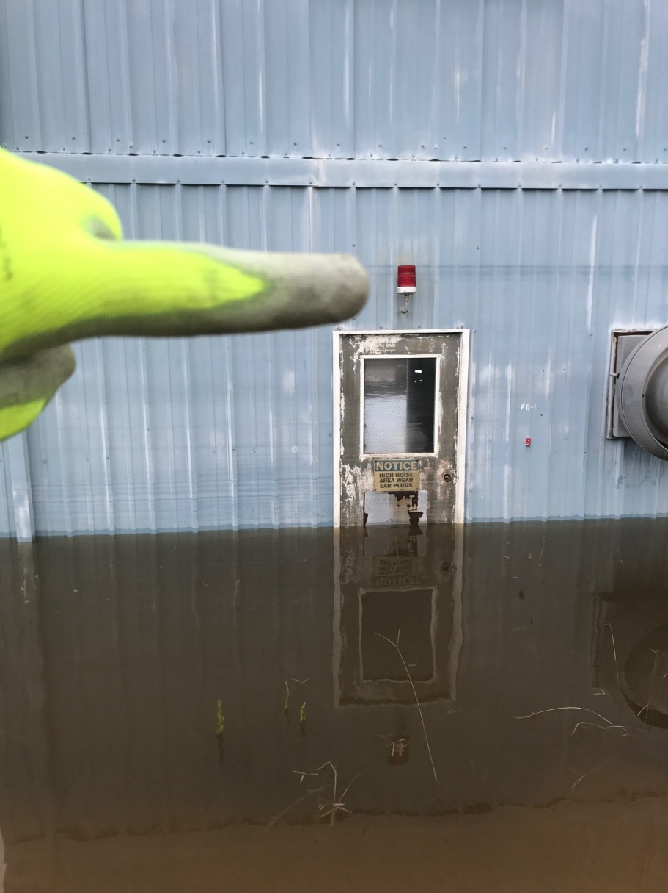
Pictures

Slide 16
Wrap-up
Expect the unexpected
You will have unplanned events occur during a major storm.
Safety of personnel is paramount
Ensure storm crews are notified early and well prepared.
Notes:
Natural gas leak at a business near our main building nearly forced us out of the building toward the end of the event. STP nearly shutdown not due to any plant issue, but due to flooding in Bay City that potentially limited access to the hospital, which is a Nuclear qualified medical facility.

Slide 17
Objectives
  List preparation steps for approaching hurricane conditions
  Identify common events impacting system equipment, facilities, customers and topography
  Identify post hurricane activities to restore the system to steady-state operations
  Identify what notifications were made for Hurricane Harvey
  Identify which procedures were followed during Hurricane Harvey

