Slide 1
Trends in Markets and Policy:
Texas and Beyond
Paul Wattles
Senior Analyst, Market Design & Development
Operator Training Seminar 2018

Slide 2
Objectives
Recall global renewable adoptions
Recognize the impacts of the declining cost of solar
Recognize the impacts of the declining cost of grid-scale wind energy
Recognize the characteristics of surging storage and EVs
Recognize the impacts of declining cost of storage
Identify the different metering options for premises with distributed generation (e.g., rooftop solar)
Recognize trends in electric vehicle adoptions
Recognize the impacts of Locational Marginal Prices compared to Load Zone prices for distributed generation

Slide 3
Policy impacts and the evolving grid
TOPICS:
Solar trends and policy issues
Tariffs on imported solar panels
Tax credits
Net metering and alternatives
FERC ‘Grid Resilience’ Rulemaking
ERCOT Market forces & trends
Storage and EV trends
Fast-acting storage in the ERCOT markets
Storage as a distribution system asset
DER market participation

Slide 4
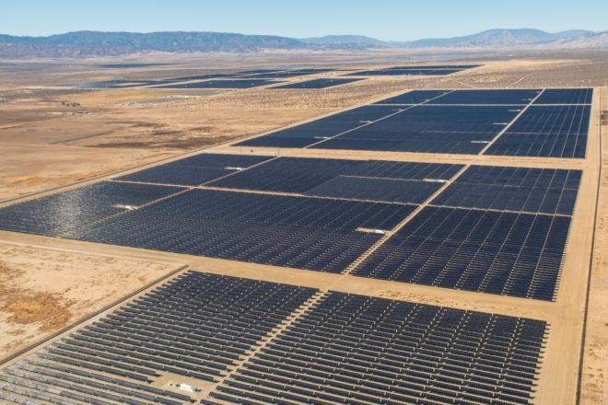
Solar

Slide 5
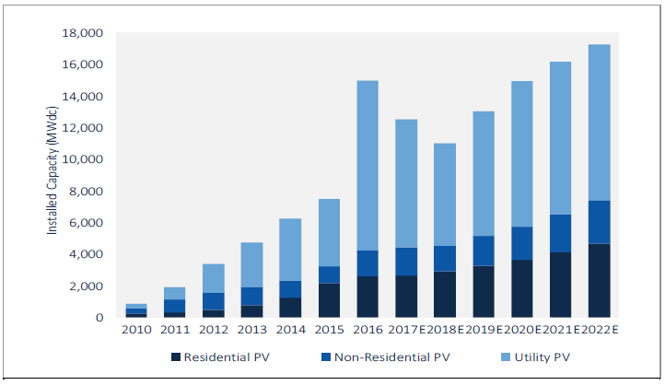
Solar history & projections
Source: GTM Research

Slide 6
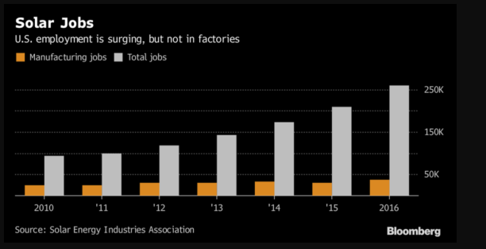
Solar job picture
In U.S., manufacturing jobs are far outweighed by other solar jobs
2016
2017
Source: Solar Foundation
GreenTech Media

Slide 7
Federal policy: The Suniva/SolarWorld Trade Case
Two domestic manufacturers of solar cells and modules – Suniva (bankrupt) and Solar World – filed a case with the U.S. International Trade Commission
The case sought to impose tariffs and a floor price on imported crystalline silicon photovoltaic cells and modules
Opposing comments were filed by numerous parties, including 27 solar mounting equipment manufacturers and their domestic suppliers
Commission recommendations then sent to President Trump, who ruled on the case on Jan. 22

Slide 8
Trade case recommendations & outcome
President Trump’s decision exempts the first 2.5 GW of imports from the tariffs
Also exempted: imports from numerous countries including India, Turkey, Brazil and South Africa – low-cost producers but with far less manufacturing capacity than China
----------------- Source: GTM Research -----------------
President Trump’s Decision | Y1 | Y2 | Y3 | Y4
Cell Quota Volume | 2.5 GW | 2.5 GW | 2.5 GW | 2.5 GW
Cell Tariffs below Quota | 0% | 0% | 0% | 0%
Cell Tariffs above Quota | 30% | 25% | 20% | 15%
Module Tariffs | 30% | 25% | 20% | 15%

Slide 9
Tariff impacts, reactions and predictions
GTM Research: U.S. solar market will see a net reduction in installations of around 11 percent as a result of the new tariffs.
A cumulative 61.3 GW of solar deployed 2018-2022 compared to an original projection of 68.9 GW
~65% of that loss demand is expected to come from the utility scale solar segment
The day Trump signed the proclamation, Texas-based solar module manufacturer Mission Solar Energy announced that it’s ramping up production to meet 2018 demand.
The company -- which had laid off workers in early 2017 -- is also hiring 50 new employees to shift production line operations to a 24/7 schedule, stating that this is just “the first phase in the plan for production increase.”

Slide 10
Tariff impacts, reactions and predictions (cont’d)
Solar Energy Industries Association:
The decision effectively will cause the loss of roughly 23,000 American jobs this year, including many in manufacturing, and it will result in the delay or cancellation of billions of dollars in solar investments.
Given how quickly the cost of solar is dropping, within a year or two we’ll have already caught up to the effect of the tariff. It maybe sets the industry back to 2016 or last year’s prices, but it’s not a huge setback. It’s more of a poke in the eye than a punch in the jaw. If you really wanted to stop solar, the tariff is really too little too late.
-- Joshua Rhodes, U.T. Energy Institute
GreenTech Media

Slide 11
Solar Futures: Tax credits
After an extension by Congress in 2015, solar projects continue to enjoy a 30% Federal Investment Tax Credit
But it doesn’t last forever…
In 2022, commercial credit goes to permanent 10%; residential credit to zero
Source: EnergySage.com

Slide 12
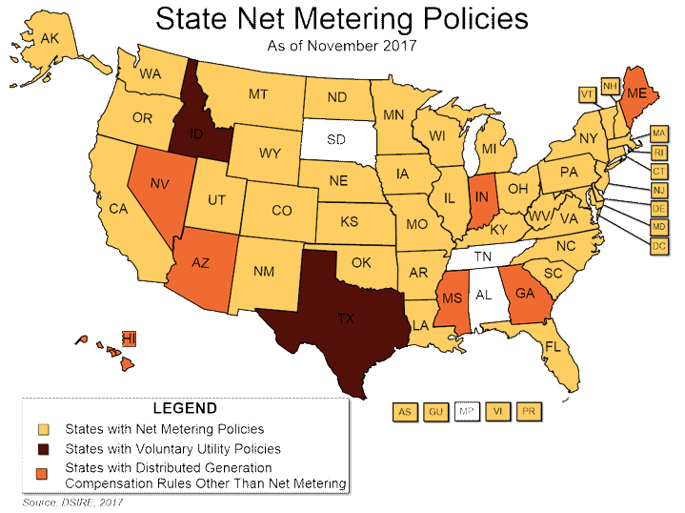
Net Metering
Net metering effectively compensates customers for their on-site generation at full retail rates
Since 2013, Hawaii, Arizona, Maine and Indiana have decided to phase out net metering, ‘crippling programs that spurred explosive growth in the rooftop solar market.’
New York Times, July 8, 2017
Source: NARUC
38 states, Washington, D.C., and four territories offer net metering, and some utilities in other states have voluntarily adopted net metering programs.
Seven states—Arizona, Georgia, Hawaii, Indiana, Nevada, Maine and Mississippi—have statewide distributed generation compensation rules other than net metering.
PUC rules for Retail Choice areas in Texas require bi-directional net metering (see next slides)

Slide 13
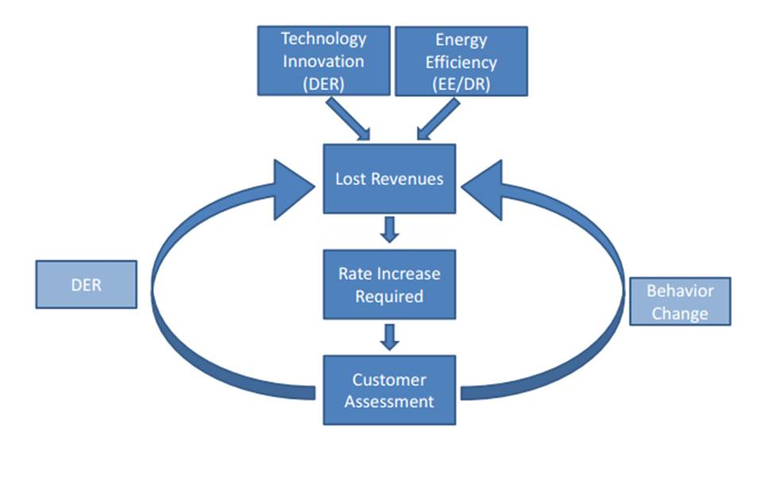
Impacts of solar DG on T&D rates
As solar costs decline, adoption rates accelerate
Net metering reduces customer’s Load, thus reducing energy and T&D costs
Overall system Load decreases, but utility must collect its rate of return on system investments
Rates go up
This further increases incentives for other customers to adopt solar
Burden of paying for the T&D system shifts disproportionately to non-solar customers
Source: EEI

Slide 14
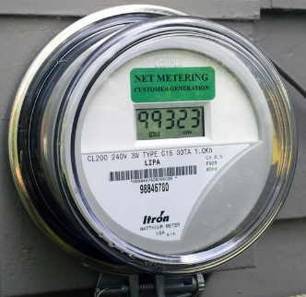
Metering Types
Type |  | Notes
Unidirectional | Measures consumption only | Load only (no DG)
‘Traditional’ Net metering | Single-channel non-directional. Single data point representing net Load minus net on-site generation over a billing period (could be a negative number). | Disallowed in ERCOT retail choice areas (PUC Rule §25.213)
Bi-directional | Two data points for each 15-minute interval: measures net in-flow to the point of delivery (i.e., may be reduced by on-site DG), and net exports to the grid from the point of delivery. | Required by PUC Rule for investor- owned TDSPs
Dual metering | Two meters, two data points for each 15-minute interval: Gross generation kWh can be added back to net Load to calculate gross consumption. | Allows DSP to bill customer based on gross consumption; allows LSE to pay customer for gross generation.

Slide 15
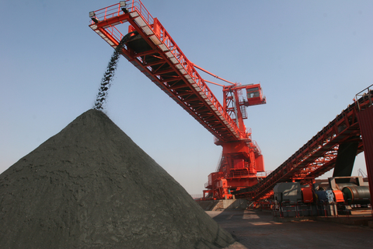
Baseload generation & grid resilience

Slide 16
Department of Energy study
Energy Secretary Rick Perry ordered staff to study impacts of Variable Renewable Energy on baseload generation retirements
‘The biggest contributor to coal and nuclear plant retirements has been the advantaged economics of natural gas-fired generation.
‘Another factor … is low growth in electricity demand.’
Staff Report to the Secretary of Energy on Electricity Markets and Reliability, August 2017
‘The state of reliability in North America remains strong, and the trend line shows continuing improvement year over year.’
-- Former NERC CEO Gerry Cauley, Summer 2017

Slide 17
Federal policy: The DOE NOPR at FERC
Following the release of the report, Secretary Perry initiated a Notice of Proposed Rulemaking (NOPR) at FERC to ‘ensure that certain reliability and resilience attributes of electric generation resources are fully valued.’
Rule proposed to single out the need for new pricing methods to deal with the ‘premature retirements of power plants that can withstand major fuel supply disruptions caused by natural or manmade disasters, and during those critical times, continue to provide electric energy, capacity, and essential grid reliability services.’
Proposed full cost recovery for merchant plants with 90 days of fuel on site (i.e., coal and nuclear)

Slide 18
DOE NOPR Comments
Over 1,500 comments filed
Opposing comments from numerous parties including:
American Petroleum Institute
Natural Gas Supply Assn.
Solar Energy Industries Assn.
Advanced Energy Economy
American Wind Energy Assn.
American Council on Renewable Energy
8 former FERC Commissioners
Attorneys General from 10 states
ISOs/RTOs
ERCOT abstained due to lack of FERC jurisdiction

Slide 19
DOE NOPR
On Jan. 8, FERC Commissioners unanimously rejected the DOE-proposed rule
Stated that DOE failed to provide evidence that retiring coal and nuclear plants represented an existential threat to grid reliability and ‘resilience’
‘While some commenters allege grid resilience or reliability issues due to potential retirements of particular resources, we find that these assertions do not demonstrate the unjustness or unreasonableness of the existing RTO/ISO tariffs.’
‘In addition, the extensive comments submitted by the RTOs/ISOs do not point to any past or planned generator retirements that may be a threat to grid resilience.’

Slide 20
FERC Grid Resilience Rulemaking
In the same order, FERC initiated a new NOPR: to ‘specifically evaluate the resilience of the bulk power system in the regions operated by RTOs and ISOs.’
Commission understands ‘resilience’ to mean: ‘The ability to withstand and reduce the magnitude and/or duration of disruptive events, which includes the capability to anticipate, absorb, adapt to, and/or rapidly recover from such an event.’
Comments from ISOs and RTOs due March 9, to be followed by public comment period
ERCOT and PUCT to file joint comments

Slide 21
ERCOT Market forces & trends

Slide 22
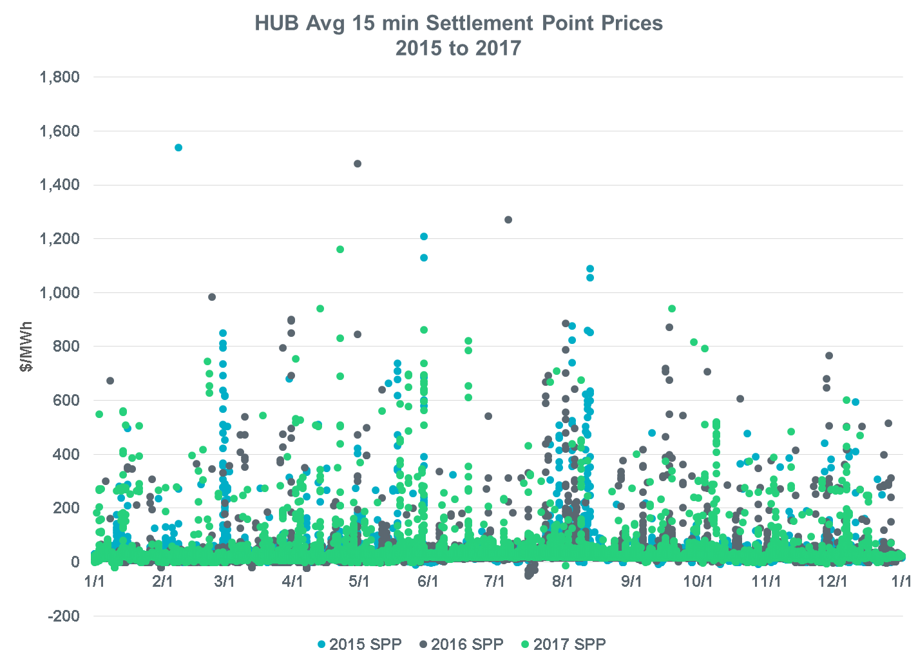
Real-Time Energy Prices
Intervals | 2015 | 2016 | 2017
<$0 | 238 | 569 | 235
$0-$30 | 31,287 | 31,562 | 30,568
>$30-$75 | 3,110 | 2,605 | 3,685
>$75 | 405 | 400 | 552
HUB Avg. 15-min. Settlement Point Prices 2015 - 2017
Prices exceeded $75/MWh in 0.013% of intervals over 3 years

Slide 23
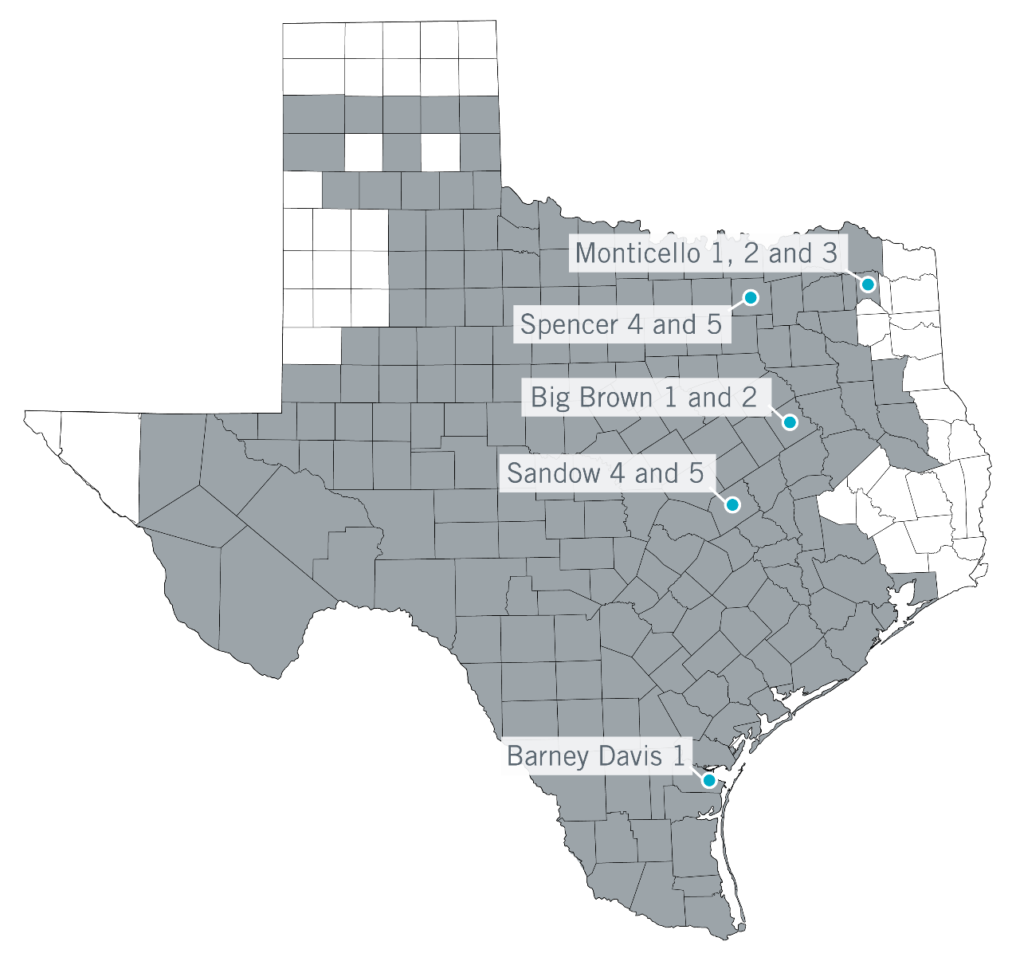
Unit Retirements
ERCOT studies determined that none of these units were needed for transmission system reliability.
Retirement Dates
Spencer, Jan. 3, 2018
118 MW gas generation
Began operating 1966, 1973
Monticello, Jan. 4, 2018
1,865 MW coal generation
Began operating 1974-78
Sandow, Jan. 11, 2018
1,200 MW coal generation
Began operating 1981, 2010
Big Brown, Feb. 12, 2018
1,208 MW coal generation
Began operating 1971, 1972
Mothball Status
Barney Davis, Dec. 31, 2017
300 MW gas generation
Began operating 1974
*Other mothballs excluded.
Total of 10 units with ~4,700 MW of capacity

Slide 24
ERCOT Installed Capacity (1999-2018E)
Wind and solar values are based on nameplate capacity (not adjusted for peak capacity contribution)
Private Use Network capacity not included
20.7%
0.3%
12.4%
51.6%
36.1%
4.8%
28.6%
16.8%

Slide 25
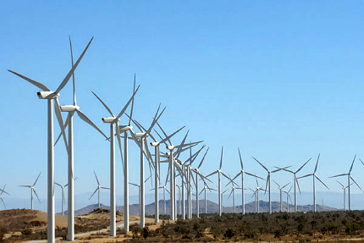
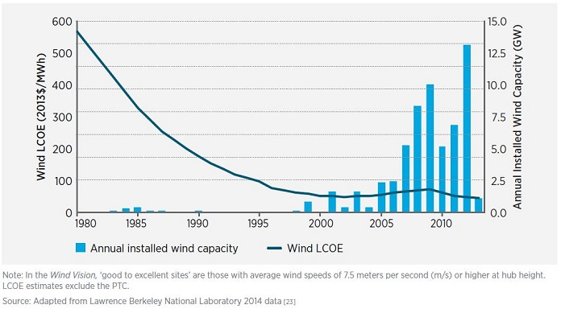
Cost of grid-scale wind
Source: AWEA and LBL
Wind Production Tax Credit (for first 10 years of operation):
$23/MWh if constructed prior to 1/1/17
$18.40/MWh if constructed during 2017
$13.80/MWh for 2018
$9.20/MWh for 2019

Slide 26
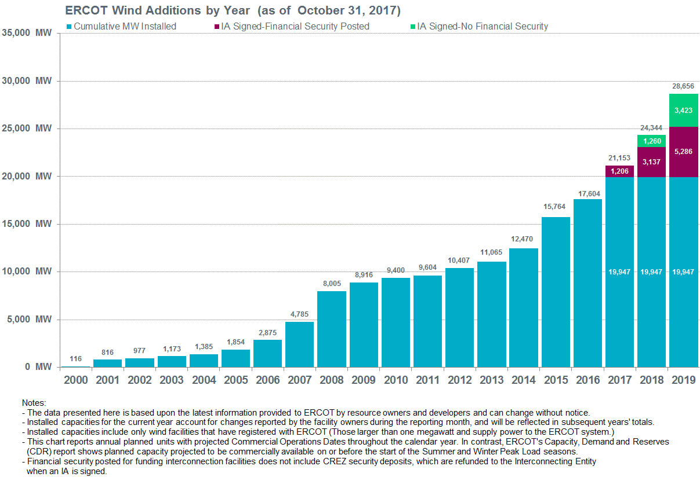
ERCOT Wind Generation Queue
SPACP | Summer | Winter
Non-Coastal | 14% | 20%
Coastal | 58% | 42%

Slide 27
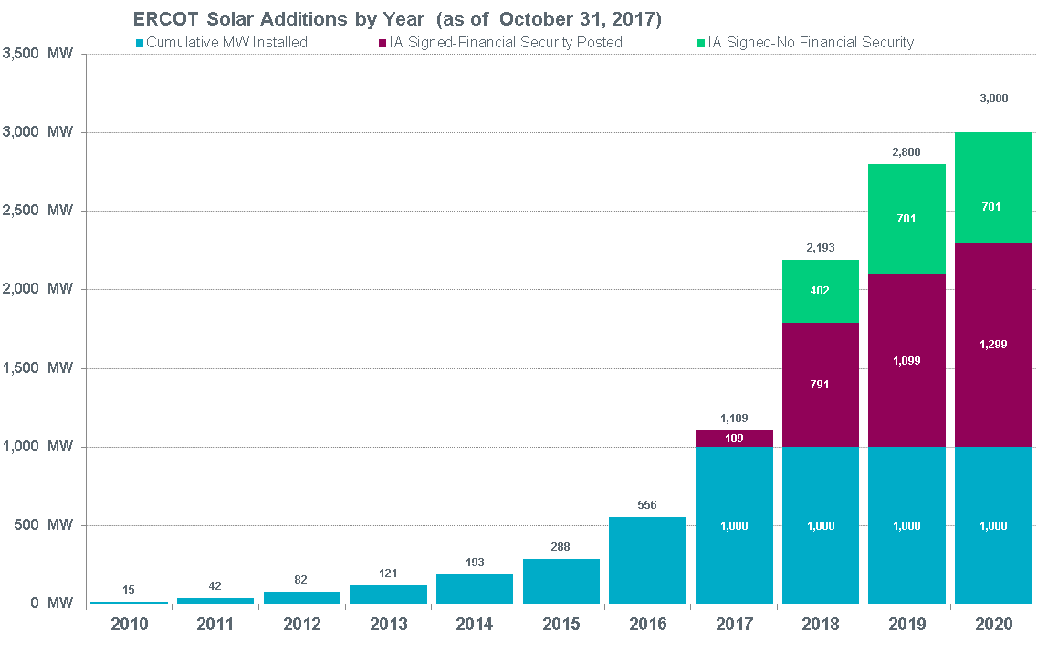
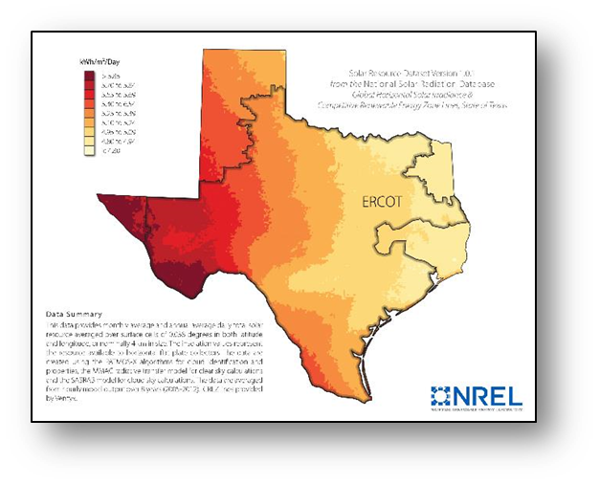
ERCOT Utility Scale Solar Generation Queue
SPACP | Summer | Winter
 | 77% | 10%

Slide 28
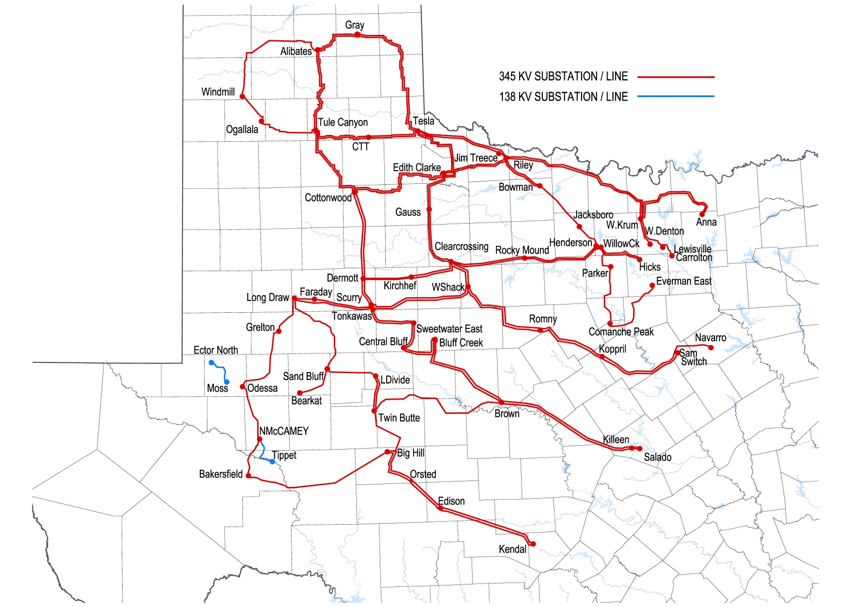
Competitive Renewable Energy Zone Transmission
As of January 30, 2014, the CREZ transmission projects were complete.
The transmission plan is designed to serve approximately 18.5 GW:
~3600 right-of-way miles of 345 kV
$6.9 billion project cost
Lines are open-access; use not limited to wind
Far West Texas project (non-CREZ, $336M)
Endorsed by ERCOT Board June 2017 Reliability project to serve growing oil field load
Expected in-service date of 2021 or 2022

Slide 29
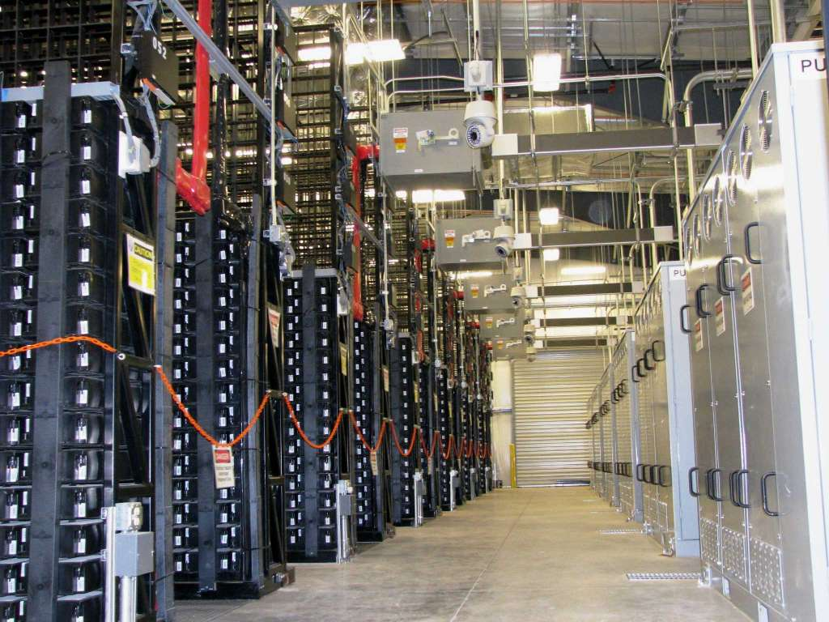
Storage

Slide 30
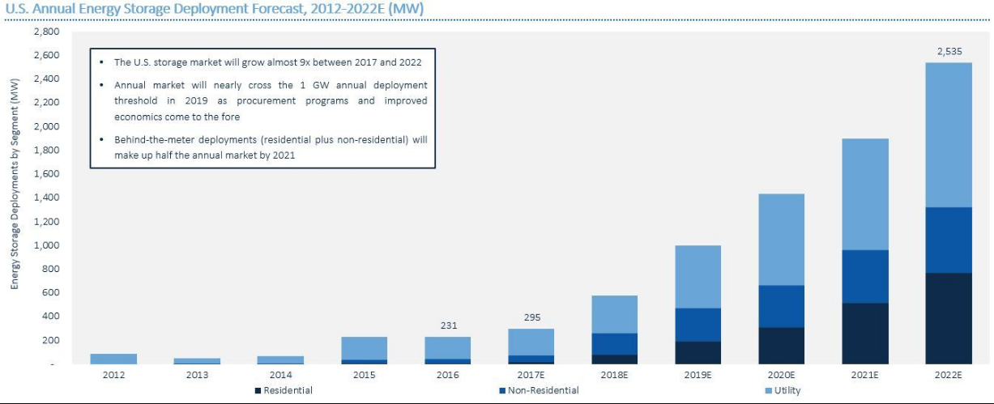
U.S. Annual Storage Deployment Forecast
The U.S. storage market will grow almost 9X between 2017 and 2022
Annual market will nearly cross the 1 GW annual deployment threshold in 2019 as procurement programs and improved economics come to the fore
Behind-the-meter deployments (residential and non-residential) will make up half the annual market by 2021
Source: GTM Research

Slide 31
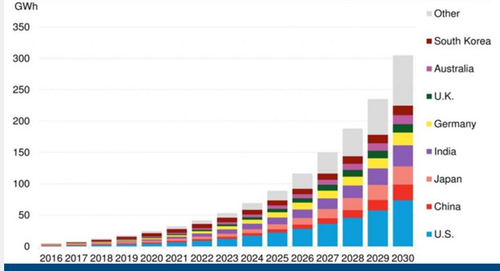
Global Storage Outlook
Bloomberg New Energy Finance predicts 305 GWh of Energy Storage online worldwide by 2030
Overall funding for storage rose from $540 million in 2016 to $890 million last year.

Slide 32
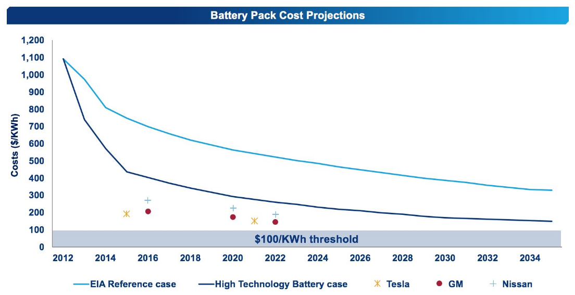
A ‘Moore’s Law’ for battery storage
2012 cost projections for 2030 have already happened
Moore's law is the observation that the number of transistors in a dense integrated circuit doubles approximately every two years. The observation is named after Gordon Moore, the co-founder of Fairchild Semiconductor and Intel.
Sources: Wood Mackenzie, EIA, battery manufacturers

Slide 33
AEP Storage Docket (46368)
In Sept. 2016, AEP Texas North applied to the PUC for approval to install utility-scale batteries in two small West Texas communities served by radial feeders
Argued that storage provided more economical option than upgrading or rebuilding substations (~$2.3M vs. ~$8M)
Energy would be treated as Unaccounted For Energy in ERCOT Settlements (non-market with uplifted costs)
Application met with opposition from a broad coalition of market participants
Rate-based vs. merchant generation
State Office of Administrative Hearings’ concluded that PUC has jurisdictional authority and recommended approval of the AEP application

Slide 34
AEP Storage Docket (46368)
On Jan. 25, PUC dismissed the proceeding without prejudice
At Chairman DeAnn Walker’s urging, the commission then opened a rulemaking
‘…to take a wider view of the innovative concepts raised in this docket as well as other potential technological solutions’
‘AEP has proposed an innovative solution to serve their distribution customers with a battery storage option that potentially could be implemented at a lesser cost to the ratepayers than traditional transmission and distribution options’
‘In the changing environment in which we live, there are new technologies that could hold significant promise to serve Texas customers more reliably and efficiently’

Slide 35
Electric vehicles (storage)
2006 documentary film explores the creation, limited commercialization, and subsequent destruction of the battery electric vehicle in the United States, specifically the General Motors EV1 of the mid-1990s. The film explores the roles of automobile manufacturers, the oil industry, the federal government of the United States, the California government, batteries, hydrogen vehicles, and consumers in limiting the development and adoption of this technology.
-- Wikipedia

Slide 36
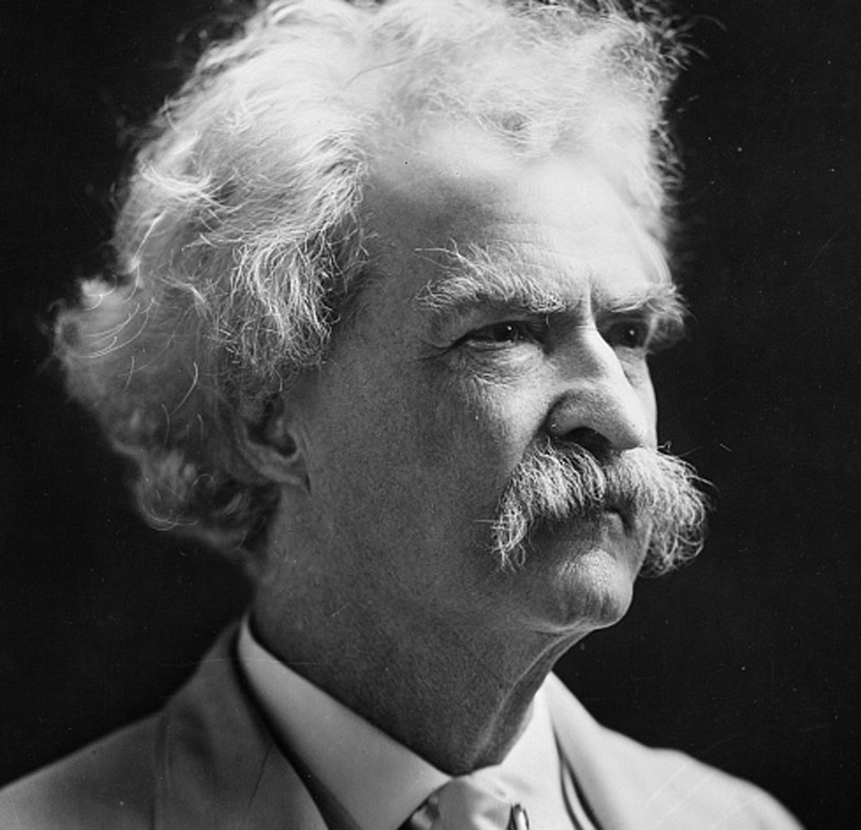
‘The reports of my death are greatly exaggerated.’
Mark Twain

Slide 37
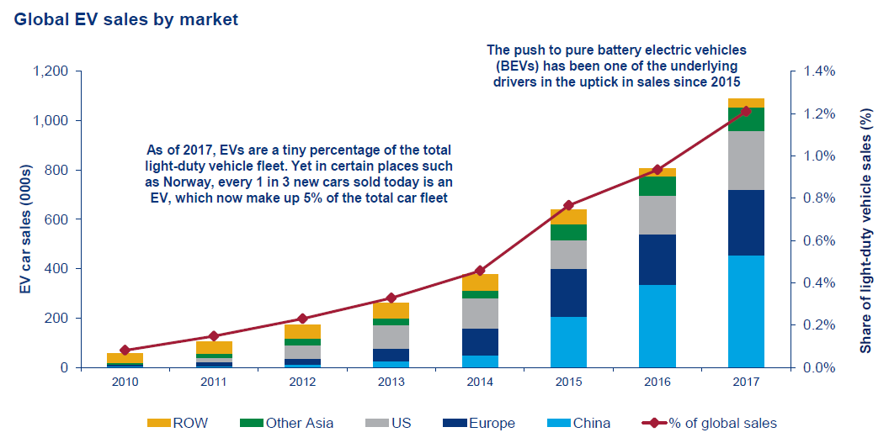
Electric vehicle adoption trends
Source: Wood Mackenzie
Over 2 million EVs on the world’s roads today

Slide 38
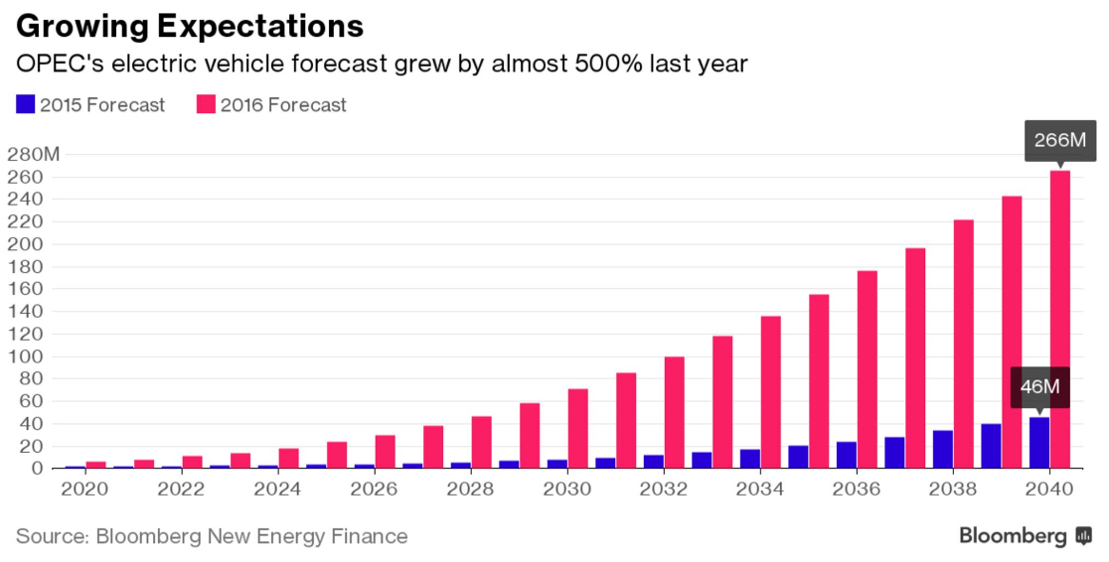
Oil industry tracking & projecting EV growth
EV adoption forecast from the Organization of Petroleum Exporting Countries
Current OPEC Members:
Algeria, Angola, Ecuador, Equatorial Guinea, Gabon, Iran, Iraq, Kuwait, Libya, Nigeria, Qatar, Saudi Arabia, United Arab Emirates, Venezuela
Projection for 2040 increased 484% in one year

Slide 39
Electric vehicles and wholesale markets
‘Cashback will save owners money on their total energy bills’
‘Will cost less than a conventional gasoline car in 3 years or less of ownership’
-- Former FERC Chair Jon Wellinghoff, Feb. 2009

Slide 40
‘It’s tough making predictions, especially about the future.’
Yogi Berra

Slide 41
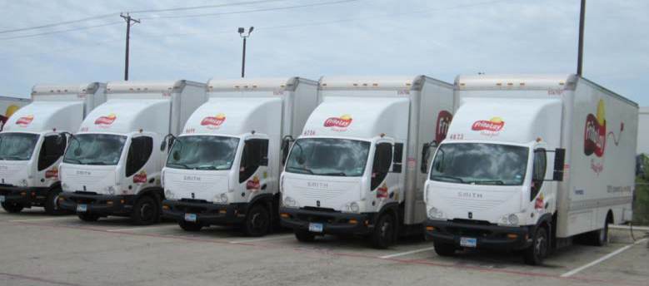
Electric vehicles and ERCOT Ancillary Services
The Frito Lay experience 2014:
12 electric trucks at single point of interconnection simplified telemetry & metering
Control hardware & software enabled participation in ERCOT Fast Responding Regulation Service
Receive ERCOT Load Frequency Control signals to move in either direction within a prescribed bandwidth
Automatic full response within 1 second if frequency reaches pre-defined levels
≥10 trucks online to reach 100 kW minimum offer
Resource qualified and performed, but project team withdrew from market due to economics

Slide 42
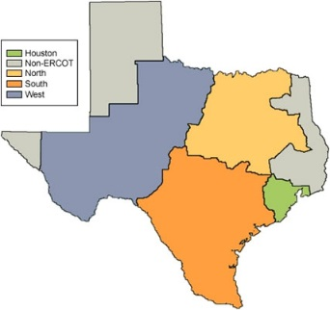
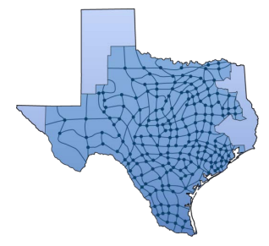
The DER market conundrum
Distributed Generation is still paid Load Zone prices in ERCOT
Zonal prices can dilute local incentives for DG to contribute to congestion management
See Rio Grande Valley example 10/8/14 (next slide)
After making the investment to bring the efficiency of Locational Marginal Pricing to the market – will we be retreating from the Nodal concept if we continue to pay DG at Zonal?
ERCOT has proposed a market framework for DERs to be settled at local (Nodal) pricing
-- Either via self-dispatch or ERCOT dispatch
-- See August 2015 DER white paper

Slide 43
Zonal vs. Nodal prices: Rio Grande Valley, Oct. 8, 2014
Concurrent outages of a major import transmission line and a large generation unit
ERCOT requested 200 MW of firm load shed (rolling outages) to maintain reliability
DG units in the constrained area saw only Zonal prices
Prices behind the constraint
South Load Zone prices

Slide 44
LMPs for DERs
If DERs could be settled on more granular pricing, then self-dispatched response would better align with grid conditions
Higher local prices indicate local scarcity – signaling DERs to chase these prices if they are capable of doing so
Ensuring correct nodal price will require a DG unit to be mapped to its appropriate Common Information Model Load on the Transmission grid
ERCOT systems are already producing 5-minute LMPs for ~4,000 CIM Loads
ERCOT is proposing mapping for Registered DG units
DG is required to register with ERCOT if >1MW and injects to the grid
Mapping process discussed in next OTS presentation

Slide 45
Disclaimer
Many of the graphics in this slide deck are the intellectual property of other organizations, and are used with their permission
They should not be used elsewhere without the permission of the originating organization
Graphics created by ERCOT and derived from ERCOT data are public and may be used with attribution

Slide 46
Objectives
Recall Global renewable adoptions
Recognize the impacts of the declining cost of solar
Recognize the impacts of the declining cost of grid-scale wind energy
Recognize the characteristics of Surging storage and EVs
Recognize the impacts of declining cost of storage
Identify the different metering options for premises with distributed generation (e.g., rooftop solar)
Recognize trends in electric vehicle adoptions
Recognize the impacts of Locational Marginal Prices compared to Load Zone prices for distributed generation

Slide 47
Questions?
‘We note that distribution outages cause customers to lose power 100 times more often than do generation resource shortages.’
--ERCOT Resource Adequacy Review, Brattle Group, 2012

