Slide 1
“Working Together to Ensure Reliability”
Hurricane Harvey from an ERCOT Perspective
Jimmy Hartmann
Sr. Manager, System Operations
Aaron Ballew
Transmission Operations Manager
Jerry Gaddy
Resource Operations Manager
2018 ERCOT Operations Training Seminar

Slide 2
Objectives
  Identify the two ERCOT departments who advised the Transmission Operators to restore Transmission Equipment
  List the four types of notifications ERCOT issued for Hurricane Harvey
  Identify the region in Texas that ERCOT had gas supply concerns
  Identify two major Impacts to the ERCOT electric grid caused by Hurricane Harvey

Slide 3
Objectives continued
  Identify which ERCOT Desk(s) issued the Emergency Notice for Hurricane Harvey.
  Identify the procedure the ERCOT Operator uses to determine when to issue an Emergency Notice.
  Identify a weather service ERCOT used during Hurricane Harvey

Slide 4
System Conditions prior to Hurricane Harvey
Before the event, local agencies and authorities had advised residents in the Corpus Christi and surrounding areas to evacuate the region due to anticipated severe weather. Flooding in areas along the coast were expected and the storm surge was predicted to be upwards of fifteen feet.
On Wednesday August 23, 2017 at 08:00, ERCOT Outage Coordination and ERCOT System Operations advised the TOs to restore any transmission equipment on planned maintenance, and to withdraw any new planned transmission outages in the South Texas area.
ERCOT contacted the Transmission Control Center Managers at BPUB, AEP, STEC, CenterPoint, and TNMP. Discussed the potential storm impacts and requested that all outages that could be restored be put back into service prior to any impacts of the potential Hurricane.
ERCOT System Operators then provided advanced notifications to market participants regarding Hurricane Harvey.

Slide 5
Gas Supply Concerns
On Thursday August 24, 2017 at 16:00, ERCOT had a phone call with gas pipeline companies serving the coast and Lower Rio Grande Valley (RGV) generation facilities to determine potential impact on gas supply to those facilities.
The gas companies indicated the potential for gas curtailments due to compressor stations and gas processing facility being shut down due to the evacuations near Corpus Christi.
One gas pipeline carrier reported it was blending raw gas to avoid curtailments and that allowed continued gas delivery to generators in the RGV.

Slide 6
Preparation for the Storm
ERCOT Disaster Management representatives (DMT) were logged in and monitoring National Weather Service briefings. System Operations representatives were on WeatherSentry briefings. We then worked together in order to determine the differences between the forecasts to assess the risk in the ERCOT region.
At a minimum, ERCOT System Operations held daily internal briefings at 8 am and 5 pm meetings. Coordinated communication regarding storm weather updates between shifts, operations staff, and management staff.
ERCOT was also in contact with SPP and MISO Reliability Coordinators prior to the event. No assistance or BLTs were needed during the events.

Slide 7
Need for Additional Staffing
ERCOT brought additional staff on site for 24-hour on-site support to the control room over the weekend. The staff included:
  Operations Support
  EMMS Production Support
  Advanced Network Applications (ANA)
  Facilities
  The on-site support began Friday afternoon and additional Outage Coordination staff was also on-site during the weekend daytime hours.
ERCOT staffed both its primary and alternate control centers during the storm. While ERCOT normally staffs the alternate control center with one System Operator at all times, an additional Real Time/DC Tie operator was on-site at the alternate site (Bastrop Control Room) on 8/26/17 and 8/27/17 due to the potential for flooding.

Slide 8
ERCOT Notifications
On Wednesday August 23, 2017 at 10:30, ERCOT System Operations issued an Operating Condition Notice (OCN) for Tropical Storm Harvey to all QSEs and TOs with instructions to evaluate fuel supplies and to review outages and emergency procedures.
On Thursday August 24, 2017 at 07:50, ERCOT System Operations issued an Advisory for Tropical Storm Harvey to all QSEs and TOs with repeating previous instructions and providing additional instructions regarding communications.
On Thursday August 24, 2017 at 11:00, ERCOT System Operations issued a Watch for Hurricane Harvey to all QSEs and TOs with additional instructions to prepare for anticipated system conditions and keep ERCOT notified of actual and anticipated resource conditions.

Slide 9
ERCOT Notifications continued
On Friday August 25, 2017 at 17:00, ERCOT System Operations issued an Emergency Notice for Hurricane Harvey to all QSEs and TOs with additional instructions to prepare for anticipated system conditions and keep ERCOT notified of actual and anticipated resource conditions.
On Wednesday August 30, 2017 at 12:00 ERCOT issued an OCN for unplanned transmission outages that may impact reliability.

Slide 10
Transmission and Security Desk Operating Procedure
7.1 (Subsection - Emergency Notice)
When Hurricane / Tropical Storm is in the ERCOT Region and is beginning to have an adverse impact on the System, the ERCOT Operator will issue an Emergency Notice

Slide 11
Emergency Notice Continued TO Script #75
T#75 Emergency for Hurricane / Tropical Storm:
“This call requires everyone to remain on the line until it is complete. [TO] I will be asking you for the repeat back. This is ERCOT operator [first and last name]. At [xx:xx], ERCOT is issuing an Emergency Notice due to [Tropical Storm/Hurricane Name] having an adverse impact on the ERCOT System [specify condition]. TOs are instructed to:
Be prepared to lose load and expect high voltage conditions
Keep ERCOT informed of any issues
ERCOT will continue to monitor the Storm. [TO] please repeat this back to me.”
If repeat back is CORRECT, “That is correct, thank you.”
If INCORRECT, repeat the process until the repeat back is correct.
http://www.ercot.com/content/wcm/key_documents_lists/90055/Scripts.docx

Slide 12
Real-time Desk Operating Procedure
5.0 (Subsection - Emergency Notice)
When Hurricane / Tropical Storm is in the ERCOT Region and is beginning to have an adverse impact on the System, the ERCOT Operator will issue an Emergency Notice

Slide 13
Emergency Notice Continued QSE Script #61
Q#61 Emergency Notice for Hurricane/Tropical Storm:
“This call requires everyone to remain on the line until it is complete. [QSE] I will be asking you for the repeat back. This is ERCOT Operator [first and last name]. At [xx:xx], ERCOT is issuing an Emergency Notice due to [Tropical Storm/Hurricane Name] having an adverse impact on the ERCOT System [specify condition]. QSEs are instructed to:
Be prepared to reduce Generator output due to anticipated load loss and respond to voltage support issues as requested,
Keep COPs and HSLs current.
ERCOT will continue to monitor [Tropical Storm/Hurricane Name]. [QSE] please repeat this back to me.”
If repeat back is CORRECT, “That is correct, thank you.”
If INCORRECT, repeat the process until the repeat back is correct.
http://www.ercot.com/content/wcm/key_documents_lists/90055/Scripts.docx

Slide 14
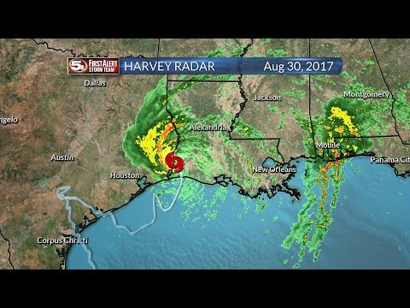
Harvey Animated
https://youtu.be/P1dh-I1_ye8
Notes:
(Double-Click the video)Predicting the storm path for Hurricane Harvey proved to be very difficult. Throughout much of the storm, the weather models used by ERCOT staff predicted varying outcomes as to the strength and path of the storm. The following are a series of Youtube videos that illustrate the weather forecast models, as the storm moved towards landfall. For nearly the entirety of the storm, once it reached the Western Gulf of Mexico, the various weather models could not agree with the expected movement of the hurricane. The one piece of the models that were in agreement was that the storm would stall out somewhere north of the Corpus Christi area for a day or so, before moving on.
Additionally, comparing the potential track areas from the National Hurricane Center, the tracks were not consistent. As of 10 AM on August 25th, the prediction was that Harvey would move east towards Louisiana, but by 4 AM on August 26th, the prediction had Harvey potentially moving further west, possibly over the Texas Hill Country. The 4 AM update on August 27th then changed the model back towards Louisiana, possibly moving off shore and rebuilding first. After the 4 AM update the storm future tracks began to be more consistent, moving the remnants of Harvey north and east; by then significant damage and flooding had already been recognized along the coastal region of Texas.

Slide 15
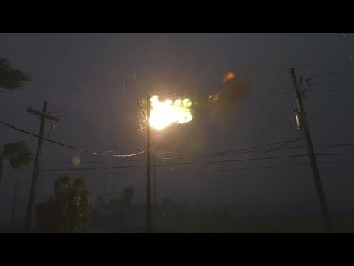
Major Impacts Storm Surge, Flooding and Wind
https://youtu.be/go-rFTzX6LU
Notes:
Rockport, Texas storm surge and powerlines exploding

Slide 16
Major Impacts due to Hurricane Harvey
Major hurricane force winds inflicted significant damage across Aransas County. Nearly every structure in Port Aransas, Rockport, and Fulton was damaged. Significant structural damage due to the winds were reported at Port Lavaca, Copano Village, and Ingleside.
The highest storm surge was recorded at the Aransas Wildlife Refuge, where a 12ft surge was reported. Port Lavaca’s storm surge topped 10 feet.
Major flooding occurred in the Houston area as a recorded 51.88 inches of rain occurred on Cedar Bayou near Highlands, Texas.

Slide 17
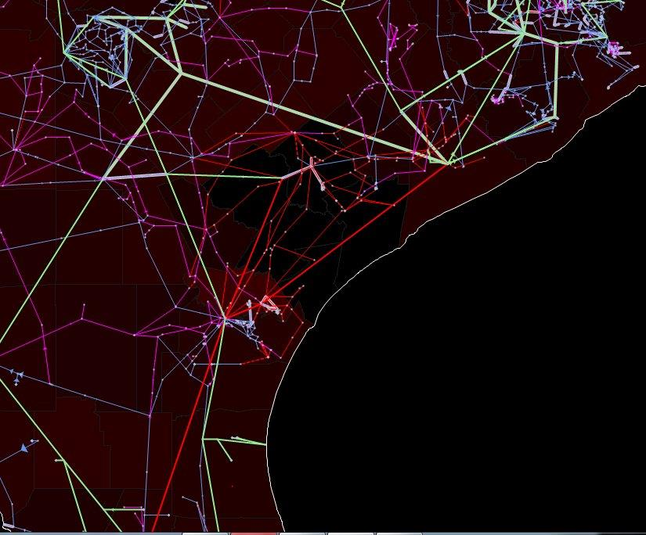
Hurricane Harvey Impact
San Antonio
Houston ↑
Corpus Christi
8/26/17 08:00
Notes:
Here is a snapshot of the ERCOT Macomber Map on the morning of 8/26/17

Slide 18
AEP Photos
STP-White Point 345kV
Tatton 69kV Substation

Slide 19
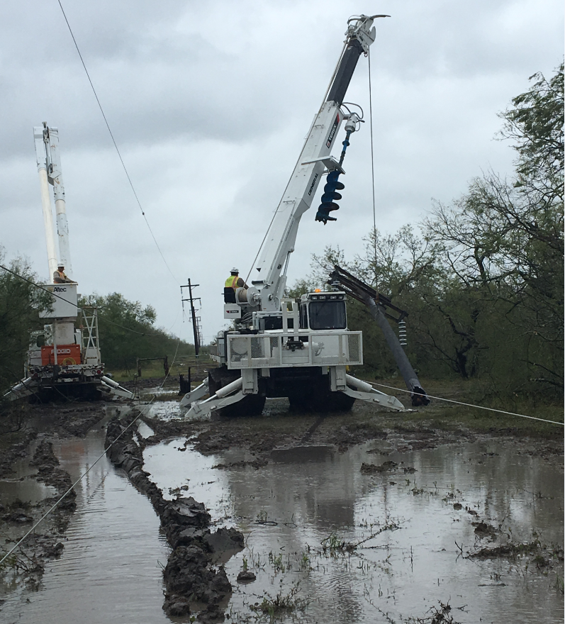
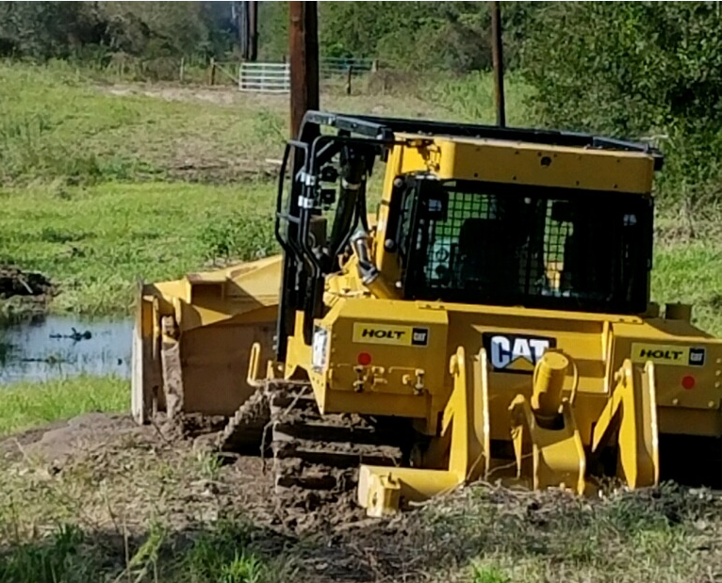

STEC Photos

Slide 20
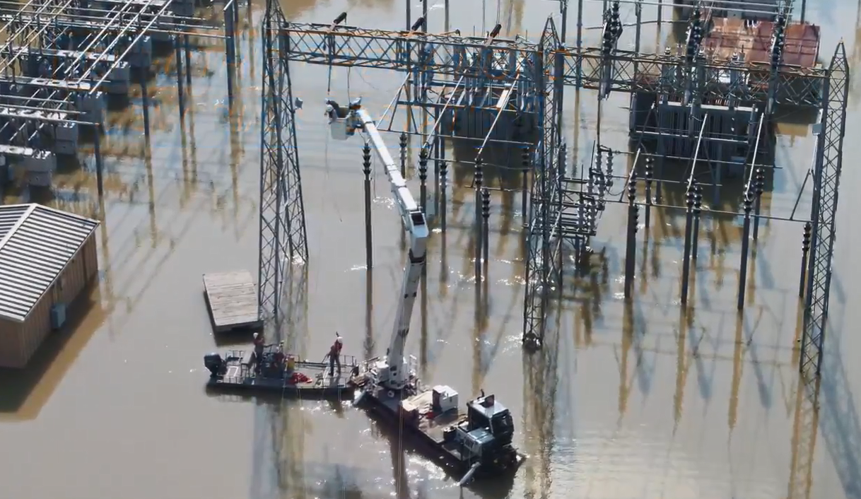
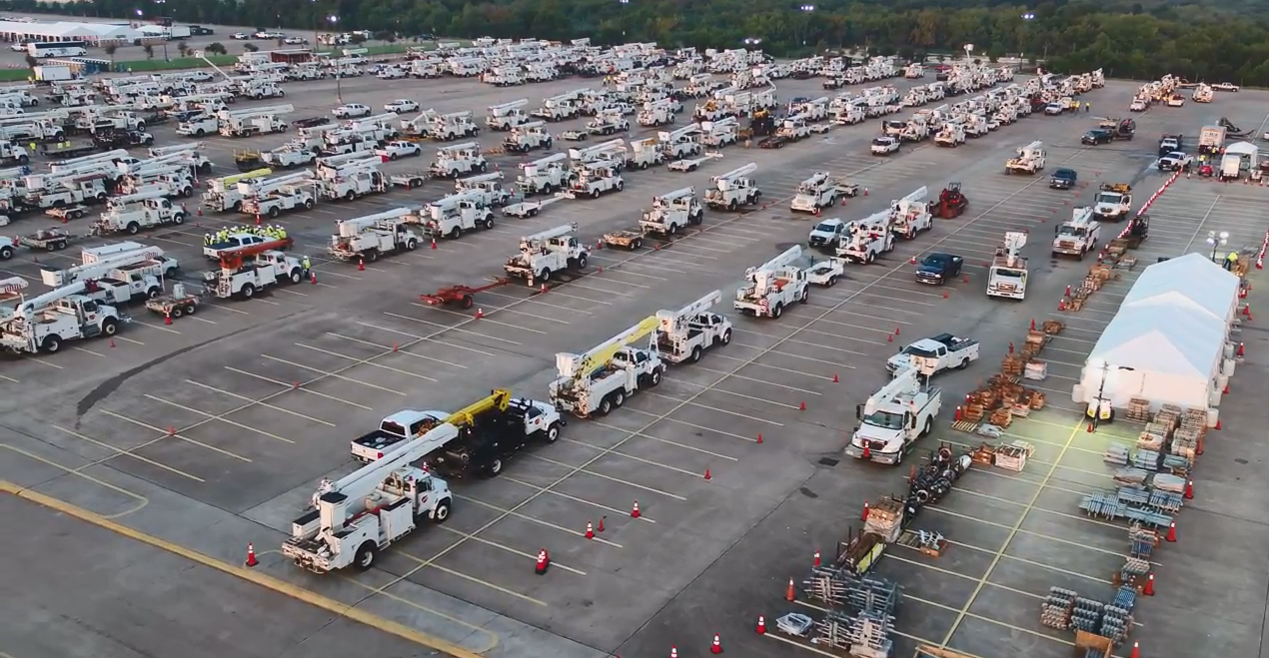
CNP Photos

Slide 21
Weather Data Information
ERCOT utilized WeatherSentry, local and national televised weather channels. Websites for National Hurricane Center (NHC), Intellicast, and National Oceanic and Atmospheric Administration (NOAA).
ERCOT’s Senior Meteorologist (Chris Coleman) also utilized computer models supplied from a weather vendor, The Weather Company/WSI, as well as models he has available; in addition to his personal forecast experience and discussions with fellow meteorologists in Houston.

Slide 22
Storm Impacts
Hurricane Harvey was a devastating storm that caused extensive damage to the bulk power system.
The ERCOT system responded very well considering:
  Loss of 10,992 MWs of ERCOT Generation (1196 MWs were Private Use Network (PUN) Generation)
  225 transmission lines
    7 – 345kV
    99 – 138kV
    119 – 69kV
  588 transmission level modeled loads
  Outages to over 1.67 million customers.

Slide 23
Reliability
ERCOT did not experience challenges associated with BPS transmission thermal issues outside of typical real-time and post-contingency issues.
Two Reliability Unit Commitments (RUC) during Hurricane Harvey.
  A forced outage on the Lon Hill – North Edinburg 345kV line prompted a RUC instruction for Duke generation in the Rio Grande Valley until the line was restored.
  Coleto Creek was instructed to remain online to provide generation to the local area in support of expected load restoration efforts in the Victoria area.

Slide 24
Recovery
In the Corpus Christi, Port Aransas, and Victoria areas, hurricane force winds and tornados damaged over 800 transmission line structures.
ERCOT System Operations, Transmission Operators and State Government officials held several conference calls on priority loads such as hydrogen gas facilities near the Gregory/Portland and Victoria areas and also the refineries in the Corpus Christi area.
ERCOT and the Transmission Operators worked to prioritize the restoration of critical transmission facilities.

Slide 25
Recovery
We also had some of the Generator Operators that evacuated the Corpus Christi area to the Houston area due to the projected landfall.
When the Generator Operators tried to return to their facilities to access the damages they ended up stranded in the Houston area due to the flooding.
The lost load coupled with the reduced amount of load due to the continued rain and lower temperatures allowed for load and reserves to be met with sufficient remaining capacity.

Slide 26
Conclusion
ERCOT Market Participants worked diligently to restore Transmission and Generation capacity as Hurricane Harvey moved out of the ERCOT region.
ERCOT and its Market Participants are “Working together to ensure Reliability”.

Slide 27
Objectives
  Identify the two ERCOT departments who advised the Transmission Operators to restore Transmission Equipment
  List the four types of notifications ERCOT issued for Hurricane Harvey
  Identify the region in Texas that ERCOT had gas supply concerns
  Identify two major Impacts to the ERCOT electric grid caused by Hurricane Harvey

Slide 28
Objectives continued
  Identify which ERCOT Desk(s) issued the Emergency Notice for Hurricane Harvey.
  Identify the procedure the ERCOT Operator uses to determine when to issue an Emergency Notice.
  Identify a weather service ERCOT used during Hurricane Harvey

Slide 29
Thank You
Questions?

