Slide 1

Hurricane Harvey
AEP
2018

Slide 2
Hurricane Harvey 8-26-17

Slide 3
Objectives
List preparation steps for approaching hurricane conditions
Identify common events impacting system equipment, facilities, customers and topography
Identify post hurricane activities to restore the system to steady-state operations
Identify what notifications were made for Hurricane Harvey
Identify which procedures were followed during Hurricane Harvey

Slide 4
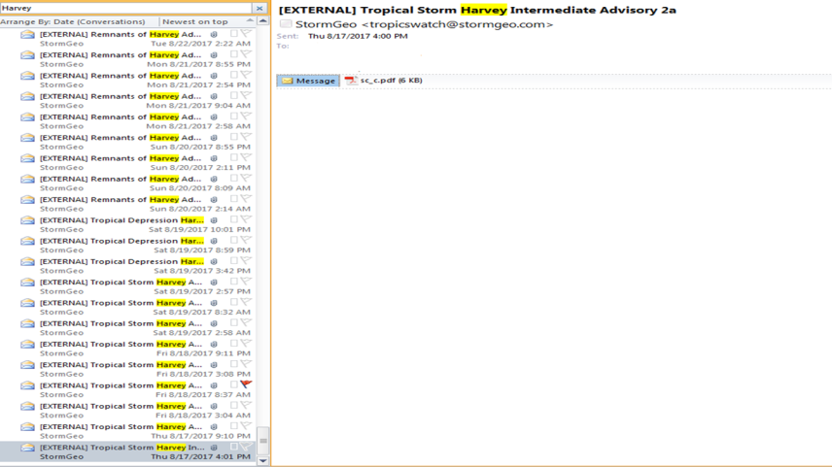

Preparation steps for approaching Hurricane conditions

Slide 5
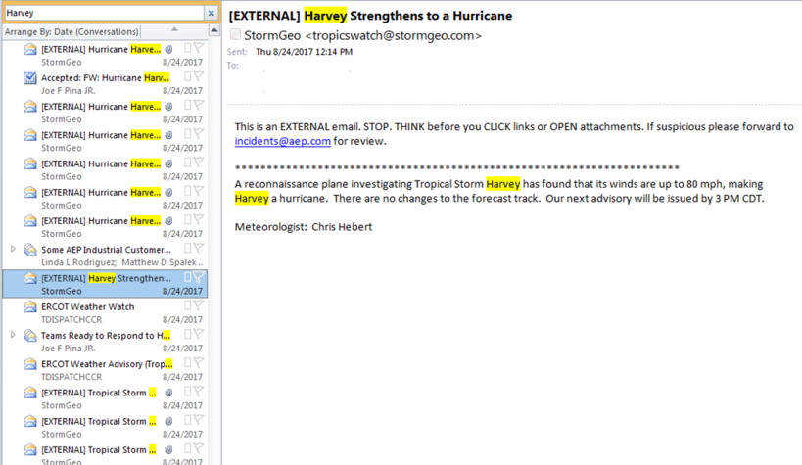

Preparation steps for approaching Hurricane conditions

Slide 6
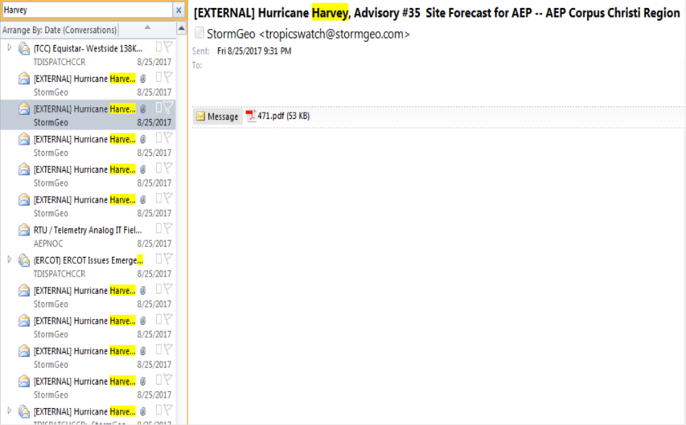

Preparation steps for approaching Hurricane conditions
Notes:
Outlook email notifications starting as Tropical Storm

Slide 7
Preparation steps for approaching Hurricane conditions
Track Storm
Determine manpower requirements
Locate Resources (materials & equipment)
Identify staging Areas
Implement ICS- Incident Command System

Slide 8
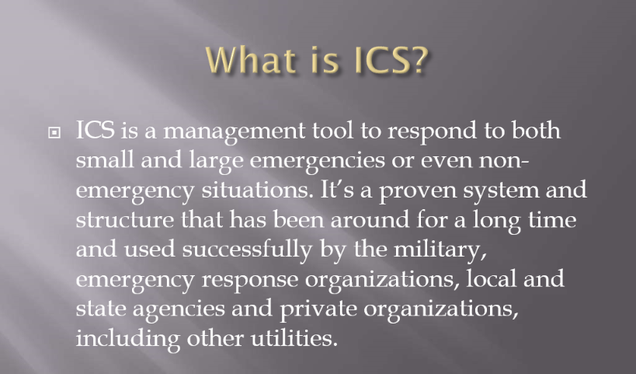
Preparation steps for approaching Hurricane conditions

Slide 9
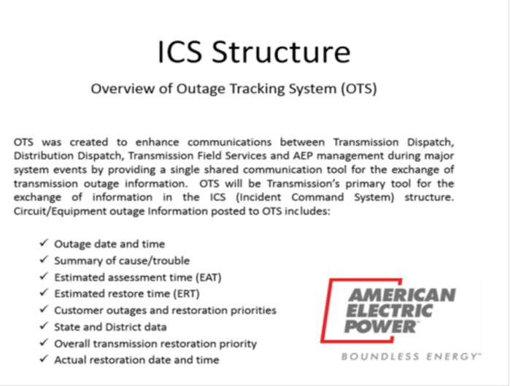
Preparation steps for approaching Hurricane conditions

Slide 10
Common events impacting system equipment, facilities, customers and topography
Category 4 hurricane made landfall in the Coastal Bend area of the AEP Texas service territory on August 25th
At peak, 220,000 outages
  Restored power to 96% by day 14
Tremendous support from community leaders and the public in the impacted areas
Collaborative efforts with other Texas utilities, ERCOT and Regional Mutual Assistance Groups

Slide 11
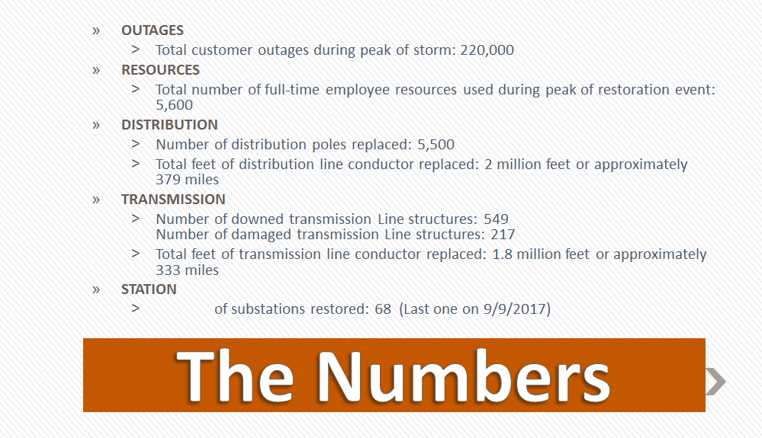
Post Hurricane activities to restore the system to steady-state operations

Slide 12
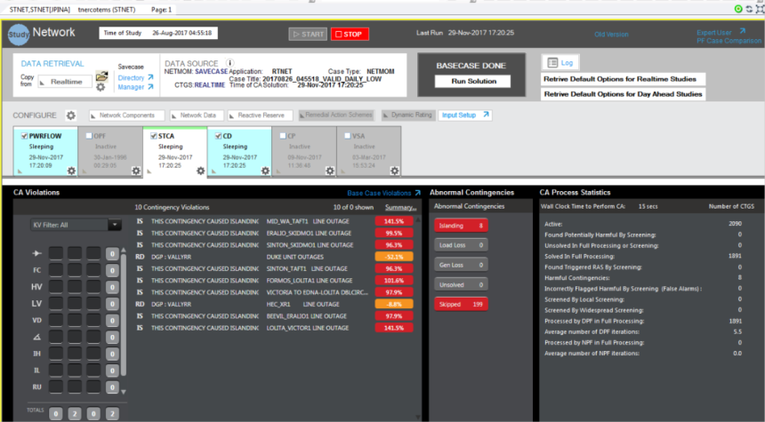
Post Hurricane activities to restore the system to steady-state operations
Notes:
One of AEP’s tools used to flag Thermal Contingency’s and Voltage violations during restoration.

Slide 13
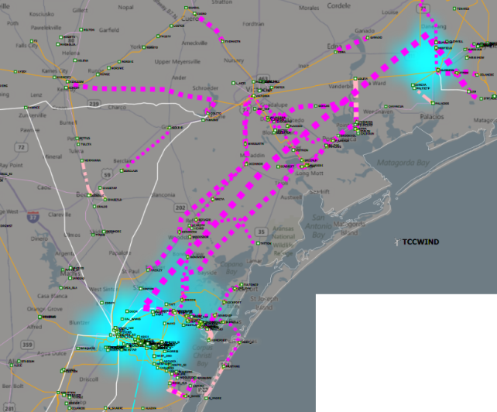
Post Hurricane activities to restore the system to steady-state operations

Slide 14
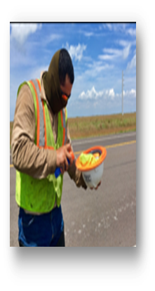
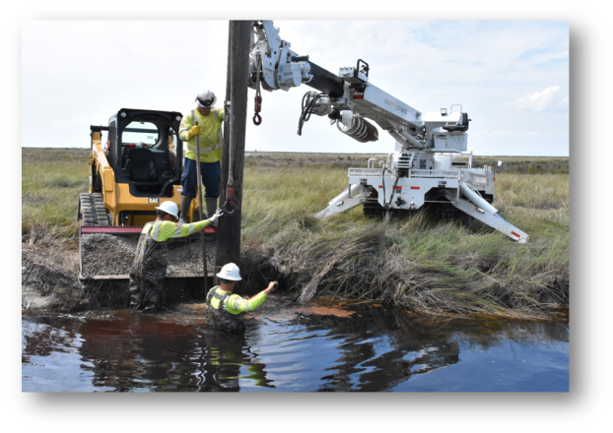
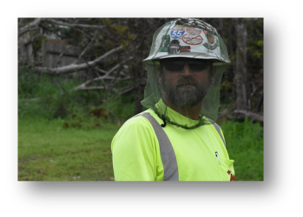
Post Hurricane activities to restore the system to steady-state operations
Notes:
CHALLENGES
Flooding, mosquitos, as well as windy and muddy conditions created special challenges for work crews.

Slide 15
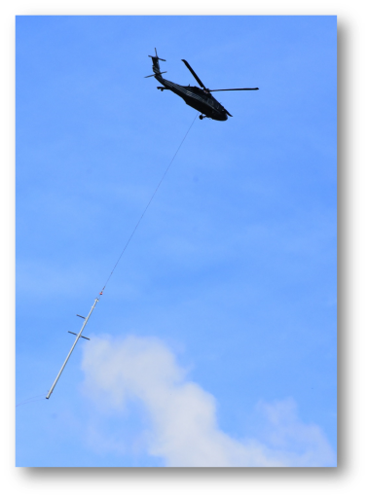
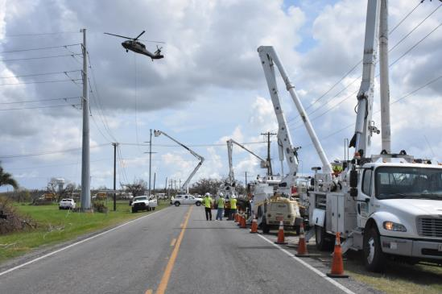
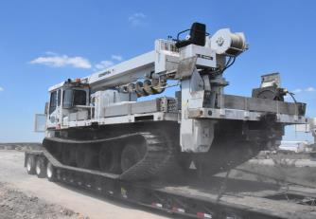
Post Hurricane activities to restore the system to steady-state operations
Notes:
To address these challenges, specialized equipment and technology, such as drones, ATVs, and helicopters were utilized during the assessment and restoration efforts.

Slide 16
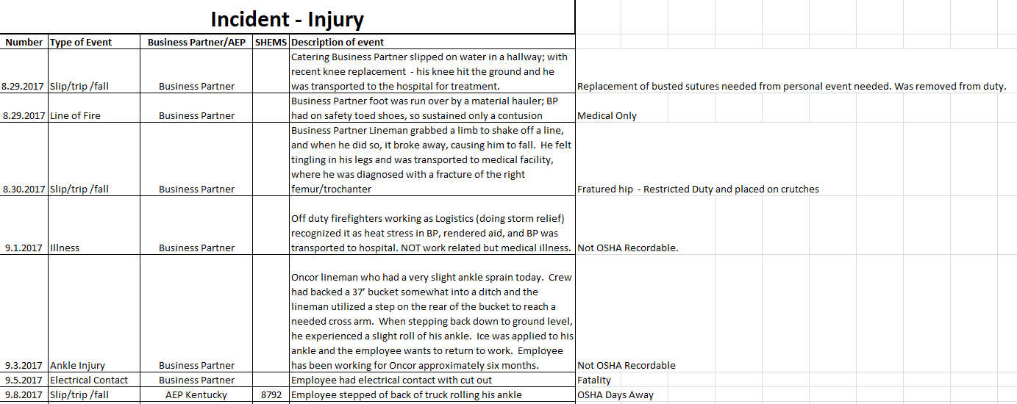

Post Hurricane activities to restore the system to steady-state operations

Slide 17
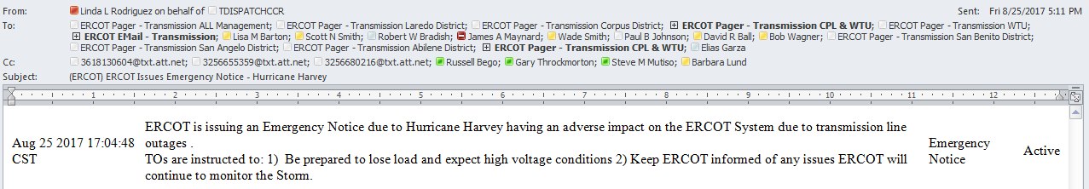
Internal Notifications made for Hurricane Harvey

Slide 18
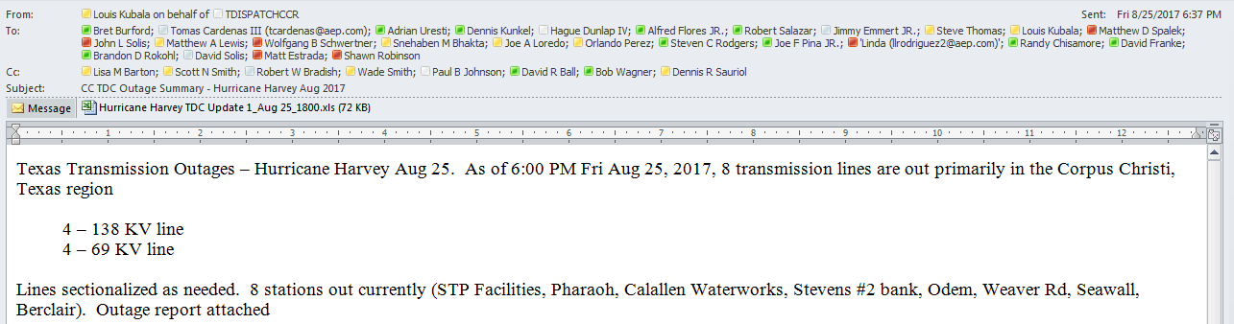
Internal Notifications made for Hurricane Harvey

Slide 19
External Notifications made for
Hurricane Harvey
Communication with ERCOT (RFI, Outages, Restoration, O.S.)
Communication with Neighboring TO’s (LCRA, STEC, CPS, Centerpoint) on restoration efforts
DOE – Loss of electric service to more than 50,000 customers for 1 hour or more
Governors office

Slide 20
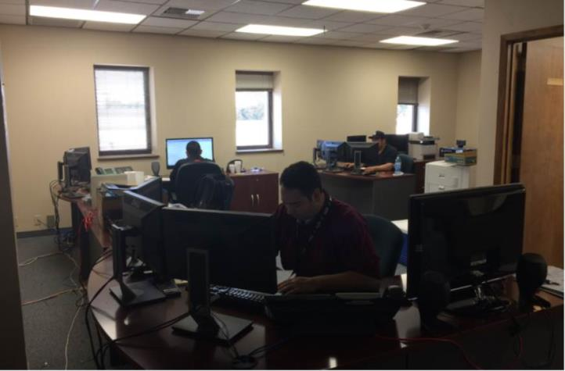
Procedures followed during Hurricane Harvey
Notes:
Dispatchers were sent to Alternate Center to dispatch all non-storm planned work. Phones from CC TDC were switched over to this location for all of AEP Northern region in addition to other areas.

Slide 21
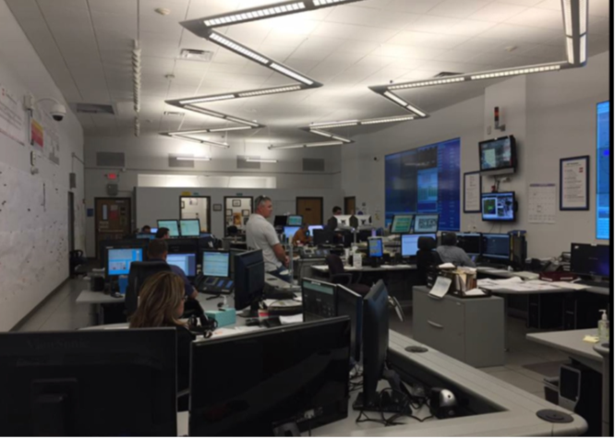
Procedures followed during Hurricane Harvey
Notes:
All desks were utilized during the storm taking calls, logging operations, writing switching, sending notifications and Dispatching restoration instructions.

Slide 22
Procedures followed during Hurricane Harvey
First Major Event for AEP w/ICS Activated
  Advantages
    Scalable
    Easy to interface with other agencies
    Specific Job Responsibilities
    Specific Chain of Command
  Challenges
    First real test on large event
    Hard to break old habits
    Stretched resources

Slide 23
Procedures followed during Hurricane Harvey
Lessons Learned
Damage assessment hampered in several areas
  Slow movement of storm
  Flooding
  Visit by POTUS
  Large amount of debris on the road
  Impact to Industrials has several levels
  Availability of Nitrogen
  Other needs
  Stock feeds (pumping stations)
  Delivery of product
  Water for process

Slide 24
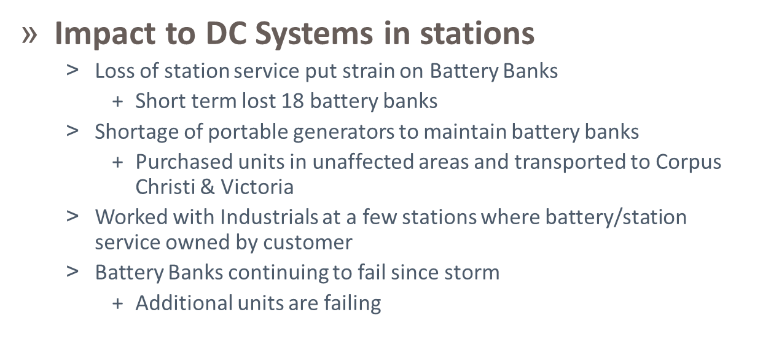
Procedures followed during Hurricane Harvey
Lessons Learned

Slide 25
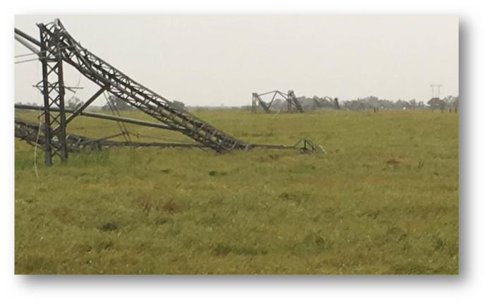
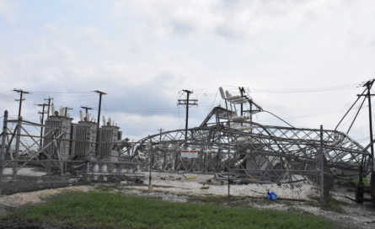
Transmission Damage

Slide 26
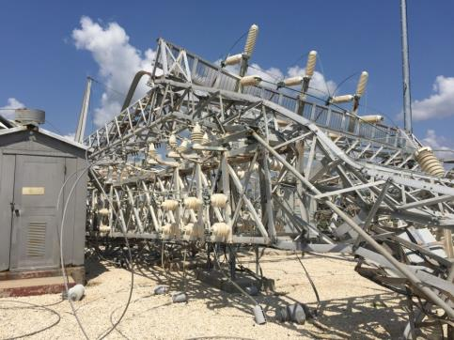
Substation Damage

Slide 27
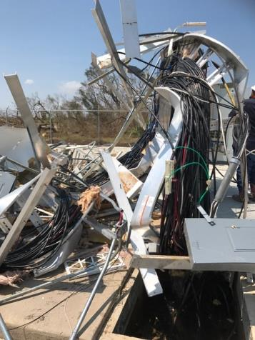
Substation Damage

Slide 28
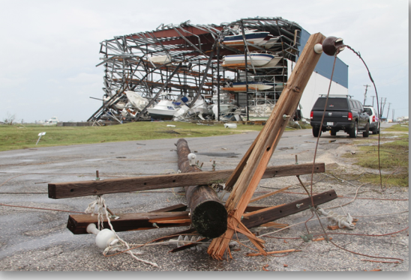
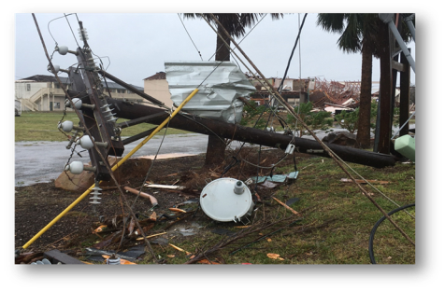
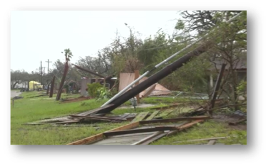
Distribution Damage

Slide 29
Other Participants in the Restoration Effort

Slide 30
SUMMARY
List preparation steps for approaching hurricane conditions
Identify common events impacting system equipment, facilities, customers and topography
Identify post hurricane activities to restore the system to steady-state operations
Identify what notifications were made for Hurricane Harvey
Identify which procedures were followed during Hurricane Harvey

Slide 31

Q & A

