Slide 1
HURRICANE HARVEY –
CenterPoint (CNP) Perspective
Tamme R. Chilton
Manager, Real Time Operations Grid Training
03/01/2018

Slide 2
https://www.youtube.com/embed/L7nOG7vmx4U?rel=0&amp;showinfo=0

Slide 3
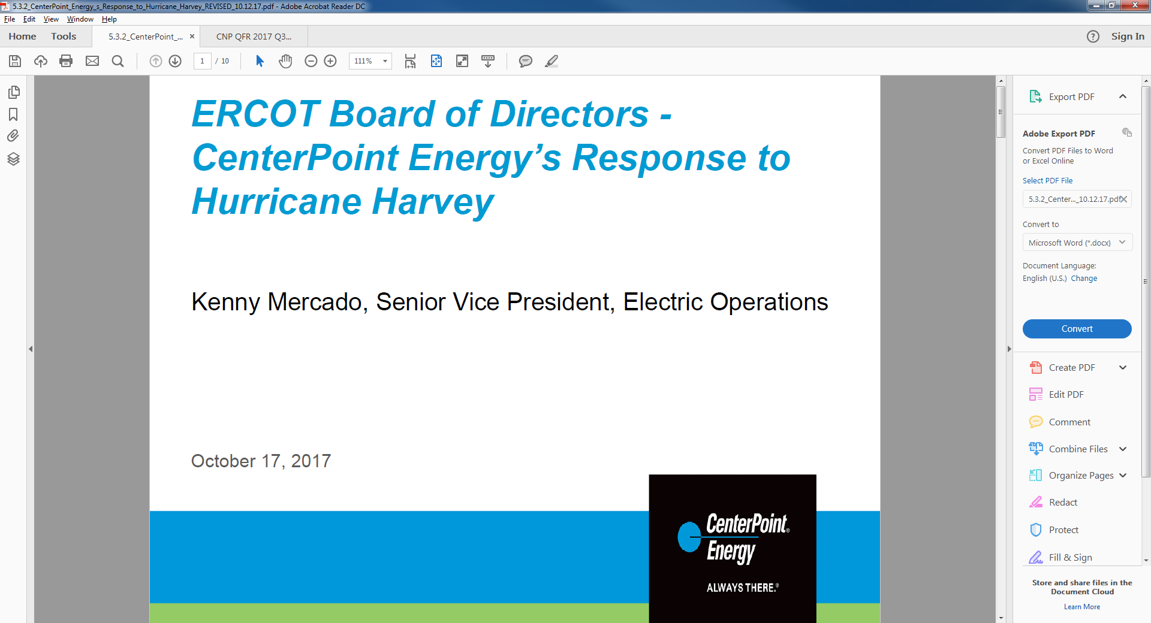
OBJECTIVES
List preparation steps for approaching hurricane conditions
Identify common events impacting system equipment, facilities, customers and topography
Identify post-hurricane activities to restore the system to steady-state operations
Identify what notifications were made for Hurricane Harvey
Identify which procedures were followed during Hurricane Harvey

Slide 4
Prep Steps
Declare Alert Levels for CNP System conditions & events
  Level 1 probable future event which may have minimal effects on the CNP Transmission System
  Level 2 existing event which has, or will, cause abnormal effects on the CNP Transmission System
  Level 3 existing event which has, or will, greatly impact the CNP Transmission System
Make notifications
  Other CNP departments
  External parties (ERCOT, adjacent TOs, etc.)

Slide 5
Prep Steps
Implement CNP/RTO Emergency Operating Plans
  Staff additional key personnel accountable for monitoring the CNP System
    Pre-landfall placement encourages safety of employees, as well as securing their families and homes
  Activate mechanisms to respond to conditions and events affecting the CNP System
    Incident Command Structure established @ Evaluation Rooms to coordinate damage assessments and work area recovery
    Automated and manual tracking tools monitored and updated (Outage Monitoring System, Storm Outage Summary)
    Periodic briefings scheduled to ascertain real-time system status, discuss and resolve concerns, and measure progress
    Activities logged for pertinent analysis, reporting, and training

Slide 6

Common events
Multiple landfalls
  Cat 4 @ Rockport, TX
  Cat 3 @ Port Aransas, TX (only 3 hrs later)
  TS @ Cameron, LA (after 4 day stall)
Greater than 52 inches of rainfall in isolated areas
More than 42,000 lightning strikes
Record number of tornado warnings

Slide 7
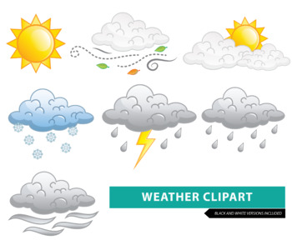
Post hurricane – status
7 transmission lines locked out
293 distribution circuits locked out
17 substations out-of-service, or inaccessible due to high water
83 Downtown Houston buildings without electrical service due to high water

Slide 8
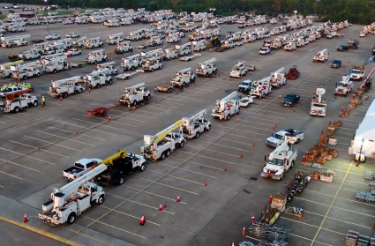
Post hurricane – restoration
Utilized 2,200 employees plus 1,500 contractors & mutual assistance from 7 states

Slide 9
Post hurricane – restoration
Operated 15 drones, tracking 500 locations

Slide 10
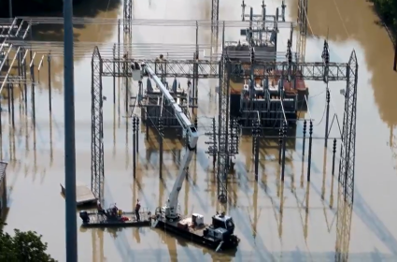
Post hurricane – restoration
Employed 36 airboats and 15 amphibious vehicles

Slide 11
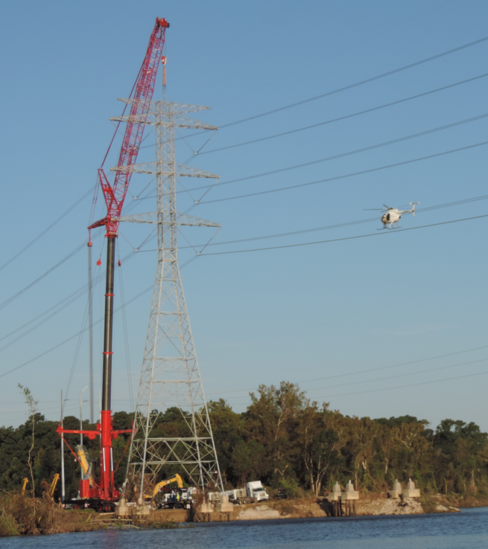
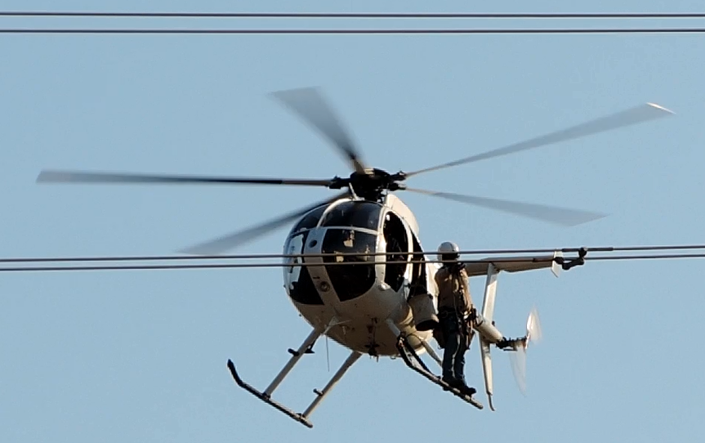
Post hurricane – restoration
Contracted 1 helicopter

Slide 12
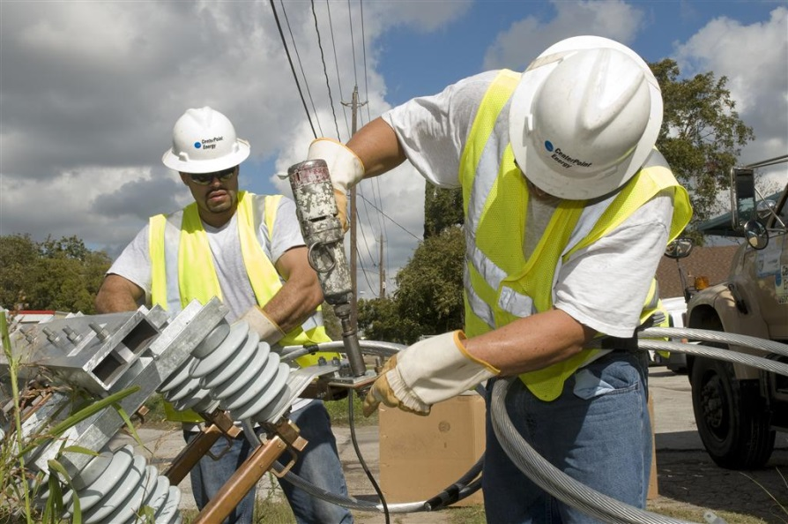
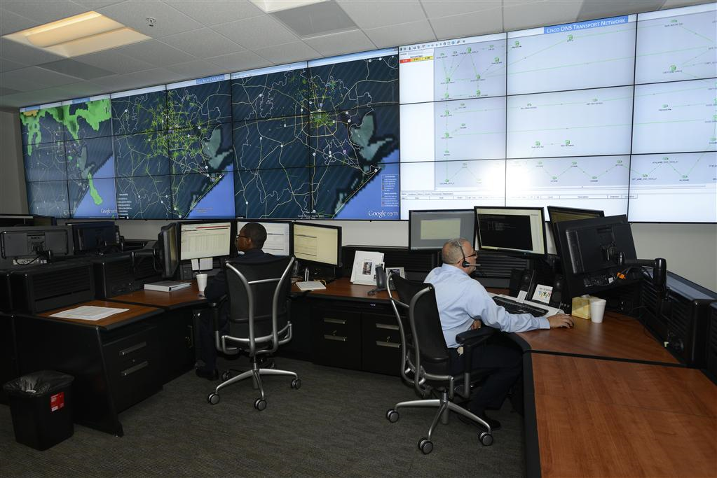
Post hurricane – restoration
Intelligent Grid operated 250 devices
AMS meters executed 45,000 orders remotely

Slide 13
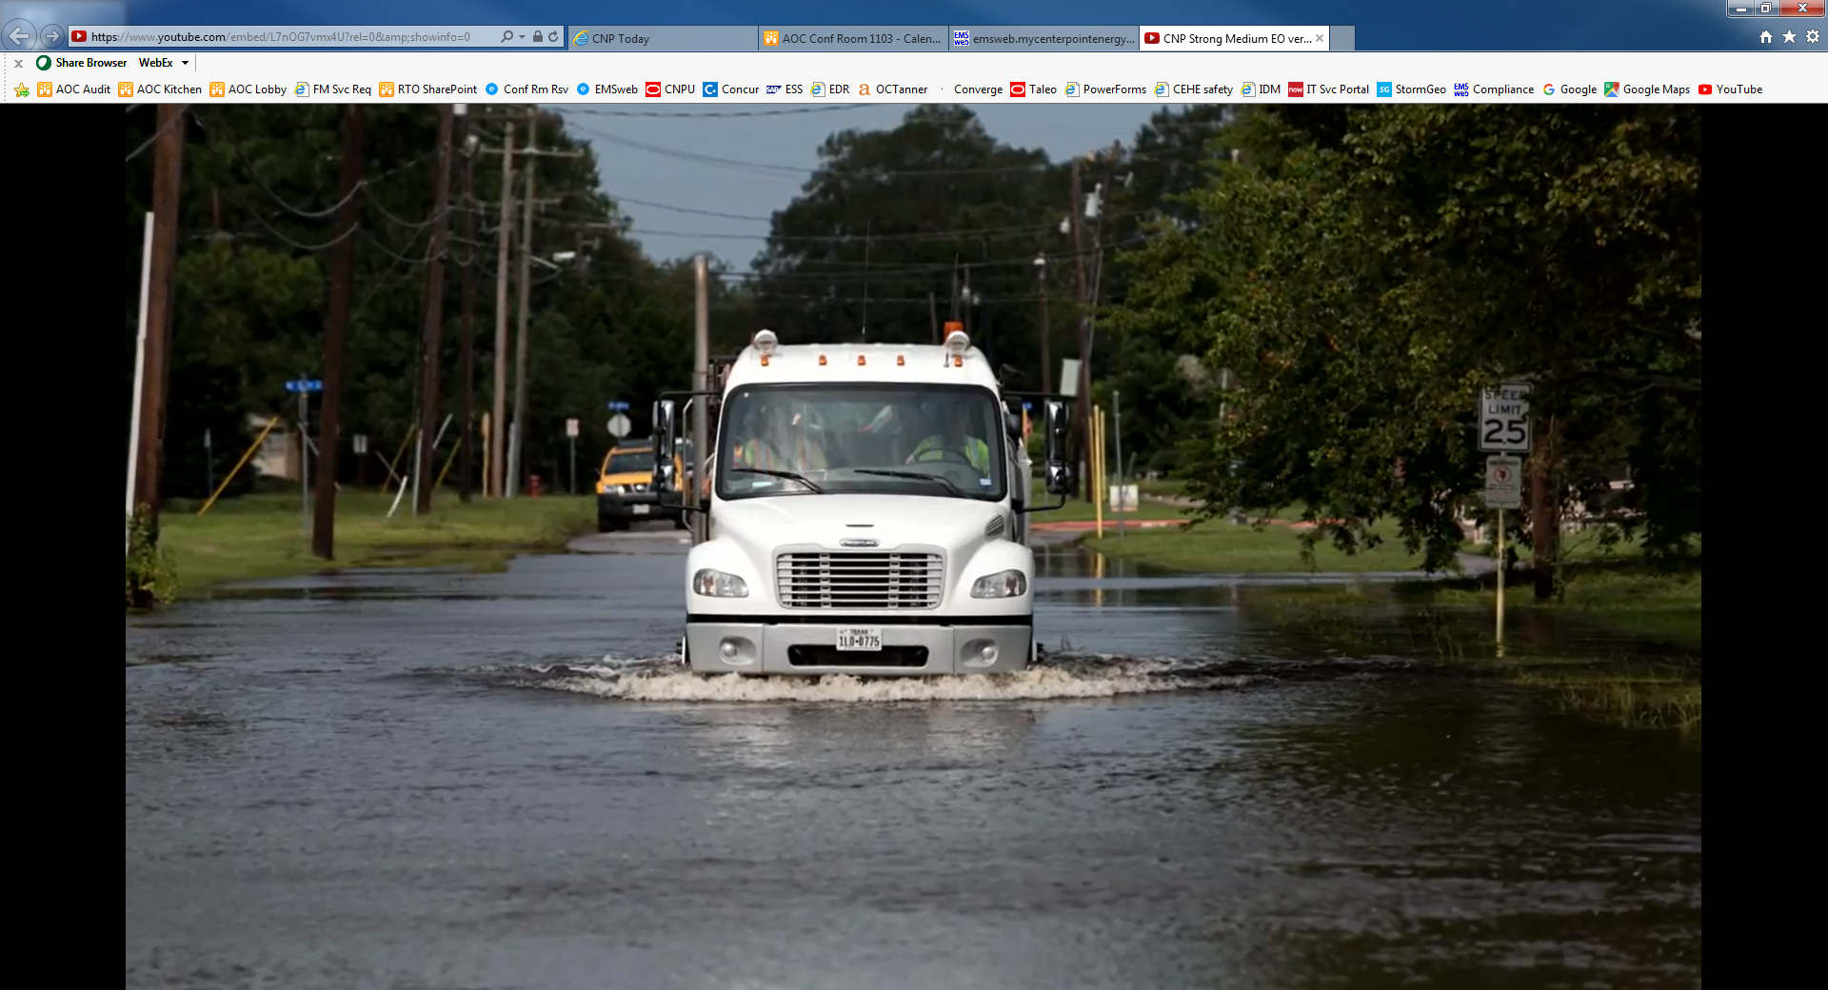
Post hurricane – restoration
1.27 MILLION total restorations (60% within 24 hours)
Near ZERO safety-related incidents

Slide 14
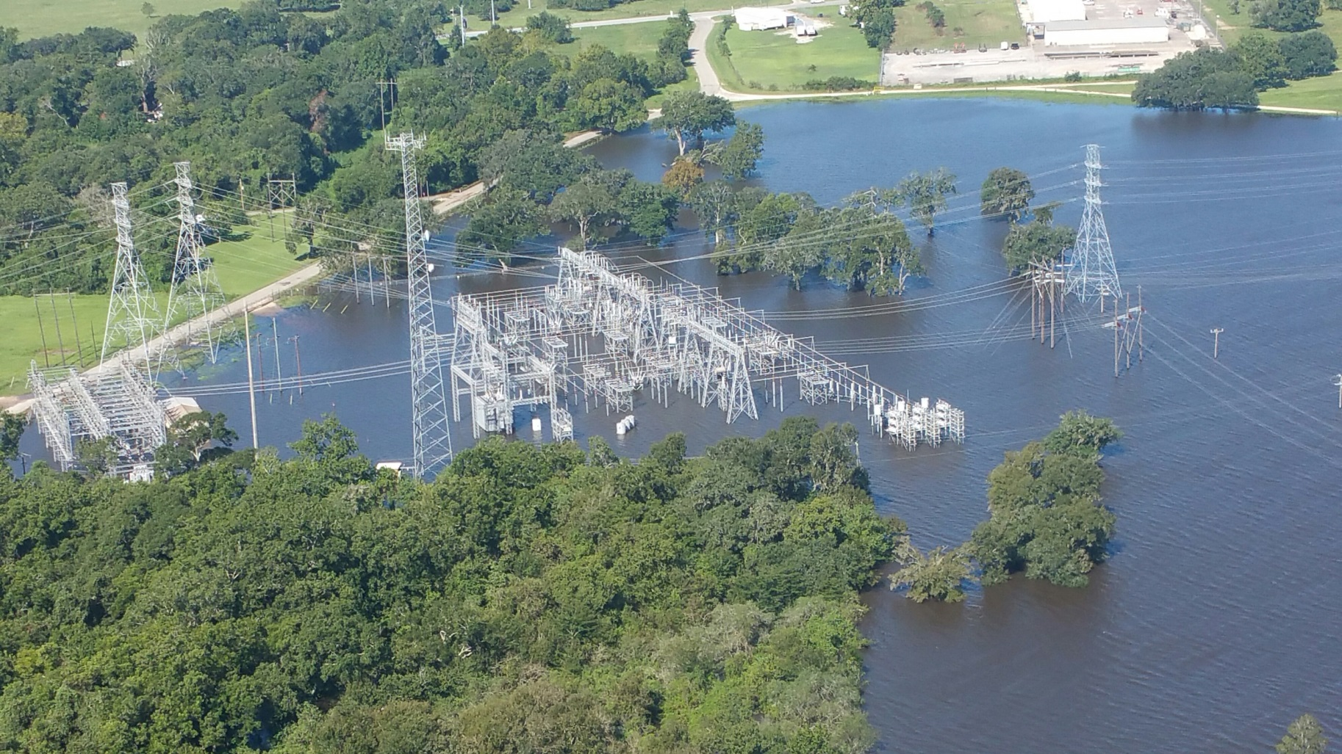
Post hurricane – restoration
West Columbia Substation
Temporary Reconfiguration – Bypass procedure
***restored***

Slide 15
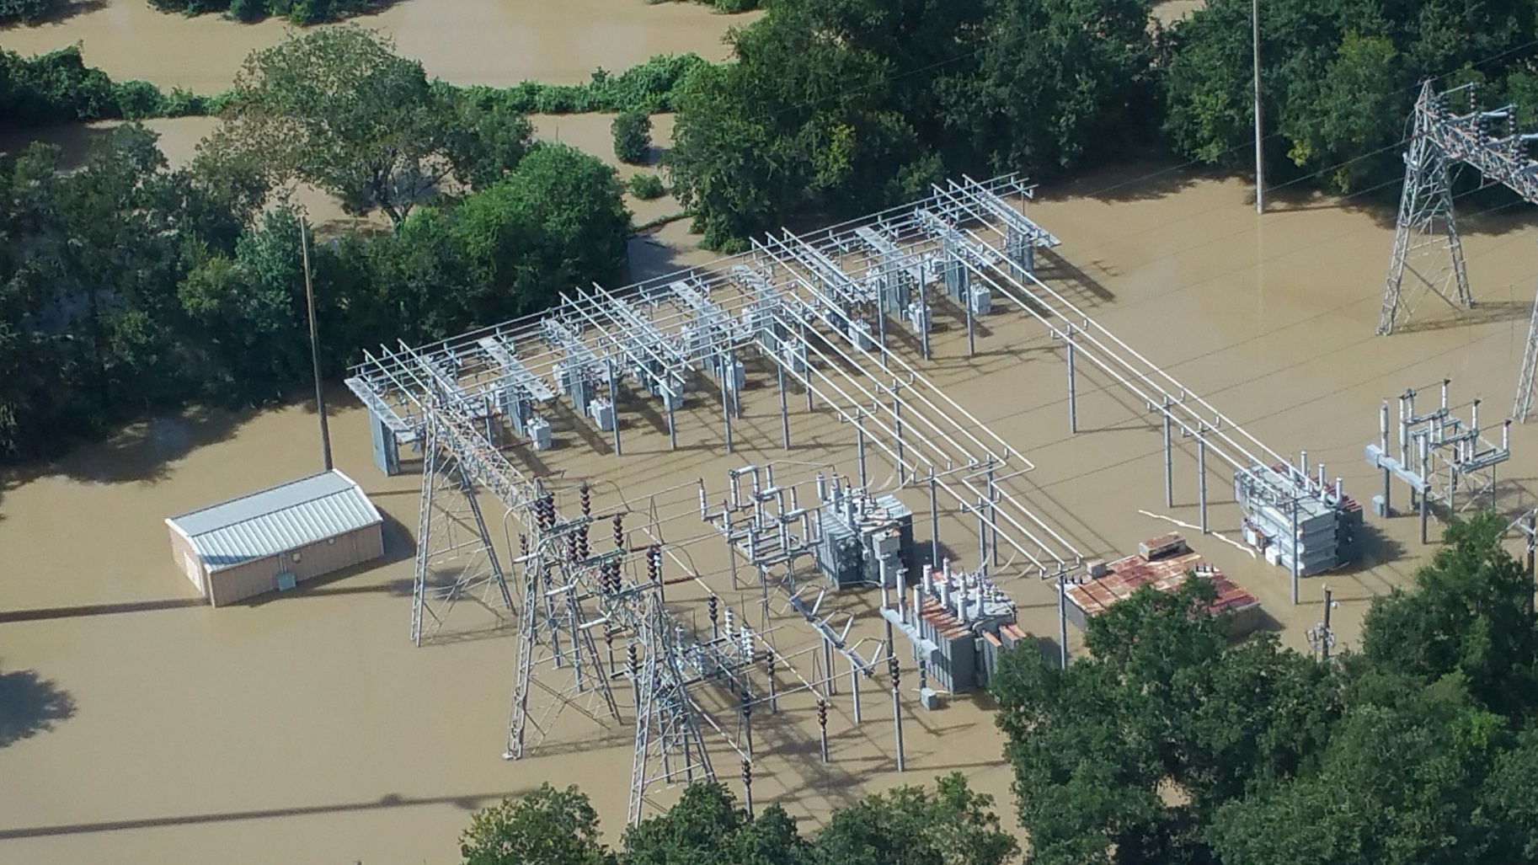
Post hurricane – restoration
Memorial Substation
Temporary Substation – 50MVA mobile
***installed in only 7 days***

Slide 16
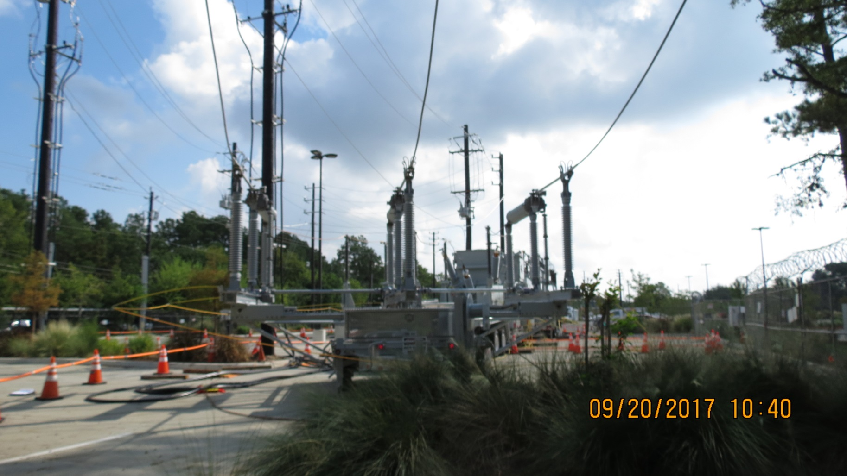


Post hurricane – restoration
Memorial Substation
Temporary Substation – 50MVA mobile
***still in service***

Slide 17
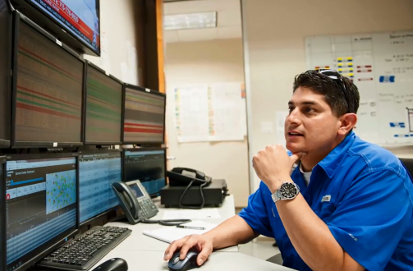
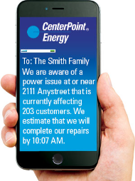
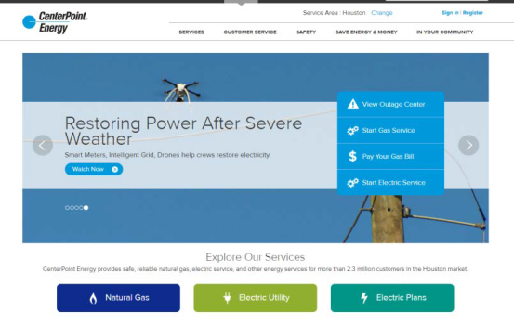
Notifications made for Hurricane Harvey
Operations
  SendWordNow paging (internal)
  Ringdown or Hotline calls (external)
Public
  Power Alert Service (PAS)
  Facebook
  Twitter
  CenterPointEnergy.com

Slide 18
Procedures followed during Hurricane Harvey
CNP Emergency Operations
LCC Emergency Operations
RTO Emergency Operations
RTO Standard Operating Procedures
System Monitoring
Paging Templates
Switching Procedures
Floodgate Deployment
Logging Procedures
Disturbance Reporting
ERCOT Emergency Operations
Operating Instructions

Slide 19
SUMMARY
Listed preparation steps for approaching hurricane conditions
Identified common events impacting system equipment, facilities, customers and topography
Identified post-hurricane activities to restore the system to steady-state operations
Identified what notifications were made for Hurricane Harvey
Identified which procedures were followed during Hurricane Harvey

Slide 20

QUESTIONS

